Slide 1
Containers and Lists
CIS 40 – Introduction to Programming in Python
De Anza College Clare Nguyen

Slide 2
Intro
Up to this point we’ve been working with single data variables, ones that can store just one integer, one float, or one string.
When working with many data values that are related to each other, it’s convenient and efficient to be able to organize them into groups so that we can access them faster. Python supports this grouping of data with containers.
Python provides many types of containers, or data storage that can hold multiple data values.
Each type of container has a unique behavior or methods of organizing and accessing data.
In this module we will look at lists, a commonly used container, as an example of how containers are in general.

Slide 3
Container Overview
A container has:
Memory to store multiple data values in an organized way
Methods and operators that help us store data, fetch data out, modify data, search for data, etc.
In our code, we call methods or use operators to work with data in the container.
Each type of container has a unique behavior: it organizes data in a specific way, which means that it has specific methods to access the data.
Therefore, the type of container we choose to use will depend on the type of application or work that we want to do.
Container
Method
Operator
data
data
data
Method
data
data
data
data
Method

Slide 4
List
A list is used to store multiple data in sequence, or one after another.
Data in a list are called items or elements.
Elements in a list can be different data types. A list can store integers, floats, strings and even other lists. Example:
This list contains an integer, a float and another list.
A list can have no data in it and is called an empty list.
List
data
data
data
data
List
int
float
str
str
int
str

Slide 5
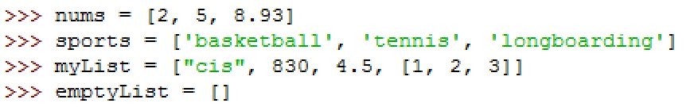
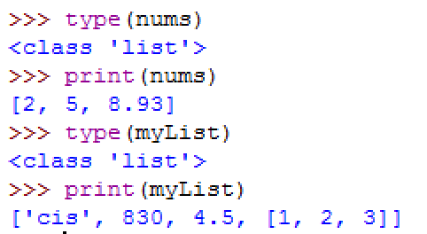
Create Lists (1 of 2)
There are different ways to create a list. A simple way is to use [ ] around comma separated data.
Examples of creating lists of different types of data:
and verifying that they are created correctly:
Note that the Python data type is list.

Slide 6
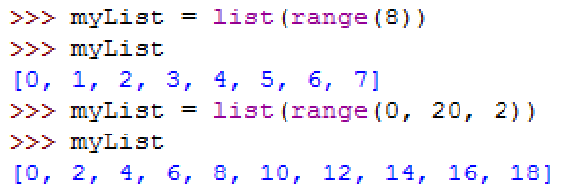
Create Lists (2 of 2)
To create a list of numeric values that are in order, we can take advantage of the range function:
list_name = list (range(values))
The range function creates the ordered list of values, and the list function stores them into a list data type.
Examples of creating lists of ordered numbers:

Slide 7
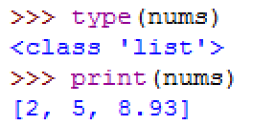
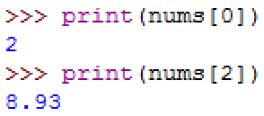
Accessing Data in Lists (1 of 2)
We’ve seen how to access the entire list by using the list name:
Since elements in a list are in a sequence, each element has a unique index value. An index value shows how far the element is from the beginning of the list.
The index of the 1st element is 0 because it is right at the beginning of the list. The index of the 2nd element is 1 because it is one element away from the beginning of the list.
To access one element, we use the same [ ] to specify the index in the list:

Slide 8
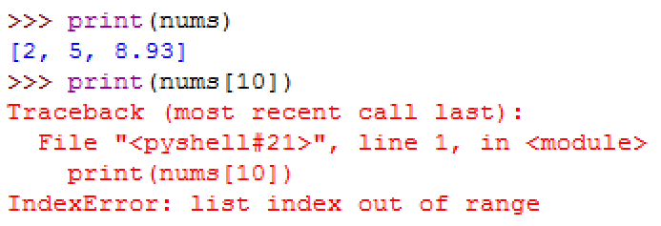
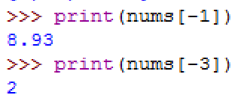
Accessing Data in Lists (2 of 2)
Be careful not to go past the last valid index value:
We can access data in the list in the reverse order (from right to left) by using negative index:
Note that negative indexing starts with -1 for the last element.
Just like with positive indexing, don’t go past the last valid negative index.
The last valid index is 2
The [ ] operator will throw an exception if we go past 2

Slide 9
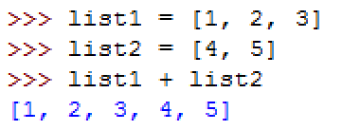

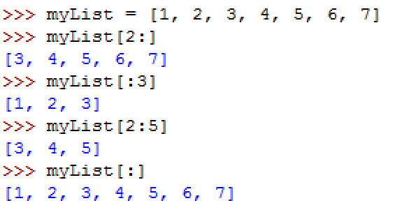
List Operators
The + operator concatenates lists (similar behavior as with strings):
The * operator duplicates lists (similar behavior as with strings):
The : operator slices the list so we get back a part of the list.
List operators do not modify the list. They return a new list.
slice from index 2 to end of list
slice from begin of list up to but not including index 3
slice from index 2 up to but not including index 5
getting a slice that is the entire list

Slide 10
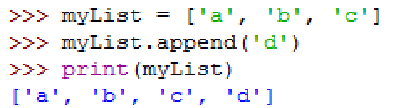
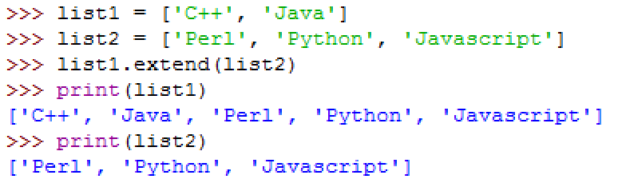
List Methods to Add (1 of 3)
Unlike operators, which don’t modify the original list, the list methods will change the list.
Recall that methods are a type of functions, so we need to call them and pass in any necessary arguments.
The append method adds one more element to the end of the list:
The extend method adds another list to the end of the list
list2, the input argument, is not changed

Slide 11
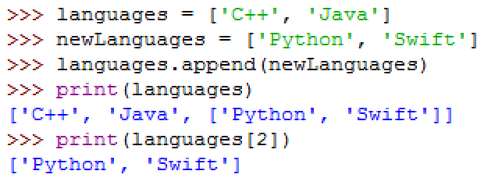
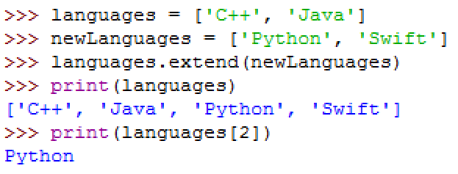
List Methods to Add (2 of 3)
Note that append will append one element, not a list. If we pass in a list to append, the entire list is considered one element of the resulting list.
Compare the 2 different results of adding newLanguages to the languages list:
append a list
newLanguages is added as a list, so the 3rd element is a list
extend a list
newLanguages is ‘flattened’ when added, so the 3rd element is a string

Slide 12
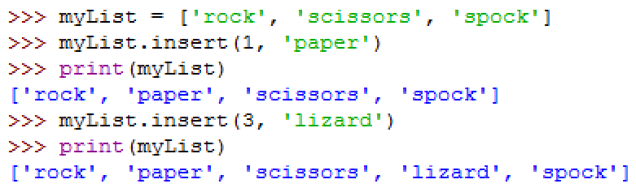
List Methods to Add (3 of 3)
The insert method adds one element at a specified index:

Slide 13
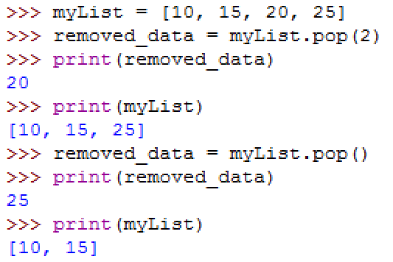
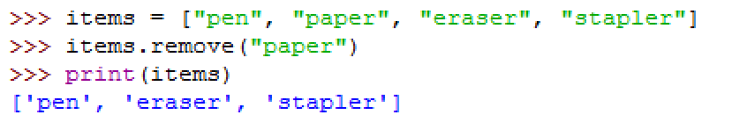
List Methods to Delete
The pop method removes an element by using its index:
The remove method removes an element by using its value:
The remove method does not return the removed element.
With no input argument, pop removes the last element

Slide 14
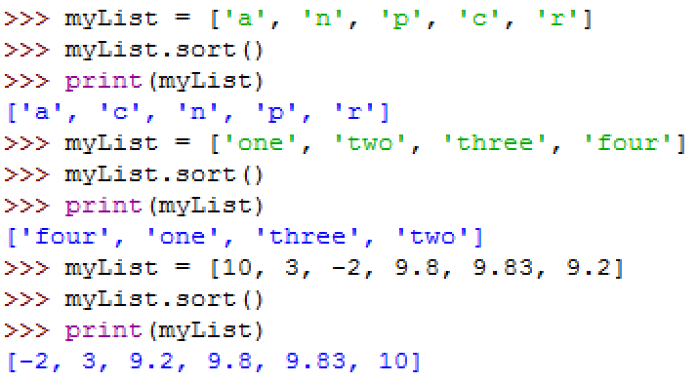
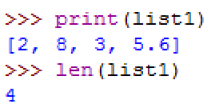
List Method to Sort, Count
The sort method sorts the list in ascending numeric or alphabetical order, depending on the data type:
The len function (not a list method) returns the number of data values in a list. This is the length function we’ve used with strings:

Slide 15
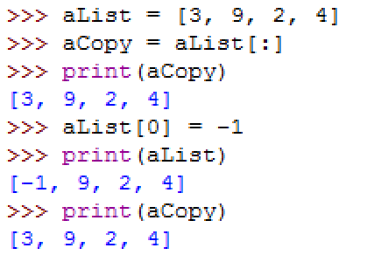
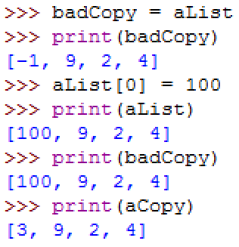
List Method to Copy
To copy a list, use the : operator to slice a new list:
Do not use the = operator to copy a list
aCopy is a new list which is identical to aList
When aList changes,
aCopy doesn’t change because
it’s a different list
badCopy is another name for aList. No copy (no new list) is created.
When aList changes,
badCopy also changes because both aList
and badCopy are names of the same list,
whereas aCopy doesn’t change because it’s
a true copy and is a different list.

Slide 16
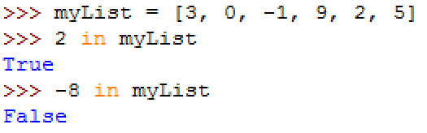
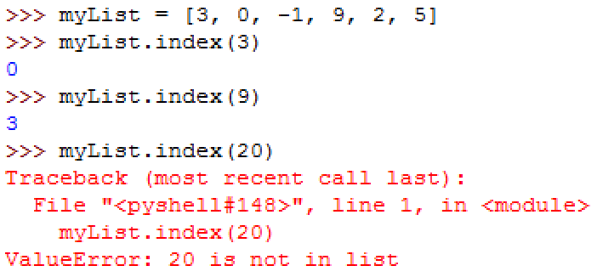
List Method to Search
The in operator returns True if a data value exists in the list. This is a similar behavior that we saw with strings.
The index method returns the index of a data value if it exists in the list. index throws an exception if the data is not in the list.

Slide 17
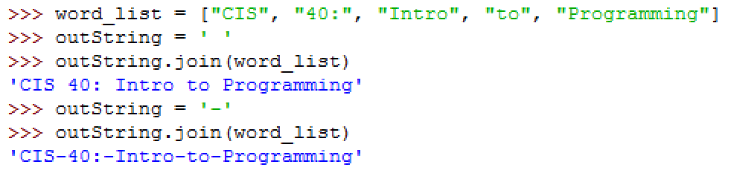
List and Strings
The string’s split method will split a string with multiple words into a list of words:
The string’s join method will join a list of words into a string. The output string needs to be initialized with a delimiter. The delimiter is used to separate the words in the output string.
text string
list of words
delimiter is space
delimiter is dash

Slide 18
Putting It All Together
Even though we’ve only spent a handful of weeks learning programming, Python has already shown us quite a few tools to help us do some “real” work.
Using all our knowledge of Python since module 1 until now, we’re going to write an application that helps students search for CIS classes. Click for a video of the problem description.
We will arrive at the solution in several steps, click on each step to follow the video sequence:
Design
Coding part 1: read input and find match
Coding part 2: print result
Test

Slide 19
More Containers (1 of 2)
There are many other methods and operators that support the list data type. The basic functionalities of list that we’ve seen in this module are representative of how containers can help us store multiple data values, quickly get information from them and do work with them.
Some other commonly used containers are sets, tuples, and dictionaries. Here is an overview of their characteristics:
A list stores data in the order that we specify and allows duplicate data.
A set is an unordered sequence of data (we have no control over which data is first or last) and every data is guaranteed to be unique.
A tuple is a list in which data cannot be changed.
A dictionary is an unordered sequence of pairs of data. The pair is made of a unique key and an associated value.

Slide 20
More Containers (2 of 2)
We choose to use a particular type of container based on what kind of work we need to do with the data.
Here are some example applications and the container that would best fit the purpose of the application.
We have a long essay with many words, and we want to see the list of unique words that are in the essay: use a set.
People sign up their names for an event, and we want to see the names of the first 20 people: use a list.
We want to store all the month names (‘January’, ‘February’, ‘March’, etc.): use a tuple.
In an address book we want to store people’s name and their contact information: use a dictionary.
There are many more containers and collections in Python than discussed in this module. Together they provide a good set of tools and data storage for many different applications.

Slide 21
What’s Next
Containers are a special data type that helps us to organize and associate groups of data quickly by providing us with many operators and methods.
How are these container data types with their useful methods get created? It turns out that Python allows us to easily create special data types and add methods to them so that they can be useful to multiple applications.
The data type that we create is the class data type and in the next module we will learn how to define or build classes.

