Slide 1
Module-1
Overview of System Software

Slide 2
What is Software???
Software is a set of instructions, data or programs used to operate computers and execute specific tasks
Program: A set of instructions that directs a computer's hardware to perform a task
Hardware: physical elements of a computer. Examples of hardware in a computer are the keyboard, the monitor, the mouse and the processing unit
Firmware is low-level software that stands between the hardware and the operating system.

Slide 3
Types of Software

Slide 4
Types of Languages
HLL
AL
ML

Slide 5
Difference between Application software and System Software
Application Software | System Software
Application software is build for specific task | System software used for application software to run
HLL are used to write the application software | LLL are used to write the System software
Without application software, system always run | Without system software, system can’t run
Application software run as per user request | System software runs when the system is turned ON and stop when the system is turned OFF
Specific purpose software | General purpose software
Example: Adobe reader, Photoshop, VLC media player etc | OS, Assembler, Compiler, Macro Processor, Loader, linker etc.

Slide 6
Types of System Software's
1) Assembler:
Assembler
ALP
ML (Object Code)

Slide 7
Types of System Software's
2) Macro Processor:

Slide 8
Types of System Software's
3) Compiler:
Compiler
Source Language (HLL)
Target Program (ML)

Slide 9
Types of System Software's
4) Translator:
Translator
Program 1 (Language1)
Program 2 (Language2)

Slide 10
Types of System Software's
5) Linker:
Object code
Linker
Object code 1
.exe file
Object code 2

Slide 11
Types of System Software's
5) Linker:
A program that combines object files generated by compiler/assembler and other pieces of codes to create an executable file with .exe extension.

Slide 12
Types of System Software's
6) Loader:
Loader
.exe file
Load it in MM

Slide 13
Types of System Software's
6) Loader:
A program that takes .exe file from linker and load it into main memory and prepare it for execution by computer

Slide 14
Types of System Software's
7) Device Drivers:

Slide 15
Types of System Software's
7) Device Drivers:
A system software that allows the OS and other applications to communicate with specific hardware device.
Every hardware device can understand only its LL commands; a device driver translate HL commands from OS or other applications and translates it into hardware specific machine code.

Slide 16
Types of System Software's
8) Editors: it is a tool which is used to write a particular code

Slide 17
Types of System Software's
9) Debugger:
It is used to present compiler generated errors in a human readable format and helps programmer in finding the errors in source code.

Slide 18
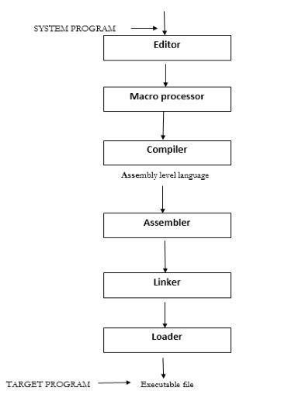
Sequence from developing a program up to it’s execution
The order in which the system programs are used, from developing program up to its execution.

