Slide 1
Module-2
Introduction to compilers and Lexical Analysis

Slide 2
What is Compiler???

Slide 3
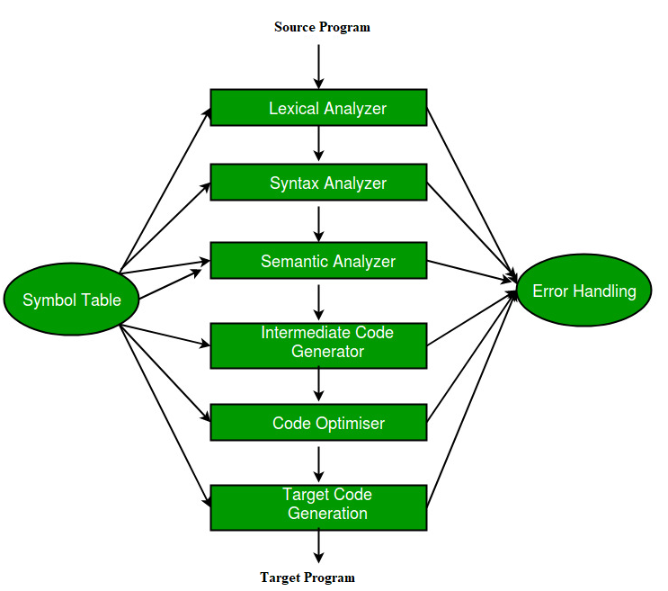
Phases of Compiler

Slide 4
Phases of Compiler with the help of an example
position = initial + rate * 60

Slide 5
Phases of Compiler with the help of an example
a = b + c + d

Slide 6
Structure of Lex Programs
Lex program will be in following form
%{
declarations Section
%}
%%
translation rules
%%
auxiliary functions / main function

Slide 7
Structure of Lex Programs
1. Declarations This section includes declaration of variables, constants and regular definitions.
2. Translation rules It contains regular expressions and code segments.
Form : Pattern {Action}
P1 {action1}
P2 {action2}
..
…
..
Pn {actionn}
Pattern is a regular expression or regular definition.
Action refers to segments of code.
Auxiliary functions
  This section holds additional functions which are used in actions. These functions are compiled separately and loaded with lexical analyzer.
  Lexical analyzer produced by lex starts its process by reading one character at a time until a valid match for a pattern is found.

Slide 8
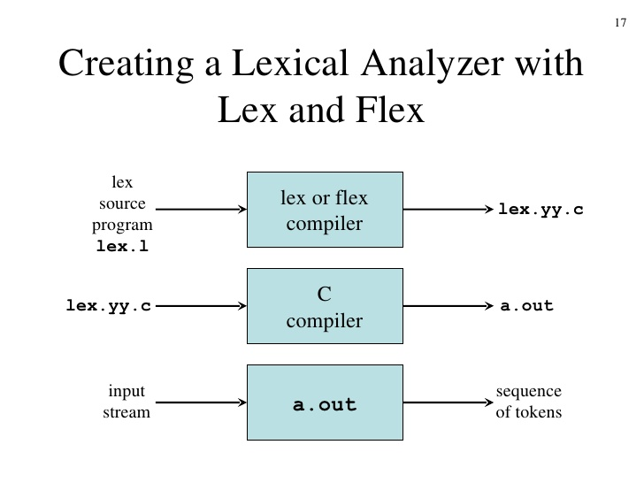
Automatic Lexical Design : Lex / Flex tool: Steps to generate LEXER

Slide 9
Lex Program to count the number of tokens
%{
int n = 0 ;
%}
%%
"while"|"if"|"else“|”int”|”float” {n++;printf("\t keywords : %s", yytext);}
[a-zA-Z][a-zA-Z0-9]* {n++;printf("\t identifier : %s", yytext);}
"<="|"=="|"="|"++"|"-"|"*"|"+" {n++;printf("\t operator : %s", yytext);}
[(){}|, ;] {n++;printf("\t separator : %s", yytext);}
[0-9]+ {n++;printf("\t integer : %s", yytext);}
”* end *” printf("\n total no. of token = %d\n", n);
%%
int main()
{
printf(“Enter an Expression \n");
yylex();
}

Slide 10
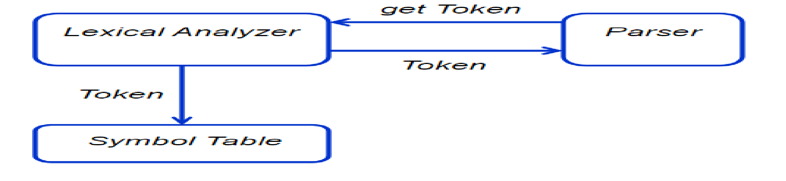
Phase 1 : lexical Analysis / Scanning

