Slide 1
Module 3
Parsing

Slide 2
Predictive Parser (LL(1) Parser)
Let ‘x’ be a stack top symbol and let ‘a’ be the input symbol
If x=a=$ then accept and break
Else if x=a!=$ then pop ‘x’ and remove ‘a’
Else if M[x,a] x-> y1 y2 …..yk then pop ‘x’ and push yk yk-1…..y1
Else ERROR()

Slide 3
Shift Reduce Parser
Definition of Handle
Definition of Handle Pruning
Actions in shift reduce parser
Algorithm

Slide 4
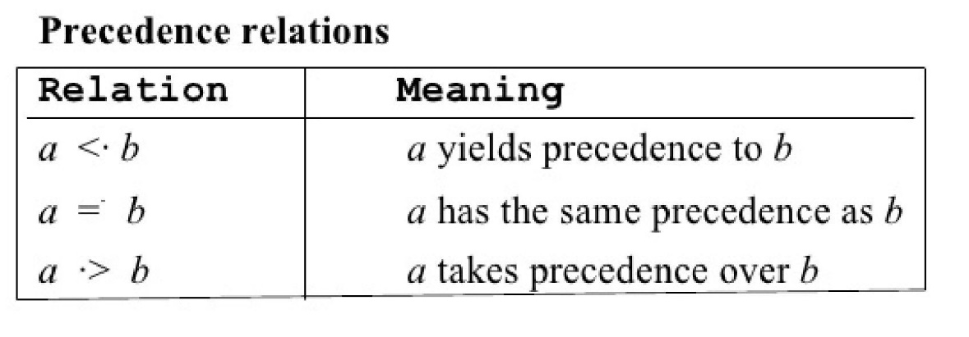
Operator Precedence Parser
If precedence of b is higher than precedence of a, then we define a < b
If precedence of b is same as precedence of a, then we define a = b
If precedence of b is lower than precedence of a, then we define a > b

Slide 5
Precedence of operator
An identifier is always given the higher precedence than any other symbol.
$ symbol is always given the lowest precedence.
If two operators have the same precedence, then we go by checking their associativity.
Operator | Precedence | Associativity
id | Highest | -
^ |  | Right
* / |  | Left
+ - |  | Left
$ | Lowest

Slide 6
Top Down VS Bottom up Parser
Top Down parser | Bottom up parser
In this technique, the construction of a parse tree begins at the root and works down towards the leaves. | In this technique, the construction of a parse tree begins at the leaves and works up towards the root.
Left recursion can make the top down parser go into an infinite loop. | Left recursion cause, no such problem.
Left-factoring is required. | Left-factoring is not required.
There is no concept of handle selection. | A selection of handles is required.
In this technique, the actions are pop and remove. | In this technique, the actions are shift and reduce.
Derive the string using LMD | Derive the string using RMD in reverse which is called canonical derivation.
It is simple to produce parser. | It is difficult to produce parser.
It uses LL(1) grammar to perform parsing. | It uses SLR, CLR and LALR to perform parsing.
It is not accepting ambiguous grammar. | It is accepting ambiguous grammar.
Example: Recursive Descent Parser, Predictive parser | Example: Shift reduce parser, OPP, SLR, CLR. LALR

Slide 7
Top Down VS Bottom up Parser
Compiler | Interpreter
For Converting the code written in a high-level language into machine-level language so that computers can easily understand. | An Interpreter works line by line on a code. It also converts high-level language to machine language.
It is faster. | It is slower.
It is more efficient. | It is less efficient.
Execution of the program takes place only after the whole program is compiled. | Execution of the program happens after every line is checked or evaluated.
The compiler generates an output in the form of (.exe). | The interpreter does not generate any output.
Object code is permanently saved for future use. | No object code is saved for future use.
CPU utilization is more in the case of a Compile. | CPU utilization is less in the case of a Interpreter.

Slide 8
SLR Parser
Closure operation: If a dot is present before any other terminal, then add all of its productions to the state.
Closure item: An item created by the closure operation on state.
Complete item: An item where dot is at the end of RHS.
LR(0) item: it is a set of production of given grammar G with dot at some position on the right side of the production.

