Slide 1
Food Hub Report
Software architecture styles

Slide 2
Our Member
Pham Thanh Long
Pham Minh Tan
Nguyen Thanh Hiep
Vu Lam Bao Van

Slide 3
01
02
Table of contents
03
04
Add Food
Add Order
As a manager, I want to add the new food, so that I can increase incomes and give the various options.
As a customer, I want to add order, so that I can get my food.
Search Food
Feedback
As a customer, I want to search foods ,so that I can get the best meals from the restaurant.
As a customer, I want to, so that I can share my opinions.

Slide 4
Introduction
Food Hub, with just a few taps on the screen, we now have access to hundreds of news and delicious restaurants ranging from every cuisine you can think of

Slide 5
Add Food
01
As a manager, I want to add the new food, so that I can increase incomes and give the various options.

Slide 6
Use Case Description

Slide 7
UC1: Add the new food to Food Hub system
Use case Name | Add new food to Food Hub system
Brief description | This use case allow manager to add the new food to increase incomes and give the various options.
Actors | Manager
Basic Flow | Manager clicks on the icon of adding the new food System will change the manager current screen to the adding the new food screen Manager chooses the type of food (fish, meat,…) Manager enters information of food (name, image, price,…) Manager click on “Add Food” button System adds a new food to the menu System displays the quantity, type and the price of all foods in the menu
Alternative Flows | Alternative flow: Manager cannot add existed food to the menu From step #4 of the basic flow, manager add another food Continue step #5 in the basic flow
Pre-conditions | Manager is logged into the Food Hub system.
Post-conditions | The manager successfully adds new food to the Food Hub system.

Slide 8
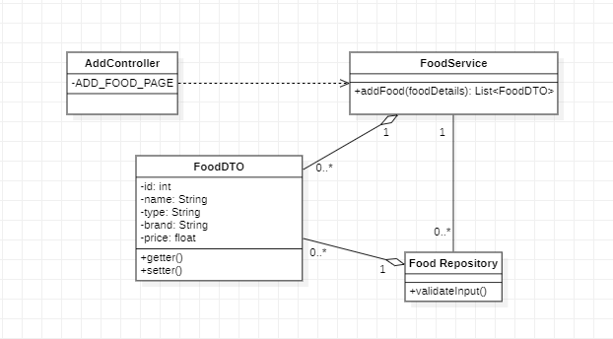
Data-centered (Repository) Style
Class Diagram

Slide 9
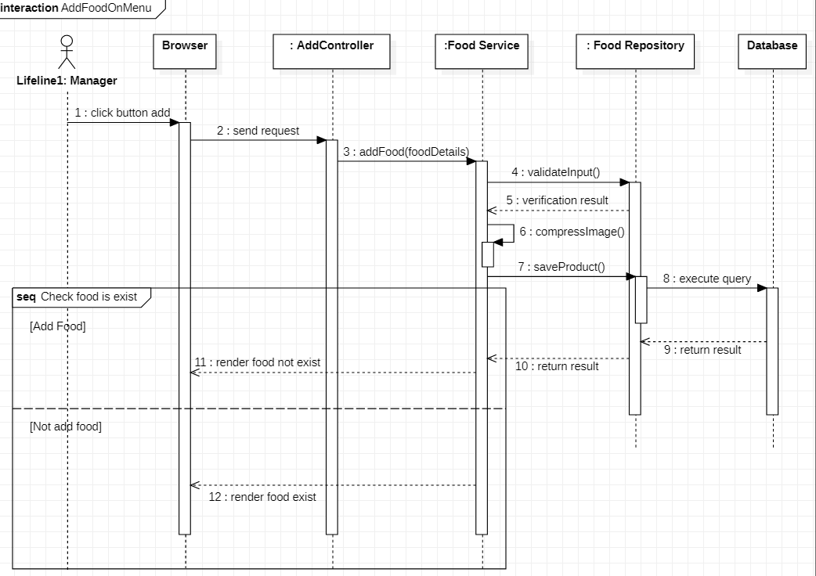
Data-centered (Repository) Style
Sequence Diagram

Slide 10
Data-centered (Repository)
Advantage:
Data integrity: easy to back up and restore
System scalability and reusability of agents: easy to add new software components because they do not have direct communication with each other
Reduces the overhead of transient data between software components

Slide 11
Add Order
02
As a customer, I want to add order, so that I can get my food.

Slide 12
Use Case Description

Slide 13
UC2: Add Order
Use case Name | Add the order
Brief description | This use case describes how the Customer can add order
Actors | Customer
Basic Flow | At the find food screen User clicks on ‘Add’ button that save to cart System displays notification “Add success” User view their cart User click button “Payment” User choose the method payment User can add one product many times
Alternative Flow | Alternative flow: The product has existed on the cart From step #2 in the basic flow, system increases the quantity and the price of the food Continue step #3
Pre-conditions | User is logged into the Food Hub system.
Post-conditions | The user successfully adds new food can see total price and the quantity of all the food on the cart.

Slide 14
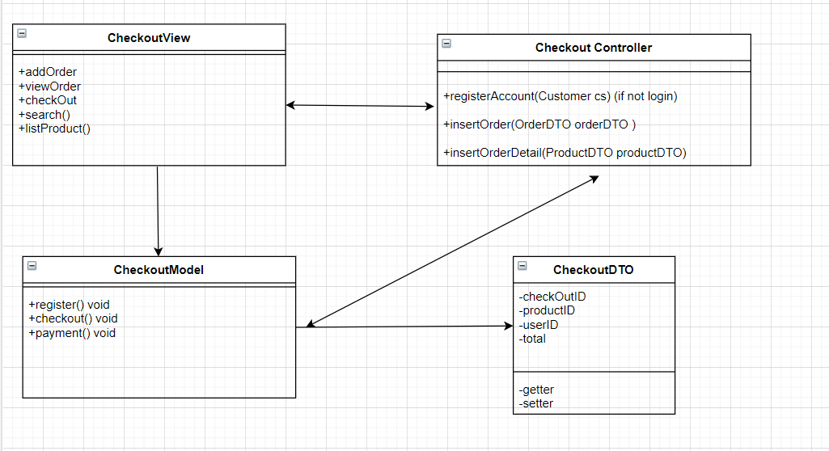
Interaction (MVC) style
Class Diagram

Slide 15
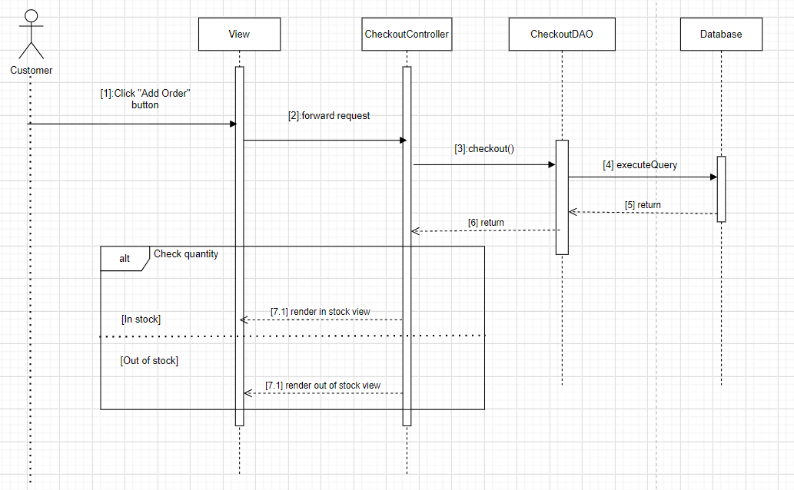
Interaction (MVC) style
Sequence Diagram

Slide 16
Interaction (MVC)
Advantage:
Development of the application becomes fast.
Easy for multiple developers to collaborate and work together.
Easier to Update the application.
Easier to Debug as we have multiple levels properly written in the application

Slide 17
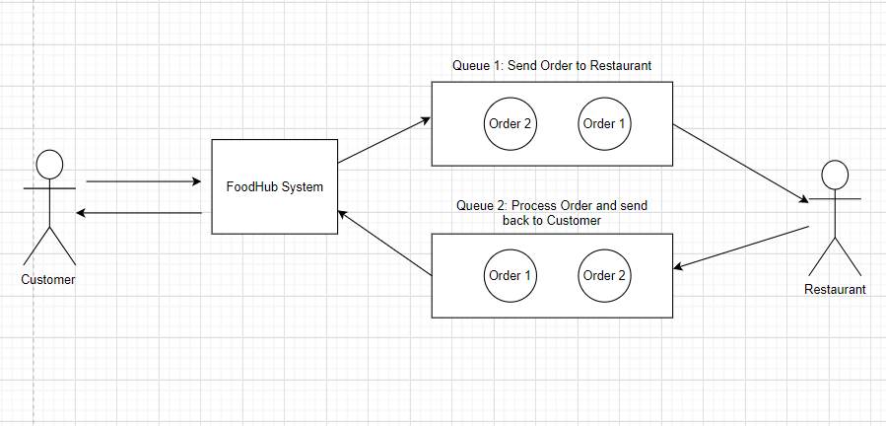
Implicit Asynchronous Communication (Buffered) Style

Slide 18
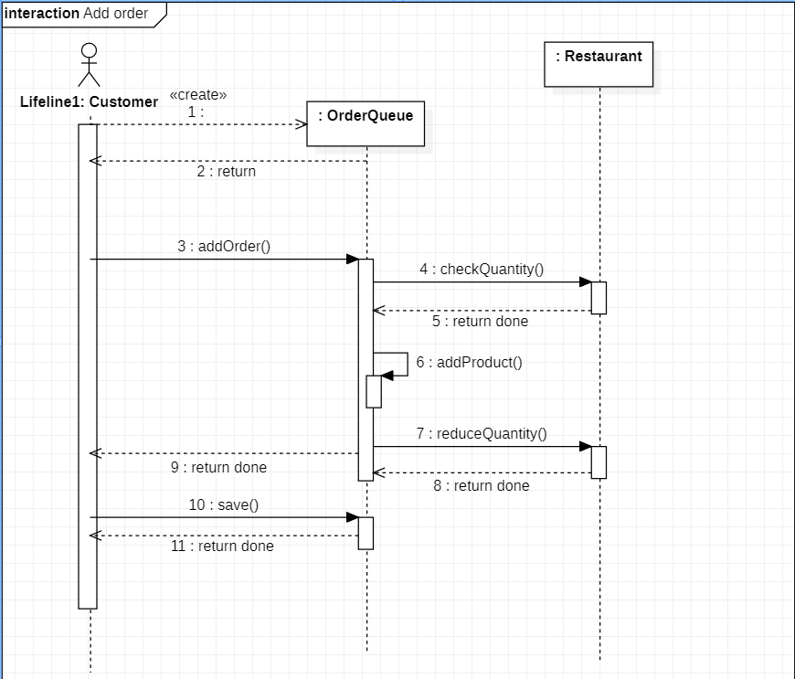
Implicit Asynchronous Communication (Buffered) Style
Sequence Diagram

Slide 19
Implicit Asynchronous Communication (Buffered)
Advantage:
Anonymity: provides high degree of anonymity between message producer and consumer.
Concurrency: supports concurrency both among consumers and between producer and consumers.
Supports loose coupling between message producers and consumers.

Slide 20
Search Food
03
As a customer, I want to search foods or the restaurants based on the location, the price or the discount, the feedback … so that I can get the best meals from the restaurant.

Slide 21
Use Case Description

Slide 22
UC3: Search food to add the order
Use case Name | Search food to add the order
Brief description | This use case describes how the Customer can search the expected food and order it.
Actors | Customer
Basic Flow | At the homepage, the user enters keywords on the ‘Search’ field User clicks on ‘Search’ button to start searching System displays the restaurant User chooses the specific restaurant System displays the foods found User chooses the specific food to see the information User clicks ‘Add to cart’ button on the expected food System adds a new food to the order System displays the quantity and the price of all foods in the order
Alternative Flows | Alternative flow 1: User cannot find products searched From step #1 of the basic flow, user enters another keyword Continue step #2 in the basic flow Alternative flow 2: User can view feedback From step #4 and step #6 of the basic flow, user views the comment and rating of another user about the food Continue step #7 in the basic flow Alternative flow 3: User can choose another search method From step #1 of the basic flow, user can enter the restaurant name to search base on: the nearest location, the price, the discount Continue step #2 in the basic flow
Pre-conditions | User is logged into the Food Hub system.
Post-conditions | The user successfully adds new food to the order or increases quantity and price of the existing food in the order.

Slide 23
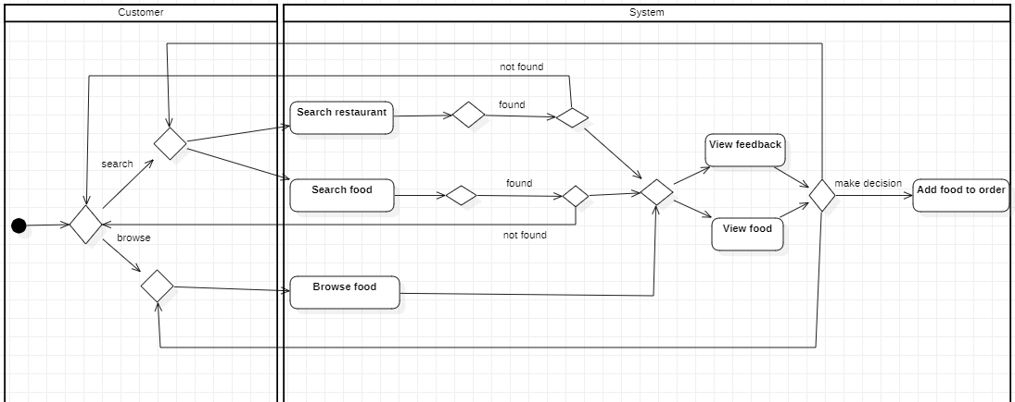
Hierarchical (Main-Subroutine)
Activity Diagram

Slide 24
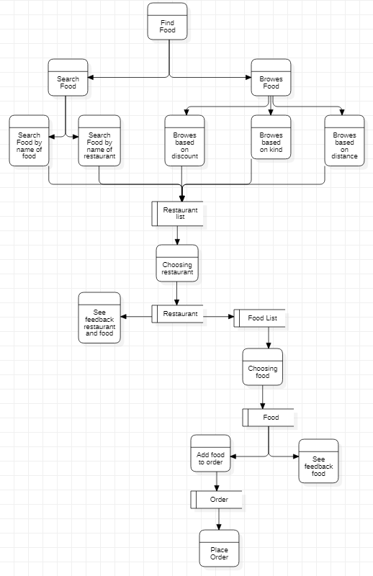
Hierarchical (Main-Subroutine)
Data Flow Diagram

Slide 25
Hierarchical (Main-Subroutine)
Advantage:
It is easy to decompose the system based on the definition of the tasks in a top-down refinement manner.
This architecture can still be used in a subsystem of OO design.

Slide 26
Feedback
04
As a customer, I want to feedback the shipper or the food or the restaurant’s service, so that I can share my opinions.

Slide 27
Use Case Description

Slide 28
UC4: Feedback
Use case Name | Feedback shipper, shop and restaurant
Brief description | This use case describes how the Customer can feedback shipper, shop and restaurant.
Actors | Customer
Basic Flow | After ordering successful, the user can feedback User enters comment in “Comment” field and rating star about shipper, restaurant or food User clicks “Send feedback” System displays “Thank you your feedback”
Pre-conditions | User is logged into the Food Hub system.
Post-conditions | The user can see their feedback.

Slide 29
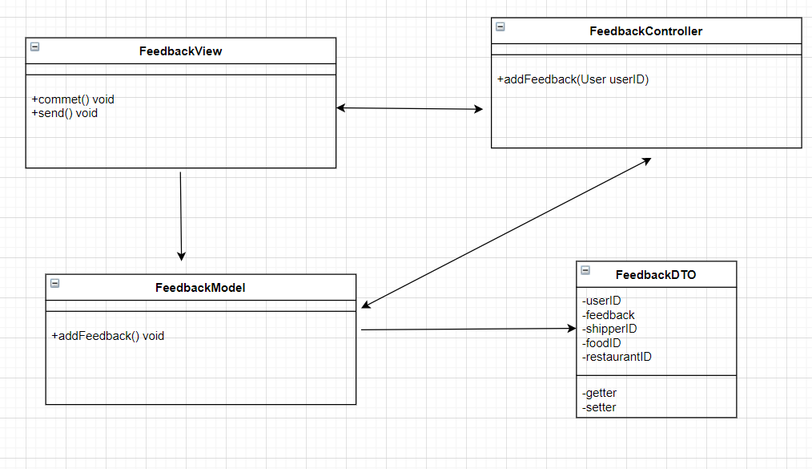
Interaction (MVC) Style
Class Diagram

Slide 30
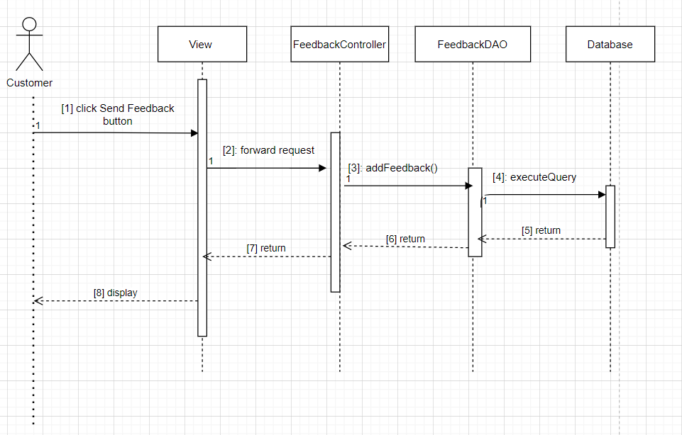
Interaction (MVC) Style
Sequence Diagram

Slide 31
Thanks Q&A

