Slide 1
FOODHUB PRESENTATION
Implicit Asynchronous Communication Software Architecture

Slide 2
Welcome to our product!
Pham Thanh Long
Pham Minh Tan
Nguyen Thanh Hiep
Vu Lam Bao Van

Slide 3
Implicit Asynchronous Communication Software Architecture

Slide 4
TABLE OF CONTENT
01.
03.
02.
04.
Overview
Non-Buffered
Buffered
UML

Slide 5
01.
Overview

Slide 6
Overview
Also called publisher-subscriber or producer-consumer patterns, where: ● The Subscribers are interested in some events or messages issued by a Publisher
● The Consumers are interested in some events or messages issued by a Producer
Two different modes:
● Nonbuffered
● Buffered:
Point-to-Point (P2P) Message: message queue
Publish-Subscribe Message (P&S): message topic

Slide 7
Buffered Message-Based Software Architecture
02

Slide 8
Definition
A Buffer is a portion in the memory that is used to store a stream of data from peripheral devices. Then from this buffer this stream of data is collected and stored in variables. A stream can be defined as a continuous flow of data.
The buffered message-based software architecture breaks into three partitions:
Message producers
Message consumers
Message service providers
-They are connected asynchronously
- Also referred to as a fire and forget system

Slide 9
Point-to Point(P2P) structure
Message queue is a point-to point(P2P) structure between producer and consumer
Message queue also called message broker is a queue of messages
placed between two parts of the system in order for them to communicate
Data transported between sender and receiver
The basic architecture of a message queue is a simple

Slide 10
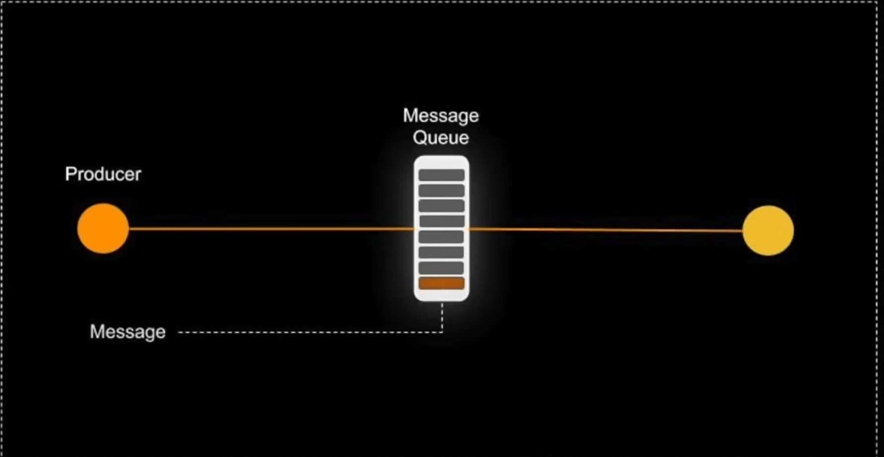
Producers create messages and deliver them to the message queue

Slide 11
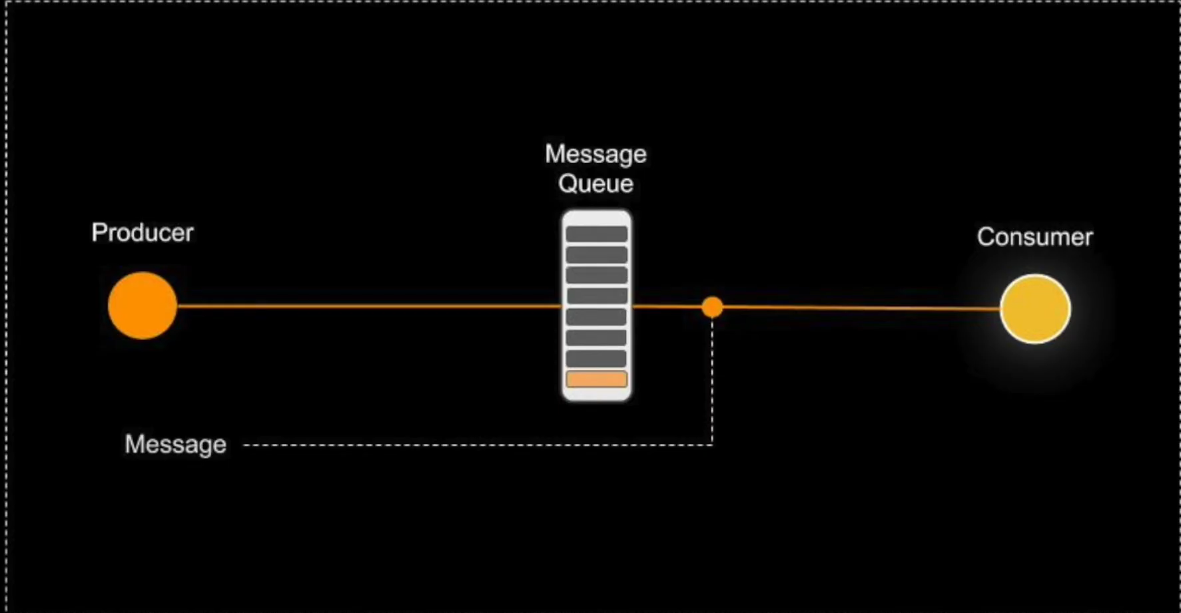
Consumers connect to queue and subscribe messages from the queue

Slide 12
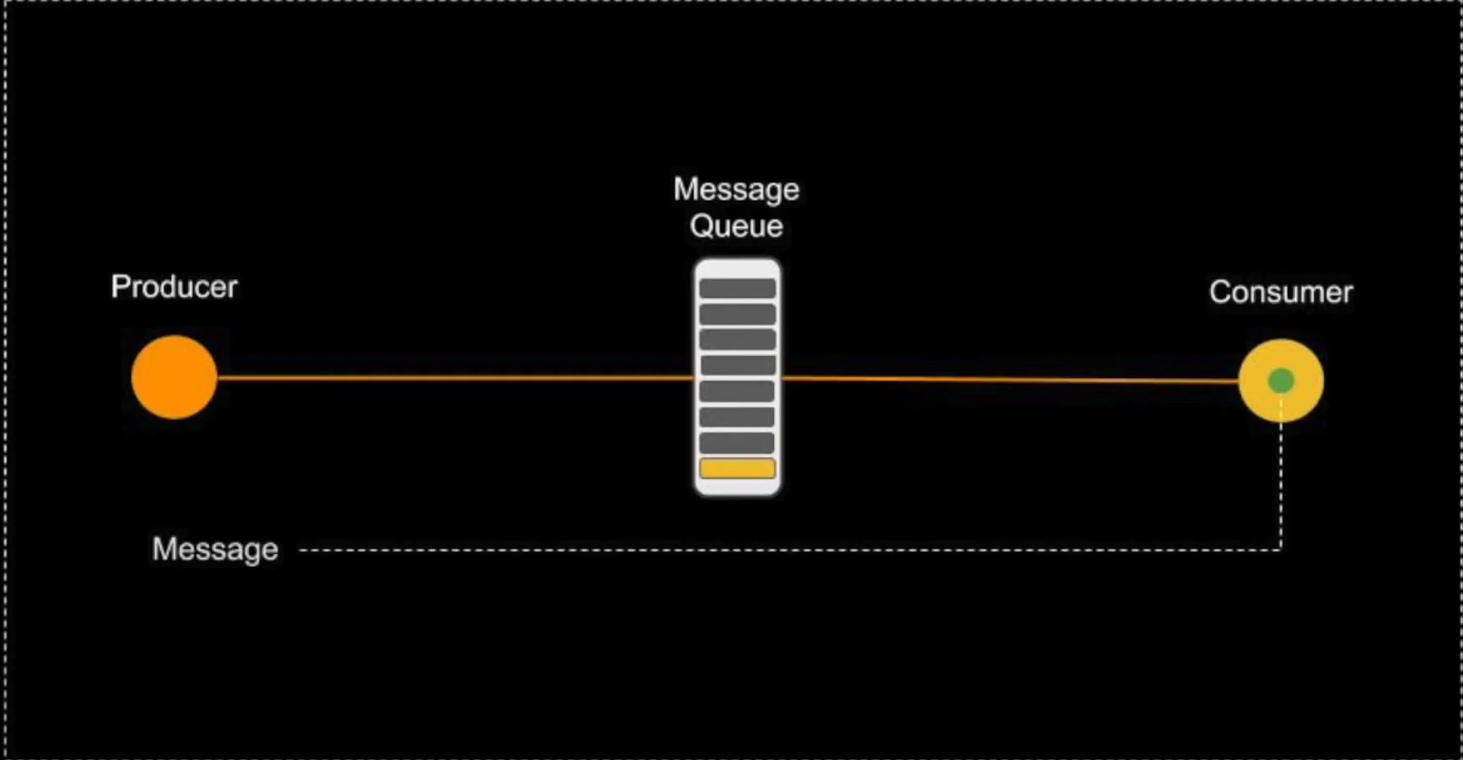

Slide 13
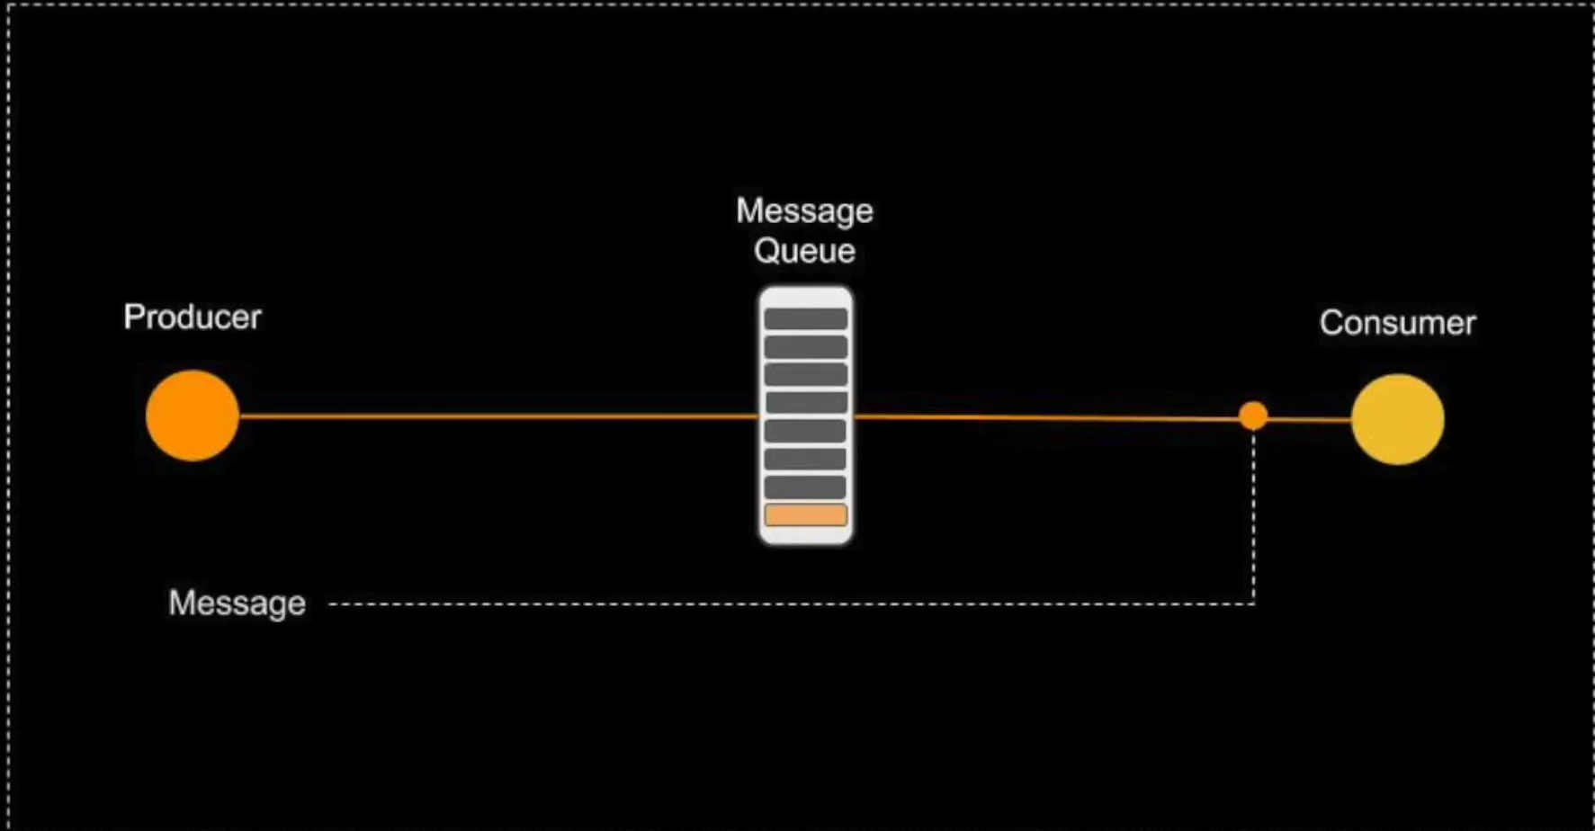
messages placed onto the queue are stored until the consumer acknowledge them meaning (received or handled)

Slide 14
Publish-Subscribe Messaging (P&S)
Hub-like architecture , where publisher clients send messages to a message topic that acts like a bulletion board
Message topic publishers and subscribers are not aware of each other
Each topic message can have multiple consumers.
The system delivers the messages to all it multiple subscribers.
Publishers and subscribers have a timing coupling dependency.
Durable subscription: is able to receive any topic messages sent while the subscribers are not active or not ready
A message topic consumer must subscribe the topic before it is published unless subscription is a durable subscription

Slide 15
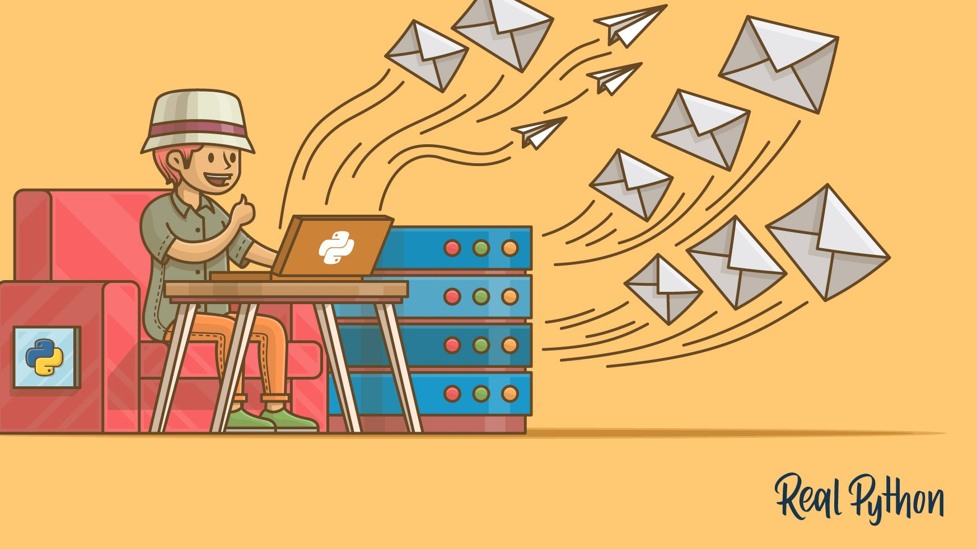
Example Asynchronous Communications Protocol
Email : when an email is sent the sender continues with other things without needing an immediate response from the receiver this way of handling messages decouples the producer from consumer

Slide 16
Benfits
Anonymity
Concurrency
Scalability and reliability of message delivery
Supports batch processing
Supports loose coupling between message producers and consumers

Slide 17
Limitations
Capacity limit of message queue
Complete separation of presentation and abstraction
Increased complexity of the system design and implementation
Decouple

Slide 18
03
Non-Buffered Event-Based Architecture
The non-buffered event-based implicit invocation architecture breaks the software system into two partitions

Slide 19
Non-Buffered Event-Based Implicit Invocations
The event registration process connects these two partitions.
There is no buffer available between these two parties.

Slide 20
Observer pattern
The Observer pattern is another name used for this type of architecture.
Subscribers is an event listener and register themselves with the event source.
Once an event is fired off by an event source, all corresponding subscribers are notified, which then take corresponding actions.

Slide 21
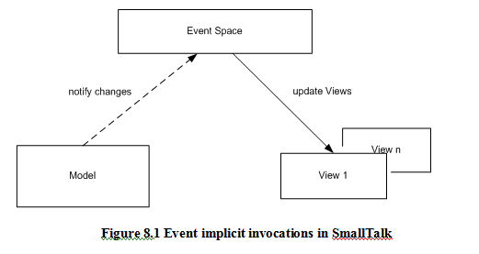
Non-Buffered Event-Based Implicit Invocations

Slide 22
Applicable Domain of Non-Buffered Event-Driven Architecture
Suitable for interactive GUI component communication and Integrated Development Environment (IDE) tools.
Suitable for applications that require loose coupling between components that need to notify or trigger other components to take actions upon asynchronous notifications.
Suitable for the implementation of state machines.
Suitable when event handlings in the application are not predictable.

Slide 23
Benefits
Framework availability: Many vendor APIs such as Java AWT and Swing components available.
Reusability of components: Easy to plug-in new event handlers without affecting the rest of the system.
System maintenance and evolution: Easy to update both of event sources and targets.
Independency and flexible connectivity: Dynamic registration and deregistration can be done dynamically at run-time.
Possibility of parallel execution of event handlings.

Slide 24
Limitations
Difficult to test and debug the system
Hard to predict and verify responses and the order of responses from the listeners.
The event source cannot determine
when a response finished or
the sequence of all responses.
Reliability and overhead of indirect invocations may be an issue.
There is more tight coupling between event sources and their listeners than in buffer-based implicit invocation.

Slide 25
03
UML

Slide 26
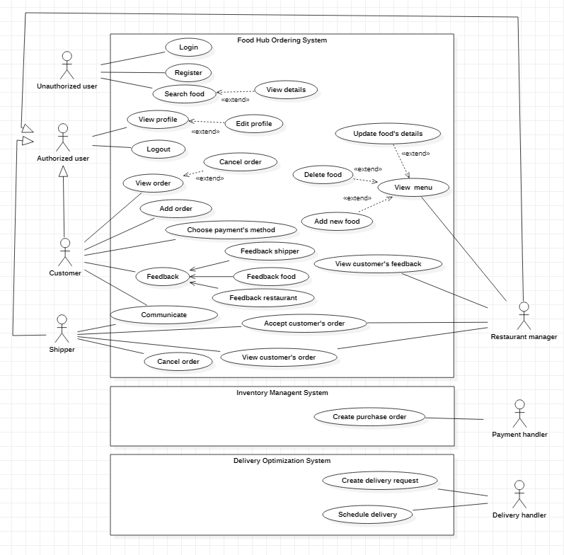
messages placed onto the queue are stored until the consumer acknowledge them meaning (received or handled)

Slide 27
