Slide 2
Objectives
To implement two pre-processing method: Discrete Wave Transformation and Pan-Tompkins Method
To Calculate RR intervals and Heart Rate Information
To calculate detection accuracy of R-waves for both model by comparing to the given dataset.
To create a training dataset with appropriate features
To implement a Support Vector Machine (SVM) classifier to classify the ECG heartbeats
To evaluate model’s performance of both pre-processing techniques in predicting Arrhythmia

Slide 3
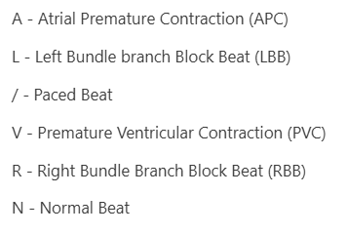
Source
MIT-BIH Arrhythmia Database (Open Source)
Contains raw ECG Signal with annotations
We selected 6 labels from a total of 41 labels and classified the remaining labels as ‘Others’

Slide 4
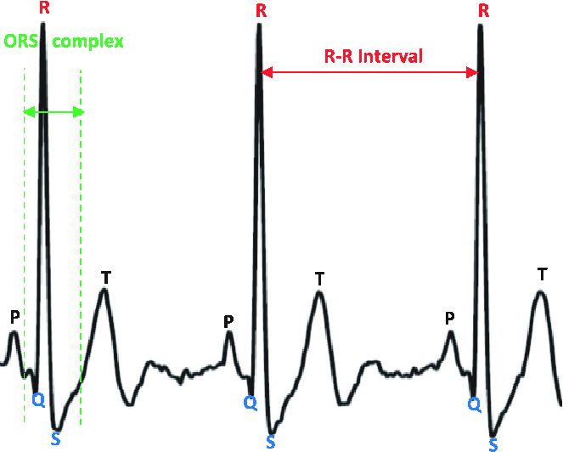
QRS Complex

Slide 5
Pre-processing Method 1
Pan-Tompkins Method
Raw ECG Signal
Pre-processing
Feature Enhancement
Threshold-Based Detection
Detected QRS

Slide 6
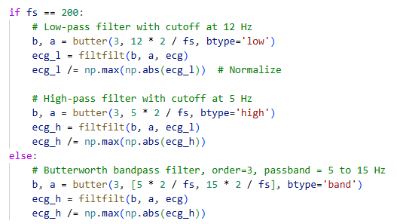


Step-1: Pre-processing
Normalization
2. Removing DC offset
3. Filtering

Slide 7
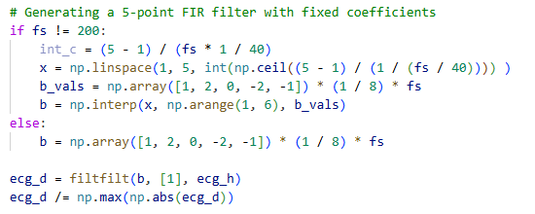

Step-2: Feature Enhancement
Derivative Filtering
2. Squaring
3. Moving Average Integration

Slide 8

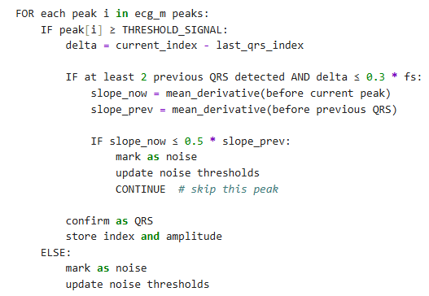
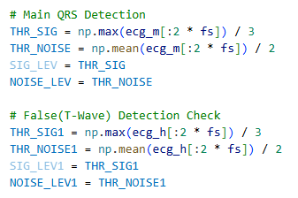
Step-3: Threshold-Based Detection
1. Finding Peaks
3. QRS Detection (Pseudocode)
2. Initial Thresholds

Slide 9
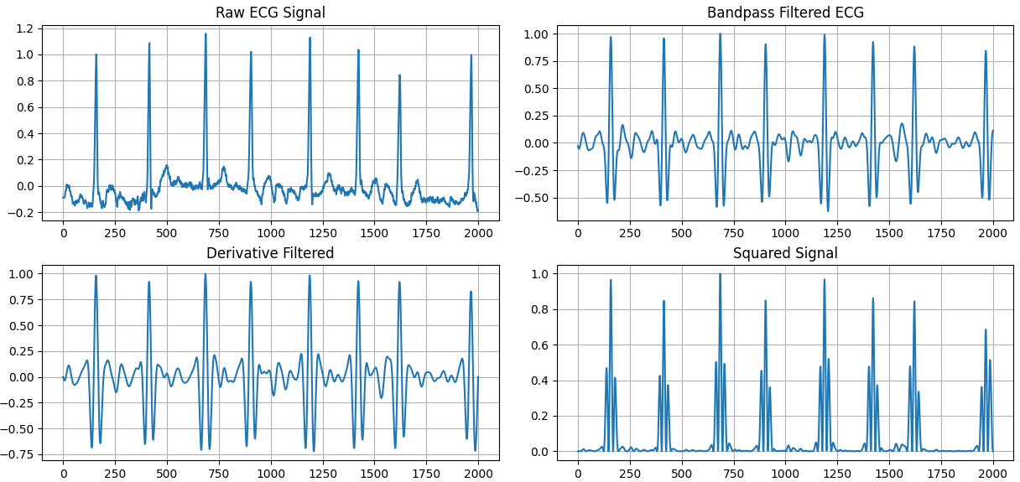
Outputs

Slide 10
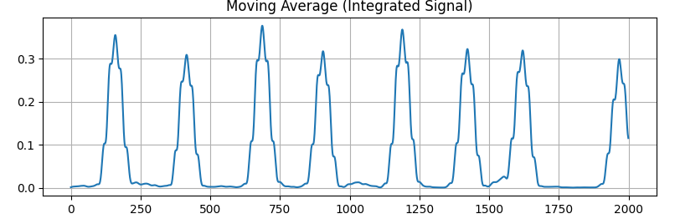
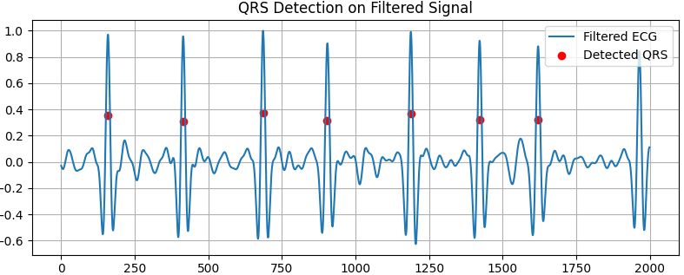
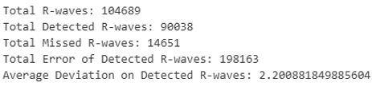
Outputs

Slide 11
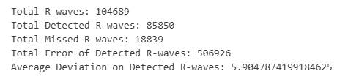

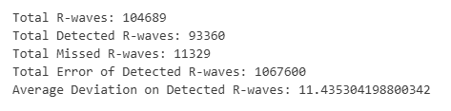


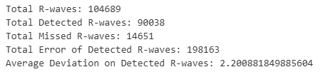
Parameter Selection
Moving Average Window Size
Refractory Period
Minimum Peak Distance
Trial and Error:
Chosen Values:

Slide 12
Pre-processing Method 2
Discrete Wavelet Transform Method
Raw ECG Signal
Pre-processing
Wavelet NeighBlock Denoising
R Peaks Detection

Slide 13

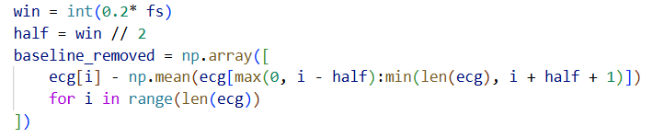
Step-1: Pre-processing
Normalization
2. Baseline Wander Removal Moving Average High Pass Filter

Slide 14
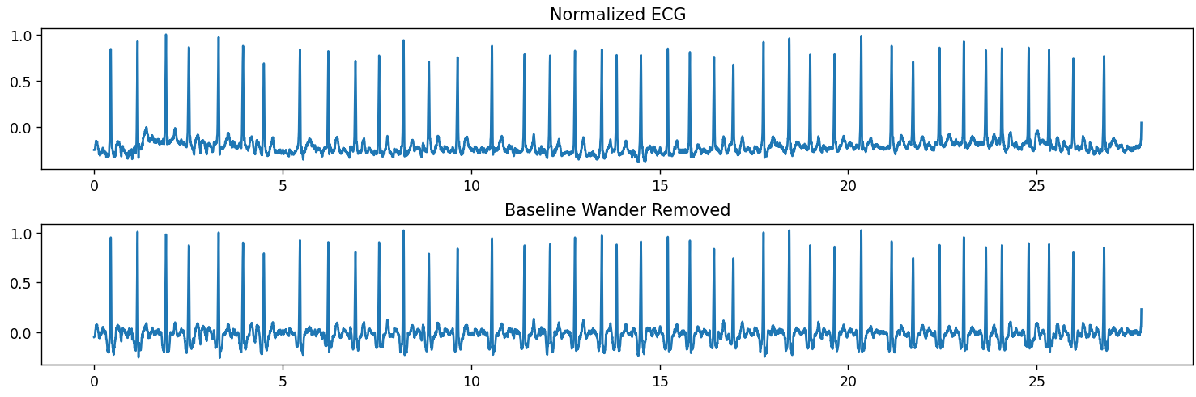
Plot After Pre-processing

Slide 15
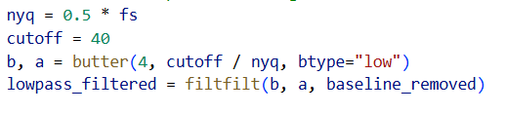
3. Low Pass Filtering 40-50 Hz suitable for QRS component 4th Order Butterworth Filter filtfilt() to avoid phase shift

Slide 16
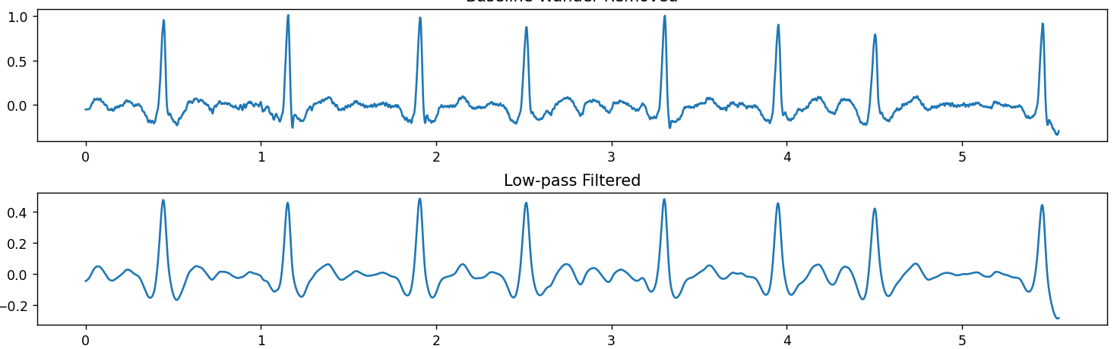
Plot After LPF

Slide 17
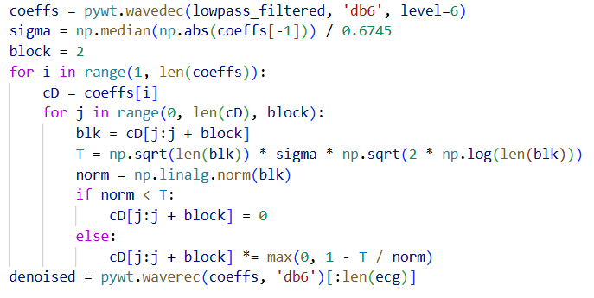
Step-2: Wavelet NeighBlock Denoising
Daubechies 6 wavelets 6 level decomposition Neighblock Shrinkage Context Aware Noise Suppression

Slide 18
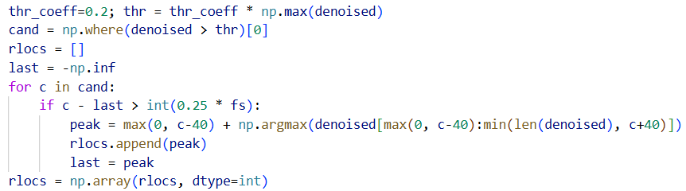
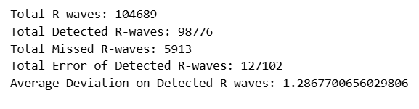
Step-3: R-Peaks Detection

Slide 19
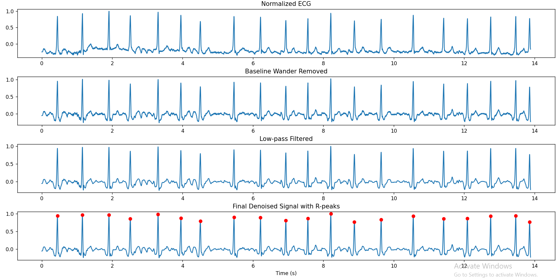
DWT for QRS Detection Plots

Slide 20
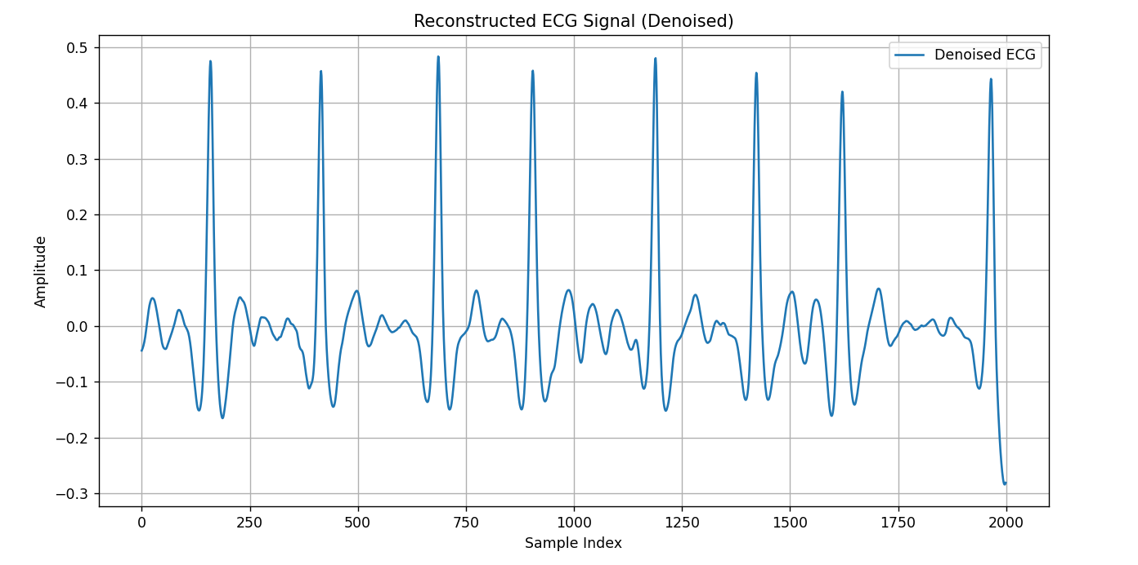
Reconstructed Signal

Slide 21
Parameter Adjustment
1. Cut Off Frequency in Filter (40-50 Hz)
2. Filter Order (4) 3. Wavelet Type (db6) 4. Wavelet Block Size 5. R-Peak Thresholding Factor 4

Slide 22
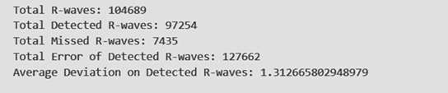
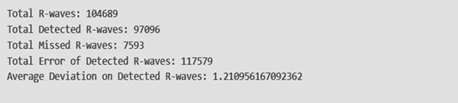
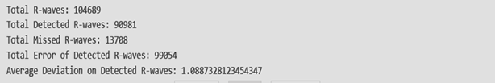
Cut-off Frequency : 50 Filter Order : 4 Wavelet Type : db6 Wavelet Block : 4 R-Peak Thresholding : 0.3 Cut-off Frequency : 40 Filter Order : 5 Wavelet Type : db6 Wavelet Block : 4 R-Peak Thresholding : 0.2 Cut-off Frequency : 40 Filter Order : 4 Wavelet Type : db4 Wavelet Block : 2 R-Peak Thresholding : 0.3

Slide 23
Arrhythmia Detection

Slide 24
Methodology
Detection Metrics Analysis
Feature Selection and Data Analysis
Training SVM Classifier
Accuracy Metrics Analysis
Data Pre-Processing and Feature Extraction

Slide 25
Step-01: Data Pre-Processing and Feature Extraction

Slide 26
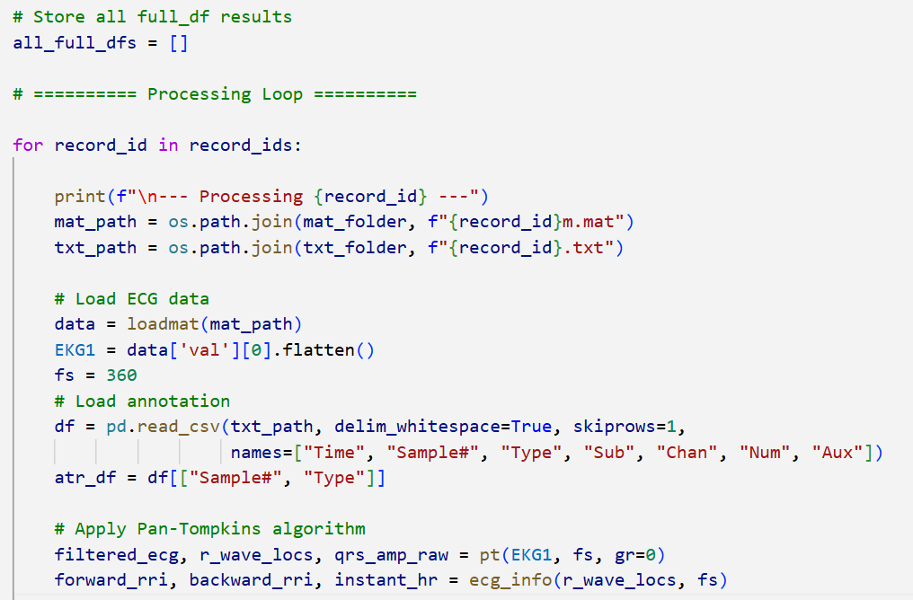
i. Load ECG signal and annotation data
ii. Apply pre-processing algorithm to detect R-peaks and generate filtered ECG Signal
iii. Derive RR intervals and heart rate information
iv. Match detected R-peaks with annotations and compare results
v. Segment ECG signals around annotated R-peaks
vi. Combine results into a unified dataframe for each record

Slide 27
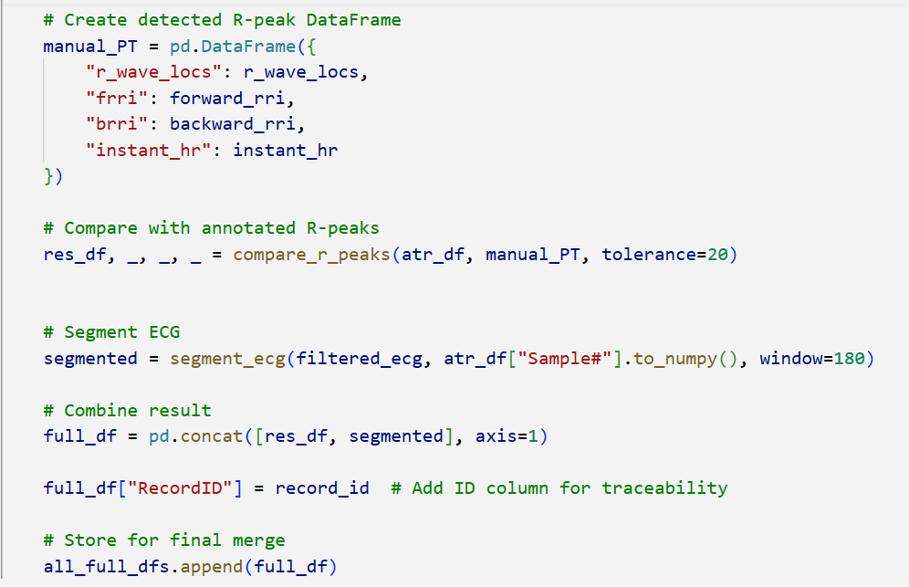

Slide 28
Step-02: Detection Metrics Analysis

Slide 29
Metrics | Pan Tompkins Algorithm | Discrete Wavelet Transform
Total R-waves | 104,689 | 104,689
Total Detected R-Waves | 90,038 | 98,776
Total Missed R-Waves | 14,651 | 5,913
Total Error of Detected R-waves | 198,163 | 127,102
Average Deviation of Detected R-waves | 2.2008 samples | 1.2867 samples

Slide 30
Step-03: Feature Selection and Data Analysis

Slide 31
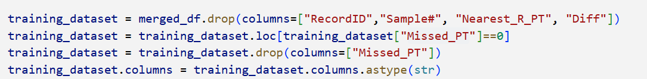
a. Feature Selection for Model Training
Selected Features:
Forward R-R Interval (FRRI)
Backward R-R Interval (BRRI)
Instant Heart Rate
360 Sample Window around Beats

Slide 32
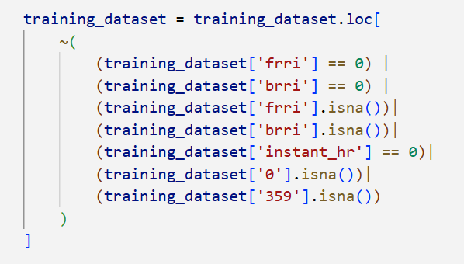
b. Exclusion of Problematic Beats

Slide 33
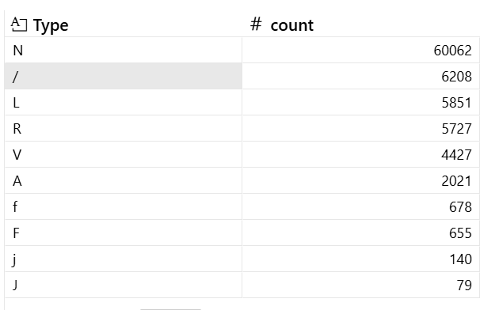
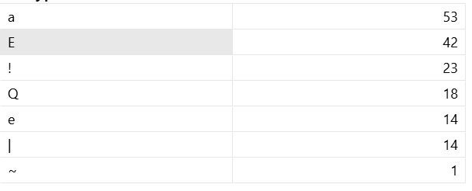
c. Type Selection for Model Training
--> Among all these labels we select the labels needed for our project and save it as the main types and other as the "Other"
--> We peaked top 6 Types training.
N - Normal Beat
/ - Paced Beat
L - Left Bundle branch Block Beat (LBB)
R - Right Bundle Branch Block Beat (RBB)
V - Premature Ventricular Contraction (PVC)
A - Atrial Premature Contraction (APC)

Slide 34
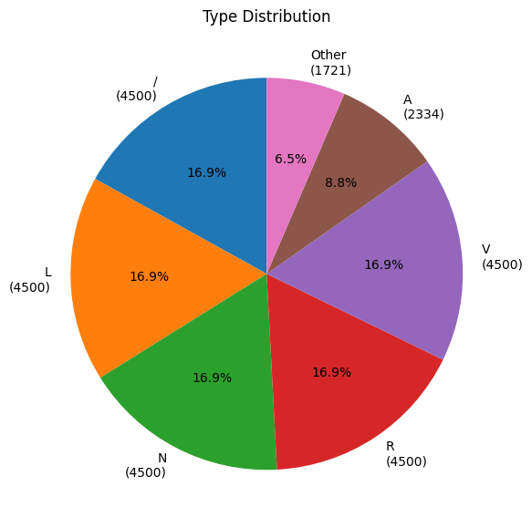
c. Splitting Training Dataset
Target Size = 4500 for each type
Training Dataset = 80%
Validation Dataset = 20%

Slide 35
Step-04: Training SVM Classifier

Slide 36
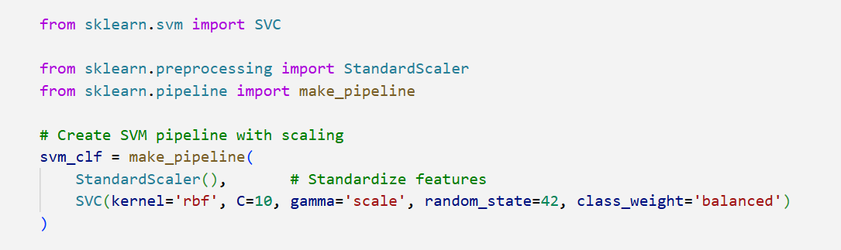
Hyperparameters Selection
Kernel = rbf (Radial Basis Function)
Regularization Parameter, C = 10
Gamma = scale
Class Weight = balanced
Random State = 42

Slide 37
Step-05: Accuracy Metrics Analysis

Slide 38
Evaluation Criteria
Accuracy:
i) Training Accuracy: Measures performance on the training dataset
ii) Validation Accuracy: Measures generalization on unseen data
2. Precision: Ratio of true positives to all predicted positives (avoid false alarms).
3. Recall (Sensitivity): Ratio of true positives to all actual positives (avoid missing true cases).
4. F1 Score: Harmonic mean of precision and recall.
5. Confusion Matrix Analysis (Diagonal Values: Correct predictions, Off-Diagonal Values: Misclassifications)

Slide 39
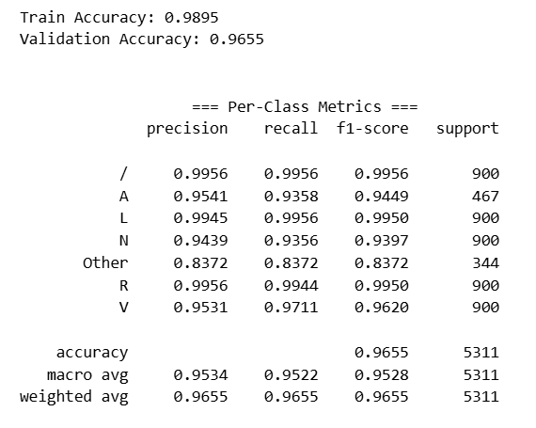
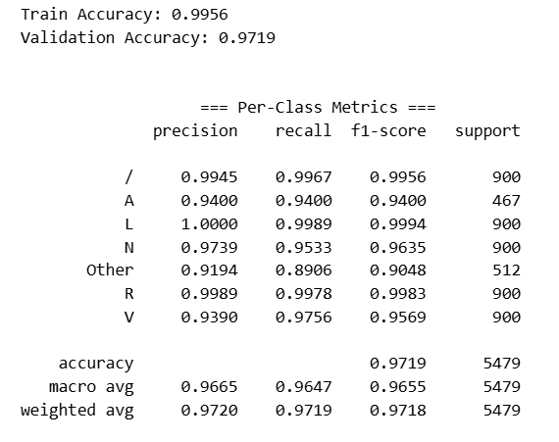
Comparison between Two Methods
Accuracy
Pan-Tompkins Method
Discrete Wavelet Transformation Method

Slide 40
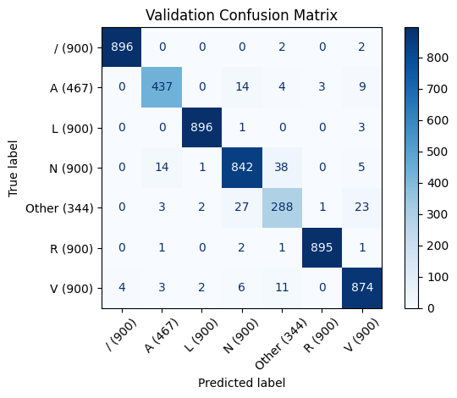

Comparison between Two Methods
Confusion Matrix
Pan-Tompkins Method
Discrete Wavelet Transformation Method

Slide 41
Conclusion
Using Discrete Wavelet Transformation Method, we have detected the R-peaks more accurately than that of Pan-Tompkins Method

Slide 42
Individual Contributions of Each Member
Md. Abu Saleh Akib(2106007) | Discrete Wavelet Transform Method Implementation, SVM Model Training and Evaluation
Md. Redowanul Hoque(2106008) | Feature Extraction, Training Dataset, Data Analysis, Pan Tompkins Method Implementation
Fariha Anjum Oshin(2106009) | Pan Tompkins Method Implementation, Feature Extraction, Training Dataset, Data Analysis
Sudipta Mondal(2106010) | SVM Model Training and Evaluation, Discrete Wavelet Transform Method Implementation

Slide 43
Outcome Based Education
CO No | Activity | Achieved PO(s)
CO4 | Design a digital system to solve a relevant problem with due considerations to public health and safety | PO(c), PO(l)
CO5 | Demonstrate application of ethical principles and practices in the project | PO(h)
CO6 | Work effectively as an individual and as a team member towards the successful completion of the project | PO(i)
CO7 | Report effectively on the design done for CO4 with presentation | PO(j)

Slide 44
References
1. Jiapu Pan And Willis J. Tompkins (1985). A Real Time QRS Detection Algorithm. IEEE. 3Transactions on Biomedical Engineering, Vol. BME-32, No 3
2. Zhang, X., & Liu, Y. (2016). ECG signal classification using wavelet tranform. Journal of Medical Systems, 40(2), 53.
3. PhysioNet. (n.d.). MIT-BIH Arrhythmia Database. Retrieved from https://www.physionet.org/content/mitdb/1.0.0/

Slide 45
Questions

Slide 46
Thank You

