Slide 1

A Project on Travel Planning
Submitted by
Redowan Billah Sami
Roll: 1409
Supervised by
Toukir Ahammed
Lecturer
IIT, University of Dhaka

Slide 2

Motivation of This Project
Providing a hassle free and simple travel planning process.
Overcoming the time constrain problem.
Provide a budget friendly travel plan.
Provide an efficient travel plan by streamlining the entire process.

Slide 3
About The Project
Implementing the graph theory and related algorithms
Viewing the route according to user’s requirement by implementing related algorithm.
Visualization of the end result

Slide 4
Features
Creating a graph from the given co-ordinates
Viewing the shortest path from source to destination
Viewing the shortest possible route, starting at the source, travelling every location and returning to the source.
Providing a budget friendly travel plan
Providing a plan with maximum destination coverage in shortest possible time.
Representing a visualization of the route

Slide 5
Algorithms Used in This Project
Dijkstra’s Algorithm
Branch and Bound Algorithm

Slide 6
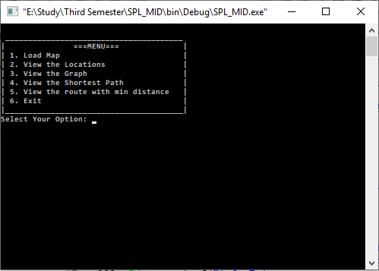
Menu
A menu will be given to choose what operation the user wants to perform. The program will terminate when “Exit” is selected

Slide 7
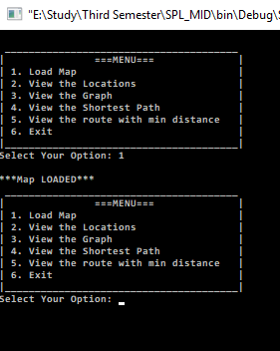
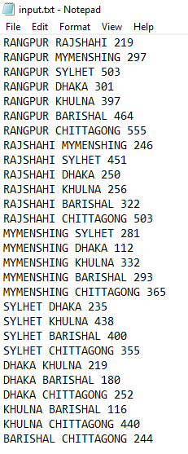
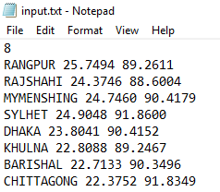
Load Map:
This will initialize the graph using the given locations, co-ordinates and weights.
Co-ordinates and distances where taken from Google

Slide 8
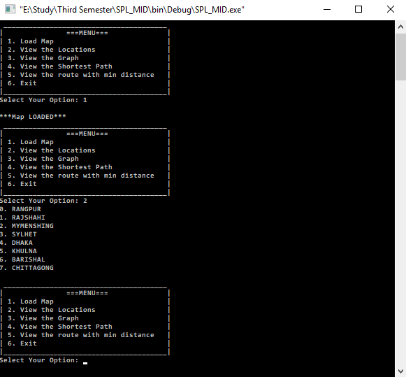
View the Locations:
This will show the list of locations from the given data.

Slide 9
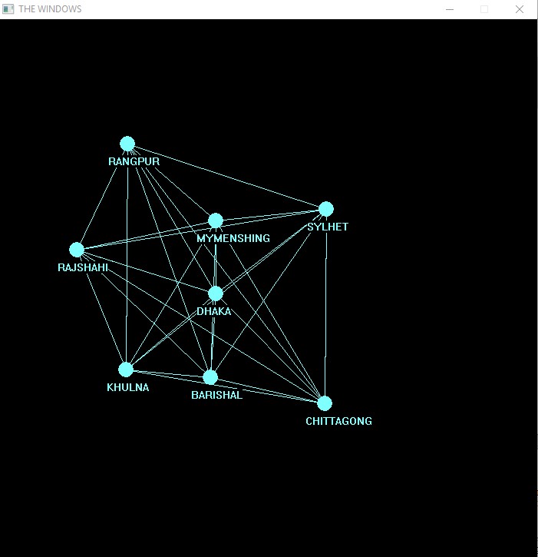
View the Graph:
A visual representation of the map will be showed using the given co-ordinates with the help of graphics.h header file.

Slide 10
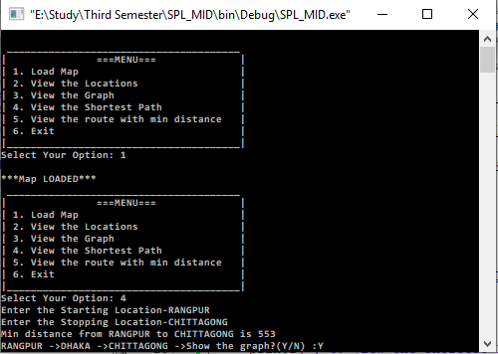
View the shortest path:
The user will be asked to input the source location and destination location. Then, Dijkstra’s Algorithm will be applied and route will be shown to the user.
The user can visually see the route by entering ‘Y’.

Slide 11
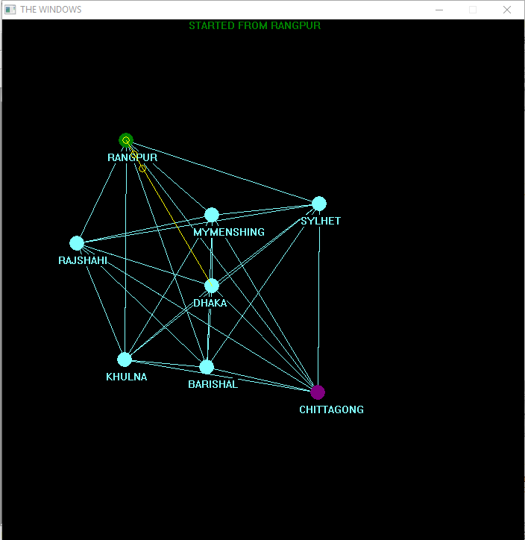
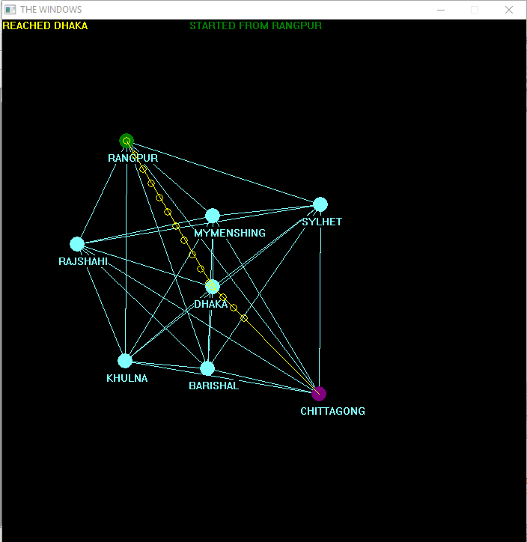
Visualization

Slide 12
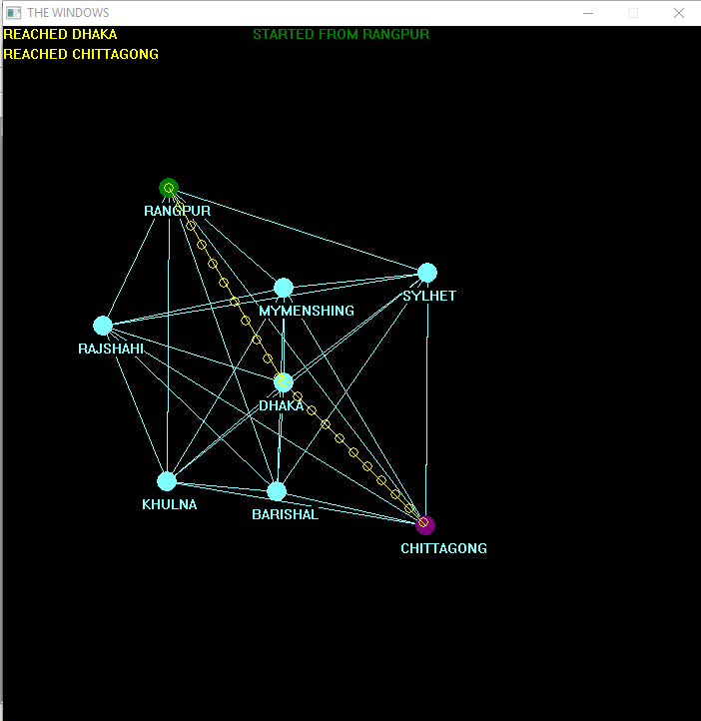
Visualization

Slide 13
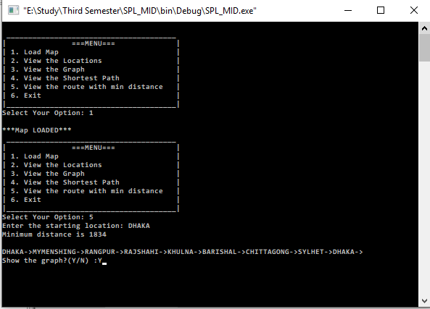
View route with minimum distance:
The user will be asked to input the source location. The problem is similar to the Travelling Salesperson Problem. So, Branch and Bound Algorithm will be applied to find the desired route.
The user can visually see the route by entering ‘Y’.

Slide 14
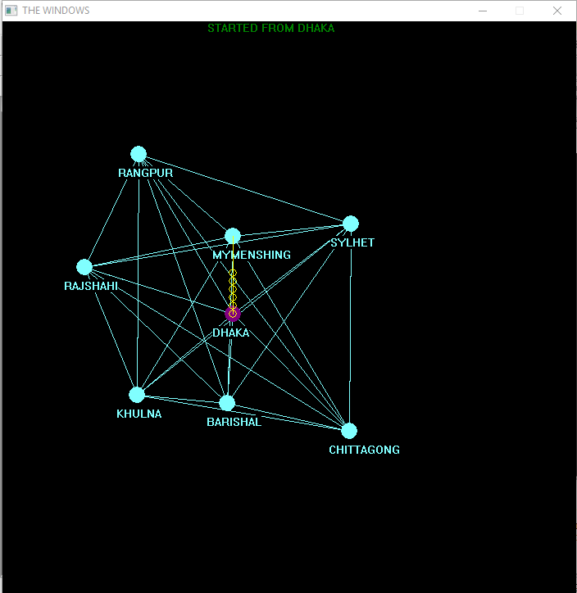
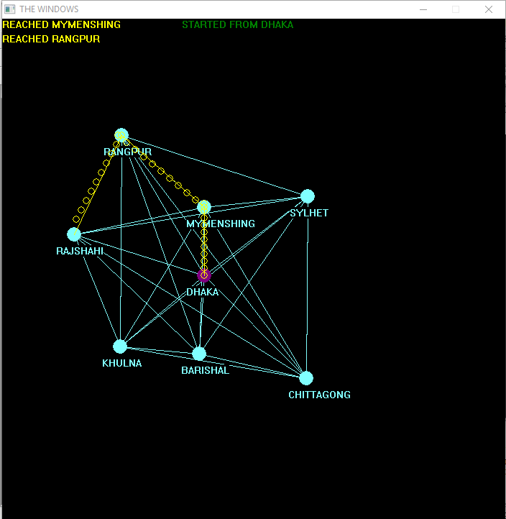
Visualization

Slide 15
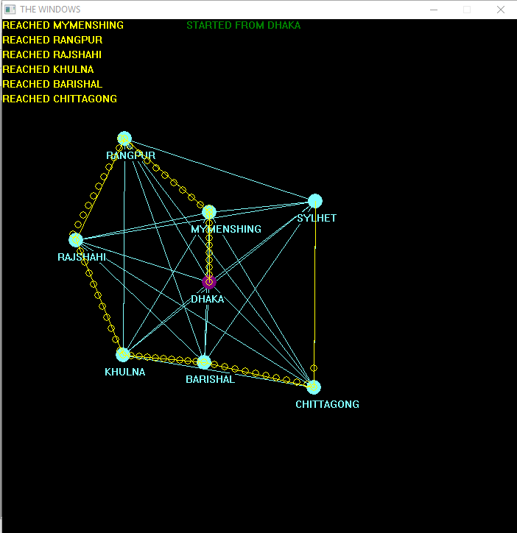
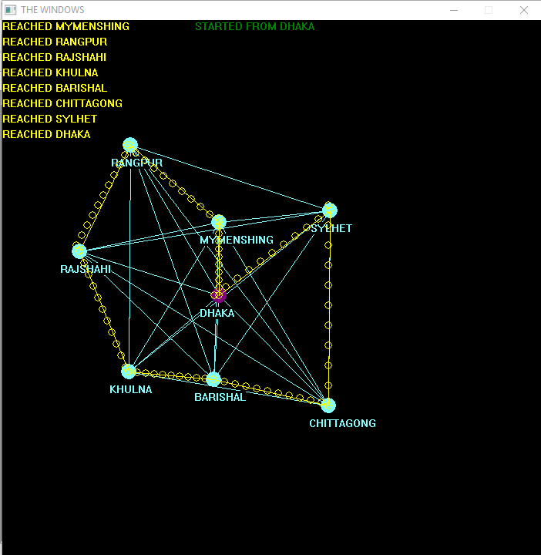
Visualization

Slide 16
My GitHub Repository https://github.com/redowansami/SPL-1

Slide 17
THANK YOU

