Slide 1
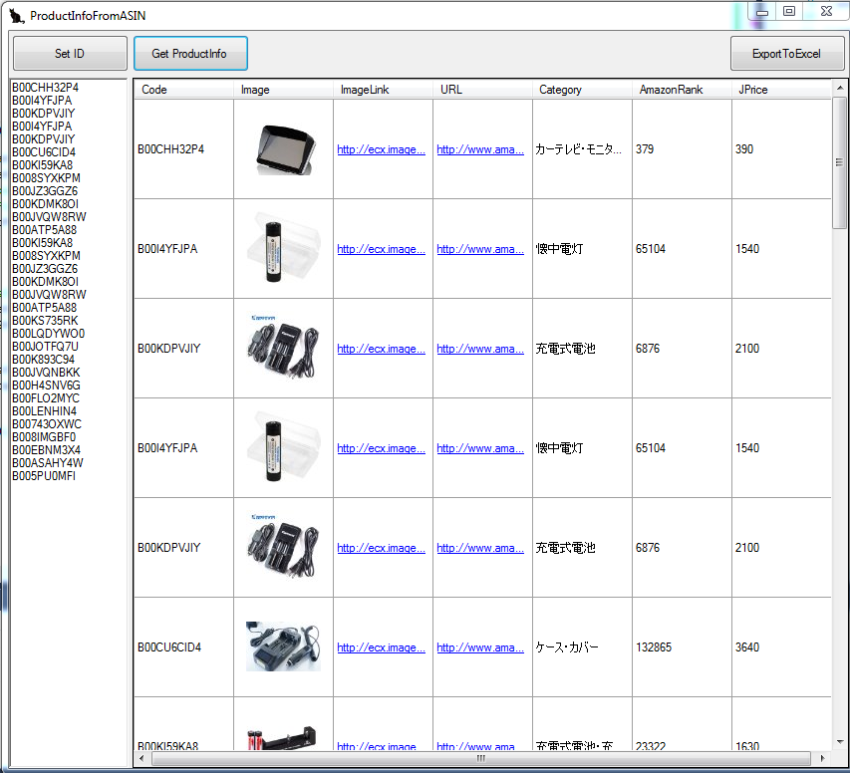
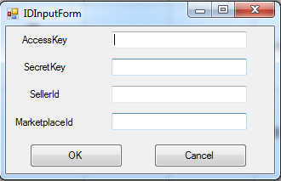
3. Get Product Info Table
4. Export to csv file
1. Input ID
2. Input ASIN

