Slide 1
config.xml
configuration
file
/etc/afm/afm-unit.conf
Config engine
json description
Mustache engine
virtual
data
systemd
units
units description
*.service
Unit installer
*.socket
...

Slide 2
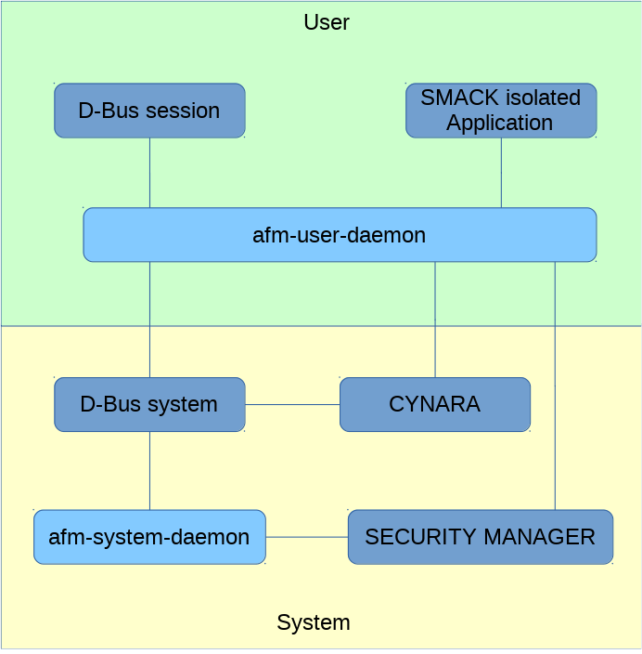

Slide 3
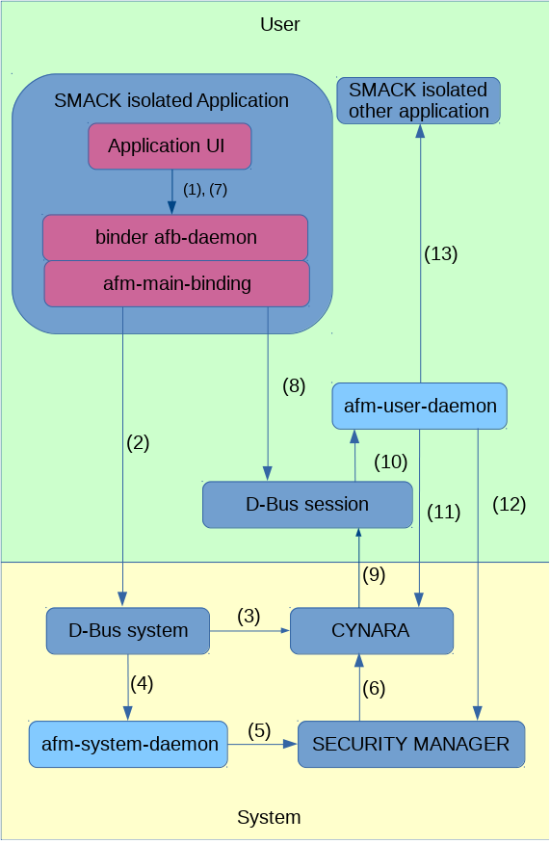

Slide 4
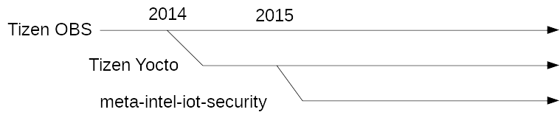

Slide 5
