Slide 2
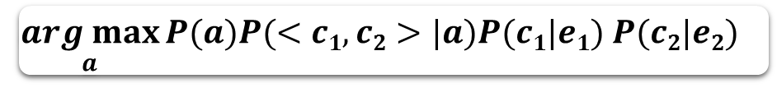
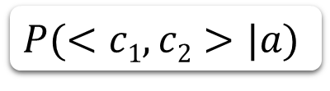
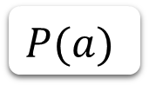
$$\underset{a}{arg max}{P(a)P(<c1,c2>|a)P(c1|e1) P(c2|e2) }⁡$$
Conceptualization
Online
Offline
$$P(a)$$
$$P(<c1,c2>|a)$$
CAC Pattern Training
DBpedia
Probase

Slide 3
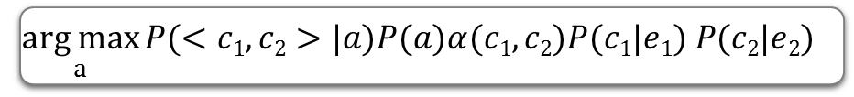
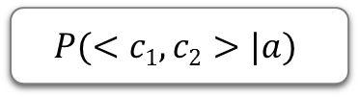
Query Entity Pair <e₁,e₂>
Conceptualization
$$\underset{a}{arg max}{P(<c1,c2>|a)P(a)α(c1,c2)P(c1|e1) P(c2|e2) }⁡$$
online
Concept Relation DB
offline
$$P(<c1,c2>|a)$$
Concept Relation Training
…
…
DBpedia
Probase
Relation KB

Slide 4
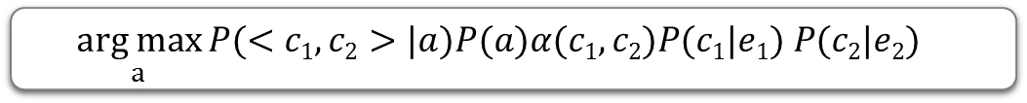

Query Entity Pair<e₁,e₂>
$$P\left(c1 | e1\right),P(c2|e2)$$
$$\underset{a}{arg max}{P(<c1,c2>|a)P(a)α(c1,c2)P(c1|e1) P(c2|e2) }⁡$$
online
Concept Relation DB
offline
P(<c₁,c₂>,a)
Concept Relation Training
…
…
DBpedia
Probase
Relation KB

Slide 5

Query Entity Pair<e₁,e₂>
$$P(<c1,c2>|<e1,e2>)$$
$$\underset{a}{arg max}{P(<c1,c2>|a)P(a)α(c1,c2)P(c1|e1) P(c2|e2) }⁡$$
online
Concept Relation DB
offline
P(<c₁,c₂>,a)
Concept Relation Training
…
…
DBpedia
Probase
Relation KB

Slide 6
…
DBpedia
1
<e1,e2>
…
Prob ReCalc
ConceptSim
3
2
2
s(c₁,c₂)
5
Prob ReCalc
2
P(<c₁,c₂>,a)
4
Probase
Concept Relation DB
P(<c₁,c₂>|<e₁,e₂>)
6
Relation Retrieval
7
ERF: Entity Relation Finder
offline
online
P(a|<e₁,e₂>)

Slide 7
…
DBpedia
1
<e1,e2>
…
3
4
Prob ReCalc
s(c₁,c₂)
ConcSim
P(<c₁,c₂>,a)
2
Prob ReCalc
2
Concept Relation DB
P(<c₁,c₂>|<e₁,e₂>)
Probase
P(a|<c₁,c₂>)
4
ERF: Entity Relation Finder
offline
online
P(a|<e₁,e₂>)
5

Slide 8
…
DBpedia
1
<e1,e2>
…
4
3
P(<c₁,c₂>|<e₁,e₂>)
P(c_{i},e_{i})
s(c₁,c₂)
P(c_{i},e_{i})
P(a,<c₁,c₂>)
2
2
P(<c₁,c₂>|<e₁,e₂>)
Probase
Concept Relation DB
4
P(a|<c₁,c₂>)
ERF: Entity Relation Finder
offline
online
5
P(a|<e₁,e₂>)

Slide 9
…
DBpedia
1
<e1,e2>
…
2
3
P(<c₁,c₂>|<e₁,e₂>)
P(a|<c₁,c₂>)
2
P(<c₁,c₂>|<e₁,e₂>)
Probase
Concept Relation DB
4
P(a|<c₁,c₂>)
ERF: Entity Relation Finder
offline
online
5
P(a|<e₁,e₂>)

Slide 10
FoundedBy
c₁
c₂
e₁
e₂
company
billionaire
MICROSOFT
Bill Gates
fruit
Entrepreneur
Apple
Steve Jobs
brand
Movie
IBM
Thomas Watson
vendor
individual

Slide 11
Head: leader
Leader
9
Business Leader
Successful
Business Leader
Industry Leader
1
17
1
1
is a
is a
Successful entrepreneur
5
founder
9
1
Bill gates

Slide 12
offline
online
Web Document
DBpedia
<e1,e2>
Relation extraction
1
1
Probability
Recalc
Probability
Recalc
Probability
Recalc
2
Typicality
Relation Typicality
Probase
Concept relation DB
<c1,c2>

Slide 13
C1
C2
E1
A
E2
c1
c2
e1
e2

