Slide 1
Data Visualization By PCA, LDA, and ICA
Tsun-Yu Yang and Chaur-Chin Chen*
Institute of Information Systems & Applications
(Department of Computer Science)
National Tsing Hua University
HsinChu (新竹), Taiwan (台灣)
cchen@cs.nthu.edu.tw,
November 6, 2015

Slide 2
Outline
Introduction
Data Description and Representation
8OX, IRIS, and Thyroid Data Sets
Three Projection Methods:
(a) PCA (b) LDA (c) ICA
K-means Clustering Results
2D Projections on 8OX, IRIS, Thyroid Data

Slide 3
Introduction
This paper reports the results of three projection algorithms PCA, LDA, and ICA on
three data sets: 8OX, IRIS, Thyroid.
PCA - Principal Component Analysis
LDA - Linear Discriminant Analysis
ICA – Independent Component Analysis
8OX: 45 patterns, 8 features, 3 categories
IRIS: 150 patterns, 4 features, 3 categories
Thyroid: 215 patterns, 5 features, 3 categories

Slide 4
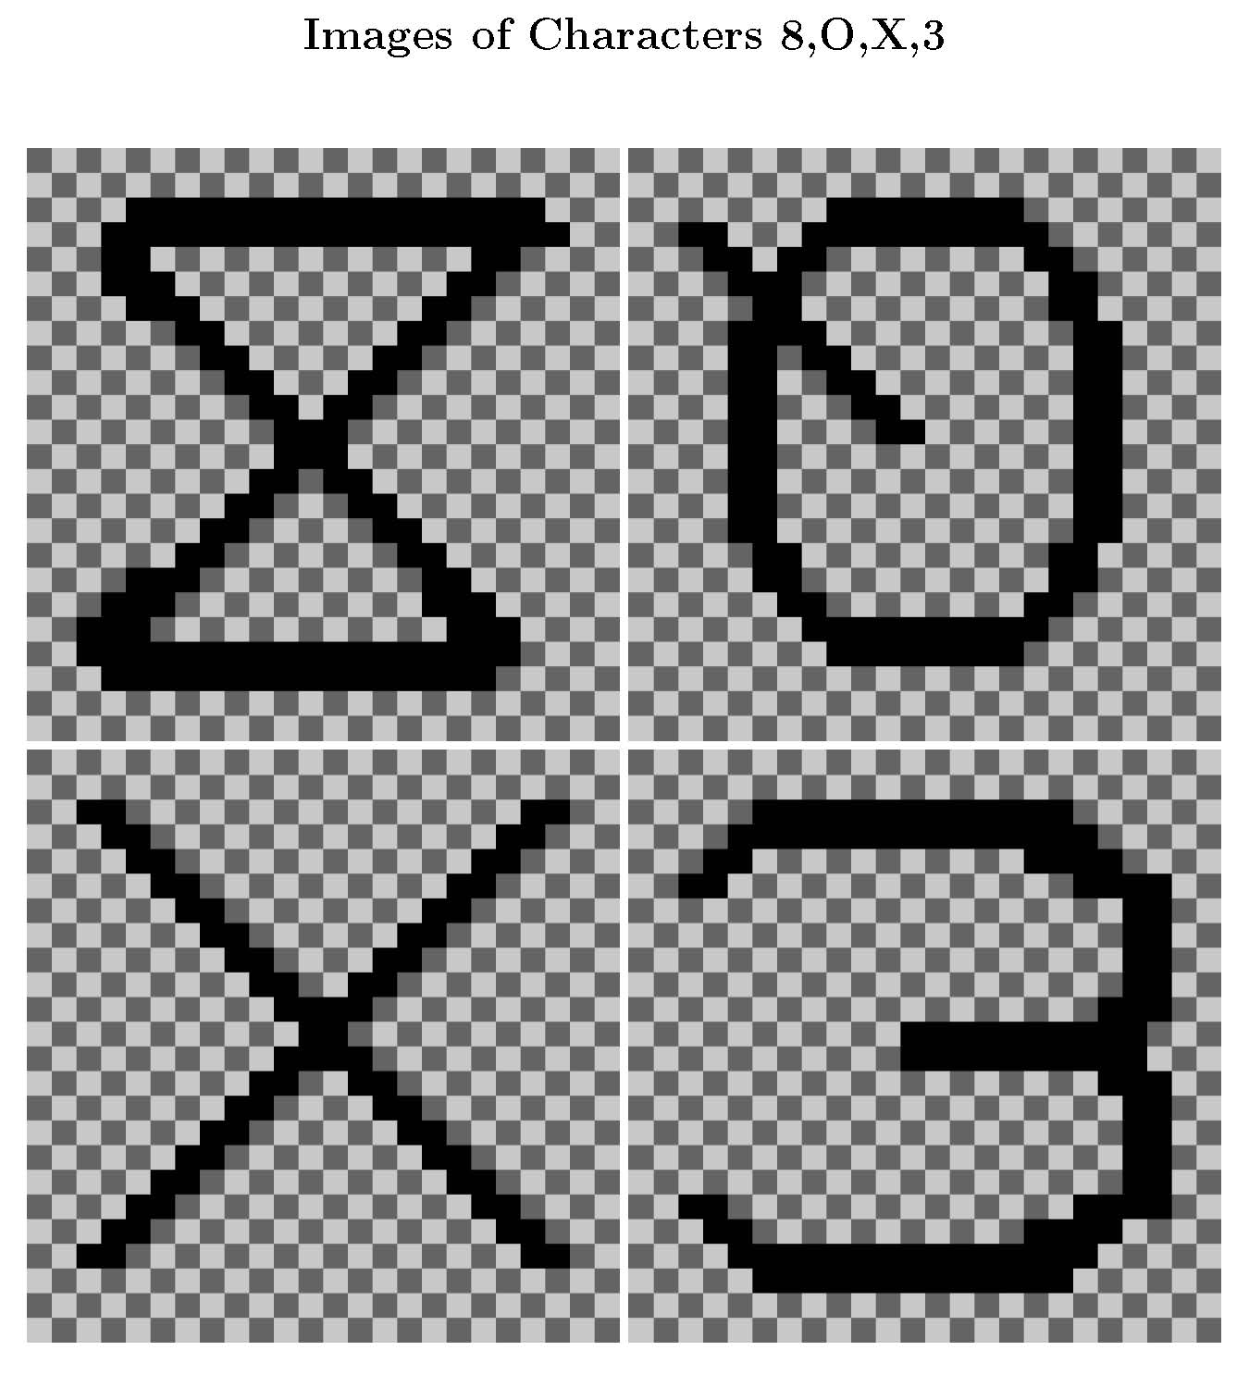

Slide 5




IRIS: Setosa, Virginica, Versicolor

Slide 6
Data Description
1. 8OX data set
2. IRIS data set
8: [11, 3, 2, 3, 10, 3, 2, 4]
O:[ 4, 5, 2, 3, 4, 6, 3, 6]
X: [11, 2,10, 3,11,4,11,3]
The 8OX data set is derived
from Munson’s handprinted
character set. Included are
15 patterns from each of the
characters ‘8’, ‘O’, ‘X’. Each
pattern consists of 8 feature measurements.
Setosa: [5.1, 3.5, 1.4, 0.2]
Virginica: [7.0, 3.2, 4.7,1.4]
Versicolor:[6.3, 3.3, 6.0, 2.5]
The IRIS data set contains
the measurements of three
species of iris flowers, it
consists of 50 patterns from
each species on 4 features
(sepal length, sepal width,
petal length, petal width).

Slide 7
Thyroid Data
Thyroid data set is one of several datasets about thyroid available at UCI repository recording 215 patients of 3 categories
(1) normal (150/215),
(2) suffers from hypothyroidism (35/215),
(3) hypothyroidism (30/215).
Each sample contains five features:
T3-resin, Thyroxin, Triiodothyroidnine, Thyroidstimulating, and THS.

Slide 8
Problem Statement for PCA
• Let X be an m-dimensional random vector with the covariance matrix C. The problem is to consecutively find the unit vectors a₁, a₂, . . . , a_{m} such that y_{i}= x^{t} a_{i} with Y_{i} = X^{t} a_{i} satisfies
1. var(Y₁) is the maximum.
2. var(Y₂) is the maximum subject to cov(Y₂, Y₁)=0.
3. var(Y_{k}) is the maximum subject to cov(Y_{k}, Y_{i})=0,
where k = 3, 4, · · ·,m and k > i.
• Y_{i} is called the i-th principal component
• Feature extraction by PCA is called PCP

Slide 9
The Solutions
Let (λ_{i}, u_{i}) be the pairs of eigenvalues and eigenvectors of the covariance matrix C such that
λ₁ ≥ λ₂ ≥ . . . ≥ λ_{m} ( ≥0 ), and
∥u_{i} ∥₂ = 1, ∀ 1 ≤ i ≤ m.
Then
a_{i} = u_{i} and var(Y_{i})=λ_{i} for 1 ≤ i ≤ m.

Slide 10
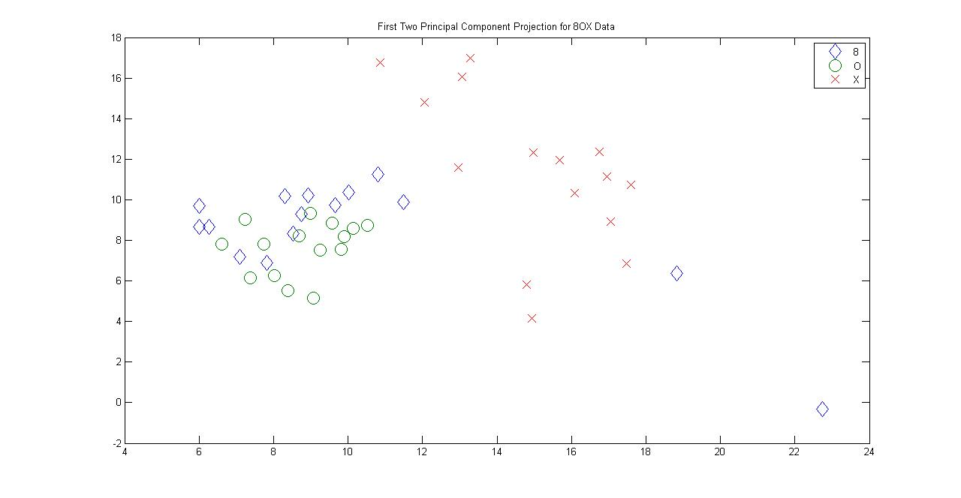
First and Second PCP for data8OX

Slide 11
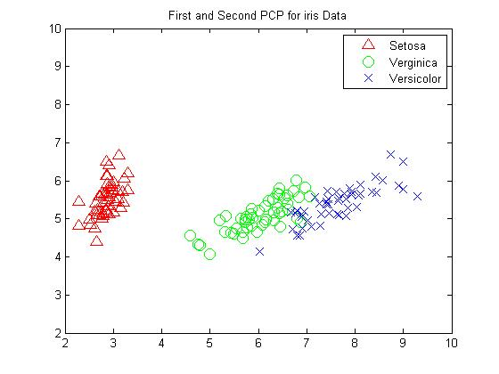
First and Second PCP for datairis

Slide 12
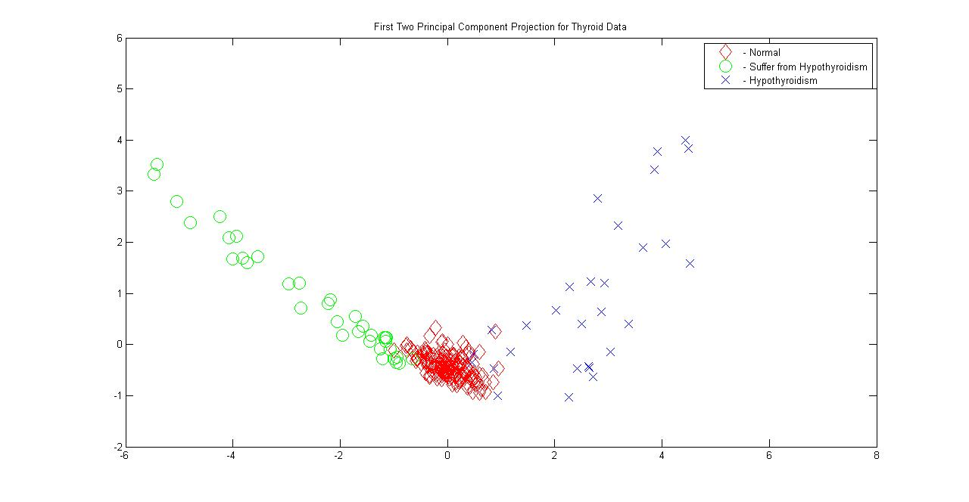
First and Second PCP for Thyroid Data Set

Slide 13
Fundamentals of LDA
Given the training patterns x₁, x₂, . . . , x_{n} from K categories, where n₁ + n₂ + … + n_{K} = n of m-dimensional column vectors. Let the between-class scatter matrix B, the within-class scatter matrix W, and the total scatter matrix T be defined below.
1. The sample mean vector u= (x₁+x₂+. . . +x_{n} )/n
2. The mean vector of category i is denoted as u_{i}
3. The between-class scatter matrix B= Σ_{i=1}^{K} n_{i}(u_{i} − u)(u_{i} − u)^{t}
4. The within-class scatter matrix W= Σ_{i=1}^{K} Σ_{x in} _{ωi}(x-u_{i} )(x-u_{i} )^{t}
5. The total scatter matrix T =Σ_{i=1}^{n} (x_{i} - u)(x_{i} - u)^{t}
Then T= B+W

Slide 14

Fisher’s Discriminant Ratio
Linear discriminant analysis for a dichotomous problem attempts to find an optimal direction w for projection which maximizes a Fisher’s discriminant ratio
J(w) =
The optimization problem is reduced to solving the generalized eigenvalue/eigenvector problem Bw= λ Ww by letting (n=n₁n₂)
Similarly, for multiclass (more than 2 classes) problems, the objective is to find the first few vectors for discriminating points in different categories which is also based on optimizing J₂(w) or solving
Bw= λ Ww for the eigenvectors associated with few largest eigenvalues.

Slide 15
Independent Component Analysis (ICA) Algorithm
▪ICA is essentially a multivariate, parallel version of projection pursuit method which is like PCA. Projection pursuit extracts a series of signals one at a time from a set of M signal mixtures but ICA extracts M signals in parallel.
▪Consider an observation matrix X, where X contains n columns of m-dimensional observed vector {w_{i}, i=1,2,…,n}. Given a number of desired components K<m. An ICA algorithm can be stated as follows (where K=2, 3 is used for visualization).

Slide 16
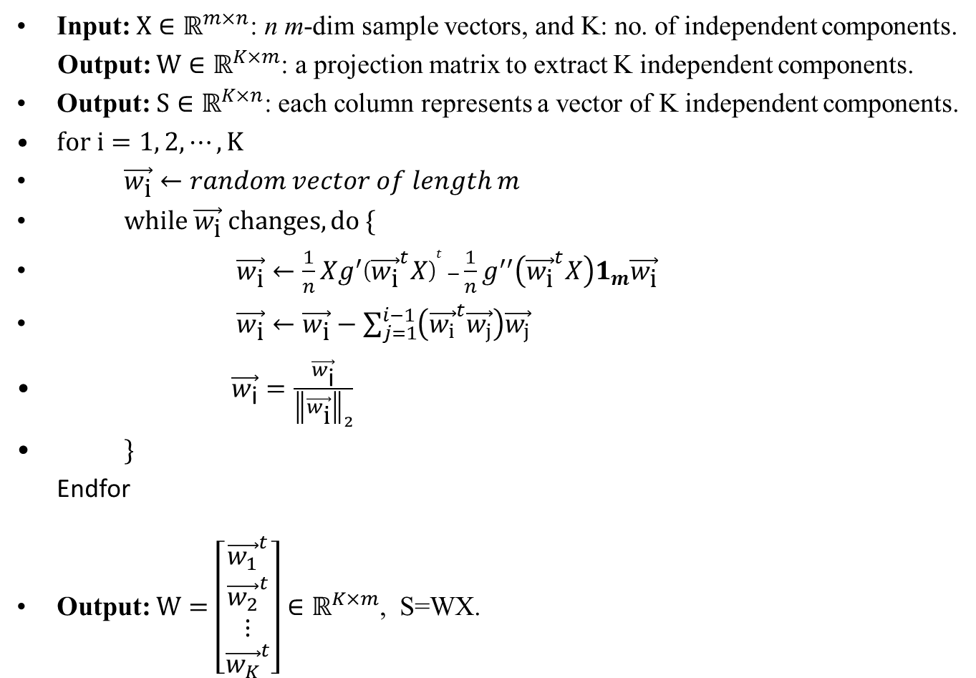
ICA Algorithm

Slide 17
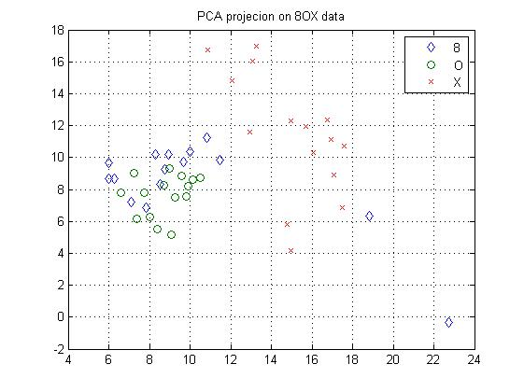
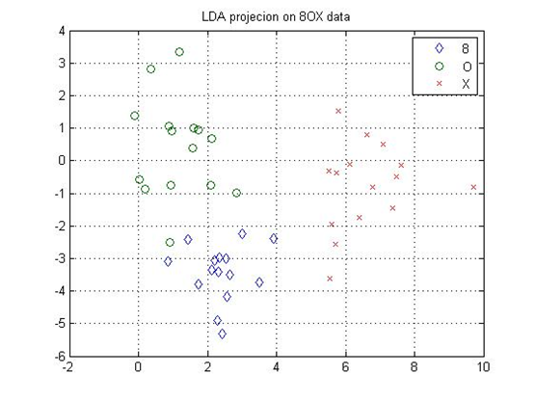
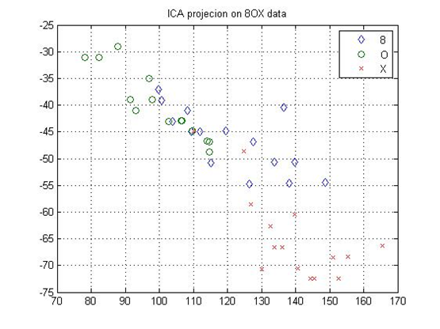
Dimensionality Reduction on 8OX Data Set
 | 8 | O | X
8 | 2 | 13 | 0
O | 0 | 15 | 0
X | 5 | 0 | 10

Slide 18
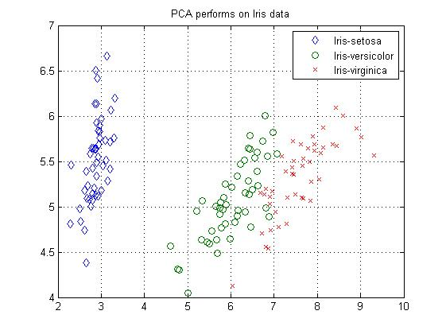
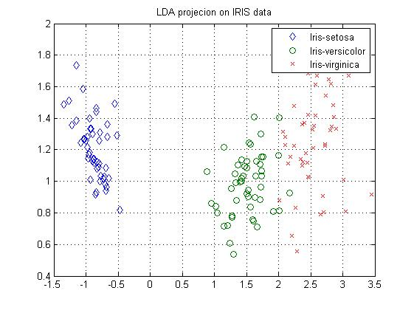
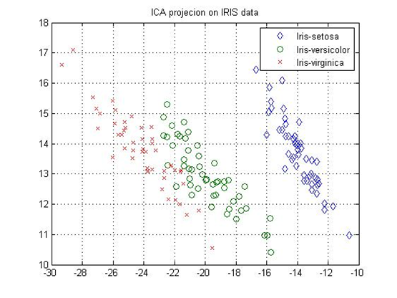
Dimensionality Reduction on IRIS Data Set
 | Setosa | Versicolor | Virginica
Setosa | 50 | 0 | 0
Versicolor | 0 | 48 | 2
Virginica | 0 | 14 | 36

Slide 19
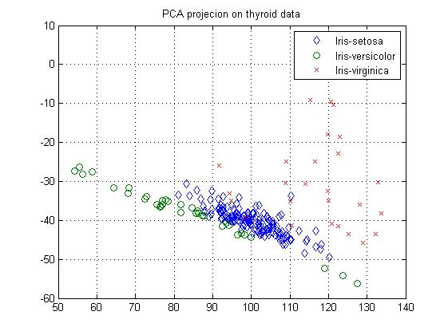
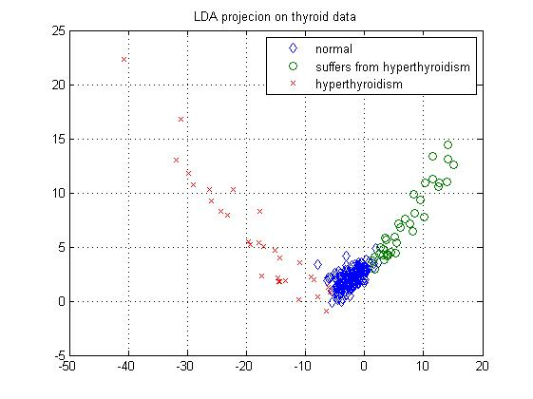
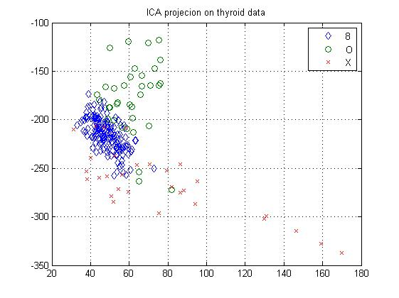
Dimensionality Reduction on Thyroid Data Set
 | Normal | Suffer | Hyperthyroidism
Normal | 136 | 5 | 9
Suffer from Hypothyroidism | 9 | 18 | 3
Hypothyroidism | 7 | 4 | 24

Slide 20
Conclusion
PCA, LDA, ICA provide good perspectives for dimensionality reduction which can preserve the clustering tendency of high-dimensional data.
PCA and ICA do not require the labels for patterns but LDA requires pattern labels.
ICA is a kind of probabilistic projection which may not provide exactly the same output.

Slide 21
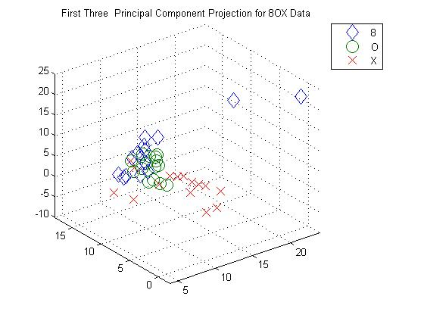
Projection of First 3 Principal Components for 8OX Data

Slide 22
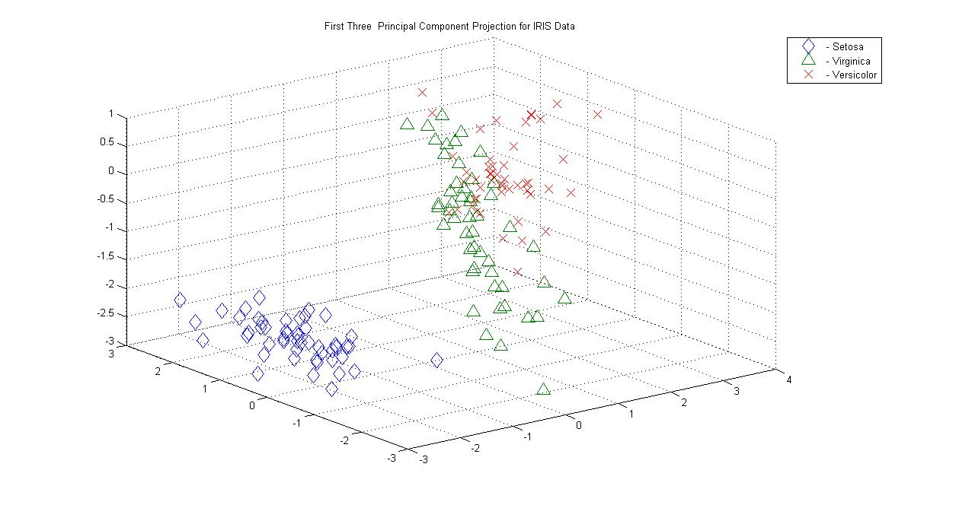
Projection of First 3 Principal Components for IRIS Data

Slide 23
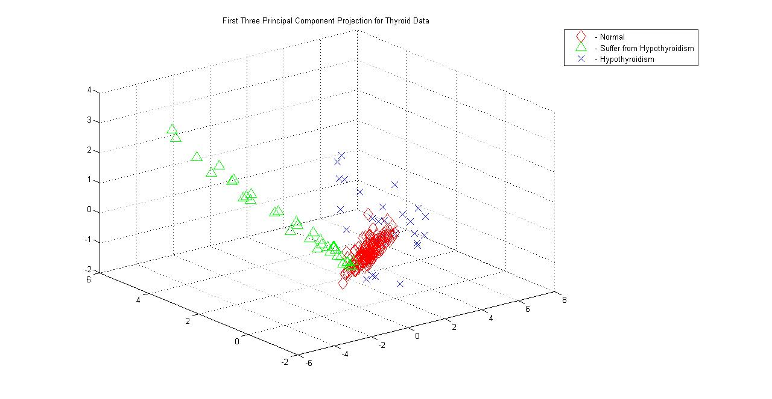
Projection of First 3 Principal Components for Thyroid Data

Slide 24
pca8OX3D.m
fin=fopen('data8OX.txt','r');
d=8+1; N=45; % d features, N patterns
fgetl(fin); fgetl(fin); fgetl(fin); % skip 3 lines
A=fscanf(fin,'%f',[d N]); A=A'; % read data
X=A(:,1:d-1); % remove the last columns
k=3; Y=PCA(X,k); % better Matlab code
X1=Y(1:15,1); Y1=Y(1:15,2); Z1=Y(1:15,1);
X2=Y(16:30,1); Y2=Y(16:30,2); Z2=Y(16:30,2);
X3=Y(31:45,1); Y3=Y(31:45,2); Z3=Y(31:45,3);
plot3(X1,Y1,Z1,'d',X2,Y2,Z2,'O',X3,Y3,Z3,'X', 'markersize',12); grid
axis([4 24, -2 18, -10,25]);
legend('8','O','X')
title('First Three Principal Component Projection for 8OX Data‘)

Slide 25
PCA.m
% Script file: PCA.m
% Find the first K Principal Components of data X
% X contains n pattern vectors with d features
function Y=PCA(X,K)
[n,d]=size(X);
C=cov(X);
[U D]=eig(C);
L=diag(D);
[sorted index]=sort(L,'descend');
Xproj=zeros(d,K); % initiate a projection matrix
for j=1:K
Xproj(:,j)=U(:,index(j));
end
Y=X*Xproj; % first K principal components

Slide 26
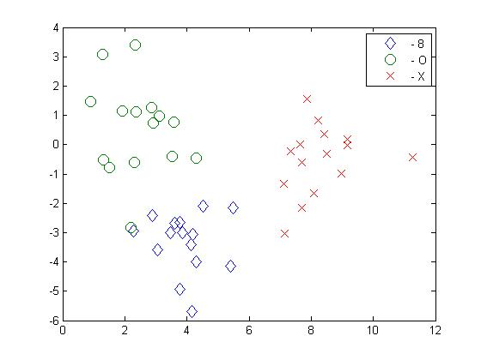
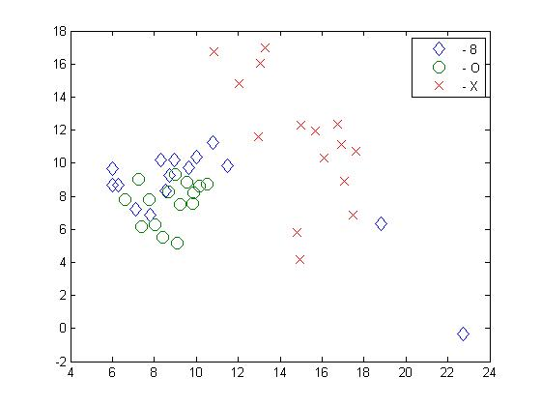
LDA and PCA on data8OX
LDA on data8OX
PCA on data8OX

Slide 27
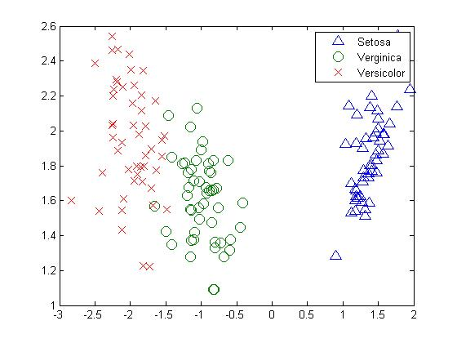

LDA and PCA on datairis
LDA on datairis
PCA on datairis

