Slide 1
Introduction to Cluster Analysis
Dr. Chaur-Chin Chen
Department of Computer Science
National Tsing Hua University
Hsinchu 30013, Taiwan
http://www.cs.nthu.edu.tw/~cchen

Slide 2
Cluster Analysis
(Unsupervised Learning)
The practice of classifying objects according to their perceived similarities is the basis for much of science. Organizing data into sensible groupings is one of the most fundamental modes of understanding and learning. Cluster Analysis is the formal study of algorithms and methods for grouping or classifying objects. An object is described either by a set of measurements or by relationships between the object and other objects. Cluster Analysis does not use the category labels that tag objects with prior identifiers. The absence of category labels distinguishes cluster analysis from discriminant analysis (Pattern Recognition).

Slide 3
Objective and List of References
The objective of cluster analysis is to find a convenient and valid organization of the data, not to establish rules for separating future data into categories.
Clustering algorithms are geared toward finding structure in the data.
B.S. Everitt, Unsolved Problems in Cluster Analysis, Biometrics, vol. 35, 169-182, 1979.
A.K. Jain and R.C. Dubes, Algorithms for Clustering Data, Prentice-Hall, New Jersey, 1988.
A.S. Pandya and R.B. Macy, Pattern Recognition with Neural Networks in C++, IEEE Press, 1995.
A.K. Jain, Data clustering : 50 years beyond K-means
Pattern Recognition Letters, vol.31, no.8, 651-666, 2010.

Slide 4
dataFive.txt
Five points for studying hierarchical clustering
2 5 2
(2I4)
4 4
8 4
15 8
24 4
24 12

Slide 5
Example of 5 2-d vectors
5
3
1 2 4

Slide 6
Clustering Algorithms
Hierarchical Clustering
Single Linkage
Complete Linkage
Average Linkage
Ward’s (variance) method
Partitioning Clustering
Forgy
K-means
Isodata
SOM (Self-Organization Map)

Slide 7
Example of 5 2-d vectors
5
3
1 2 4

Slide 8
Distance Computation
X Y
4 4 v₁
8 4 v₂
15 8 v₃
24 4 v₄
24 12 v₅
∥v₃ – v₂ ∥₁ = δ|(v₃ ,v₂ )
=∣15-8∣+∣8-4∣=11
∥v₃ – v₂ ∥₂ = δ₂(v₃ ,v₂ )
=[(15-8)²+(8-4)² ]^{1/2}
⁼65^{1/2} ～8.062
∥v₃ – v₂ ∥∞ =
δ∞(v₃ ,v₂ ) =
max(∣15-8∣,∣8-4∣) = 7

Slide 9
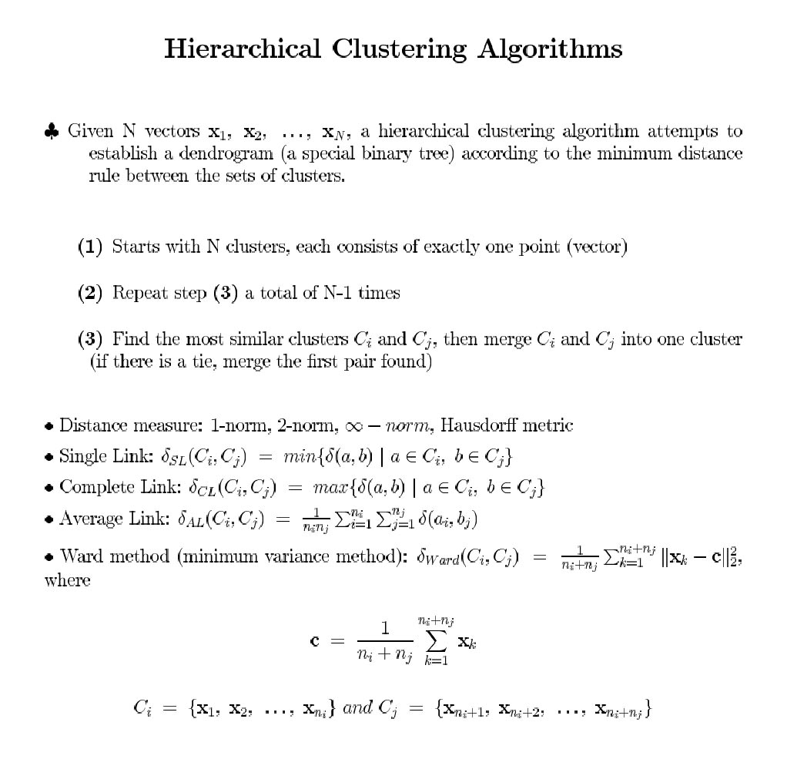

Slide 10
An Example with 5 Points
X Y
4 4
8 4
15 8
24 4
24 12
(1) (2) (3) (4) (5)
(1) - 4.0 11.7 20.0 21.5
(2) - 8.1 16.0 17.9
(3) - 9.8 9.8
- 8.0
-
Proximity Matrix with Euclidean Distance

Slide 11
Dissimilarity Matrix
(1) (2) (3) (4) (5)
* 4.0 11.7 20.0 21.5 (1)
* 8.1 16.0 17.9 (2)
* 9.8 9.8 (3)
* 8.0 (4)
* (5)

Slide 12
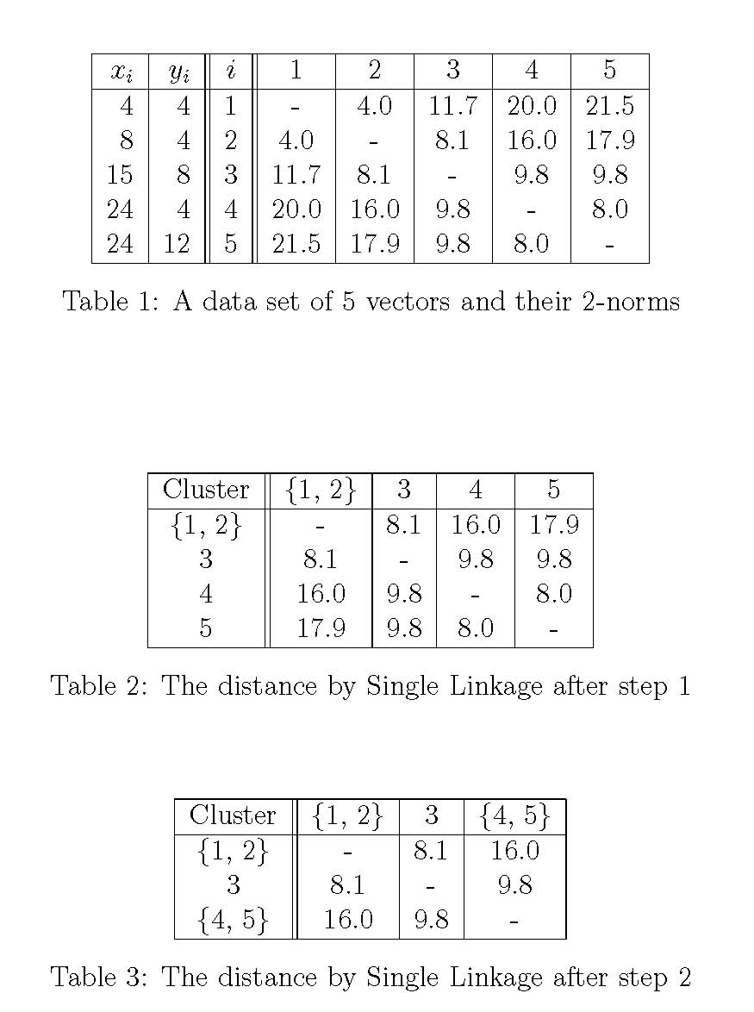

Slide 13
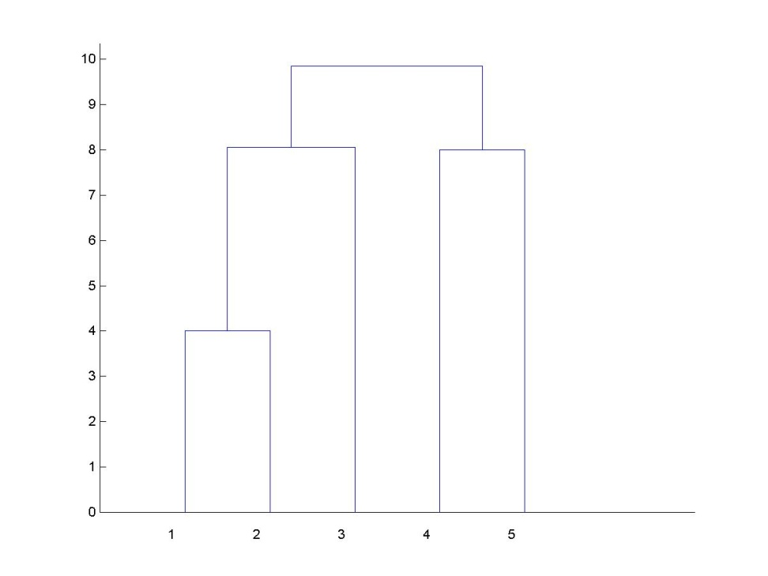
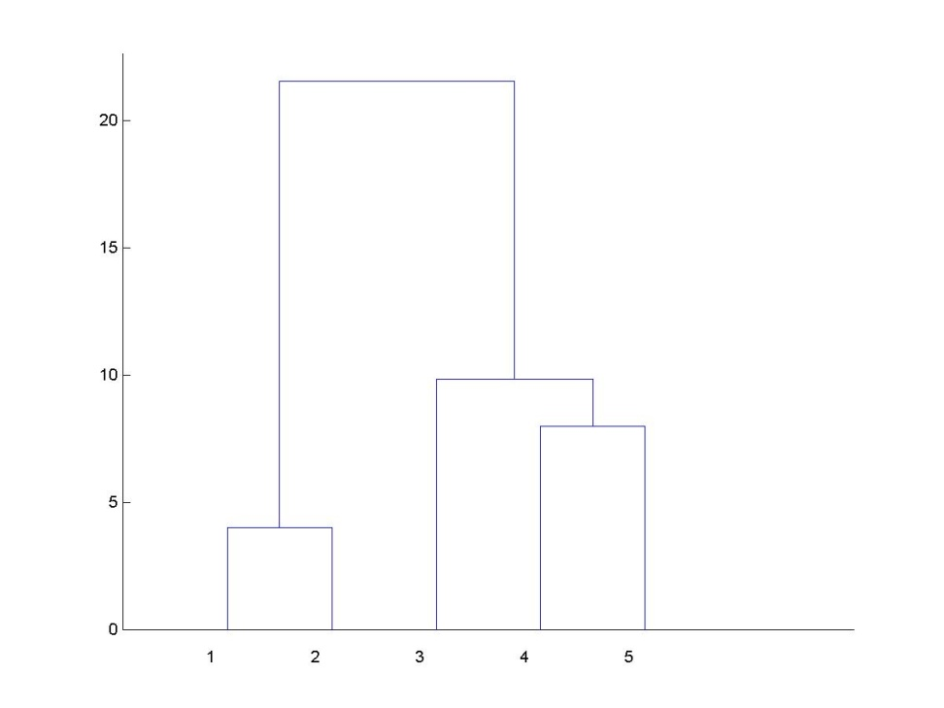
Dendrograms of Single and Complete Linkages

Slide 14
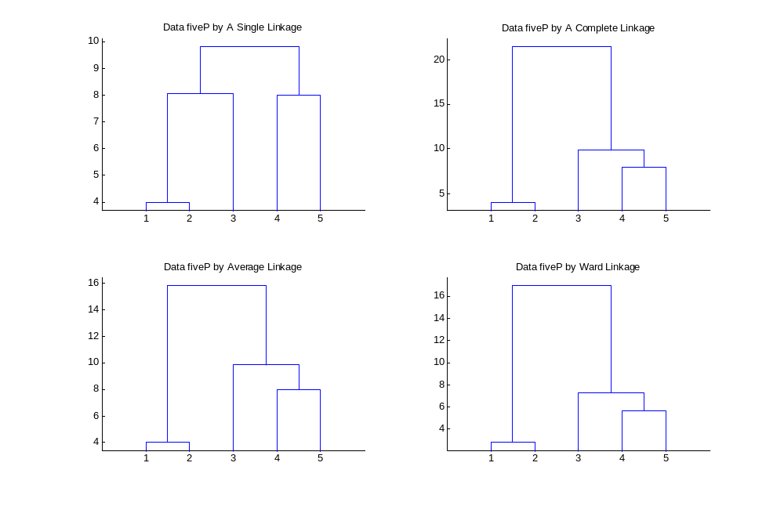
Results By Different Linkages

Slide 15
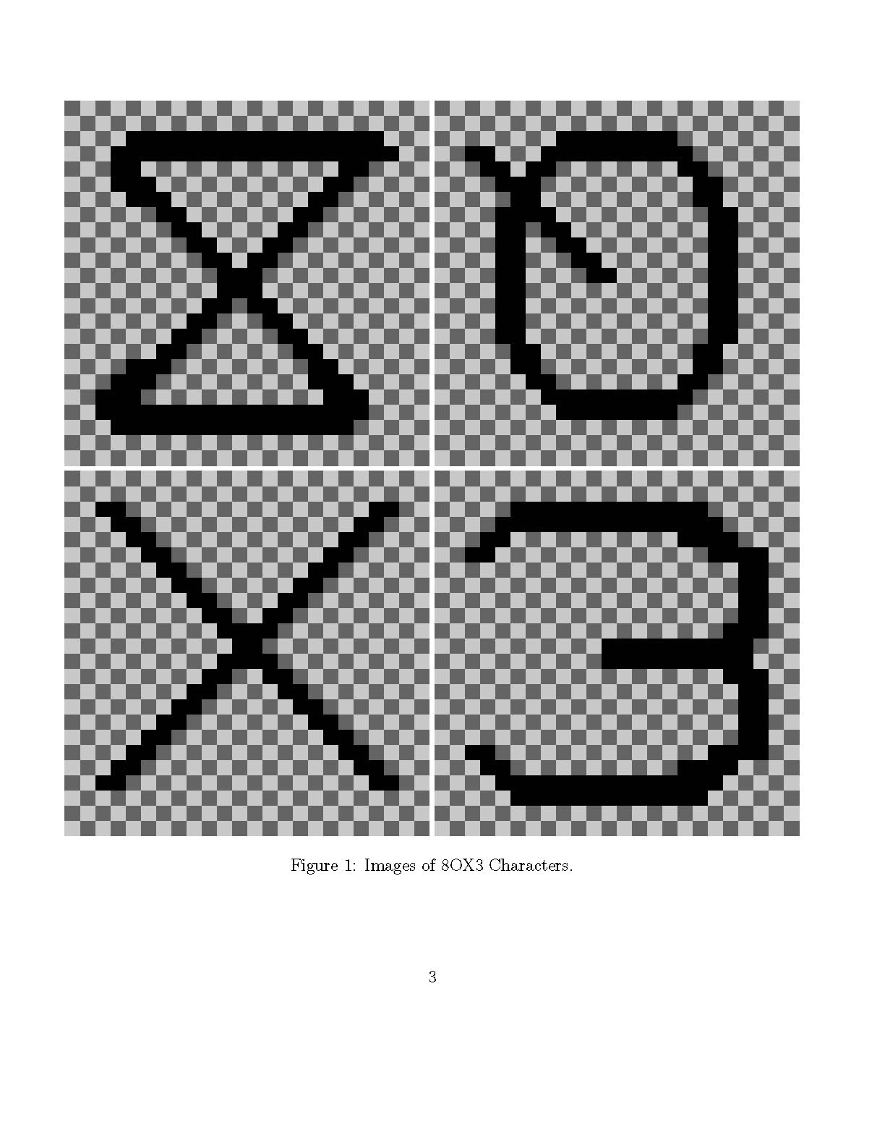

Slide 16
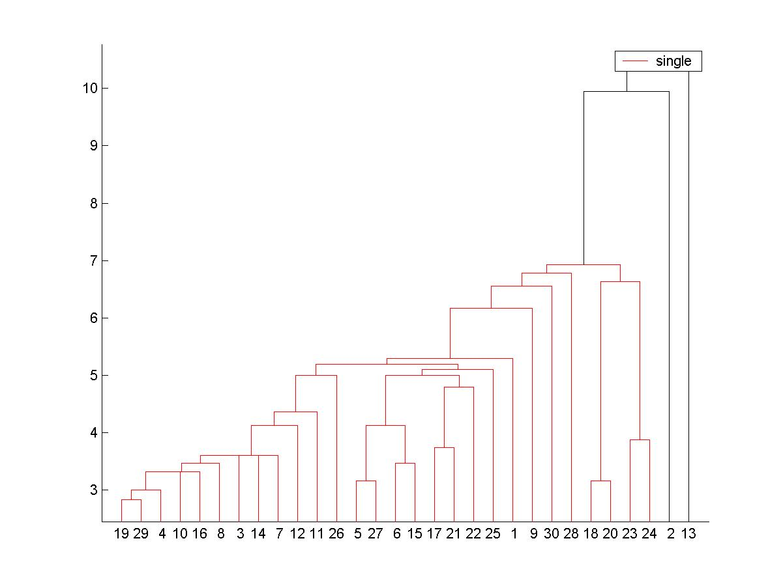
Single Linkage for 8OX Data

Slide 17
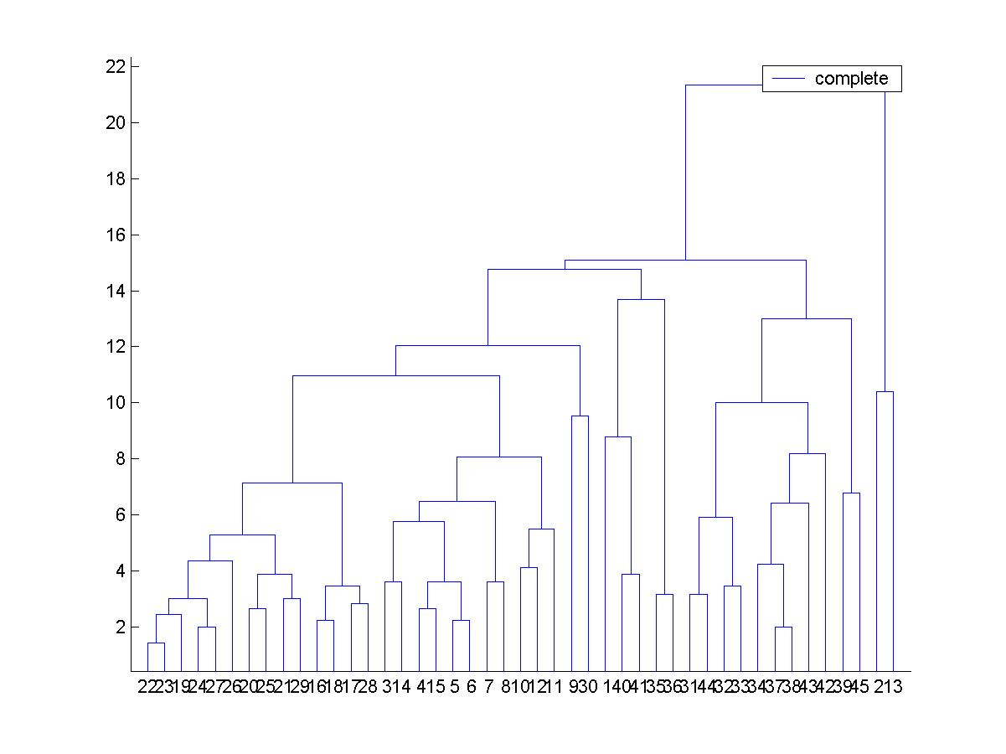
Complete Linkage for 8OX Data

Slide 18
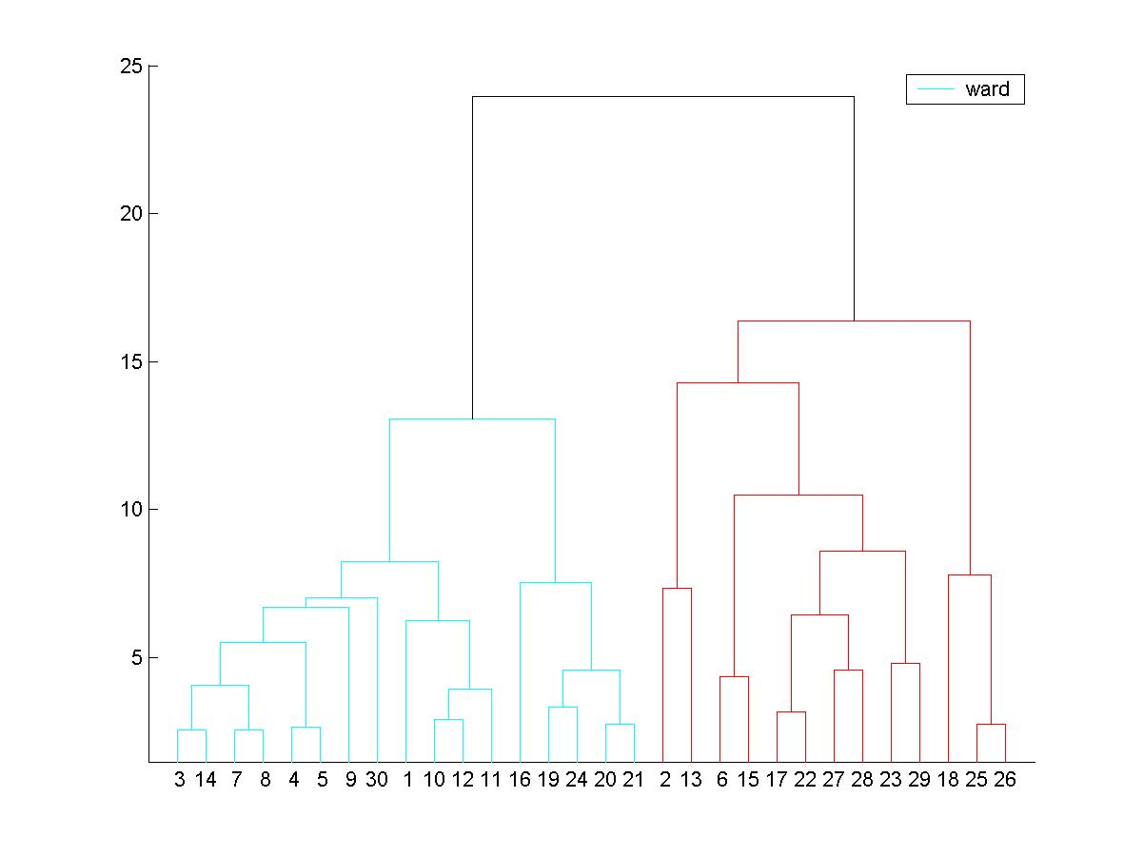
Dendrogram by Ward’s Method

Slide 19
Matlab for Drawing Dendrogram
d=8; n=45;
fin=fopen(‘data8OX.txt’);
fgetL(fin); fgetL(fin); fgetL(fin); %skip 3 lines
A=fscanf(fin,’%f’, [d+1, n]);
A=A’; X=A(:,1:d);
Y=pdist(X,’euclid’);
Z=linkage(Y,’complete’);
dendrogram(Z,n);
title(‘Dendrogram for 8OX data’)

Slide 20
Forgy K-means Algorithms
Given N vectors x₁,x₂,…,x_{N} and K, the number of expected clusters in the range [Kmin, Kmax]
Randomly choose K vectors as cluster centers (Forgy)
Classify the remaining N-K (or N) vectors by the minimum mean distance rule
Update K new cluster centers by maximum likelihood estimation
Repeat steps (2),(3) until no rearrangements or M iterations
Compute the performance index P, the sum of squared errors for the K clusters
Do steps (1~5) from K=Kmin to K=Kmax, plot P vs. K and use the knee to pick up the best number of clusters
Isodata and SOM algorithms can be regarded as the extension of a
K-means algorithm

Slide 21
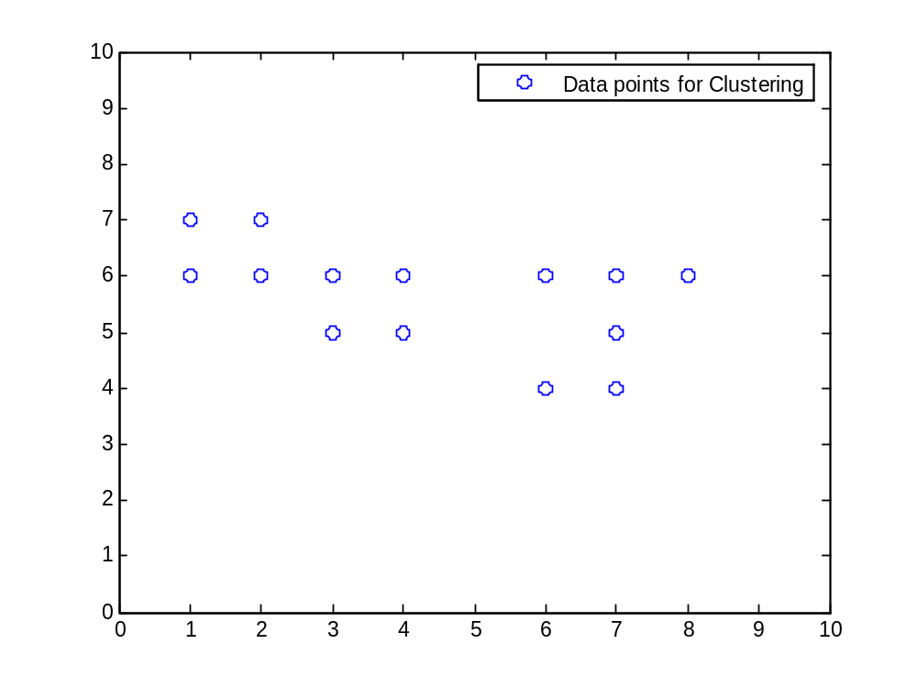
Data Set dataK14.txt
14 2-d points for K-means algorithm
2 14 2
(2F5.0,I7)
1. 7. 1
1. 6. 1
2. 7. 1
2. 6. 1
3. 6. 1
3. 5. 1
4. 6. 1
4. 5. 1
6. 6. 2
6. 4. 2
7. 6. 2
7. 5. 2
7. 4. 2
8. 6. 2

Slide 22
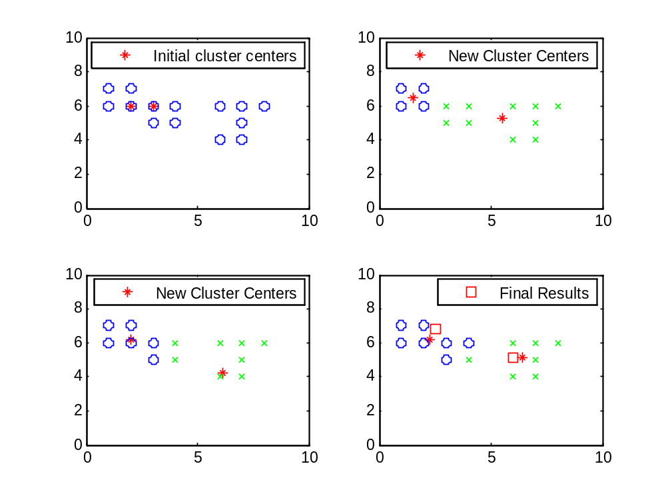
Illustration of K-means Algorithm

Slide 23
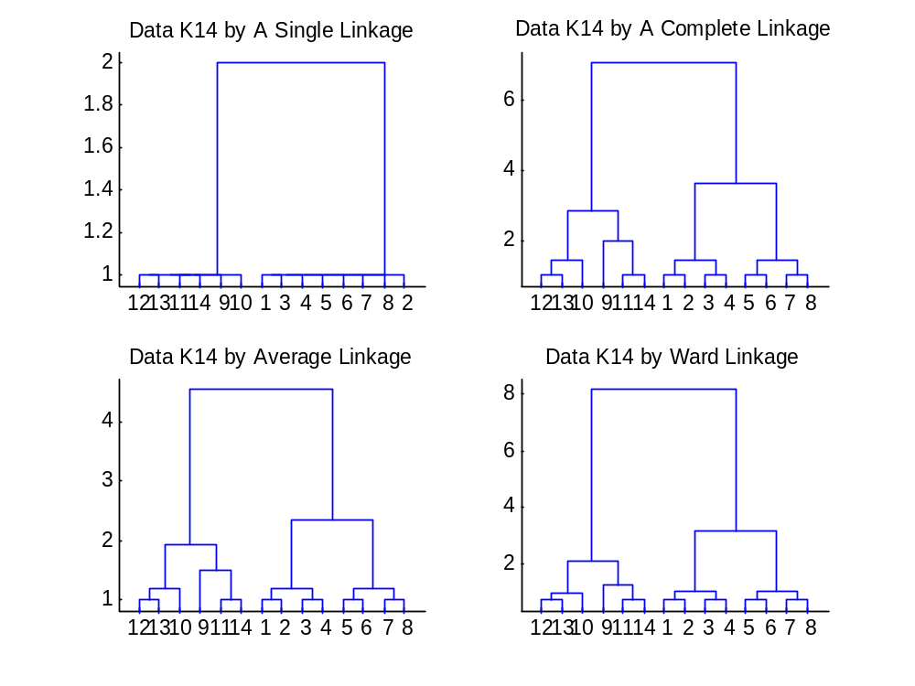
Results of Hierarchical Clustering

Slide 24
K-means Algorithm for 8OX Data
K=2, P=1507 [12111 11111 11211]
[11111 11111 11111] [22222 22222 22222]
K=3, P=1319 [13111 11111 11311]
[22222 22222 12222] [33333 33333 11333]
K= 4, P=1038 [32333 33333 33233]
[44444 44444 44444] [22211 11111 11121]

Slide 25
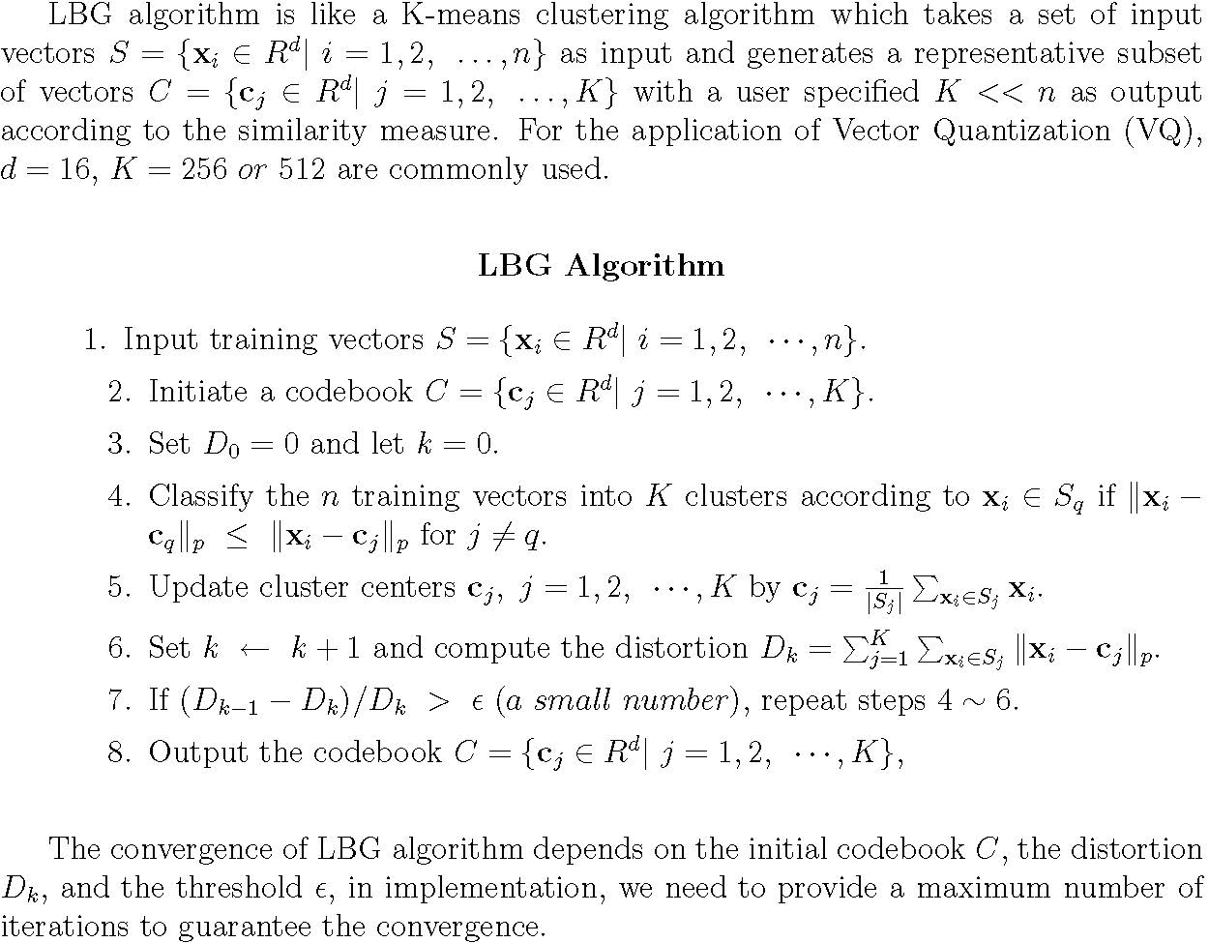
LBG Algorithm

Slide 26
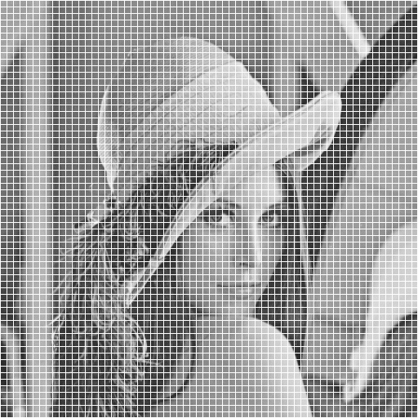
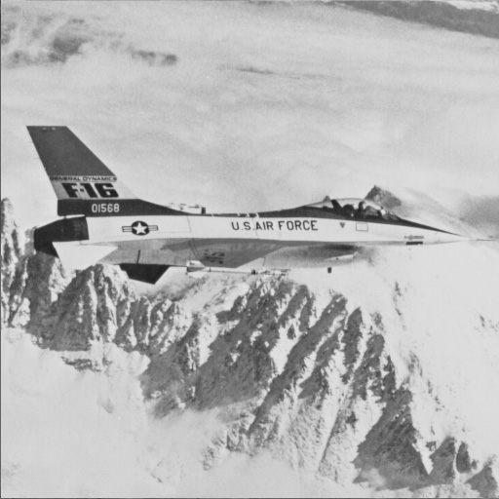
4 Images to Train a Codebook

Slide 27
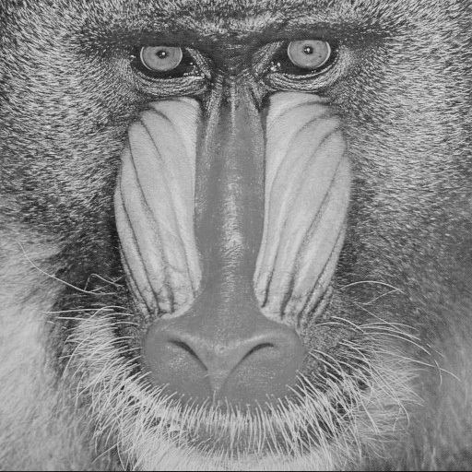
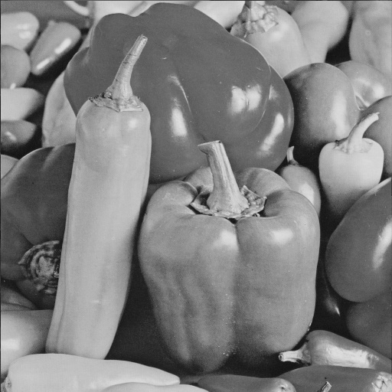
Images to Train Codebook

Slide 28

A Codebook of 256 codevectors

Slide 29


Lenna and Decoded Lenna
Original
Decoded image, psnr: 31.32

Slide 30
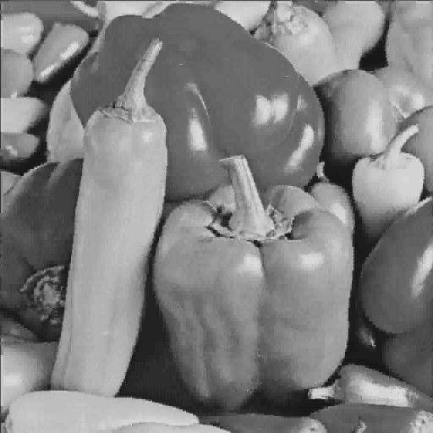
Peppers and Decoded Peppers
Original
Decoded image, psnr:30.86

Slide 31
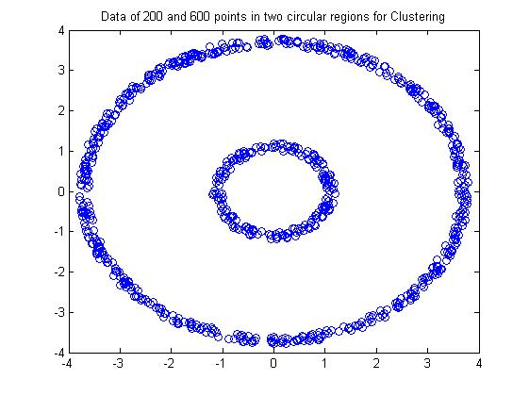
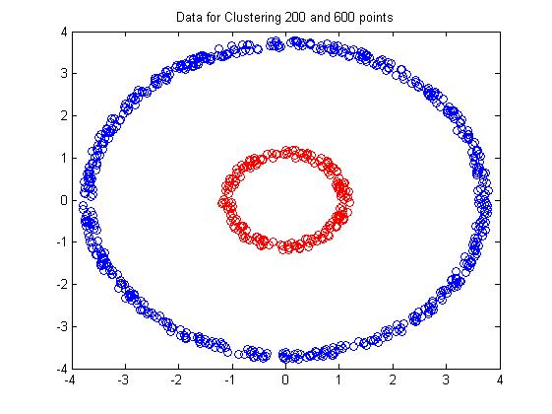
Data for Clustering
200 and 600 points in 2 regions
Expected result by visualization

Slide 32
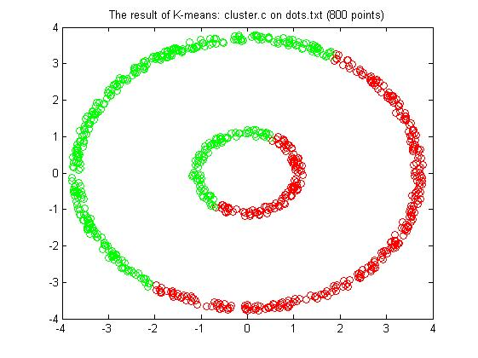
Data Clustering by K-means Algorithm
Expected result by visualization
Result by K-means Algorithm

Slide 33
Self-Organizing Map (SOM)
The Self-Organizing Map (SOM) was developed by Kohonen in the early 1980s.
  Based on the artificial neural networks.
  Neurons placed at the nodes of a lattice with one or two dimensions.
  Visualize high-dimensional data in a lattice with lower-dimensional space.
  SOM is also called as topology-preserving map.

Slide 34
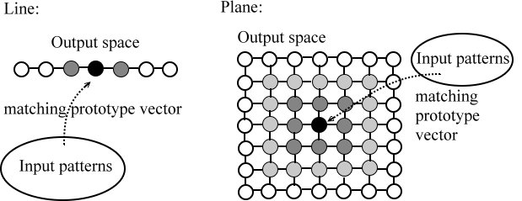
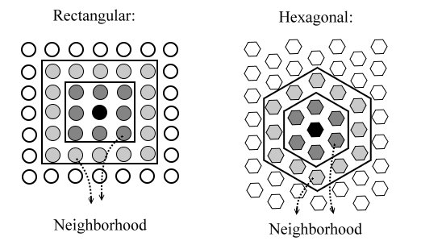
Illustration of Topological Maps
Illustration of the SOM model with one or two-dimensional map.
Example of the SOM model with the rectangular or hexagonal map.

Slide 35



Algorithm for Kohonen’s SOM
Let the map of size M by M, and the weight vector of neuron i is .
Step 1: Initialize all weight vectors randomly or systematically.
Step 2: A vector x is randomly chosen from the training data.
Then, compute the Euclidean distance d_{i} between x and neuron i.
Step 3: Find the best matching neuron (winning node) c.
Step 4: Update the weight vectors of the winning node c and its neighborhood as follows.
where is an adaptive function which decreases with time.
Step 5: Iterate the Step 2-4 until the sufficiently accurate map is acquired.

Slide 36
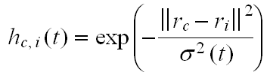


Neighborhood Kernel
The h_{c,i}(t) is a neighborhood kernel centered at the winning node c, which decreases with time and the distance between neurons c and i in the topology map.
where r_{c} and r_{i} are the coordinates of neurons c and i.
The is a suitable decreasing function of time,
e.g. .

Slide 37
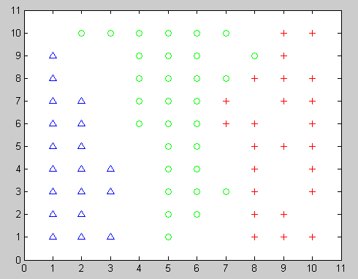
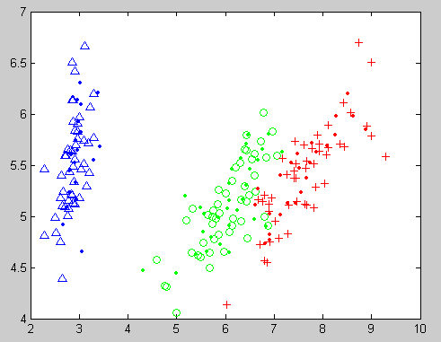
Data Classification Based on SOM
Results of clustering of the iris data
Map units PCA

Slide 38
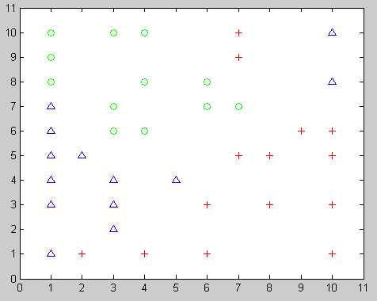
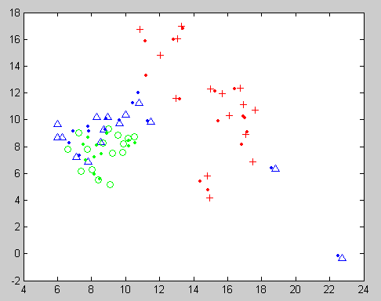
Data Classification Based on SOM
Results of clustering of the 8OX data
Map units PCA

Slide 39
References
T. Kohonen, Self-Organizing Maps, 3rd Extended Edition, Springer, Berlin, 2001.
T. Kohonen, “The self-organizing map,” Proc. IEEE, vol. 78, pp.1464-1480, 1990.
A. K. Jain and R.C. Dubes, Algorithms for Clustering Data, Prentice-Hall, 1988.
□ A.K. Jain, Data clustering : 50 years beyond K-means,
Pattern Recognition Letters, vol.31, no.8, 651-666, 2010.

Slide 40
Alternative Algorithm for SOM
Initialize the weight vectors W_{j}(0) and learning rate L(0)
(2) For each x in the sample, do 2(a),(b),(c)
(a) Place the sensory stimulus vector x onto the input layer of network
(b) select neuron which “best matches” x as the winning neuron by
Assign x to class k if |W_{k} –x| < |W_{j} – x| for j=1,2,…..,C
(c) Training the W_{j} vectors such that the neurons within the activity bubble are moved toward the input vector as follows:
W_{j}(n+1)=W_{j}(n)+L(n)*[x-W_{j}(n)] if j in neighborhood of class k
W_{j}(n+1)=W_{j}(n) otherwise
Update the learning rate L(n) (decreasing as n gets larger)
Reduce the neighborhood function F_{k}(n)
Exit when no noticeable change to the feature map has occurred. Otherwise, go to (2).

Slide 41
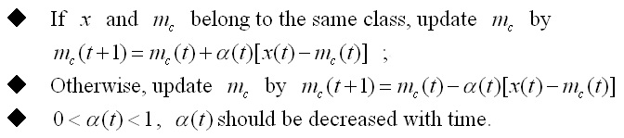
  Step4 : Fine-tuning method :

Slide 42
Data Sets 8OX and iris
http://www.cs.nthu.edu.tw/~cchen/ISA5305

