Slide 1
SoRec: Social Recommendation Using
Probabilistic Matrix Factorization
Hao Ma
Dept. of Computer Science & Engineering
The Chinese University of Hong Kong
Co-work with Haixuan Yang, Michael R. Lyu and Irwin King

Slide 2

Background
Do you have this experience?

Slide 3



Slide 4
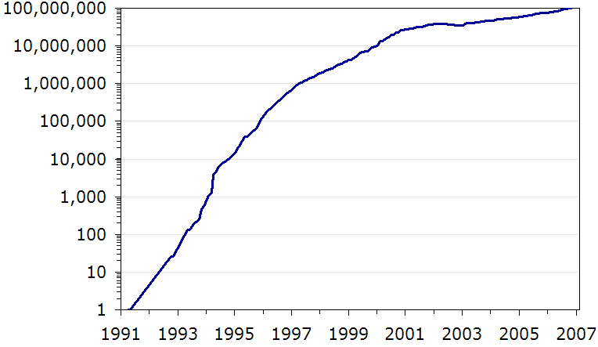
Background
Recommender Systems become more and more important
The number of Internet websites each year since the Web's founding.
From http://www.useit.com/alertbox/web-growth.html

Slide 5


Challenges
Data sparsity problem
My Blueberry Nights (2008)

Slide 6
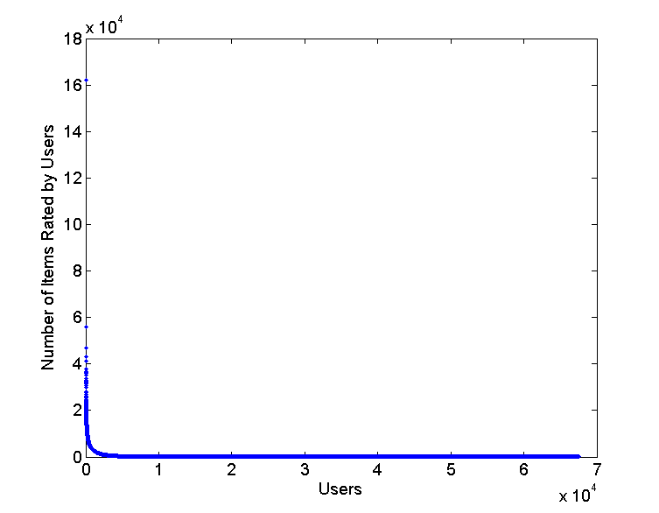
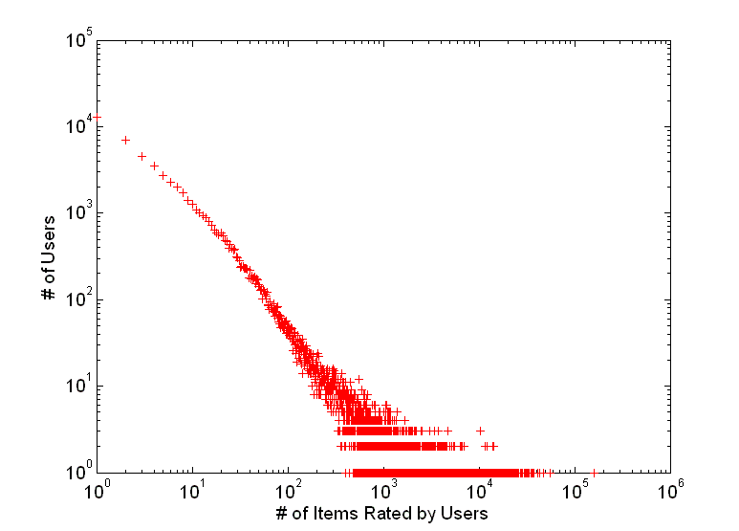
Number of Ratings per User
Extracted From Epinions.com
114,222 users, 754,987 items and 13,385,713 ratings

Slide 7





Challenges
Traditional recommender systems ignore the social connections between users
Which one should I read?
Recommendations from friends

Slide 8
Challenges
“Yes, there is a correlation - from social networks to personal behavior on the web”
  Parag Singla and Matthew Richardson (WWW’08)
  Analyze the who talks to whom social network over 10 million people with their related search results
  People who chat with each other are more likely to share the same or similar interests

Slide 9
Motivation
To improve the recommendation accuracy and solve the data sparsity problem, users’ social network should be taken into consideration

Slide 10
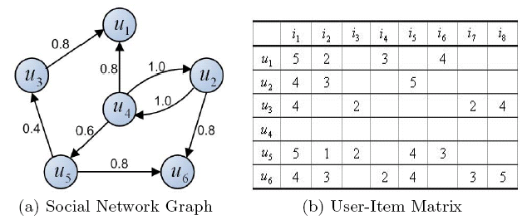
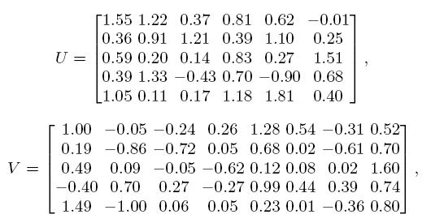
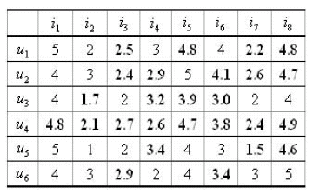
Problem Definition

Slide 11
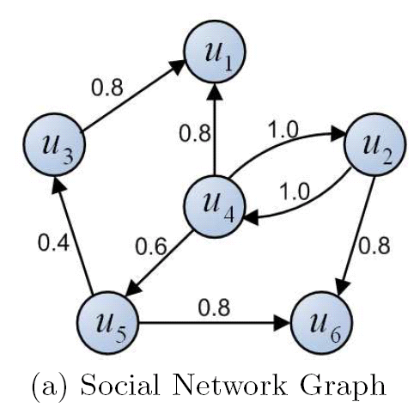
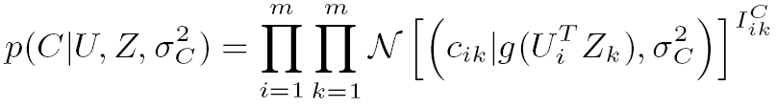
Social Network Graph
Matrix Factorization

Slide 12
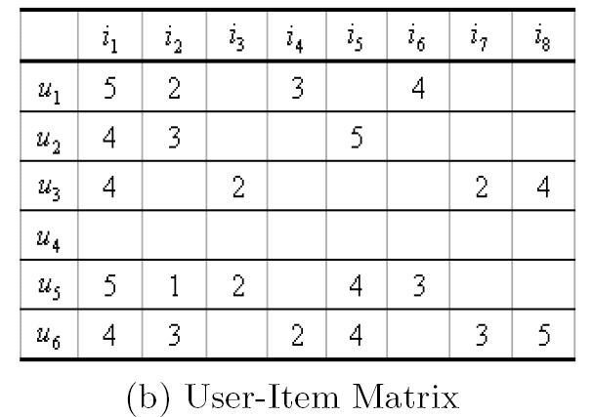

User-Item Rating
Matrix Factorization

Slide 13
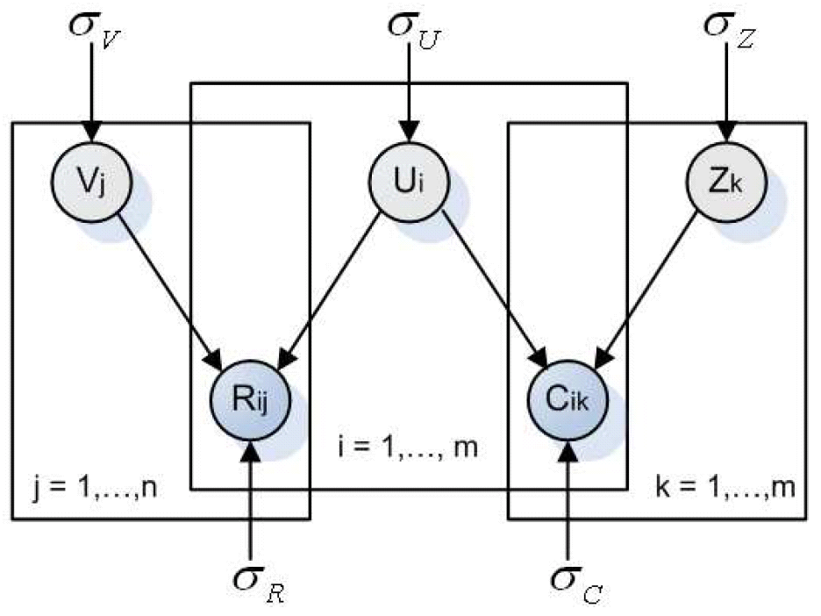
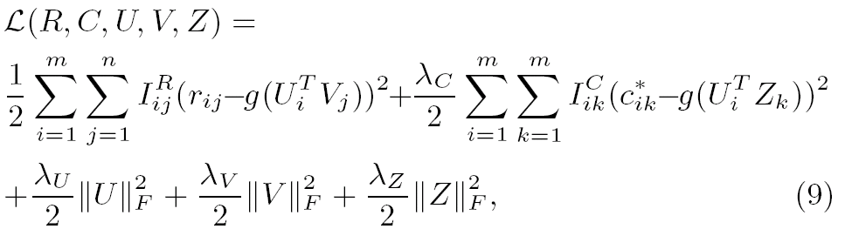
Social Recommendation

Slide 14
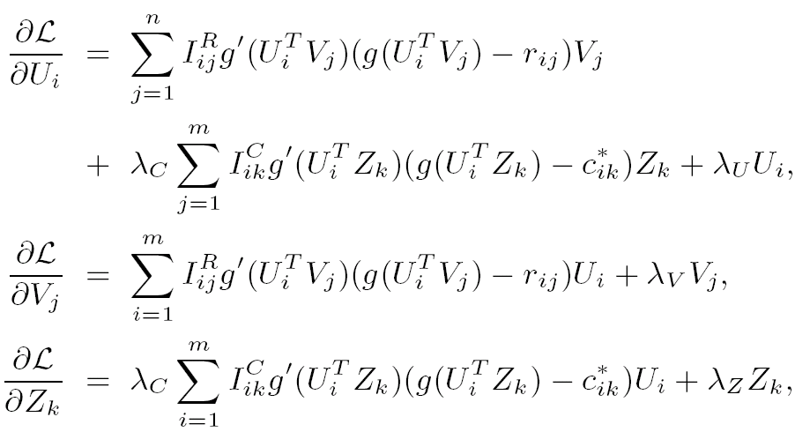
Gradient Descent

Slide 15







Complexity Analysis
For the Objective Function
For , the complexity is
For , the complexity is
For , the complexity is
In general, the complexity of our method is linear with the observations in these two matrices

Slide 16
Related Work
Combining content and link for classification using matrix factorization
Shenghuo Zhu, et al. (SIGIR 2007)
Differences
  Our method can deal with missing value problem
  Our method is interpreted using a probabilistic model
  Complexity analysis shows that our method is more efficient

Slide 17
Epinions Dataset
40,163 users who rated 139,529 items with totally 664,824 ratings
Rating Density 0.01186%
18,826 users, representing 46.87% of the population, submitted fewer than or equal to 5 reviews
The total number of issued trust statements is 487,183

Slide 18
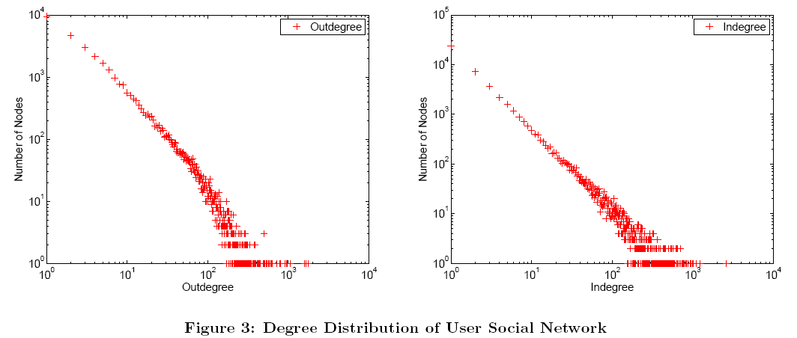

Slide 19

Metrics
Mean Absolute Error

Slide 20
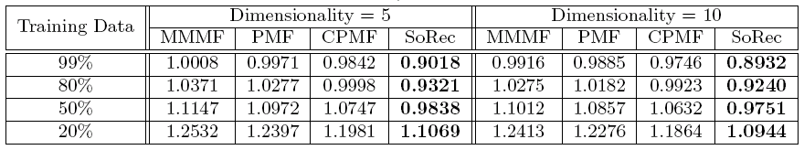
Comparisons
MAE comparison with other approaches (A smaller MAE value means a better performance)
MMMF
J. D. M. Rennie and N. Srebro
(ICML’05)
PMF & CPMF
R. Salakhutdinov and A. Mnih
(NIPS’08)

Slide 21
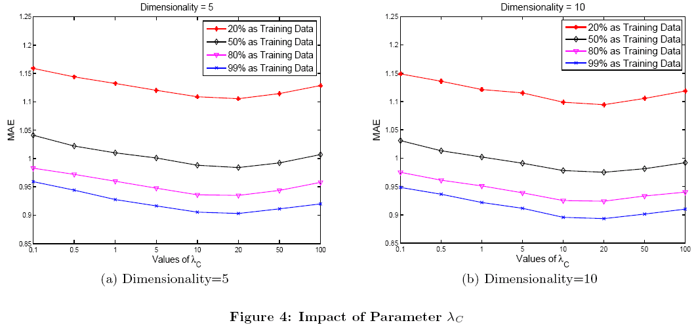
Impact of Parameters

Slide 22
Performance on Different Users
Group all the users based on the number of observed ratings in the training data
10 classes: “= 0”, “1 − 5”, “6 − 10”, “11 − 20”, “21 − 40”, “41 − 80”, “81 − 160”, “160 − 320”, “320 − 640”, and “> 640”,

Slide 23
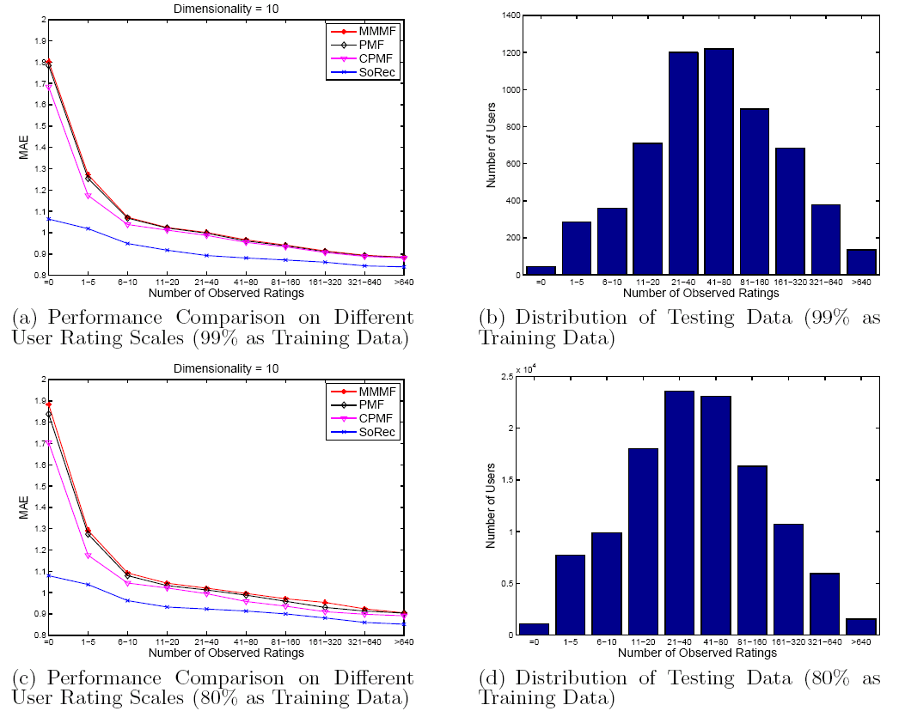

Slide 24
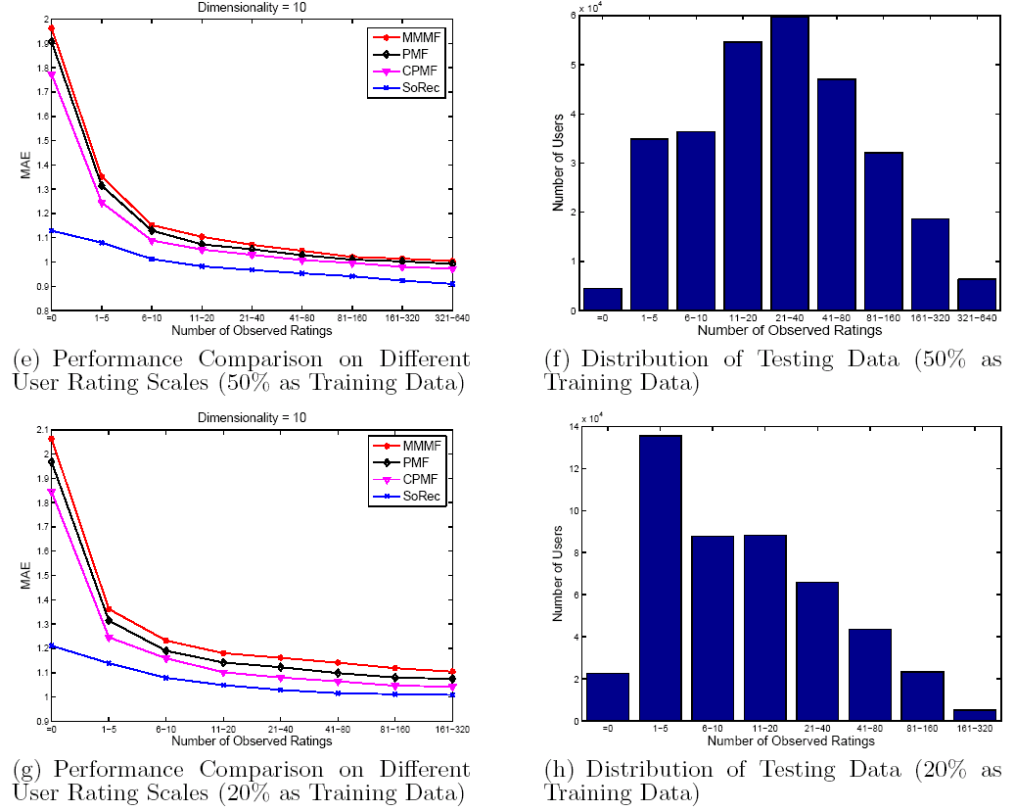

Slide 25
Efficiency Analysis
On a normal PC with Intel Pentium D (3.0 GHz, Dual Core) CPU, 1 Giga bytes memory
When using 99% data as training data
  Less than 20 minutes to train the model
When using 20% data as training data
  Less than 5 minutes to train the model

Slide 26
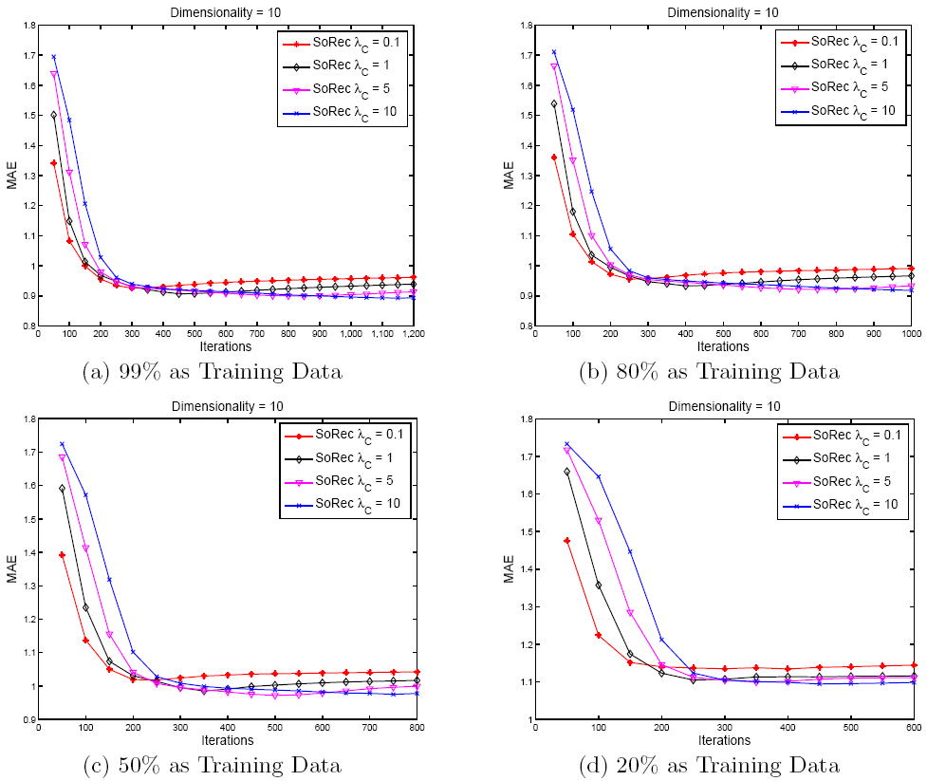

Slide 27
Conclusions
Propose a novel Social Recommendation framework
Outperforms the other state-of-the-art collaborative filtering algorithms
Scalable to very large datasets
Show the promising future of social-based techniques

Slide 28
Future Work
Kernel representation
Information diffusion between users
Distrust information

Slide 29
Thanks!
Q & A
Hao Ma
Email: hma@cse.cuhk.edu.hk

