Slide 1

Global Terrorism Database ( GTD )
University del Maryland - START Consortium
Keeps track of 180k+ terrorist attacks on a global scale ( 1970 – 2017 )
130+ columns of unique data: Coordinates, Terrorist Group Names, Activity and much more

Slide 2

Analysis goals
Extract interesting and relevant information:
🌍 Geographic factors
⏳ Temporal trends
💥 Operational methods
🔁 Data relationships

Slide 3
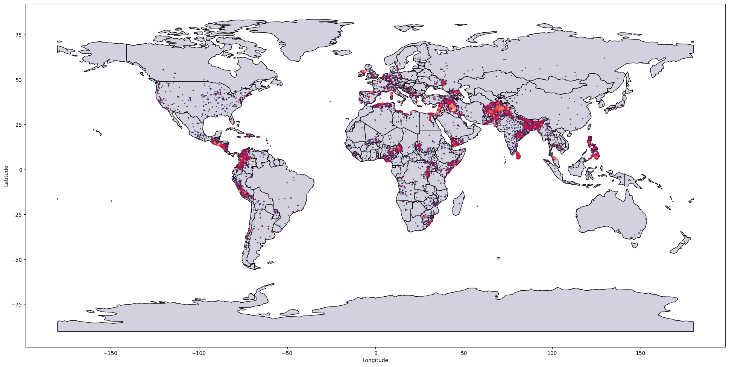
Global Map of Terrorist Attacks

Slide 4
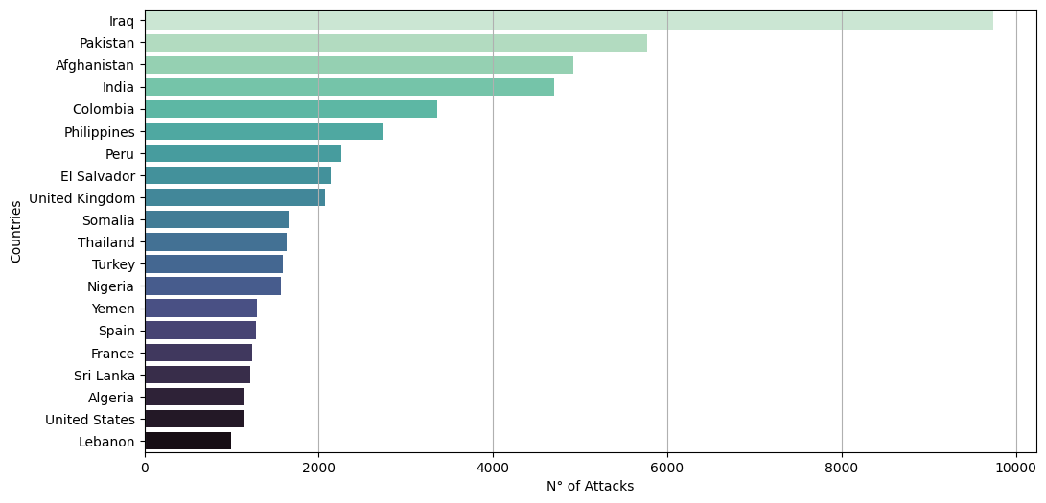
Most Attacked Countries

Slide 5
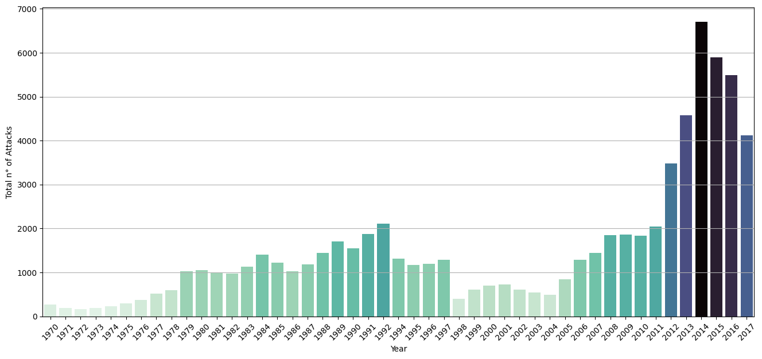
Annual Attack Trend

Slide 6
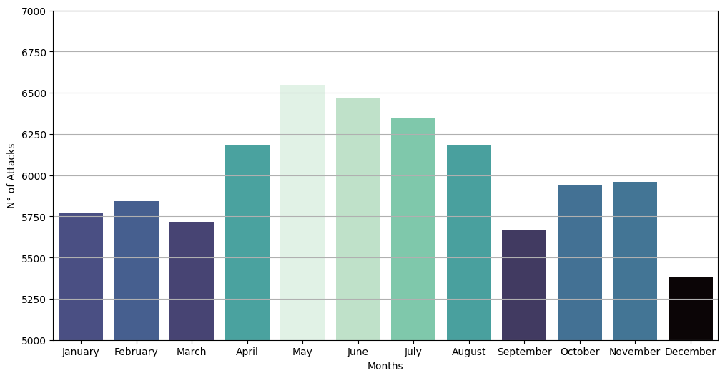
Monthly Average ( 1970 – 2017 )

Slide 7
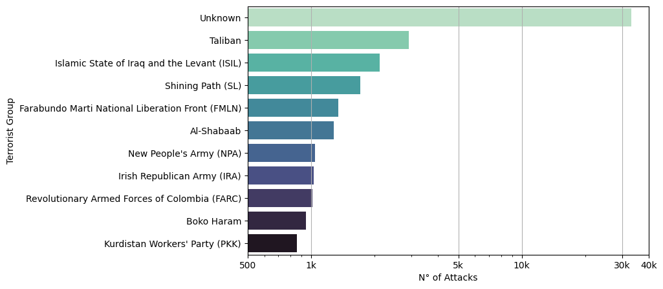
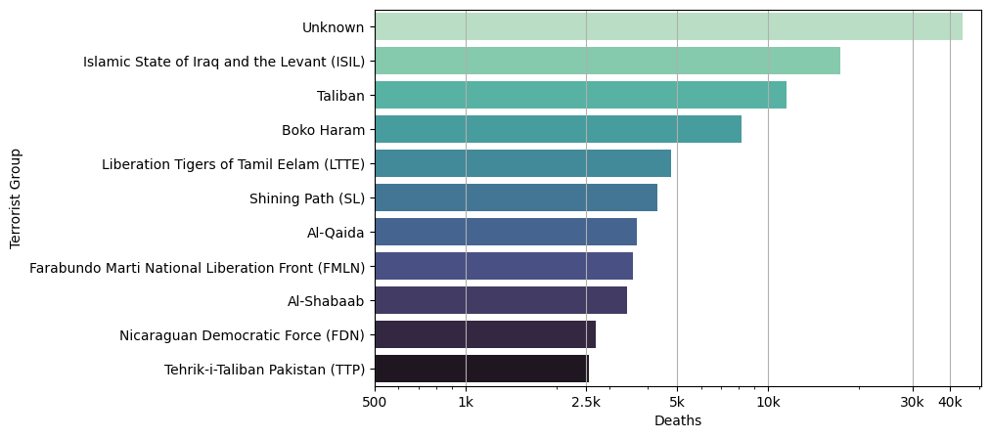
Most Active and Violent Groups ( log scale )

Slide 8
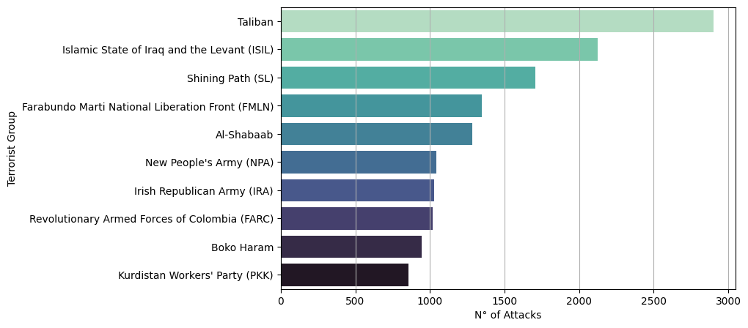
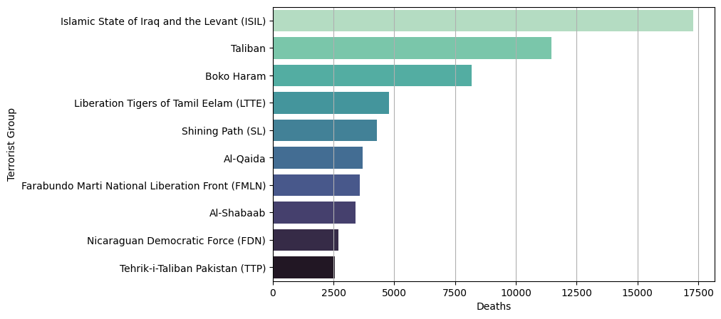
Most Active and Violent Groups ( linear scale )

Slide 9
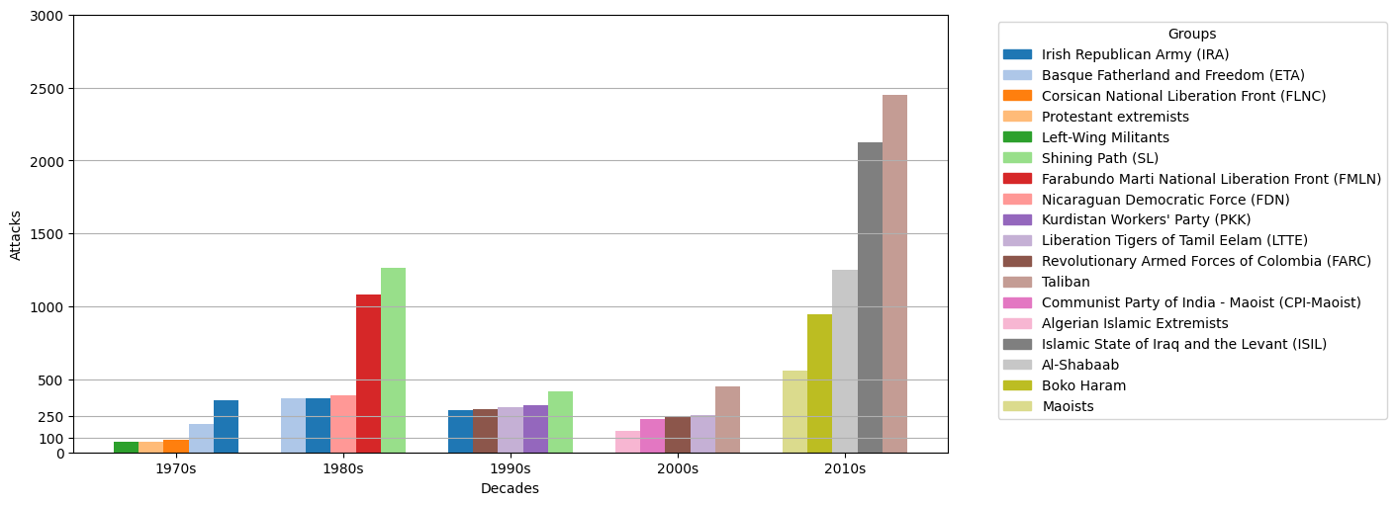
Most Active Groups each decade

Slide 10
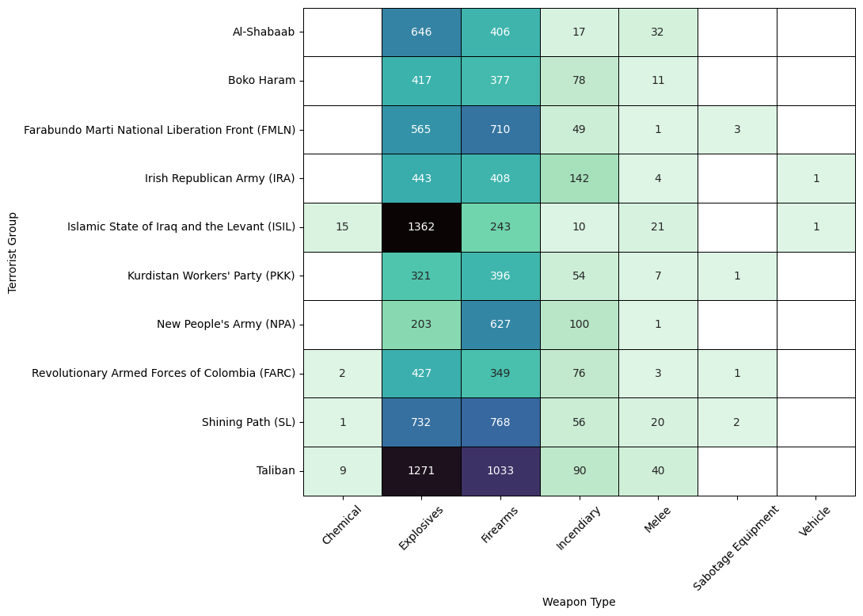
Preferred Weapons by Groups

Slide 11
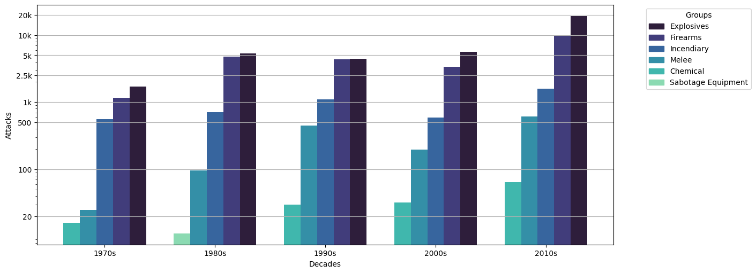
Weapon Type Trend by decade

Slide 12
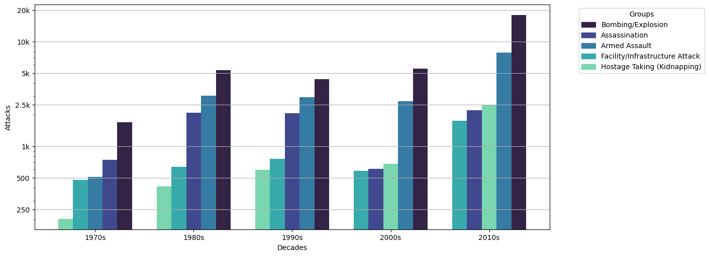
Attack Type Trend by decade

Slide 13
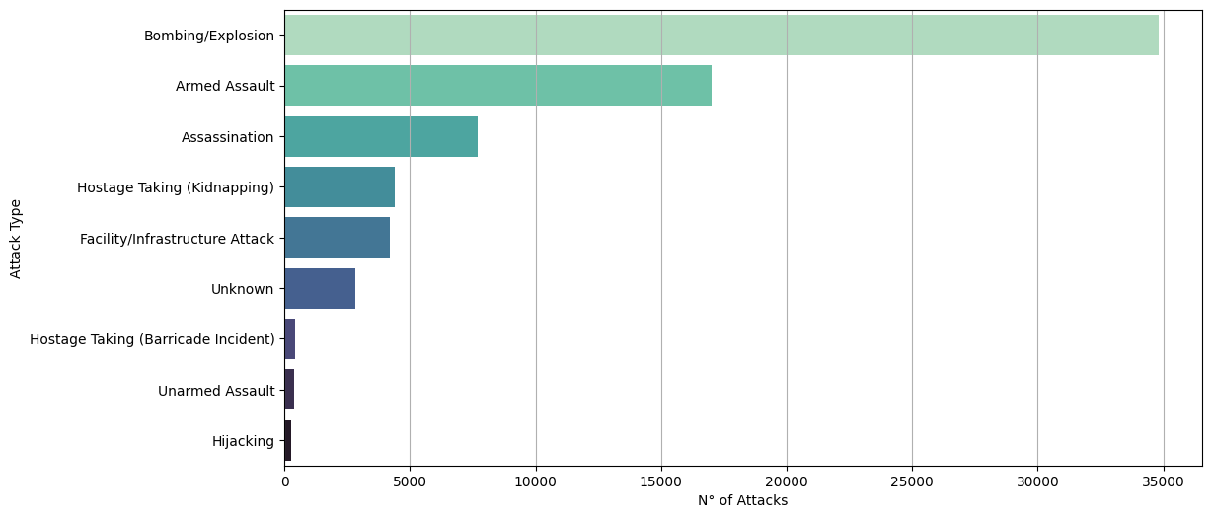
Most Common Attacks

Slide 14
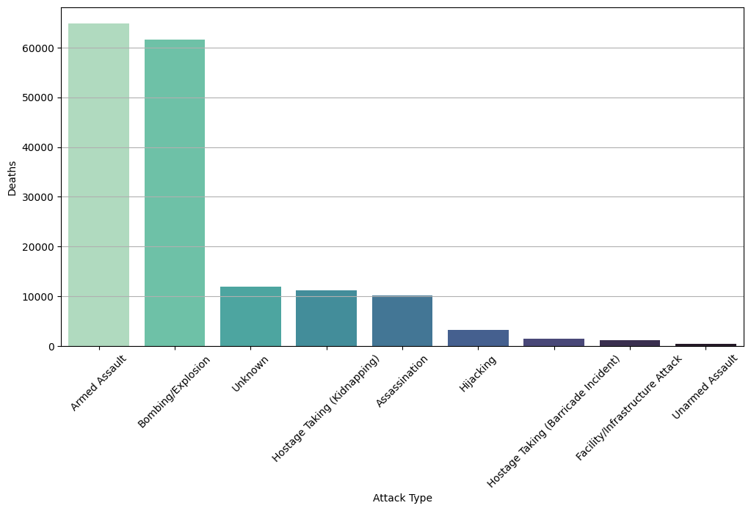
Deaths by Attack Type

Slide 15
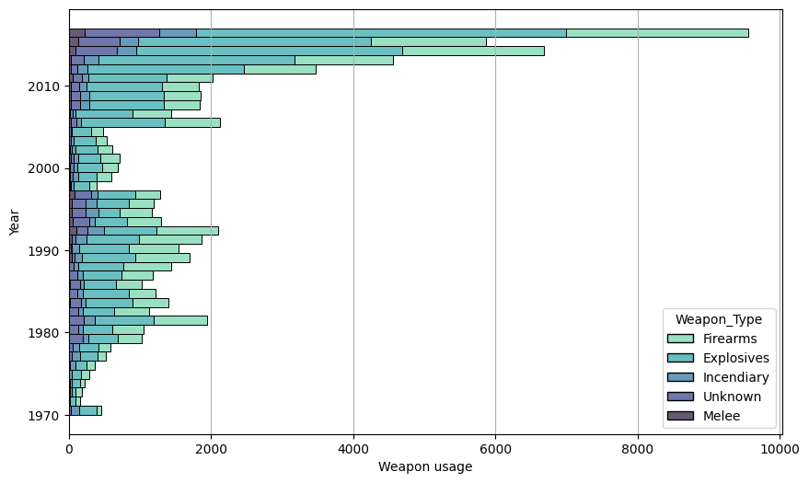
Weapon trends during the years

Slide 16
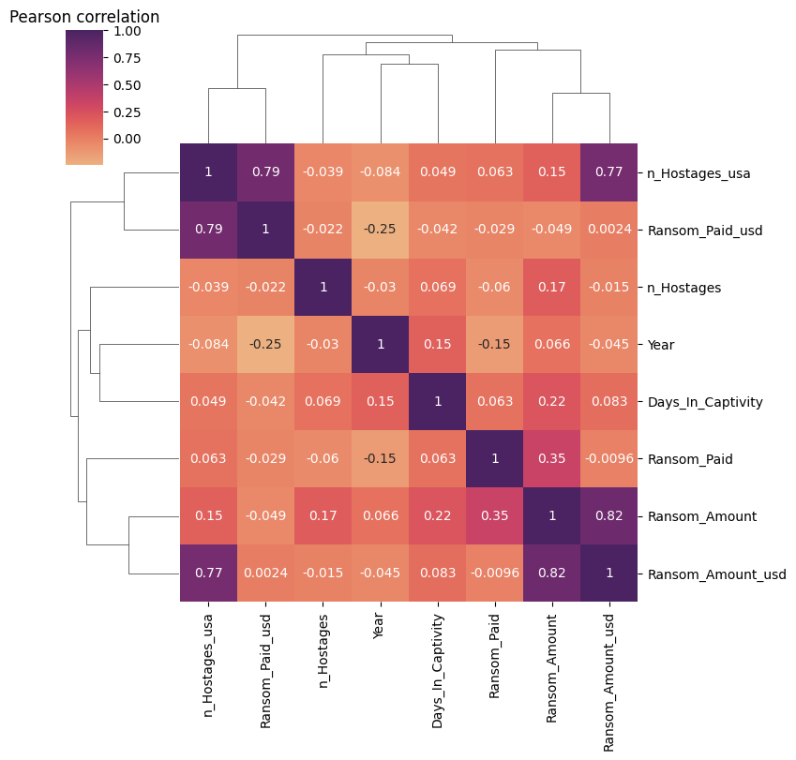
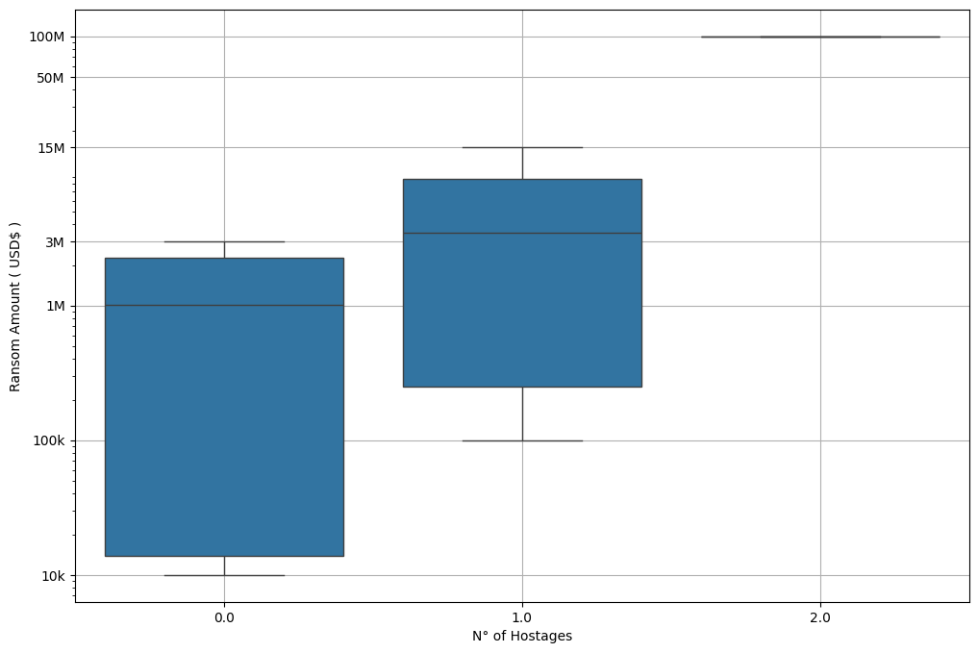
Pearson Correlations

Slide 17
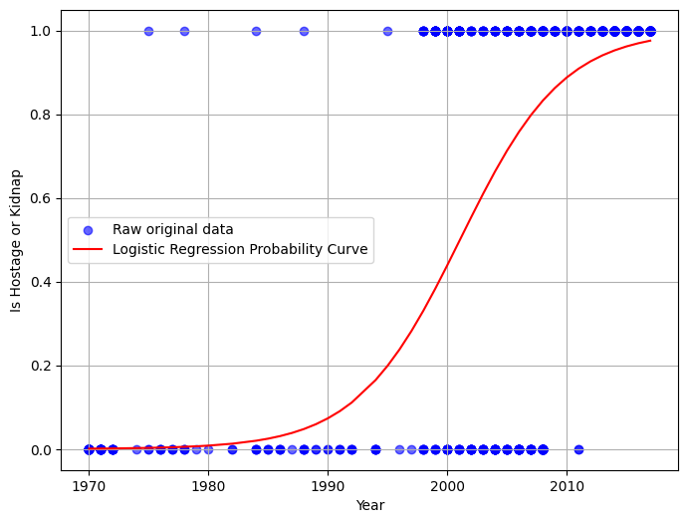
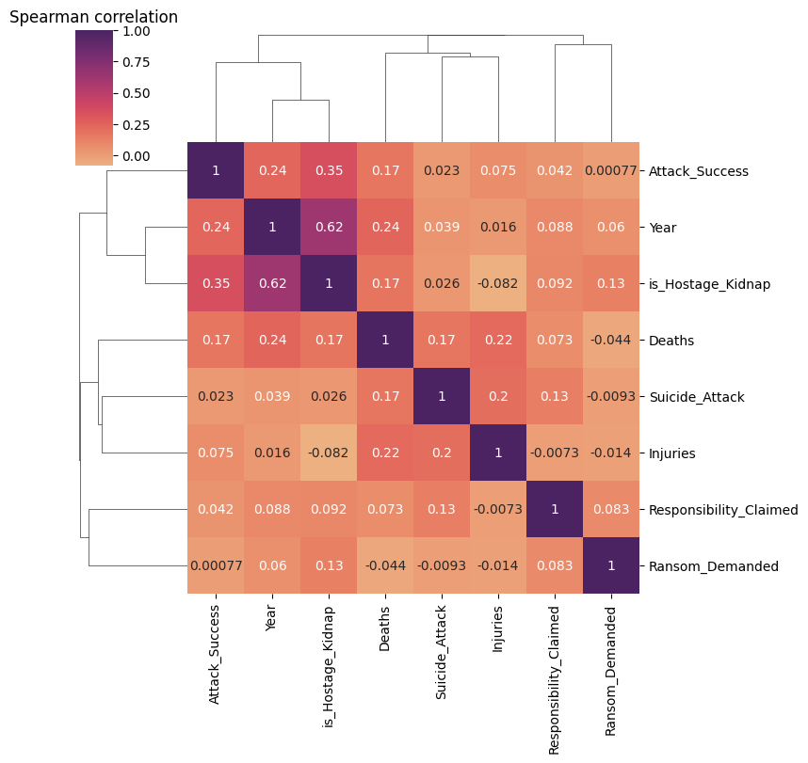
Spearman Correlations and Logistic Regression
Logistic regression score: 0.81

Slide 18
Recap - What We've Covered
General analysis of the dataset
Geographic trends and visualization
Temporal trends
Group preferences – Weapons and Attack Types
Statistical analysis: correlations and logistic regression

Slide 19
THANKS FOR THE ATTENTION

