Slide 1
GHG DATA
WORKFLOW TUTORIAL
EZRA
MOSES

Slide 2
OVERVIEW
Pros of an R package for this workflow:
Reproducibility across projects
  Methods are the same, variables differ
Ezra maintains the functions’ code; project leads get example scripts to use and build from
When Ezra makes changes (e.g. adds functions), those changes are available to everyone by simply updating the package.
You’ll learn how to learn and interact with an R package, which is the foundation of R itself.
Package documentation can be accessed with help(function) or ?function
Potential Cons:
Functions may not work immediately in every situation
  If something is not working, email Ezra ASAP!
Code is ‘hidden’ inside functions, which could detract from R learning. Run View([function]) to see a function’s code if you are interested.
The workflow’s functions are contained in an R package called gaseous.

Slide 3
OVERVIEW
How to Get Started
The workflow’s functions are contained in an R package called gaseous.
Understanding Stages in the Workflow
How to Keep Up-to-Date

Slide 4

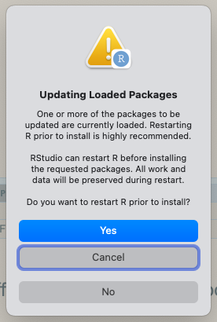
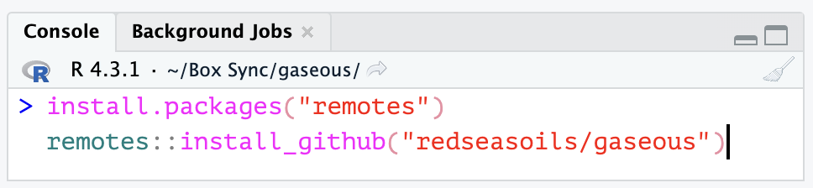
1. INSTALL gaseous
If you get a pop-up window like the one below, choose “Yes”
To install, run the following code in the Rstudio console:
install.packages(“remotes”)
remotes::install_github('redseasoils/gaseous')
Click here to copy the code to the clipboard
This may also appear as a message in the console that prompts you to type a number. Type 1 and hit Enter/Return.
Notes:
install.packages(“remotes”)
remotes::install_github('redseasoils/gaseous')

Slide 5
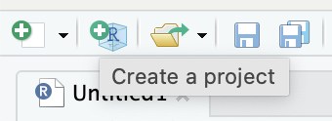
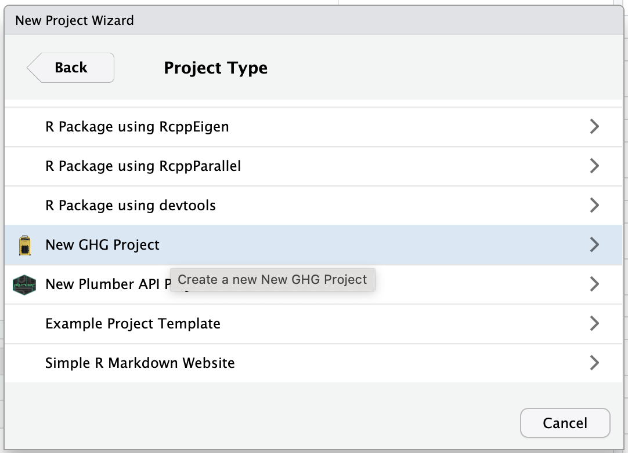
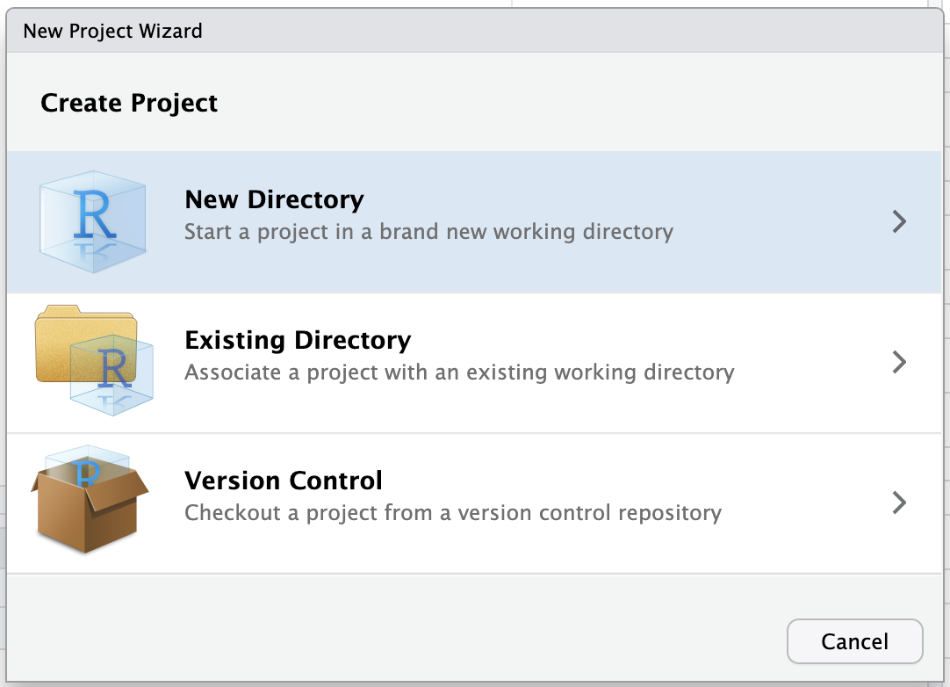
2. CREATE A NEW R PROJECT
Create an R Project by clicking on this icon in the top left in RStudio:
In Project Type, scroll down and click New GHG Project
Then choose New Directory

Slide 6
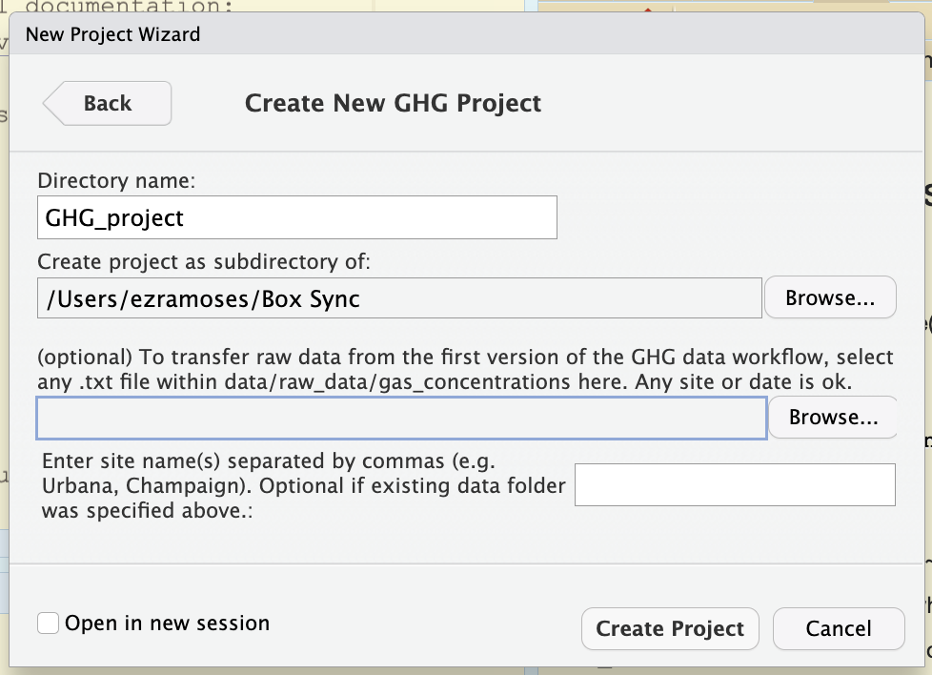
2. CREATE A NEW R PROJECT
New folder name: Can be anything you want. Preferably contains your name or your project name and “GHG”
Option 1: If you already have files organized for V1 of this workflow, click ‘Browse’ and select any raw data .txt file from those organized files.
New folder location. Should be in Box so you can share with Ezra. Recommended to be inside your project’s main folder (you can share solely the GHG subfolder with Ezra)
Option 2: Enter site names here. You’ll have to move raw data into the new project folders manually.
Click Create Project when you’re done

Slide 7
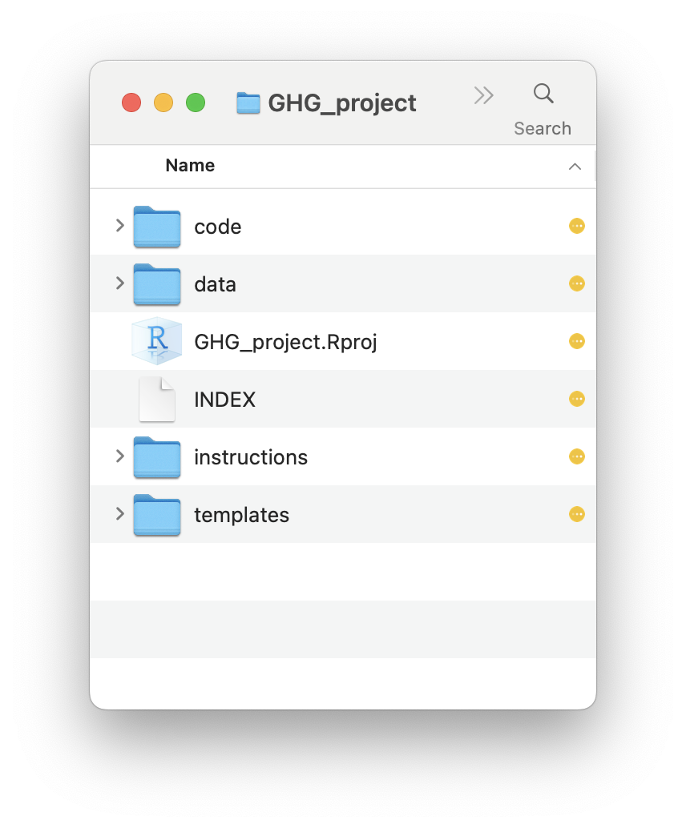
3. EXPLORE NEW FILES
If you chose Option 1 in the previous step, your raw data files will be reorganized and stored in the new data folder. You can proceed to creating a treatment key.
If you chose Option 2 in the previous step, your new data folder will have subfolders in which you’ll need to organize your raw data.
Move onto step 5: creating treatment key
Note: This slideshow is stored in the instructions folder
Move onto step 4: organizing raw data

Slide 8
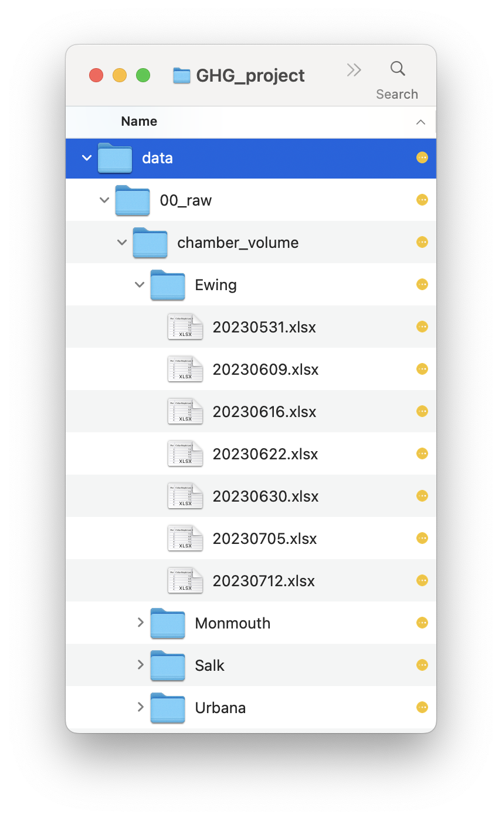
4. ORGANIZE RAW DATA
In each data/00_raw/chamber_volume/[site] folder, where [site] is one of your project’s site names, you will need to add Excel spreadsheets for each sampling date at [site], named in YYYYMMDD format after the sampling date.
Each chamber volume Excel spreadsheet should be a copy of the chamber volume template, which can be found in the templates folder.
Note that in this latest version of the workflow, the chamber volume template has been updated to include columns for Soil Temperature and Soil Moisture. Please update old chamber volume files to mimic the new template.
See example of organized data to the right for reference.

Slide 9
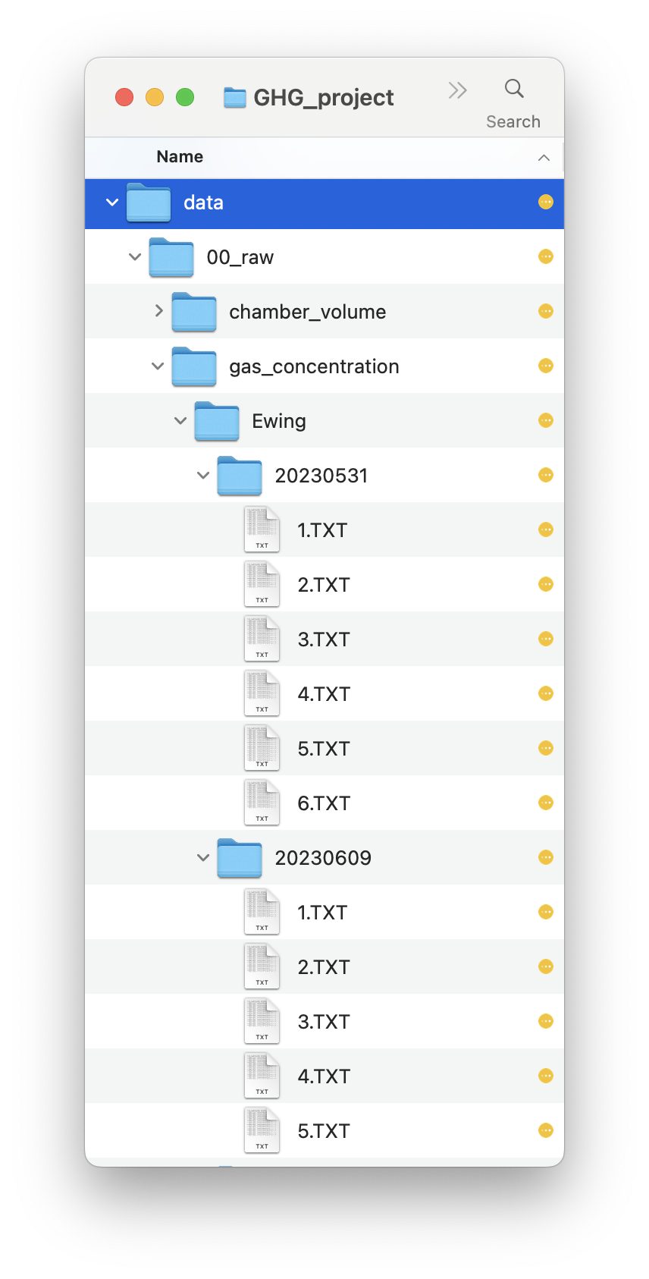
4. ORGANIZE RAW DATA
In each data/00_raw/gas_concentration/[site] folder, where [site] is one of your project’s site names, you will need to add folders for each date on which [site] was sampled (named in YYYYMMDD format).
Then put all files from the Gasmet into their respective folders, named [plot].txt or [plot].TXT, where [plot] is the plot ID for the data contained in the file.
See example of organized data to the right for reference.
Click here to move onto step 5: creating a treatment key

Slide 10
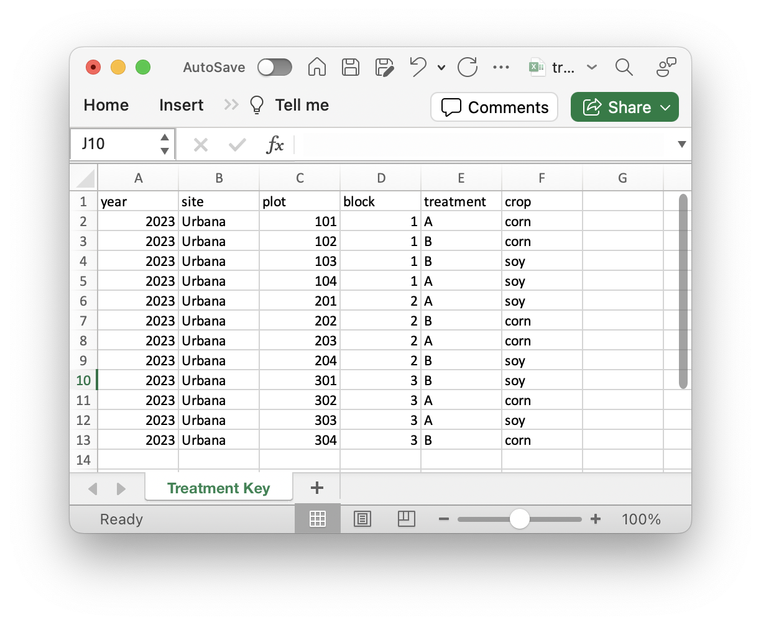
5. CREATE TREAMENT KEY
The treatment key is a spreadsheet that matches plot IDs with plot metadata like treatment, block, etc.
In the keys folder, you’ll see an Excel spreadsheet called treatment_key.xlsx
  If you have a treatment key already created from the previous version of this workflow, delete the file from the new project files and copy your original treatment key into the new keys folder. Make sure it’s still named treatment_key.xlsx
  If you don’t have a treatment key already, use the spreadsheet as a starting point. Do not change the existing columns, but feel free to add more if there is more plot metadata pertinent to your project.
To the left is an example of how you might fill in the treatment key.
Do not change the name of the file, sheet, or existing columns.
Click here to move onto step 6: running code

Slide 11

6. RUN CODE
TIP: Whenever you run code for this workflow, make sure the project is open in RStudio! When a project is open, the project name (e.g., GHG_project) is displayed at the top right corner of RStudio next to the icon to the left.
Scripts in the code folder are prefixed with a number that tells you in what order to run the scripts.
The prefix also tells you what stage of the workflow the code executes:
  100s → preprocessing
  200s → processing
  300s → summarization
  400s → analysis
  500s → visualization/figure building
You can’t “mess up” anything by running any of the code in this folder. The only way to “mess up” this workflow is to delete raw data. Short of adding code that does that, I encourage you to try things out! Add your own code or whole new scripts! Make it yours!
Click here to learn more about each stage of the workflow.

Slide 12
STAGES IN THE WORKFLOW
Step 1: Preprocess
Step 3: Summarize
Step 5: Visualize
Step 2: Process
Step 4: Analyze
Click any bubble to advance to that stage

Slide 13
PREPROCESSING
Preprocessing script(s) in code folder:
110_preprocessing.R
110_preprocessing.Rmd
  Do not run the Rmd directly (you can edit it though!) – the make_preprocessing_reports( ) function runs the Rmd file with many different subsets of data
Preprocessing converts raw gas data (ppm) to gas flux (kg ha⁻¹ day⁻¹).
This stage utilizes automated algorithms that depend on meticulous data management.
Imports:
  Organized files from data/00_raw/gas_concentration and data/00_raw/chamber_volume
Exports:
  data/01_converted_to_flux_rate/[site] containing .csv files of gas data converted to flux rate
  data/01_converted_to_flux_rate/[site]/html_reports subfolders which should be reviewed after running the script
  data/01_converted_to_flux_rate/
  preprocessing_master.csv containing flux data compiled across sampling dates
    One row per ~20s interval measurement (i.e., multiple rows per site/plot/date)
Click here to learn how to organize data

Slide 14
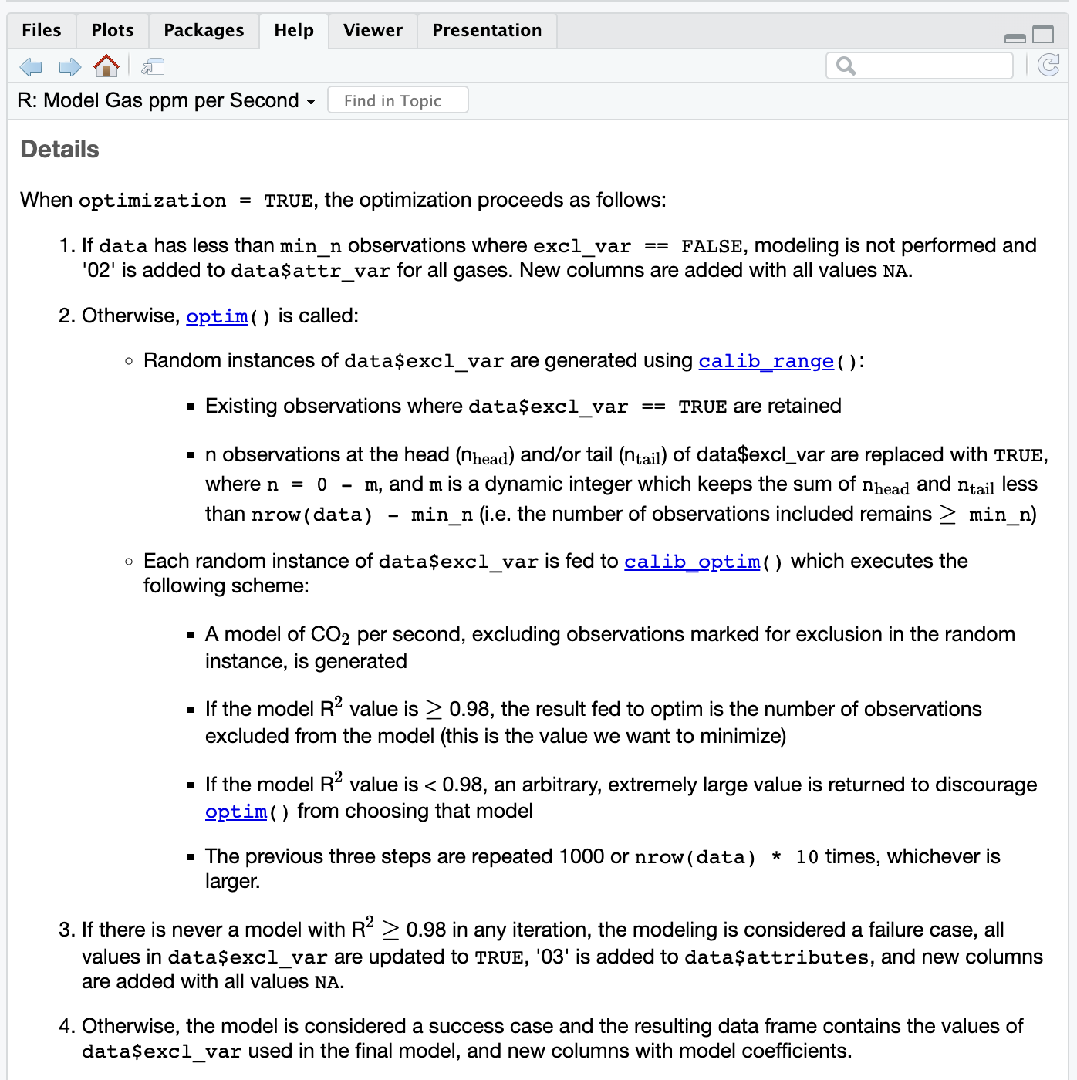
PREPROCESSING – CO2 ALGORITHM
110_preprocessing.Rmd, line 85:
The function ppm_seconds_lm(…, optimization = TRUE) finds a subset of data points in each Gasmet sample where a linear model of CO₂ ppm by seconds has an R² value of at least 0.98 and the maximum possible number of data points retained in the model.
  ≥ min_n data points are retained in the model or else the entire plot is rejected. The min_n argument defaults to 4, but you can change this if you’d like,
  e.g. ppm_seconds_lm(.x, optimization = TRUE, min_n = 5)
  Only endpoints are ever removed – not points in the middle of the measurement
More details available in function documentation (partly shown to the left). Run ?ppm_seconds_lm in the R console to see the documentation.

Slide 15
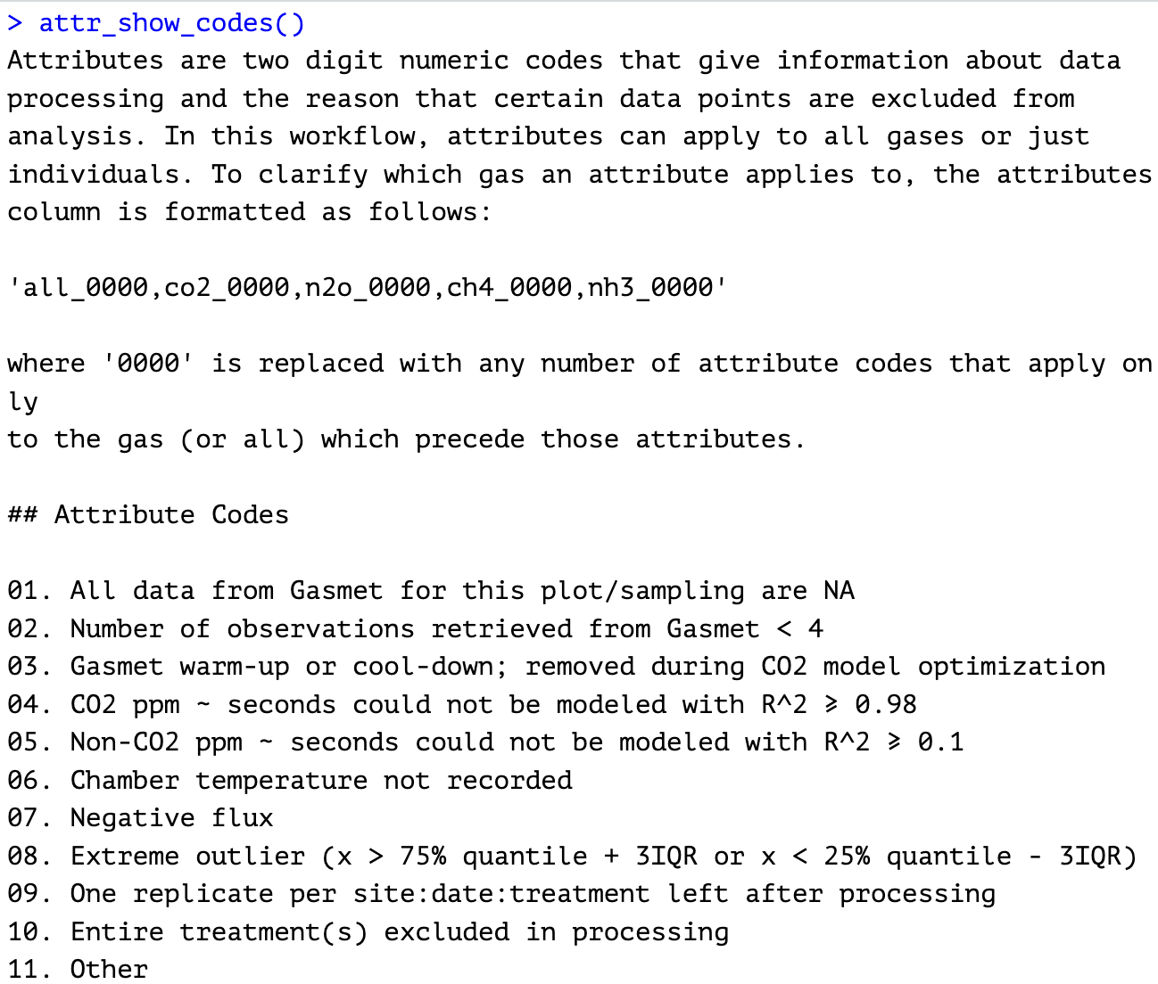
PREPROCESSING - ATTRIBUTES
Data may be rejected during preprocessing for several reasons.
Removing data is not a good practice; instead, it’s better to create an explicit system to track which data points should be excluded and why.
Specific columns in the data set track which data points are being excluded. E.g., column co2_exclude entries are TRUE when the CO₂ value has been rejected in that same row of data.
Attributes track why data
points are excluded, in
shorthand.
To see what attribute codes
exist and what they mean,
run attr_show_codes( ) in R
(gaseous library must be
loaded).
Attributes are 2-digit codes that tell you why a particular data point got rejected in processing. They are stored in a column named ‘attributes’.

Slide 16
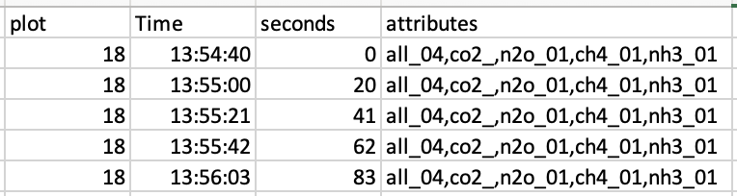
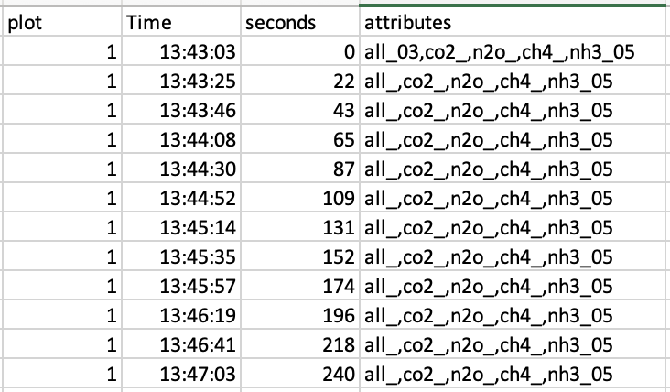
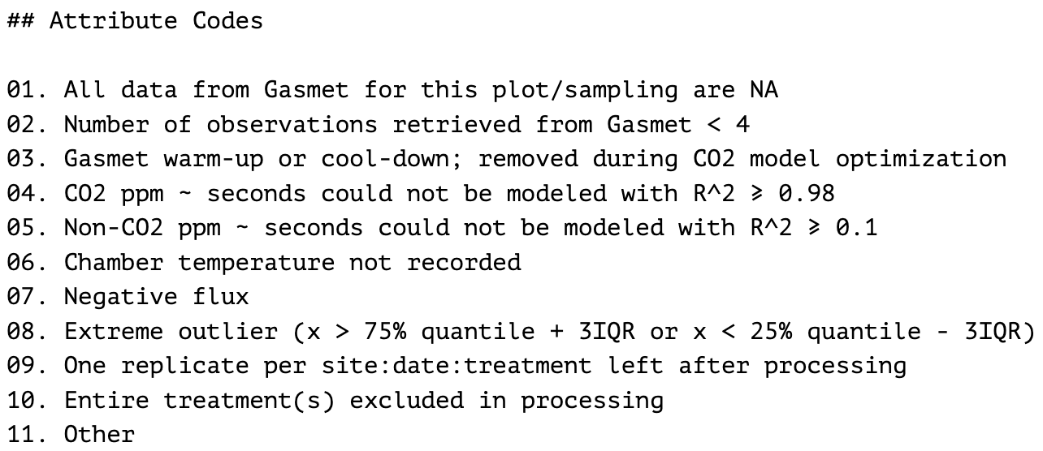
PREPROCESSING - ATTRIBUTES
To the left are examples of a few entries in the attributes column in a preprocessing export (data/01_converted_to_flux_rate/preprocessing_master.csv).
In the first example, ‘all_04’ tells you that all gases in that row will be excluded from downstream processing and analyses because the CO₂ data for this plot’s sampling couldn’t be modeled with R² ≥ 0.98. Code ‘n2o_01’ tells you that all entries of N₂O ppm data from the Gasmet were NA.
In the second example, only the first row contains ‘all_03’, which means it was flagged as a Gasmet warm-up or cool-down point in the CO₂ optimization algorithm. This is the only case where attributes will be inconsistent across a single sampling.
Review attributes and use your judgement. If the attributes are telling you something you didn’t anticipate, you should double check your raw data files, re-download files from the Gasmet if needed, and/or contact Ezra.

Slide 17
PREPROCESSING – GET STARTED
Open 110_preprocessing.R and 110_preprocessing.Rmd in RStudio (make sure the project is open too!)
Review both scripts. Run ?function to review each functions’ documentation and make changes to function arguments if you’d like.
Source or run line-by-line 110_preprocessing.R
Troubleshoot errors if needed using instructions on the following slide.
After running the script, review the HTML reports generated in data/01_converted_to_flux_rate/[site]/html_reports
  If something in an html report seems incorrect, go back and check the raw data for that site/date. If you make updates to the raw data for a particular site/date, delete the corresponding html report and re-run the script. The data for each site/date will only be preprocessed if its corresponding html report doesn’t exist.
As you continue to sample plots and add raw data, you can just keep running the script periodically. It will find new raw data and add it onto the data set.
Once you have run 110_preprocessing.R entirely without errors, you can move onto processing!

Slide 18
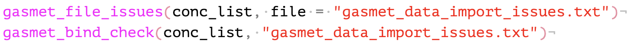
PREPROCESSING - TROUBLESHOOT
Preprocessing errors typically occur because of issues with raw data organization or formatting.
Built-in tools can help you identify the cause of these errors.
In 110_preprocessing.R the functions above detect and describe issues with raw data that will cause downstream errors. They stop the script from proceeding and open a new .txt file describing issues if necessary.
Issues listed in the file under the heading “The following issues must be fixed before processing can continue” must be corrected manually. After making corrections, restart R (run .rs.restartR( ) or click Session→Restart R in RStudio).
Common issues include:
  Date of file name does not match Date column entries in .txt file
  Multiple dates contained in one .txt file
  Date format is inconsistent within a .txt file (e.g. some entries MM/DD/YYYY, some YYYY-MM-DD)

Slide 19
PROCESSING
Processing script(s) in code folder:
210_cleaning.R
220_impute.R
230_unit_conversions.R
240_NOAA_merge.R
Each of these scripts is described in the next slides.
Imports:
  data/01_converted_to_flux_rate/
  preprocessing_master.csv, an export of preprocessing
Exports:
  data/02_processed/master_datasheet.csv
    Cleaned kg ha⁻¹ day⁻¹ data, ready for modeling
    New attributes pertinent to processing
  data/02_processed/imputed_master.csv
    Same as above, but with missing values imputed
  data/02_processed/master_with_conversions.csv
    Same as above, with conversions to cumulative loads and CO₂ equivalency
  data/02_processed/master_merged_with_NOAA.csv
    Same data as above, but with one row per day (even non-sampling days), and daily precipitation and air temperature values merged
Processing prepares gas flux data until they’re model ready.

Slide 20
PROCESSING – 210_cleaning.R
Summary of steps:
Reduce data to one row per site/plot/date
  Note that this reduction requires removal of ’03’ attribute (Gasmet warm-up or cool-down) since that is specific to certain seconds within a measurement. Therefore, ‘03’ attributes are only present in the preprocessing master data sheet.
Join with plot metadata in keys/treatment_key.xlsx
Function exclude_outliers( ): Check for and exclude extreme outliers
Function negative_flux( ): Check for negative flux values. Exclude values below those set by the zero_threshold argument. There is code in the script to calculate thresholds as one standard deviation below zero for each gas, but this can be modified as needed.
Function exclude_one_rep( ): Check modeling potential for remaining, non-excluded data. If only one replicate remains for a particular site/date/treatment, the replicate will be excluded since it cannot be modeled.
Function replace_gas_with_na( ): Change gas flux values that have been marked for exclusion to NA
Function add_missing_rows( ): Ensure one row per sample, even if the sample was excluded. This makes missing data explicit.
Create master datasheet and export to data/02_processed/master_datasheet.csv

Slide 21
PROCESSING – 220_impute.R
Summary of steps:
This script has only one step, which is to impute missing data using impute_missing_values( ). Currently, imputation proceeds as follows, as described in the function documentation:
  Data are arranged by site, plot, and date so that each plot's samplings appear in chronological order in the data.
  Columns are added that fill NAs with the nearest non-NA observation before AND after each missing value.
  The distance between the missing values and each of the values it was filled with is calculated (i.e. how many samplings between the missing value and the nearest non-NA values before and after, chronologically?)
  If the minimum distance between the missing value and a non-NA value is 2 or less, the missing value is replaced with the mean of the previous non-NA value and the next non-NA value chronologically.
  If the minimum distance is greater than 2, the missing value is replaced with the grand mean of all non-NA observations for the plot.
A ‘method’ argument may be added to this function in the future which would allow for alternate imputation methods like linear interpolation or random forest.
Imputed data are exported to data/02_processed/imputed_master.csv

Slide 22
PROCESSING – 230_unit_conversions.R
Summary of steps:
Function calculate_gas_loads( ): Convert flux data to cumulative loads by plot using area under the curve. This method requires imputed data, so loads should be interpreted with attention to the amount of missing data which was imputed.
Convert flux data to CO₂ equivalency using the sum of CO₂, 298 ⨉ N₂O, and 25 ⨉ CH₄. NH₃ is not known to have a CO₂ equivalency and is therefore not included.
Data with unit conversions are exported to data/02_processed/master_with_conversions.csv

Slide 23
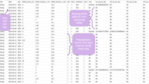
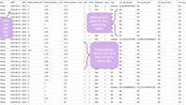
PROCESSING – 240_NOAA_merge.R
This script WILL NOT WORK unless you have a NOAA_CDO_data.csv file in the data subfolder.
  Ezra creates and maintains this file for each project. To get it, you must:
    Share your GHG project folder with Ezra in Box.
    Email Ezra a set of GPS coordinates for each of your sites (can be approximate; this is used to find the nearest NOAA weather station to each site). Also include the range of sampling dates for each site (or just the date of the first sampling at each site if the sites are still actively being sampled)
Data with NOAA daily precipitation and air temperature data are exported to data/02_processed/master_merged_with_NOAA.csv; example below.
Click here to see an example of the exported datasheet →

Slide 24
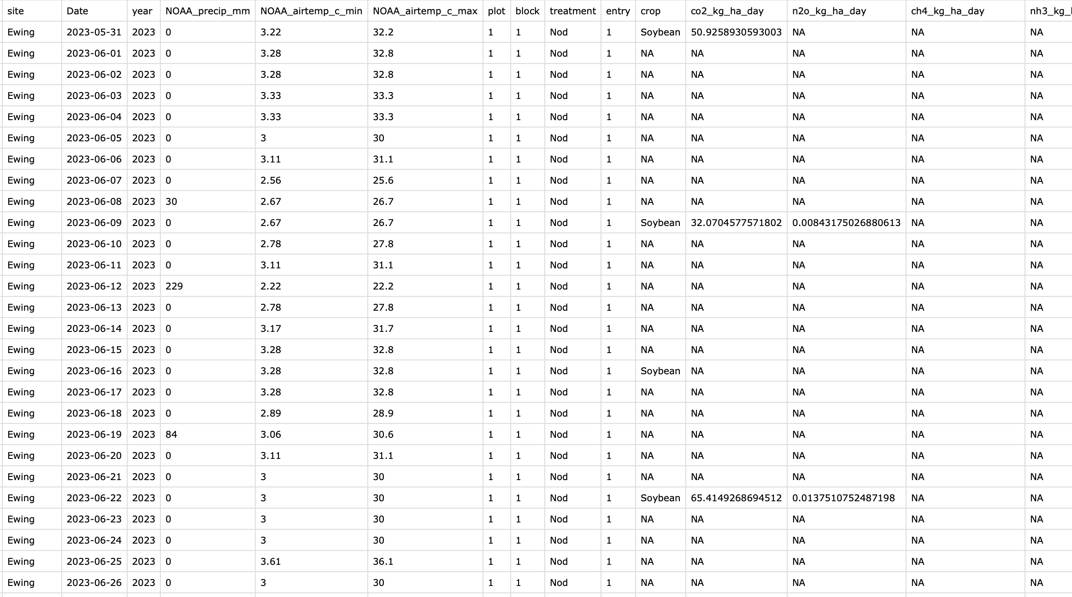
Missing GHG data on non-sampling dates
One row per day/ site
Precipitation (mm), min and max air temp every day

Slide 25
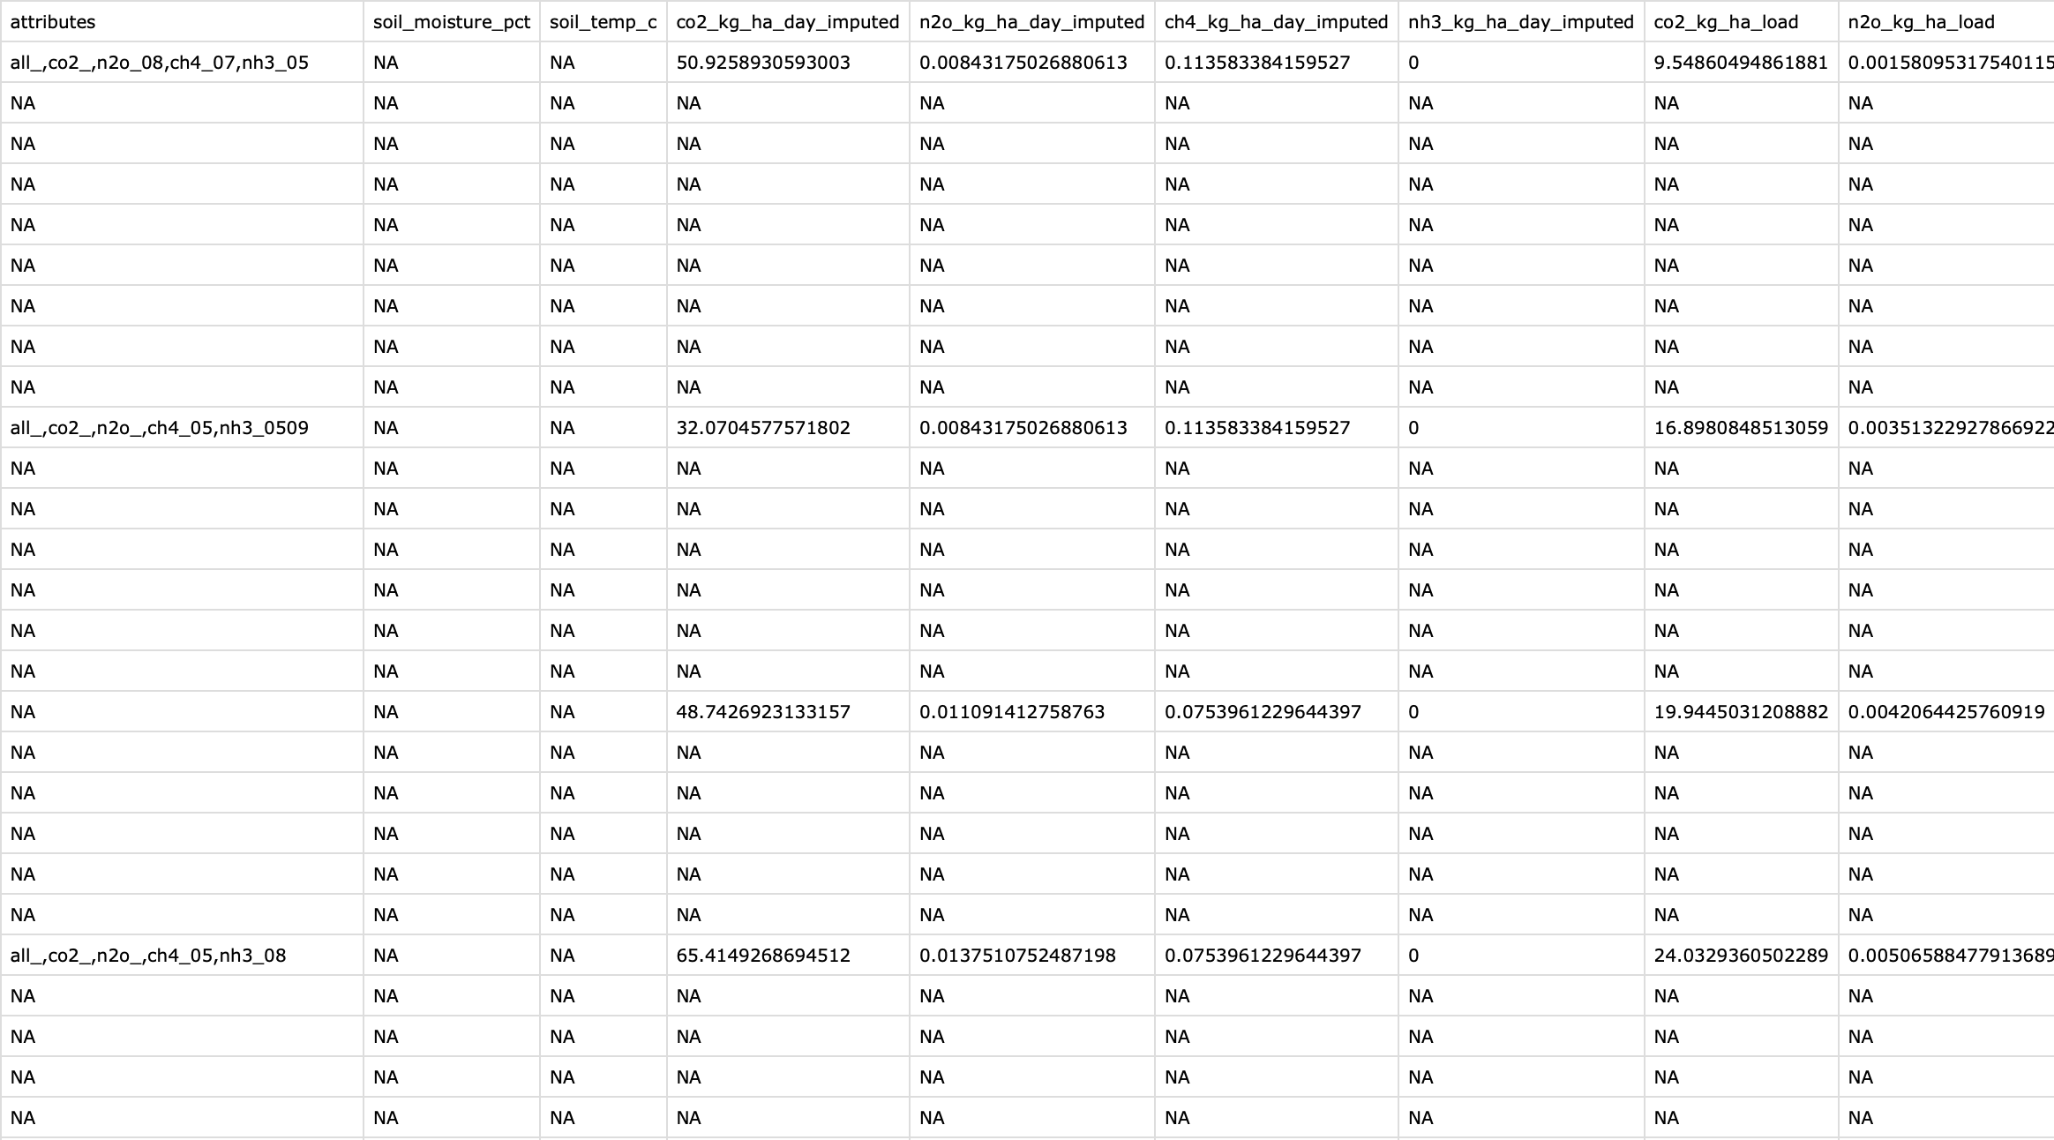
Converted data (loads, CO₂ equivalency) also included (not all shown)

Slide 26
SUMMARIZATION
Summarization script(s) in code folder:
310_summarize_visual.R
320_summarize_tabular.Rmd
Summarization creates exploratory data visuals and calculates summary statistics.
Imports:
  Various data sheets from data/02_processed
Exports:
  Exploratory boxplots to the figures/boxplots folder
  Summary statistics data sheets to the folder data/03_summarized

Slide 27
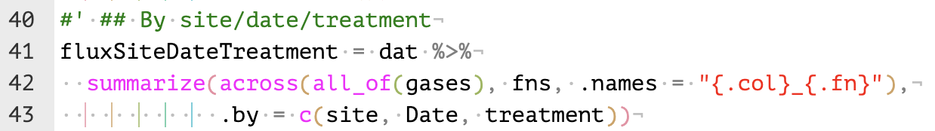
SUMMARIZATION - MODIFICATIONS
You can add your own data summaries!
Copy and paste the above lines of code from 320_summarize_tabular.R, change the name of the object “fluxSiteDateTreatment” object, and change the “.by” argument to whatever variables you’d like to summarize by.
  E.g., if you want summary statistics for each site, you might change:
  “fluxSiteDateTreatment” to “fluxSite”, and
  “.by = c(site, Date, treatment)” to “.by = site”
These summaries are often useful for parenthetical statistics when writing up data. For example, in a Results section, you might write, “Flux of CO₂ was greater in treatment A (mean ± SEM) than treatment B (mean ± SEM).” You can use these summaries to calculate the mean and SEM by treatment.
Summaries are also useful for figures like bar plots or time series. Create summaries in this script to use in figures later.

Slide 28
(**NEEDS UPDATE) ANALYSIS
Analysis script(s) in code folder:
410_lm_flux.R
411_lm_load.R
412_lm_co2_equiv.R
Analysis creates and evaluates data models to answer research questions.
Linear-mixed effect models and ANOVA are the current focus.
Imports:
  Various data sheets from data/02_processed
Exports:
  All exports stored in data/04_analyzed/[y variable], where [y variable] is either flux, load, or co2_equiv, depending on the y variable used in the corresponding model(s)
  ANOVA assumptions checks (residual plots and quantile-quantile plots) as PDFs and/or PNGs
  ANOVA statistics as CSVs
  Long form model statistics (ANOVA + post HOC) as R data files (.RDS)

Slide 29
(**NEEDS UPDATE) ANALYSIS – TEMPLATE SCRIPTS
The template script name indicates the dependent variable being analyzed in the script
  E.g., Models of gas flux by treatment may not be equivalent to models of cumulative gas loads by treatment, so different scripts address these different dependent variables
Template analysis scripts usually contain 2 linear models each. Exports will contain the shorthand model ‘names’, so it’s important to check the annotation in the scripts to know important model details.
  Models are described in detail in the script annotations – read them thoroughly
  mod0 is typically intended to be a ‘base model’. It uses all available, pertinent data & includes all experimental effects as interactive effects.
  mod1 breaks the data into subsets by sampling date, then creates simple, by-treatment models on each subset
Linear models can be modified or added to the template scripts as needed
  You can change model formulas, pre-modeling data transformations, post-HOC methods, etc.

Slide 30
(**NEEDS UPDATE) VISUALIZATION (FIGURE BUILDING)
Visualization script(s) in code folder:
510_figures.R
Visualization creates publication-ready figures depicting key findings.
This step varies the most between projects, and therefore requires the most collaboration.
Imports:
  Summary figures (e.g., bar plots, time series) import data from data/03_summarized
  Analysis figures (e.g. regression plots) import data from data/02_processed
Exports:
  Nothing by default. Figure exports are highly custom and must be added to the scripts or otherwise completed by the user. This often requires a cycle of exporting, viewing, altering export dimensions and text sizes, and re-exporting.
Click to return to STEPS IN THE WORKFLOW

Slide 31
UPDATE gaseous
If you get a pop-up window like the one below, choose “Yes”
I will send out an email each time I make updates to the package available. Updating the package works exactly like installing it. Run the following code:
install.packages(“remotes”)
remotes::install_github('redseasoils/gaseous')
This may also appear as a message in the console that prompts you to type a number. Type 1 and hit Enter/Return.
Click here to copy the code to the clipboard

Slide 32
(**NEEDS UPDATE) What to do with new raw data
install.packages(“remotes”)
remotes::install_github('redseasoils/gaseous')

