Slide 1
Web Intelligence
Text Mining, and web-related Applications
’

Slide 2
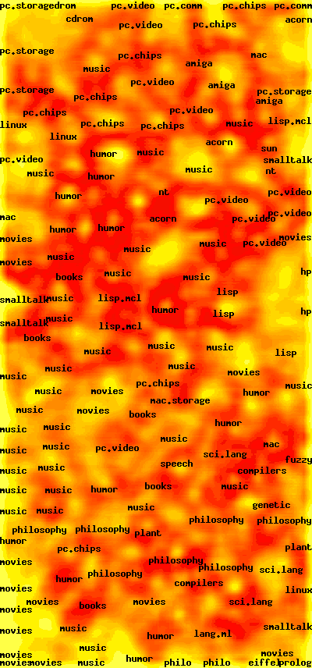
WEB-SOM
A self-organizing-map (SOM) algorithm applied to over 1M newsgroup posts.
See http://websom.hut.fi/websom/milliondemo/html/root.html and play around with it.

Slide 3
Finding similar literature
Two different www documents X and Y might be closely related.
If they are, then:
a user interested in X will also probably be interested in Y
If X is highly ranked in a search, Y should also be made prominently
available to the searcher
If a user is specifically trying to find documents similar to X, then
Y is one of them.
But, the problem is:
X might turn up in a search, but not Y. There are no links between
X and Y, they may be in very separated components of the www
graph.

Slide 4
Another way of looking at it
Suppose you do a search on the keyword pasta
Google may retrieve 1,000,000 documents
How can you (or, hopefully, an automated system) usefully
organise these documents?
If the documents were automatically clustered, so that similar
groups of documents were put together in the same cluster,
then we would be able to impose useful organisation.
E.g. one cluster might be documents about the history of pasta,
another cluster may be mainly recipes, etc…
So, it will be very useful if we have some way of working out similarity between documents – then we can cluster them.

Slide 5
Applications/Motivations for document similarity
Recommendations
  Many search engines and other sites try to help you manage your bookmarks/favourites; as part of this they offer recommendations, i.e. “if you like that, you might also like these …”
  On amazon, or any general product sales site, this can be based on distances between (e.g.) 200 word summaries or ToC of a book, or text that describes a product in a catalogue
Research (scientific, scholarly, for lit review, for market research)
Mapping for Browsing purposes – a 2D visualisation of the web, or a subset, where each page is a (clickable) point, and distance between them is related to document similarity

Slide 6
But a document is a “bag of words” – to work out distances, we need numbers

Slide 7
How did I get these vectors from these two `documents’?
<h1> Compilers: lecture 1 </h1>
<p> This lecture will introduce the
concept of lexical analysis, in which
the source code is scanned to reveal
the basic tokens it contains. For this,
we will need the concept of
regular expressions (r.e.s).</p>
<h1> Compilers</h1>
<p> The Guardian uses several
compilers for its daily cryptic
crosswords. One of the most
frequently used is Araucaria,
and one of the most difficult
is Bunthorne.</p>
35, 2, 0
26, 2, 2

Slide 8
What about these two vectors?
<h1> Compilers: lecture 1 </h1>
<p> This lecture will introduce the
concept of lexical analysis, in which
the source code is scanned to reveal
the basic tokens it contains. For this,
we will need the concept of
regular expressions (r.e.s).</p>
<h1> Compilers</h1>
<p> The Guardian uses several
compilers for its daily cryptic
crosswords. One of the most
frequently used is Araucaria,
and one of the most difficult
is Bunthorne.</p>
0, 0, 0, 1, 1, 1
1, 1, 1, 0, 0, 0

Slide 9
An unfair question, but I got that by using the following word vector:
(Crossword, Cryptic, Difficult, Expression, Lexical, Token)
If a document contains the word `crossword’, it gets a 1 in position 1 of the vector, otherwise 0. If it contains `lexical’, it gets
a 1 in position 5, otherwise 0, and so on.
How similar would be the vectors for two pages about crossword
compilers?
The key to measuring document similarity is turning documents into vectors based on specific words and their frequencies.

Slide 10
Turning a document into a vector
We start with a template for the vector, which needs a master list of terms . A term can be a word, or a number, or anything that appears frequently in documents.
There are almost 200,000 words in English – it would take much too
long to process documents vectors of that length.
Commonly, vectors are made from a small number (50—1000) of
most frequently-occurring words.
However, the master list usually does not include words from a stoplist,
Which contains words such as the, and, there, which, etc … why?

Slide 11

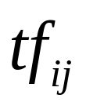
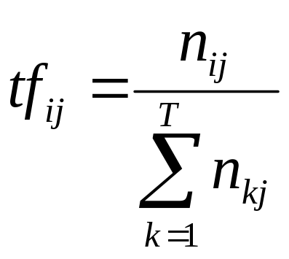
The TFIDF Encoding
(Term Frequency x Inverse Document Frequency)
A term is a word, or some other frequently occuring item
Given some term i, and a document j, the term count
is the number of times that term i occurs in document j
Given a collection of k terms and a set D of documents, the term frequency, is:
… considering only the terms of interest, this is the proportion of document j that is made up from term i.

Slide 12
Term frequency is a measure of the importance of term i in document j
Inverse document frequency (which we see next) is a measure of the general importance of the term.
I.e. High term frequency for “apple” means that apple is an important word in a specific document.
But high document frequency (low inverse document frequency) for “apple”, given a particular set of documents, means that apple is not all that important overall, since it is in all of the documents.

Slide 13
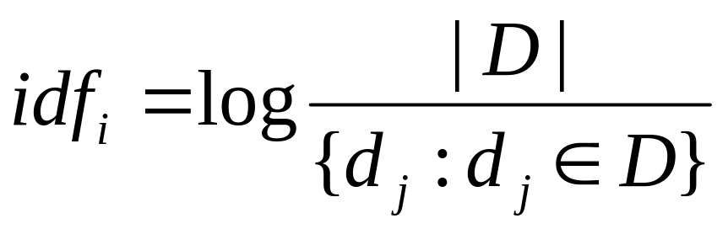
Inverse document frequency of term i is:
Log of: … the number of documents in the master collection,
divided by the number of those documents that contain the term.

Slide 14
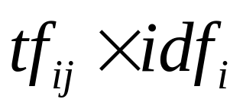
TFIDF encoding of a document
So, given:
- a background collection of documents
(e.g. 100,000 random web pages,
all the articles we can find about cancer
100 student essays submitted as coursework
…)
- a specific ordered list (possibly large) of terms
We can encode any document as a vector of TFIDF numbers,
where the ith entry in the vector for document j is:

Slide 15
Turning a document into a vector
Suppose our Master List is:
(banana, cat, dog, fish, read)
Suppose document 1 contains only:
“Bananas are grown in hot countries, and cats like bananas.”
And suppose the background frequencies of these words in a large
random collection of documents is (0.2, 0.1, 0.05, 0.05, 0.2)
The document 1 vector entry for word w is:
This is just a rephrasing of TFIDF, where:
freqindoc(w) is the frequency of w in document 1,
and freq_in_bg(w) is the `background’ frequency in our
reference set of documents

Slide 16
Turning a document into a vector
Master list: (banana, cat, dog, fish, read)
Background frequencies: (0.2, 0.1, 0.05, 0.05, 0.2)
Document 1:
“Bananas are grown in hot countries, and cats like bananas.”
Frequencies are proportions. The background frequency of banana is
0.2, meaning that 20% of documents in general contain `banana’, or bananas, etc. (note that read includes reads, reading, reader, etc…)
The frequency of banana in document 1 is also 0.2 – why?
The TFIDF encoding of this document is:
Suppose another document has
exactly the same vector – will it
be the same document?
0.464, 0.332, 0, 0, 0

Slide 17
Vector representation of documents underpins:
Many areas of automated document analysis
Such as: automated classification of documents
Clustering and organising document collections
Building maps of the web, and of different web communities
Understanding the interactions between different scientific communities, which in turn will lead to helping with automated WWW-based scientific discovery.

Slide 18
What can you say about the TFIDF value for the word “and”?
What about the word “cancer”?
What is the TFIDF value of cancer, where the background collection of document is a collection of abstracts from a cancer journal?

Slide 19
Stoplists and Stemming
Stoplists – we mentioned these already; this is a list of words that we should ignore when processing documents, since they give no useful information about content. Examples of such words?
Stemming – this is the process of treating a set of words like “fights, fighting, fighter, …” as all instances of the same term – in this case the stem is “fight”. Why is this useful?

Slide 20
Examinable Reading
The Sinka/Corne paper on my teaching site;
I want you to be able to talk clearly about the findings (e.g. how the quality of clustering was affected by whether or not stemming was used)

