Slide 1

Redis
Our Swiss Army Datastore

Slide 2
What is Redis?
Redis == REmote DIctionary Server
“Redis is an open source, advanced key-value store. … It is often referred to as a data structure server since keys can contain strings, hashes, lists, sets and sorted sets.” (copy & pasted from http://redis.io)

Slide 3
What is awesome about Redis?

Slide 4
Hashes ☺

Slide 5
Lists ☺

Slide 6
Sets ☺

Slide 7
Atomic operations ☺

Slide 8
Expirations ☺

Slide 9
Replication ☺

Slide 10
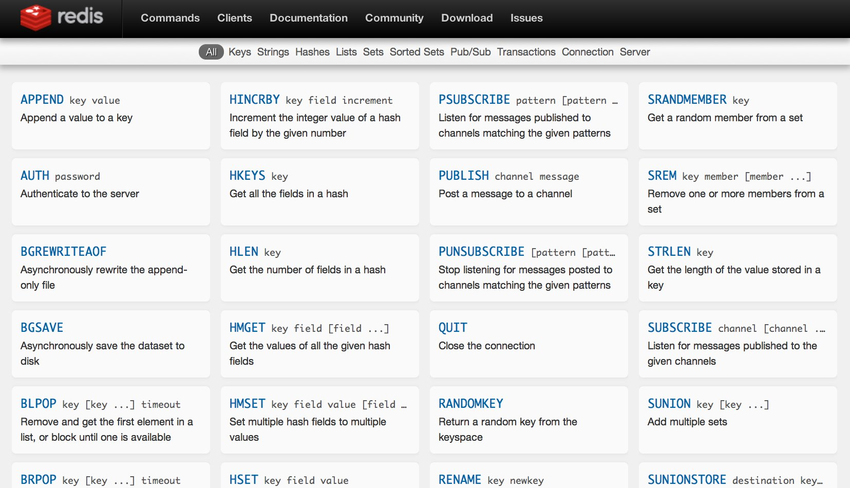
http://redis.io/commands ☺

Slide 11
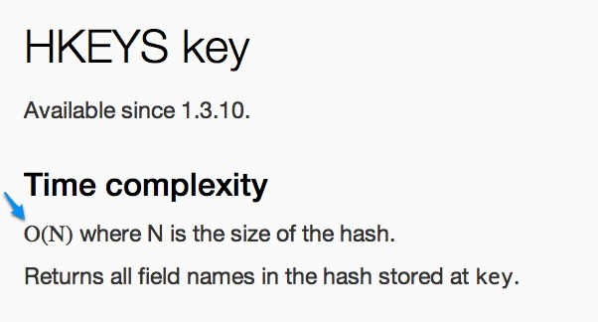
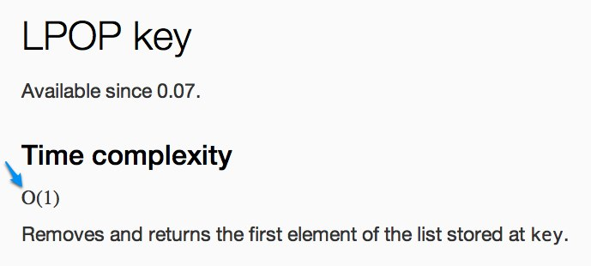
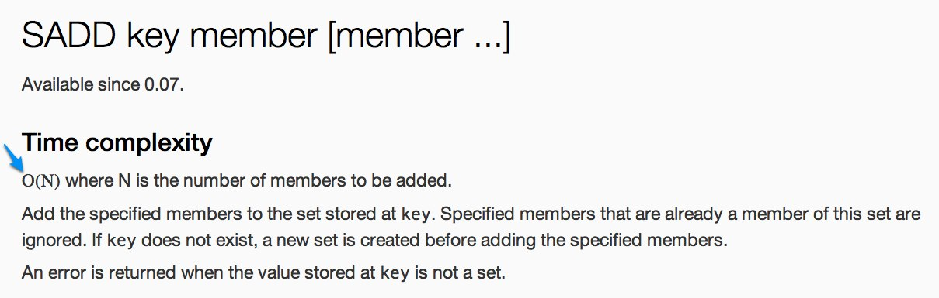
http://redis.io/commands ☺

Slide 12
What sucks about Redis?

Slide 13
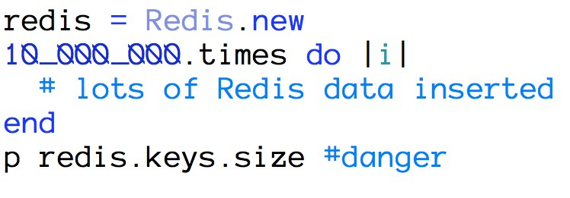
Keys is tempting ☹

Slide 14
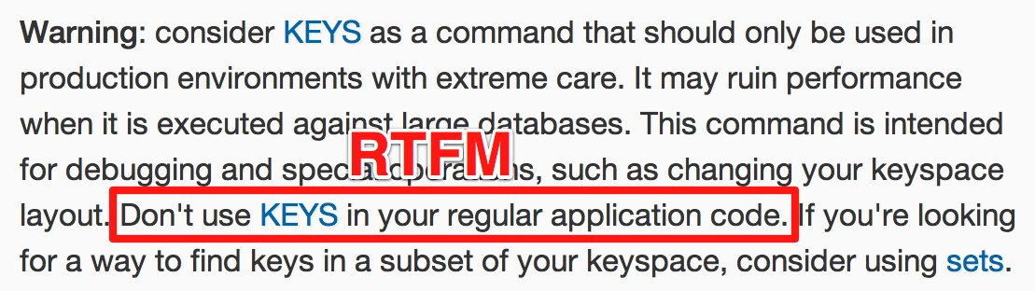
Keys is tempting ☹

Slide 15
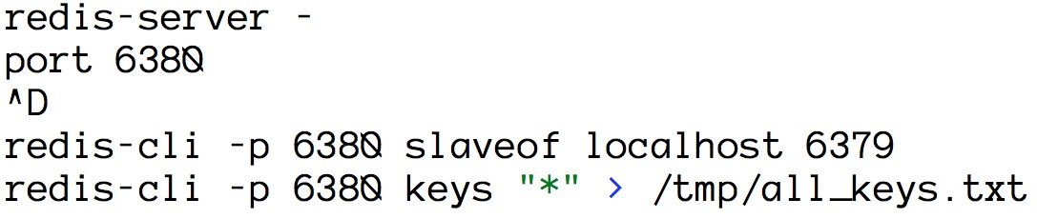
Keys is tempting… Keep replica(s) around for reporting ☺

Slide 16
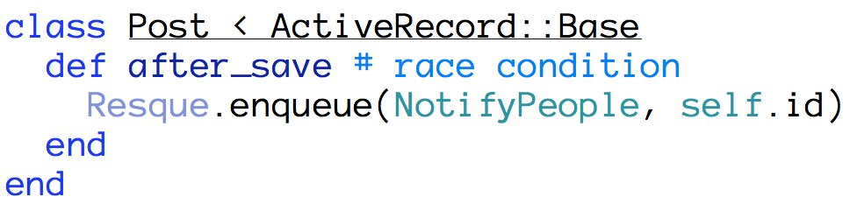
ActiveRecord callbacks ☹

Slide 17
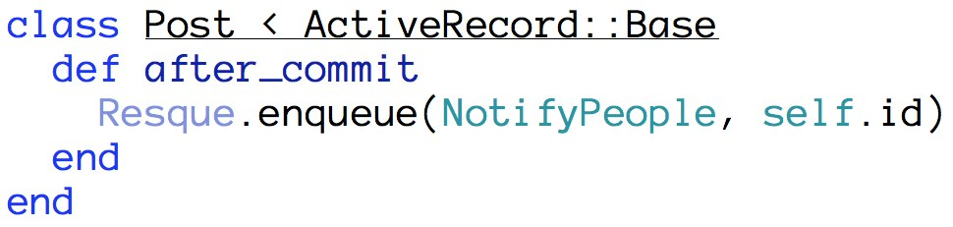
ActiveRecord callbacks Use after_commit instead ☺

Slide 18
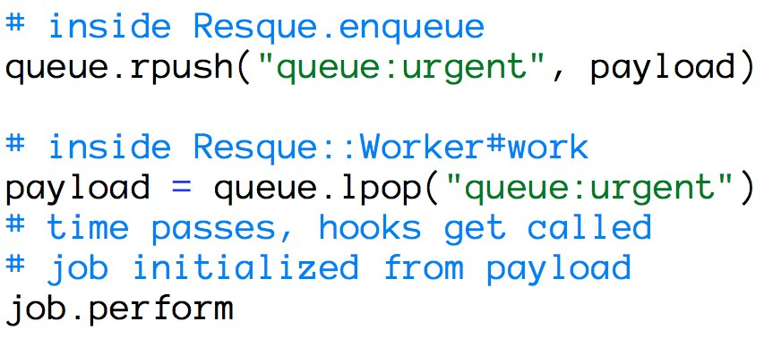
Resque dropping data ☹

Slide 19
Resque not dropping data ☺
Send copious +1’s to:
https://github.com/defunkt/resque/pull/531

Slide 20
How do you test with Redis?

Slide 21
fakeredis ☺

Slide 22
How are we using Redis?
incr/decr for deal inventory
expireat to keep the datasets leaner
hset/hgetall to track who has seen what deal
lpush/rpop for custom message queues
get/setex for abandoned cart reminders
Replication/Failover to provide high availability
Redis::Distributed to shard large datasets

Slide 23
What have we learned?
Start with expireat. Do we need this forever?
Start with slaveof. Keep a replica or two around.
Upgrade to 2.4.6 made hset/hgetall performant.
Resque can’t be entirely trusted (see fork).
Redis Cluster is still a ways off, so PRESHARD.
Single-purpose instances over one multi-purpose.
resque-jobs-per-fork has a nasty bug (fixed).
Use fakeredis (work in progress) for testing.

Slide 24
Questions?
Source and Slides at
https://github.com/redsquirrel/redis-at-groupon

Slide 25
Thanks ☺
Dave Hoover
@redsquirrel

