Slide 1

Redis
Our Swiss Army Datastore

Slide 2
What is Redis?
Redis is an open source, advanced key-value store.
It is often referred to as a data structure server since keys can contain strings, hashes, lists, sets and sorted sets.
(copy & pasted from http://redis.io)

Slide 3
What is awesome about Redis?

Slide 4
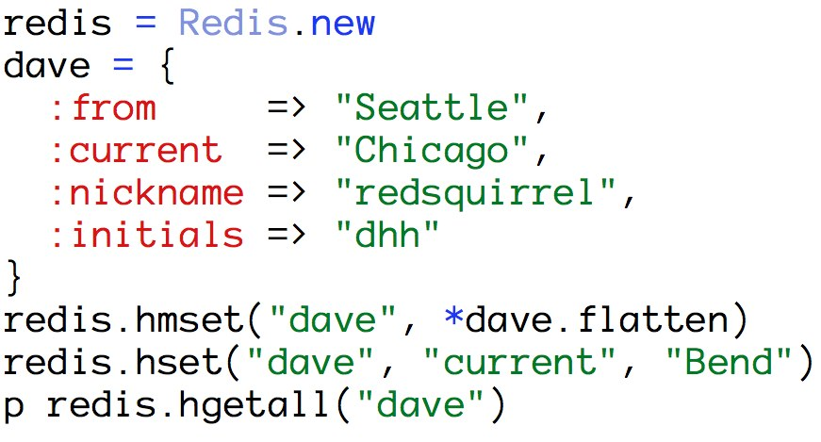
Built-in data structures ☺

Slide 5
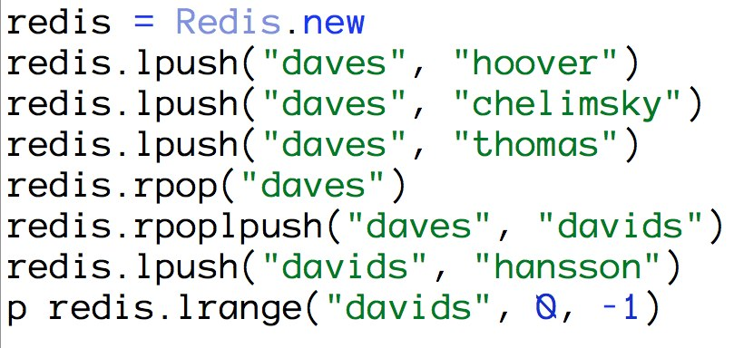
Built-in data structures ☺

Slide 6
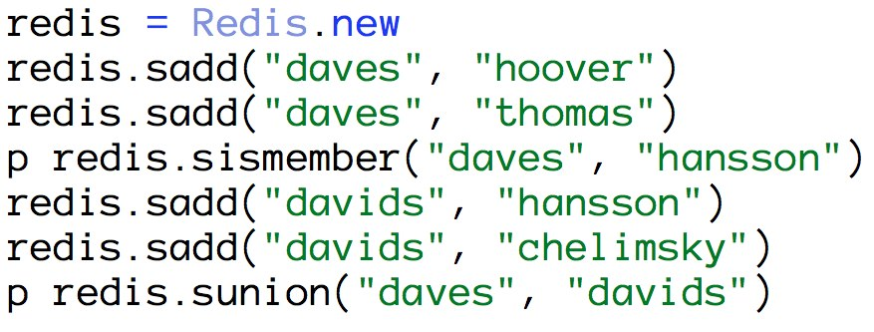
Built-in data structures ☺

Slide 7
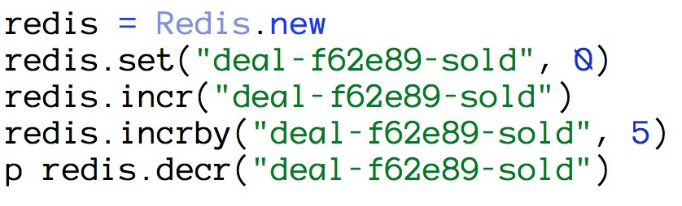
Atomic operations ☺

Slide 8
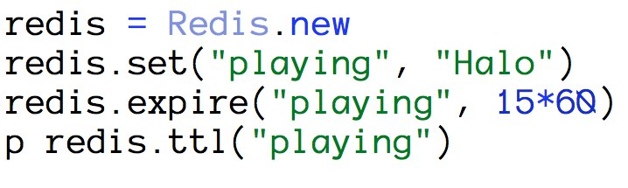
Expirations ☺

Slide 9
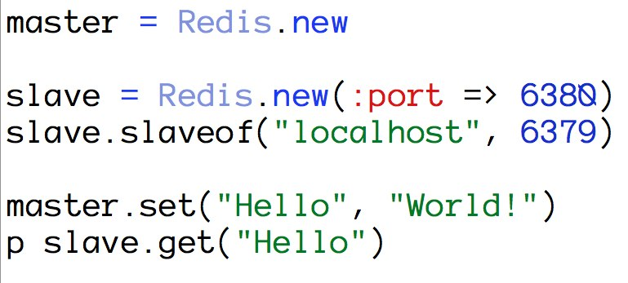
Replication ☺

Slide 10
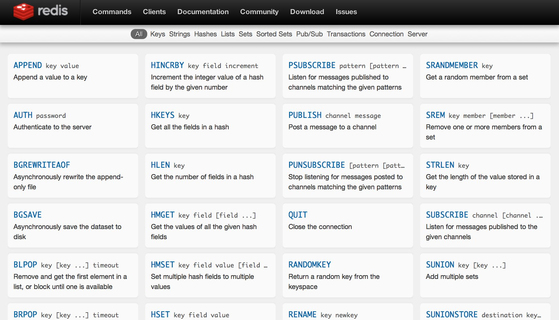
http://redis.io/commands ☺

Slide 11
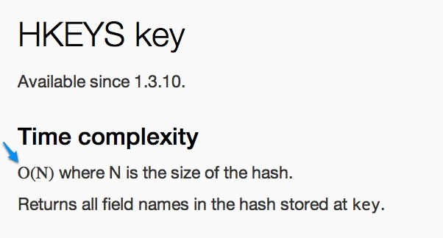
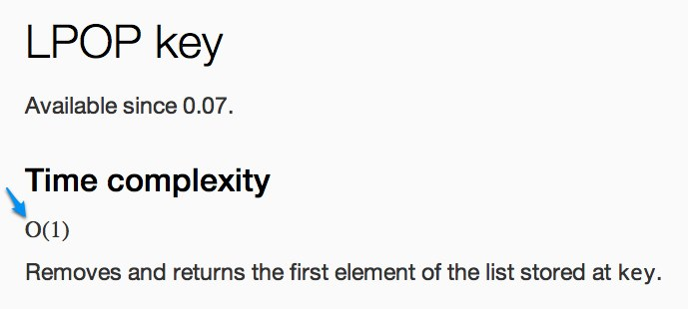
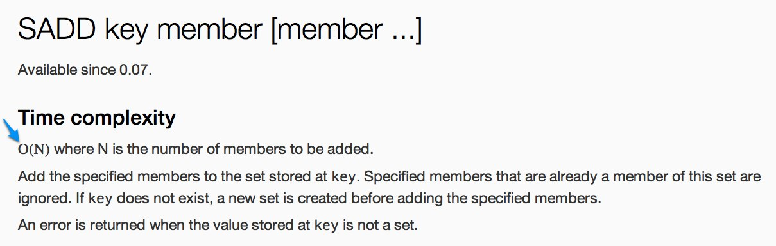
http://redis.io/commands ☺

Slide 12
What sucks about Redis?

Slide 13
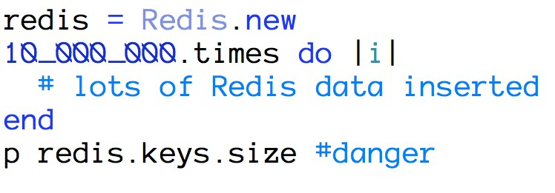
Keys is tempting ☹

Slide 14
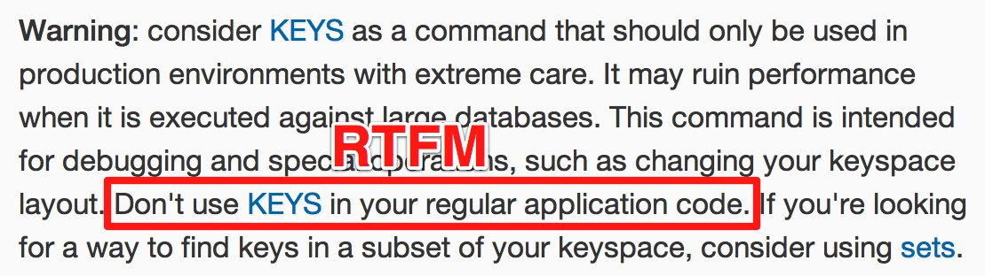
Keys is tempting ☹

Slide 15
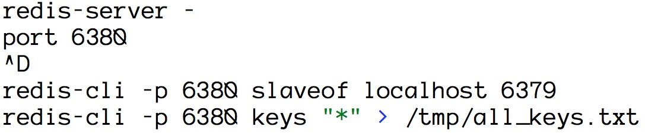
Keys is tempting ☹ Use replication to grab a snapshot…

Slide 16
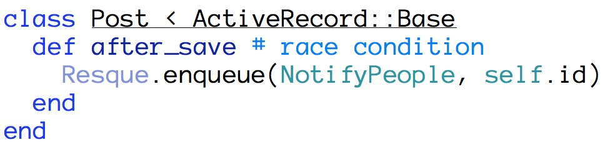
ActiveRecord callbacks ☹

Slide 17
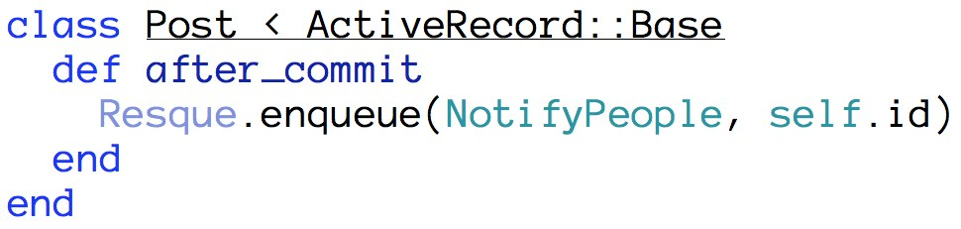
ActiveRecord callbacks ☺ Use after_commit instead…

Slide 18
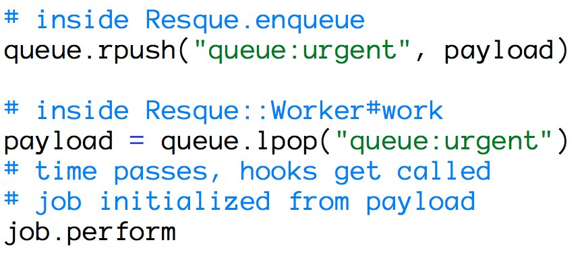
Resque dropping data ☹

Slide 19
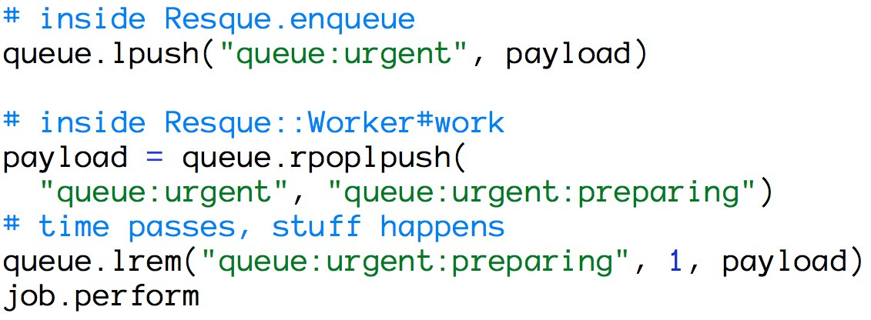
Resque dropping data TODO: submit rpoplpush patch 😐

Slide 20
How do you test with Redis?

Slide 21
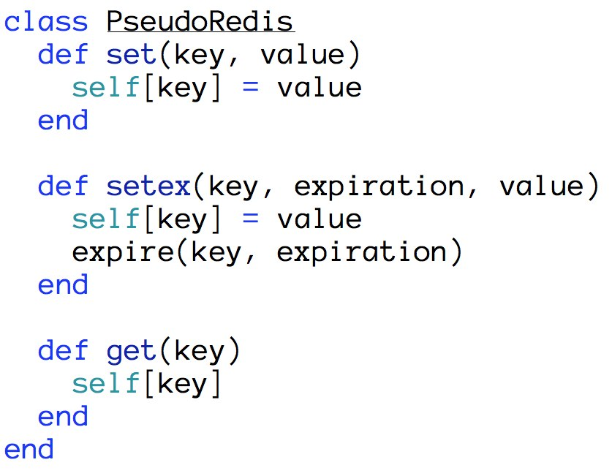
PseudoRedis ☺

Slide 22
How are we using Redis?
incr/decr for deal inventory
expireat to keep the datasets leaner
hset/hgetall to track who has seen what deal
lpush/rpop for custom message queues
sadd/sismember to prevent duplicate work
Replication/Failover to provide high availability
Redis::Distributed to shard large datasets

Slide 23
Questions?

Slide 24
Thanks ☺
Dave Hoover
@redsquirrel

