Slide 1

Growth of the Video Game Industry in the Past Four Decades
Axel López
José G. Portela
Alejandro Llera Fábregas

Slide 2

Project Overview
Our topic is related to the growth of the video games industry in the past four decades, using a data set with differents variables including the global total sales to analyze the increase in growth revenue through the years.
Dataset & Hypothesis Formulation:
The data set contains sales data for video games across various platforms, genres and including global ranking, title, platform, release year, genre, publisher info, sale information for global total of all sales.
The proposed hypothesis is that the Adventure genre has different behaviors compared to the others genres in revenue growth over the last four decades.

Slide 3

Data Set Cleaning and Analysis Process
Data Cleaning Technique and Analysis Process:
Data cleaning wasn’t conducted after extraction because missing values had no major impact on the analysis's results.
Our analysis begins by selecting the variables to be used and verifying null values. The linear graph suggests a different behavior in the Adventures genres in terms of revenue growth compared to other genres.

Slide 4

Data Wrangling
Encountered Challenges in Data Cleaning:
A hurdle found during data cleansing was the need to transform date values into years. To address this, a column was created to better represent the trends in the graph.
API and Web scraping to collect and enrich the dataset:
We were able to directly access the necessary data from the existing data base, eliminating the need for API and Web scraping.

Slide 5
EXPLORATORY DATA ANALYSIS
A two-sample t-test was done to compare the means of the two independent groups, Adventure genre and other genres, to determine if there is a significant difference between them.
A linear graph was plotted to show the behaviour of the Adventure genre in comparison to the other ones.

Slide 6

Exploratory Data Analysis
Utilized Data Analysis Methods:
Throughout the analysis phases, various methods were employed, including “aggrupation’, “lock” “lambda”, ”value_contents””Dtap” and “Noll’s”.
Uncovered Insights and Patterns:
The p-value of 4.860077353336951 x 10⁻¹⁵ from the two-sample t-test confirms a significant difference in behavior between the Adventure genre and other genres.

Slide 7
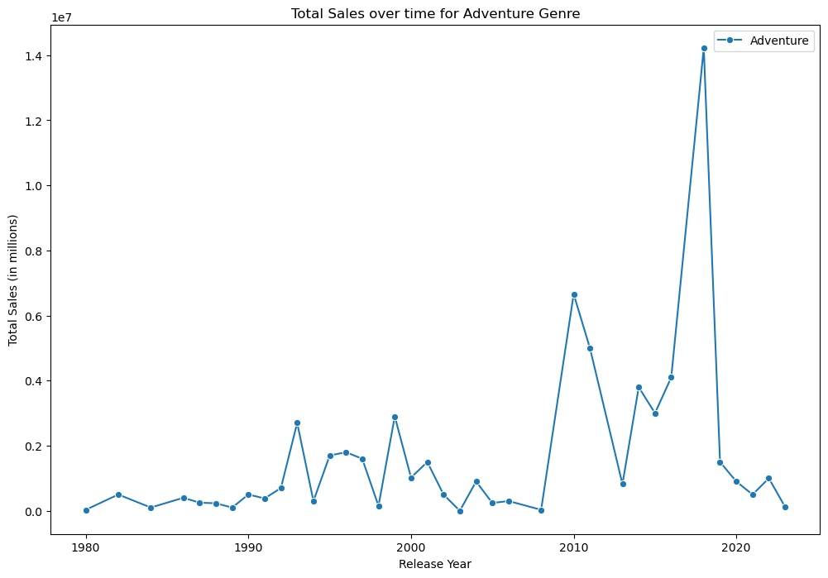

Slide 8
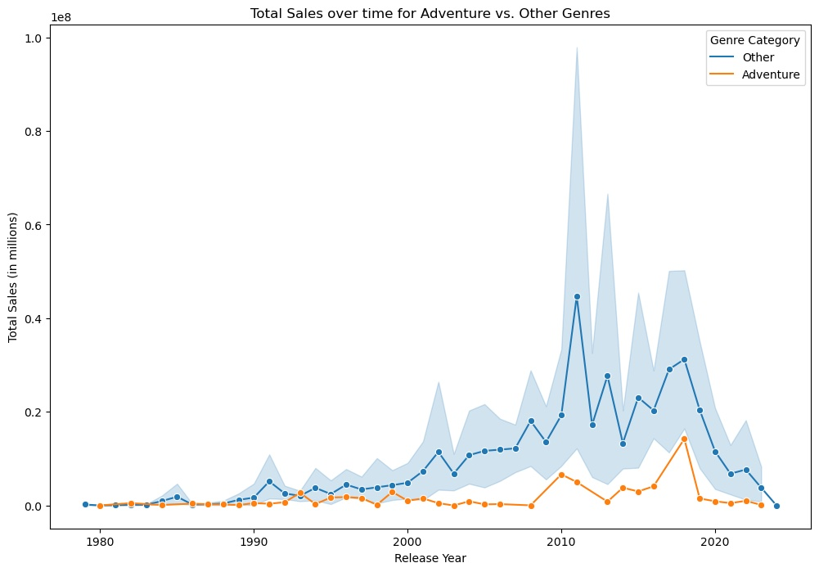

Slide 9
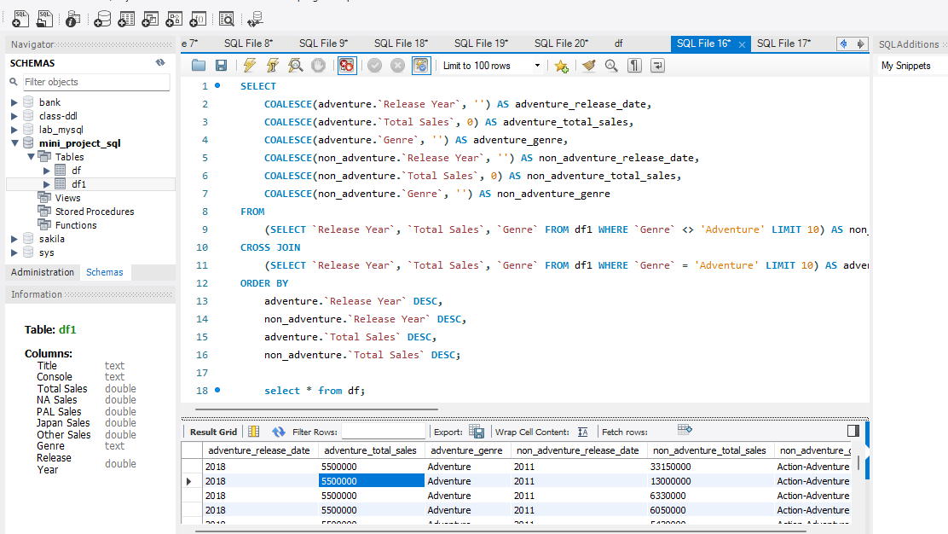
QUERY

Slide 10
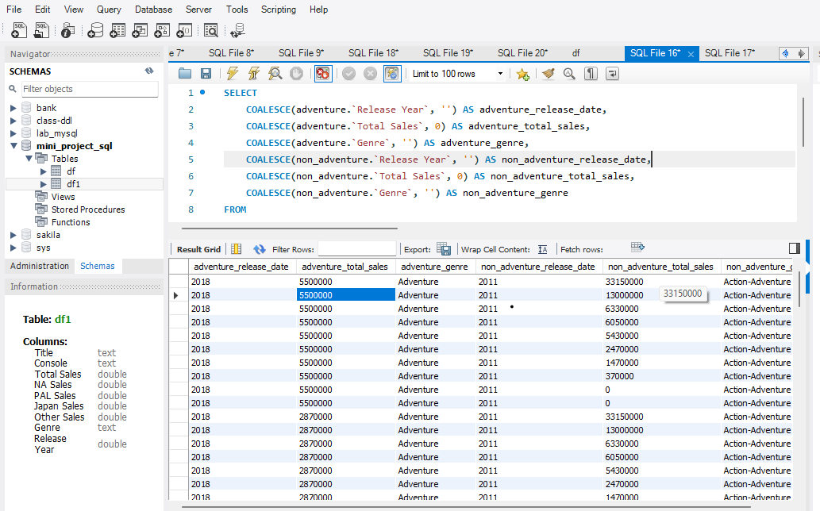

Slide 11
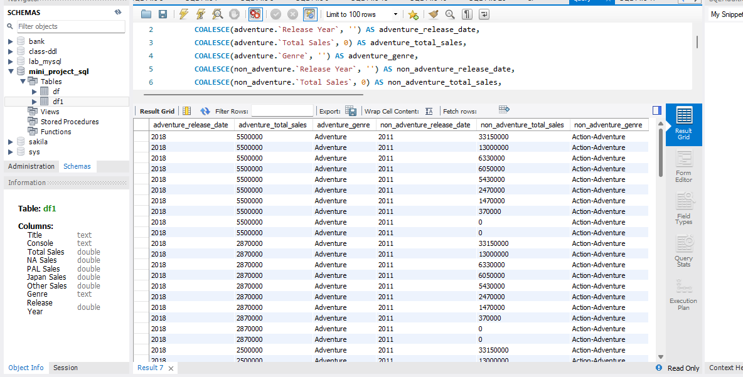

Slide 12
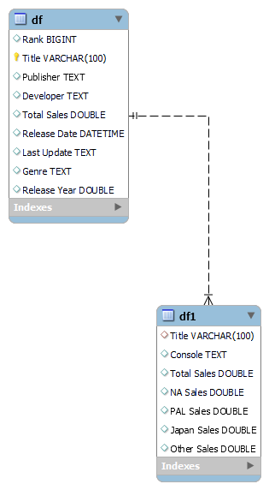
DIAGRAM

Slide 13

Major Obstacles
Encountering biggest obstacles or mistakes:
The most significant hurdle faced in this project revolved around identifying the best graph to visualize the diverse relationship among variables to validate our hypothesis.
Learnings and Overcoming challenges:
This project provided us the opportunity to implement meticulous methods to obtain the data set and perform the analysis utilizing libraries such as sea born and matplotlib.

Slide 14
Conclusion and Insights
Overview of Outcomes:
The outcomes showed a significant difference in the behavior between the revenue growth of the Adventure genre compared to other ones. This was supported by the p-value and linear graph representation, allowing us to accept the formulated hypothesis.
Surprising Insights and Revelations:
Following the modification of the original hypothesis, we obtained the true relationship between the selected variables, and managed to visualize it in the linear graph.

Slide 15

Conclusion and Insights
Potential implications of Findings:
There are unknown variables that are influencing the behavior of the adventure genre when you compare it to the other video games genres.

Slide 16
Recommendations
To assess additional factors that might have influenced the revenue growth of the video game industry throughout the past four decades, it would be desirable to employ an external source of data.
Our search turned up previous publications that discussed factors such as social interaction, vertical integration, and technological developments that have made video games more visually stunning, immersive, and technically sophisticated over time.
These would be useful for future research as they would provide more precise outcomes and better insights into the growth patterns.

Slide 17
References
Babb,J. Terry,N. Dana,K. (2013). The Impact Of Platform On Global Video Game Sales. International Business & Economics Research Journal, vol.12(10), p.1273-p.1288.
Gil, R. Warzinski,F. (2014). Vertical Integration, Exclusivity, and Game Sales Performance in the US Video Game Industry. Journal of Law, Economics, and Organization. Vol.31(suppl 1), i143-i168. doi:10.1093/jleo/ewu006.

