Slide 1
Welcome to Python and Single Linked Lists
November 17, 2017 Rosa Esquivel
City College of San Francisco

Slide 2
Concepts for Linked Lists
What is a Linked List?
Nodes
Data
Pointers
Head
None
Singly Linked Lists
Python Coding
Define the Node Class
Linked List Object
Define the head
Last node is (Next) is set to None
Append()
Get()
Display()
Length()
Remove()

Slide 3
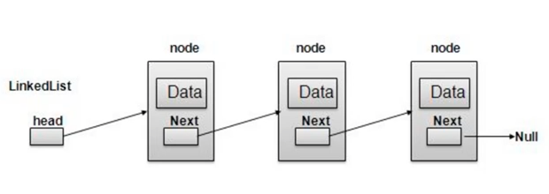
Singly Linked List
NONE
Notes:
None in python
Visual from

Slide 4
linked list code
head
data
None
data
Notes:
Self.head=node() #after you create the node class
class node:
def __init__(self,data=None):
self.data=data
self.next=None

Slide 5
Linked List
Notes:
None in python
Visual from

Slide 6
Linked List
NONE
Notes:
None in python
Visual from

Slide 7
Summary
We just focused on linked lists.
We have studied the concepts that underlie lists,
such as nodes
and pointers to other nodes.
We implemented the major operations that occur on these types of list and saw how their worst case running times compare
Next arrays and lists

Slide 8
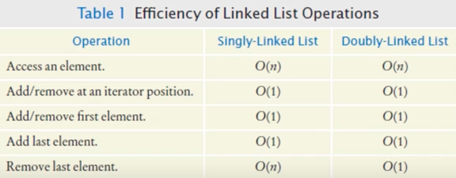
O Operator

Slide 9
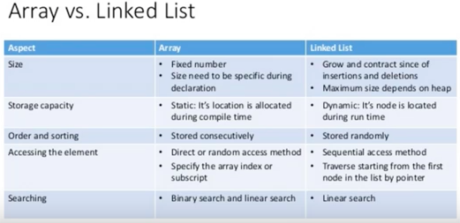
Array Vs. Linked List

Slide 10
Singly linked list
A singly linked list is a list with only one pointer between two successive nodes.
It can only be traversed in a single direction,
that is, you can go from the first node in the list to the last node,
you cannot move from the last node to the first node

Slide 11
Define node class
class Node:
def __init__(self, data=None):
self.data = data
self.next = None

Slide 12
Append operation
class linked_list: def __init__(self): self.head=node() #head node is just a named element to access list def append(self,data): #add a new node to linked list new_node=node(data) #create a new node cur=self.head #start on left while cur.next!=None: cur=cur.next cur.next=new_node def length(self): #only pass instance of linked list cur=self.head total=0 while cur.next!=None: total+=1 cur=cur.next return total def display(self): elems=[] # this is a regular list with nothing for now cur_node=self.head while cur_node.next!=None: cur_node=cur_node.next elems.append(cur_node.data) print(elems) def get(self,index): if index>=self.length(): print("ERROR: Get index not in array!") return None cur_idx=0 cur_node=self.head while True: cur_node=cur_node.next if cur_idx==index: return cur_node.data cur_idx+=1 def erase(self,index): if index>=self.length(): print("Error: 'Index out of error") return cur_idx=0 cur_node=self.head while True: last_node=cur_node cur_node=cur_node.next# cur_node=cur_node.next if cur_idx==index: last_node.next=cur_node.next return cur_idx+=1 def display1(self): elems1=[] # this is a regular list with nothing for now cur=self.head while cur.next!=None: cur=cur.next elems1.append(cur.data) print(elems1)

Slide 13
Getting size of list
def length(self): #only pass instance of linked list cur=self.head total=0 while cur.next!=None: total+=1 cur=cur.next

Slide 14
We would like to be able to get the size of the list by counting the number of nodes. One way we could do this is by traversing the entire list and increasing a counter as we go along:
This works, but list traversal is potentially an expensive operation that we should avoid when we can. So instead, we shall opt for another rewrite of the method. We add a size member to the SinglyLinkedList class, initializing it to 0 in the constructor. Then we increment size by one in the append method:
Because we are now only reading the size attribute of the node object, and not using a loop to count the number of nodes in the list, we get to reduce the worst case running time from O(n) to O(1).

Slide 15
Comparing
A list is clearly a separate concept from a node.
So we start by creating a very simple class to hold our list. We will start with a constructor that holds a reference to the very first node in the list. Since this list is initially empty, we will start by setting this reference to None:

Slide 16
node
class Node:
def __init__(self, data=None):
self.data = data
self.next = None
To print self
def __str__(self):
return str(data)

Slide 17
concepts
Pointers
nodes

Slide 18
Types of linked lists
Singly
Doubly
Circular

Slide 19
Singly linked list
One point between two successive nodes

Slide 20
Java
C/C++

Slide 21
Understand Lists and Pointers
Python's list implementation is designed to be powerful and to encompass several different use cases. We are going to be a bit more strict in our definition of what a list is.
The concept of a node is very important to lists. We shall discuss them in this chapter, but this concept will, in different forms, come back throughout the rest of the book.
The focus of this chapter will be the following:
Understand pointers in Python
Treating the concept of nodes
Implementing singly, doubly, and circularly linked lists

Slide 22
Notes
Overview of data types and objects
Python contains 12 built-in data types. These include four numeric types (int, float, complex, bool), four sequence types (str, list, tuple, range), one mapping type (dict), and two set types. It is also possible to create user-defined objects such as functions or classes.
All data types in Python are objects, including modules, classes, and functions, and literals such as strings and integers.
Each object in Python has a type, a value, and an identity. When we write greet = "hello world" we are creating an instance of a string object with the value "hello world" and the identity of greet. The identity of an object acts as a pointer to the object's location in memory. The type of an object, also known as the object's class, describes the object's internal representation as well as the methods and operations it supports.
Once an instance of an object is created, its identity and type cannot be changed.

Slide 23
Not Covering
Doubly linked lists
Circular linked lists

Slide 24
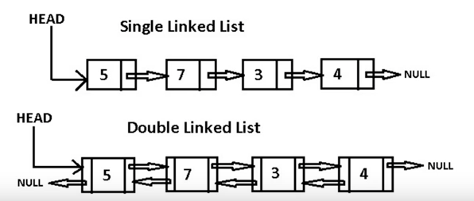
Doubly Linked Lists

Slide 25
Credits
Python Data Structures and Algorithms
by Benjamin Baka
Published by Show publisher page link if publisher pages switch is on Packt Publishing, 2017
Faure, Brian: “Python Data Structures #2: Linked List”, August 26, 2017, youtube

