Slide 1
Welcome to Python and Single Linked Lists
November 17, 2017 Rosa Esquivel
City College of San Francisco

Slide 2
Concepts for Linked Lists
What is a Linked List?
Nodes
Data
Pointers
Head
None
Singly Linked Lists
Python Coding
Define the Node Class
Linked List Object
Define the head
Last node is (Next) is set to None
Append()
Get()
Display()
Length()
Remove()

Slide 3
linked list code
head
data
None
data
Pointer
Notes:
A singly linked list is a list with only one pointer between two successive nodes
It can only be traversed in a single direction,
that is, you can go from the first node in the list to the last node,
you cannot move from the last node to the first node
Self.head=node() #after you create the node class
class node:
def __init__(self,data=None):
self.data=data
self.next=None

Slide 4
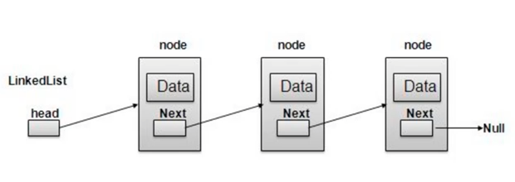
Better Graphic
NONE
Notes:
None in python
Visual from

Slide 5
Singly linked list
A list with only one pointer between two successive nodes
Can only be traversed in a single direction
You can go from the first node in the list to the last node
You cannot move from the last node to the first node
Notes:
A singly linked list is a list with only one pointer between two successive nodes
It can only be traversed in a single direction,
that is, you can go from the first node in the list to the last node,
you cannot move from the last node to the first node

Slide 6
Repeat
Head
Node with Data
Node with Pointer to Next
None

Slide 7
Python Programming
Time to switch

Slide 8
Plan of Attack
Node class
Initialize
Append
Get
Erase
Length
Display

Slide 9
Define node class
class Node:
def __init__(self, data=None):
self.data = data
self.next = None

Slide 10
initialize linked list
class linked_list:
def __init__(self):
self.head=node() #head node is just a named element to access list

Slide 11
append
def append(self,data): #add a new node
new_node=node(data) #create a new node cur=self.head #start on left while cur.next!=None:
cur=cur.next
cur.next=new_node

Slide 12
length
def length(self): #only pass instance of linked list
cur=self.head
total=0
while cur.next!=None:
total+=1
cur=cur.next
return total

Slide 13
display
def display(self):
elems=[] # this is a regular list with nothing for now
cur_node=self.head
while cur_node.next!=None:
cur_node=cur_node.next
elems.append(cur_node.data)
print(elems)

Slide 14
get
def get(self,index):
if index>=self.length():
print("ERROR: Get index not in array!")
return None
cur_idx=0
cur_node=self.head
while True:
cur_node=cur_node.next
if cur_idx==index:
return cur_node.data
cur_idx+=1

Slide 15
erase
def erase(self,index):
if index>=self.length():
print("Error: 'Index out of error")
return
cur_idx=0
cur_node=self.head
while True:
last_node=cur_node
cur_node=cur_node.next
if cur_idx==index:
last_node.next=cur_node.next
return
cur_idx+=1

Slide 16
Python basics
variables
data types
functions
relational v. assignment operators
Operators
Constructors
methods
class
arguments
self
init
arguments
return
for, if
while
Notes:
Data types (numeric string Boolean
Functions (define
relational operators (==,!=) vs. Assignment (=, +=)
returning data (return)

Slide 17
Review of Known Concepts
Object
Class
Define
Variables
Assign (=,+=) vs. Compare (== or !=)

Slide 18
Coming Soon
Tuple
Dictionary
Queue
Deque
Not supported: stack

Slide 19
We would like to be able to get the size of the list by counting the number of nodes. One way we could do this is by traversing the entire list and increasing a counter as we go along:
This works, but list traversal is potentially an expensive operation that we should avoid when we can. So instead, we shall opt for another rewrite of the method. We add a size member to the SinglyLinkedList class, initializing it to 0 in the constructor. Then we increment size by one in the append method:
Because we are now only reading the size attribute of the node object, and not using a loop to count the number of nodes in the list, we get to reduce the worst case running time from O(n) to O(1).

Slide 20
Comparing
A list is clearly a separate concept from a node.
So we start by creating a very simple class to hold our list. We will start with a constructor that holds a reference to the very first node in the list. Since this list is initially empty, we will start by setting this reference to None:

Slide 21
node
class Node:
def __init__(self, data=None):
self.data = data
self.next = None
To print self
def __str__(self):
return str(data)

Slide 22
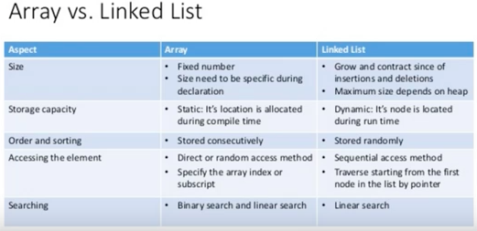
Array Vs. Linked List

Slide 23
Singly linked list
One point between two successive nodes

Slide 24
Understand Lists and Pointers
Python's list implementation is designed to be powerful and to encompass several different use cases. We are going to be a bit more strict in our definition of what a list is.
The concept of a node is very important to lists. We shall discuss them in this chapter, but this concept will, in different forms, come back throughout the rest of the book.
The focus of this chapter will be the following:
Understand pointers in Python
Treating the concept of nodes
Implementing singly, doubly, and circularly linked lists

Slide 25
Notes
Overview of data types and objects
Python contains 12 built-in data types. These include four numeric types (int, float, complex, bool), four sequence types (str, list, tuple, range), one mapping type (dict), and two set types. It is also possible to create user-defined objects such as functions or classes.
All data types in Python are objects, including modules, classes, and functions, and literals such as strings and integers.
Each object in Python has a type, a value, and an identity. When we write greet = "hello world" we are creating an instance of a string object with the value "hello world" and the identity of greet. The identity of an object acts as a pointer to the object's location in memory. The type of an object, also known as the object's class, describes the object's internal representation as well as the methods and operations it supports.
Once an instance of an object is created, its identity and type cannot be changed.

Slide 26
Types of linked lists
Singly
Doubly - Not discussed today
Circular – Not discussed today

Slide 27
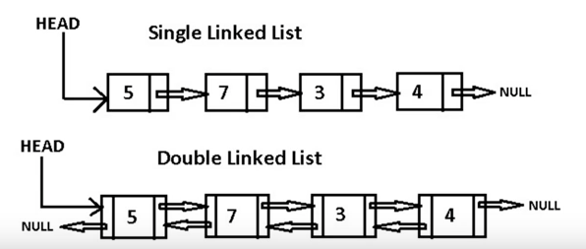
Doubly Linked Lists

Slide 28
Summary
Focused on linked lists
Studied the concepts that underlie lists
nodes
pointers
Defined major operations typical of a linked link
Node
Append
Get
Erase
Length
Display
Next session: arrays and lists
Notes:
Focused on linked lists
Studied the concepts that underlie lists
nodes
pointers
We implemented the major operations that occur on these types of list and saw how their worst case running times compare
Next arrays and lists

Slide 29
Credits
Python Data Structures and Algorithms
by Benjamin Baka
Published by Show publisher page link if publisher pages switch is on Packt Publishing, 2017
Faure, Brian: “Python Data Structures #2: Linked List”, August 26, 2017, youtube

