Slide 1


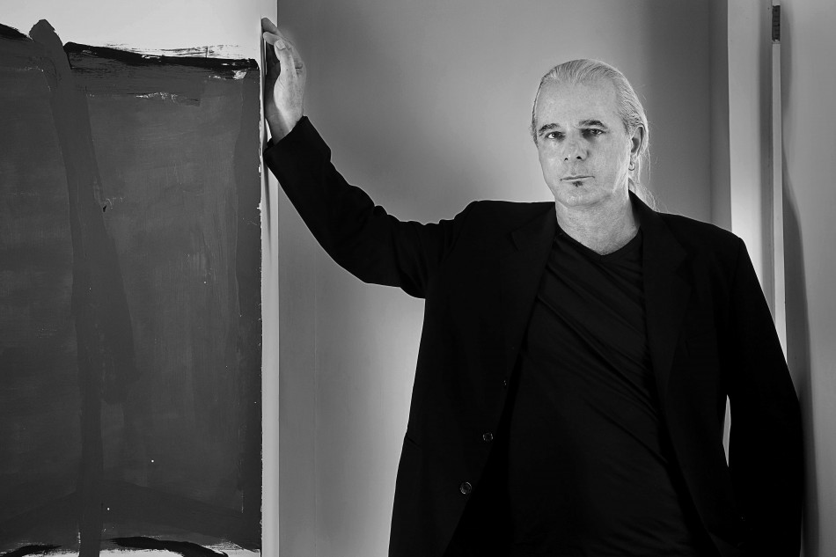
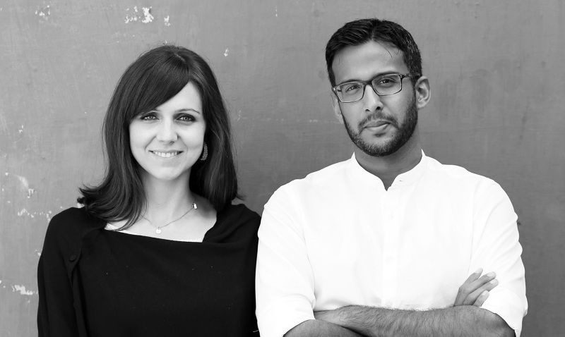












redthreadinterviews
latest interview
Dominic Dube
Principal Architect of DDIR
Watch interview
Interviews
Collective Project
Venkatesh R.
Collective Project
Étendre is primarily a selective design studio focussing on "Transformation Architecture". It is headed by its Principal Architect — Mr. Venkatesh R. Check out his discourse on the fusion of architecture with social responsibility.
Étendre is primarily a selective design studio focussing on "Transformation Architecture". It is headed by its Principal Architect — Mr. Venkatesh R. Check out his discourse on the fusion of architecture with social responsibility.
Étendre is primarily a selective design studio focussing on "Transformation Architecture". It is headed by its Principal Architect — Mr. Venkatesh R. Check out his discourse on the fusion of architecture with social responsibility.
this architect’s ecosystem includes…
Right Job
Right Candidate
Portfolio I Resume
Build your profile, Sync and publish.We take the criteria you put into your profile and search our network for perfect opportunities that match your needs based on your style location and more.
Custom recommendations for each job you post. From interns, junior architects to practised professionals, we'll recommend the right creative talent based on your style, location and more.
Meticulously curated portfolios and a comprehensive resource of project examples. Bookmark or rate your favorite portfolios to convey your interest in a firm or a candidate.
Great Projects
Inspiration
Happenings
Most Ideal platform for Freelancers. By matching your scope of work with needs of clients, we will align suitable projects for you to associate with.
Watch. Reflect. Apply.
Our exclusive interviews with acclaimed architects will give you the much-needed inspiration to push your boundaries.
A one-stop destination to keep track of various competitions, workshops and events in the city. With us, you always remain in the loop.
Listings
Materials I Services
Network
Listings of all the architectural firms Design schools — established or upcoming — in the country.
Hosting a verified list of building materials/ suppliers. Includes a database of MEP consultants for different scaled projects
Be a part of a cohesive community of architects, designers , top creative firms mentors, and contractors.
Redthread bridges the gap between
creative talent and top architecture firms
10,000+
design firms
40,000+
architect’s graduate/year
Contact
Quit wandering
Start connecting.

