Slide 1
Python Basics
Introduction to Python
Karan Balkar

Slide 2
Python!
Created in 1991 by Guido van Rossum (now at Google)
Named for Monty Python
Useful as a scripting language
script: A small program meant for one-time use
Targeted towards small to medium sized projects
Used by:
Google, Yahoo!, Youtube
Many Linux distributions
Games and apps

Slide 3
Installing Python
Windows:
Download Python from http://www.python.org
Install Python.
Run Idle from the Start Menu.
Mac OS X:
Python is already installed.
Open a terminal and run python or run Idle from Finder.
Linux:
Chances are you already have Python installed. To check, run python from the terminal.
If not, install from your distribution's package system.

Slide 4
Interpreted Languages
interpreted
Not compiled like Java
Code is written and then directly executed by an interpreter
Type commands into interpreter and see immediate results
Java:
Code
Compiler
Runtime
Environment
Computer
Python:
Code
Interpreter
Computer

Slide 5
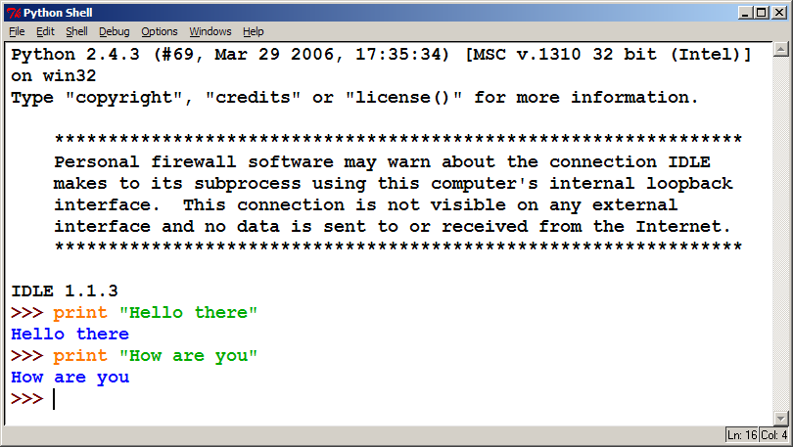
The Python Interpreter
Allows you to type commands one-at-a-time and see result

Slide 6
Our First Python Program
Python does not have a main method like Java
The program's main code is just written directly in the file
Python statements do not end with semicolons
hello.py
1 | print("Hello, world!")

Slide 7
The print Statement
print("text")
print() (a blank line)
Escape sequences such as \" are the same as in Java
Strings can also start/end with '
sample.py
1 2 3 4 | print("Hello, world!") print() print("Suppose two swallows \"carry\" it together.") print('African or "European" swallows?')

Slide 8
Comments
Syntax:
# comment text (one line)
comments.py
1 2 3 4 5 6 | # Suzy Student, CSE 142, Fall 2097 # This program prints important messages. print("Hello, world!") print() # blank line print("Suppose two swallows \"carry\" it together.") print('African or "European" swallows?')

Slide 9
Functions
Function: Equivalent to a static method in Java.
Syntax:
def name():
statement
statement
...
statement
Must be declared above the 'main' code
Statements inside the function must be indented
hello2.py
1 2 3 4 5 6 7 | # Prints a helpful message. def hello(): print("Hello, world!") # main (calls hello twice) hello() hello()

Slide 10
Whitespace Significance
Python uses indentation to indicate blocks, instead of {}
Makes the code simpler and more readable
In Java, indenting is optional. In Python, you must indent.
hello3.py
1 2 3 4 5 6 7 8 | # Prints a helpful message. def hello(): print("Hello, world!") print("How are you?") # main (calls hello twice) hello() hello()

Slide 11
Data Types
Strings
#This is a string
name = "Foo bar (that\"s me)"
#This is a multiline string
multiline = '''You can find me online
on sites like Twitter and Github'''

Slide 12
Data Types
Numbers
#Integer numbers
year = 2010
year = int("2010")
# Floating point numbers
pi = 3.14159265
#Fixed point numbers
from decimal import Decimal
price = Decimal("0.02")

Slide 13
Data Types
Null
optional_data = None
Lists
numbers = [1,2,3,4,5]
len(numbers)
numbers[0]
numbers[0:2]
numbers[2:]

Slide 14
Data Types
Dictionary
person = { 'name': 'John', 'age': 30 } person['name']
person.keys() person.values()
Boolean
is_Available = True

Slide 15
Control Flows
If-elif-else statements
grade = 82
if grade >= 90:
if grade == 100:
print("A+")
else:
print("A")
elif grade >= 80:
print("B")
elif grade >= 70:
print("C")
else:
print("F")

Slide 16
Control Flows
For loops
for x in range(10):
print(x)
Expanded For loops
for key, value in states.items():
print (key,value)
While loops
x=0
while x < 100:
print(x)
x += 1

Slide 17
Break & Continue
for num in range(0,10):
if num == 5:
break
print(f'Iteration: {num}')
Output
Iteration: 0
Iteration: 1
Iteration: 2
Iteration: 3
Iteration: 4

Slide 18
Break & Continue
for num in range(0,10):
if num == 5:
continue
print(f'Iteration: {num}')
Output
Iteration: 0
Iteration: 1
Iteration: 2
Iteration: 3
Iteration: 4
Iteration: 6
Iteration: 7
Iteration: 8
Iteration: 9

Slide 19
Pass
for num in range(0,10):
if num == 5:
pass
print(f'Iteration: {num}')
Output
Iteration: 0
Iteration: 1
Iteration: 2
Iteration: 3
Iteration: 4
Iteration: 5
Iteration: 6
Iteration: 7
Iteration: 8
Iteration: 9

Slide 20
Assignment
Write a program to implement Fibonacci series in Python
Write a program to print all the prime numbers in a given range.

Slide 21
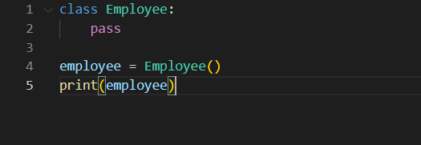
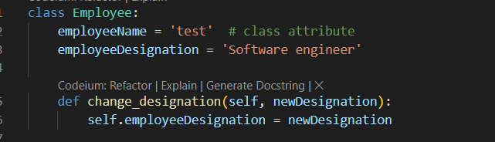
Classes & Objects
A class is a code template for creating objects. Objects have member variables and have behaviour associated with them. In python a class is created by the keyword class.
Attributes and Methods in class

Slide 22
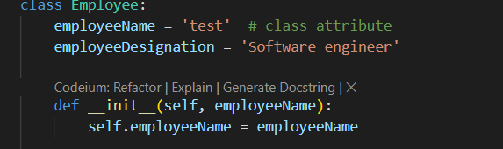
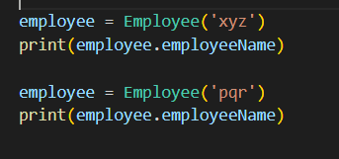
init method
init method can be used to provide values for the attributes at runtime. The following example illustrates this:
Output
xyz
pqr

Slide 23
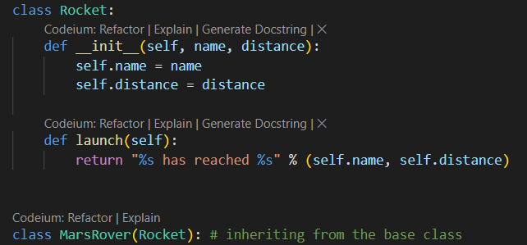
Inheritance
Inheritance allows us to define a class that inherits all the methods and properties from another class.
Parent class is the class being inherited from, also called base class.
Child class is the class that inherits from another class, also called derived class.

Slide 24
Assignment
Write a program to implement inheritance using Python

Slide 25
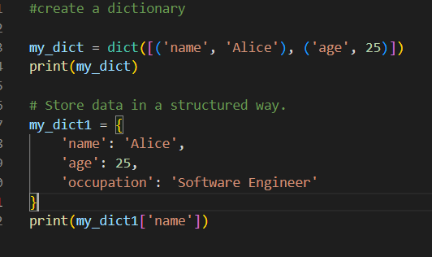
Dictionaries & Sets
Python offers several built-in data structures like tuples, sets, and dictionaries.
A dictionary is an ordered collection of key-value pairs. Imagine a real-life dictionary where you look up a word (the key) to find its definition (the value). Similarly, you use a key in a Python dictionary to retrieve its corresponding value.

Slide 26
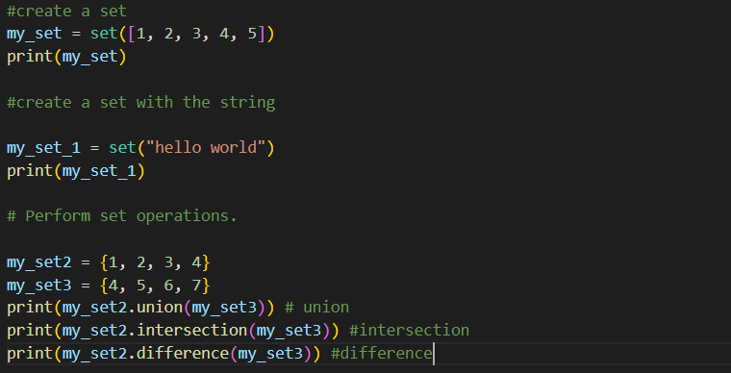
Dictionaries & Sets
Python offers several built-in data structures like tuples, sets, and dictionaries.
A set is an unordered collection of unique elements. Think of it as a bag where you can throw in items, but each item can exist only once. But if you try to add a duplicate, python will simply ignore it.

Slide 27
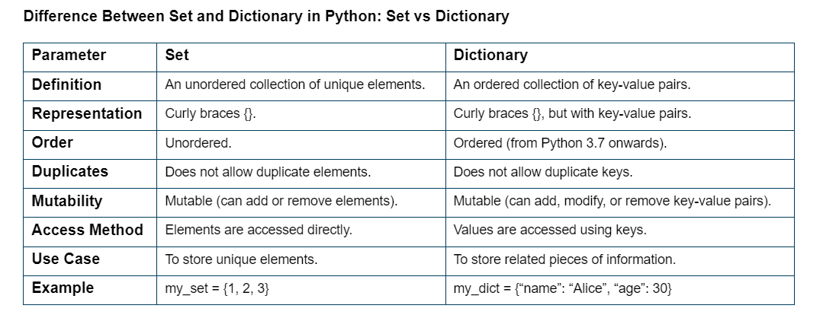
Dictionary V/s Set

Slide 28
Key features
Key Features of Set in Python
Unordered: The elements in the set are unordered, i.e., elements are not in a specific order.
Mutable: You can add or delete elements from a set.
No Duplicate: Sets automatically remove duplicate elements.
Representation: Represented by curly ({}) braces.
Key Features of Dictionaries
Key-Value Pairs: Each entry in a dictionary consists of a key and its associated value.
Ordered: Since Python 3.7, dictionaries maintain the order of insertion.
Mutable: You can modify a dictionary by adding or removing key-value pairs after its creation.
Unique Keys: While values can be duplicated, each key in a dictionary must be unique.
Representation: Dictionaries also use curly braces {} but with key-value pairs.

Slide 29
Operations using Dictionary
get(): Get the value associated with a key. The default value is returned if the key is not present in the dictionary.
items(): Return a list of key-value pairs in the dictionary.
keys(): Return a list of keys in the dictionary.
values(): Return a list of values in the dictionary.
update(): Update the dictionary with a new set of key-value pairs.
clear(): Remove all key-value pairs from the dictionary.

Slide 30
Operations using Set
add(): Add an element to the set.
remove(): Remove an element from the set.
discard(): Remove an element from the set, but only if it is present.
clear(): Remove all elements from the set.
union(): Return a new set containing the union of two sets’ elements.
intersection(): Return a new set containing the intersection of two sets’ elements.
difference(): Return a new set that contains the difference of the elements of two sets.
issubset(): Return True if the first set is a subset of the second set; otherwise, return False.
issuperset(): Return True if the first set is a superset of the second set; otherwise, return False.

Slide 31
Assignment
Write a program to implement web scraping and display list of unique URL’s using Python.
Note: Sets can be used to remove duplicate elements from a list of URLs to scrape or to find the unique elements in a list of scraped data.

Slide 32
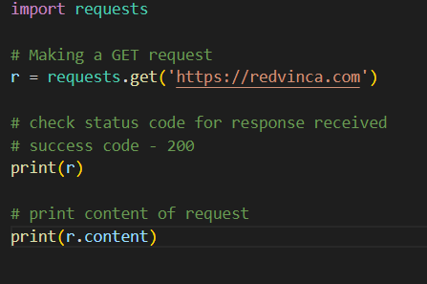
Networking in Python
The requests module allows you to send HTTP requests using Python.
The HTTP request returns a Response Object with all the response data (content, encoding, status, etc.)
Command to install module:
pip install requests

Slide 33
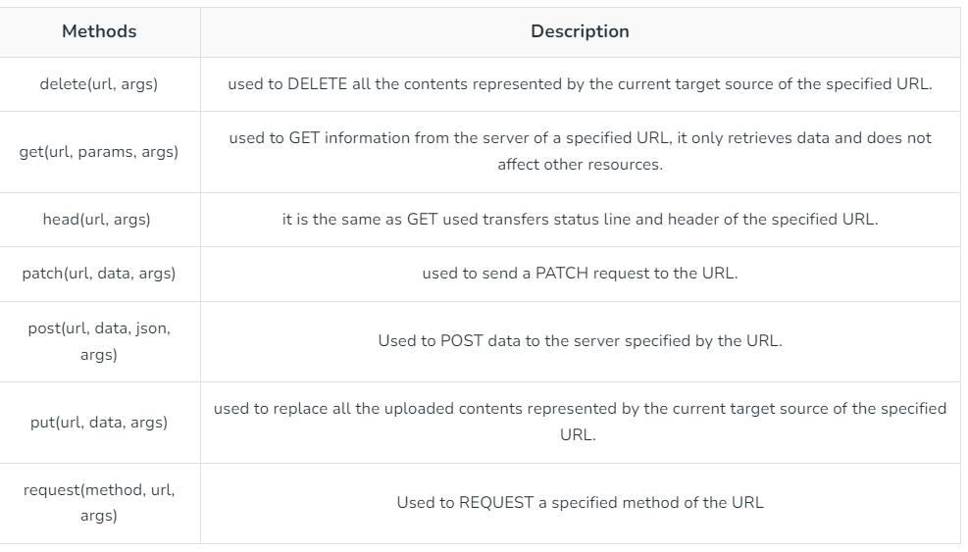
HTTP Methods

Slide 34
Calling REST APIs
https://fakestoreapi.com/docs
HTTP GET
HTTP GET (with params)
HTTP POST
HTTP PUT
HTTP DELETE

Slide 35
Assignment
Write a program to call ShoppingCart backend API’s using Python
Note: APIs are already developed in Java backend project repo

Slide 36
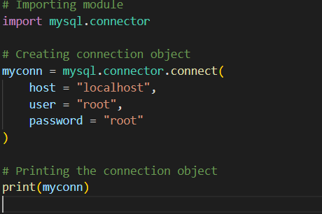
Database connectivity
MySQL Connector/Python enables Python programs to access MySQL databases, using an API that is compliant with the Python Database API Specification.
Install the following module
pip install mysql-connector-python

Slide 37
Querying the database
Use the cursor() method
Use the cursor() method of a MySQLConnection object to create a cursor object to perform various SQL operations.
Use the execute() method.
The execute() methods run the SQL query and return the result.
Extract result using fetchall()
Use cursor.fetchall() or fetchone() or fetchmany() to read query result.
Close cursor and connection objects.
use cursor.close() and connection.close() method to close open connections after your work completes.

Slide 38
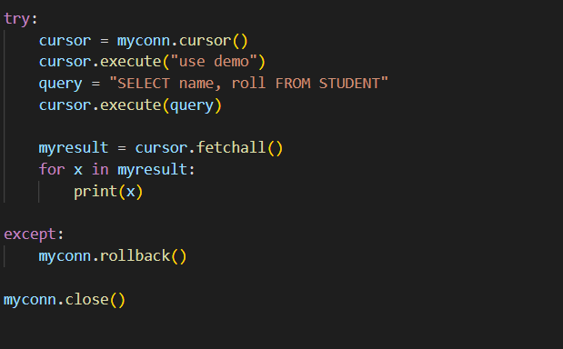
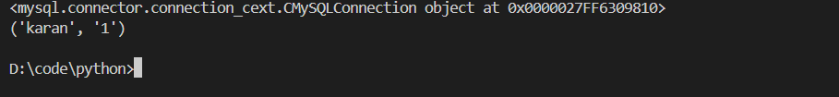
Running queries

Slide 39
Assignment
Write a program to implement backend database CRUD operations in Python
Note: APIs are already developed in Java backend project repo

Slide 40
Python Frameworks
Django
ORM (Object-Relational Mapping) for database interactions
Built-in admin interface for quick backend management
Robust security features, including protection against SQL injection, cross-site scripting, and CSRF
URL routing system for clean, SEO-friendly URLs
Template engine for dynamic HTML generation
Extensive documentation and large community support
Flask
Lightweight and easy to get started
Jinja2 templating engine for dynamic content
Built-in development server and debugger
RESTful request dispatching
Extensive documentation and active community

Slide 41
Flask Framework
Flask is a lightweight Python web framework that provides useful tools and features for creating web applications in the Python Language. It gives developers flexibility and is an accessible framework for new developers because you can build a web application quickly using only a single Python file. Flask is also extensible and doesn’t force a particular directory structure or require complicated boilerplate code before getting started.

Slide 42
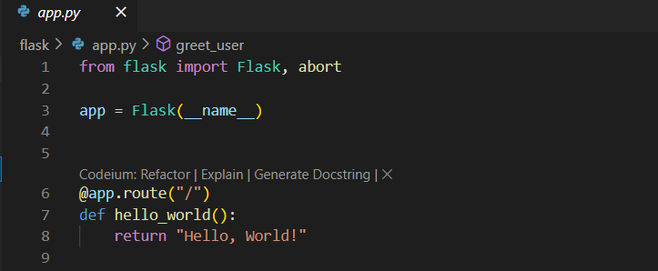
Flask Framework
Step 1: Create virtual environment
py -3 -m venv venv
Step 2: Activate scripts
venv\Scripts\activate
Step 3: Install the following module
pip install Flask

Slide 43
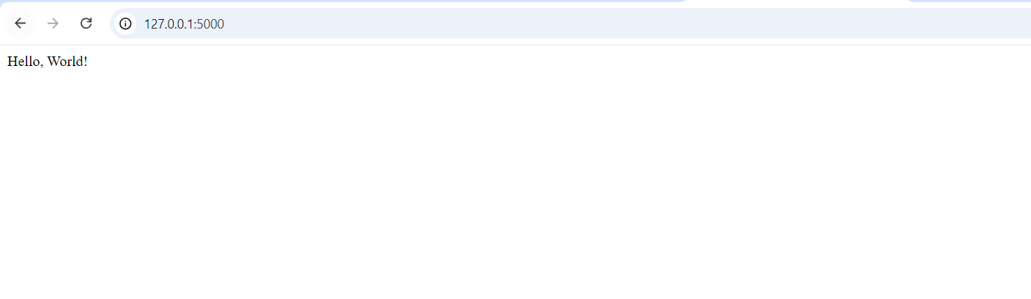
Running the app
Step 4: Setting Flask environment variables
set FLASK_APP=app.py
set FLASK_ENV=development
Step 5: Run the app
flask run
Step 6: Open browser to view output

Slide 44
Assignment
Write a program to implement ShoppingCart backend APIs using Flask framework

