Slide 1
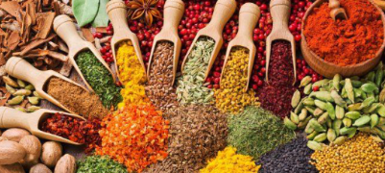
Lab1. Unsupervised Learning
Max Kovalchuk, MI-4

Slide 2
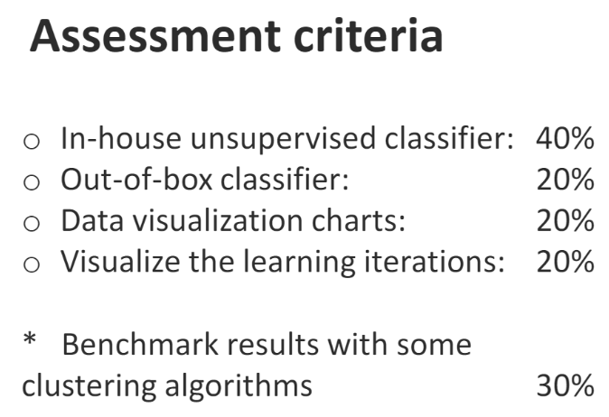
Content
1. In-house unsupervised classifiers:
1.1. Data visualization (PCA)
1.2. Comparison of results (benchmark)
2. Out-of-box classifier: hierarchical clustering
3. Visualizing iterations of Kometa K-Means (Slow K-Means)
https://github.com/reeWorlds/ML_S4_labs/tree/main/Lab1

Slide 3
In-house unsupervised classifiers
Library: sklearn
K-Means
Mean Shift
DBSCAN
OPTICS
Spectral clustering
BIRCH

Slide 4
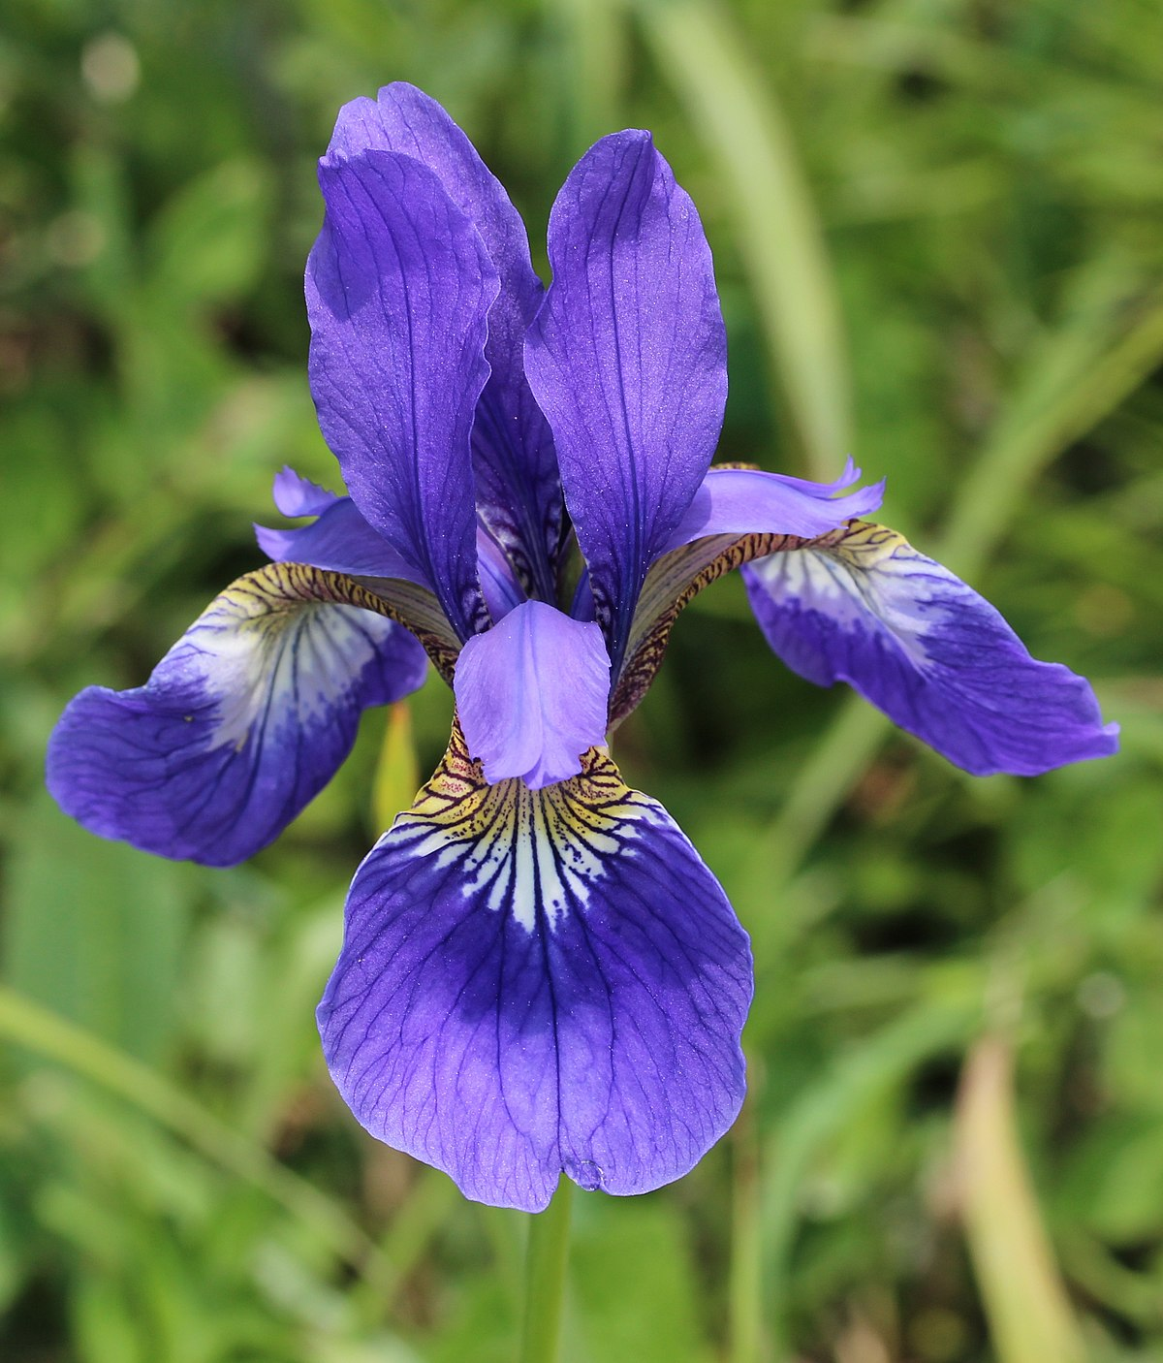
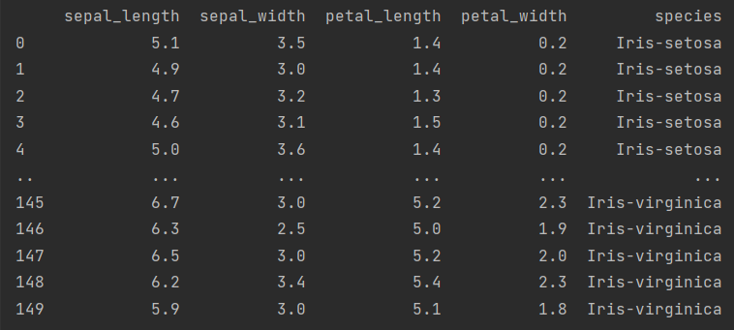
Dataset
Iris dataset:
3 clusters, 50 elements each
4 dimensions of float values

Slide 5
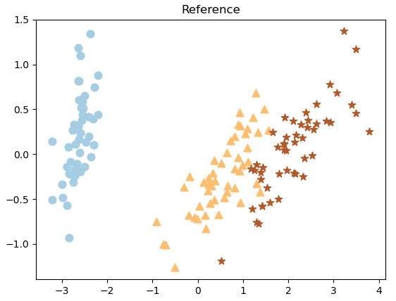
Dataset (PCA)
Color – algorithm clusters Marker - reference

Slide 6
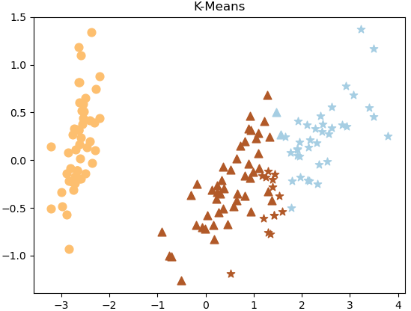
K-Means
Color – algorithm clusters Marker - reference

Slide 7
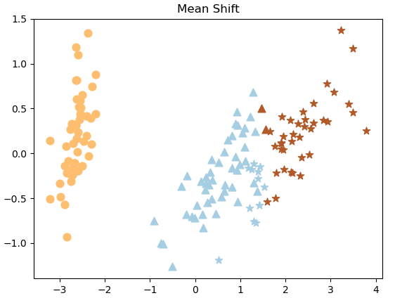
Mean Shift
Color – algorithm clusters Marker - reference

Slide 8
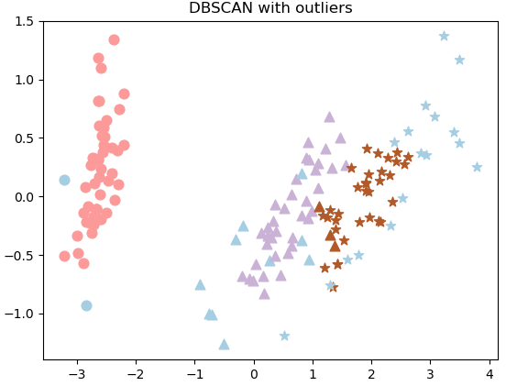
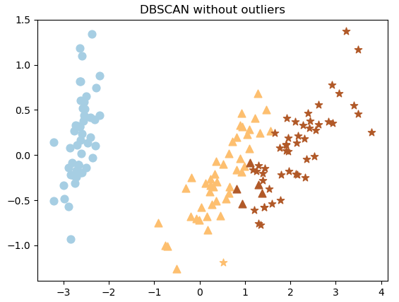
DBSCAN
Color – algorithm clusters Marker - reference

Slide 9
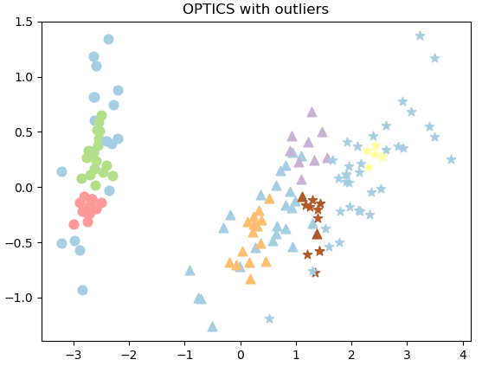
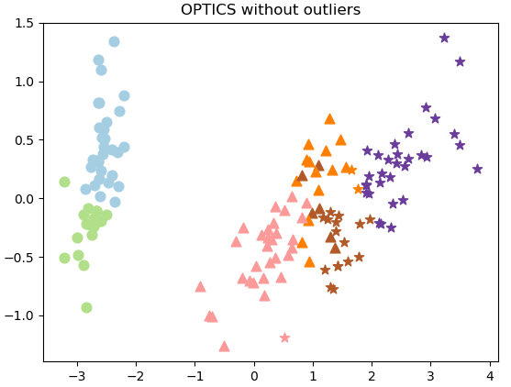
OPTICS
Color – algorithm clusters Marker - reference

Slide 10
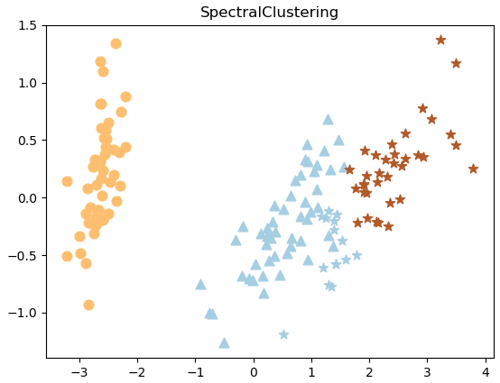
Spectral clustering
Color – algorithm clusters Marker - reference

Slide 11
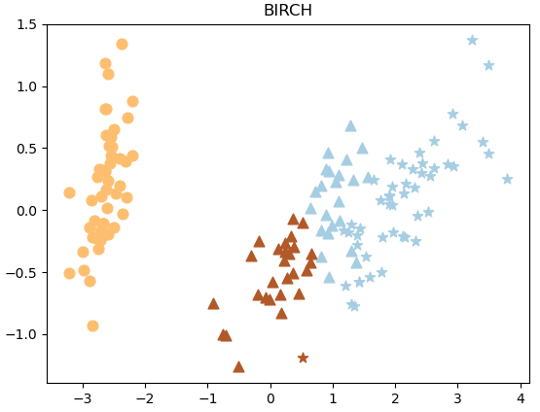
BIRCH
Color – algorithm clusters Marker - reference

Slide 12
Results comparison
Name | Homogeneity | Completeness | V measure
KMeans | 0.751 | 0.764 | 0.758
Mean Shift | 0.760 | 0.771 | 0.766
DBSCAN | 0.869 | 0.871 | 0.870
OPTICS | 0.858 | 0.535 | 0.659
Spectral Clustering | 0.786 | 0.809 | 0.797
BIRCH | 0.700 | 0.745 | 0.722

Slide 13
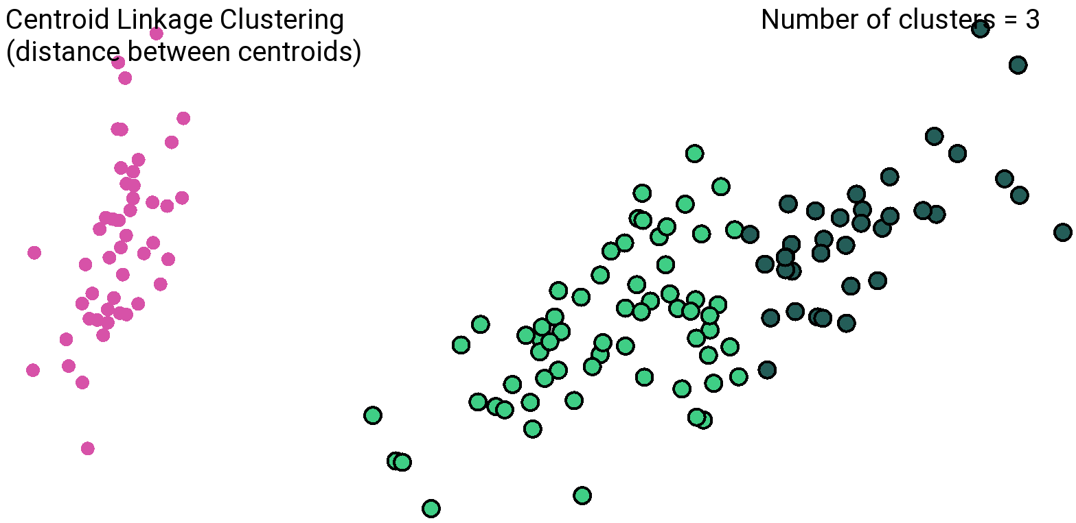
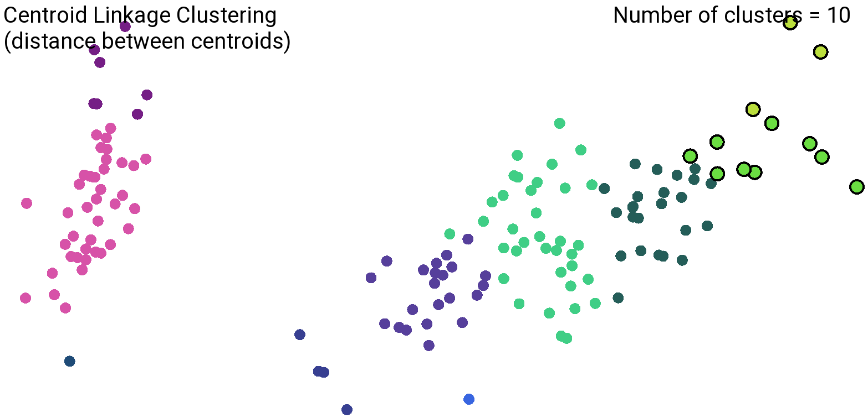
Out-of-box classifier
Hierarchical clustering

Slide 14
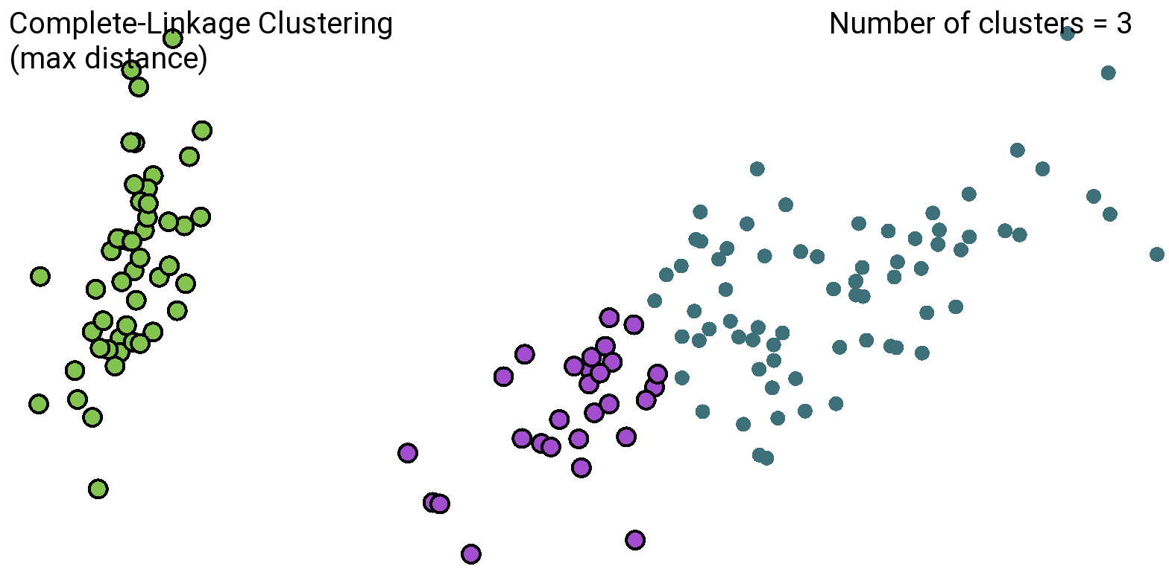
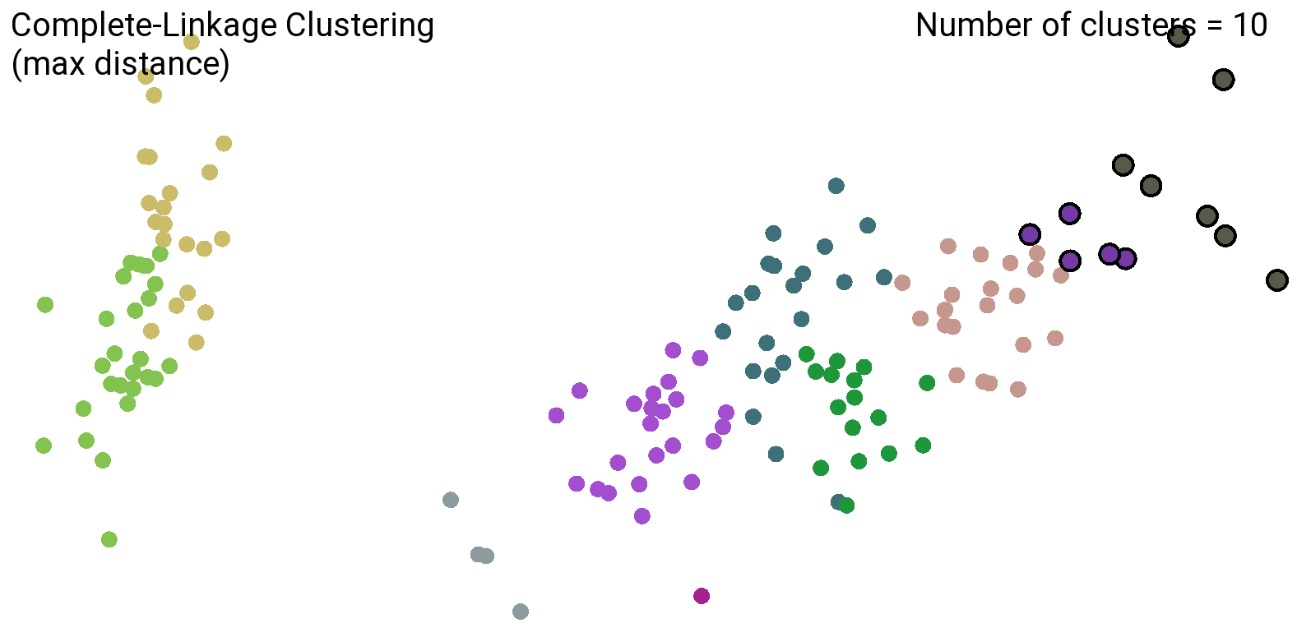
Out-of-box classifier
Hierarchical clustering

Slide 15
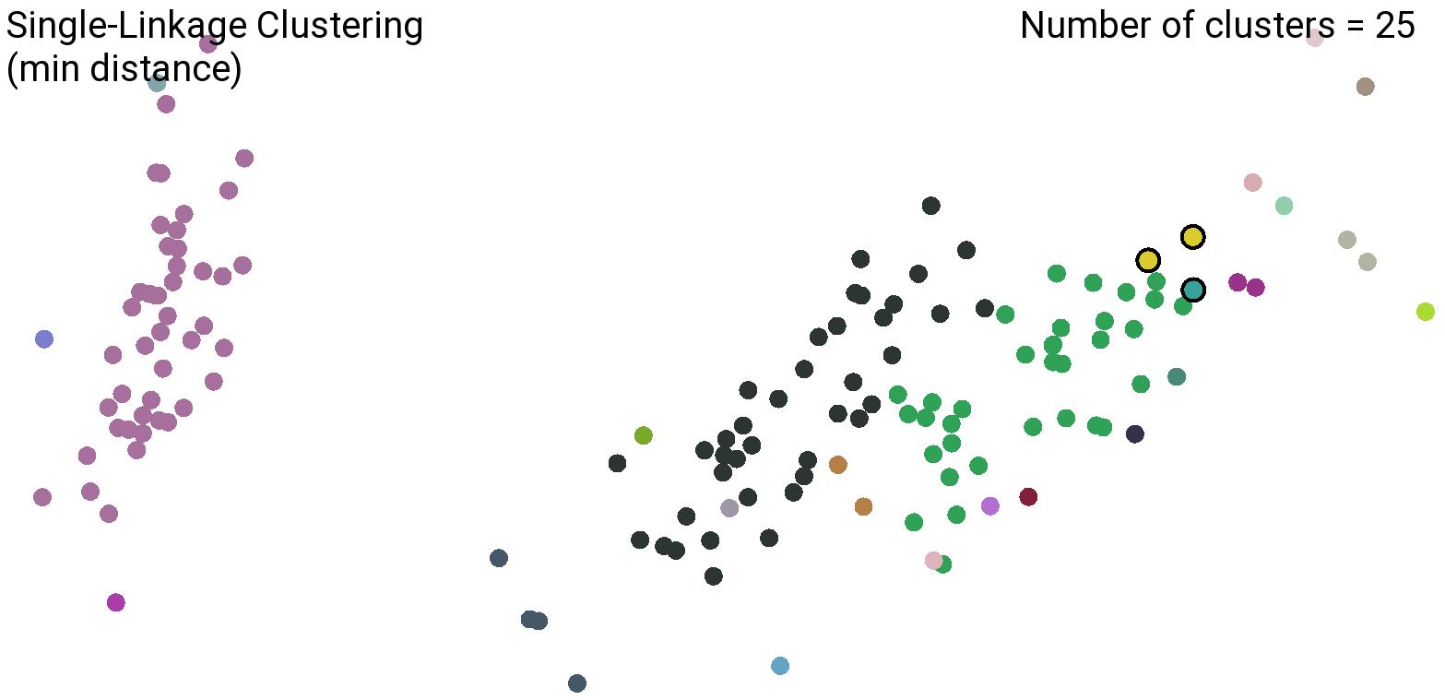
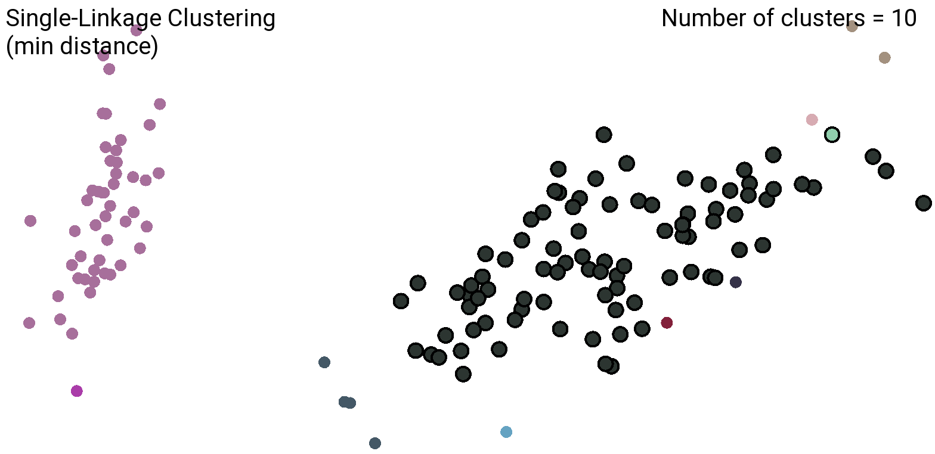
Out-of-box classifier
Hierarchical clustering

Slide 16
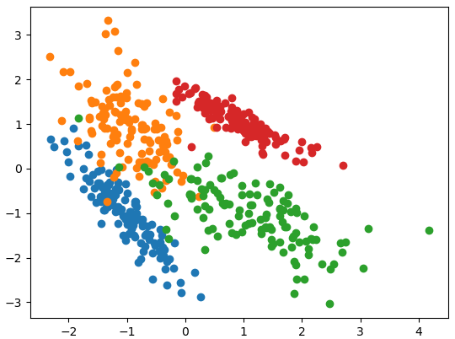
Visualizing iterations of Kometa K-Means
(Slow K-Means)

Slide 17
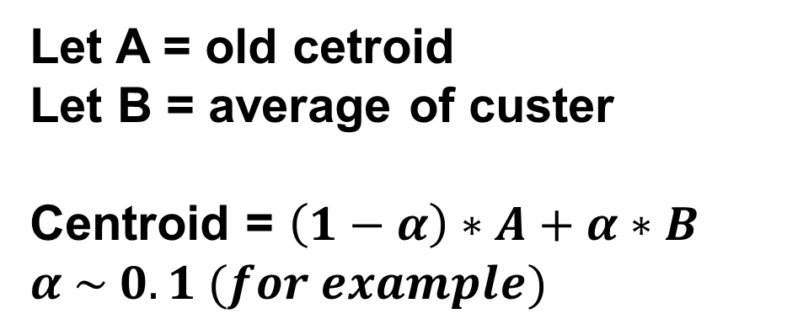
Visualizing iterations of Kometa K-Means
(Slow K-Means)
K-Means
Kometa K-Means
Let A = old cetroid
Let B = average of custer
Centroid = $\left(1−α\right)∗A+α∗B$
$$α \sim 0.1 (for example)$$
Centroid = average of custer
Algorithm slower than original K-Means
Centroids move smoothly

Slide 18
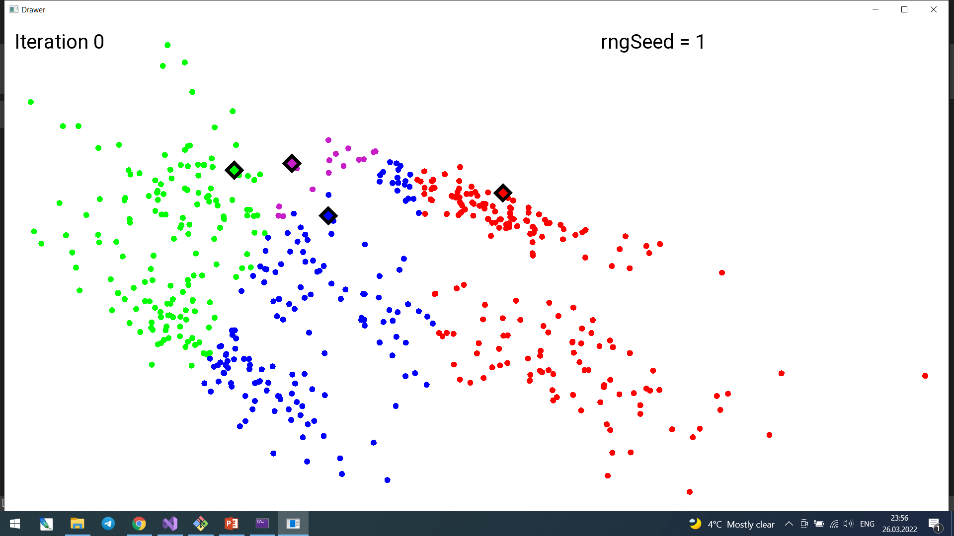
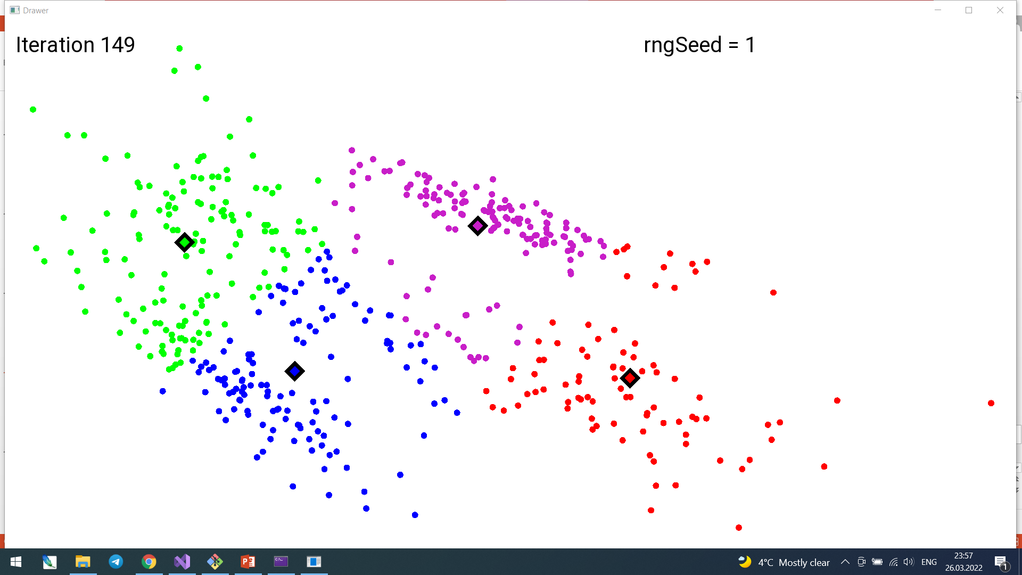
Visualizing iterations of Kometa K-Means
(Slow K-Means)
https://youtu.be/HJFb86L-Nsg

