Slide 1
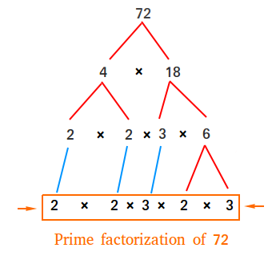
LENSTRA BASED PARALLEL
FACTORIZATION ALGORITHM

Slide 2
FACTORIZATION ALGORITHM
GET FACTOR OF A NUMBER
CHECK IF NUMBER IS PRIME
Lenstra elliptic
curve factorization
Miller-Rabin primality test

Slide 3
LENSTRA ALGORITHM
Can answer for the query “give factor of a number” with some probability (or fail)
Requires random initialization
Queries are independent
Can be very well paralleled:
Do not require much data transition between threads
Heavy queries
Allows decrease factorization time almost linearly to number of threads

Slide 4


PROGAM STRUCTURE
C++ std::thread’s
MPI Threads
Communicator thread #1
Worker thread #1
main thread #0
common memory
Communicator thread #2
Worker thread #2
Communicator thread #3
Worker thread #3
$$…$$
$$…$$
Main thread #0
MPI Thread
Communicator thread #n
Worker thread #n

