Slide 1
Midterm2- review-homework

Slide 2
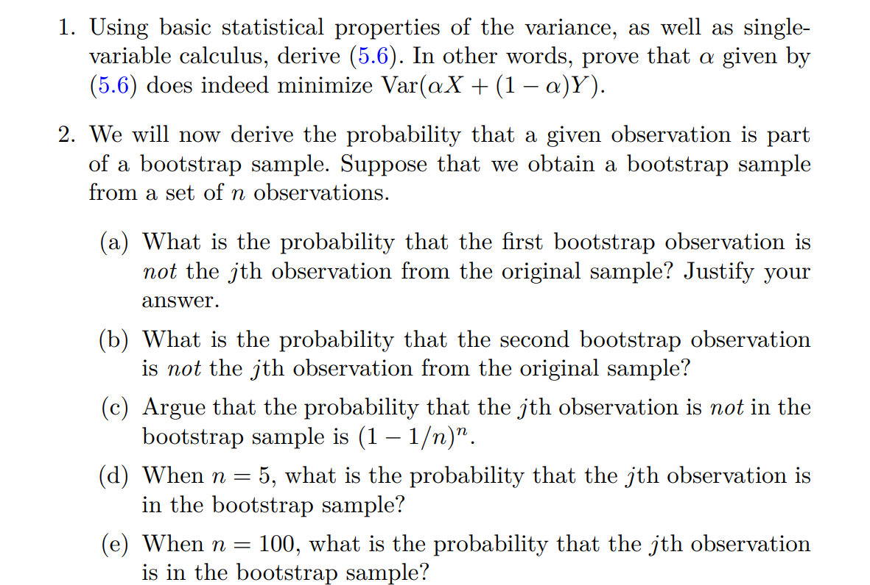

Hw 6: 5.4.1, 5.4.2

Slide 3
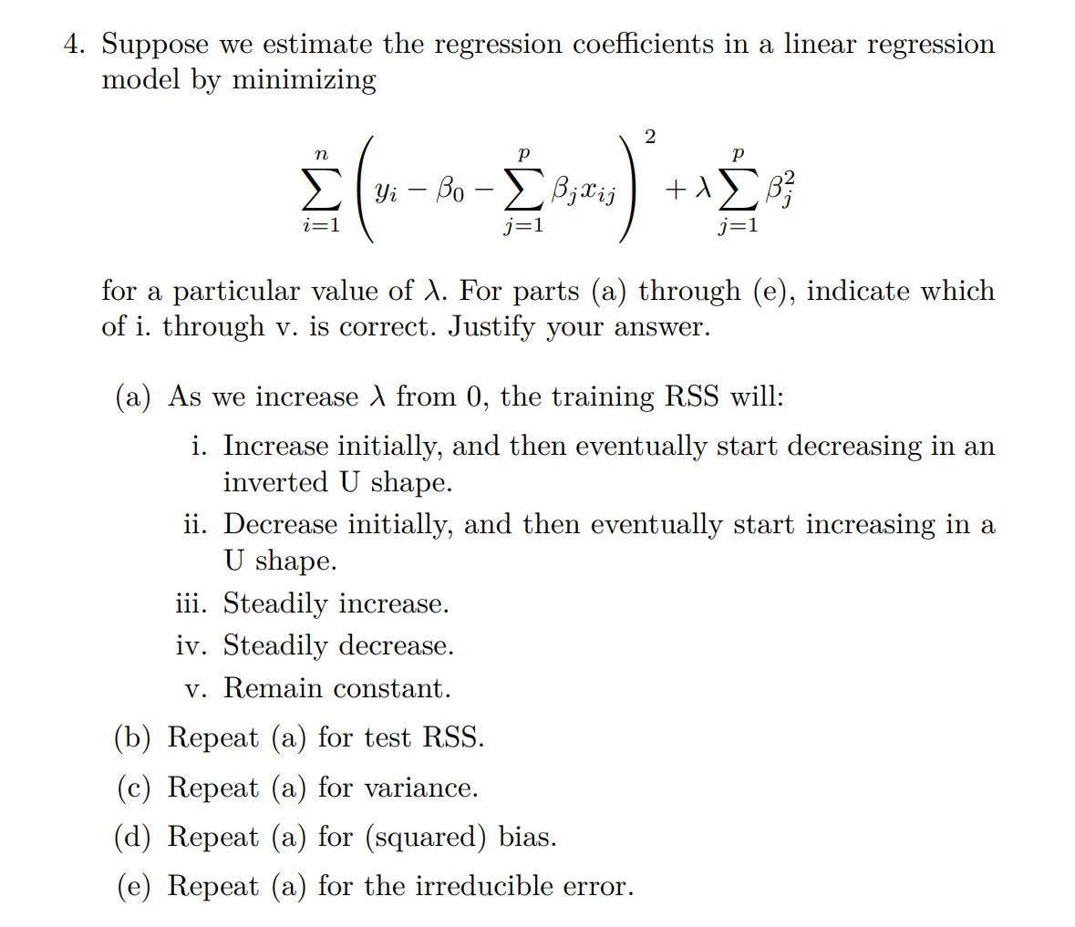
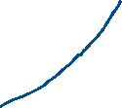









Hw 7: 6.6.4

Slide 4
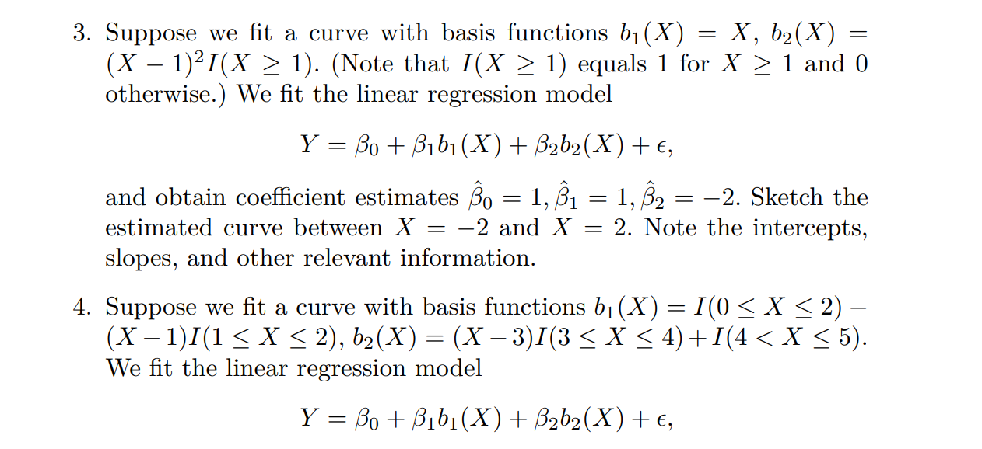




Hw 8: 7.9.3,7.9.4

Slide 5
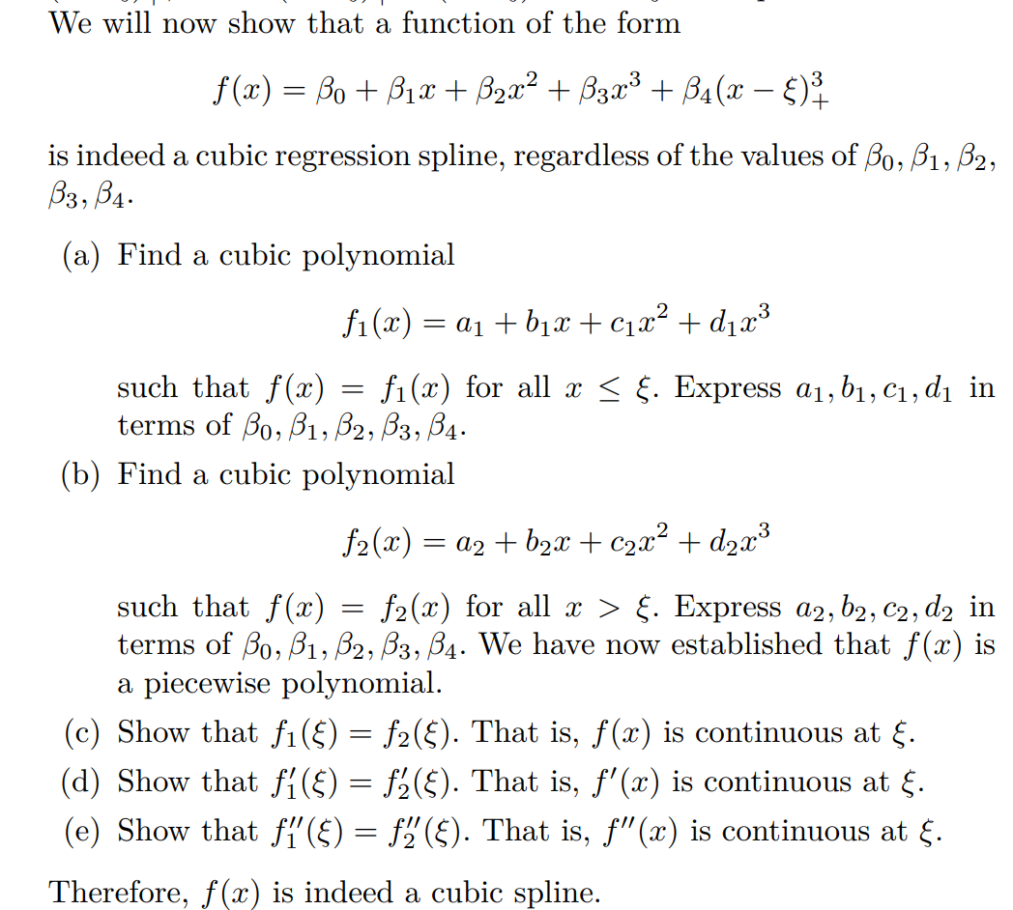
Hw 9: 7.9.1(a)-(e)

Slide 6
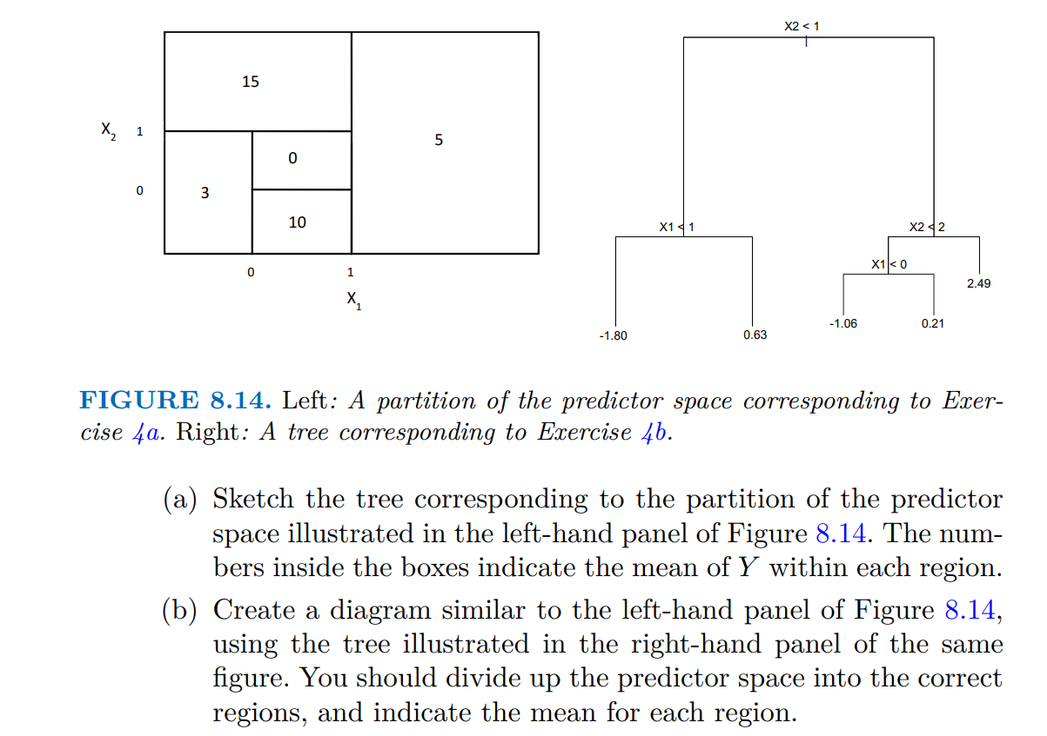





Hw 9: 8.4.4 (a),(b)

Slide 7




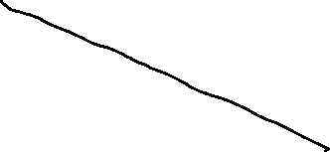

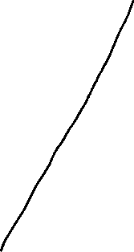



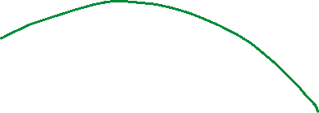

Hw10: 9.7.1

Slide 8
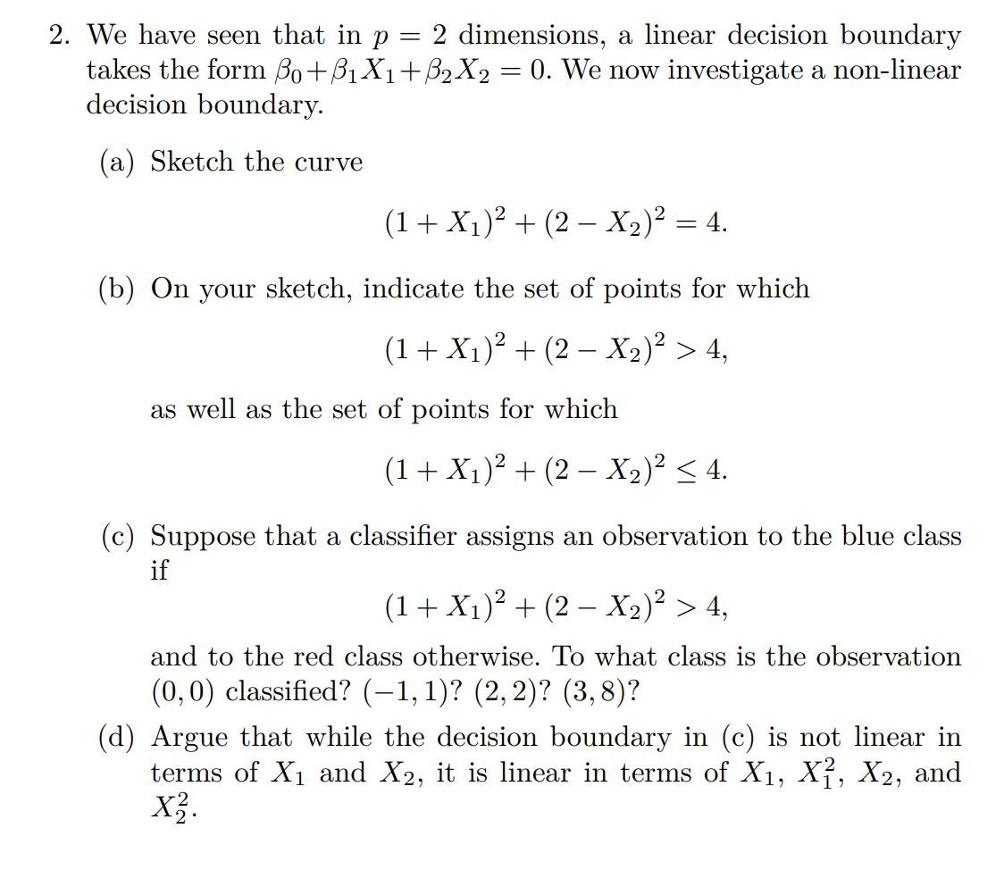

Hw10: 9.7.2

Slide 9
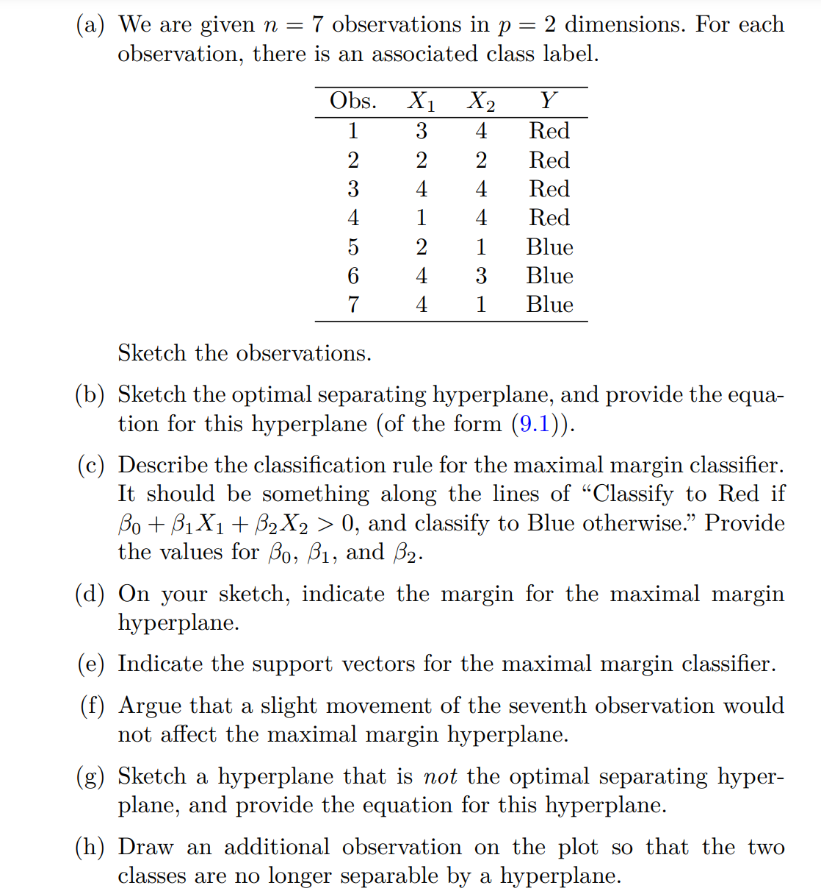







Hw10: 9.7.3

Slide 10






Hw11: 10.10.4

