Slide 1
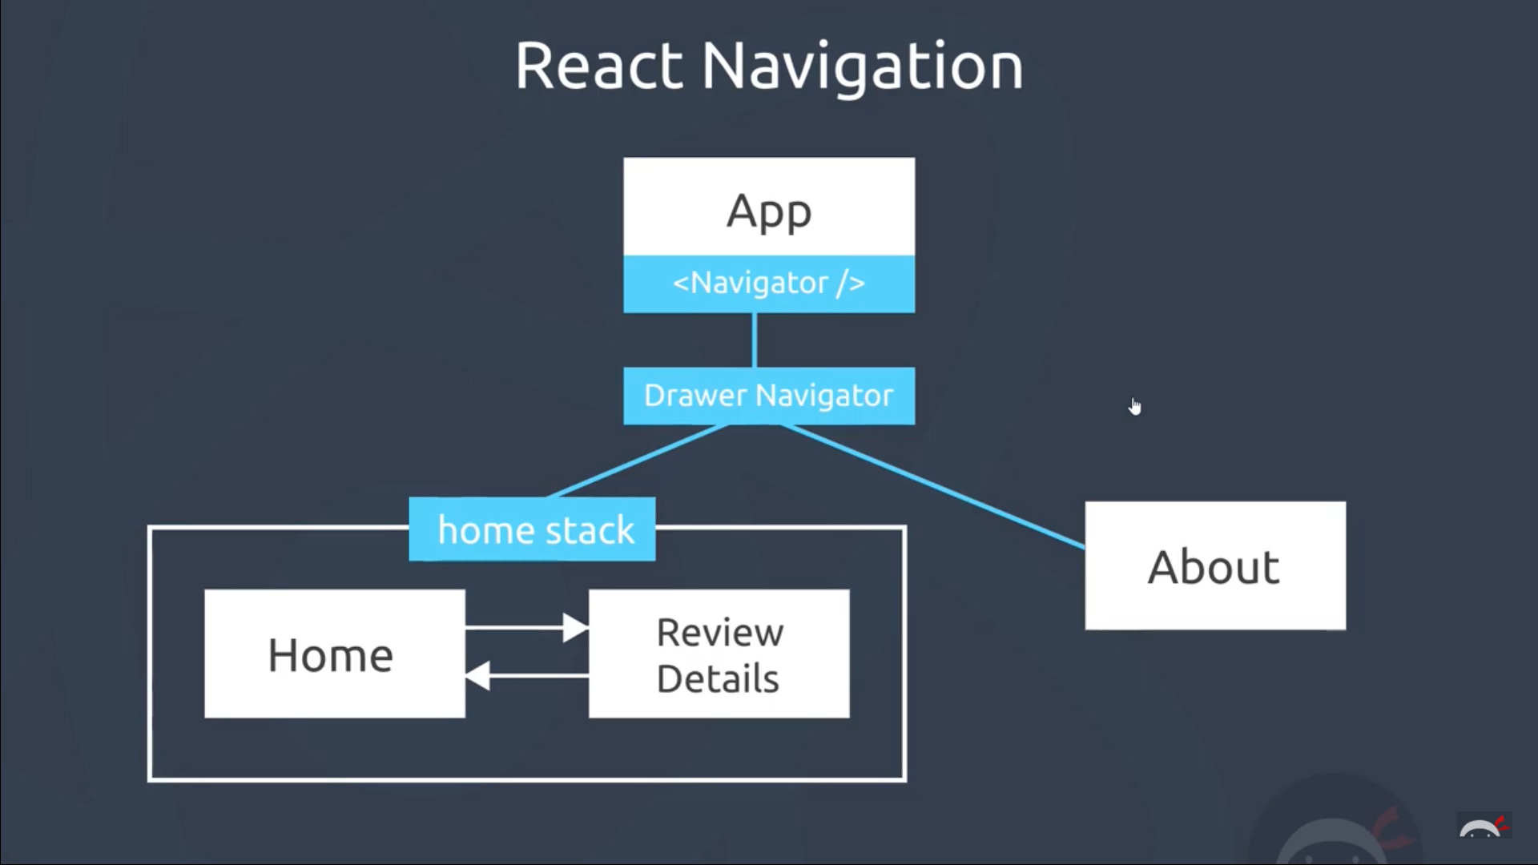
Drawer + Stack
App.js
Drawer Navigator
HomeStack
AboutStack
Home Screen
About Screen
Blank Screen
Review Details Screen

Slide 2
Drawer + Tab + Stack
1. App calls Drawer
2. Drawer calls Tab
3. Tab calls Stack
4. Stack calls screens
App.js
Drawer Navigator
Tab Navigator
HomeStack
AboutStack
Home Screen
About Screen
Blank Screen
Review Details Screen

