Slide 1
Noodles Crypto Analytics Platform
End-to-End Data Pipeline with Python & Power BI
Reece Gow
September 2026

Slide 2
Executive Summary
What: Automated cryptocurrency and social-engagement analytics pipeline
Why: Turn raw market and social data into reliable, decision-ready insights
How: Python ETL + MySQL star schema + SQL analytical views + Power BI
Output: Interactive dashboards covering token performance, platforms, trends and executive insights
Impact: Faster repeatable analysis with automated aggregation, validation and reporting

Slide 3
Business Problem
Challenge: Manual crypto and social-engagement analysis is time-consuming and difficult to repeat consistently.
Need: A reliable, automated and scalable analytics solution.
Users: Executives, analysts and decision-makers.
Problem: Raw JSON data sits across multiple sources and needs cleaning, validation, aggregation and modelling before it becomes useful.
Success Metric: Deliver clear, daily, decision-ready insights through Power BI.

Slide 4
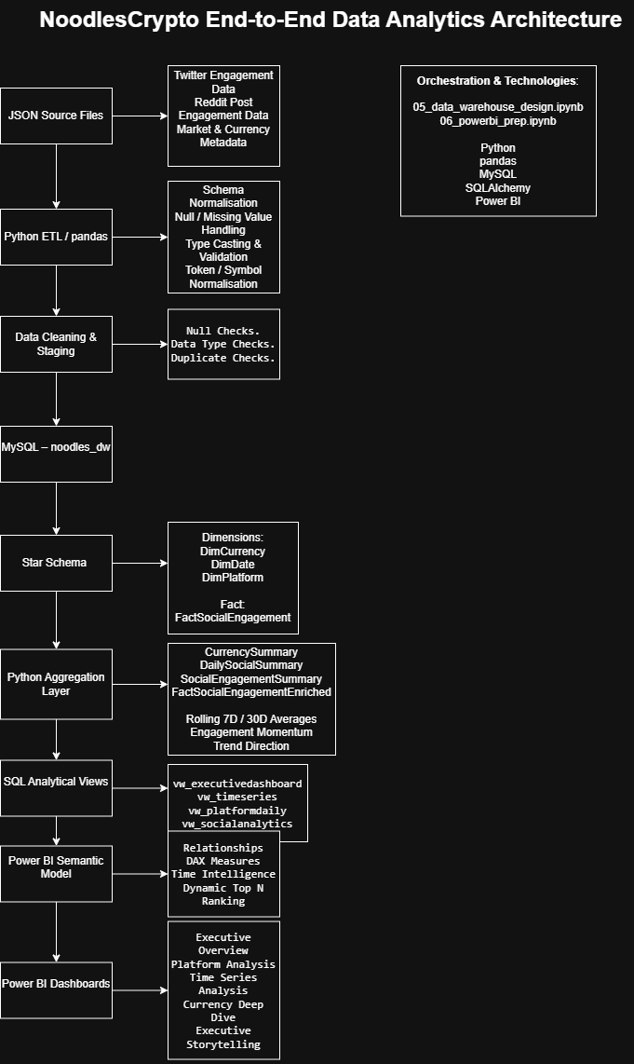
Technical Architecture
Tech: Python, pandas, SQLAlchemy, MySQL, Power BI
Flow: JSON → Staging → Star Schema → Aggregations → SQL Views → Dashboards
Automation: Jupyter-based ETL + scheduled refresh
Model: DimCurrency, DimDate, DimPlatform, FactSocialEngagement

Slide 5
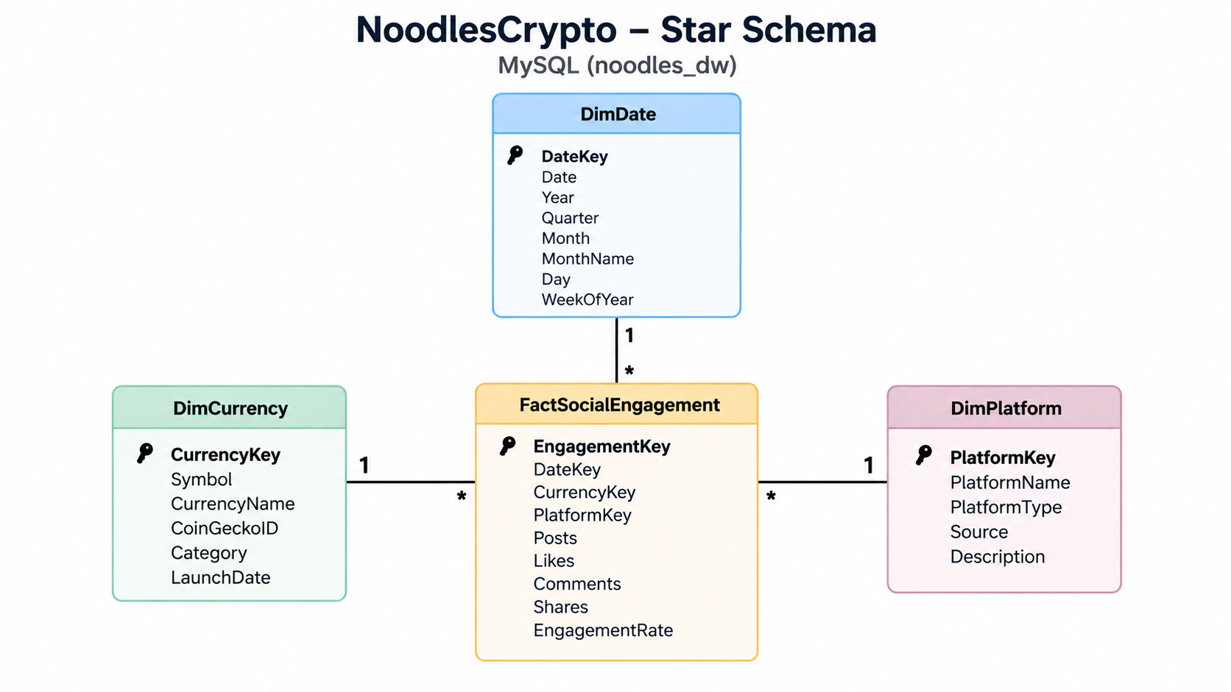
Data Model
Schema: Star schema in MySQL noodles_dw
Dimensions: DimCurrency, DimDate, DimPlatform
Fact Table: FactSocialEngagement
Purpose: Separate descriptive dimensions from engagement measures for cleaner analysis
Benefits: Simpler relationships, better Power BI performance, reusable time intelligence
Grain: Social-engagement records linked to currency, date and platform

Slide 6
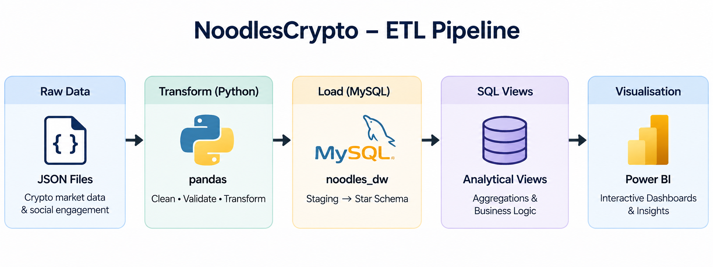
Python ETL Pipeline
Extract: Load raw JSON source files
Transform: Clean, normalise and validate data with pandas
Load: Write validated data into MySQL noodles_dw
Features: Error handling, logging, null checks, duplicate checks
Output: Aggregation tables and Power BI-ready SQL views
Monitoring: Validation cells + ETL logs

Slide 7
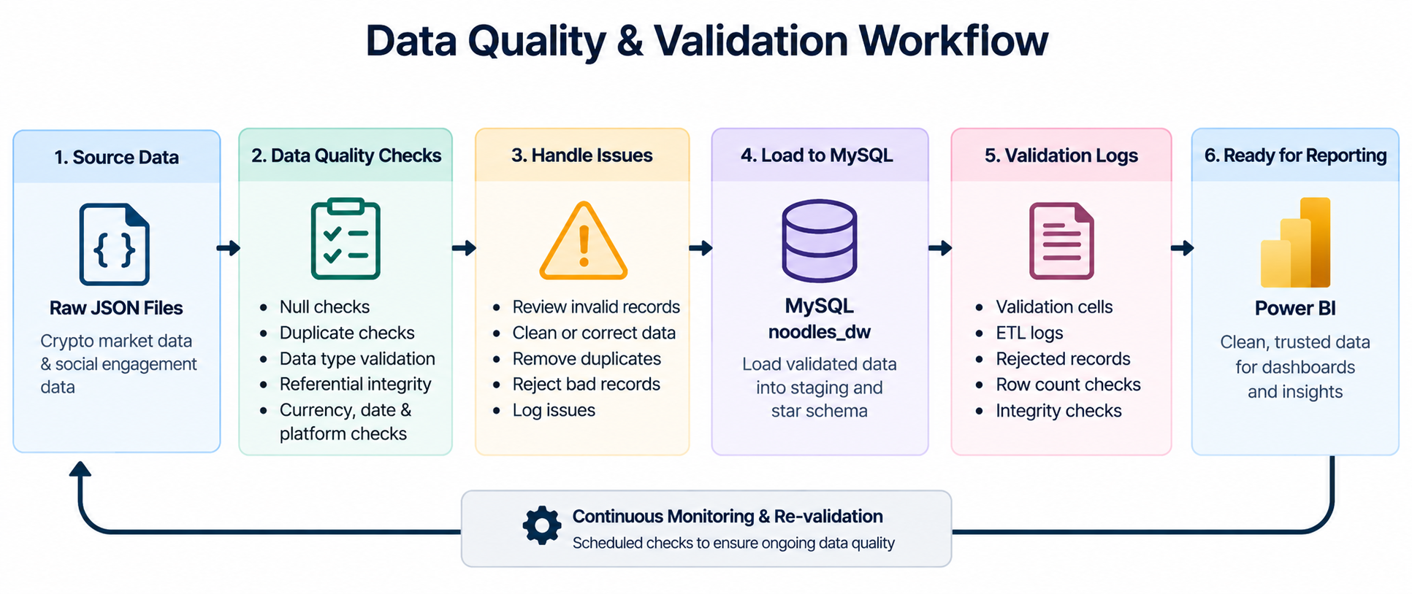
Data Quality & Validation
Checks: Nulls, duplicates, data types and referential integrity
Validation: Currency, date and platform relationships checked before reporting
Reject Handling: Invalid records reviewed before loading
QA: Re-run validation cells in 06_powerbi_prep.ipynb
Expected Result: No orphaned records, expected row counts, integrity checks pass
Purpose: Prevent bad data from reaching Power BI

Slide 8
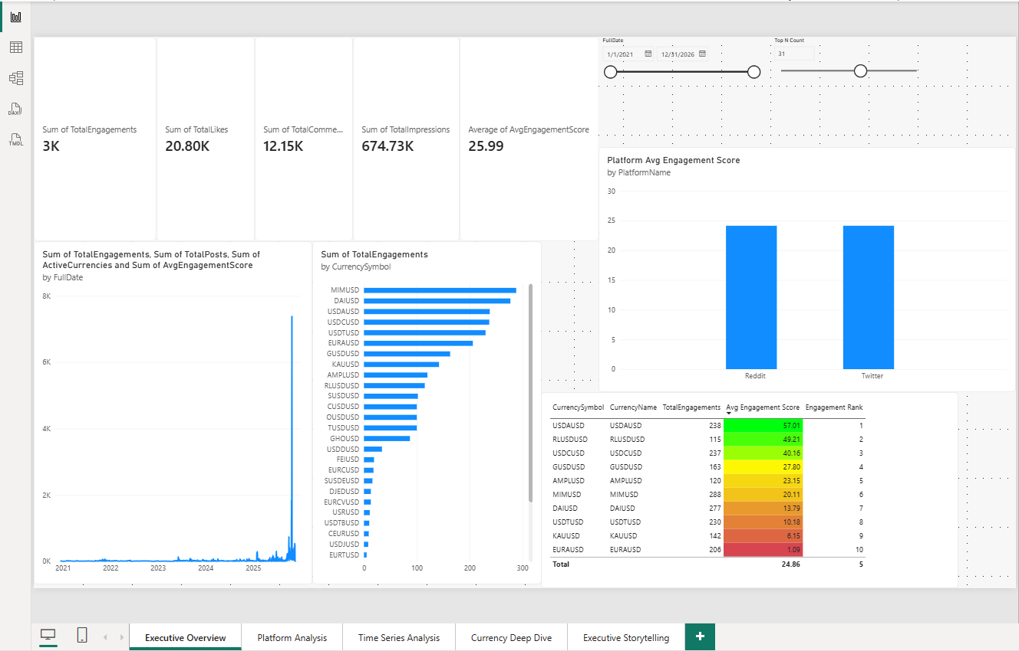
Power BI Executive Dashboard
KPIs: Total Engagements, Avg Engagement Score, Recent Engagement, MoM Change
Features: Interactive slicers, cross-filtering, drill-through and bookmarks
Views: Executive Overview, Platform Analysis, Time Series, Currency Deep Dive, Executive Storytelling
Analysis: Token performance, platform comparison and historical trends
Purpose: Turn cleaned warehouse data into decision-ready executive insights

Slide 9
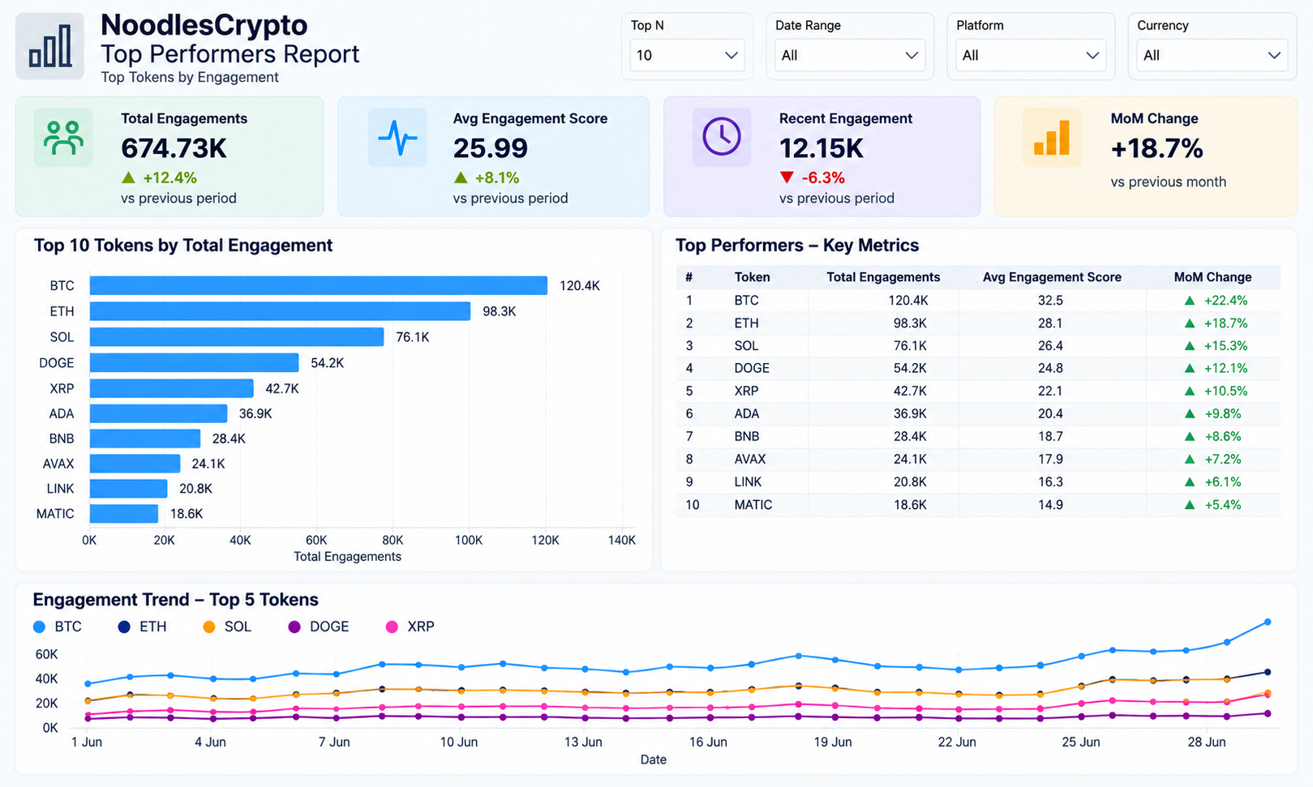
Top Performers Report
Focus: Identify the strongest-performing tokens by engagement
Ranking: Uses token engagement rank and Dynamic Top N
Filters: Top N selection lets users control how many tokens are shown
Comparison: Review engagement totals and Avg Engagement Score
Use Case: Quickly surface leading tokens for deeper analysis

Slide 10
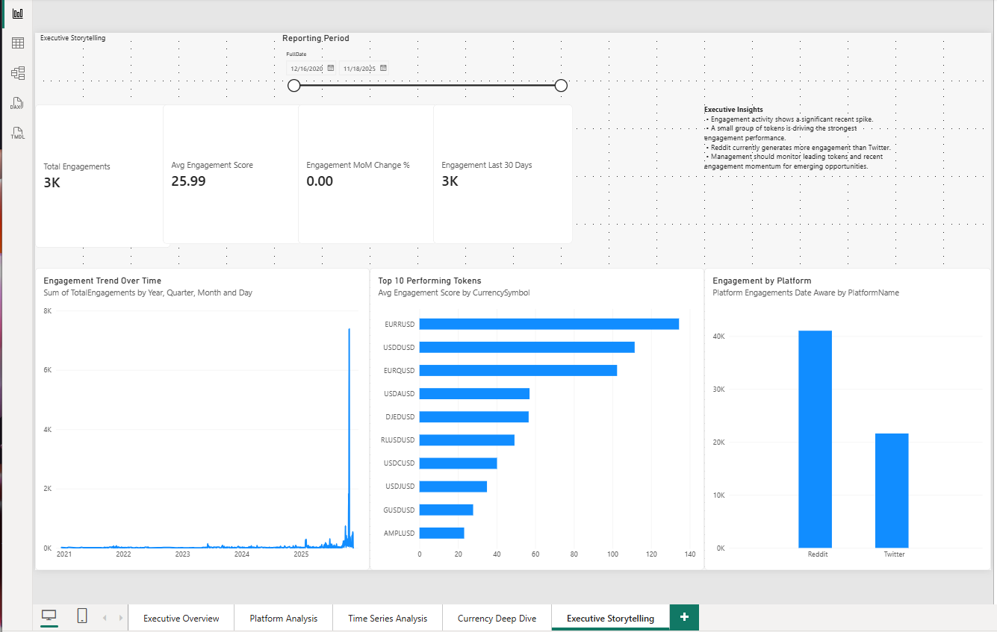
Key Insights
Insight 1: Recent engagement activity shows a significant spike.
Insight 2: A relatively small group of tokens is driving the strongest engagement performance.
Insight 3: Reddit currently generates more engagement than Twitter in the platform comparison.
Insight 4: Management should monitor leading tokens alongside recent engagement momentum.
Takeaway: Combining token ranking, platform analysis and time trends gives a clearer picture than any single KPI.

Slide 11
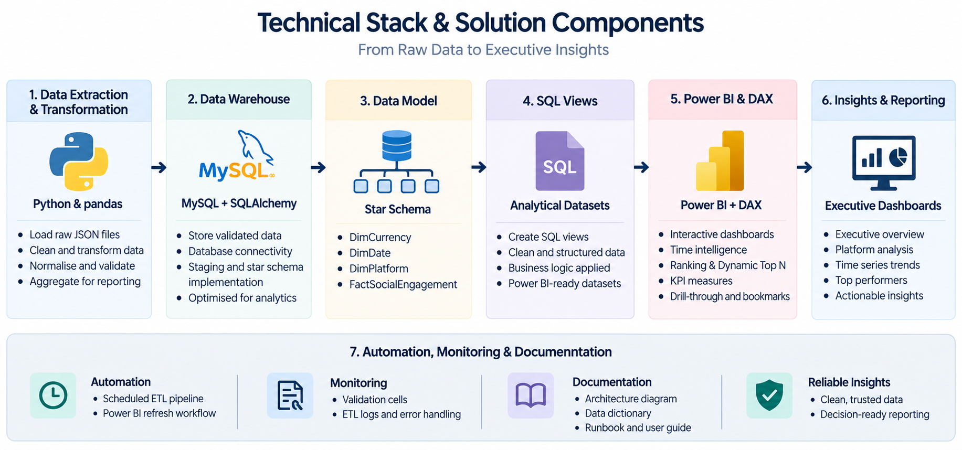
Technical Highlights
Python & pandas: ETL, cleaning, transformation and aggregation
MySQL + SQLAlchemy: Warehouse storage and database connectivity
Star Schema: DimCurrency, DimDate, DimPlatform, FactSocialEngagement
SQL Views: Power BI-ready analytical datasets
DAX: Time intelligence, ranking, Dynamic Top N and KPI measures
Automation: Scheduled ETL + Power BI refresh workflow
Documentation: Architecture diagram, data dictionary, runbook and user guide

Slide 12
Thank You
Reece Gow
NoodlesCrypto Analytics Platform
End-to-End Data Pipeline with Python & Power BI
GitHub: add your repo link
Demo Video: add the video link after you record it
Questions?

