Slide 1
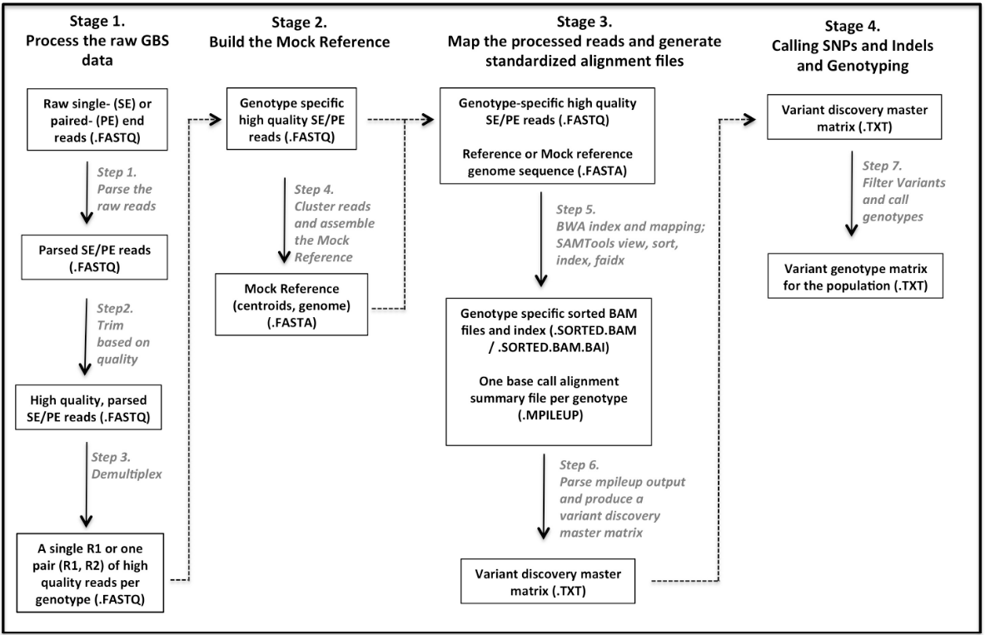
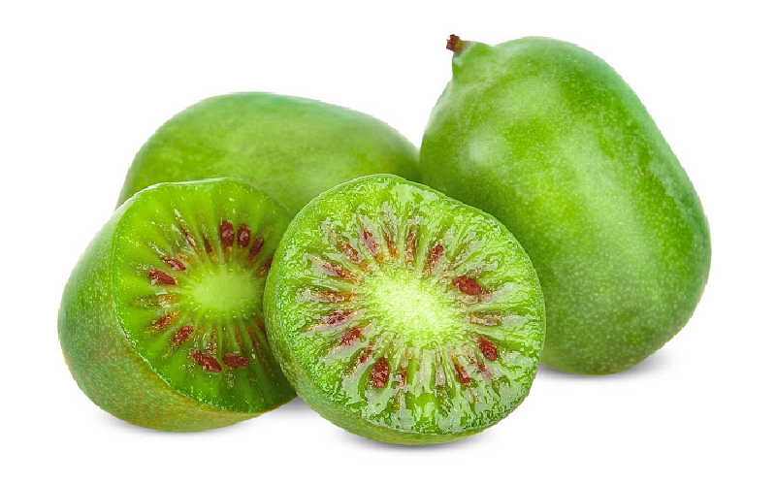
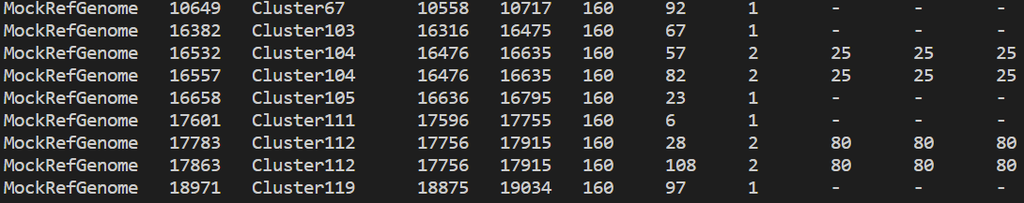
Variant Calling on Kiwiberry genome accessions using GBS-SNP-CROP
Introduction
Kiwiberry (Actinidia arguta) is an emerging berry crop within highly diverse Actinidia genus
Importance
Cold hardy in nature and tolerant up to (-30°C)
Flavorful and smooth edible skin
Rich in vitamins (A, B8, C, E), carotenoids (lutein, beta-carotene), and minerals (potassium, calcium) (Latocha, 2017).
Possess therapeutic value to anticancer (Yu et al., 2015), anti-fatigue, and anit-inflammatory properties.
Errors ran onto
Setting up the premise script
2) Samtools view for conversion
Objectives
To create a vcf file with all the possible SNPs for kiwiberry genome using GBS-SNP-CROP pipeline (perl script)
To create linkage map from the genotypic data (but using rose data just for the sample)
Further work
Visualize the vcf file
Work on the development of linkage map
Methodology
Mock Reference
All the computational work is done through premise after an account was setup.(done)
Data of 10 different kiwiberry accession was collected from Hale lab. The provided data was trimmed and demultiplexed.
3 different stages within variant calling
1) Building the mock reference genome
2)Processing the reads and sequence alignment with the reference
3) Variant calling
Building linkage map using PolyMapR (R-package)
Variant discovery master matrix
Melo et al. GBS-SNP-CROP: A reference-optional pipeline for SNP discovery and plant germplasm characterization using genotyping-by-sequencing data. BMC Bioinformatics. 2016. 17:29. DOI 10.1186/s12859-016-0879-y.
Reference
Descriptive file on SNPs

