Slide 1
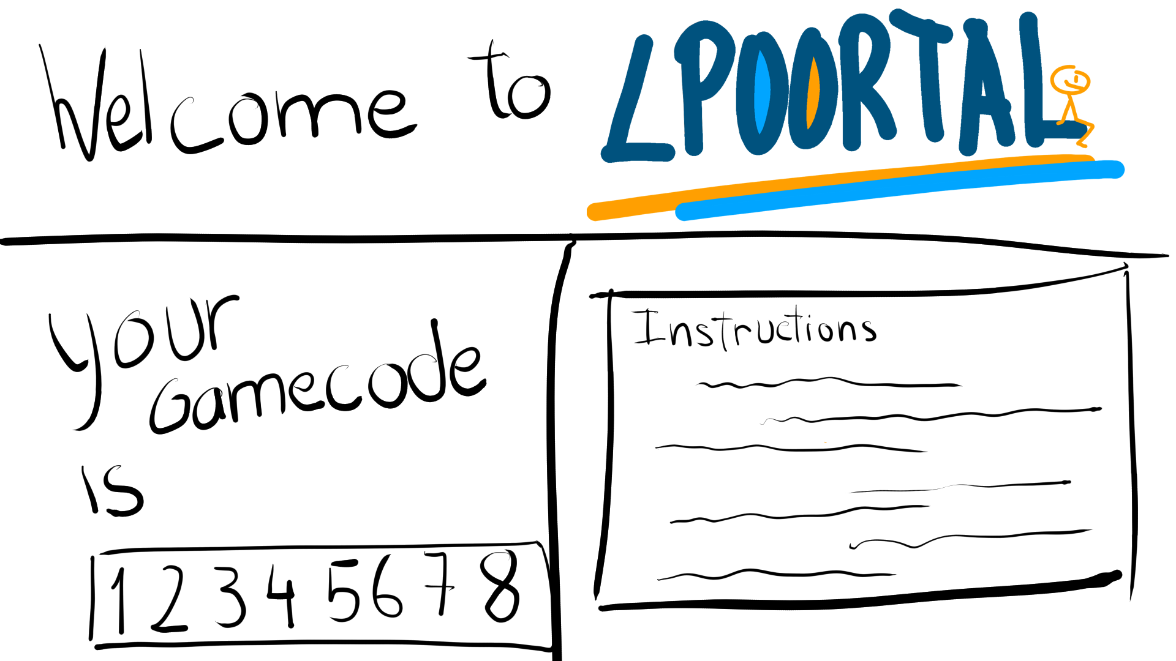
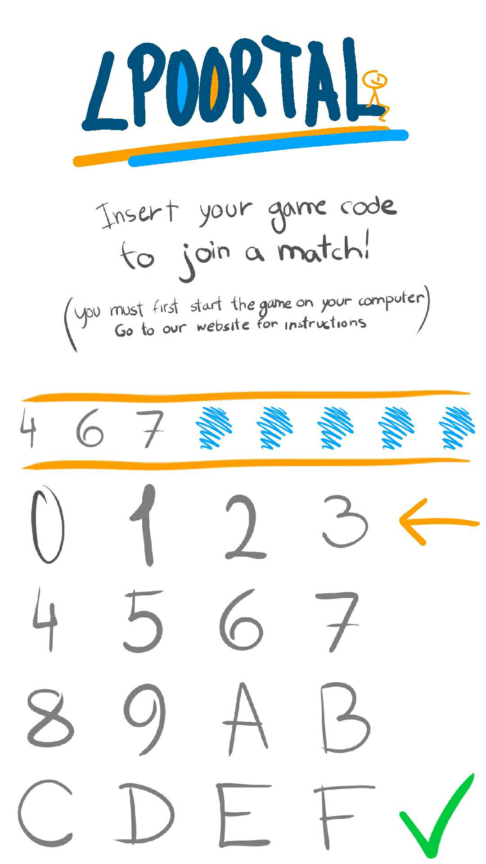
Welcome Screen
Desktop App
Mobile App
Player 1
Player 2
When the users launch the game, they will be presented with a screen on the desktop app that contains instructions and a gamecode (an hex representation of the computer’s IP address). The two players will now have to insert that gamecode in their mobile devices as to connect to the server on the desktop app

Slide 2
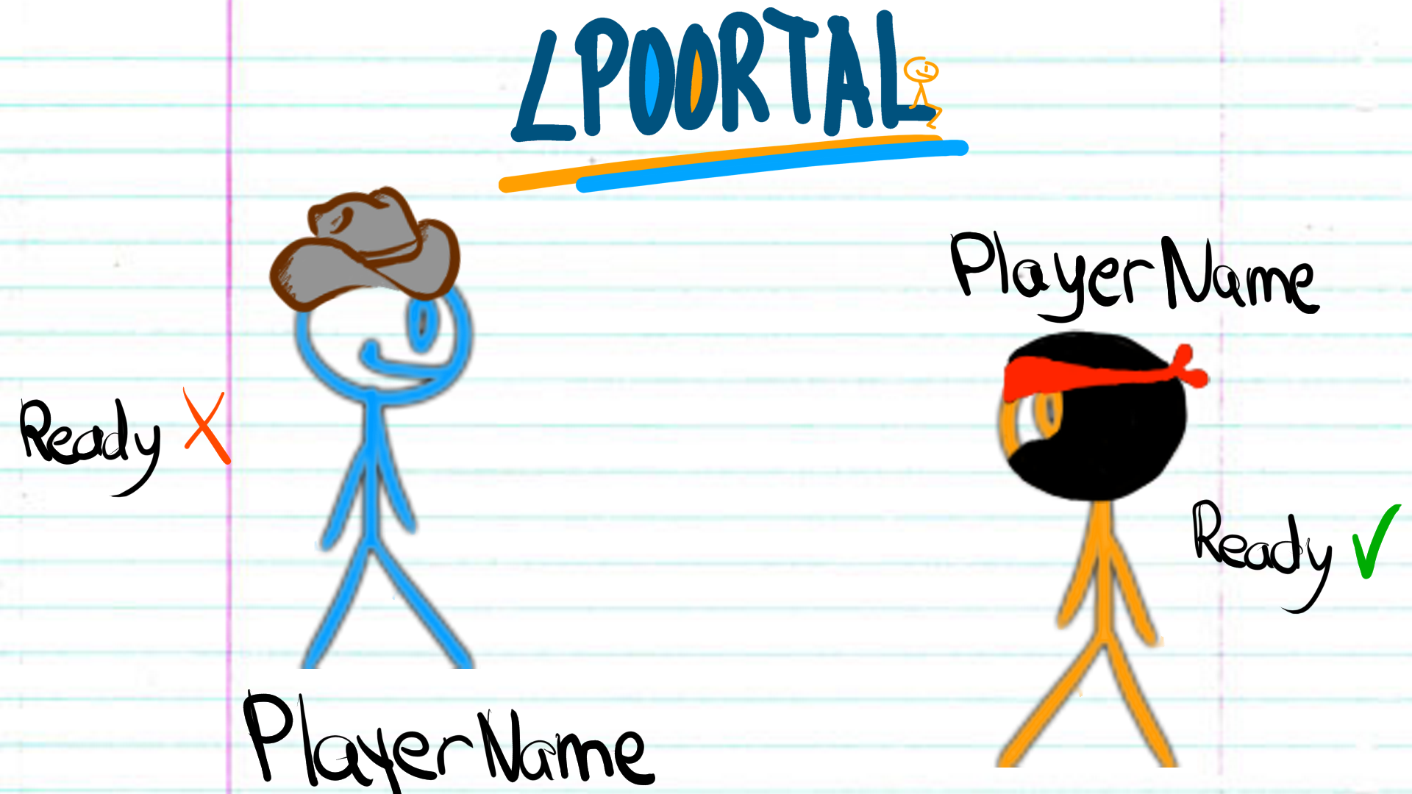
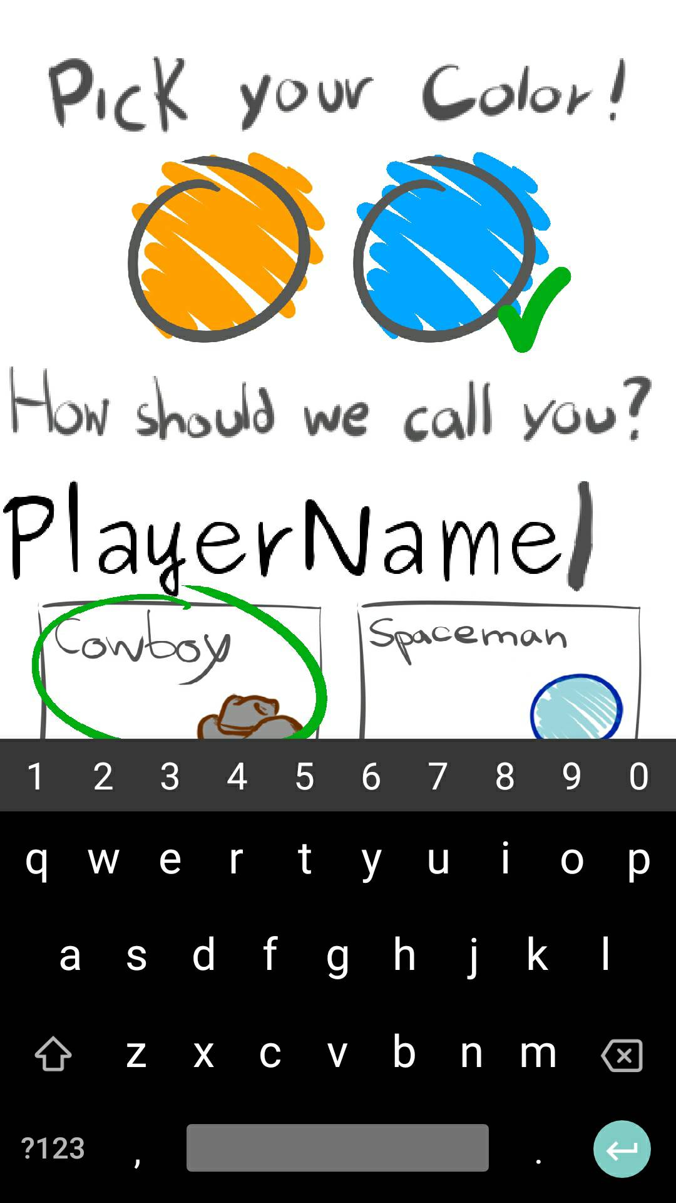
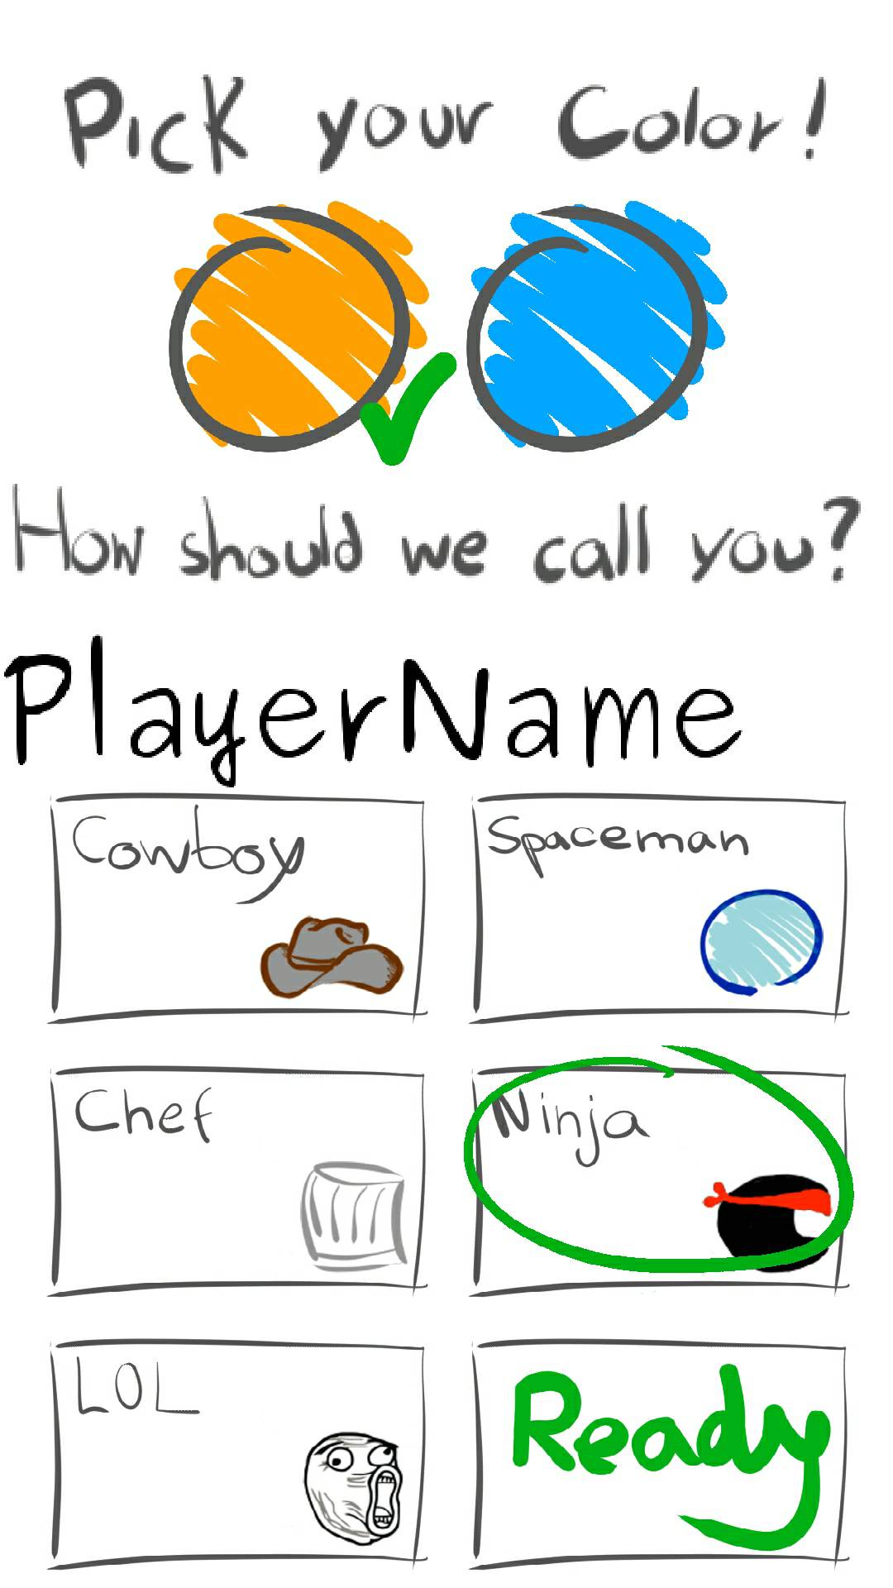
Player Customization Screen
Desktop App
Mobile App
Player 1
Player 2
After each player has connected, they will be able to customize their character through an on-screen interface where they pick the color, name and skin of their stickman. When both players have clicked the “Ready” button (and if their colors are different), the game will launch.

Slide 3

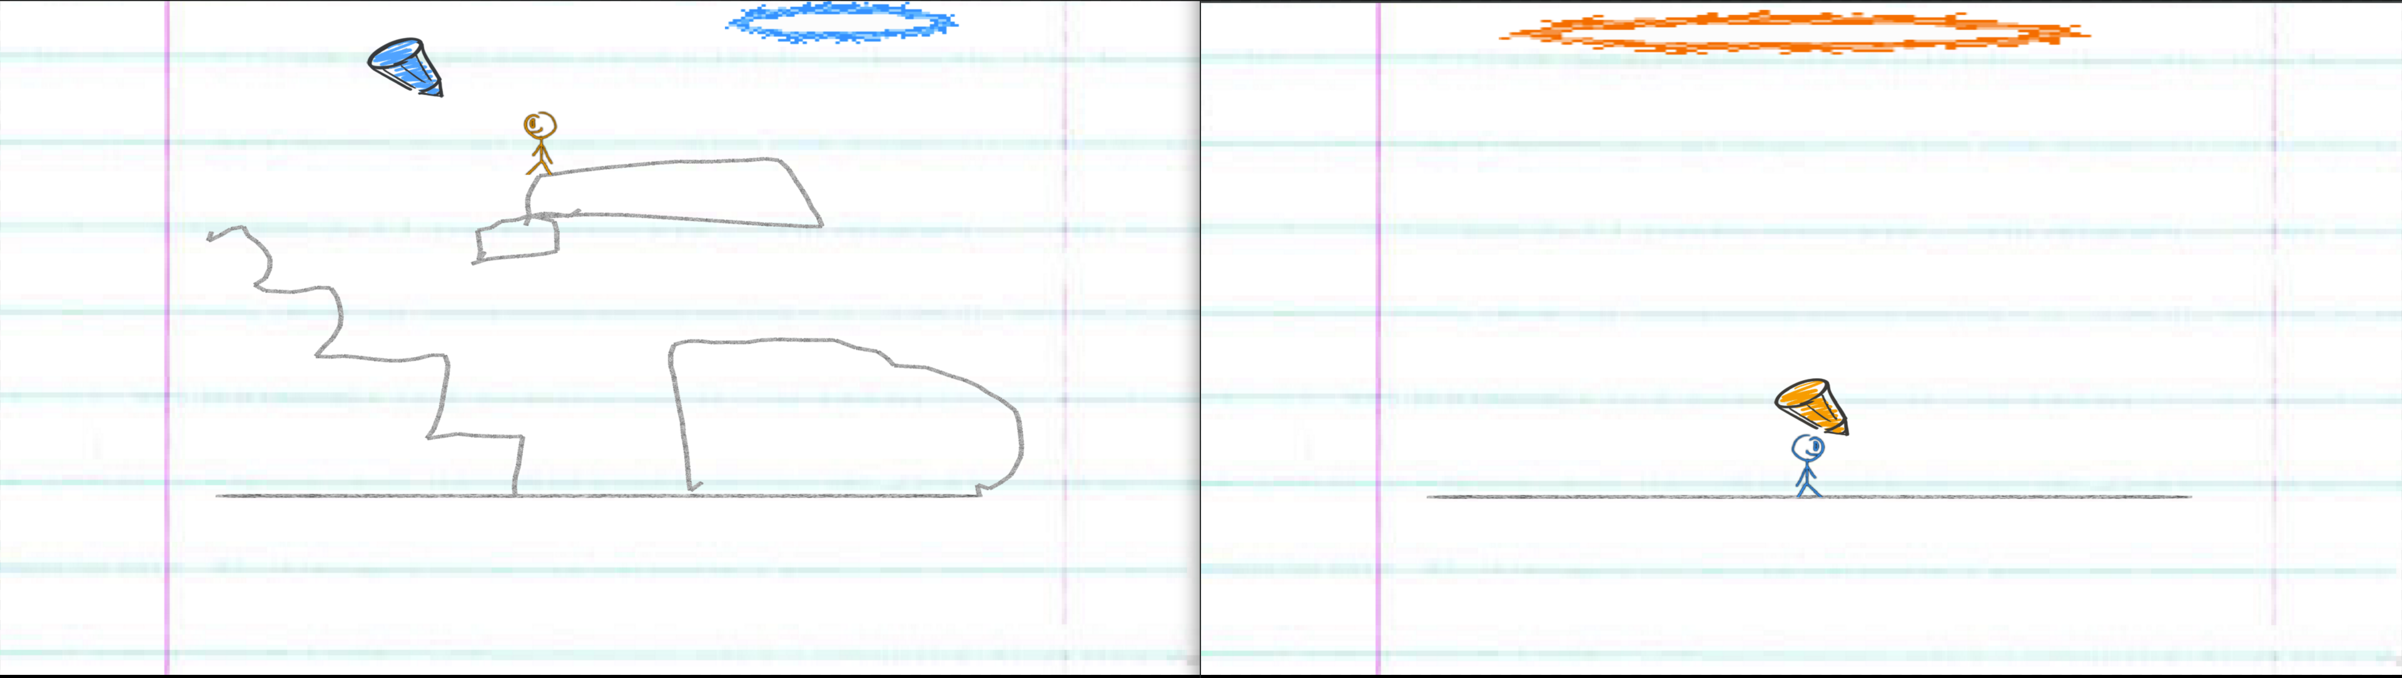
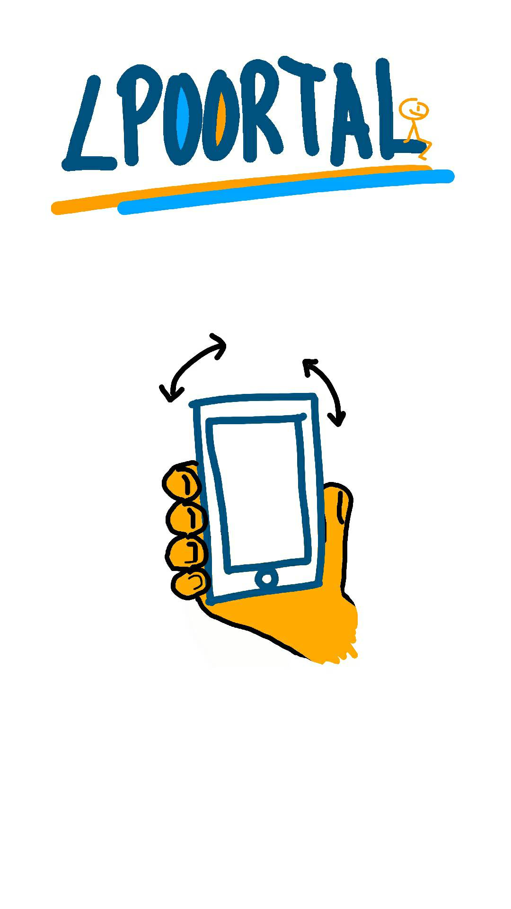
Desktop App
Mobile App
Player 1
Player 2
When the actual game starts, one player (in this example, player 1) controls the stickman shown on the desktop app with the controllers that appear in their mobile app. The stickman will have the player’s chosen colour. Meanwhile, the other player (in this case, player 2) will be presented with an image indicating that they will be controlling the pencil through the mobile device’s gyroscope as if it was a laser pointer (explained at the end). The goal is to go through the portal
(seen on top of the level) before it shrinks and disappears.

Slide 4

Desktop App
Mobile App
Player 1
Player 2
When the players manage to get the stickman through the portal, the game swaps the player’s tasks and creates a new level. The players now have to do what the other player did on the previous level. For every level that the players successfully pass, their score will increase by 1 point. The levels will increase in difficulty as to test the players’ skills. The main objetive of the game is to have the highest score possible.

Slide 5
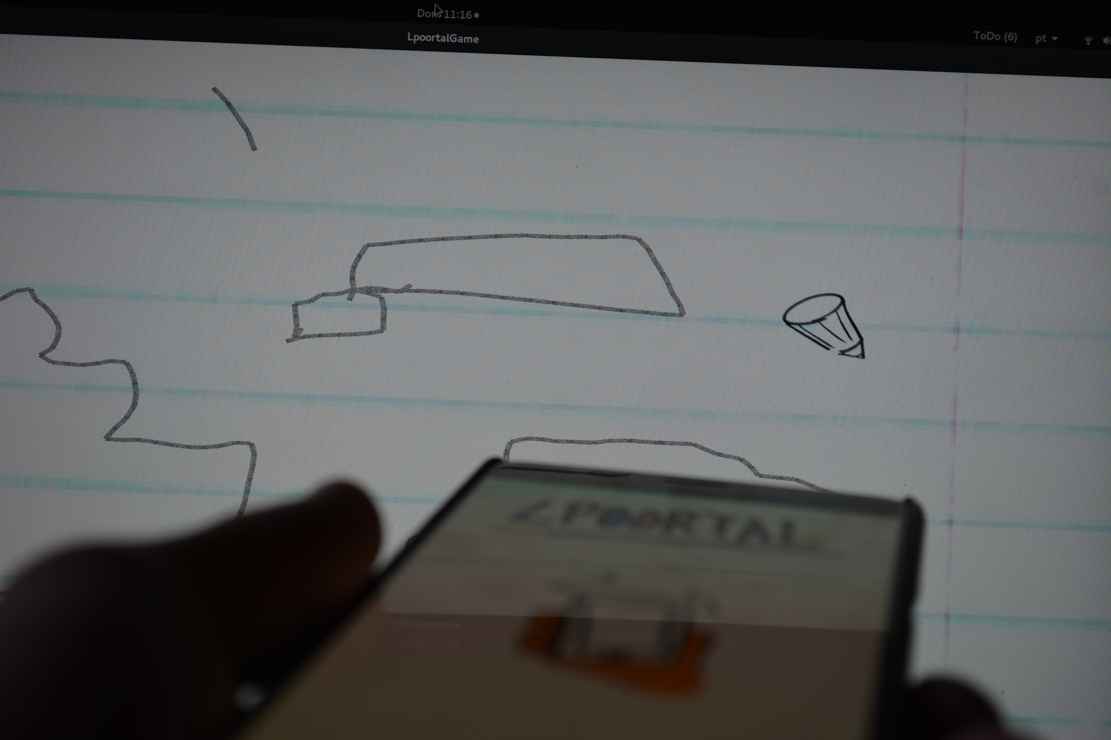
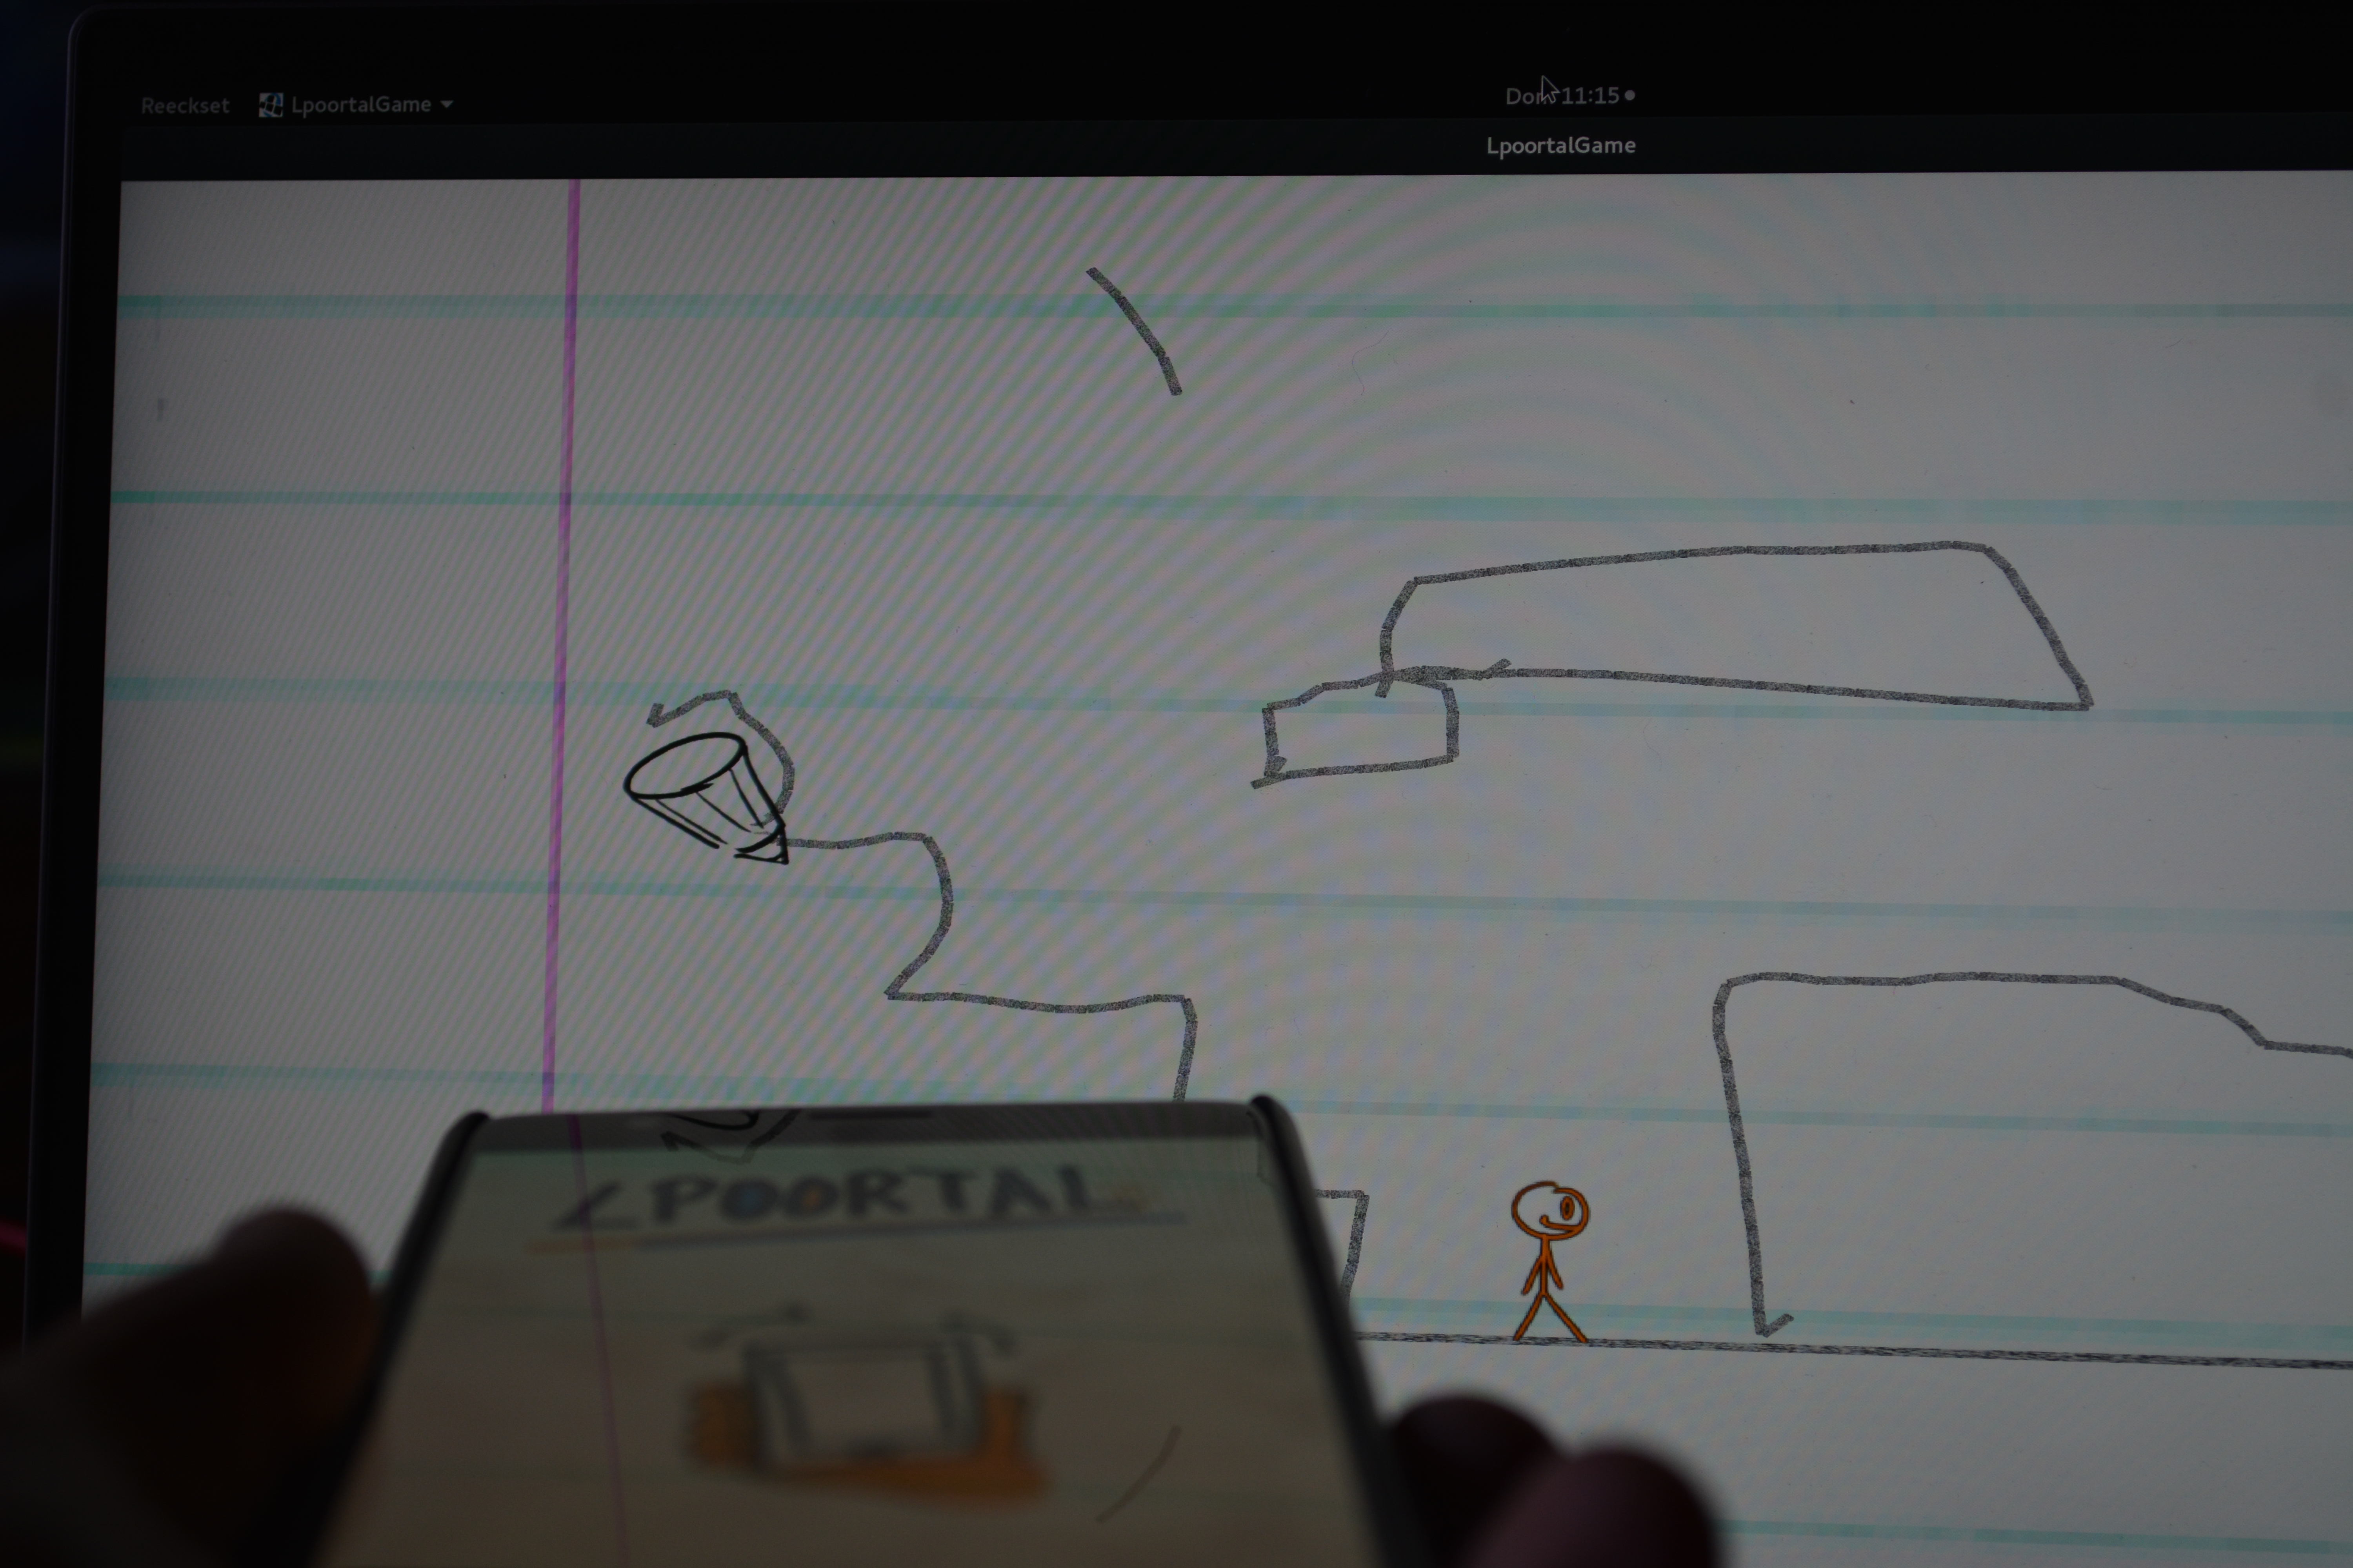
Gyroscope controlled pencil
When the player is controlling the pencil, the mobile device will act like a laser pointer, making the pencil move on screen according to the device’s rotation. The player can now draw by pressing the device’s screen while moving the pencil on the desktop app

