Slide 1
Measured Unrest in the Poetry of the Black Arts Movement
Ethan Reed
ecr6nd@virginia.edu

Slide 2
“Anger is loaded with information and energy.”
Audre Lorde, “The Uses of Anger,” Women’s Studies Quarterly, vol. 25, no. 1/2 (1997; 1981)

Slide 3
“Black Art is the aesthetic and spiritual sister of the Black Power concept. As such, it envisions an art that speaks directly to the needs and aspirations of Black America. In order to perform this task, the Black Arts Movement proposes a radical reordering of the western cultural aesthetic. It proposes a separate symbolism, mythology, critique, and iconology.”
From Larry Neal, “The Black Arts Movement,” The Drama Review vol. 12, no. 4 (1968): 29.

Slide 4
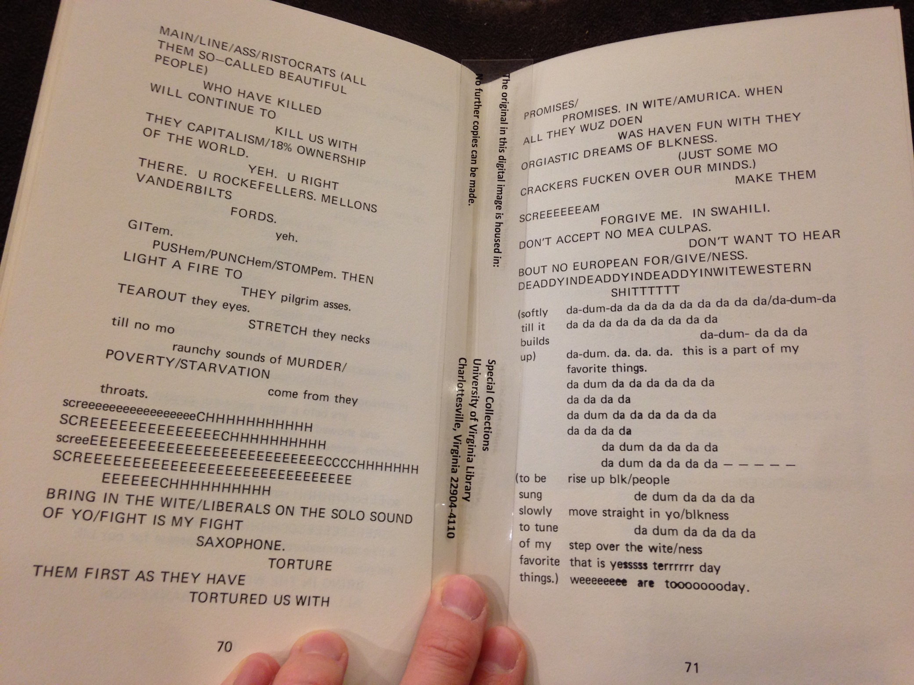
From Sonia Sanchez
“a/coltrane/poem,” in We A BaddDDD People (1970)

Slide 5
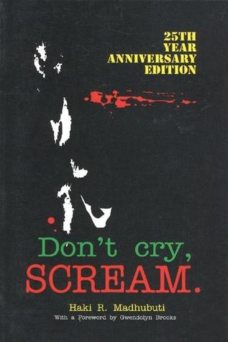
“[Lee] is not interested in supplying the needs of the English Departments at Harvard and Oxford nor the editors of Partisan Review … He speaks to blacks hungry for what they themselves refer to as “real poetry.” … Don Lee has no patience with black writers who do not direct their blackness toward black audiences.”
From Gwendolyn Brooks’ intro to Don’t Cry, Scream by Don L. Lee (1969)

Slide 6
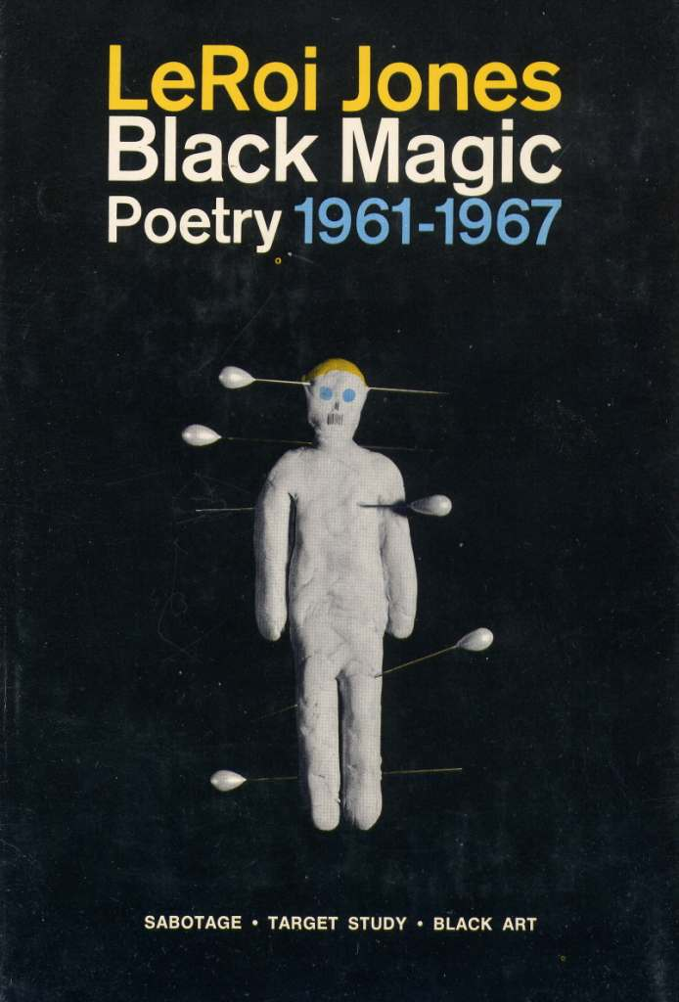
“Sabotage meant I had come to see the superstructure of filth Americans call their way of life, and wanted to see it fall. To sabotage it, I thought maybe by talking bad and getting high, layin out on they whole chorus. But Target Study is trying to really study, like bomber crews do the soon to be destroyed cities. Less passive now, less uselessly ‘literary.’”
From Amiri Baraka, “An Explanation of the Work,” Black Magic (1969)

Slide 7
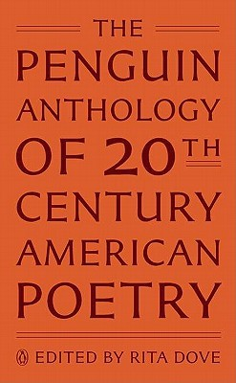
Includes poems by:
Etheridge Knight (1)
Amiri Baraka (4)
Audre Lorde (1)
Sonia Sanchez (1)
June Jordan (1)
Haki R. Madhubuti (2)
Apparently does NOT include enough:
Wallace Stevens (6)

Slide 8
“… Dove is at pains to include angry outbursts as well as artistically ambitious meditations. … the new ‘literary standards’ behind this example of Baraka’s verse don’t immediately declare themselves. Printing something in short lines doesn’t make the writer a poet; it only makes him a person with a book of short lines.”
From Helen Vendler, “Are These the Poems to Remember?” The New York Review of Books, November 24, 2011.
“It is astounding to me how utterly Vendler misreads my critical assessment of the Black Arts Movement, construing my straightforward account of their defiant manifesto as endorsement of their tactics …”
From Rita Dove, “Defending an Anthology,” New York Review of Books, December 22, 2011.

Slide 9
“I think what Black Arts did was inspire a whole lot of Black people to write. Moreover, there would be no multi-culturalism movement without Black Arts. Latinos, Asian Americans, and others all say they began writing as a result of the example of the 1960s. Blacks gave the example that you don’t have to assimilate. You could do your own thing, get into your own background, your own history, your own tradition and your own culture. I think the challenge is for cultural sovereignty and Black Arts struck a blow for that.”
Ishmael Reed, a 1995 interview quoted in The Oxford Companion to African American Literature (1997): 70.

Slide 10
Poetry + sentiment analysis = ?

Slide 11
Sentiment analysis & literary study
Matthew Jockers and syuzhet (2015)
http://www.matthewjockers.net/2015/02/02/syuzhet/
Ryan Heuser et al., “Literary Lab Pamphlet 13: The Emotions of London” (2013)
https://litlab.stanford.edu/LiteraryLabPamphlet13.pdf
Kurt Cavender et al., “Body Language: Toward an Affective Formalism of Ulysses” in Reading Modernism with Machines (2016)

Slide 12
What is machine learning?
Unsupervised learning:
“Go forth, Algorithm: what patterns see you in these inputs (data)?”
Supervised learning:
“Sing, O Algorithm, of how you would categorize all this new stuff according to predetermined categories/outputs we’ve already discussed!”

Slide 13
Sentiment analysis
Feed algorithm many text snippets pre-identified by humans (very expensive) as “positive” / “negative”
Ask it to make some generalizations about what makes a text snippet “positive” / “negative” based on those examples
Show it new snippets its never seen before but YOU ALREADY KNOW to be pos/neg (also marked by humans) and see how it does
Re-work until accurate
Unleash on the world

Slide 14
Sentiment classifiers
Pattern
Python package that “provides general cross-domain functionality” across” web mining, natural language processing, machine learning and network analysis, with a focus on ease-of-use”
https://github.com/clips/pattern/blob/master/pattern/text/en/en-sentiment.xml
VADER
Trained for “sentiment-oriented language of social media text”
https://github.com/cjhutto/vaderSentiment/blob/master/vaderSentiment/vader_lexicon.txt

Slide 15
The time
cracks into furious flower. Lifts its face
all unashamed. And sways in wicked grace.
…
It is lonesome, yes. For we are the last of the loud.
Nevertheless, live.
Conduct your blooming in the noise and whip of the whirlwind.
Gwendolyn Brooks, “The Second Sermon on the
Warpland,” In the Mecca (1968)

Slide 16
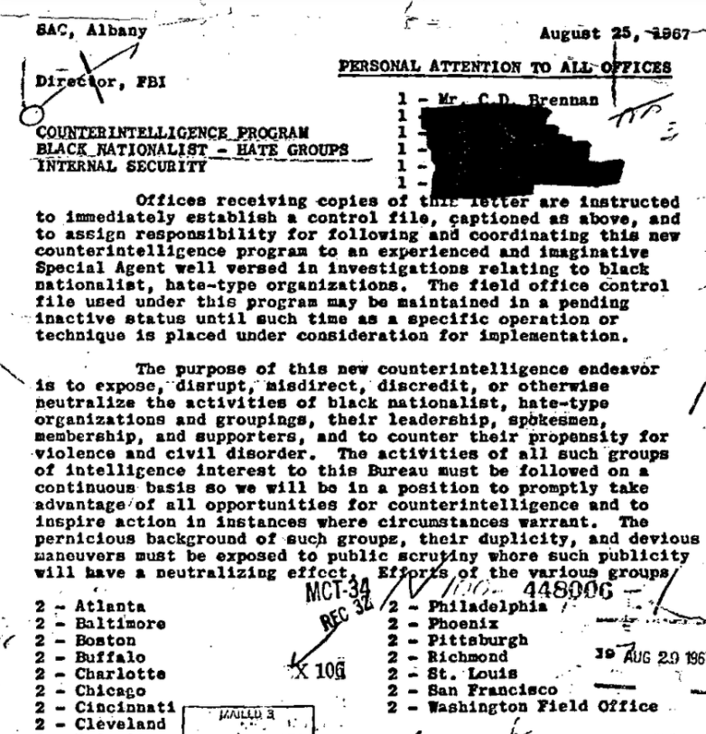
“The purpose of this new counterintelligence endeavor is to expose, disrupt, misdirect, discredit, or otherwise neutralize the activities of black nationalist, hate-type organizations and groupings, their leadership, spokesmen, membership, and supporters …”
From https://vault.fbi.gov/cointel-pro/cointel-pro-black-extremists/cointelpro-black-extremists-part-01-of/view

Slide 17
THE CORPUS
Amiri Baraka, Black Magic: Sabotage, Target Study, Black Art: Collected Poetry, 1961-1967 (1969)
Gwendolyn Brooks, In the Mecca (1968)
Jayne Cortez, Festivals and Funerals (1971)
Jayne Cortez, Pissstained Stairs and The Monkey Man’s Wares (1969)
Mari Evans, I am a Black Woman (1970)
Nikki Giovanni, Black Feeling, Black Talk, Black Judgement (1968)
Nikki Giovanni, Re:creation (1970)
Etheridge Knight, Poems from Prison (1968)
Audre Lorde, Cables to Rage (1970)
Audre Lorde, From a Land Where Other People Live (1973)
Haki M. Madhubuti, Black Pride (1968)
Haki M. Madhubuti, Don’t Cry, Scream (1969)
Haki M. Madhubuti, Think Black (1969)
Dudley Randall, Cities Burning (1968)
Dudley Randall, More to Remember (1971)
Ishmael Reed, Catechism of d neoamerican hoodoo church (1970)
Carolyn M. Rodgers, Paper Soul (1968)
Carolyn M. Rodgers, Songs of a Black Bird (1969)
Sonia Sanchez, Home Coming (1969)
Sonia Sanchez, It’s a New Day (1971)
Sonia Sanchez, We a BaddDDD People (1970)
Askia M. Toure, Juju (1970)
Quincy Troupe, Embryo Poems, 1967-1971 (1972)

Slide 18
PATTERN
‘more_to_remember': 0.03708888740566922
‘cities_burning': 0.031608076180274836
'juju': 0.024093820056905725
‘black_judgement': 0.019895827243241133
‘re_creation': 0.019437039611030917
‘dont_cry_scream': 0.01852086143627801
‘pissstained_stairs': 0.0177342647844337
‘from_a_land': 0.016361752168861297
‘black_pride': 0.014461637368368701
‘black_art': 0.014336735561742584
‘sabotage': 0.013962549381732551
‘we_a_baddddd_people': 0.013295700482187036
'festivals_and_funerals': 0.012913786536916255
‘embryo': 0.01267886490831049
‘its_a_new_day': 0.011470297979781437
‘poems_from_prison': 0.00825207149945368
‘think_black': 0.008036257618958915
‘songs_of_a_black_bird': 0.006181661418085379
‘black_feeling': 0.004455560447873473
‘catechism': 0.00351852738373735
‘home_coming': 0.0034715298404443973
‘black_woman': 0.002638587566581121
‘target_study': 0.002040780907881012
'paper_soul': 0.0015056872850942263
‘cables': 0.010843057733438306
‘in_the_mecca': -0.0009358048123658369
VADER
‘more_to_remember': 0.032412304551051735
‘cities_burning': 0.028423698233105813
'its_a_new_day': 0.025577372026960046
‘catechism': 0.022798172494442194
‘re_creation': 0.019290298439975186
‘from_a_land': 0.019021184523888394
‘dont_cry_scream': 0.016908077077112792
‘black_woman': 0.012608598432759865
‘songs_of_a_black_bird': 0.012122430962745873
‘black_pride': 0.010452279837773783
‘black_judgement': 0.009680236657707217
‘think_black': 0.009166229993243066
‘in_the_mecca': 0.008558339957607918
‘juju': 0.008479560365161745
‘cables': 0.0044342334892545545
‘sabotage': 0.0012580091767110519
‘black_art': -0.0007859526250118996
‘embryo': -0.0038785897191656376
‘paper_soul': -0.010360282913062792
‘we_a_baddddd_people': -0.010702266135733402
‘pissstained_stairs': -0.016873052556528427
‘home_coming': -0.0207653610074234
‘poems_from_prison': -0.024416571163173188
‘black_feeling': -0.02531071447730113
‘target_study': -0.029030293265101426
‘festivals_and_funerals': -0.03214015822567145

Slide 19
PATTERN
‘target_study': 0.002040780907881012
('t t jackson sings', -0.09999999999999999)
('cold term ii', -0.08795518207282914)
('ghosts', -0.08615319865319865)
('a poem for oswald spengler', -0.084992784992785)
'in_the_mecca': -0.0009358048123658369
('to a winter squirrel', -0.05)
('boy breaking glass', -0.030177406657669815)
('ii', -0.022126436781609204)
('the second sermon on the warpland', -0.012506764069264072)
Most negative poems in corpus
('i am a black woman', -0.16666666666666666)
('i am a black woman', -0.16666666666666666)
('come sing a song', -0.1564102564102564)
('i said it', -0.13529411764705881)
VADER
‘target_study': -0.029030293265101426
('word from the right wing', -0.2602035714285714)
('poem for religious fanatics', -0.194848275862069)
('corregidor', -0.16206315789473685)
('a poem for oswald spengler', -0.15387272727272727)
'in_the_mecca': 0.008558339957607918
('to a winter squirrel', -0.08742)
('ii', -0.04397931034482759)
('boy breaking glass', -0.0321421052631579)
('the second sermon on the warpland', -0.01656785714285714)]
Most negative poems in corpus
('the true import of present dialogue black vs negro', -0.40323571428571414)
('poem', -0.35145)
('poem for lloyd', -0.331668)
('incident', -0.2663571428571429)

Slide 20
PATTERN
(‘come sing a song’, -0.1564102564102564)
('come sing a song', 0.0)
('come sing a song black man', -0.166666666666666)
('sing of blind joe death', -0.5)
('sing a blues', 0.0)
('sing a blackblues song', 0.0)
('sing a blind joe death blues song', -0.5)
('sing a work song', 0.0)
('sing a prison chain gang', 0.0)
('southern blues worksong', 0.0)
('sing jazz rock or r b', 0.0)
('sing a song black man', -0.16666666666666666)
('sing a bad freedom song', -0.6999999999999998)
VADER
(‘come sing a song,’ -0.1432846153846154)
('come sing a song', 0.0, 1.0, 0.0, 0.0)
('come sing a song black man', 0.0, 1.0, 0.0, 0.0)
('sing of blind joe death', 0.688, 0.312, 0.0, -0.765)
('sing a blues', 0.0, 1.0, 0.0, 0.0)
('sing a blackblues song', 0.0, 1.0, 0.0, 0.0)
('sing a blind joe death blues song', 0.623, 0.377, 0.0, -0.765)
('sing a work song', 0.0, 1.0, 0.0, 0.0)
('sing a prison chain gang', 0.524, 0.476, 0.0, -0.5106)
('southern blues worksong', 0.0, 1.0, 0.0, 0.0)
('sing jazz rock or r b', 0.0, 1.0, 0.0, 0.0)
('sing a song black man', 0.0, 1.0, 0.0, 0.0)
('sing a bad freedom song', 0.361, 0.206, 0.433, 0.1779)

Slide 21
<word form="black" cornetto_synset_id="c_387" wordnet_id="a-00241952" pos="JJ" sense="of or belonging to a racial group having dark skin especially of sub-Saharan African origin" polarity="0.0" subjectivity="0.1" intensity="1.0" confidence="0.8" />
<word form="black" cornetto_synset_id="n_a-536067" wordnet_id="a-00274068" pos="JJ" sense="extremely dark" polarity="-0.4" subjectivity="1.0" intensity="1.0" confidence="0.8" />
<word form="black" cornetto_synset_id="n_a-536093" wordnet_id="a-00392812" pos="JJ" sense="being of the achromatic color of maximum darkness" polarity="-0.1" subjectivity="0.2" intensity="1.0" confidence="0.8" />

Slide 22
PATTERN
(‘the true import’, 0.021527777777777778)
…
('can you kill', 0.0)
('can you run a protestant down with your', -0.156)
('68 el dorado', 0.0)
('that s all they re good for anyway', 0.7)
('can you kill', 0.0)
('can you piss on a blond head', 0.0)
('can you cut it off', 0.0)
('can you kill', 0.0)
…
('can you shoot straight and', 0.2)
('fire for good measure', 0.7)
('can you splatter their brains in the street',0.0)
('can you kill them', 0.0)
('can you lure them to bed to kill them', 0.0)
('we kill in viet nam', 0.0)
('for them', 0.0)
VADER
(‘the true import’) -0.40323571428571414
…
('can you kill', 0.701, 0.299, 0.0, -0.6908)
('can you run a protestant down with your', 0.0, 1.0, 0.0, 0.0)
('68 el dorado', 0.0, 1.0, 0.0, 0.0)
('that s all they re good for anyway', 0.0, 0.674, 0.326, 0.4404)
('can you kill', 0.701, 0.299, 0.0, -0.6908)
('can you piss on a blond head', 0.351, 0.649, 0.0, -0.4019)
('can you cut it off', 0.344, 0.656, 0.0, -0.2732)
('can you kill', 0.701, 0.299, 0.0, -0.6908)
…
('can you shoot straight and', 0.329, 0.411, 0.26, -0.128)
('fire for good measure', 0.329, 0.274, 0.397, 0.128)
('can you splatter their brains in the street', 0.0, 1.0, 0.0, 0.0)
('can you kill them', 0.61, 0.39, 0.0, -0.6908)
('can you lure them to bed to kill them', 0.37, 0.63, 0.0, -0.6908)
('we kill in viet nam', 0.54, 0.46, 0.0, -0.6908)
('for them', 0.0, 1.0, 0.0, 0.0)

Slide 23
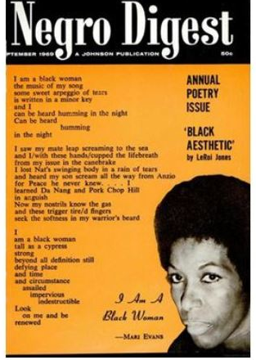
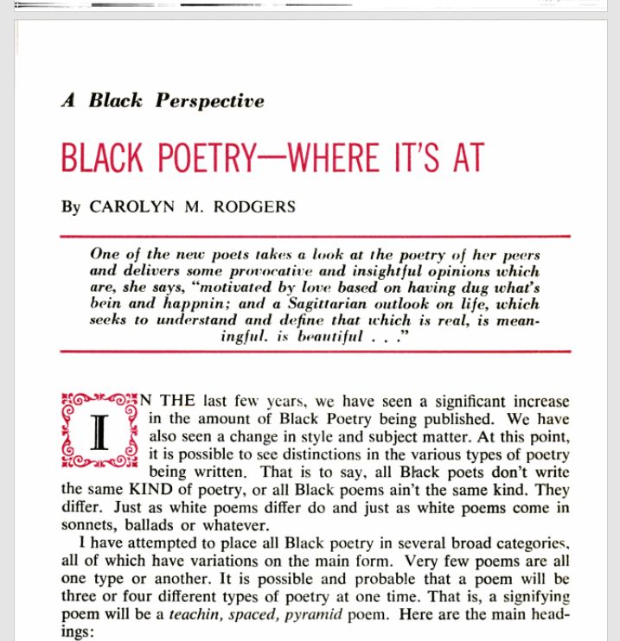

Slide 24
Carolyn M. Rodgers, “Black Poetry—Where It’s At,” (1969)
On signifying poetry:
“…a way of saying the truth that hurts with a laugh … a love/hate exercise in exorcising one’s hostilities. … [signifying] is very often a bloody knife job.”
“I know, and you know, that we have always signified. On the corners, in the poolrooms, the playgrounds, anywhere and everywhere we have had the opportunity. … However, to my knowledge, no group of Black writers has ever used it as a poetic technique as much as today’s writers. It is done with polish. … Too much signifying can be negative, I think; however, most of today’s poets are very conscious of how important positive vibrations are, and few have carried signification to an extreme. In the main, it is being used, for constructive destruction.”

Slide 25
I. A. Richards, Practical Criticism (1929)
“…we are concerned, firstly, with the feeling actually aroused by the word in the poem, not with the feelings the word might have in other contexts, or the feeling it generally has, or the feeling it “ought to have,” though these may have with advantage be remembered, for a word’s feeling is often determined in part by its senses in other contexts. … Is the pull exerted by context … sufficient to overcome what may be described as the normal separate feeling of the questionable word? Can this pull bring it in, as an item either in accordance or in due contrast to the rest? Or does the word resist, stay outside, or wrench the rest of the poem into crudity and or confusion?” (201-203)

Slide 26
??
??
??
??
??
Surface sentiment?
Feeling in poem vs. “normal separate feeling”?
Brandishing anger vs. being angry?
Positive negativity?
“Constructive deconstruction”?
??
??
??
??
??
??
??
??
??
??
??

Slide 27
Thank you!!

