Slide 1
Multinomial N-mixture models
Definition. Conceptually analogous to binomial N-mixture model but with multinomial observation data: Point count or site-referenced data using “removal”, multiple observers or similar protocols
(Just a multivariate version of the N-mixture model)
2. Likelihood analysis in unmarked using multinomPois, gmultmix
Summary analysis functions
3. Custom multinomial models
Capture-recapture data
Chandler's flycatcher data.
Bayesian analysis of multinomial N-mixture models
6. Open models multmixOpen
7. Bayesian analysis of open models

Slide 2
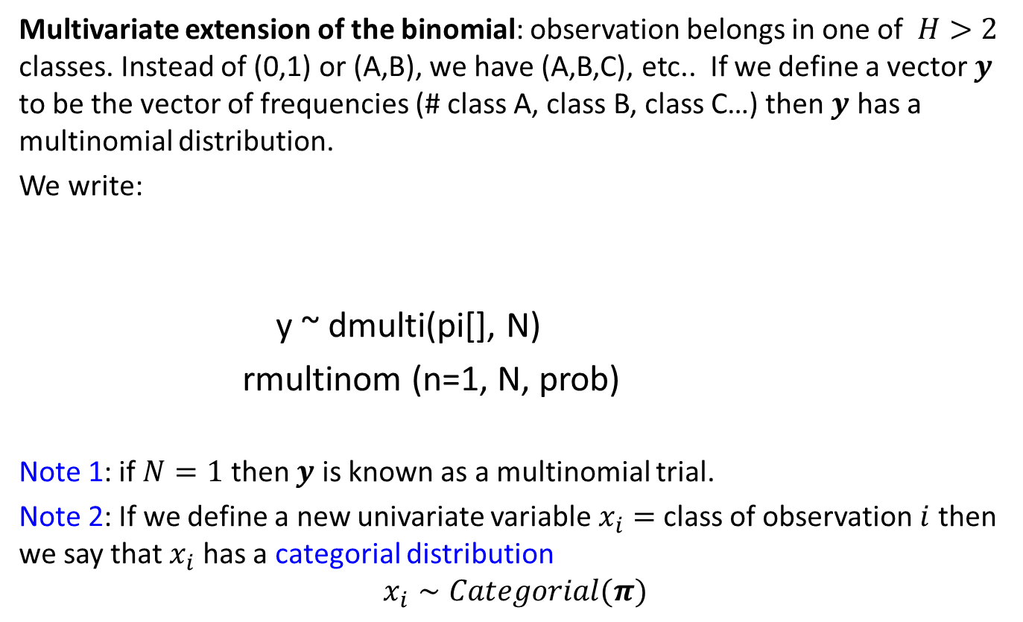
The multinomial distribution
Multivariate extension of the binomial: observation belongs in one of $H>2$ classes. Instead of (0,1) or (A,B), we have (A,B,C), etc.. If we define a vector $y$ to be the vector of frequencies (# class A, class B, class C…) then $y$ has a multinomial distribution.
We write:
y ~ dmulti(pi[], N)
rmultinom (n=1, N, prob)
Note 1: if $N=1$ then $y$ is known as a multinomial trial.
Note 2: If we define a new univariate variable $x_{i}=$class of observation $i$ then we say that $x_{i}$ has a categorial distribution
$$x_{i}∼Categorial(π)$$
Short-hand notation
BUGS language
R language
dcat() in BUGS

Slide 3
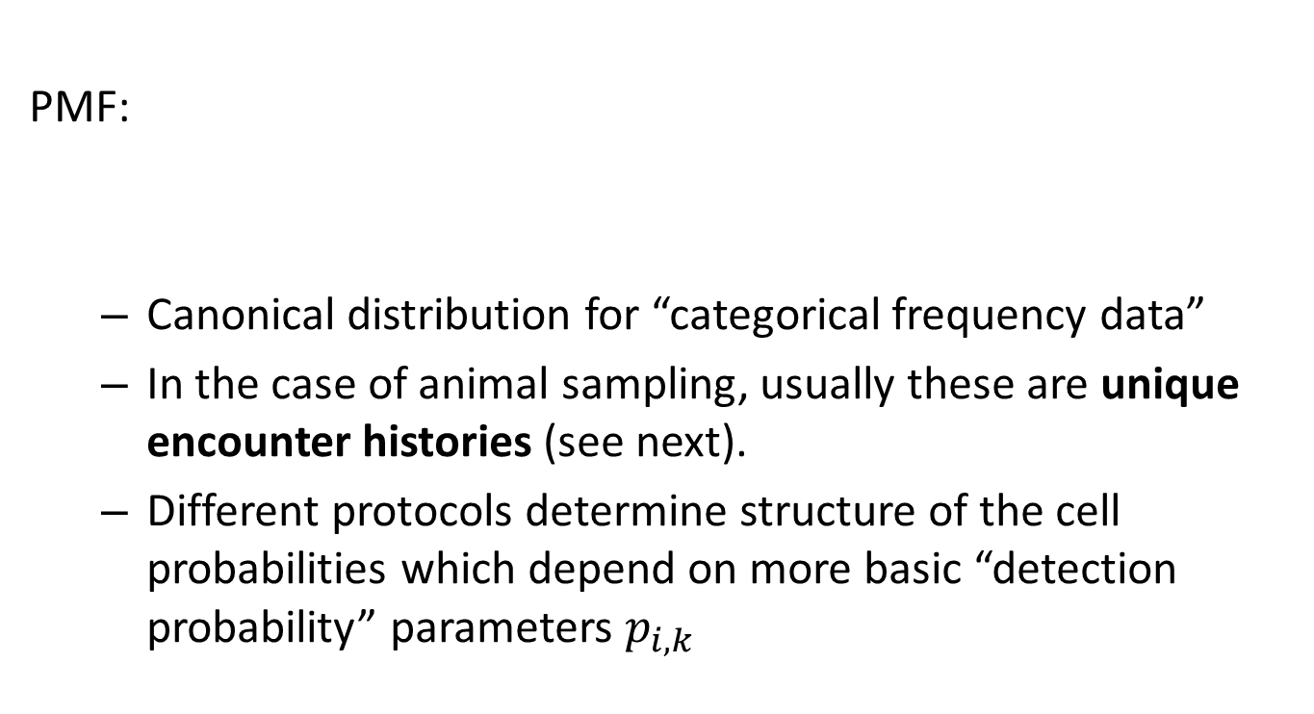
The multinomial distribution
PMF:
Canonical distribution for “categorical frequency data”
In the case of animal sampling, usually these are unique encounter histories (see next).
Different protocols determine structure of the cell probabilities which depend on more basic “detection probability” parameters $p_{i,k}$
In JAGS:
y[1:4] ~ dmulti(pi[1:H], N)

Slide 4
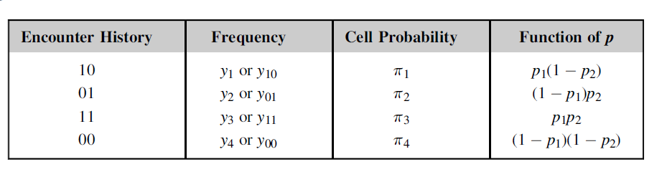
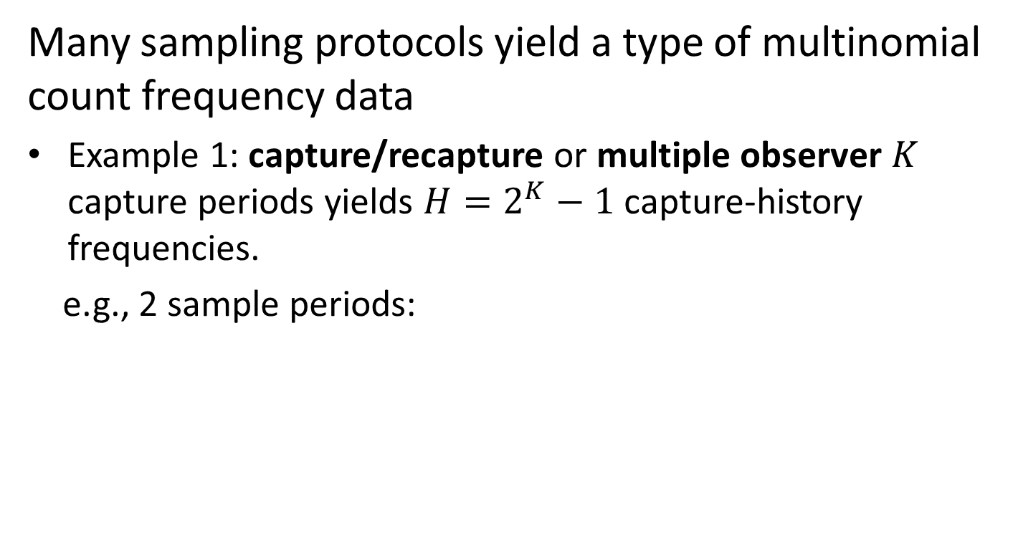
Multinomial observation models in ecological sampling
Many sampling protocols yield a type of multinomial count frequency data
Example 1: capture/recapture or multiple observer $K$ capture periods yields $H=2^{K}−1$ capture-history frequencies.
e.g., 2 sample periods:

Slide 5
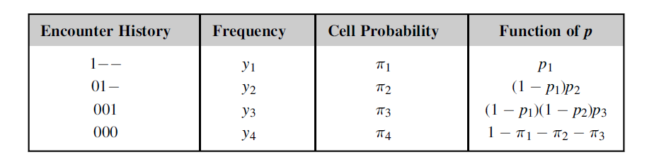
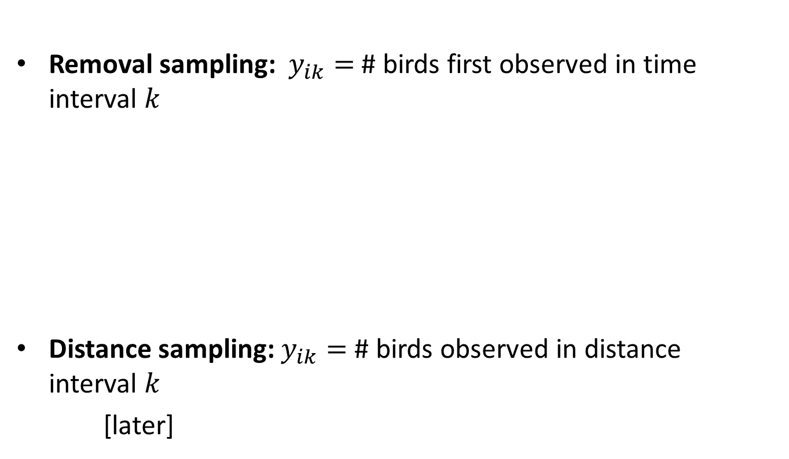
Multinomial observation models in ecological sampling
Removal sampling: $y_{ik}=$# birds first observed in time interval $k$
Distance sampling: $y_{ik}=$ # birds observed in distance interval $k$
[later]

Slide 6
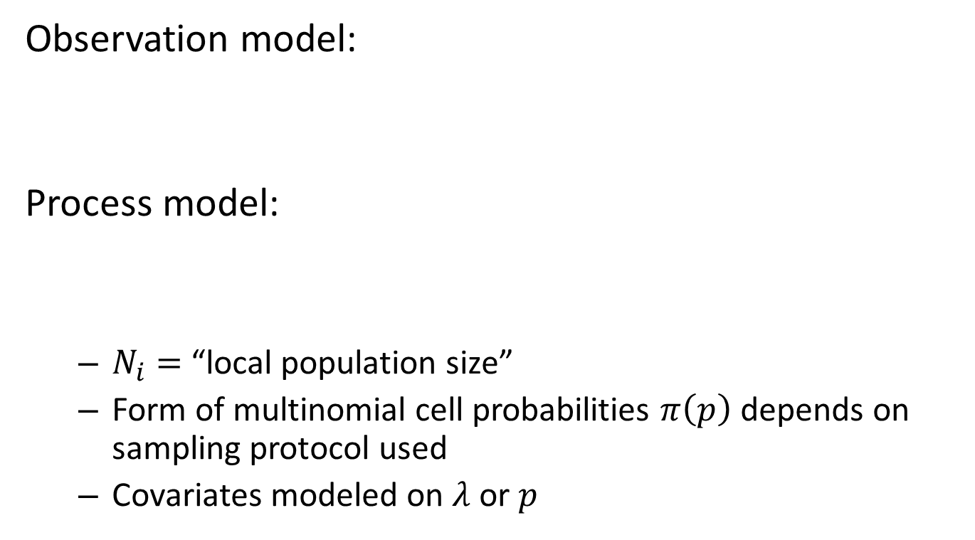
Multinomial N-mixture models
Observation model:
Process model:
$N_{i}=$“local population size”
Form of multinomial cell probabilities $π\left(p\right)$ depends on sampling protocol used
Covariates modeled on $λ$ or $p$

Slide 7
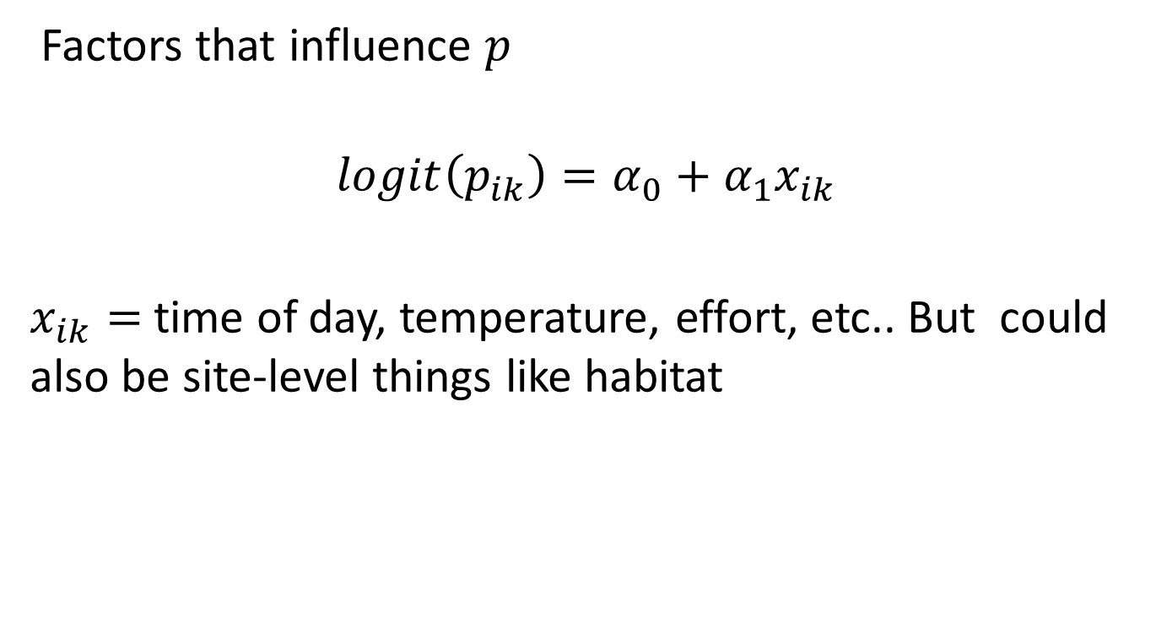

Key idea 1: modeling $p_{i,k}$
Factors that influence $p$
$$logit\left(p_{ik}\right)=α_{0}+α_{1}x_{ik}$$
$x_{ik}=$time of day, temperature, effort, etc.. But could also be site-level things like habitat

Slide 8


Key idea 2: modeling $N_{i}$
Local abundance varies across sites
$N_{i}$ is a latent variable:
$$N_{i}\sim g(θ)$$
$$\log\left(E\left(N_{i}\right)\right)=α+β∗covariate[i]$$

Slide 9
Simulation practice
set.seed(2015) # Initialize RNG
# Simulate covariate values and local population size for each point
x <- rnorm(100)
N <- rpois(100, lambda=exp(-1 + 1*x) ) # Intercept and slope equal to 1
table(N) # Summarize
N
0 1 2 3 4 5 6
72 17 6 1 2 1 1
# Define detection probabilities (p) for both observers
p1 <- 0.8
p2 <- 0.6
# Construct the multinomial cell probabilities (pi)
cellprobs <- c(p1*p2, p1*(1-p2), (1-p1)*p2, (1-p1)*(1-p2))
# Create a matrix to hold the data
y <- matrix(NA, nrow=100, ncol=4)
dimnames(y) <- list(1:100, c("11", "10", "01", "00"))
# Loop over sites and generate data with function rmultinom()
for(i in 1:100){
y[i,] <- rmultinom(1, N[i], cellprobs)
}
# Remove 4th column ("not detected") and summarize results
y <- y[,-4]
apply(y, 2, sum)
11 10 01
23 17 6
Double observer or 2-sample capture-recapture model

Slide 10
Inference in multinomial mixtures
Local abundance is a discrete latent variable or “random effect”
Marginal likelihood (or integrated) – remove random effect from the conditional likelihood
Bayesian analysis by MCMC: really easy also (this is lecture 2, coming up later)

Slide 11
Dual inference paradigm
It’s good to know both (see AHM book)
First we consider likelihood inference using the “marginal likelihood” which is implemented in unmarked
Bayesian analysis using JAGS

Slide 12
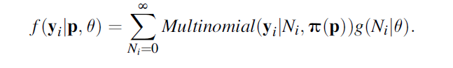
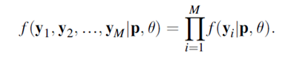
Likelihood inference

Slide 13
Doing it in unmarked
unmarked has 3 main functions for fitting multinomial abundance models:
multinomPois -- Multinomial-Poisson mixture (computationally efficient). Redundant with gmultmix
gmultmix -- Generalized multinomial-mixture model: other abundance models and open populations
multmixOpen – open populations w/dynamics
Helper-functions for set-up:
unmarkedFrameGMM and unmarkedFrameMPois
unmarkedFrameMMO (open models)
type = removal or type = double (also depDouble) but other types can be described.

Slide 14
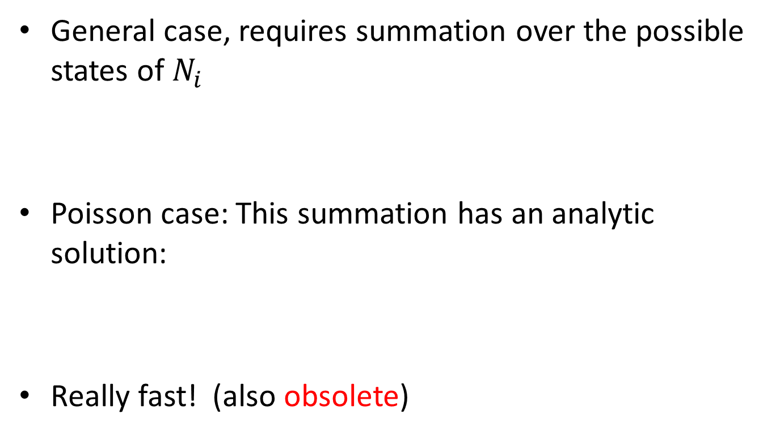
multinomPois
General case, requires summation over the possible states of $N_{i}$
Poisson case: This summation has an analytic solution:
Really fast! (also obsolete)

Slide 15
Doing it in unmarked
Summary methods
parboot
fitList
AIC, modSel
predict, fitted
raneff
bup
confint

Slide 16
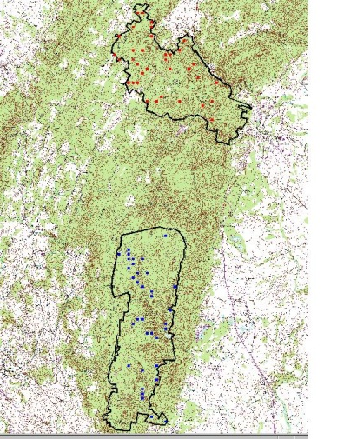
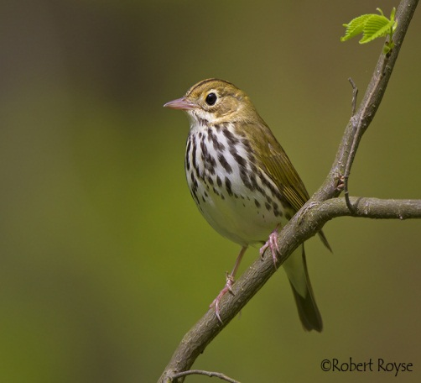
Demonstration
Maryland forest comprising Catoctin Mountain National Park}, Frederick Co. WMA, and various other land units.
Deanna Dawson, USGS
Scott Bates, NPS
70 point count locations
Sampling protocol: ``mental removal'‘
4 removal intervals
Habitat covariates:
Understory cover (UFC)
Basal area of large trees (TRBA)
data set is provided with unmarked :
data(ovendata)

Slide 17
data(ovendata)
ovendata.list$data[11:20,] # Look at a snippet of data set
[,1] [,2] [,3] [,4]
[1,] 0 0 0 0
[2,] 0 0 0 0
[3,] 2 0 1 0
[4,] 1 0 0 0
[5,] 1 0 0 0
[6,] 0 0 0 0
[7,] 0 1 0 1
[8,] 0 1 0 0
[9,] 0 0 0 0
[10,] 0 0 0 0
apply(ovendata.list$data,2,sum) # Removals in occasion 1-4
[1] 49 16 5 7
The focus of the study had to do with effects of deer management on vegetation characteristics and hence bird populations and diversity (Zipkin et al. 2010).

Slide 18
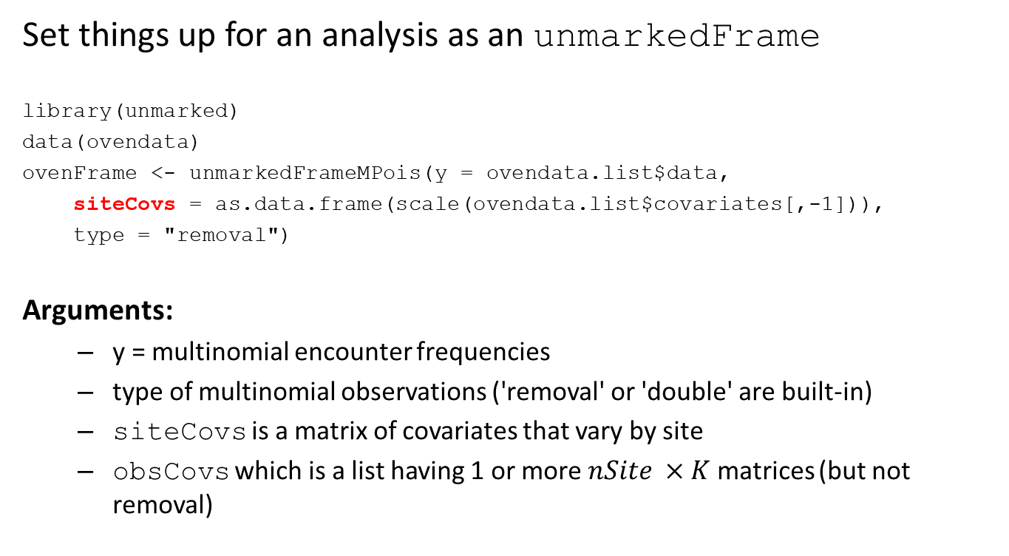
7.5.1 Setting up the data for analysis
Set things up for an analysis as an unmarkedFrame
library(unmarked)
data(ovendata)
ovenFrame <- unmarkedFrameMPois(y = ovendata.list$data,
siteCovs = as.data.frame(scale(ovendata.list$covariates[,-1])),
type = "removal")
Arguments:
y = multinomial encounter frequencies
type of multinomial observations ('removal' or 'double' are built-in)
siteCovs is a matrix of covariates that vary by site
obsCovs which is a list having 1 or more $nSite ×K$matrices (but not removal)
There can also be covariates that vary by sample interval these are “obsCovs” but usually not for ‘removal’ type data

Slide 19
7.5.2 Fitting models using function multinomPois
# Fit models: multinomPois
# order of formulas: detection, abundance
fm0 <- multinomPois(~ 1 ~ 1, ovenFrame)
fm1 <- multinomPois(~ 1 ~ ufc, ovenFrame)
fm2 <- multinomPois(~ 1 ~ trba, ovenFrame)
fm3 <- multinomPois(~ 1 ~ ufc + trba, ovenFrame)
fm4 <- multinomPois(~ 1 ~ ufc + trba + ufc:trba, ovenFrame)
fm5 <- multinomPois(~ ufc ~ ufc + trba, ovenFrame)
fm6 <- multinomPois(~ ufc ~ ufc + trba + ufc:trba, ovenFrame)

Slide 20
7.5.3 Fitting models using function gmultmix
Features of gmultmix:

Slide 21
7.5.3 Fitting models using function gmultmix
To set-up the data for analysis using gmultmix, we use the constructor function unmarkedFrameGMM as follows:
ovenFrame <- unmarkedFrameGMM(ovendata.list$data,
siteCovs=as.data.frame(scale(ovendata.list$covariates[,-1])),
numPrimary=1,type = "removal")
fm0 <- gmultmix(lambdaformula = ~1, phiformula = ~1, pformula = ~1,
data=ovenFrame)
NOTE: Formulas separated by commas
phiformula = ~ 1 and numPrimary = 1 in unmarkedFrameGMM
for closed population case

Slide 22
Fitting some models to the ovenbird data
# Fit Poisson models
fm1 <- gmultmix(~ ufc, ~ 1, ~ 1, data = ovenFrame)
fm2 <- gmultmix(~ trba, ~ 1, ~ 1, data = ovenFrame)
fm3 <- gmultmix(~ ufc + trba, ~ 1, ~ 1, data = ovenFrame)
fm4 <- gmultmix(~ ufc + trba + ufc:trba, ~ 1, ~ 1, data = ovenFrame)
# Maybe p also depends on understory foliage?
fm5 <- gmultmix(~ ufc + trba, ~ 1, ~ ufc, data = ovenFrame)
fm6 <- gmultmix(~ ufc + trba + ufc:trba, ~ 1, ~ ufc, data = ovenFrame)
# Fit analogous NegBin models
fm0nb <- gmultmix(~ 1, ~ 1, ~ 1, mixture = "NB", data = ovenFrame)
fm1nb <- gmultmix(~ ufc, ~ 1, ~ 1, mixture = "NB", data = ovenFrame)
fm2nb <- gmultmix(~ trba, ~ 1, ~ 1, mixture = "NB", data = ovenFrame)
fm3nb <- gmultmix(~ ufc + trba , ~ 1, ~ 1, mixture = "NB", data = ovenFrame)
fm4nb <- gmultmix(~ ufc + trba + ufc:trba, ~ 1, ~ 1, mixture = "NB",
data = ovenFrame)
# p depends on understory foliage?
fm5nb <- gmultmix(~ ufc + trba, ~ 1, ~ ufc, mixture = "NB",
data = ovenFrame)
fm6nb <- gmultmix(~ ufc + trba + ufc:trba, ~ 1, ~ ufc, mixture = "NB",
data = ovenFrame)

Slide 23
Model selection and summary
# Rank models by AIC
gms <- fitList(
"lam(.)p(.)" = fm0,
"lam(ufc)p(.)" = fm1,
"lam(trba)p(.)" = fm2,
"lam(ufc+trba)p(.)" = fm3,
"lam(ufc+trba+ufc:trba)p(.)" = fm4,
"lam(ufc+trba)p(ufc)" = fm5,
"lam(ufc+trba+ufc:trba)p(ufc)" = fm6,
"NB,lam(.)p(.)" = fm0nb,
"NB,lam(ufc)p(.)" = fm1nb,
"NB,lam(trba)p(.)" = fm2nb,
"NB,lam(ufc+trba)p(.)" = fm3nb,
"NB,lam(ufc+trba+ufc:trba)p(.)" = fm4nb,
"NB,lam(ufc+trba)p(ufc)" = fm5nb,
"NB,lam(ufc+trba+ufc:trba)p(ufc)" = fm6nb)
(gms1 <- modSel(gms))
# Table with everything you could possibly need
output <- as(gms1, "data.frame")

Slide 24
Model selection and summary
# Summary results
gms1
nPars AIC delta AICwt cumltvWt
lam(trba)p(.) 3 302.35 0.00 0.208 0.21
lam(ufp)p(.) 3 303.32 0.96 0.128 0.34
lam(ufp+trba)p(.) 4 303.72 1.37 0.105 0.44
lam(.)p(.) 2 303.86 1.51 0.097 0.54
lam(ufp+trba)p(ufp) 5 304.21 1.86 0.082 0.62
NB,lam(trba)p(.) 4 304.35 2.00 0.076 0.70
lam(ufp+trba+ufp:trba)p(.) 5 304.75 2.40 0.063 0.76
lam(ufp+trba+ufp:trba)p(ufp) 6 305.30 2.95 0.047 0.81
NB,lam(ufp)p(.) 4 305.31 2.95 0.047 0.85
NB,lam(ufp+trba)p(.) 5 305.72 3.37 0.038 0.89
NB,lam(.)p(.) 3 305.78 3.43 0.037 0.93
NB,lam(ufp+trba)p(ufp) 6 306.21 3.86 0.030 0.96
NB,lam(ufp+trba+ufp:trba)p(.) 6 306.75 4.40 0.023 0.98
NB,lam(ufp+trba+ufp:trba)p(ufp) 7 307.32 4.97 0.017 1.00

Slide 25
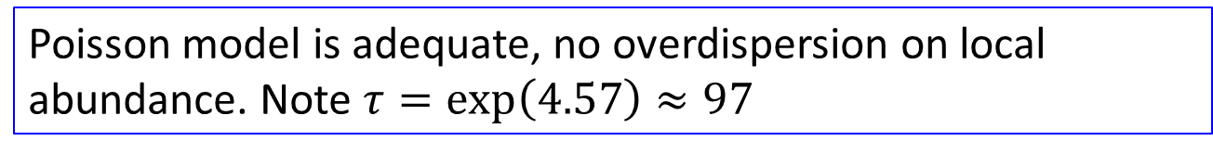
Poisson model is adequate, no overdispersion on local abundance. Note $τ=\exp\left(4.57\right)≈97$

Slide 26
7.5.4 Assessing model fit in unmarked
parboot function takes an R function defining the fit statistic(s), and an unmarked fit object, and carries-out a parametric bootstrap goodness-of-fit evaluation.
fitstats (see the unmarked helpfile ?parboot) : error sums-of-squares, the standard chi-square and the Freeman-Tukey statistic,
fitstats <- function(fm) {
observed <- getY(fm@data)
expected <- fitted(fm)
resids <- residuals(fm)
sse <- sum(resids^2,na.rm=TRUE)
chisq <- sum((observed - expected)^2 / expected,na.rm=TRUE)
freeTuke <- sum((sqrt(observed) - sqrt(expected))^2,na.rm=TRUE)
out <- c(SSE=sse, Chisq=chisq, freemanTukey=freeTuke)
return(out)
}
gof <- parboot(fm1, fitstats, nsim=100, report=1)

Slide 27
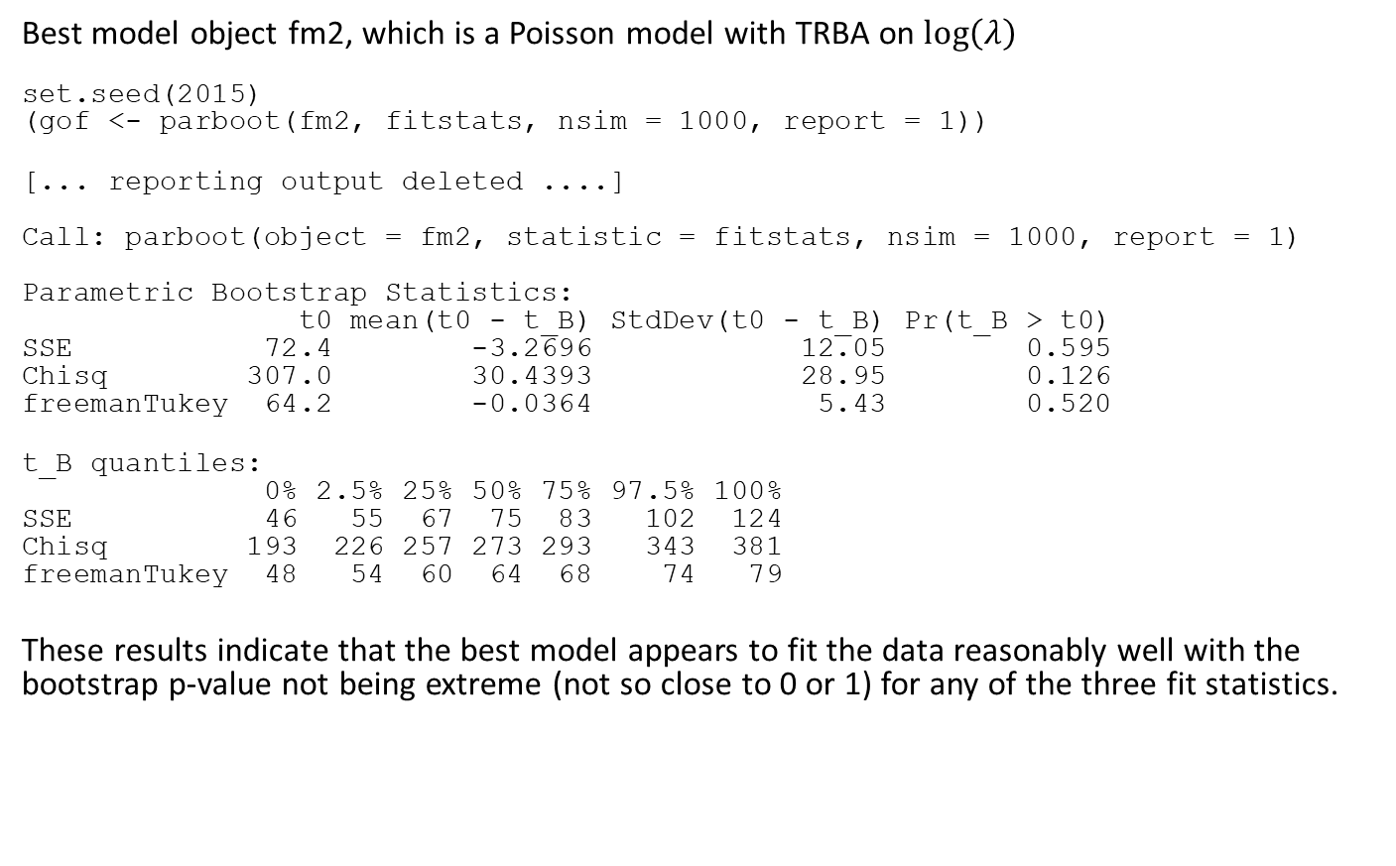
7.5.4 Assessing model fit in unmarked
Best model object fm2, which is a Poisson model with TRBA on $\log\left(λ\right)$
set.seed(2015)
(gof <- parboot(fm2, fitstats, nsim = 1000, report = 1))
[... reporting output deleted ....]
Call: parboot(object = fm2, statistic = fitstats, nsim = 1000, report = 1)
Parametric Bootstrap Statistics:
t0 mean(t0 - t_B) StdDev(t0 - t_B) Pr(t_B > t0)
SSE 72.4 -3.2696 12.05 0.595
Chisq 307.0 30.4393 28.95 0.126
freemanTukey 64.2 -0.0364 5.43 0.520
t_B quantiles:
0% 2.5% 25% 50% 75% 97.5% 100%
SSE 46 55 67 75 83 102 124
Chisq 193 226 257 273 293 343 381
freemanTukey 48 54 60 64 68 74 79
These results indicate that the best model appears to fit the data reasonably well with the bootstrap p-value not being extreme (not so close to 0 or 1) for any of the three fit statistics.

Slide 28
7.7 Building custom multinomial models in unmarked
By default unmarked can accommodate two types of multinomial sampling models: double observer and removal sampling.
Internally, unmarked has a special function (called the piFun) which builds the multinomial cell probabilities depending on the specified type of sampling protocol. The piFun maps “per sample” detection probabilities to multinomial cell probabilities.
If you can build a piFun then unmarked will fit the appropriate multinomial model
The piFun is passed as an argument to the unmarkedFrame

Slide 29
help file ?piFuns.
# Removal model: capture probs for 5 sites, with 3 removal periods
(pRem <- matrix(0.5, nrow=5, ncol=3))
[,1] [,2] [,3]
[1,] 0.5 0.5 0.5
[2,] 0.5 0.5 0.5
[3,] 0.5 0.5 0.5
[4,] 0.5 0.5 0.5
[5,] 0.5 0.5 0.5
removalPiFun(pRem) # Multinomial cell probabilities for each site
[,1] [,2] [,3]
[1,] 0.5 0.25 0.125
[2,] 0.5 0.25 0.125
[3,] 0.5 0.25 0.125
[4,] 0.5 0.25 0.125
[5,] 0.5 0.25 0.125
# Double observer model: capture probs for 5 sites, with 2 observers
(pDouble <- matrix(c(0.8, 0.6), 5, 2,byrow=TRUE))
[,1] [,2]
[1,] 0.8 0.6
[2,] 0.8 0.6
[3,] 0.8 0.6
[4,] 0.8 0.6
[5,] 0.8 0.6
doublePiFun(pDouble) # Multinomial cell probabilities for each site
[,1] [,2] [,3]
[1,] 0.32 0.12 0.48
[2,] 0.32 0.12 0.48
[3,] 0.32 0.12 0.48
[4,] 0.32 0.12 0.48
[5,] 0.32 0.12 0.48

Slide 30
Example
A pi function for removal sampling when the time intervals differ: 10-minute point count divided into three intervals of length 2, 3 and 5 minutes.
instRemPiFun <- function(p){
M <- nrow(p)
J <- ncol(p)
pi <- matrix(NA, M, J)
p[,1] <- pi[,1] <- 1 - (1 - p[,1])^2
p[,2] <- 1 - (1 - p[,2])^3
p[,3] <- 1 - (1 - p[,3])^5
for(i in 2:J) {
pi[,i] <- pi[, i - 1]/p[, i - 1] * (1 - p[, i - 1]) * p[, i]
}
return(pi)
}
pRem<- matrix(0.5, 5,3)
instRemPiFun(pRem)
[,1] [,2] [,3]
[1,] 0.75 0.21875 0.03027344
[2,] 0.75 0.21875 0.03027344
[3,] 0.75 0.21875 0.03027344
[4,] 0.75 0.21875 0.03027344
[5,] 0.75 0.21875 0.03027344
The function expresses the detection probability for each time interval relative to a base per-minute detection probability and is defined as follows (see ?PiFuns):
These are the expected cell frequencies for the 2, 3 and 5 minute period
Notes:
The expression in the 2:J loop works out, trust us! E.g., for J = 3: Pr(removed interval 1 ) = one minus not removed in either minute hence 1 – (1-p1)^2
Similarly the probability of being removed in the 2nd interval which is 3 minutes in width means: you were not removed in the first 2-minute interal

Slide 31
7.8 Spatially Stratified Capture-Recapture Models
Capture-recapture is one of the most widely used methods for sampling animal populations. CR models are usually consistent with the multinomial N-mixture model:
Includes classical capture-recapture
Small mammal studies at a M sites
Mist net studies of birds
Territory mapping
“mental” capture-recapture

Slide 32


Capture-recapture pi function
crPiFun <- function(p) {
p1 <- p[,1]
p2 <- p[,2]
p3 <- p[,3]
cbind("001" = (1 - p1) * (1 - p2) * p3,
"010" = (1 - p1) * p2 * (1 - p3),
"011" = (1 - p1) * p2 * p3,
"100" = p1 * (1 - p2) * (1 - p3),
"101" = p1 * (1 - p2) * p3,
"110" = p1 * p2 * (1 - p3),
"111" = p1 * p2 * p3)
}
With this we can fit some unique capture-recapture models that combine classical ideas (e.g., Mb, Mt) with N-mixture modeling ideas.
$T=3$ sample occasions means 3 canonical detection parameters
$$Encounter history$$
$$probabilities are$$
$$constructed here$$

Slide 33
Demonstration: Chandler’s flycatcher data
Encounter history data for Chandler’s ALFL data
alfl <- read.csv(system.file("csv", "alfl.csv", package="unmarked"))
head(alfl, 5)
id survey interval1 interval2 interval3
1 crick1_05 1 1 1 1
2 crick1_05 3 1 0 1
3 his1_05 1 0 1 1
4 his1_05 1 1 1 1
5 his1_05 2 0 1 1
There are 3 surveys (different days) with 3 intervals (consecutive) each.
We use survey = 1 only to demonstrate the basic models.
Notes:
Each row is an encounter history of a specific individual during a specific survey occasion. The 3 intervals are sub-intervals.

Slide 34
Example: Chandler’s flycatcher data
alfl.covs <- read.csv(system.file("csv", "alflCovs.csv",package="unmarked"),
row.names=1)
head(alfl.covs)
struct woody time.1 time.2 time.3 date.1 date.2 date.3
crick1_05 5.45 0.30 8.68 8.73 5.72 6 25 34
his1_05 4.75 0.05 9.43 7.40 7.58 20 32 54
hisw1_05 14.70 0.35 8.25 6.70 7.62 20 32 47
hisw2_05 5.05 0.30 7.77 6.23 7.17 20 32 47
kenc1_05 4.15 0.10 9.57 9.55 5.73 8 27 36
kenc2_05 9.75 0.40 9.10 9.12 9.12 8 27 36
Each row of the data matrix contains the covariate values for a given point count location, defined as follows:
struct is a measure of vegetation structure
woody is the percent cover of woody vegetation
time.x is the time of day for each of the three sample occasions
date.x is the day of each sample occasion.

Slide 35
Example: Chandler’s flycatcher data
Subset the data to the first survey (survey = 1)
alfl$captureHistory <- paste(alfl$interval1, alfl$interval2, alfl$interval3, sep="")
alfl$captureHistory <- factor(alfl$captureHistory,
levels=c("001", "010", "011", "100", "101", "110", "111"))
alfl$id <- factor(alfl$id, levels=rownames(alfl.covs))
alfl.v1 <- alfl[alfl$survey==1,]
alfl.H1 <- table(alfl.v1$id, alfl.v1$captureHistory)
head(alfl.H1, 5)
001 010 011 100 101 110 111
crick1_05 0 0 0 0 0 0 1
his1_05 0 0 1 0 0 0 1
hisw1_05 0 0 0 0 0 0 0
hisw2_05 0 0 0 0 0 0 1
kenc1_05 0 0 0 0 0 0 0
Now we have basic capture-recapture data for each point count location

Slide 36
ALFL data: setting up the analysis
intervalMat <- matrix(c('1','2','3'), 50, 3, byrow=TRUE)
class(alfl.H1) <- "matrix"
o2y <- matrix(1, 3, 7)
umf.cr1 <- unmarkedFrameMPois(y = alfl.H1,
siteCovs=alfl.covs[,c("woody", "struct", time.1")],
obsCovs=list(interval=intervalMat), obsToY=o2y, piFun="crPiFun")
# 4 candidate models
M0 <- multinomPois(~ 1 ~ 1, umf.cr1)
Mt <- multinomPois(~ interval - 1 ~ 1, umf.cr1)
Mx <- multinomPois(~ time.1 ~ 1, umf.cr1)
(M0.woody <- multinomPois(~ 1 ~ woody, umf.cr1))
What????
This is related to missing value handling.
Notes:
You have to write this o2y function if you build custom pi functions. You should call Richard if you want to understand that.

Slide 37
Example: Chandler’s flycatcher data
(M0.woody <- multinomPois(~ 1 ~ woody, umf.cr1))
Call:
multinomPois(formula = ~1 ~ woody, data = umf.cr1)
Abundance:
Estimate SE z P(>|z|)
(Intercept) -0.962 0.325 -2.96 0.003059
woody 2.587 0.680 3.80 0.000143
Detection:
Estimate SE z P(>|z|)
1.43 0.216 6.63 3.42e-11
AIC: 245.9301

Slide 38
Example: Chandler’s flycatcher data
fl <- modSel(fitList(M0, Mt, Mx, M0.woody))
nPars AIC delta AICwt cumltvWt
M0.woody 3 245.93 0.00 0.99634 1.00
M0 2 258.24 12.31 0.00212 1.00
Mx 3 259.67 13.74 0.00104 1.00
Mt 4 261.10 15.17 0.00051 1.00

Slide 39
Example: Chandler’s flycatcher data
Response curve:
nd <- data.frame(woody=seq(0, 0.8, length=50))
E.abundance <- predict(M0.woody, type="state", newdata=nd, appendData=TRUE)
plot(Predicted ~ woody, E.abundance, type="l", ylim=c(0, 6), ylab="Alder flycatchers / plot", xlab="Woody vegetation cover", frame = F)
lines(lower ~ woody, E.abundance, col=gray(0.7))
lines(upper ~ woody, E.abundance, col=gray(0.7))

Slide 40
Class work session 1
Fit Negative binomial abundance models to the flycatcher data using the gmultmix function (use the same set of models as just fit using the Poisson function)
Also fit Poisson models using the same function and compare by AIC
Do a goodness-of-fit analysis of the AIC-best NB and Poisson models

Slide 41
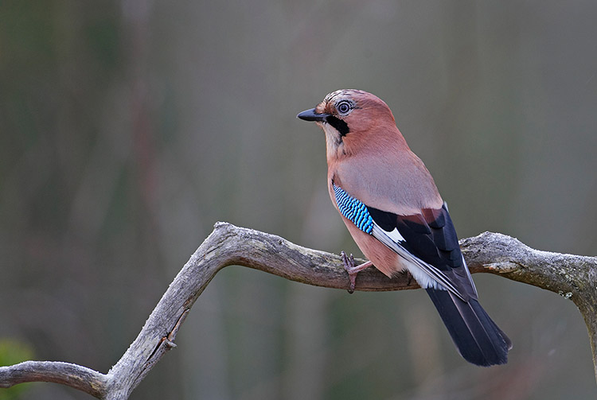
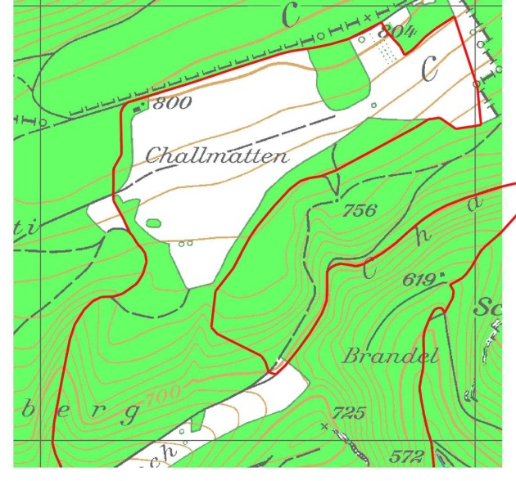
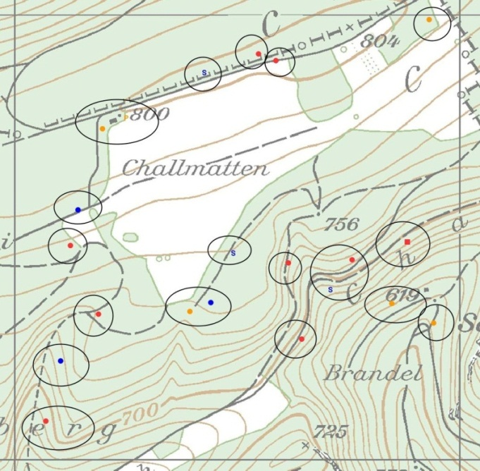
7.9 Case Study: Jays in the Swiss MHB
Territory encounter data:
Mixed sampling protocol
Notes:
This is a comprehensive case study which we cannot go over in detail due to time… but it has some unique aspects to it. See the book!

Slide 42
Summary
A large number of important protocols yield multinomial observation vectors. Multinomial N-mixture models are really useful for such data.
Spatially structured capture-recapture!
Distance sampling can be formulated in terms of a multinomial observation model (tomorrow)
unmarked has unique capabilities for analyzing these models.

Slide 43
3. Bayesian Analysis of Multinomial N-mixture models in BUGS

Slide 44
Multinomial N-mixture in BUGS
Bayesian analysis of multinomial observation models does not pose any novel technical difficulty.
JAGS (and other BUGS) has a multinomial distribution function.
In principle we just specify the multinomial/Poisson model directly:
y[i,] ~ dmulti( probs[i,], N[i] )
N[i] ~ dpois(lambda[i])
However, this construction doesn't work (in JAGS). Cannot have “random” sample size in multinomial distribution. (not so Binomial!)

Slide 45
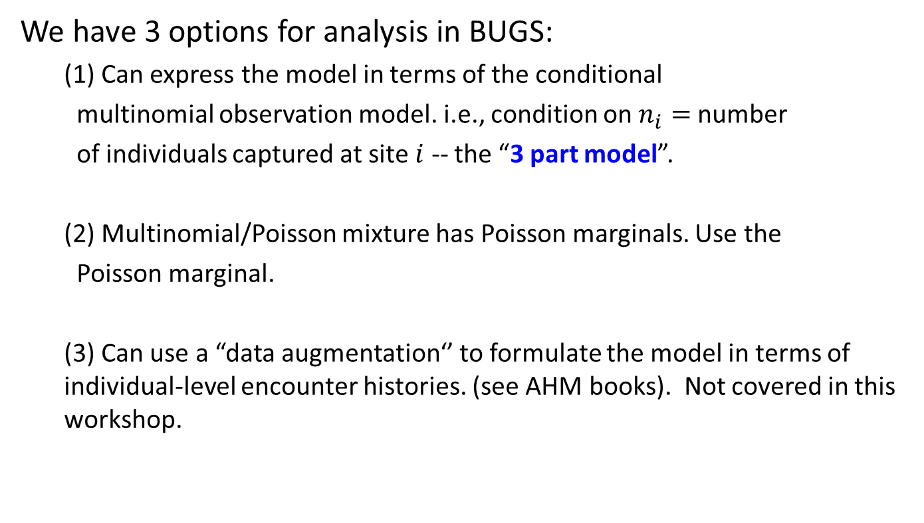
Approaches to Bayesian analysis
We have 3 options for analysis in BUGS:
(1) Can express the model in terms of the conditional
multinomial observation model. i.e., condition on $n_{i}=$number
of individuals captured at site $i$ -- the “3 part model”.
(2) Multinomial/Poisson mixture has Poisson marginals. Use the
Poisson marginal.
(3) Can use a “data augmentation‘’ to formulate the model in terms of individual-level encounter histories. (see AHM books). Not covered in this workshop.
Notes:
DA is “advanced” – won’t cover it here.

Slide 46
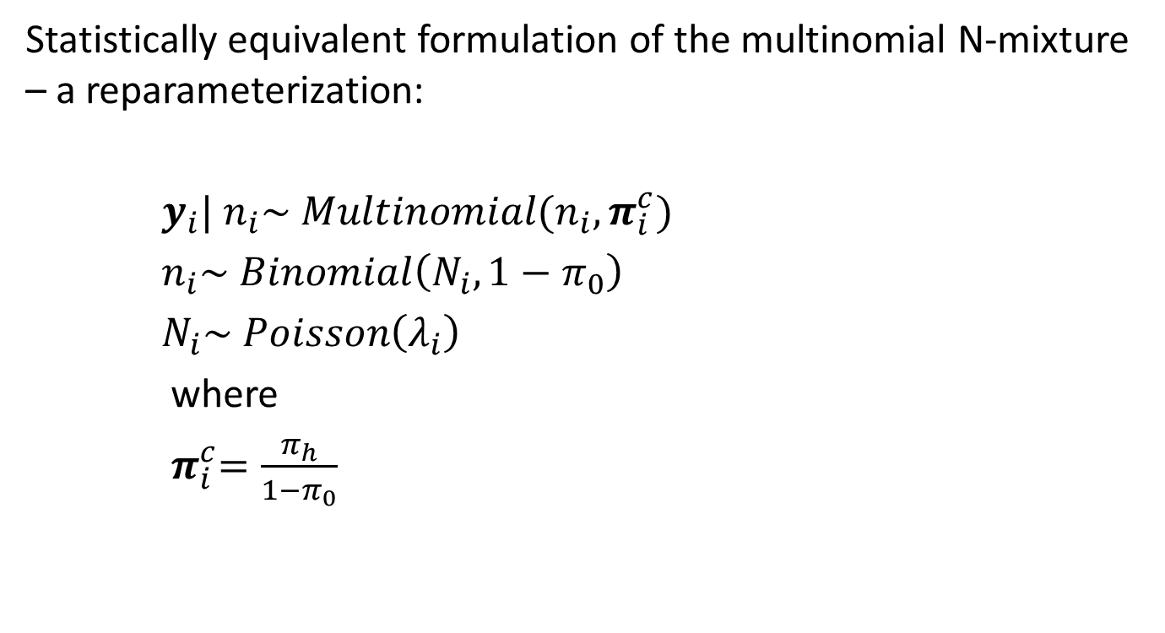
The 3-part (conditional multinomial) model
Statistically equivalent formulation of the multinomial N-mixture – a reparameterization:
$y_{i}| n_{i}\sim Multinomial(n_{i}, π_{i}^{c})$
$n_{i}\sim Binomial\left(N_{i}, 1−π_{0}\right)$
$N_{i}\sim Poisson\left(λ_{i}\right)$
where
${ π}_{i}^{c}=\frac{π_{h}}{1−π_{0}}$
These 2 pieces are equivalent to the target multinomial:
y[i,]~dmulti(pi[i,],N[i])
These are “conditional” cell probabilities – the probability of class h given that it’s in one of the observable classes
Notes:
Pr(a | B) = Pr(a, B)/Pr(B) Pr(B) here = Pr(observable history)

Slide 47
Demonstration: ovenbird data
library(unmarked)
data(ovendata)
# For unmarked
ovenFrame <- unmarkedFrameMPois(y = ovendata.list$data,
siteCovs = as.data.frame(scale(ovendata.list$covariates[,-1])),
type = "removal")
# Harvest the data and bundle it up for sending to BUGS
y <- as.matrix(getY(ovenFrame))
ncap <- apply(y, 1, sum) # number of individuals removed per point
# Bundle the data
data <- list(y = y, M = nrow(y), n = ncap, X=as.matrix(siteCovs(ovenFrame)))
str(data) # Good practice to always inspect your BUGS data
List of 4
$ y: num [1:70, 1:4] 0 1 0 0 0 0 0 0 2 1 ...
$ M: int 70
$ n: num [1:70] 0 1 0 0 0 0 0 0 2 1 ...
$ X: num [1:70, 1:2] 0.8418 0.0302 2.1002 1.086 1.0049 ...
..- attr(*, "dimnames")=List of 2
.. ..$ : chr [1:70] "1" "2" "3" "4" ...
.. ..$ : chr [1:2] "ufc" "trba"

Slide 48
model {
# Prior distributions
p0 ~ dunif(0,1)
alpha0 <- logit(p0)
alpha1 ~ dnorm(0, 0.01)
beta0 ~ dnorm(0, 0.01)
beta1 ~ dnorm(0, 0.01)
beta2 ~ dnorm(0, 0.01)
beta3 ~ dnorm(0, 0.01)
for(i in 1:M){ # Loop over sites
# Conditional multinomial cell probabilities
pi[i,1] <- p[i]
pi[i,2] <- p[i]*(1-p[i])
pi[i,3] <- p[i]*(1-p[i])*(1-p[i])
pi[i,4] <- p[i]*(1-p[i])*(1-p[i])*(1-p[i])
pi0[i] <- 1 - (pi[i,1] + pi[i,2] + pi[i,3] + pi[i,4])
pcap[i] <- 1 - pi0[i]
for(j in 1:4){
pic[i,j] <- pi[i,j] / pcap[i] # compute conditional probs
}
# logit-linear model for detection: understory cover effect
logit(p[i]) <- alpha0 + alpha1 * X[i,1]
# Model specification, three parts:
y[i,1:4] ~ dmulti(pic[i,1:4], n[i]) # component 1 uses the
# conditional cell probabilities
n[i] ~ dbin(pcap[i], N[i]) # component 2 is a model
# for the observed sample size
N[i] ~ dpois(lambda[i]) # part 3 is the process model
# log-linear model for abundance: UFC + TRBA + UFC:TRBA
log(lambda[i])<- beta0 + beta1*X[i,1] + beta2*X[i,2] + beta3*X[i,2]*X[i,1]
}
}
Have to write out the cell probabilities explicitly

Slide 49
Running the model
# Initial values
inits <- function(){
list (p0 = runif(1), alpha1 = runif(1), beta0 = runif(1), N = ncap+2)
}
# Parameters monitored
parameters <- c("p0", "alpha0", "alpha1", "beta0", "beta1", "beta2", "beta3")
# MCMC settings
nc <- 3 ; ni <- 6000 ; nb <- 1000 ; nt <- 1
# Run JAGS and print posterior summary
library(jagsUI)
out1<- jags(data, inits, parameters, "model.txt", n.thin=nt,
n.chains=nc, n.burnin=nb, n.iter=ni)
print(out1, 3)

Slide 50
> print(out1, 3)
JAGS output for model 'model.txt', generated by jagsUI.
Estimates based on 3 chains of 6000 iterations,
adaptation = 100 iterations (sufficient),
burn-in = 1000 iterations and thin rate = 1,
yielding 15000 total samples from the joint posterior.
MCMC ran for 0.111 minutes at time 2023-07-19 16:06:18.
mean sd 2.5% 50% 97.5% overlap0 f Rhat n.eff
p0 0.571 0.062 0.439 0.574 0.681 FALSE 1.000 1.003 1177
alpha0 0.288 0.255 -0.245 0.299 0.757 TRUE 0.876 1.003 1199
alpha1 -0.382 0.314 -1.052 -0.371 0.201 TRUE 0.896 1.003 2091
beta0 0.157 0.136 -0.112 0.158 0.412 TRUE 0.874 1.007 509
beta1 0.217 0.148 -0.076 0.217 0.513 TRUE 0.930 1.009 382
beta2 -0.152 0.138 -0.422 -0.150 0.114 TRUE 0.867 1.013 209
beta3 0.138 0.140 -0.132 0.138 0.415 TRUE 0.837 1.002 1170
deviance 156.394 15.677 132.657 153.868 193.907 FALSE 1.000 1.006 1029

Slide 51
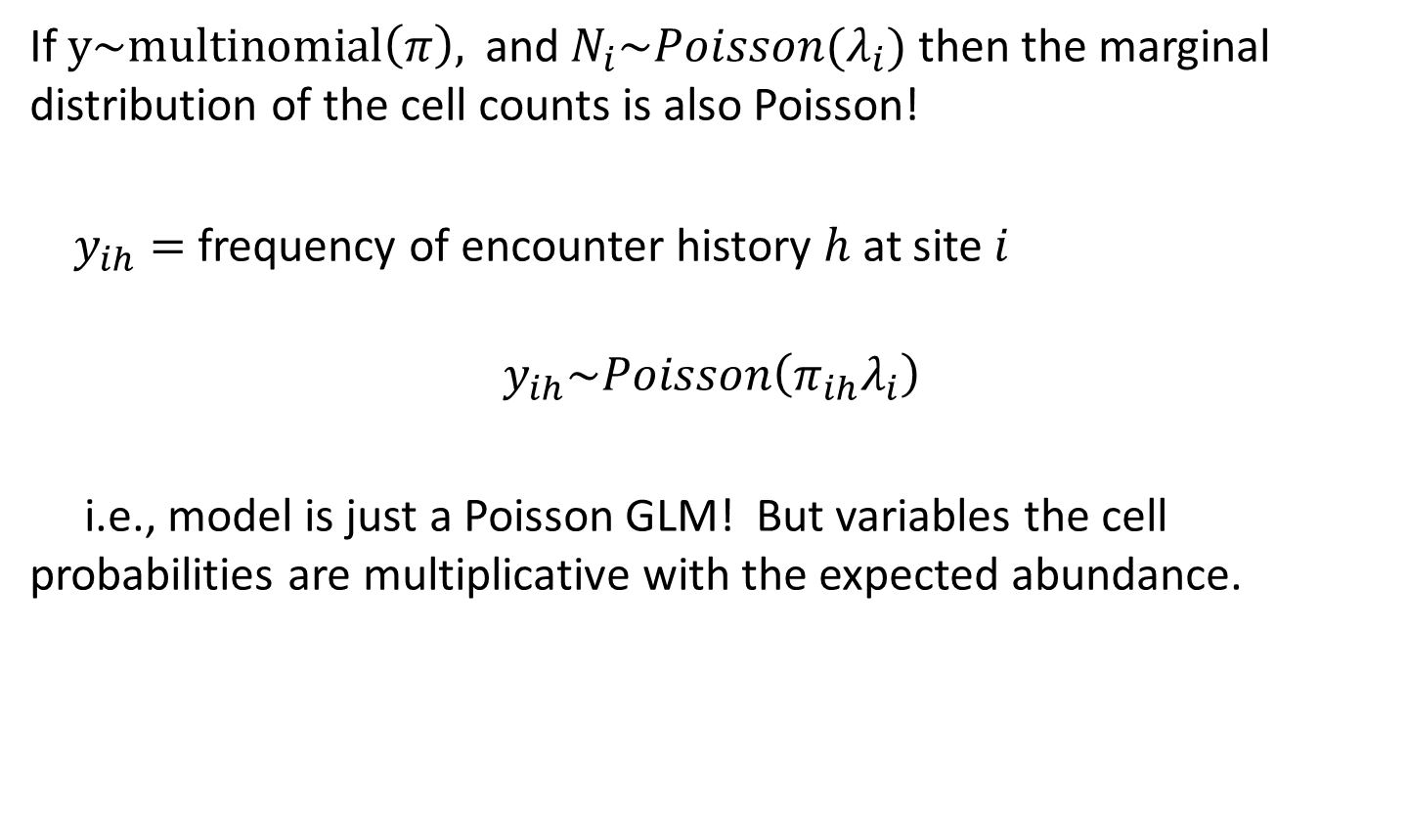
Poisson formulation of the model
If $y\sim multinomial\left(π\right),$and$N_{i}\sim Poisson(λ_{i})$ then the marginal distribution of the cell counts is also Poisson!
$y_{ih}=$frequency of encounter history $h$ at site $i$
$$y_{ih}\sim Poisson\left(π_{ih}λ_{i}\right)$$
i.e., model is just a Poisson GLM! But variables the cell probabilities are multiplicative with the expected abundance.

Slide 52
model {
# Prior distributions
p0 ~ dunif(0,1)
alpha0 <- logit(p0)
alpha1 ~ dnorm(0, 0.01)
beta0 ~ dnorm(0, 0.01)
beta1 ~ dnorm(0, 0.01)
beta2 ~ dnorm(0, 0.01)
beta3 ~ dnorm(0, 0.01)
for(i in 1:M){
# logit-linear model for detection: understory cover effect
logit(p[i]) <- alpha0 + alpha1 * X[i,1]
# log-linear model for abundance: UFC + TRBA + UFC:TRBA
log(lambda[i])<- beta0 + beta1*X[i,1] + beta2*X[i,2] + beta3*X[i,2]*X[i,1]
# Poisson parameter = multinomial cellprobs x expected abundance
pi[i,1] <- p[i] * lambda[i]
pi[i,2] <- p[i] * (1-p[i]) * lambda[i]
pi[i,3] <- p[i] * (1-p[i]) * (1-p[i]) * lambda[i]
pi[i,4] <- p[i] * (1-p[i]) * (1-p[i]) * (1-p[i]) * lambda[i]
for(j in 1:4){
y[i,j] ~ dpois(pi[i,j])
}
# Generate predictions of N[i]
N[i] ~ dpois(lambda[i])
}
These are not “cell probabilities” any more even though I retain the ‘pi’ formulation.

Slide 53
Setting up the analysis
# Bundle up the data and inits
data <- list(y = y, M = nrow(y), X = as.matrix(siteCovs(ovenFrame)))
inits <- function(){
list (p0 = runif(1), alpha1=runif(1), beta0=runif(1), beta1=runif(1), beta2=runif(1),
beta3=runif(1))
}
# Define parameters to save and MCMC settings
parameters <- c("p0", "alpha1", "beta0", "beta1", "beta2", "beta3", "N")
nc <- 3 ; ni <- 6000 ; nb <- 1000 ; nt <- 1
# Call WinBUGS from R and summarize marginal posteriors
out4 <- jags(data, inits, parameters, "modelP.txt", n.thin=nt,
n.chains = nc, n.burnin = nb, n.iter = ni,parallel=FALSE)
print(out4, 3)

Slide 54
Results
> print(out4, 3)
JAGS output for model 'modelP.txt', generated by jagsUI.
Estimates based on 3 chains of 6000 iterations,
adaptation = 100 iterations (sufficient),
burn-in = 1000 iterations and thin rate = 1,
yielding 15000 total samples from the joint posterior.
MCMC ran for 0.192 minutes at time 2023-07-19 20:48:12.
mean sd 2.5% 50% 97.5% overlap0 f Rhat n.eff
p0 0.568 0.062 0.437 0.571 0.681 FALSE 1.000 1.001 10978
alpha1 -0.395 0.319 -1.061 -0.380 0.194 TRUE 0.902 1.000 15000
beta0 0.159 0.133 -0.109 0.160 0.410 TRUE 0.885 1.001 2685
beta1 0.217 0.154 -0.072 0.213 0.529 TRUE 0.931 1.001 2065
beta2 -0.150 0.139 -0.419 -0.151 0.125 TRUE 0.861 1.001 2777
beta3 0.135 0.137 -0.125 0.132 0.414 TRUE 0.837 1.001 2182
deviance 321.853 3.535 316.989 321.248 330.330 FALSE 1.000 1.001 2325
Successful convergence based on Rhat values (all < 1.1).

Slide 55
Class exercise 2
For the ovenbird data, the first 35 sites were in Catoctin National Park and the last 35 were in Frederick County Watershed (where deer harvest occurs).
Expand the model to include a discrete “land unit” effect and see if that is significant or changes the effects of the covariates.
You might consider including an interaction between covariates and land unit.
> ovendata.list$covariates
site ufc trba
1 CAT003 23.43 62.5
2 CAT004 15.62 70.0
3 CAT011 35.54 90.0
4 CAT013 25.78 60.0
5 CAT017 25.00 122.5
6 CAT023 23.43 107.5
7 CAT030 6.64 145.0
8 CAT040 8.20 90.0
9 CAT059 9.70 110.0
10 CAT061 28.12 92.5
11 CAT068 9.37 85.0
12 CAT071 25.78 97.5
CAT = sites 1-35
FCW = sites 36 - 70

Slide 56
PART 4: Multi-session and open population models: Multiple or repeated surveys (JAGS and unmarked)

Slide 57
Multi-session and open population models: Multiple or repeated surveys
Repeated survey episodes within or among seasons. This is very common!
We might like to combine the data from these multiple sessions into a single joint analysis
Improved power to estimate effects, etc..
Temporal dynamics
Avoid having to “do statistics on statistics” and deal properly with uncertainty
Temporal replication allows the possibility that abundance is changing over time and hence we might consider “open populations”

Slide 58
Confusing Nomenclature
Terminology is very confusing here: sample, survey, replicate, session, period, occasion, season, year, blah blah blah
Define: Session = survey episode that produces data suitable for estimating parameters of interest for a closed population. Usually the same as: primary period or “year” or “season”
Within a session or primary period, N is not changing.
Among sessions or primary periods, N may change.
Sampling within a primary period is where information about detection parameters comes from: Replicate counts (binomial counts) or class structure (multinomial counts)
“Robust design” structure (2-levels of sampling)

Slide 59
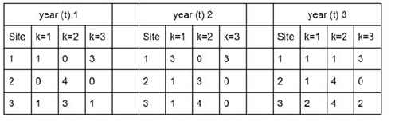
Multiple Survey Sessions
Multi-session data structure (shown here for simple counts)
(note: year == “primary period” not necessarily year)
What do we do with this type of data?
Depends on whether we are interested in dynamics among the primary periods (survival, recruitment)

Slide 60
Multi-session Multinomial mixture models
No dynamics: Stack the data: treat each session as a new sites
Assumes sites (hence sessions) are independent and closed
Probably adequate for modeling covariates with slight misspecification of variance estimates
Partial or random dynamics: Can fit a temporary emigration model using gpcount(also gdistsamp,gmultmix) (Chandler et al. 2011)
Model dynamics by random temporary emigration (“implicit” dynamics)
Accounts for dependence across sessions within a site
Full dynamics: Dail-Madsen (2011) model (pcountOpen, multimixOpen, distsampOpen)
Model survival and recruitment rate explicitly!
Notes:
How to analyze multi-session data

Slide 61
Approaches to open models in unmarked
 | Stacked data (“year as stratum”) | Partial dynamics: Temporary emigration | Full dynamics
Count data | pcount | gpcount | pcountOpen
Multinomial data | gmultmix | gmultmix | multmixOpen
Distance sampling data | distsamp/ gdistsamp | gdistsamp | distsampOpen
You can do all of these in BUGS/JAGS too!

Slide 62
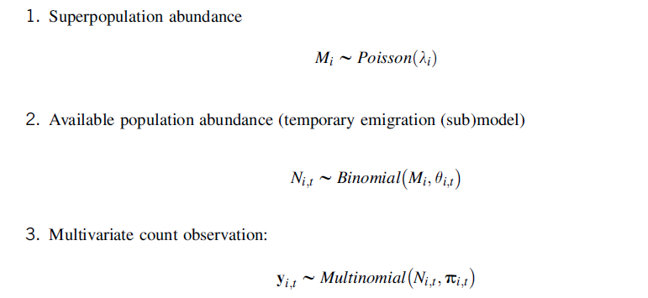
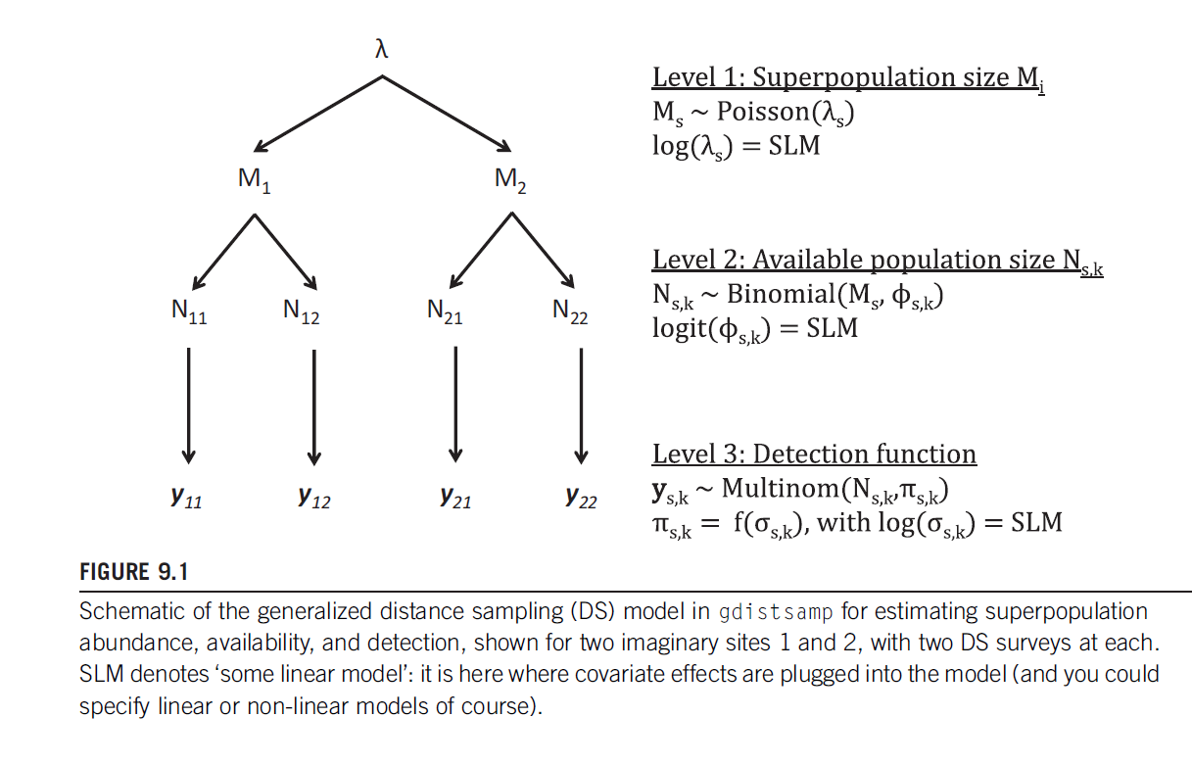
Independent Dynamics – temporary emigration
3-level hierarchical model
Notes:
This is the “partial dynamics” or “random dynamics” model.

Slide 63
gmultmix data structure
Data structure for multi-session designs is a lot more complicated!
Specify multiple sessions with numPrimary argument
Multi-session data should be in “wide” format (i.e., not stacked)
There can be covariates that vary by site AND session. In unmarked we call these “yearly site covariates” and they get stuffed into the unmarkedFrame as yearlySiteCovs argument. Constant across reps within sessions.
obsCovs are also in wide format (matrix for each session)
summary(alfl.umf <- unmarkedFrameGMM(y = Ywide,
siteCovs = alfl.covs[,c("woody", "struct")], obsCovs = list(occ = occ),
numPrimary = 3, yearlySiteCovs = list(time = time, date = date),
obsToY = o2y, piFun = "crPiFun") )
obsCovs = “wide” format [X1, X2, … ] example: in ALFL data: occasion to demo but not really meaningful since reps are consecutive
yearlySiteCovs = nsites x nPrimary matrix. Example: in ALFL data, time of survey, day of survey. These vary by site and the primary occasion but not (practically speaking) within the primary occasion.
Notes:
Data structure for the partial/random dynamics. Example in R script.

Slide 64
Chandler’s ALFL data
For ALFL data the covariates are “date” and “time” (of day)
These become YearlySiteCovs b/c they are constant across all intervals within a sample session
But they can affect p or phi (availability) or both
Here we think of things like day or time of day as affecting availability most likely. Given availability, detection should not depend on time of day. But this is debatable!
See R script for example of random dynamics model (aka temporary emigration)
Notes:
Data structure for the partial/random dynamics. Example in R script.

Slide 65
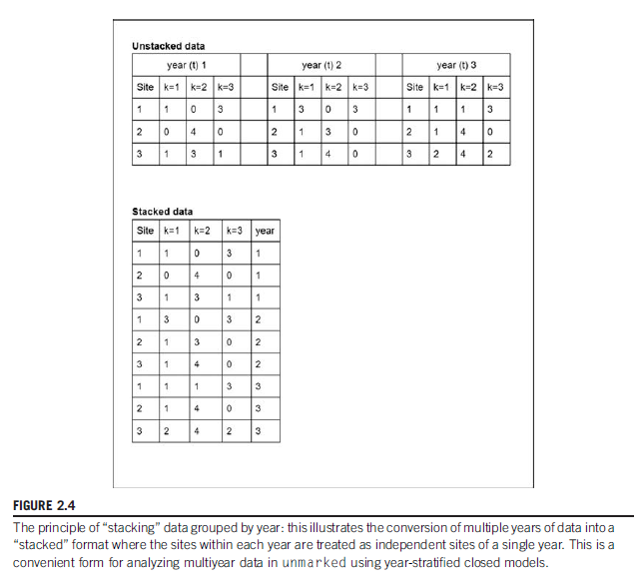
Stacking the data
E.g., a survey design with 3 “primary periods”, as in Robust Design
gmultmix operates on the wide matrix: Y = [Y1, Y2, Y3]
Each Yt = nsites x nreps
Y = nsites x (3*nreps)
Ystacked = rbind(Y1, Y2, Y3)
Ystacked is 3*nsites x nreps
Primary periods become “new” sites in a larger Y matrix.
We have to replicate each siteCov and we have to vectorize each yearlySitecov. These are both treated as siteCovs now.
From AHM2

Slide 66
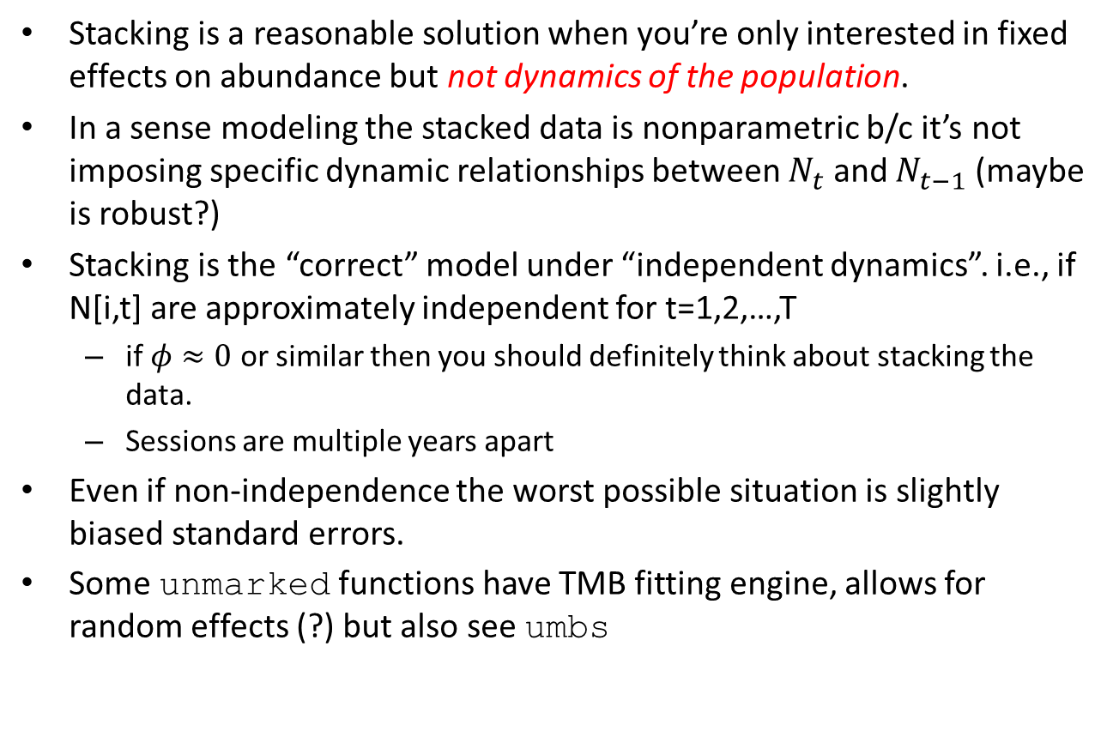
Stacking the data
Stacking is a reasonable solution when you’re only interested in fixed effects on abundance but not dynamics of the population.
In a sense modeling the stacked data is nonparametric b/c it’s not imposing specific dynamic relationships between $N_{t}$ and $N_{t−1}$ (maybe is robust?)
Stacking is the “correct” model under “independent dynamics”. i.e., if N[i,t] are approximately independent for t=1,2,…,T
if $φ≈0$ or similar then you should definitely think about stacking the data.
Sessions are multiple years apart
Even if non-independence the worst possible situation is slightly biased standard errors.
Some unmarked functions have TMB fitting engine, allows for random effects (?) but also see umbs

Slide 67
ALFL analysis (stacked data)
# Load ALFL data as before
… not shown …
# Stacked data
Ystacked <- rbind(Ywide[,1:7], Ywide[,8:14], Ywide[,15:21])
sc <- alfl.covs[,c("woody", "struct")]
sc <- rbind(sc, sc, sc) # Repeat the site covs matrix
sc <- cbind(sc, date = c(date), time = c(time)) # YearlySiteCovs become siteCovs
# Specify numPrimary = 1 for the stacked data
summary(stacked.umf <- unmarkedFrameGMM(y = Ystacked, siteCovs = sc, numPrimary = 1,
obsToY = o2y, piFun = "crPiFun") )
#
# Use gmultmix here. Remember order of formulas: lambda, phi, p. phi = ~1 for stacked data
#
# Models with time on lambda or p or both
m0 <- gmultmix( ~1, ~1, ~1, data = stacked.umf, mixture = "P")
m1 <- gmultmix( ~1, ~1, ~time, data = stacked.umf, mixture = "P")
m1b <- gmultmix( ~time, ~1, ~1, data = stacked.umf, mixture = "P")
m1c <- gmultmix( ~time, ~1, ~time, data = stacked.umf, mixture = "P")
(see script)

Slide 68
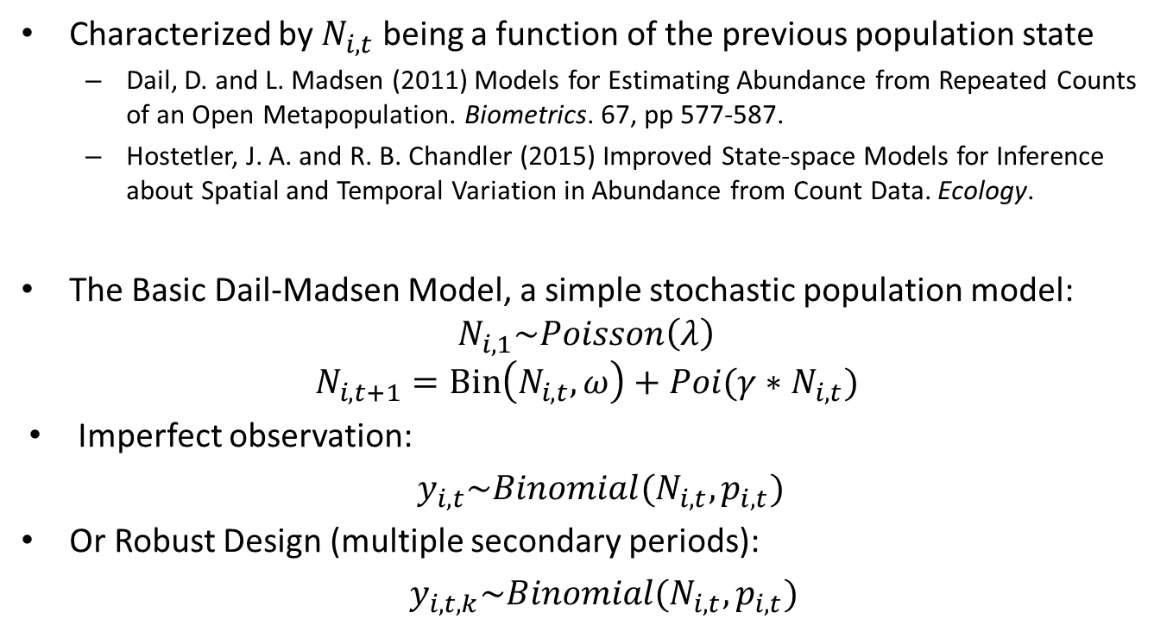
Fully Dynamic Models
Characterized by $N_{i,t}$ being a function of the previous population state
Dail, D. and L. Madsen (2011) Models for Estimating Abundance from Repeated Counts of an Open Metapopulation. Biometrics. 67, pp 577-587.
Hostetler, J. A. and R. B. Chandler (2015) Improved State-space Models for Inference about Spatial and Temporal Variation in Abundance from Count Data. Ecology.
The Basic Dail-Madsen Model, a simple stochastic population model:
$$N_{i,1}\sim Poisson\left(λ\right)$$
$$N_{i,t+1}=Bin\left(N_{i,t},ω\right)+Poi(γ{∗N}_{i,t})$$
Imperfect observation:
$y_{i,t}\sim Binomial(N_{i,t}, p_{i,t})$
Or Robust Design (multiple secondary periods):
$y_{i,t,k}\sim Binomial(N_{i,t},p_{i,t})$

Slide 69
Fully Dynamic Models
Typically, we think of the D-M model as a model of population dynamics over annual time periods. But it’s a fine model of within year dynamics too, such as to describe migration dynamics at stopover sites and within-season dynamics

Slide 70
Fully Dynamic Models: multmixOpen
abundance
multmixOpen(lambdaformula,
gammaformula,
omegaformula,
pformula,
data, mixture = c("P", "NB", "ZIP"), K, dynamics=c("constant", "autoreg", "notrend", "trend", "ricker", "gompertz"), fix=c("none", "gamma", "omega"), starts, method = "BFGS", se = TRUE, immigration = FALSE, iotaformula = ~1, ...)
recruitment
survival
detection

Slide 71
Fully Dynamic Models: unmarkedFrameMMO
unmarkedFrameMMO:Data packaging function for open models class “multmixOpen”
umf <- unmarkedFrameMMO(y=y, numPrimary=3, siteCovs=sc, type="removal")
Same structure for objects as before
Does not yet allow custom piFuns (e.g., capture-recapture)
Have to fake-up removal data for ALFL data

Slide 72
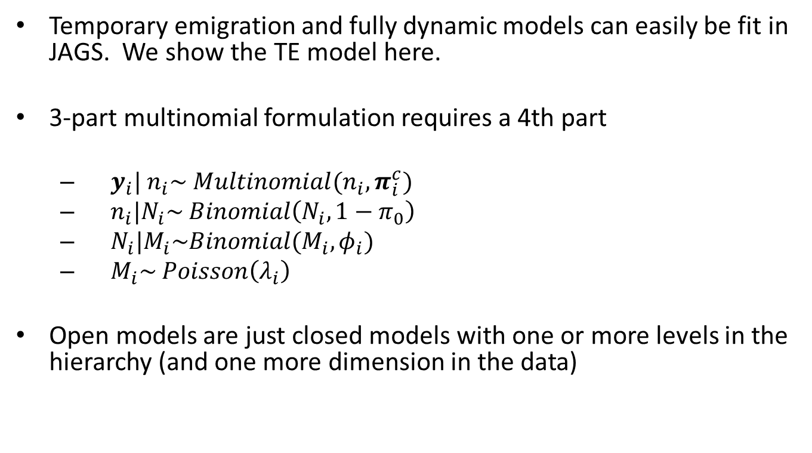
Open population models in JAGS
Temporary emigration and fully dynamic models can easily be fit in JAGS. We show the TE model here.
3-part multinomial formulation requires a 4th part
$y_{i}| n_{i}\sim Multinomial(n_{i}, π_{i}^{c})$
$n_{i}|N_{i}\sim Binomial\left(N_{i}, 1−π_{0}\right)$
$N_{i}|M_{i}\sim Binomial(M_{i}, φ_{i})$
$M_{i}\sim Poisson\left(λ_{i}\right)$
Open models are just closed models with one or more levels in the hierarchy (and one more dimension in the data)

Slide 73
Open model data structures
In the BUGS engines we use a 3-d data structure which is very convenient in BUGS model specifications:
# For ALFL data (7 encounter histories, 3 sessions)
y3d <- array(NA, dim = c(nrow(Ywide), 7, 3) ) # Create 3D array
y3d[,,1] <- Ywide[,1:7]
y3d[,,2] <- Ywide[,8:14]
y3d[,,3] <- Ywide[,15:21]
nsessions <- 3 # Number of primary sessions
nsites <- nrow(Ywide) # Number of sites
nobs <- apply(y3d, c(1,3), sum) # Total detections per site and session

Slide 74
In JAGS (this is covered in Section 2.7 of AHM2)
# Likelihood
for (i in 1:nsites) {
# Linear model for lambda
log(lambda[i]) <- beta0 + beta1*woody[i] + beta2*struct[i]
for(k in 1:nseasons){
# Linear models for phi and p
logit(phi[i,k]) <- gamma0 + gamma1*date[i,k] + gamma2*time[i,k]
logit(p[i,k]) <- alpha0 + alpha1*date[i,k]
# Define multinomial cell probabilities
cp[i,k,1] <- (1-p[i,k])*(1-p[i,k])*p[i,k]
cp[i,k,2] <- (1-p[i,k])*p[i,k]*(1-p[i,k])
cp[i,k,3] <- (1-p[i,k])*p[i,k]*p[i,k]
cp[i,k,4] <- p[i,k]*(1-p[i,k])*(1-p[i,k])
cp[i,k,5] <- p[i,k]*(1-p[i,k])*p[i,k]
cp[i,k,6] <- p[i,k]*p[i,k]*(1-p[i,k])
cp[i,k,7] <- p[i,k]*p[i,k]*p[i,k]
cp[i,k,8] <- 1-sum(cp[i,k,1:7])
cellprobs.cond[i,k,1] <- cp[i,k,1]/sum(cp[i,k,1:7])
cellprobs.cond[i,k,2] <- cp[i,k,2]/sum(cp[i,k,1:7])
cellprobs.cond[i,k,3] <- cp[i,k,3]/sum(cp[i,k,1:7])
cellprobs.cond[i,k,4] <- cp[i,k,4]/sum(cp[i,k,1:7])
cellprobs.cond[i,k,5] <- cp[i,k,5]/sum(cp[i,k,1:7])
cellprobs.cond[i,k,6] <- cp[i,k,6]/sum(cp[i,k,1:7])
cellprobs.cond[i,k,7] <- cp[i,k,7]/sum(cp[i,k,1:7])
# Conditional 4-part version of the model
pdet[i,k] <- sum(cp[i,k, 1:7])
pmarg[i,k] <- pdet[i,k]*phi[i,k]
#Part 4: Multinomial
y3d[i,1:7,k] ~ dmulti(cellprobs.cond[i,k,1:7], nobs[i,k])
#Part 3: Number of detected individuals
nobs[i,k] ~ dbin(pmarg[i,k], M[i])
#Part 2: Number of available individuals
Navail[i,k] ~ dbin(phi[i,k], M[i])
} # end k
M[i] ~ dpois(lambda[i]) #Part 1: Abundance model
} # end i
This example shows a capture-recapture type of protocol with 3 capture periods, such as applicable to the ALFL data (or Swiss MHB data)

Slide 75
ALFL model results
> print(out7, 3)
JAGS output for model 'CR_TE.txt', generated by jagsUI.
Estimates based on 3 chains of 10000 iterations,
adaptation = 1000 iterations (sufficient),
burn-in = 5000 iterations and thin rate = 5,
yielding 3000 total samples from the joint posterior.
MCMC ran in parallel for 0.541 minutes at time 2023-06-27 13:49:25.
mean sd 2.5% 50% 97.5% overlap0 f Rhat n.eff
beta0 -0.781 0.411 -1.613 -0.778 -0.003 FALSE 0.975 1.012 205
beta1 1.952 0.619 0.706 1.970 3.143 FALSE 1.000 1.005 603
beta2 0.054 0.036 -0.019 0.055 0.121 TRUE 0.927 1.001 1798
alpha0 0.717 0.159 0.412 0.714 1.022 FALSE 1.000 1.000 3000
alpha1 -0.038 0.012 -0.061 -0.037 -0.015 FALSE 0.998 1.002 1773 # date is on detection too
gamma0 -0.359 0.295 -0.986 -0.353 0.180 TRUE 0.891 1.007 296
gamma1 -0.059 0.015 -0.089 -0.058 -0.031 FALSE 1.000 1.003 643
gamma2 -0.414 0.145 -0.709 -0.412 -0.143 FALSE 0.999 1.003 701
Mtotal 80.598 11.247 66.000 78.000 108.000 FALSE 1.000 1.010 204
Davail[1] 0.395 0.167 0.154 0.365 0.797 FALSE 1.000 1.004 484
Davail[2] 0.289 0.123 0.115 0.268 0.584 FALSE 1.000 1.003 611
Davail[3] 0.163 0.074 0.062 0.149 0.346 FALSE 1.000 1.004 583
Dtotal 0.634 0.264 0.254 0.585 1.269 FALSE 1.000 1.013 212
deviance 480.901 13.992 458.027 479.353 511.974 FALSE 1.000 1.012 174
Habitat covariates: woody and struct
Availability covs: date and time

Slide 76
The end
For Bayesian analysis of the DM model – you have the tools to do it!

