Slide 1
An Analysis of Logistic Regression vs. Artificial Neural Network for Predicting Loan Default
Katherine Reed
CSCI U599
December 9, 2020

Slide 2
Presentation Outline
Introduction
Literature Review
Methodology
Implementation
Experimental setup
Results analysis
Conclusions
References
Demo

Slide 3
Introduction

Slide 4

Introduction
Relevance of Study
The United States loan market is a multi-trillion-dollar industry
Majority of Americans take out a loan from a financial institution at least once in their lives
Loan Application Evaluation
When evaluating a loan application, lenders must determine the applicant’s credit risk
Lenders typically estimate an applicant’s credit risk by evaluating factors such as:
Loan amount Debt-to-income ratio
Loan purpose Employment history
Loan interest rate Credit history
Figure 1. Retrieved from https://wallethub.com/edu/pl/same-day-loans/67705

Slide 5

Introduction
Problem Statement
When a person receives a loan, they must repay the loan and any accrued interest in full within a certain timeframe agreed upon by both parties.
If the borrower fails to repay the loan, the loan goes into default, which can have serious negative consequences for both the lender and the borrower.
Purpose of Study
Evaluate a person’s credit risk using two machine learning algorithms, Logistic Regression and Artificial Neural Networks, to determine the likelihood of a person defaulting on a loan
Use various metrics to compare these two algorithms for their respective ability to predict the outcome of a loan
Figure 2. Retrieved from https://becominghuman.ai/an-introduction-to-machine-learning-33a1b5d3a560

Slide 6
Literature Review

Slide 7
Literature Review
Knowledge Discovery: Some Empirical Evidence and Directions for Future Research (2001)
Handzic and Aurum conducted an experiment in which 32 subjects acted as managers of a fake ice cream company. Their task was to forecast the amount of ice cream sold each day for 30 consecutive days based on historical transaction data available in the company’s database
This study found that humans have a reasonably good ability to discover relationships and patterns in data. However, the study showed that this predictive power is less than what is theoretically possible based on the actual patterns and relationships present in the data.
Effectiveness of Artificial Neural Network in Credit Risk Analysis (2019)
Jepkemei conducted a study on loan default prediction by applying a neural network to data of 1,000 customers of multiple financial institutions in Kenya.
Her experimental model predicted loan default with 99.3% accuracy
A Study on Predicting Loan Default Based on the Random Forest Algorithm (2019)
Zhu et al. applied various machine learning models, including random forest, decision tree, support vector machine, and logistic regression, to the analysis of 115, 000 Q1 2019 loans from Lending Club.
Random forest model accuracy – 98%, decision tree accuracy – 95%, support vector machine accuracy – 75%, logistic regression accuracy – 73%

Slide 8
Methodology

Slide 9
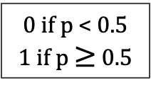
Logistic Regression
Logistic regression functions as a binary classifier by using a linear combination of independent variables to estimate the probability, p, that a specific outcome will occur, i.e. the probability that a person will default on a loan
Because the result of logistic regression is a probability value, the number generated must be bounded by 0 and 1. This makes this algorithm well-suited for solving binary classification problems.
Independent predictor variables: financial data about the person and the loan
Binary dependent variable: loan status (0 for fully paid; 1 for default)
0 if p < 0.5
1 if p $≥$ 0.5

Slide 10
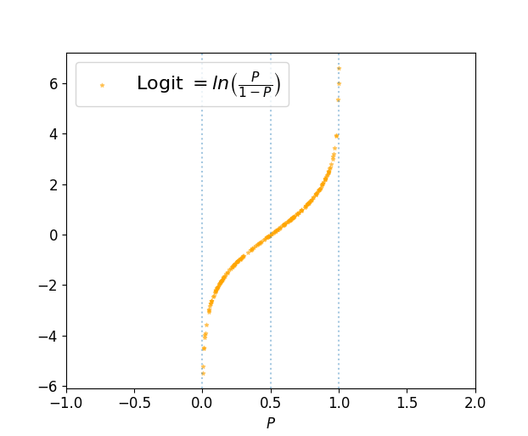
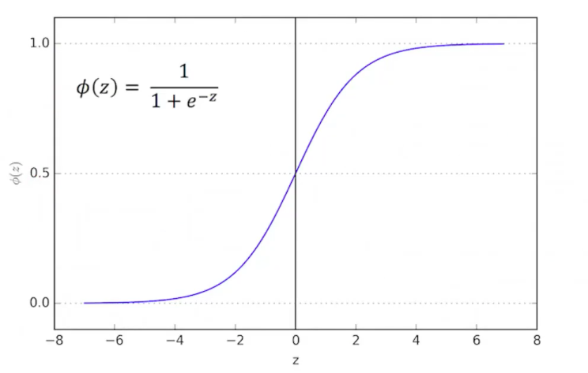
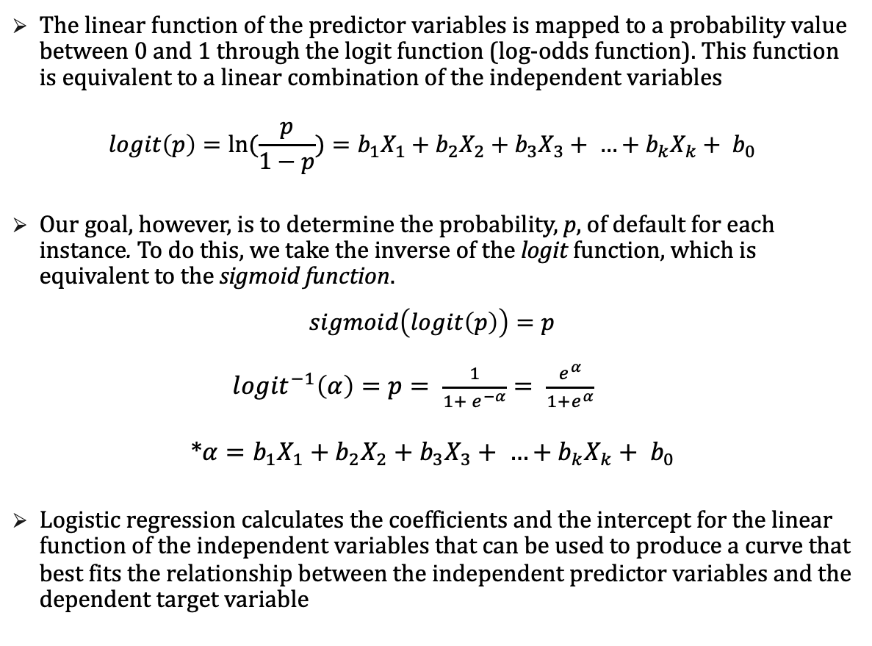
Logistic Regression
The linear function of the predictor variables is mapped to a probability value between 0 and 1 through the logit function (log-odds function). This function is equivalent to a linear combination of the independent variables
$$logit\left(p\right)=\ln{(\frac{p}{1−p})}=b_{1}X_{1}+b_{2}X_{2}+b_{3}X_{3}+ …+b_{k}X_{k}+ b_{0}$$
Our goal, however, is to determine the probability, p, of default for each instance. To do this, we take the inverse of the logit function, which is equivalent to the sigmoid function.
$$sigmoid\left(logit\left(p\right)\right)=p$$
${logit}^{−1}\left(α\right)=p= \frac{1}{1+ e^{−α}}= \frac{e^{α}}{1+e^{α}}$
*$α=b_{1}X_{1}+b_{2}X_{2}+b_{3}X_{3}+ …+b_{k}X_{k}+ b_{0}$
Logistic regression calculates the coefficients and the intercept for the linear function of the independent variables that can be used to produce a curve that best fits the relationship between the independent predictor variables and the dependent target variable
Logit
Figure 3. Retrieved from: https://towardsdatascience.com/logit-of-logistic-regression-understanding-the-fundamentals-f384152a33d1
Sigmoid
Figure 4. Retrieved from https://towardsdatascience.com/logistic-regression-a-simplified-approach-using-python-c4bc81a87c31

Slide 11
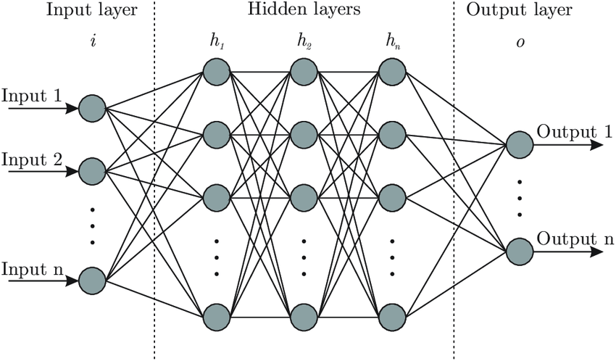
Artificial Neural Network
Artificial neural networks are computational models that are designed to mimic the structure of biological neural networks found in the brain.
The structure of a neural network consists of nodes (the neurons) that are arranged into multiple layers:
Input layer – first layer; provides the initial data about the independent variables/features to the network for processing
One or more intermediate hidden layers – performs computations on the data from the input layer and transfer the results to the output layer
Output layer – last layer; produces the final prediction generated by the neural network
The neurons in each layer have weighted connections to each neuron in the next layer.
Each neuron also has an associated bias term.
Figure 5. Retrieved from https://www.kdnuggets.com/2019/11/designing-neural-networks.html

Slide 12
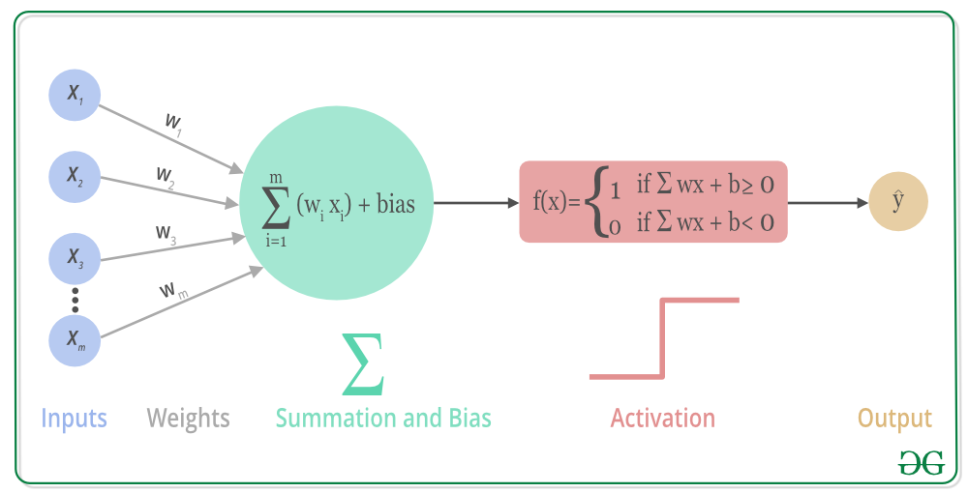
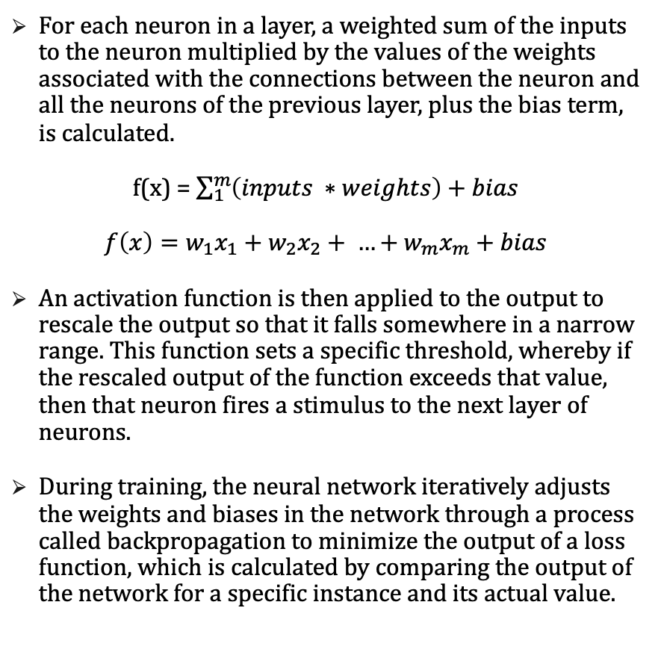
Artificial Neural Network
For each neuron in a layer, a weighted sum of the inputs to the neuron multiplied by the values of the weights associated with the connections between the neuron and all the neurons of the previous layer, plus the bias term, is calculated.
f(x) = $\sum_{1}^{m}{\left(inputs ∗weights\right)+bias}$
$$f\left(x\right)=w_{1}x_{1}+w_{2}x_{2}+ …+w_{m}x_{m}+bias$$
An activation function is then applied to the output to rescale the output so that it falls somewhere in a narrow range. This function sets a specific threshold, whereby if the rescaled output of the function exceeds that value, then that neuron fires a stimulus to the next layer of neurons.
During training, the neural network iteratively adjusts the weights and biases in the network through a process called backpropagation to minimize the output of a loss function, which is calculated by comparing the output of the network for a specific instance and its actual value.
Figure 6. Retrieved from
https://www.geeksforgeeks.org/understanding-activation-functions-in-depth/

Slide 13
Implementation

Slide 14
Implementation
Technology
Application: Jupyter Notebook
Language: Python 3.8
Libraries:
Pandas – data analysis
Numpy – operating on arrays/matrices
Scikit-learn – logistic regression & metrics
Imblearn – correcting imbalanced dataset
Keras – artificial neural network
Dataset
Kaggle dataset that contains loan data for loans issued between 2007 and 2011 from Lending Club, an online peer-to-peer lending company
39,718 loans/rows
111 features/columns, including:
Loan amount
Interest rate
Annual income
Home ownership type (rent/own)
Employment length
Loan status (target variable)
Etc.

Slide 15
Experimental Setup

Slide 16
Experimental Setup
Remove Null values
Remove columns that contain only one unique value
Remove rows in which loan_status isn’t ‘Fully Paid’ or ‘Charged Off’ (default)
Convert loan_status to 0 if loan was ‘Fully Paid’ and 1 if loan was ‘Charged Off’
Remove columns that are irrelevant in predicting loan default

Slide 17
Experimental Setup
Remove outliers
Top 3% of values
Create dummy variables for categorical columns
Split into train and test sets
80% train
20% test
Normalize features using Standard Scaler
Clean up data formats

Slide 18
Experimental Setup
Correct imbalanced data using Synthetic Minority Oversampling Technique (SMOTE)
Implement algorithms
Scikit-Learn – Logistic Regression
Keras – Neural Network
Metrics evaluation

Slide 19
Results Analysis

Slide 20
Results Analysis
Logistic Regression
Neural Network
Predicted Values
Predicted Values
Negative (0)
Positive (1)
Negative (0)
Positive (1)
2291 | 1297
188 | 322
3115 | 473
402 | 108
Negative (0)
Negative (0)
Actual Values
Actual Values
Positive (1)
Positive (1)

Slide 21
Results Analysis
Accuracy: the proportion of the total number of predictions that were correctly predicted
Precision: the proportion of the positive predictions (model output of 1) that were correctly predicted
Recall / Sensitivity: the proportion of actual positive instances (target variable value of 1) that were correctly predicted
Specificity: the proportion of actual negative instances (target variable value of 0) that were correctly predicted
 | Logistic Regression | Neural Network
Accuracy Correct predictions / All predictions | 63.76% | 78.55%
Precision True positives / (True positives + false positives) | 19.89% | 18.78%
Recall / Sensitivity True positives / (True positives + false negatives) | 63.14% | 21.76%
Specificity True negatives / (True negatives + false positives) | 63.85% | 86.62%

Slide 22
Conclusions

Slide 23
Conclusions
The artificial neural network model had better accuracy and higher specificity
Logistic regression model had better precision and higher sensitivity
Financial institutions must decide for themselves what level of risk they are willing to assume when issuing a loan because they must balance the benefits of generating a profit from the interest payments with the potential risk of not recovering the full amount of the loan
If the financial institution is most concerned with being able to correctly predict that the applicant will default on the loan, logistic regression yielded the better model. Downside of a model with high sensitivity and low specificity: higher rate of false positives (loss of potential profits)
If the financial institution is most concerned with being able to correctly predict that the applicant will repay the loan in full, the artificial neural network yielded the better model. Downside of a model with high specificity and low sensitivity: higher rate of false negatives (more instances of default)
Dataset only contained 39,718 loans for training and testing purposes, and the true predictive power of artificial neural networks is realized with extremely large datasets

Slide 24
References

Slide 25
References
Brixius, Nathan. “The Logit and Sigmoid Functions.” Nathan Brixius, 30 Jan. 2019, nathanbrixius.wordpress.com/2016/06/04/functions-i-have-known-logit-and-sigmoid/.
Eletter, Shorouq & Yaseen, Saad & Elrefae, Ghaleb. 2010. Neuro-Based Artificial Intelligence Model for Loan Decisions. American Journal of Economics and Business Administration 2, 1 (Jan. 2010), 27-34. DOI: 10.3844/ajebasp.2010.27.34.
Handzic, Meliha & Aurum, Aybüke. 2001. Knowledge Discovery: Some Empirical Evidence and Directions for Future Research. 70. DOI: 10.1007/978-3-642-57547-1_86.
“Initializing and Accessing Bias with Keras.” Deeplizard, deeplizard.com/learn/video/zralyi2Ft20.
Jepkemei, Betty. 2019. Effectiveness of Artificial Neural Network in Credit Risk Analysis. International Journal of Scientific & Engineering Research 10, 7 (June 2019).
Jordan, Jeremy. “Neural Networks: Representation.” Jeremy Jordan, Jeremy Jordan, 26 Jan. 2018, www.jeremyjordan.me/intro-to-neural-networks/.
Keras Team. “Keras Documentation: Layer Weight Initializers.” Keras, keras.io/api/layers/initializers/.
Kostadinov, S. (2019, August 12). Understanding Backpropagation Algorithm. Retrieved October 25, 2020, from https://towardsdatascience.com/understanding-backpropagation-algorithm-7bb3aa2f95fd

Slide 26
References
Mulla, Zeeshan. “Cost, Activation, Loss Function|| Neural Network|| Deep Learning. What Are These?” Medium, Medium, 5 May 2020, medium.com/@zeeshanmulla/cost-activation-loss-function-neural-network-deep-learning-what-are-these-91167825a4de.
Schoonjans, Frank. “Logistic Regression.” MedCalc, MedCalc Software, 1 July 2020, www.medcalc.org/manual/logistic_regression.php
Keras Team. “Keras Documentation: Layer Weight Initializers.” Keras, keras.io/api/layers/initializers/.
Sharma, Avinash V. “Understanding Activation Functions in Neural Networks.” Medium, The Theory Of Everything, 30 Mar. 2017, medium.com/the-theory-of-everything/understanding-activation-functions-in-neural-networks-9491262884e0.
Wijaya, C. Y. (2020, September 14). 5 SMOTE Techniques for Oversampling your Imbalance Data. Retrieved October 25, 2020, from https://towardsdatascience.com/5-smote-techniques-for-oversampling-your-imbalance-data-b8155bdbe2b5
Zhu, Lin & Qiu, Dafeng & Ergu, Daji & Ying, Cai & Liu, Kuiyi. 2019. A study on predicting loan default based on the random forest algorithm. Procedia Computer Science 162 (Jan. 2019), 503-513. DOI: 10.1016/j.procs.2019.12.017.

