Slide 1

What is the NBA?
Team 5:
Kenneth Reed, John Michals, Michael Oristano, Fardi Yeung
27 September 2018

Slide 2





Notes:
Ken

Slide 3
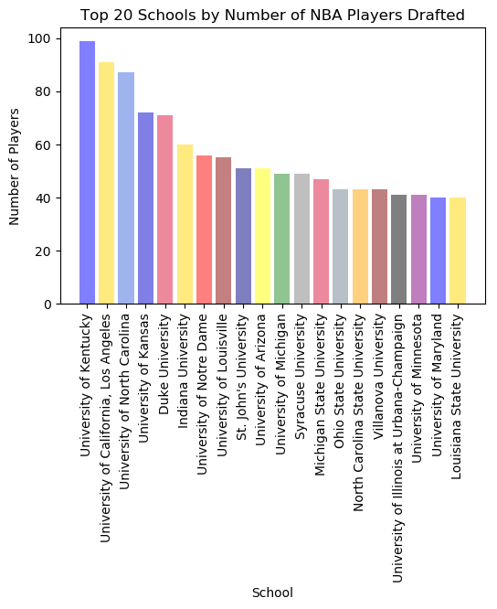
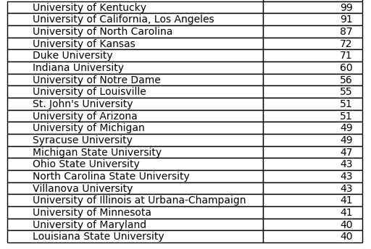
Which Schools Produce the Most NBA Player?
School Name # of Students

Slide 4
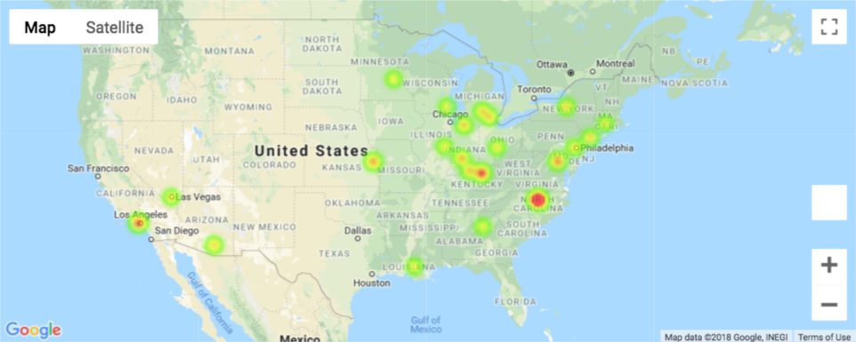


Where are the Schools that produce the most Players?
Notes:
Ken

Slide 5
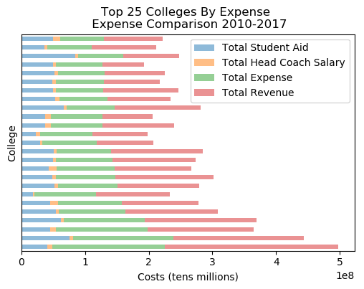
What do the top 25 expenses and revenues look like?
Institution Name | Total Expense | Total Revenue
University of Notre Dame | $37,852,017.00 | $36,053,910.00
Georgia Institute of Technology-Main Campus | $45,498,472.00 | $57,368,983.00
Louisiana State University and Agricultural & Mechanical College | $47,165,015.00 | $59,713,588.00
University of Nevada-Las Vegas | $34,483,011.00 | $62,101,359.00
St Johns University-New York | $64,364,232.00 | $64,364,232.00
University of Connecticut | $72,284,673.00 | $65,413,874.00
Villanova University | $64,312,118.00 | $73,595,234.00
University of Michigan-Ann Arbor | $71,060,957.00 | $87,705,454.00
University of California-Los Angeles | $74,282,397.00 | $88,005,440.00
Georgetown University | $85,306,187.00 | $88,956,862.00
University of Maryland-College Park | $72,991,337.00 | $93,766,500.00
North Carolina State University at Raleigh | $63,493,129.00 | $96,557,161.00
University of Minnesota-Twin Cities | $69,712,529.00 | $101,293,810.00
Marquette University | $96,422,052.00 | $115,471,497.00
University of Illinois at Urbana-Champaign | $74,376,659.00 | $117,210,503.00
University of Kansas | $100,002,548.00 | $120,665,973.00
Michigan State University | $92,567,212.00 | $127,945,009.00
Ohio State University-Main Campus | $74,844,862.00 | $134,688,064.00
University of North Carolina at Chapel Hill | $85,624,904.00 | $144,504,936.00
Indiana University-Bloomington | $104,947,378.00 | $144,558,624.00
University of Arizona | $92,465,752.00 | $154,126,340.00
University of Kentucky | $144,133,449.00 | $166,569,620.00
Syracuse University | $126,942,611.00 | $175,512,227.00
Duke University | $156,658,579.00 | $205,155,916.00
University of Louisville | $176,300,783.00 | $272,985,062.00
Notes:
Ken

Slide 6
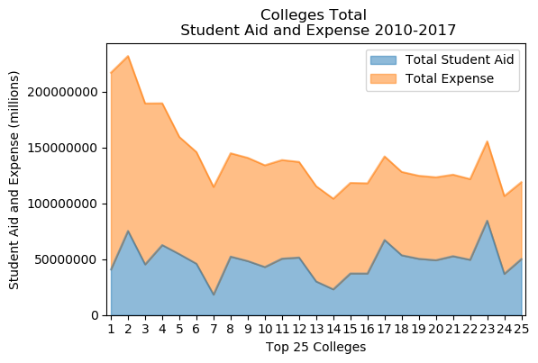
How does the student aid compare to total expenses ?
Notes:
Ken

Slide 7
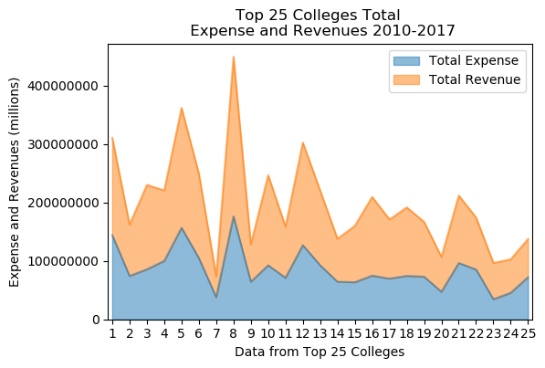
Overall expense and revenue comparison for the top 25 by players
Institution Name | Total Players
University of Kentucky | 99
University of California-Los Angeles | 91
University of North Carolina at Chapel Hill | 87
University of Kansas | 72
Duke University | 71
Indiana University-Bloomington | 60
University of Notre Dame | 56
University of Louisville | 55
St Johns University-New York | 51
University of Arizona | 51
University of Michigan-Ann Arbor | 49
Syracuse University | 49
Michigan State University | 47
Villanova University | 43
North Carolina State University at Raleigh | 43
Ohio State University-Main Campus | 43
University of Minnesota-Twin Cities | 41
University of Illinois at Urbana-Champaign | 41
University of Maryland-College Park | 40
Louisiana State University and Agricultural & Mechanical College | 40
Marquette University | 39
Georgetown University | 39
University of Nevada-Las Vegas | 38
Georgia Institute of Technology-Main Campus | 38
University of Connecticut | 36
Notes:
Ken

Slide 8
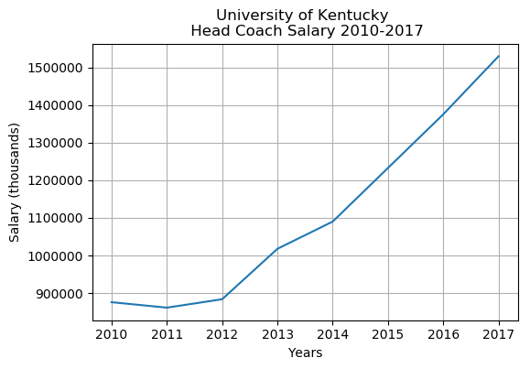

What is the University of Kentucky’s head coach salary?
Notes:
Ken

Slide 9
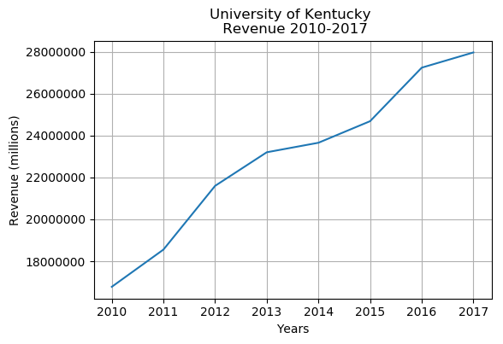
How does that compare to Kentucky’s basketball revenue?
Notes:
Ken

Slide 10
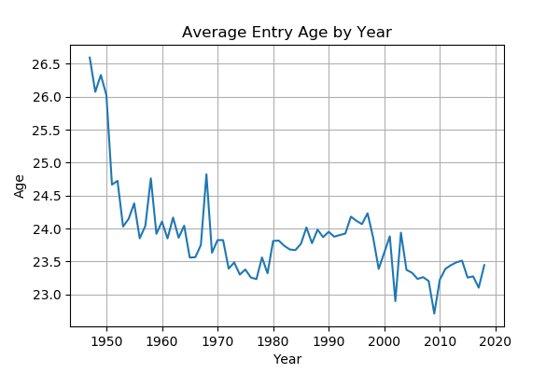

What is the average age of the players entering the NBA?
*2018 NBA Draft Class
Notes:
Ken

Slide 11
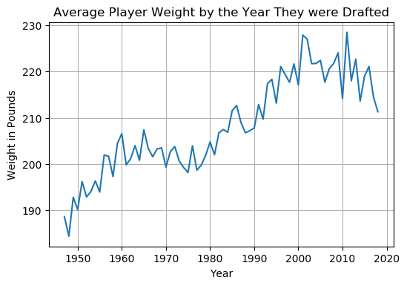
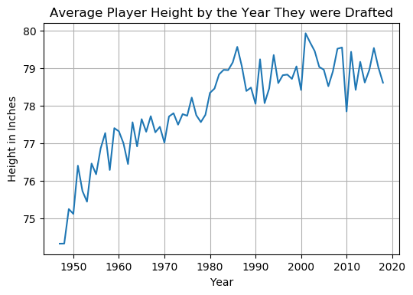

How have the players changed physically since the start of the League?

Slide 12
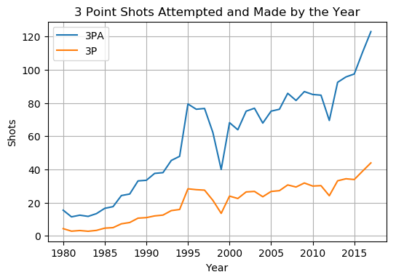

How has the game changed since the implementation of the three point line (1980)?

Slide 13

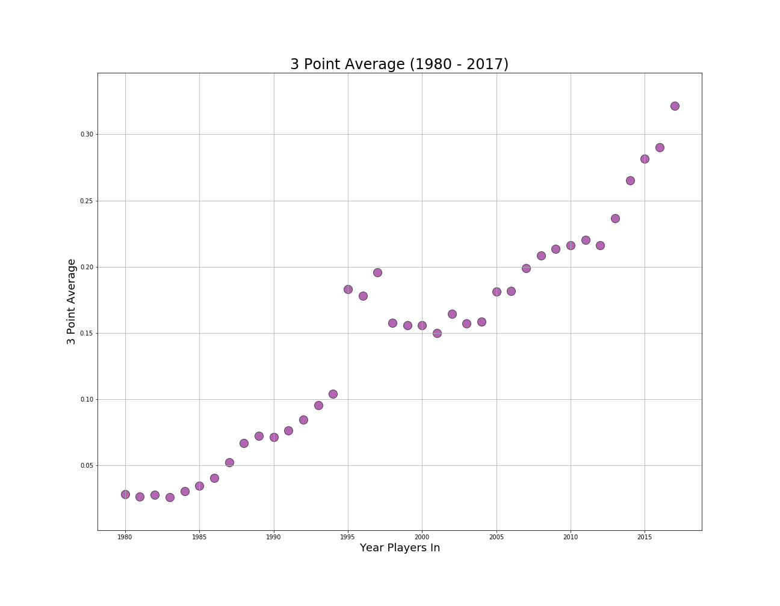
How has the 3 point shooting % average of players changed over time?
Notes:
Fardi

Slide 14
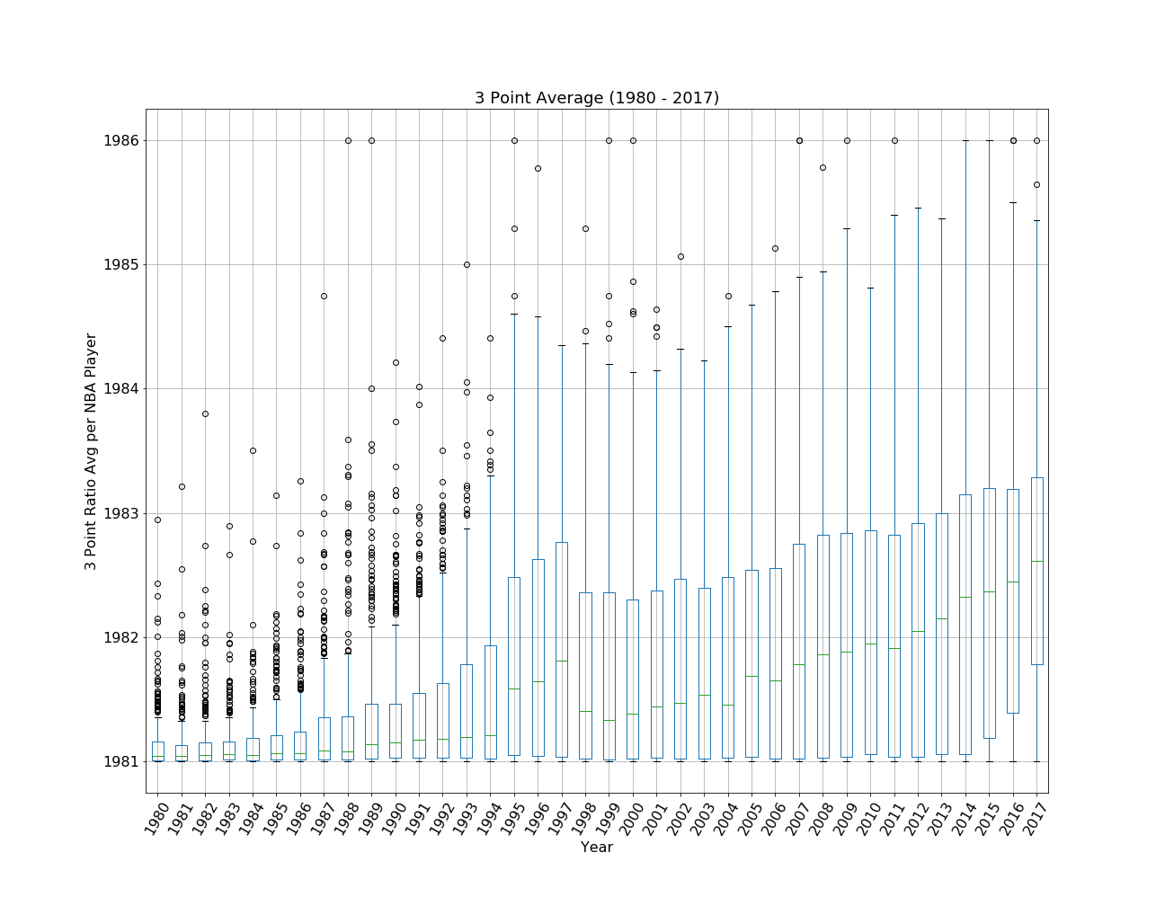
How do the ratio of 3 PAvr of players change over time?
Notes:
Fardi

Slide 15
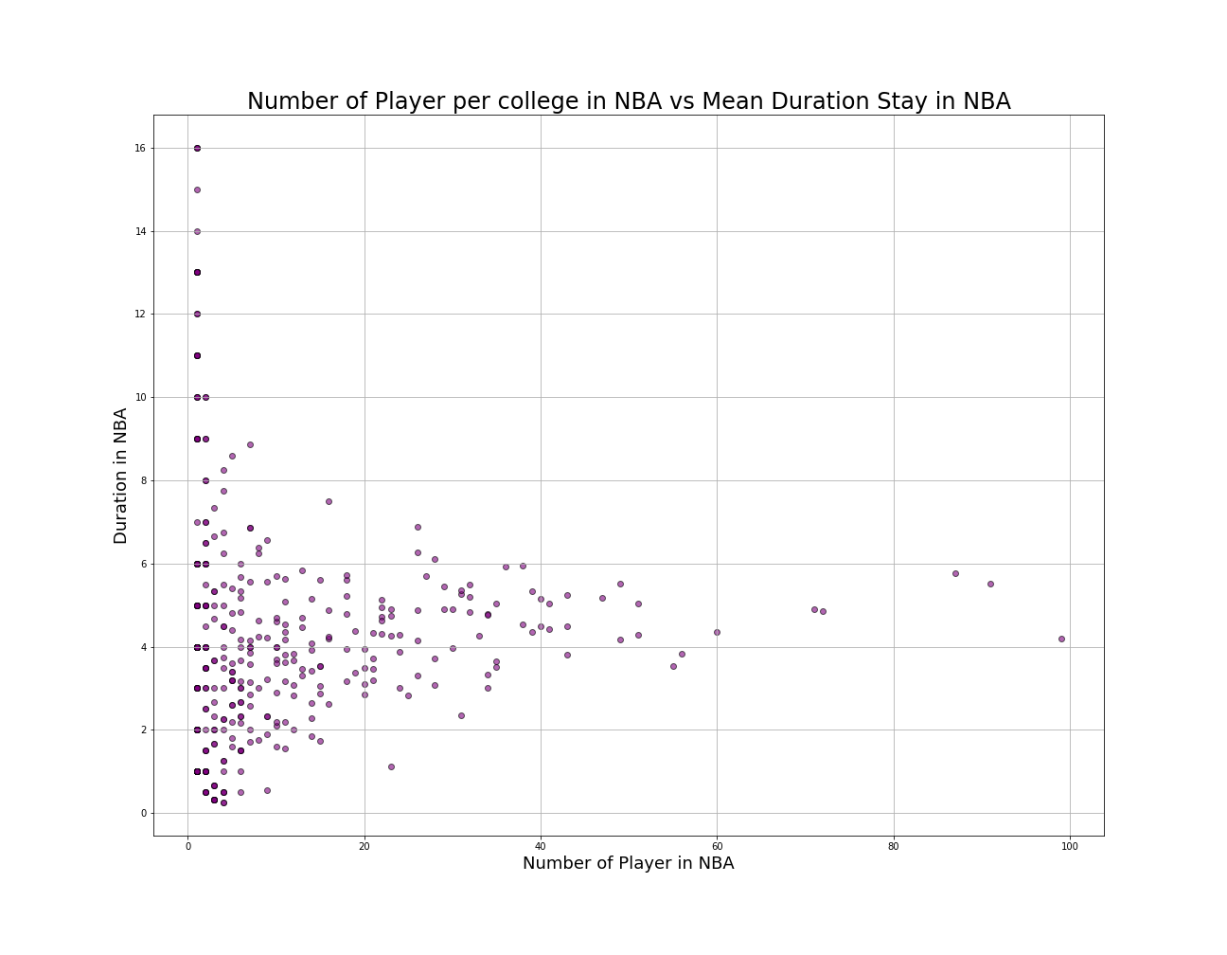

Is There is a Relationship Between the Length of a Player’s Career and the Number of Players his College Produced?
Notes:
Fardi

Slide 16
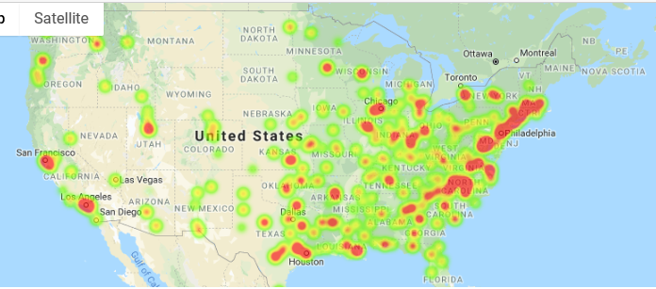
The mean duration of stay in NBA by College Location
Notes:
Fardi

Slide 17
PER : The Money Stat
uPER =
(1 / MP) * [ 3P + (2/3) * AST + (2 - factor * (team_AST / team_FG)) * FG + (FT *0.5 * (1 + (1 - (team_AST / team_FG)) + (2/3) * (team_AST / team_FG))) - VOP * TOV - VOP * DRB% * (FGA - FG) - VOP * 0.44 * (0.44 + (0.56 * DRB%)) * (FTA - FT) + VOP * (1 - DRB%) * (TRB - ORB) + VOP * DRB% * ORB + VOP * STL + VOP * DRB% * BLK - PF * ((lg_FT / lg_PF) - 0.44 * (lg_FTA / lg_PF) * VOP) ]
HUH?

Slide 18
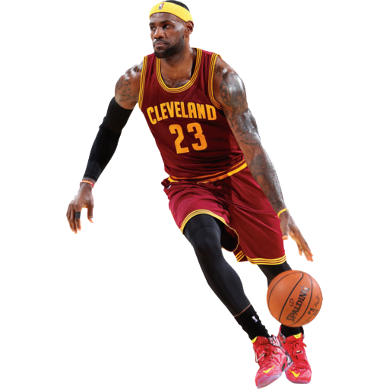
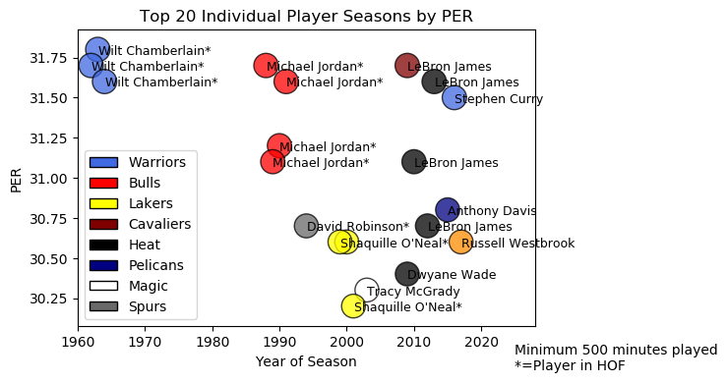
What are the Greatest Individual Seasons in NBA History?

Slide 19
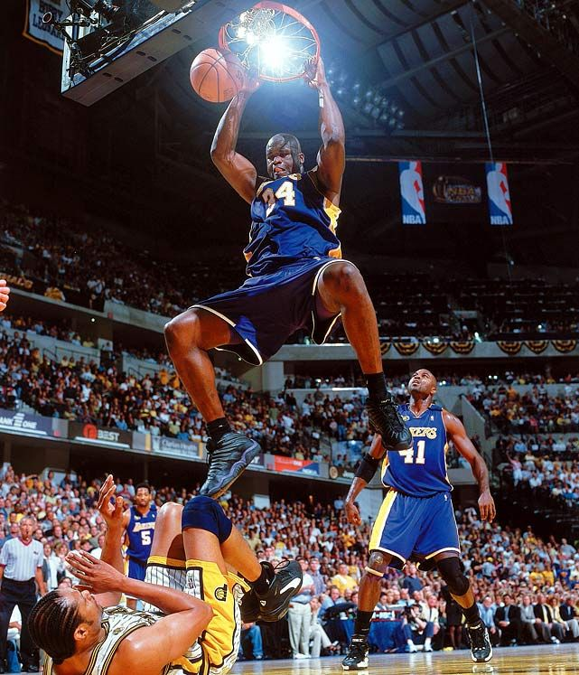
The Death of a Center?
In 2011, Shaquille O’Neal, one of the NBA’s greatest centers of all time, said that the modern big men have either “fell of or evolved” and earlier in the year he declared the center “dead”.
What Shaq “the Big Cactus”, “the Big Shamrock”, “the Big Aristotle”, “Shaq Diesel” correct?
Notes:
John

Slide 20
NO!!!!
Notes:
John

Slide 21
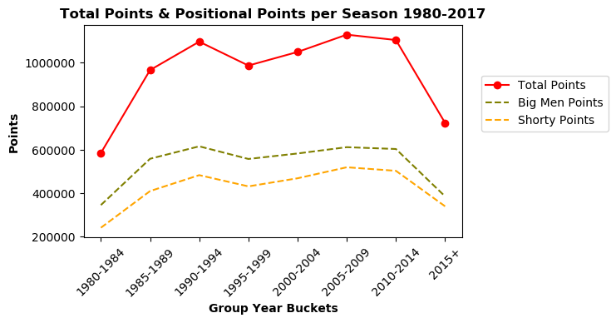
NBA Scoring and Scorers
-Historically speaking, the NBA scoring is high, don’t let chart crime victimize you!
-Additionally, when compared, big men score more points than their shorter counterparts.
Notes:
John

Slide 22

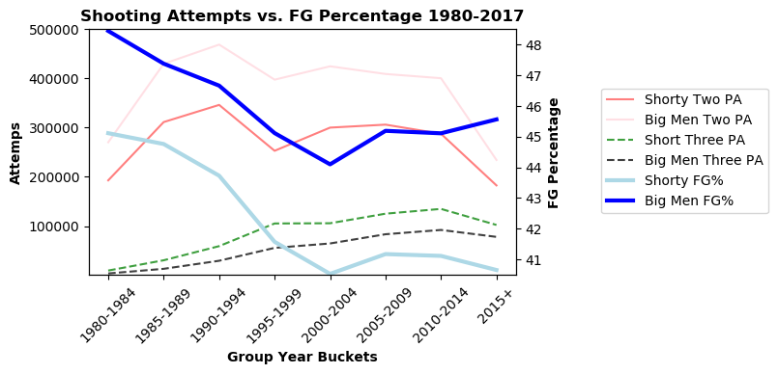
Death of a Center cont’d
Notes:
John

Slide 23
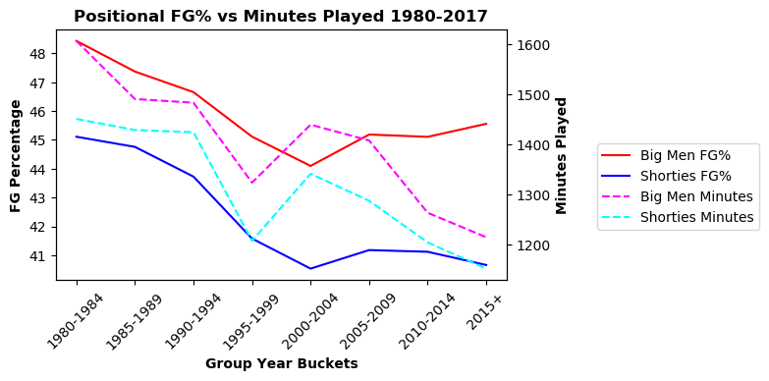
Centers dominate with less opportunities
-Less minutes for Big men equals more production when measured by FG%. The opposite is true for the smaller guys on the court.
Notes:
John

Slide 24
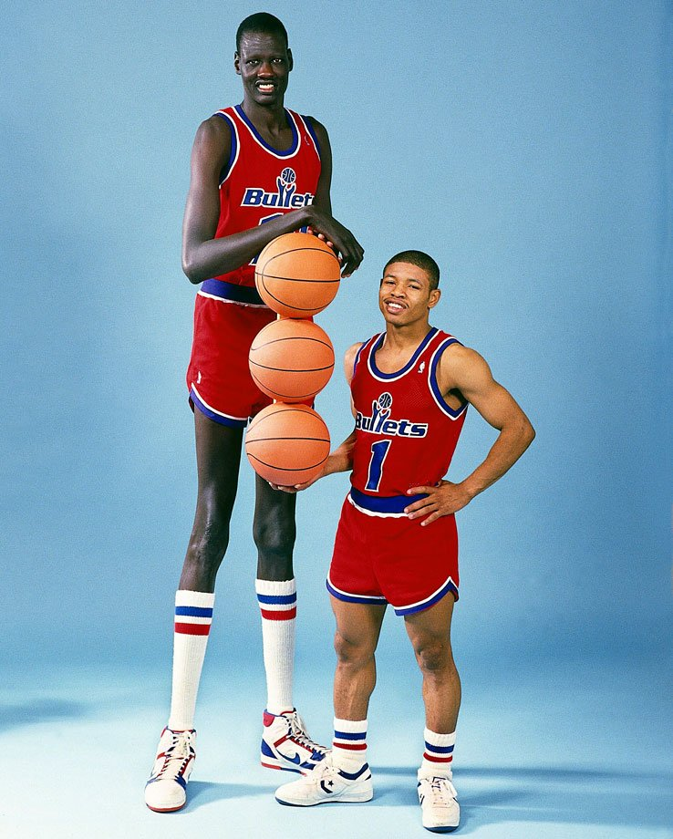
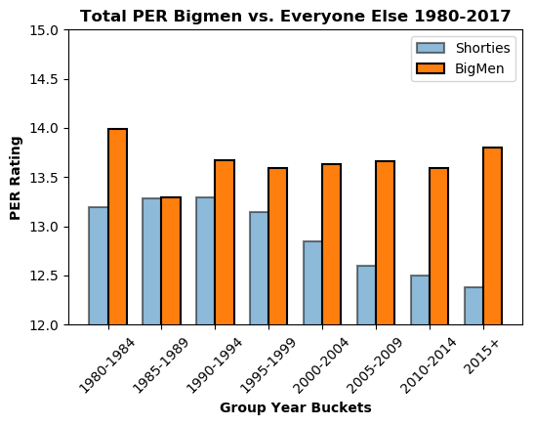
PER : The Money Stat
Notes:
John

Slide 25
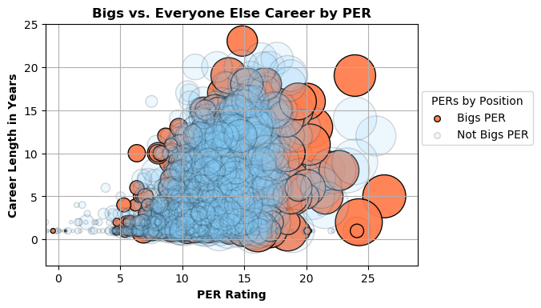
Notes:
John

Slide 26
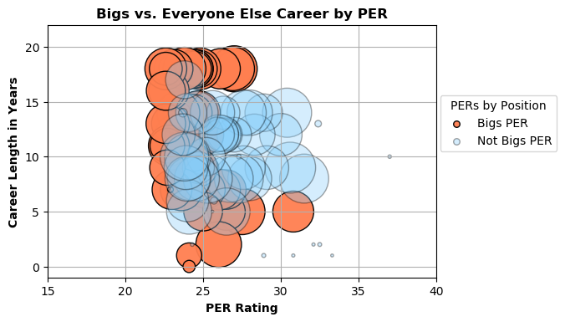
Show me the money
Notes:
John

Slide 27
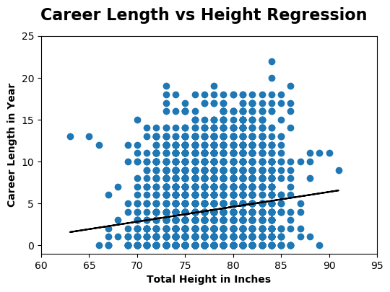
The next steps….
The expected career length for a Center with the height of 84 inches is 5.299141601976114.
Too simplistic, we could/should,
Test the residuals
Build out the regression with multiple independent variables
Notes:
John

