Slide 1
NBA

Slide 2
What is the NBA?

Slide 3
Where do the Players come from?

Slide 4
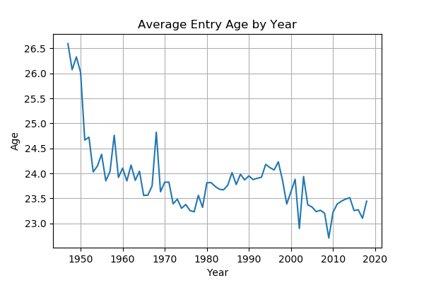
Where do the Players come from?

Slide 5

Where do the Players come from?

Slide 6
How have the players changed since the start of the League?

Slide 7
How have the players changed since the start of the League?

Slide 8
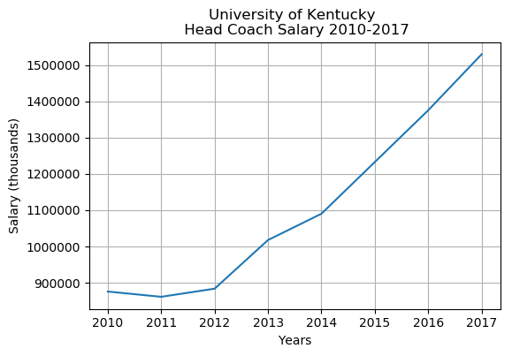
What is University of Kentucky’s head coach salary?

Slide 9
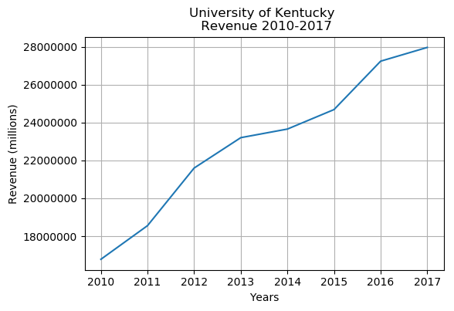
What is University of Kentucky’s Basketball Revenue?

Slide 10
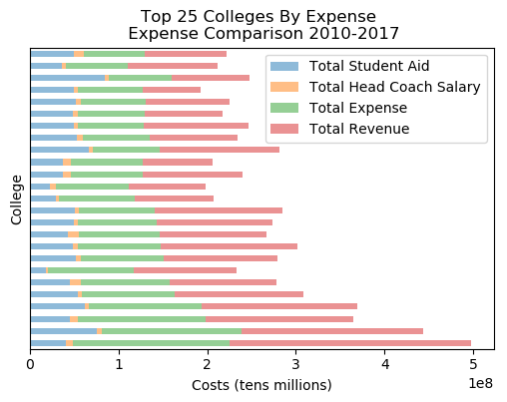
What do the top 25 expenses and revenues look like?
Institution Name | Total Expense | Total Revenue
University of Notre Dame | $37,852,017.00 | $36,053,910.00
Georgia Institute of Technology-Main Campus | $45,498,472.00 | $57,368,983.00
Louisiana State University and Agricultural & Mechanical College | $47,165,015.00 | $59,713,588.00
University of Nevada-Las Vegas | $34,483,011.00 | $62,101,359.00
St Johns University-New York | $64,364,232.00 | $64,364,232.00
University of Connecticut | $72,284,673.00 | $65,413,874.00
Villanova University | $64,312,118.00 | $73,595,234.00
University of Michigan-Ann Arbor | $71,060,957.00 | $87,705,454.00
University of California-Los Angeles | $74,282,397.00 | $88,005,440.00
Georgetown University | $85,306,187.00 | $88,956,862.00
University of Maryland-College Park | $72,991,337.00 | $93,766,500.00
North Carolina State University at Raleigh | $63,493,129.00 | $96,557,161.00
University of Minnesota-Twin Cities | $69,712,529.00 | $101,293,810.00
Marquette University | $96,422,052.00 | $115,471,497.00
University of Illinois at Urbana-Champaign | $74,376,659.00 | $117,210,503.00
University of Kansas | $100,002,548.00 | $120,665,973.00
Michigan State University | $92,567,212.00 | $127,945,009.00
Ohio State University-Main Campus | $74,844,862.00 | $134,688,064.00
University of North Carolina at Chapel Hill | $85,624,904.00 | $144,504,936.00
Indiana University-Bloomington | $104,947,378.00 | $144,558,624.00
University of Arizona | $92,465,752.00 | $154,126,340.00
University of Kentucky | $144,133,449.00 | $166,569,620.00
Syracuse University | $126,942,611.00 | $175,512,227.00
Duke University | $156,658,579.00 | $205,155,916.00
University of Louisville | $176,300,783.00 | $272,985,062.00

Slide 11
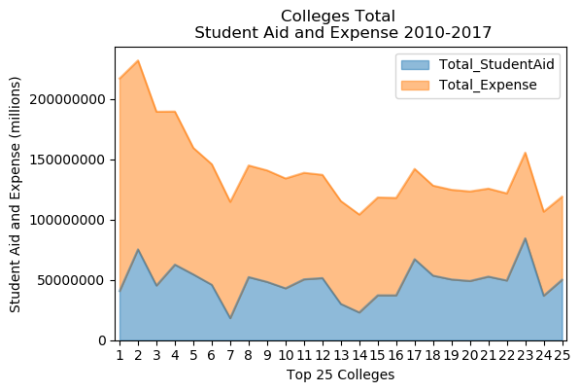
How does the student aid compare to total expenses ?

Slide 12
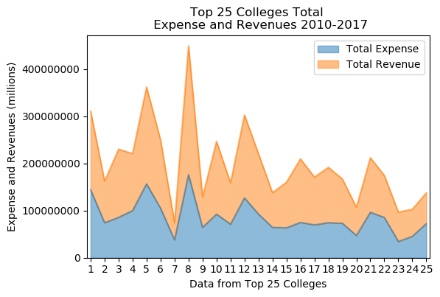
Overall expense and revenue comparions for the top 25 by players
Institution Name | Total Players
University of Kentucky | 99
University of California-Los Angeles | 91
University of North Carolina at Chapel Hill | 87
University of Kansas | 72
Duke University | 71
Indiana University-Bloomington | 60
University of Notre Dame | 56
University of Louisville | 55
St Johns University-New York | 51
University of Arizona | 51
University of Michigan-Ann Arbor | 49
Syracuse University | 49
Michigan State University | 47
Villanova University | 43
North Carolina State University at Raleigh | 43
Ohio State University-Main Campus | 43
University of Minnesota-Twin Cities | 41
University of Illinois at Urbana-Champaign | 41
University of Maryland-College Park | 40
Louisiana State University and Agricultural & Mechanical College | 40
Marquette University | 39
Georgetown University | 39
University of Nevada-Las Vegas | 38
Georgia Institute of Technology-Main Campus | 38
University of Connecticut | 36

Slide 13
How has the game changed since the implementation of the three point line (1980)?

