Slide 1
Comprehensive Slides
Welcome 7/22/22

Slide 2
Outline
Intro to NLS (Non-linear Least Squares)
Key aspects, key vocabulary: objective function, error or fval, x0, etc.
MATLAB Optimization Toolbox
Specifically, functions: lsqnonlin, fmincon, GlobalSearch, and Multistart
Neo-Hookean, Mooney-Rivlin, Yeoh, Gent, Lopez-Paimes, and Ogden models
Polyconvexity and consistency conditions
Differences in solving techniques
How to perform an error calculation
Calculation of shear modulus

Slide 3

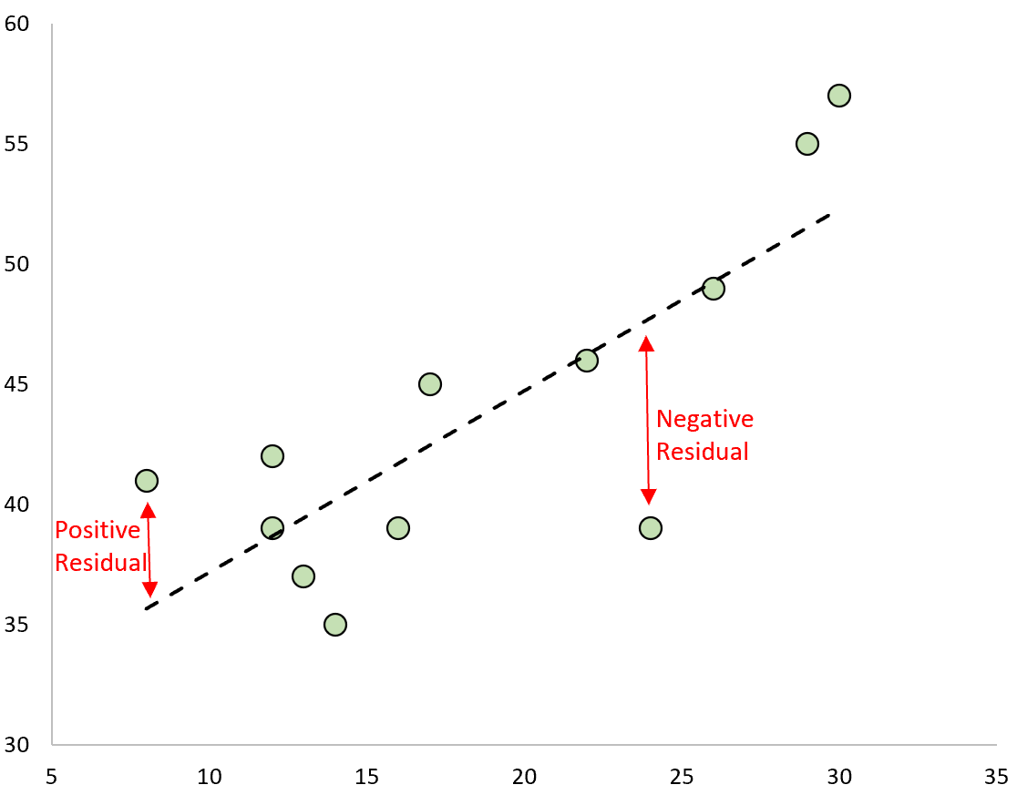

NLS
If our function is non-linear in its parameters, then we will use NLS
Fundamental principle: minimizing the norm of the residuals or -->
Where $r_{i}$ is the residual (Observed-estimated)
See bottom right if this is a new concept (- - - - is Observed/experimental data)
Can think of it as minimizing the sum of the squared errors
Goal: estimate model parameters given observations hence, curve fitting.
Techniques require an initial guess, denoted as x0
The value for the norm of the residuals is what I call total error (sum of each individual error = total error, technically ‘squared error’)

Slide 4
How does NLS work?
Well, if you want the theoretical framework, it is right here, but it’s a little hard to explain over just pictures and text.
The basic goal of NLS solvers is to find the global minimum, where f(x) attaints its minimum
Problems: it is never a guarantee you have the global minimum and are most likely working with a local/false minima (this is okay but know there is a more optimal solution).
The problem of discerning between these minimum is expressed in a multitude of papers and not a totally answerable question
The minimum, obviously, is where the error is the least.
The function in which we are minimizing is referred to as the objective function.

Slide 5
MATLAB Optimization toolbox
1) Lsqnonlin
2) Multistart (lsqnonlin and Multistart are paired together in our code)
3) Fmincon
4) GlobalSearch (fmincon and GlobalSearch are paired together)
Importantly, lsqnonlin and fmincon are solvers, implementing algorithms that solve NLS problems. Multistart and GlobalSearch are tools in which run these solvers over various starting points to get a better grasp of where the local minimum are or potentially finding the global minima.

Slide 6
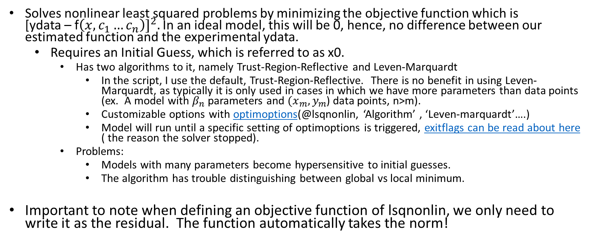
lsqnonlin
Solves nonlinear least squared problems by minimizing the objective function which is [ydata – f${\left(x,c_{1}…c_{n}\right)]}^{2}.$ In an ideal model, this will be 0, hence, no difference between our estimated function and the experimental ydata.
Requires an Initial Guess, which is referred to as x0.
Has two algorithms to it, namely Trust-Region-Reflective and Leven-Marquardt
In the script, I use the default, Trust-Region-Reflective. There is no benefit in using Leven-Marquardt, as typically it is only used in cases in which we have more parameters than data points (ex. A model with $β_{n}$ parameters and ${(x}_{m},y_{m}$) data points, n>m).
Customizable options with optimoptions(@lsqnonlin, ‘Algorithm’ , ‘Leven-marquardt’….)
Model will run until a specific setting of optimoptions is triggered, exitflags can be read about here ( the reason the solver stopped).
Problems:
Models with many parameters become hypersensitive to initial guesses.
The algorithm has trouble distinguishing between global vs local minimum.
Important to note when defining an objective function of lsqnonlin, we only need to write it as the residual. The function automatically takes the norm!

Slide 7
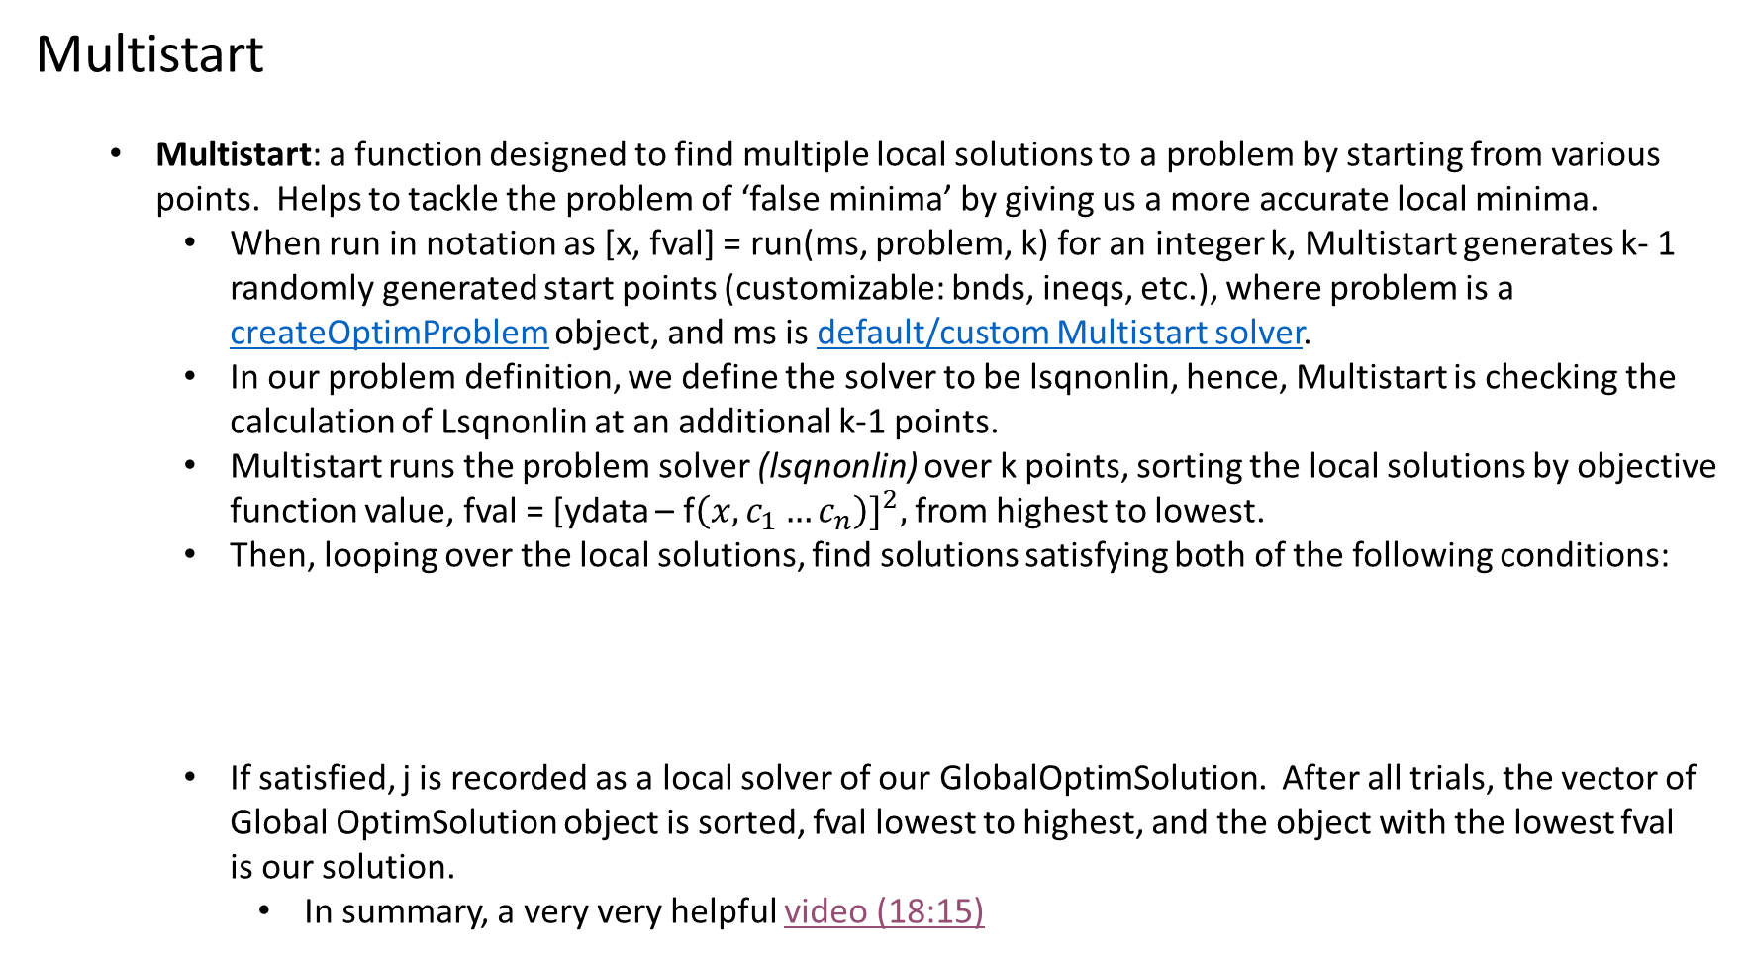
Multistart
Multistart: a function designed to find multiple local solutions to a problem by starting from various points. Helps to tackle the problem of ‘false minima’ by giving us a more accurate local minima.
When run in notation as [x, fval] = run(ms, problem, k) for an integer k, Multistart generates k- 1 randomly generated start points (customizable: bnds, ineqs, etc.), where problem is a createOptimProblem object, and ms is default/custom Multistart solver.
In our problem definition, we define the solver to be lsqnonlin, hence, Multistart is checking the calculation of Lsqnonlin at an additional k-1 points.
Multistart runs the problem solver (lsqnonlin) over k points, sorting the local solutions by objective function value, fval = [ydata – f${\left(x,c_{1}…c_{n}\right)]}^{2},$ from highest to lowest.
Then, looping over the local solutions, find solutions satisfying both of the following conditions:
If satisfied, j is recorded as a local solver of our GlobalOptimSolution. After all trials, the vector of Global OptimSolution object is sorted, fval lowest to highest, and the object with the lowest fval is our solution.
In summary, a very very helpful video (18:15)
|fval(k) - fval(j)| <= FunctionTolerance* max( 1,|Fval(j)| )
|x(k) - x(j)| <= XTolerance*max( 1,|x(j)| ) (Note: FunctionTolerance and XTolerance are defined/customizable in our Multistart object, ms)

Slide 8
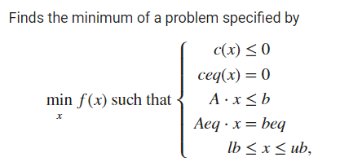

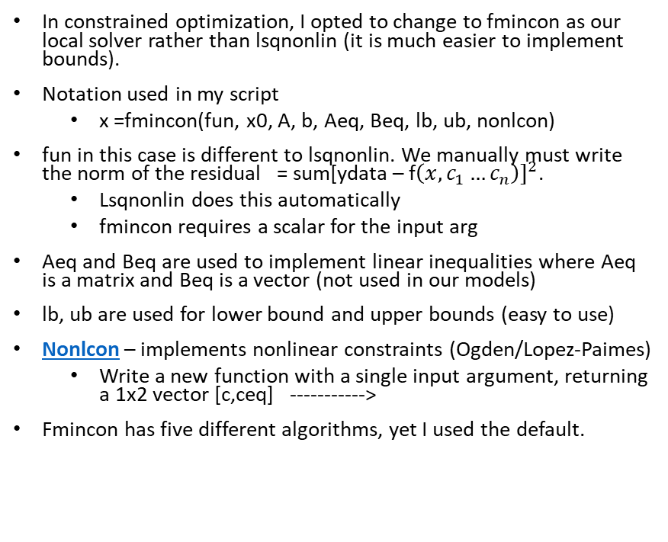
fmincon
In constrained optimization, I opted to change to fmincon as our local solver rather than lsqnonlin (it is much easier to implement bounds).
Notation used in my script
x =fmincon(fun, x0, A, b, Aeq, Beq, lb, ub, nonlcon)
fun in this case is different to lsqnonlin. We manually must write the norm of the residual = sum[ydata – f${\left(x,c_{1}…c_{n}\right)]}^{2}$.
Lsqnonlin does this automatically
fmincon requires a scalar for the input arg
Aeq and Beq are used to implement linear inequalities where Aeq is a matrix and Beq is a vector (not used in our models)
lb, ub are used for lower bound and upper bounds (easy to use)
Nonlcon – implements nonlinear constraints (Ogden/Lopez-Paimes)
Write a new function with a single input argument, returning a 1x2 vector [c,ceq] ----------->
Fmincon has five different algorithms, yet I used the default.

Slide 9
Global Search
Multistart and Global Search differ in a couple of ways
1st Multistart generates its trial points randomly from a uniform distribution, while GlobalSearch will run our fmincon at x0 and then use a ‘scatter search algorithm’ to generate our trial points. Fmincon is then run from these trial points
A really helpful video to get a grasp of Globalsearch…. I recommend just watching this and if you want more reading the documentation.

Slide 10
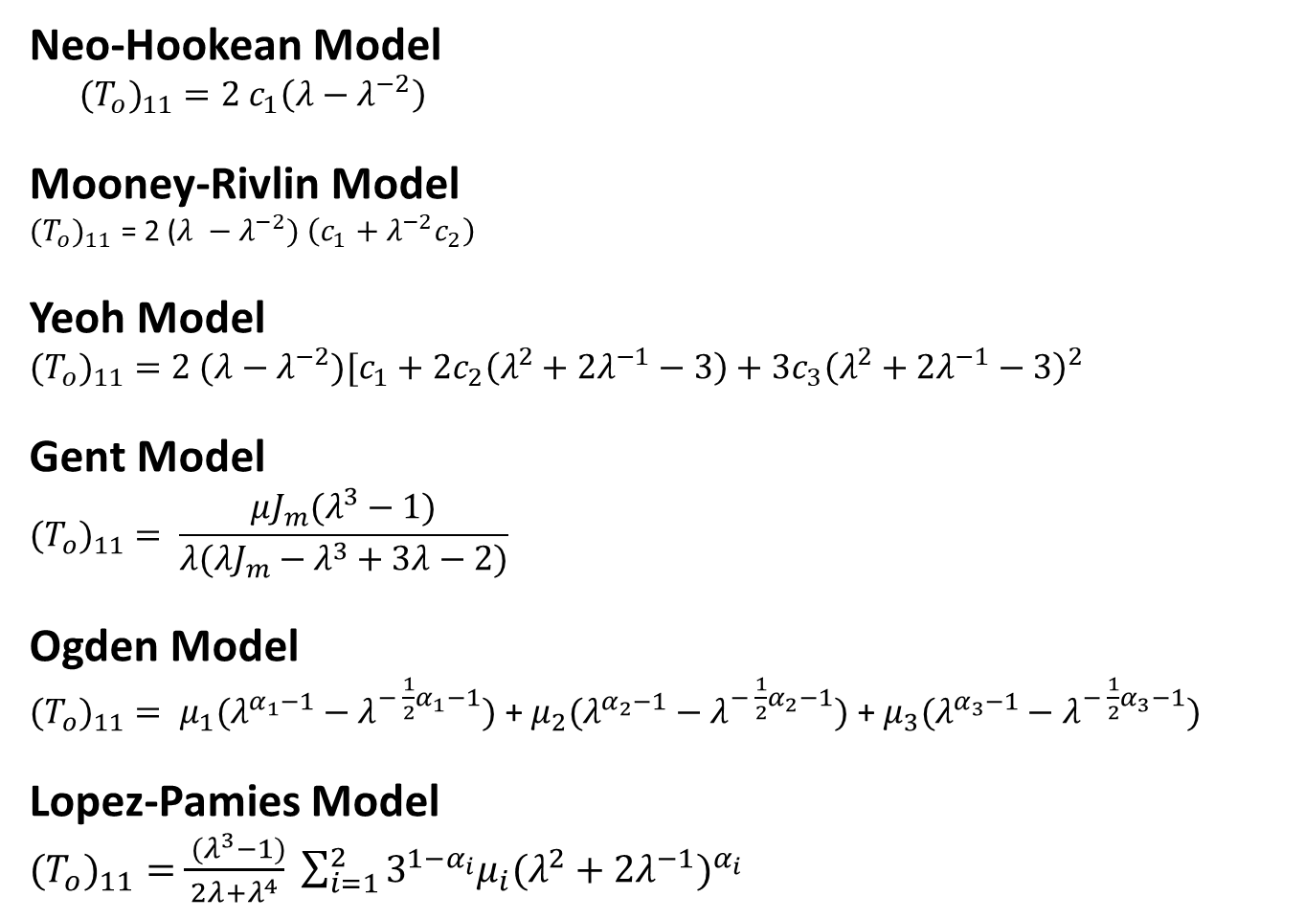
Moving on, Models we are fitting to
Neo-Hookean Model
${{(T}_{o})}_{11}=2 c_{1}\left(λ−λ^{−2}\right)$
Mooney-Rivlin Model
${{(T}_{o})}_{11}$ = 2 ($λ −$ $λ^{−2}) \left(c_{1}+λ^{−2}c_{2}\right)$
Yeoh Model
$${{(T}_{o})}_{11}=2 (λ−λ^{−2})[c_{1}+2c_{2}\left(λ^{2}+2λ^{−1}−3\right)+3c_{3}{\left(λ^{2}+2λ^{−1}−3\right)}^{2}$$
Gent Model
$${{(T}_{o})}_{11}= \frac{μJ_{m}(λ^{3}−1)}{λ(λJ_{m}−λ^{3}+3λ−2)}$$
Ogden Model
${{(T}_{o})}_{11}= μ_{1}(λ^{α_{1}−1}−λ^{{− \frac{1}{2}α}_{1}−1})$ + $μ_{2}(λ^{α_{2}−1}−λ^{{− \frac{1}{2}α}_{2}−1})$ + $μ_{3}(λ^{α_{3}−1}−λ^{{− \frac{1}{2}α}_{3}−1})$
Lopez-Pamies Model
${{(T}_{o})}_{11}=$ $\frac{ (λ^{3}−1)}{2λ+λ^{4}} \sum_{i=1}^{2}{3^{1−α_{i}}μ_{i}{(λ^{2}+2λ^{−1})}^{α_{i}}}$

Slide 11
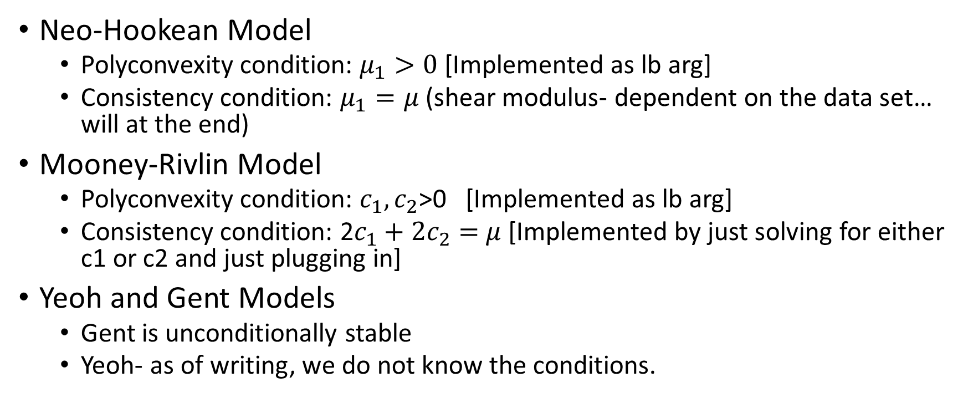
Constraint Optimization:
Neo-Hookean Model
Polyconvexity condition: $μ_{1}>0$ [Implemented as lb arg]
Consistency condition: $μ_{1}=μ$ (shear modulus- dependent on the data set… will at the end)
Mooney-Rivlin Model
Polyconvexity condition: $c_{1},c_{2}$>0 [Implemented as lb arg]
Consistency condition: 2$c_{1}+{2c}_{2}=$ $μ$ [Implemented by just solving for either c1 or c2 and just plugging in]
Yeoh and Gent Models
Gent is unconditionally stable
Yeoh- as of writing, we do not know the conditions.

Slide 12
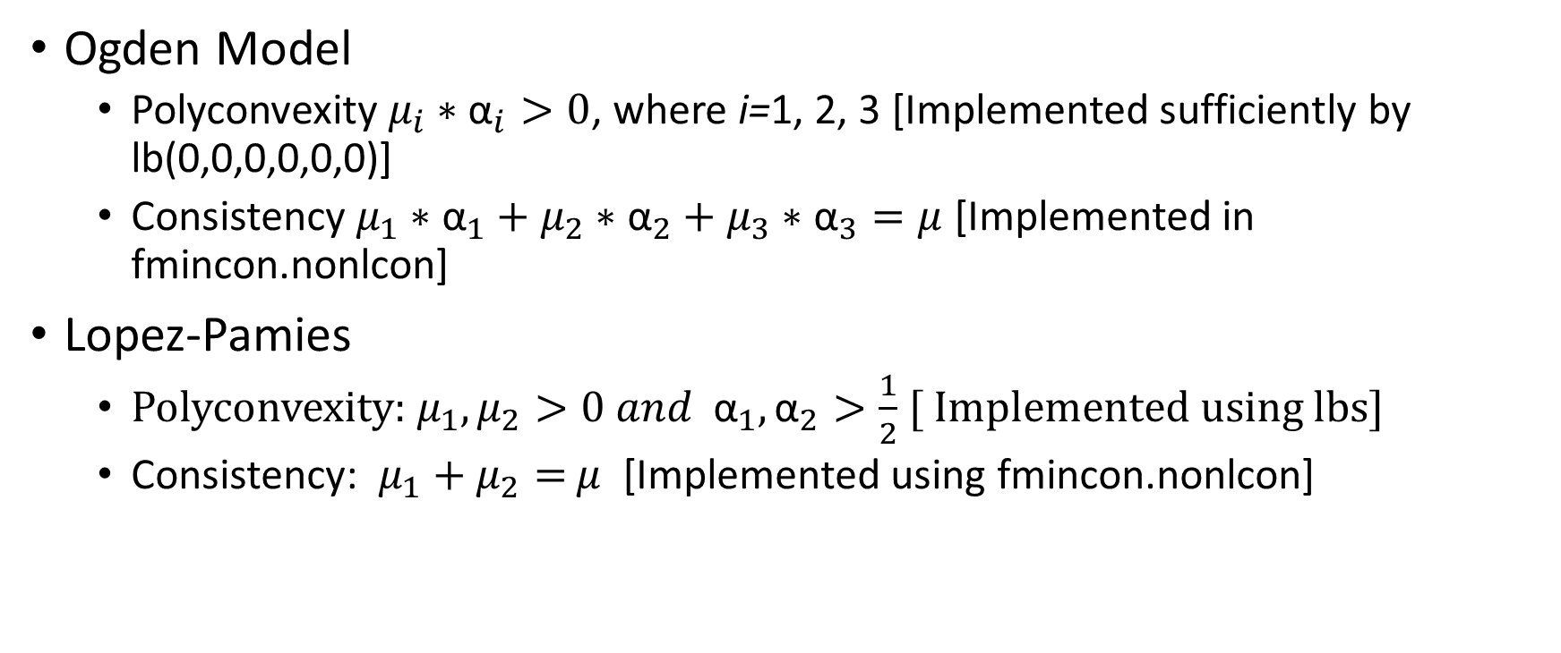
Constraint optimization cont.
Ogden Model
Polyconvexity $μ_{i}∗{\text{α}}_{i}>0$, where i=1, 2, 3 [Implemented sufficiently by lb(0,0,0,0,0,0)]
Consistency $μ_{1}∗{\text{α}}_{1}+μ_{2}∗{\text{α}}_{2}+μ_{3}∗{\text{α}}_{3}=μ$ [Implemented in fmincon.nonlcon]
Lopez-Pamies
Polyconvexity: $μ_{1},μ_{2}>0 and {\text{α}}_{1},{\text{α}}_{2}>\frac{1}{2}$ [ Implemented using lbs]
Consistency: $μ_{1}+μ_{2}=$ $μ$ [Implemented using fmincon.nonlcon]

Slide 13


Example- Implementing Constraints on Ogden
Reminder, look at fmincon format
Our conditions are as follows:
Consistency $μ_{1}∗{\text{α}}_{1}+μ_{2}∗{\text{α}}_{2}+μ_{3}∗{\text{α}}_{3}=μ$
Polyconvexity $μ_{i}∗{\text{α}}_{i}>0$, for i=1,2,3
Another way of writing our polyconvexity condition is $μ_{1}∗{\text{α}}_{1}≤0,μ_{1}∗{\text{α}}_{1}≤0…$
Seen as z in our defined function
For our consistency condition, we implement it as zeq = 0 , where in this case our shear modulus =.27
You then call @nonlincon as an argument in fmincon declaration.

Slide 14
Calculation of Shear Modulus
The best way I have found is just by using excel, graphing and then using a line of best fit.
This will give us a slope, and then dividing by 3 will give the shear modulus.
There is not a single best technique, nor (to my knowledge) a common practice on how many points to look at. Try to take the beginning points in which it is most linear.

Slide 15
Steinmann Paper
This is a paper we used as a reference quite often. Not only did it give us polyconvexity and consistency conditions of several models, but it provided a reference which I could test and verify my values with.
He too fitted Treloar Uniaxial Tension (UT) data.
In this next section, I compare my program to Steinmann’s

Slide 16
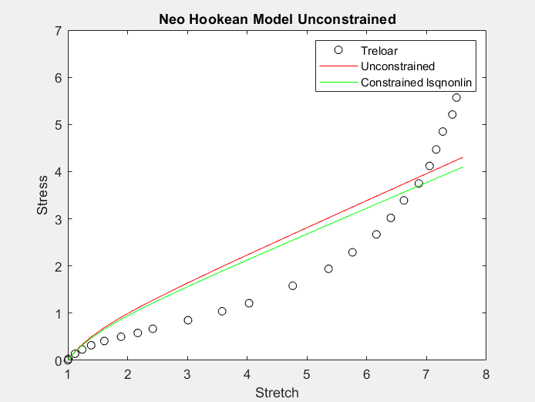
Neo-Hookean
Error estimates are the same, thus our model works (assuming Steinmann is correct too).
Model | C1 | Error
Reed (unconstrained/poly) | .28358 | 15.475
Reed (PolyAndConsistency) | .27 | 15.935
Steinmann | .28365 | 15.475

Slide 17
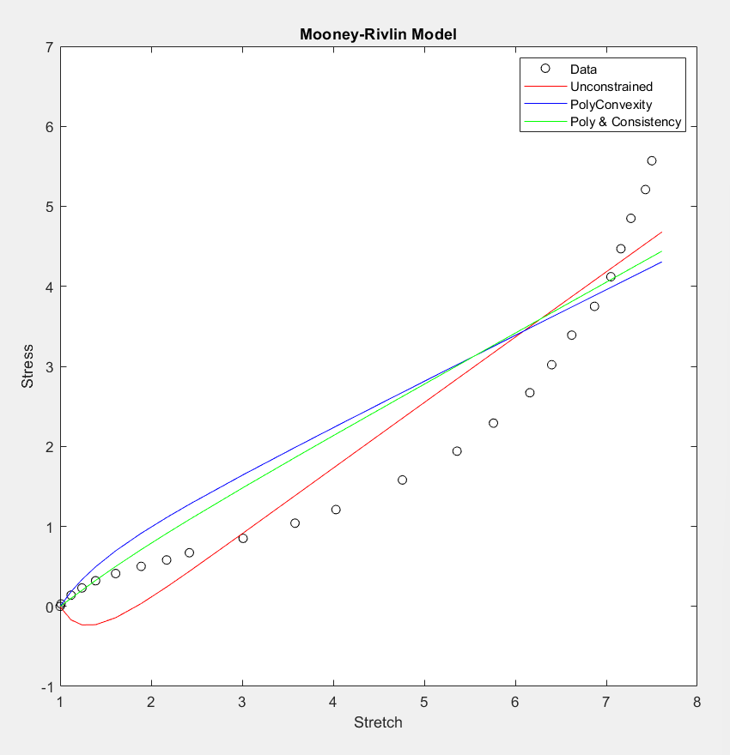
Mooney-Rivlin
Steinmann’s error is the highest of all cases.
Model | C1 | C2 | Error
Reed (Unconstrained) | .40638 | -0.74775 | 9.6588
Reed(Polyconvexity) | .28358 | 1.4051e-13 | 15.475
Reed(PolyAndConsistency) | .31615 | -0.046154 | 13.018
Steinmann | .2588 | -0.449 | 17.379

Slide 18
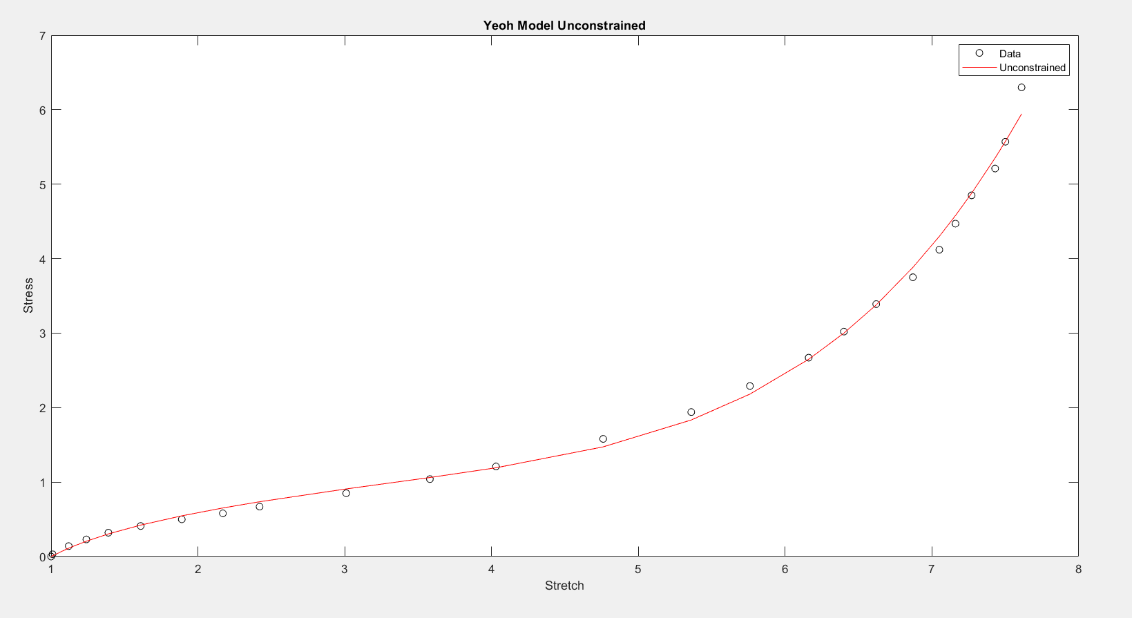
Yeoh Model
Steinmann error is approximately 1.5x larger than our calculated error
Model | c1 | c2 | c3 | error
Reed | .1755 | -0.00188 | 4.63e-05 | .2644785
Steinmann | .1634 | -1.198e-3 | 3.781e-5 | .422415

Slide 19
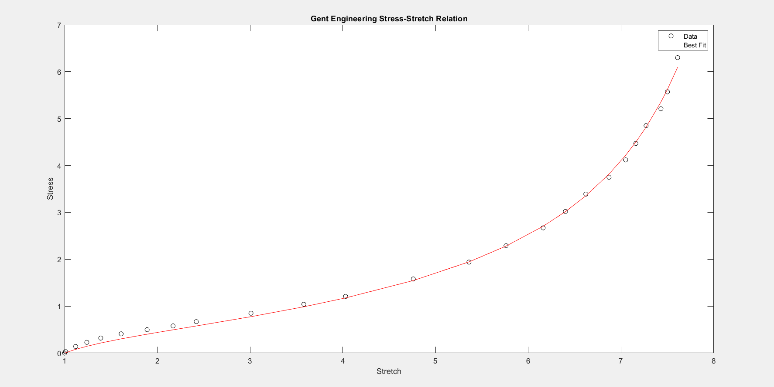
Gent Model
Steinmann’s error is about 1.25x larger than our calculated error.
Model | μ | J | Error
Reed’s | .24515 | 79.437 | .15334
Steinmann’s | .2514 | 81.16 | .195639

Slide 20
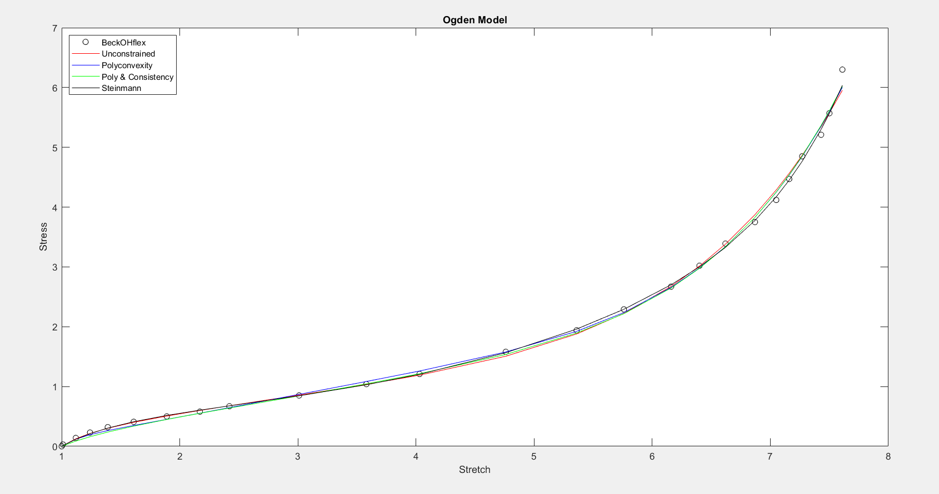
Ogden model
Ogden Unconstrained is very hard to work with. The unconstrained case should be the most accurate, but the solver is overwhelmed with the number of starting points to try.
Polyconvexity is only sufficient here, I need to implement the necessary but not restrictive constraint.
Steinman’s error is much smaller than ours
Model | m1 | m2 | m3 | a1 | a2 | a3 | Error
Reed (Unconstrained) | 0.187 | -0.126 | 7.568 | 1.899 | -3.917 | 7.482 | 0.21
Reed (Polyconvexity suff) | 0.159 | 1.17e-06 | 0.1886 | 1.4914 | 2.1327 | 8.3769 | 0.1589
Reed (Poly&Consistency) | 0.256 | 8.98 | -0.0015 | 2.105 | 8.49 | -0.0111 | 0.171
Steinmann | 0.5649 | 3.856e−3 | 5.7e−13 | 1.297 | 4.342 | 15.13 | .0973
Notes:
Using Global Search/Totality of Accuracy

Slide 21
Lopez-Pamies
Model | μ1 | μ2 | α1 | α2 | Error
Reed (Unconstrained) | 0.2741 | 2.98 e-06 | 5.0173 | 1.0937 | .1329
Reed (Polyconvexity) | 0.28852 | 1.0348e-05 | 4.605 | 1.054 | 0.147
Reed(Poly & Consistency) | 0.26999 | 3.139e-06 | 1.09988 | 4.9971 | 0.1332
Lopez-Paper | 0.26999 | 1.771e-05 | 1.08 | 4.4 | .32600
In both the Polyconvexity and Poly&Consistency conditions, our calculations are about 2x more accurate than Lopez’.
The unconstrained case is very sensitive to how many trials we run (ex. Maybe we find .1329 in 1000 trials, perhaps it takes 10,000)

Slide 22
Next Steps
Increasing the accuracy, especially in Ogden & Lopez
Customization of optimization options (Reading up on StepTolerance and FunctionTolerance, usually culprits of our exit flag)
Fmincon has 5 different algorithm options, experimenting and reading about the differences between them.
In my for-loop script the wider the range of points the better, but it also leads to the breakdown of the program (too big of calculations due to exponents)
Implementing more models
Fitting three distinct data sets to three distinct models, having the same parameters for each model (minimization of all three)
Continue working on new data sets
I have found just with Daniel’s Bechoflex that it leads to problems and helps motivate me to brainstorm and further develop the code to be more ‘inclusive’
Sometimes it is difficult to compare results just from looking at the table, implementing it such that parameter1 <= parameter2<= …. ParameterN would make it look much prettier.
Further verification
More material models
Potentially R or python implementation… or a new program solver

