Slide 1
Transformers
Reed Shay

Slide 2
AGENDA
Big Ideas
Transformer Architecture :
Embedding
Encoder
Decoder
Simple model

Slide 3
Big Ideas of Transformers
“Attention Is All You Need” by Ashish Vaswani
Relay on the concept of attention, enhancing some aspects of the data while diminishing other parts
Self-attention mechanism : considering the relevance of each word in the input sequence relative to the others.

Slide 4
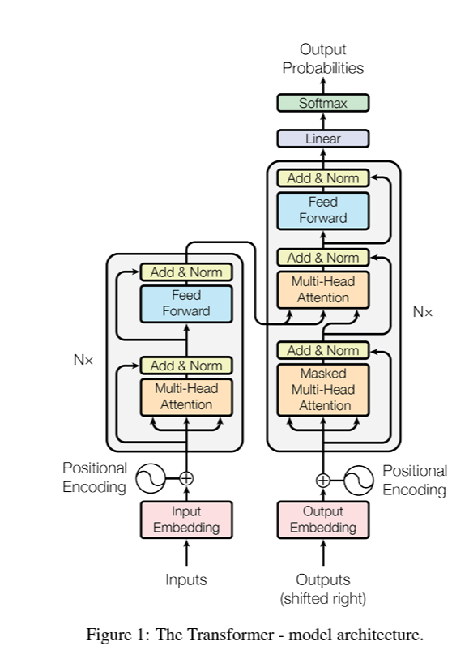
Transformer architecture

Slide 5
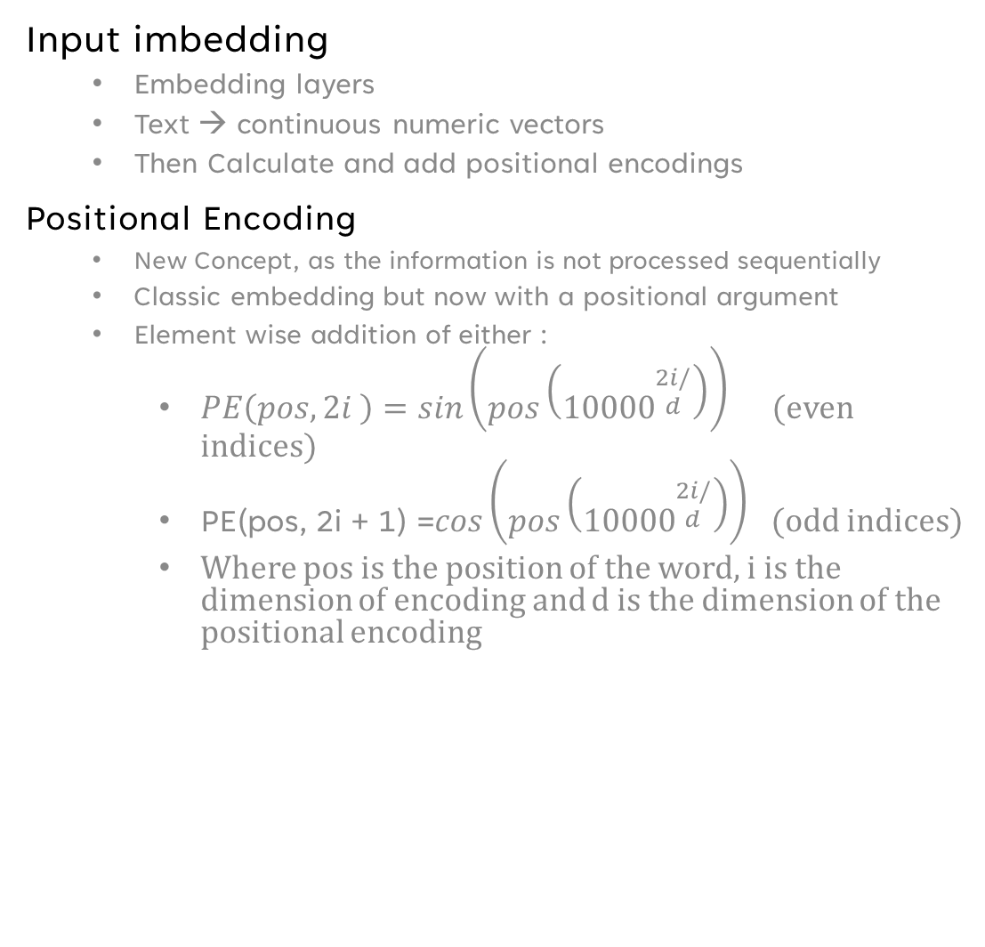
Embedding
Input imbedding
Embedding layers
Text → continuous numeric vectors
Then Calculate and add positional encodings
Positional Encoding
New Concept, as the information is not processed sequentially
Classic embedding but now with a positional argument
Element wise addition of either :
$PE\left(pos, 2i \right)=sin\left(pos\left({10000}^{\begin{aligned}2i/ \\ d\end{aligned}}\right)\right)$ (even indices)
$\text{PE}\text{(}\text{pos}\text{, 2}\text{i}\text{ + 1) =}cos\left(pos\left({10000}^{\begin{aligned}2i/ \\ d\end{aligned}}\right)\right)$ (odd indices)
Where pos is the position of the word, i is the dimension of encoding and d is the dimension of the positional encoding
Notes:
d or d_model in “Attention is All You Need” is 1024.

Slide 6
Encoder-Decoder
Two main sublayers in each
1) Multi-Head Attention Layers
2) Feedforward Networks

Slide 7
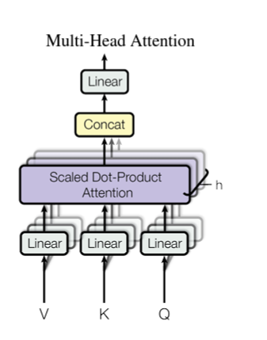
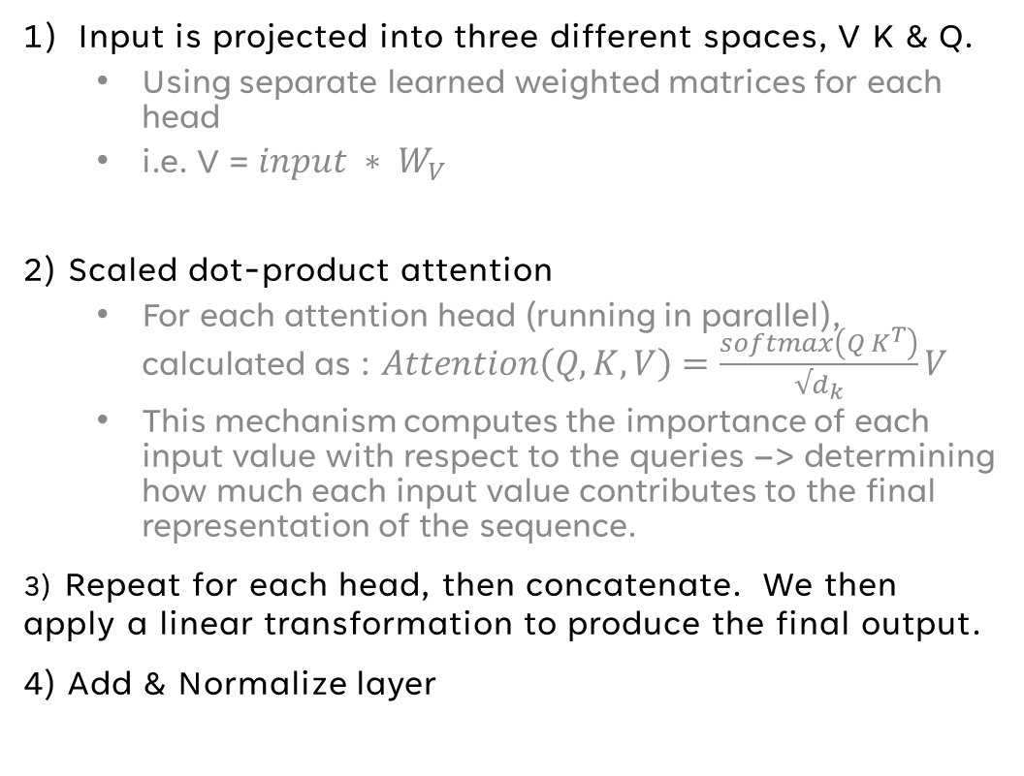
Multi-Head attention layers
Input is projected into three different spaces, V K & Q.
Using separate learned weighted matrices for each head
i.e. V = ${input ∗ W}_{V}$
2) Scaled dot-product attention
For each attention head (running in parallel), calculated as : $Attention\left(Q,K,V\right)=\frac{softmax\left(Q K^{T}\right)}{√d_{k}}V$
This mechanism computes the importance of each input value with respect to the queries –> determining how much each input value contributes to the final representation of the sequence.
3) Repeat for each head, then concatenate. We then apply a linear transformation to produce the final output.
4) Add & Normalize layer
Notes:
d or d_model in “Attention is All You Need” is 1024.

Slide 8
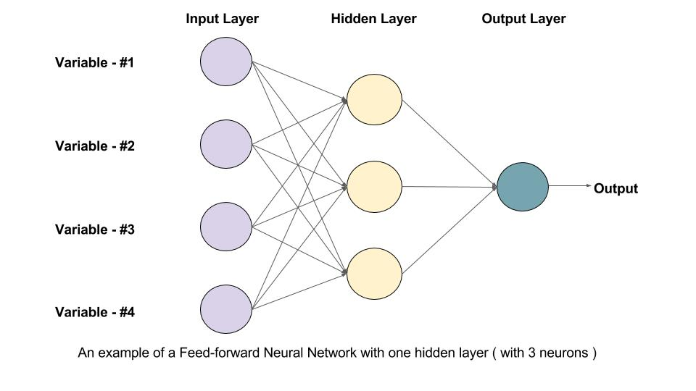
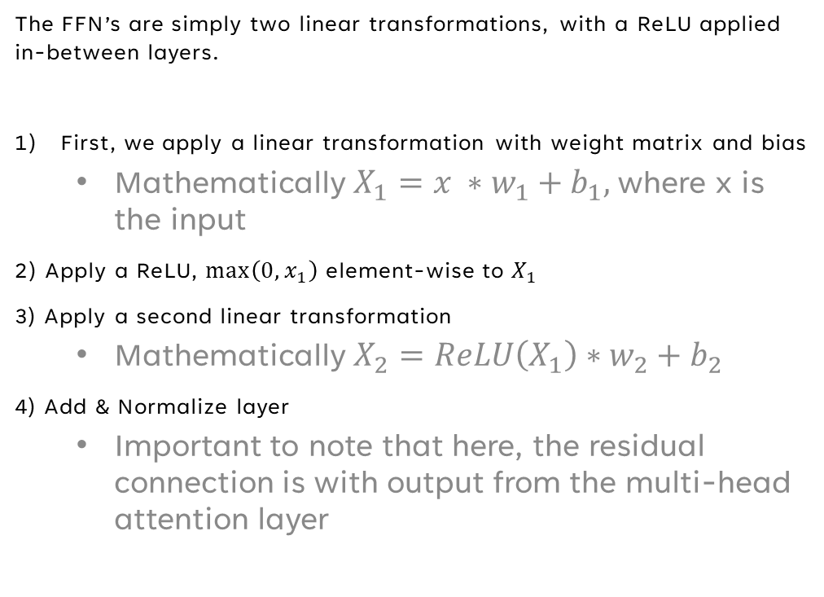
Feed Forward Network
The FFN’s are simply two linear transformations, with a ReLU applied in-between layers.
First, we apply a linear transformation with weight matrix and bias
Mathematically $X_{1}=x ∗w_{1}+b_{1},$where x is the input
2) Apply a ReLU, $\max\left(0,x_{1}\right)$ element-wise to $X_{1}$
3) Apply a second linear transformation
Mathematically $X_{2}=ReLU\left(X_{1}\right)∗w_{2}+b_{2}$
4) Add & Normalize layer
Important to note that here, the residual connection is with output from the multi-head attention layer

Slide 9
Transformer architecture

Slide 10
My dataset
Tatoeba Translation Dataset
Over 250,000 English sentences translated to Spanish
Will be truncating, only using 25,000, randomly selected

Slide 11
My model Simplified Transformer
Encoder
Decoder
Output Layer
A stack of 2 identical layers
Encoder has two MultiHeadAttention and Layer Normalization layers.
Each MultiHeadAttention Layer computes self-attention for the input sequence, followed by dropout and residual connections.
Number of parallel heads = 6
A stack of 2 identical layers
Decoder inputs tokenized Spanish sentences.
Has two MultiHeadAttention & layernormilization layers. The first MultiHeadAttention layer computes the self-attention for the input sequence.
The second computes attention between the encoder and decoder representations, allowing the model to capture the relationships between the source (EN) and target (Spanish) Sequences.
A dense layer with a SoftMax activation function is used to produce the probability distribution over the target vocabulary for each position in the output sequence

Slide 12
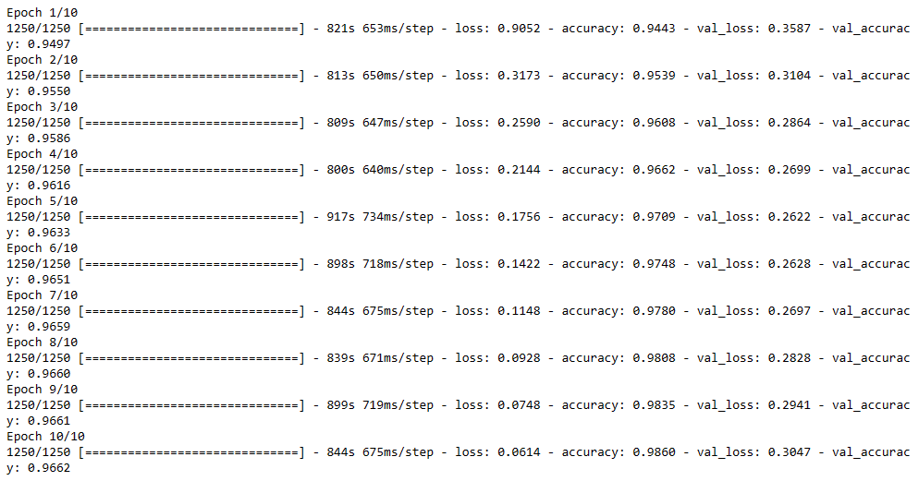

Slide 13
Limitations/Next steps
Training time & Computer ~ complexity of model
Small Dataset
Hyperparameter tuning
Out-of-vocabulary words are not handled well
Overfitting (regularization/early stopping)

Slide 14
THANK YOU & Questions
Reed Shay

