Slide 1
Netflix IMDb Ratings Analysis
In depth analysis of Netflix’s Movies and TV shows ratings

Slide 2
INTRODUCTION
These slides will take you through a journey of different analysis gathered from the datasets “Netflix TV Shows and Movies” and “Netflix Titles”. One of the datasets give us information on their imdb ratings and the other gives us more info on the genre.

Slide 3
Reem Anwar!
Bachelors of Science in Business Analytics. Passionate about using data to collect insights and make predictions in the entertainment, food, and real estate industry!

Slide 4
301,600,000
Paid Netflix Subscriptions.

Slide 5
01
Which genres perform the best, having the highest average in IMDb ratings?

Slide 6
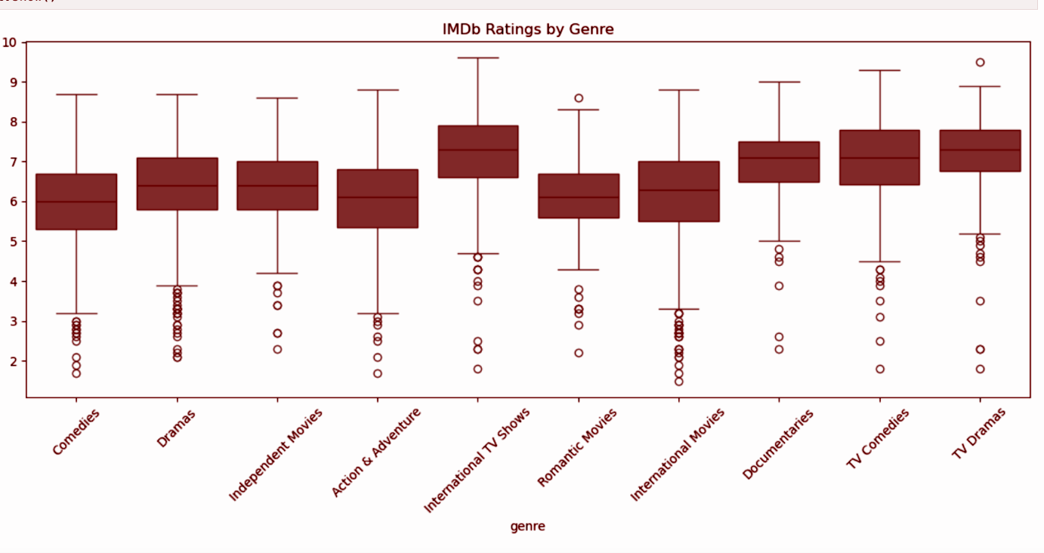

Slide 7
INTERNATIONAL GENRES
TV COMEDY WEAKNESS
International TV Shows and Movies have high medians but wide variability, with many low-rated titles showing inconsistent quality.
TV Comedies share a decent median but suffer from many low-rated titles, indicating uneven performance.
ACTION AND ADVENTURE
MAINSTREAM VOLITALITY
These titles span a wide rating range, with a median around 6 — a genre with hit-or-miss audience appeal.
Comedies and Dramas are popular but show many low outliers, suggesting mixed viewer satisfaction.
TV DRAMAS STRENGTH
ROMANCE UNDERPERFORMS
TV Dramas stand out with strong medians and tight distributions, signaling quality and consistency.
Romantic Movies show tightly clustered low ratings with rare standouts, suggesting poor reception overall.

Slide 8
02
Which Genre has the most title? Is that genre top rated or not?

Slide 9
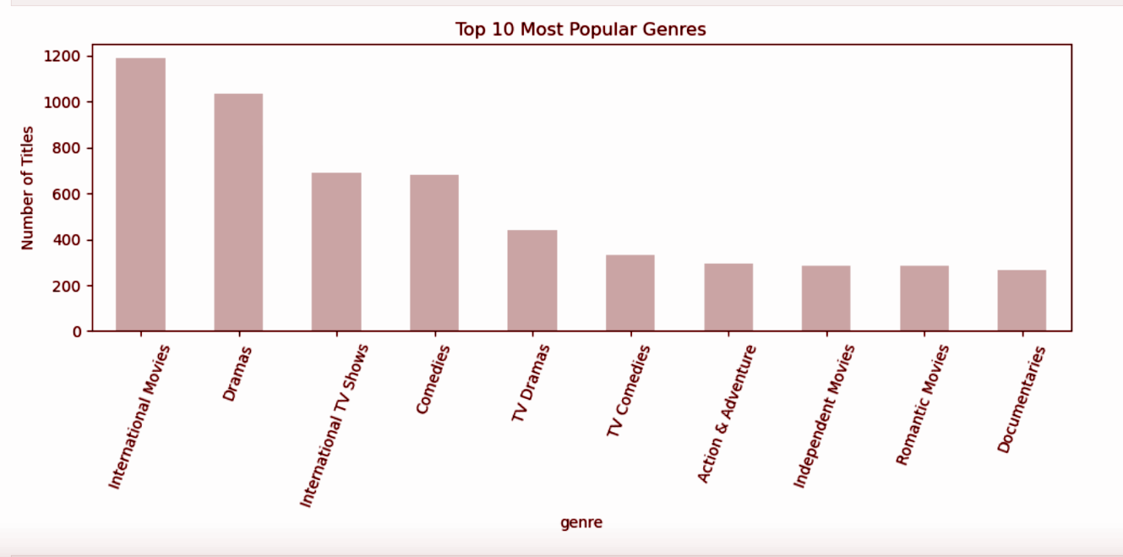

Slide 10
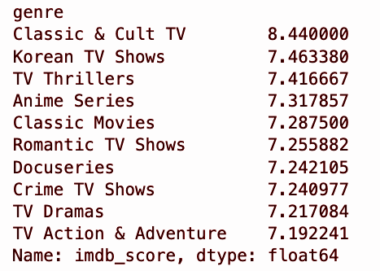
Top Rated Genres based on IMdb Score

Slide 11
International movies have the most titles, this is because there is a large number of titles that fall under this umbrella, automatically claiming the most number of titles.
However, it is not in the top 10 of best rated genres. Same goes for Drama Movies.
Classic and Cult TV takes top place in average best rated genre. Defined as having a strong fan base, these shows get higher ratings but not a popular genre, as number of titles are not in the top 10.
Korean TV Shows can also fall under International TV Shows, which is a popular genre containing many titles, But now we see that Korean TV in specific get more ratings than others.

Slide 12
03
Average IMDb Rating by Year & Number of Titles Released per Year .

Slide 13
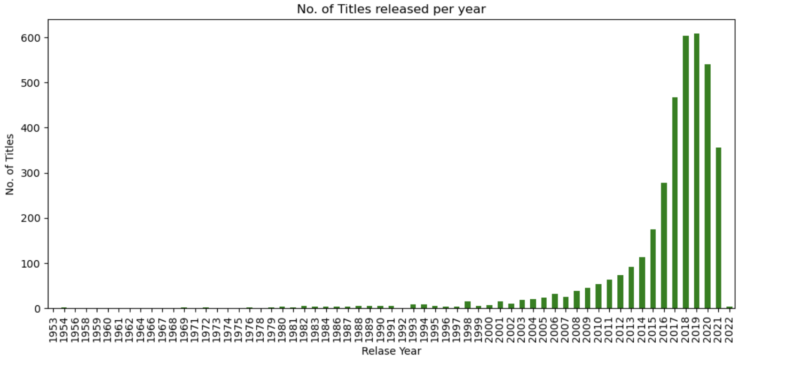
There is a clear depiction that the number of titles being released each year has increased. This is due to new technologies, accessible equipment, possibly social media and other external factors. We have also seen an expansion in the film and production industry in the past 30 years. 2018 and 2019 hold the top places for the no. of titles released per year, with around 600 titles released. We see a decline in 2021 and 2022, this maybe due to the covid-19 pandemic. Due to global lockdowns, filming and direction was stopped for most tv shows and movies.

Slide 14
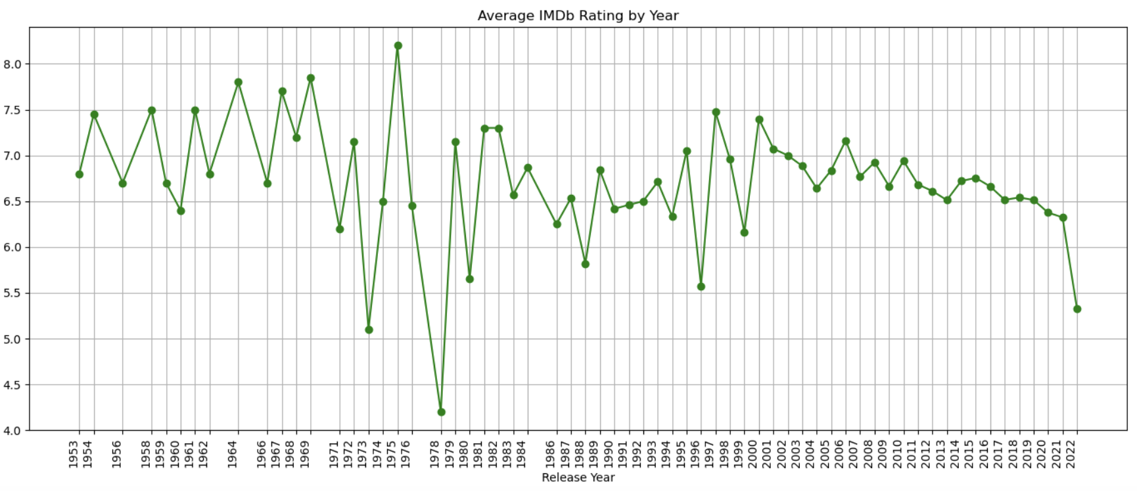
The Average IMDb rating per year shows an interesting analysis we can combine with the bar graph. The movies release in the earlier years have more intense high and lows when it comes to ratings, this is possibly due to the fact that there were not a large number of titles released during that year, which skews the the data if looking at overall average rating throughout.

Slide 15
This part of the analysis offers us more insight about the storytelling aspect instead of the trends. The reason being that volume of titles in the early years was low, while the recent releases volume have been higher, specifically after the 2010’s, this does not give us insight on trend of average rating over time.

Slide 16
04
Trend Overtime.

Slide 17
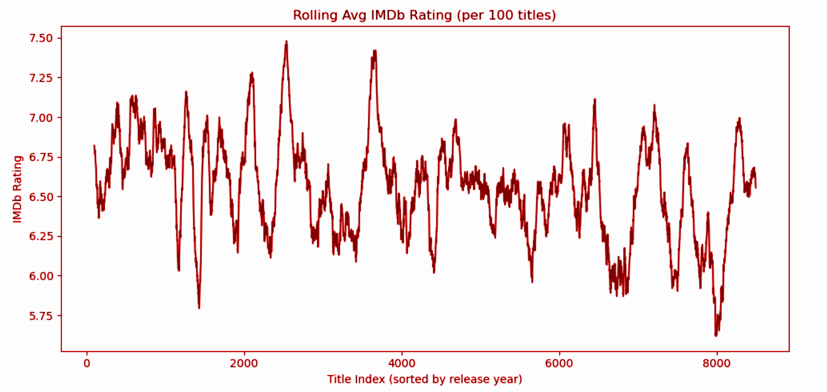

Slide 18
KEY POINTS
0
8000
100
Latest Year Index
Title Sample Size
Earliest Year Index
1953 is the earliest release year, mapped to 0 on the X-axis.
2022 is the most recent release year in the dataset, mapped to 8000 on the X-axis.
Using 100 titles per point reduces skew from release volume and shows true rating trends.

Slide 19
Thats all for the analysis part!
Check out the business recommendations in the github read me files.

