Slide 1


Slide 2


Slide 3








Site 1
MB - 07
Ahmedabad
Shivranjani Bridge- Fcg. Shyamal 4 road Jnc - Left (1)
Size: 30x10 ft
Type: Gantry
Illumination: BL
Adv.fee per month: ₹ 2,25,000/-
Availability: Available
Location Coordinates: 23.018881, 72.530022

Slide 4
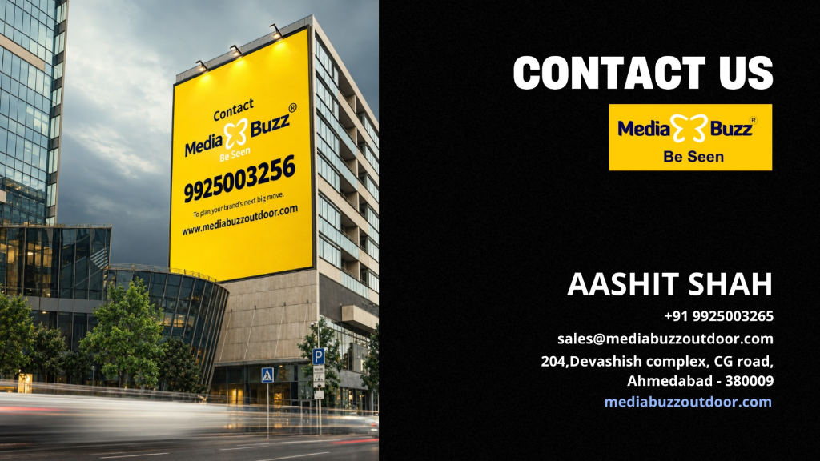
mediabuzzoutdoor.com

