Slide 1
Telegram Chatbot using OpenAI

Slide 2
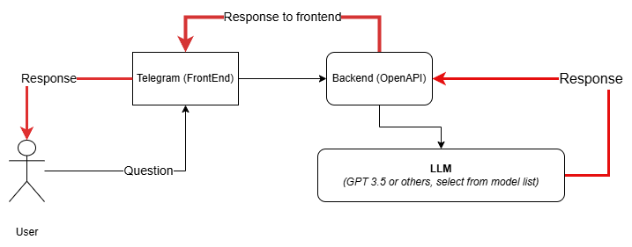
Architecture

Slide 3
Extra package for telegram bot
Aiogram:- https://docs.aiogram.dev/en/latest/

