Slide 1

Constants in Go

Slide 2

Const properties
Cannot be redeclared/reassigned
Can only hold scalar values
Can hold large high precision numbers
Can be created from expressions of other constants
Can be untyped (kind)
Constants exist only during compilation time

Slide 3

Scalar def
A scalar variable, or scalar field, is a variable that holds one value at a time. It is a single component that assumes a range of number or string values. A scalar value is associated with every point in a space.
In computing, the term scalar is derived from the scalar processor, which processes one data item at a time

Slide 4
Syntax
// one line untyped
const identifier = 10
// one line typed
const identifier string = "Hello World!"
// multi line (group) mixed
const (
// numbers
num1 = 10
num2 = 10.25
num3 = 1 + 2i
// strings
str1 = "Hello"
str2 = "World"
// typed
complexNum complex128 = 1 + 0i
)

Slide 5

Identifiers
An identifier is a sequence of one or more unicode letters and digits, the first character must be a unicode letter (including underscore)
const (
identifier = 10
_underscore = "underscore"
hello_world = "hello_world"
c1 = 1
c2 = 2
αβ = "Greek"
汉字 = "Chinese"
)

Slide 6
Reserved identifiers
keywords
break
default
func
interface
select
case
defer
go
map
struct
chan
else
goto
package
switch
const
fallthrough
if
range
type
continue
for
import
return
var
operators & punctuation
+
&
+=
&=
&&
==
!=
(
)
-
|
-=
|=
||
<
<=
[
]
*
^
*=
^=
<-
>
>=
{
}
/
<<
/=
<<=
++
=
:=
,
;
%
>>
%=
>>=
--
!
...
.
:
&^=

Slide 7
Blank identifier
Unused identifiers/imports
import (
// unused import
_ "fmt"
// side effects
_ "github.com/go-sql-driver/mysql"
)
Unused errors
Side effects
// unused identifier
const _ = iota
// unused (ignored) error
val, _ := SomeValAndErr()

Slide 8
General const types
Boolean
Integer
Untyped
Floating-point
Typed
Complex
String
Custom Type

Slide 9
Specific Const types
bool
uint
float32
untyped bool
int
uint8/byte
float64
untyped int/iota
int8
uint16
complex64
untyped rune
int16
uint32
complex128
untyped float
int32/rune
uint64
string
untyped complex
int64
uintptr
untyped string
custom type

Slide 10
Iota def
Greek name of the ninth letter of the Greek alphabet, they spelled it as either iota or jota(the letters i and j were simply variants of each other), and these spellings eventually passed into English as iota and jot. Since the Greek letter iota is the smallest letter of its alphabet, both words eventually came to be used in reference to very small things

Slide 11
Iota examples
const (
// first value ignored
_ = iota
KB = 1 << (iota * 10)
MB
GB
)
iota is an alias of untyped int
const (
Sunday = iota + 1
Monday
Tuesday
Wednesday
Thursday
Friday
Saturday
)

Slide 12
Const operation restrictions
Can't mix and match types
Be explicit about the end result

Slide 13


C background
C
unsigned int u = 1e9;
long signed int i = 1;
... i + u ...
Go
const (
u uint = 1e9;
i int = 1;
)
... i + u ...
In a binary operation Go works only with values of the same type

Slide 14
Const Visibility (Scope)
Exported
Starts with uppercase letter
Recommended to have explanatory comments aka docs
Unexported
Starts with lowercase letter

Slide 15


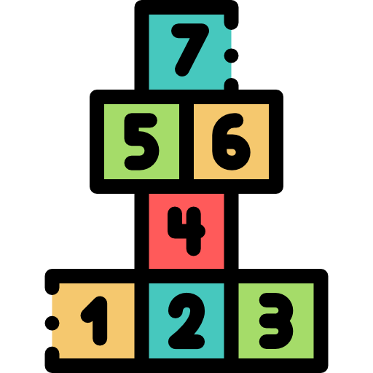
Untyped const(s) - kind
Except bool and string types, every other const type is just a number
Boolean space
String space
Number space

Slide 16
kind default types
untyped bool
bool
untyped int
int
iota
int
untyped rune
int32
untyped float
float64
untyped complex
complex128
untyped string
string

Slide 17



Const overflow
50000 mAh
2000 mAh
Huge = 1.2676506002282294e+30 = 2^100
i64 = 2.147483648e+09 = 2^63

Slide 18
Untyped const high precision
Mathematically exact values

Slide 19
Implicit type conversion
By syntax
Untyped constants
By type
Typed constants / variables

Slide 20
Kind promotion
5)
Integer
K1
comparison
K2
untyped bool
4)
Floating-point
uint
shift
uint
untyped int
3)
Complex
K
operation (no shift)
K
untyped K
2)
String
K1
operation
K2
untyped const
1)
Custom type
K
operation
T
T

Slide 21
expression conversion
Integer
type T complex128
Floating-point
const (
t T = 1;
n = 2 + t * 'c' * 2.0 + 35i
)
Complex
String
1. Select the type with the highest priority
Custom type
2. Convert all other kinds to the selected type
3. Apply the expression operations
T
int
T
T
int32
T
float64
T
complex128
T

Slide 22
Exercise
main.T
int32
type T complex128
const (
t T = 1;
n = 2 + t * 'c' * 2.0 + 35i
shift = 'a' << 4
)
func main() {
fmt.Println("%T\n", n)
fmt.Println("%T", shift)
}

