Slide 1
Text Summarization Using Natural Language Processing for Books
Submitted by:
Akhil Sanker- [RA1811026020035] Melvin Abraham- [RA1811026020029] K Prasath -[RA1811026020061] D Raj Praneeth-[RA1811026020058]
Under the guidance of MS.GOUTHAMI

Slide 2
Problem Statement
As of late, there has been a blast in the measure of text data from an assortment of sources. This volume of text is a priceless source of information and knowledge, which should be effectively summarized to be useful. In this problem, the main objective is to automatic text summarization are described below for lighting more about processes. With the dramatic growth of the Internet, people are overwhelmed by the tremendous amount of online information and documents.
This expanding availability of documents has demanded exhaustive research in automatic text summarization. Now days many research is going on for text summarization. Because of increasing information in the internet, these kinds of research are gaining more and more attention among the researchers.
Extractive text summarization generates a summary by extracting proper set of sentences from a document or multiple documents by deep learning. The whole concept is to reduce or minimize the valuable information present in the documents.
The procedure can be manipulated Neural Networks with the help of Specific model namely Stacked LSTM , it also uses a mechanism of Attention algorithm for better efficiency by removing redundant sentences.

Slide 3
Introduction
Think of the internet, comprised of web pages, news articles, status updates, blogs and so much more. The data is unstructured and the best that we can do to navigate it is to use search and skim the results. There is a great need to reduce much of this text data to shorter, focused summaries that capture the salient details, both so we can navigate it more effectively as well as check whether the larger documents contain the information that we are looking for.
We cannot possibly create summaries of all of the text manually; there is a great need for automatic methods.
1. Summaries reduce reading time.
2. When researching documents, summaries make the selection process easier.
3. Automatic summarization improves the effectiveness of indexing.
4. Automatic summarization algorithms are less biased than human summarizers.
5. Personalized summaries are useful in question-answering systems as they provide personalized information.
6. Using automatic or semi-automatic summarization systems enables commercial abstract services to increase the number of texts they are able to process.
we have focused on analyzing and pre- processing data sets as well as the deployment of the Stacked LSTM models with attention for the purpose of Getting an Apt Summary for our documents.

Slide 4
LITERATURE SURVEY - melvin

Slide 5
PROPOSED CONCEPT ( IDEA ) - melvin

Slide 6
Algo / tech - prasath

Slide 7
Arch diag - prasath

Slide 8
Module explanation - prasath

Slide 9
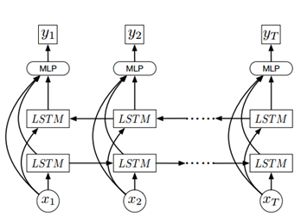
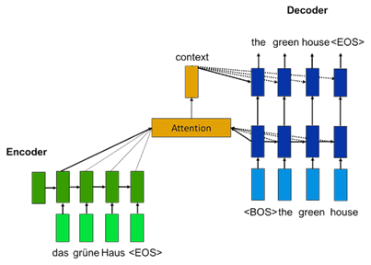
Project Implementation - 1

Slide 10
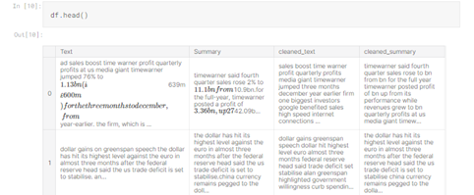

Project Implementation - 2

Slide 11
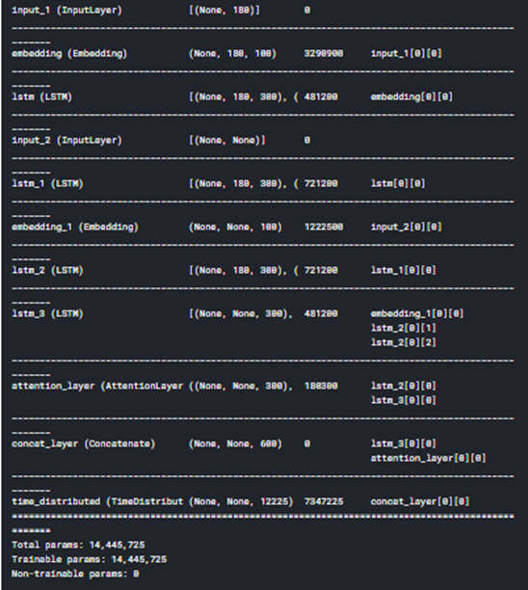
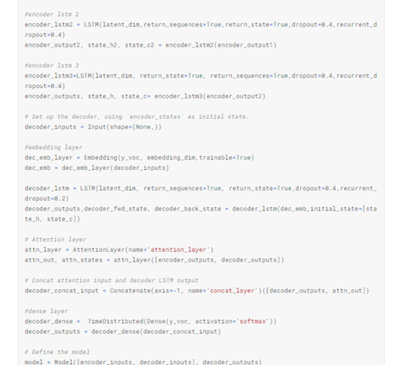
Project Implementation - 3

Slide 12
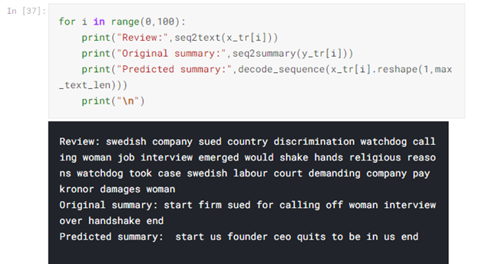
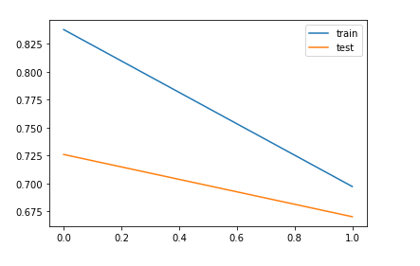
Project Implementation - 4

Slide 13
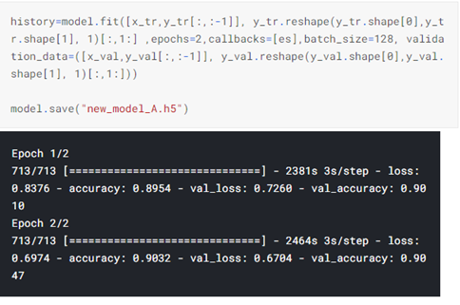
Project Implementation – 5 ref :- https://www.kaggle.com/reekithak/lstmnew

Slide 14
Conclusion
We have described the a study that explores extractive summarization using Neural Networks and abstractive summarization using seq-seq LSTM stacked model.
We used multiple Stacked - LSTM . Representation capacity is increased by using this model.
Experiments on the given data is by using these two techniques which outperforms several previously proposed models.
In addition to it , we’ve used attention mechanism to improve the outputs of our model.

Slide 15
References
Paper 1
https://www.researchgate.net/publication/221237689_Text_summarization_techniques_SVM_versus_neural_networks
Paper 2
https://www.aclweb.org/anthology/W14-1504/
Paper 3
https://www.researchgate.net/publication/329740404_Sequence_Generative_ Adversarial_Network_for_Long_Text_Summarization
Paper 4
https://arxiv.org/abs/1912.08777
Paper 5
https://www.researchgate.net/publication/310596578_Literature_Study_on_ Multi-document_Text_Summarization_Techniques
Paper 6
https://www.researchgate.net/publication/228989228_A_survey_on_automati c_text_summarization

