Slide 1
Phylogenetics for Ecologists
National Institute of Ecology, Spring 2016
Richard Ree <rree@fieldmuseum.org>
Associate Curator of Botany, Field Museum of Natural History
Committee on Evolutionary Biology, University of Chicago http://www.reelab.net

Slide 2
Overview
nomenclature
  phylogenetic knowledge reflected in taxonomy
  Phylocode
biodiversity conservation
  phylogenetic diversity and the preservation of evolutionary history
  EDGE species: evolutionarily distinct, globally endangered
community ecology
  phylogenetic structure of communities in relation to the traits and interactions of co-occurring species

Slide 3
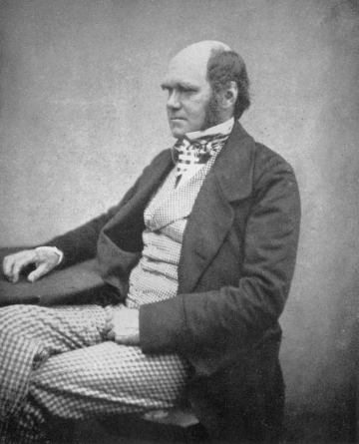
The Darwinian revolution
prior to Darwin, no explanation for why “natural” groups shared similar traits; this gap filled by common ancestry
“... the characters which naturalists consider as showing true affinity between any two or more species, are those which have been inherited from a common parent... all true classification is genealogical; ... community of descent is the hidden bond which naturalists have been unconsciously seeking.”
  (Origin of Species, p. 420)

Slide 4
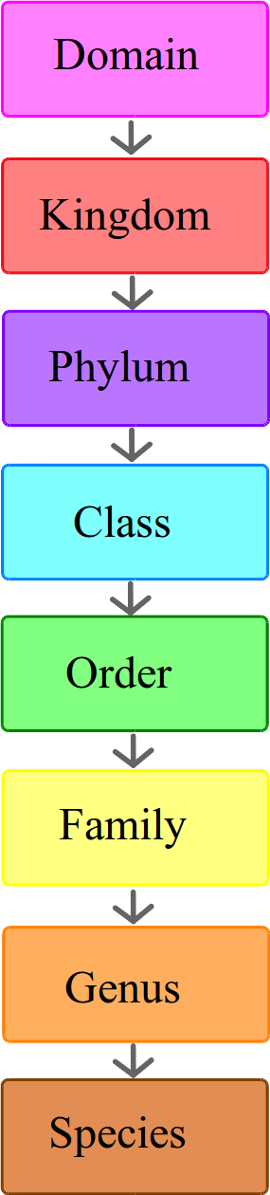
Phylogenetic nomenclature: naming the tree of life
nomenclature: rules governing the validity of taxonomic names
current system:
  conventions inherited from Linnaeus
  a name must have a rank, a type, and a diagnosis (description)
  changing knowledge of phylogeny causes instability
    the meaning of a name can change
    taxa of the same or higher rank cannot be nested, requiring name changes even if the meaning doesn't change

Slide 5
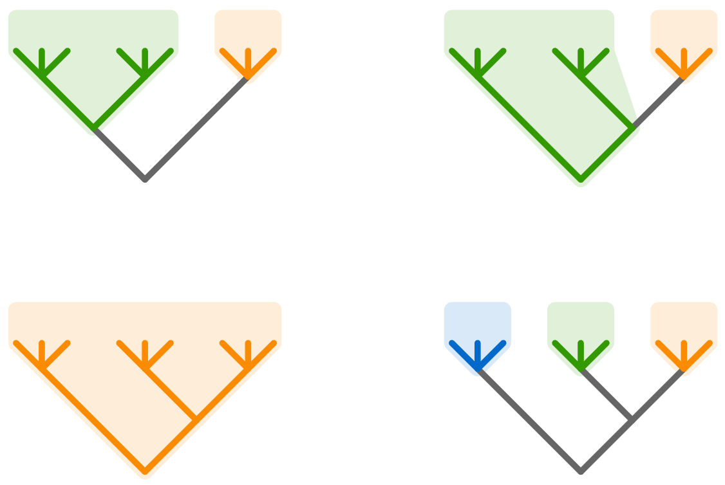
Instability of rank-based names
Agamidae
Chamaeleonidae
Agamidae
Chamaeleonidae
Chamaeleonidae
Leolepididae
Agamidae
Chamaeleonidae
de Quieroz and Gauthier (1994) Trends Ecol. Evol.

Slide 6
Phylogenetic nomenclature: naming the Tree of Life
nomenclature: rules governing the validity of taxonomic names
phylogenetic system:
  a name has a phylogenetic definition, and refers unambiguously to a branch on the tree of life
  as knowledge of phylogeny changes, the species included in a taxon may change, but the name definition remains the same
  ranks are explicitly disallowed

Slide 7
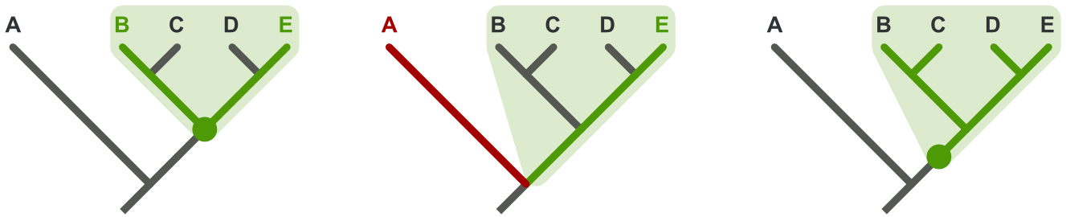
Kinds of phylogenetic definitions
node-based: name refers to the most recent common ancestor of two or more specifier taxa, plus all of the descendants of that ancestor
stem-based: name refers to all species more closely related to one species than another
apomorphy-based: name refers to the first ancestor to evolve a specified character
de Quieroz and Gauthier (1994) Trends Ecol. Evol.

Slide 8

Stability of phylogenetically-defined names
Agamidae
Chamaeleonidae
Agamidae
Chamaeleonidae
de Quieroz and Gauthier (1994) Trends Ecol. Evol.

Slide 9
Conserving biodiversity: which species should be saved?
traditional measures of diversity:
  alpha – species richness of a single site/region
  beta – turnover of species across sites
  gamma – total richness across sites (e.g., ecosystems in a large geographic region)
  caveat: all species treated as equivalent units

Slide 10
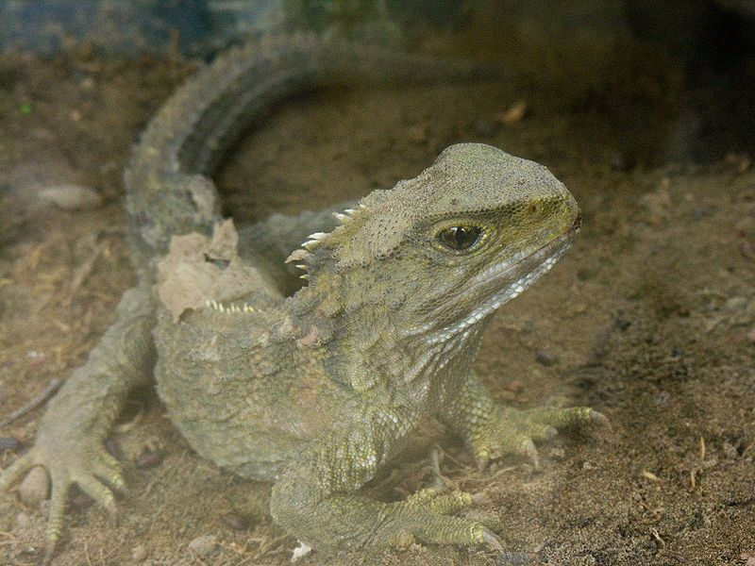

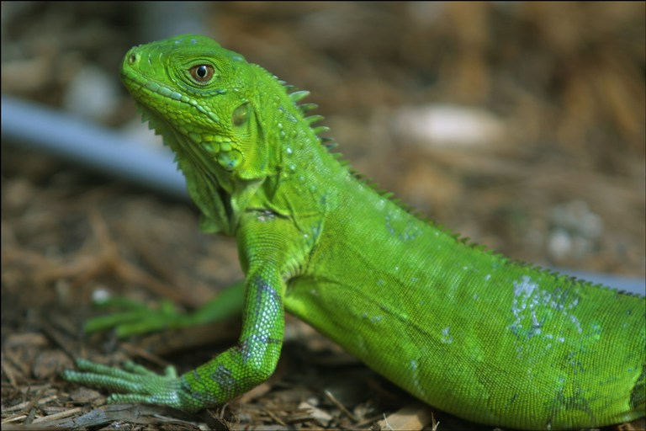
Conserving biodiversity: which species should be saved?

Slide 11
Conserving biodiversity: which species should be saved?
tuatara
iguana
iguana
200 Myr

Slide 12
Phylogenetic diversity
definition: total length of the minimum spanning path connecting a subset of species on a tree to the root node

Slide 13
Phylogenetic diversity
definition: total length of the minimum spanning path connecting a subset of species on a tree to the root node

Slide 14
Phylogenetic diversity
definition: total length of the minimum spanning path connecting a sample of species on a tree to the root node
when scaled to absolute time, measures the amount of evolutionary history encapsulated by the sample of species
could also measure other units of branch length, e.g. character change
general idea: more is better
can be used as a priority criterion in reserve design

Slide 15
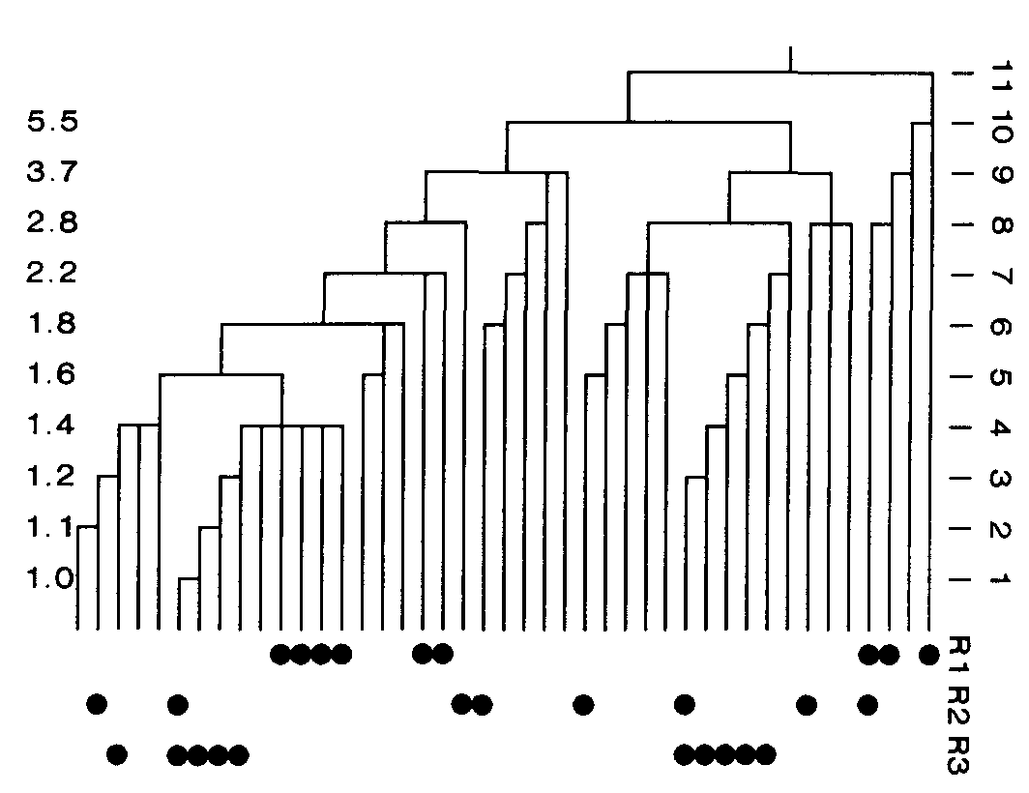
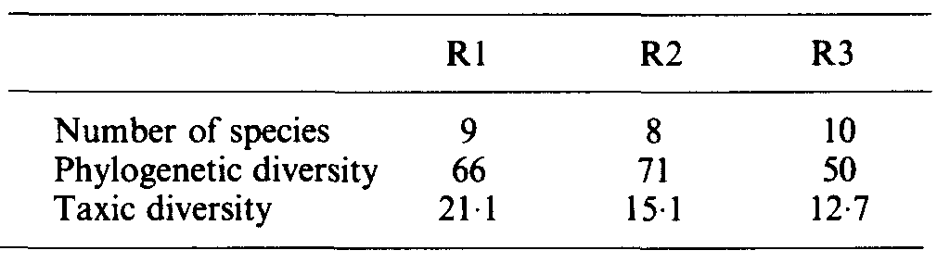
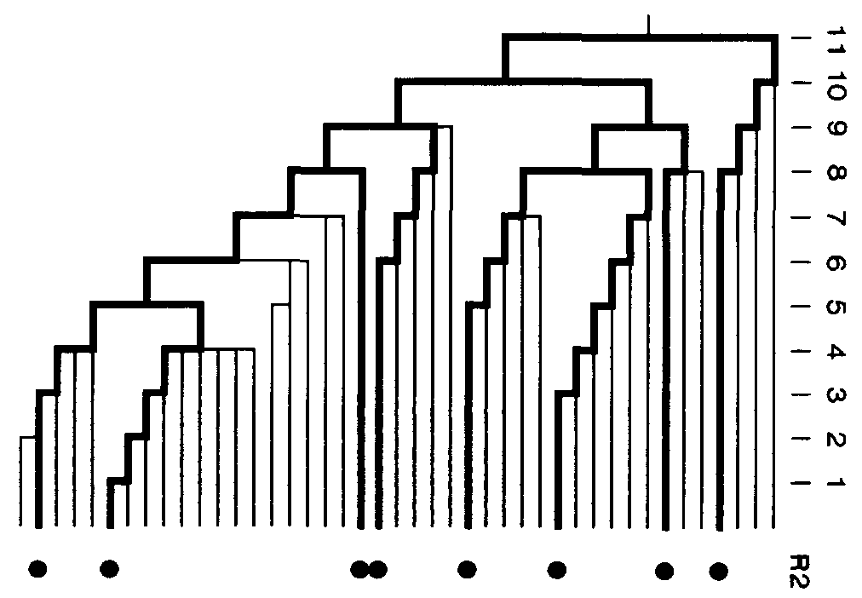
reserve R2 maximizes phylogenetic diversity, but not species richness or “taxic” diversity
Faith (1992) Biol. Cons. 61:1-10

Slide 16
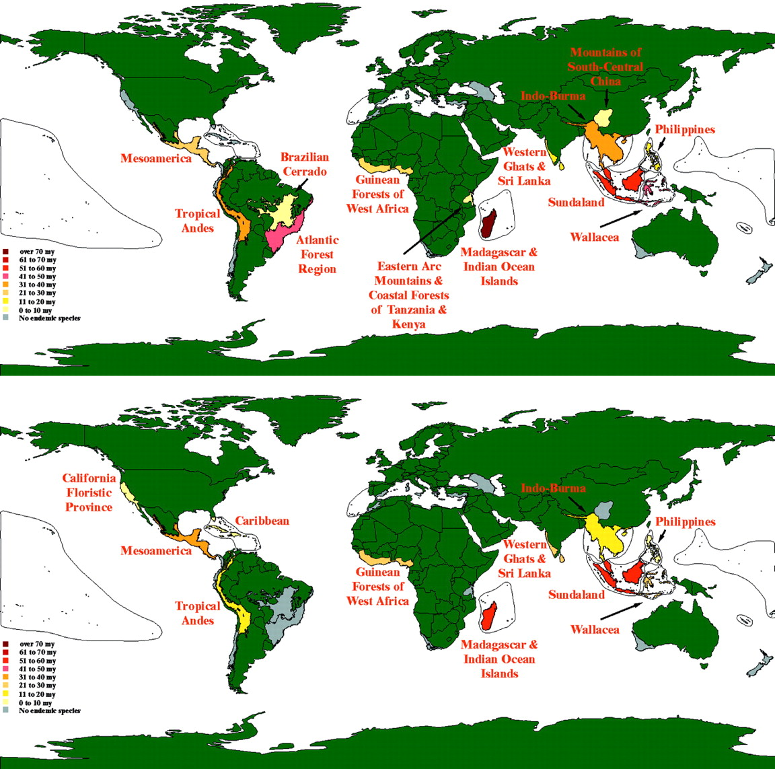
Endemic phylogenetic diversity in biodiversity hotspots
primates
carnivores
Sechrest et al. PNAS 2002;99:2067-2071

Slide 17
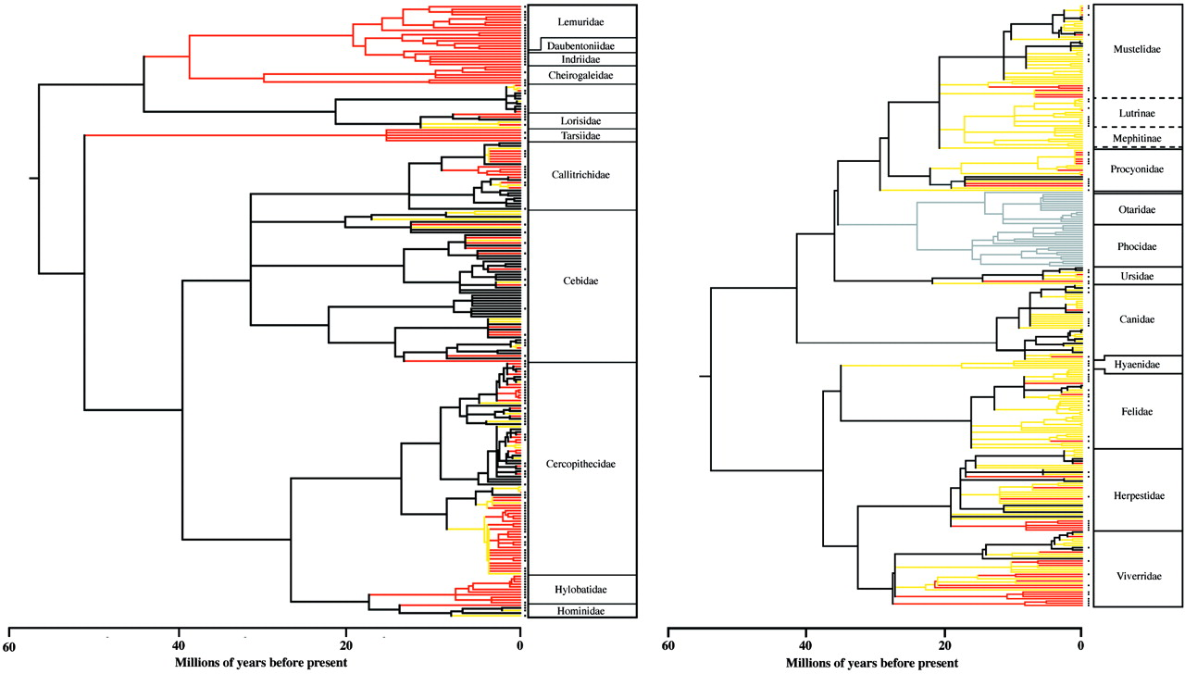
Biodiversity hotspots harbor more evolutionary history of mammals than expected by chance
primates
carnivores
endemic to a hotspot
resident in a hotspot
Sechrest et al. PNAS 2002;99:2067-2071

Slide 18
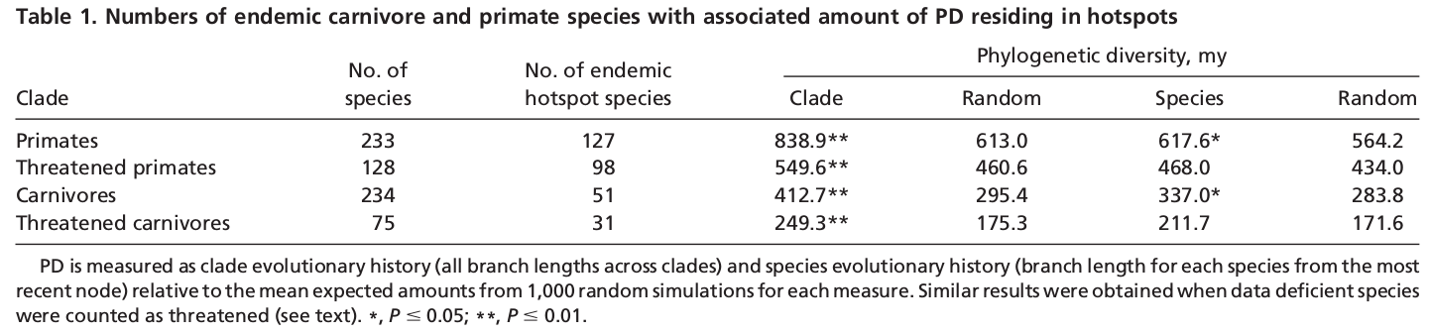
Sechrest et al. PNAS 2002;99:2067-2071

Slide 19
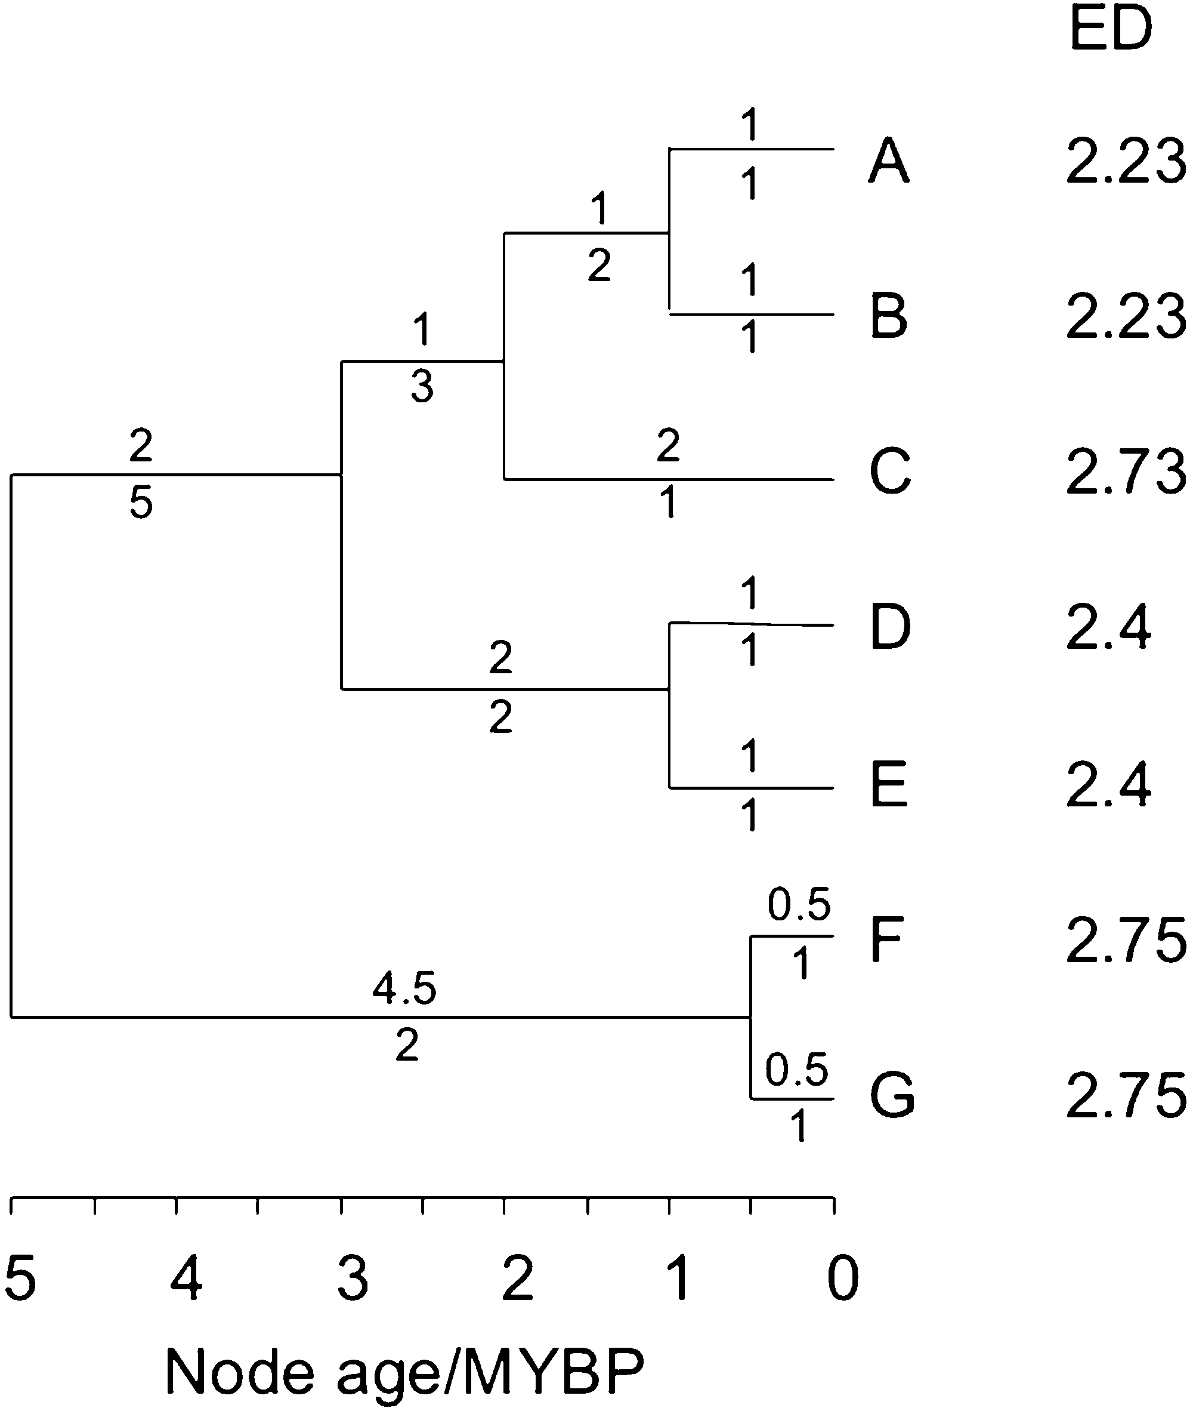
EDGE species: evolutionarily distinct, globally endangered
ED = evolutionary distinctiveness score
  for a single branch, ED is its length divided by the number of descendant species
  for a species, ED is the sum of branch scores along the path to the root
GE = global extinction risk
EDGE = ln(1+ED) + GE x ln(2)
Issac et al. (2007) PLoS ONE

Slide 20
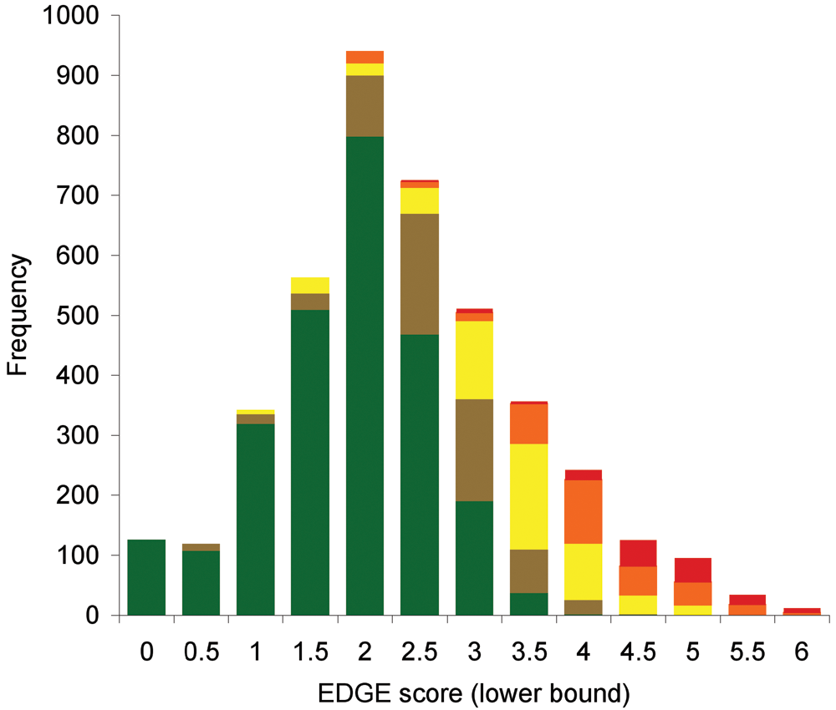
Histogram of EDGE scores for 4182 mammal species, by threat category. Colours indicate the Red List category: Least Concern (green), Near Threatened and Conservation Dependent (brown), Vulnerable (yellow), Endangered (orange) and Critically Endangered (red).
Issac et al. (2007) PLoS ONE

Slide 21
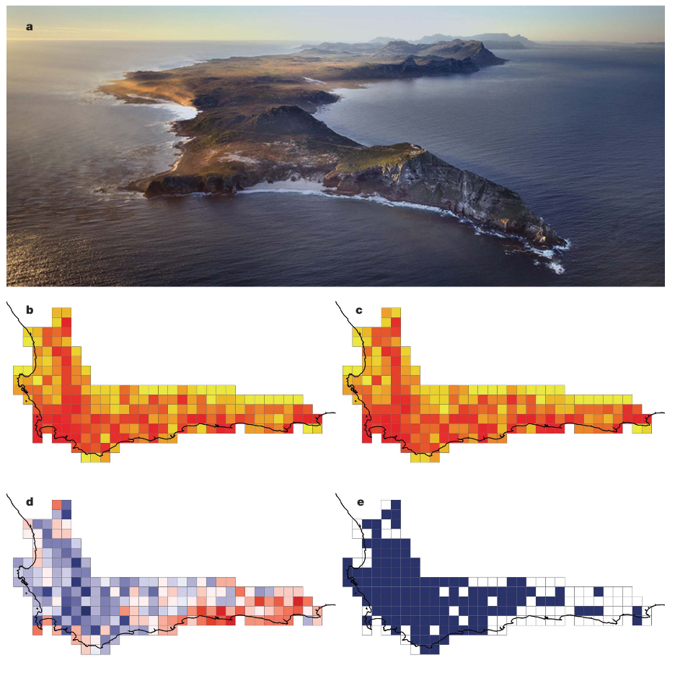
genus richness
phylogenetic diversity
residuals of PD on richness
cells of unusually low PD
Felix et al. (2007) Nature

Slide 22
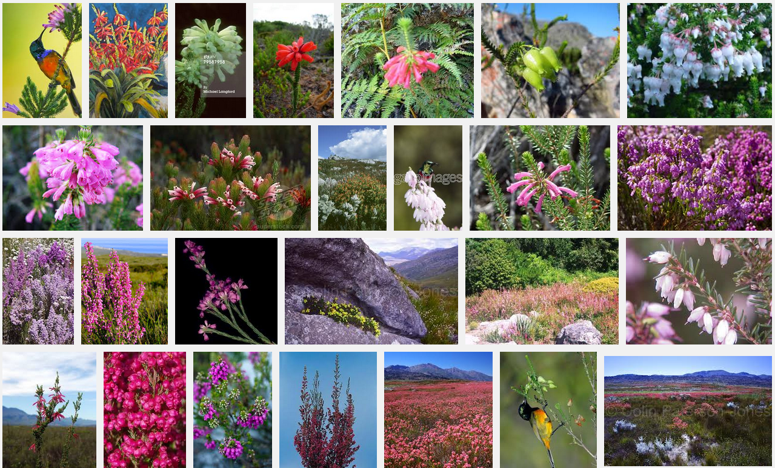
Erica spp., Cape Floristic Region, South Africa

Slide 23
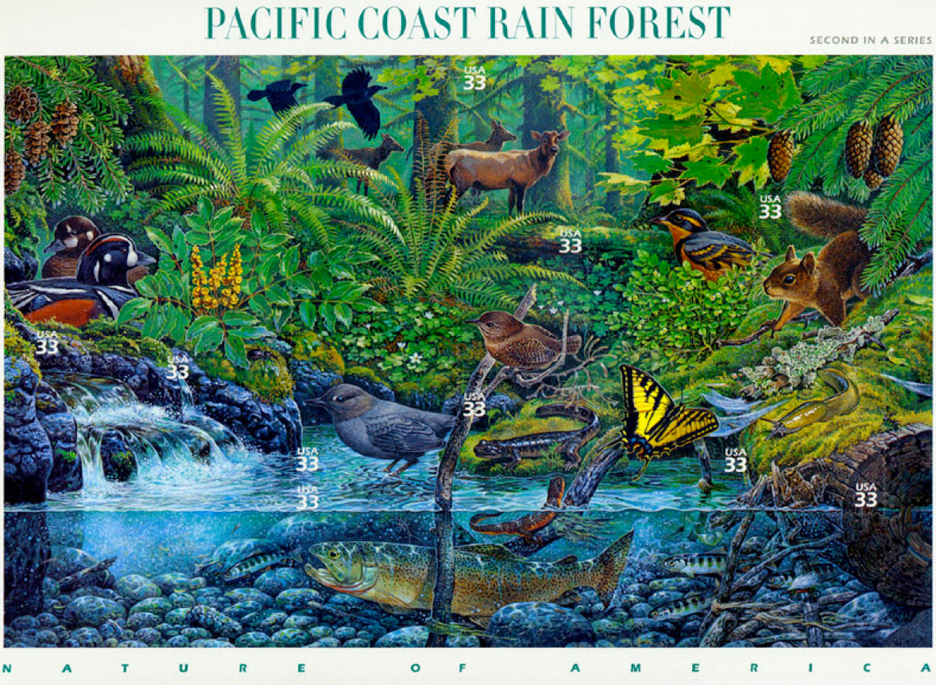
Phylogenetic diversity in a community context
can phylogeny help us understand the co-occurrence of species and their ecological relationships?

Slide 24
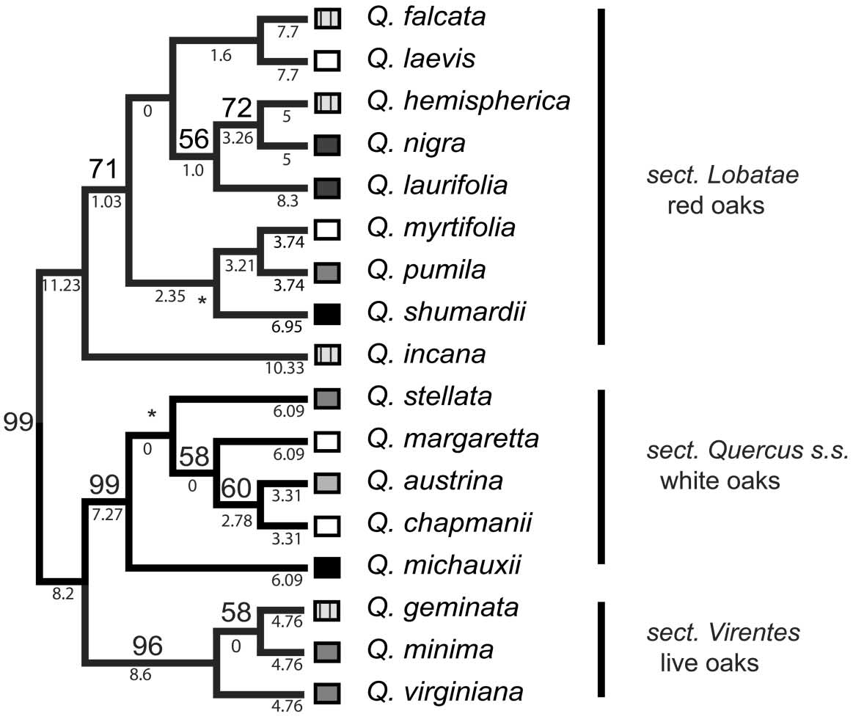
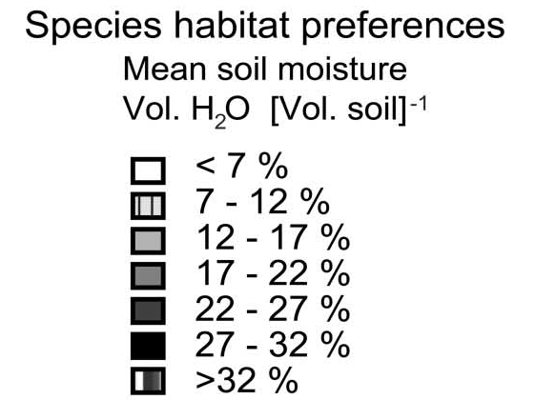
Cavender-Bares et al. (2004) American Naturalist

Slide 25
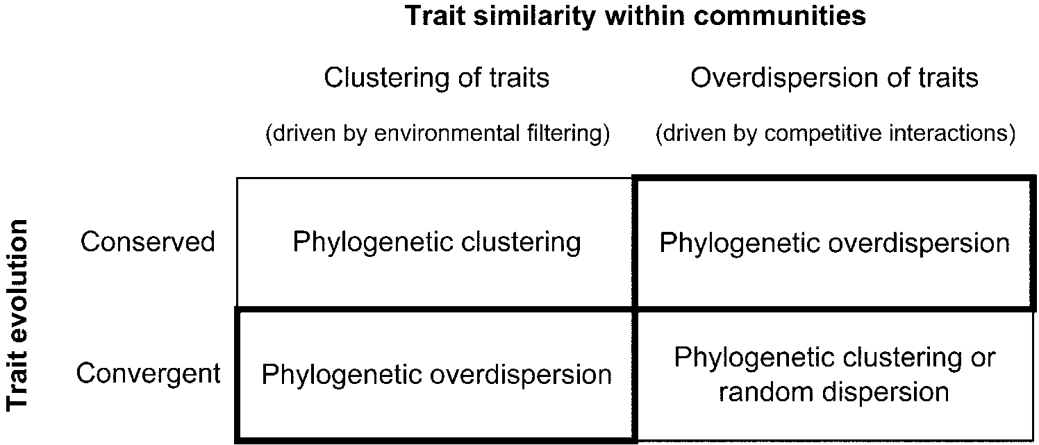
Relatedness of co-occurring species w.r.t. traits
Cavender-Bares et al. (2004) American Naturalist

Slide 26
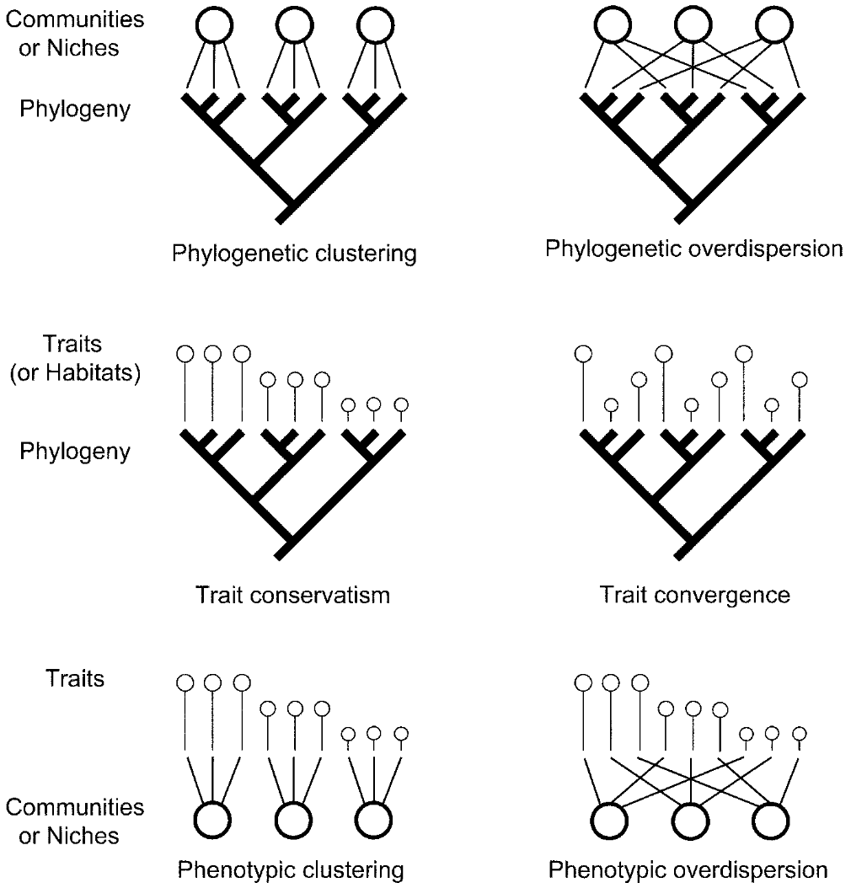
Clustering vs overdispersion (“evenness”): phylogeny vs traits
Cavender-Bares et al. (2004) American Naturalist

Slide 27
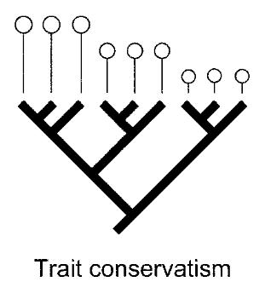
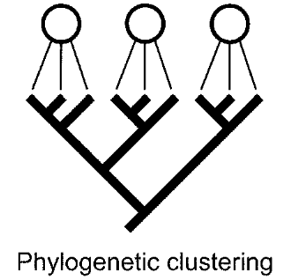
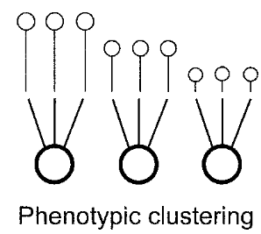
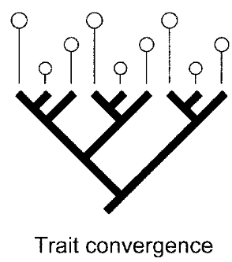
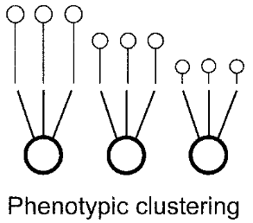
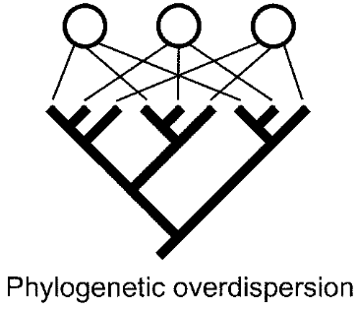
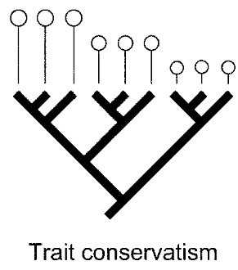
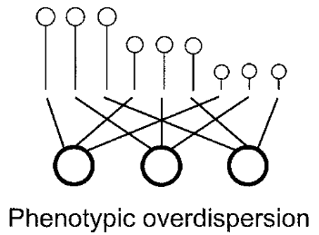
environmental filtering
+
=
+
=
biotic interactions?
=
+

Slide 28
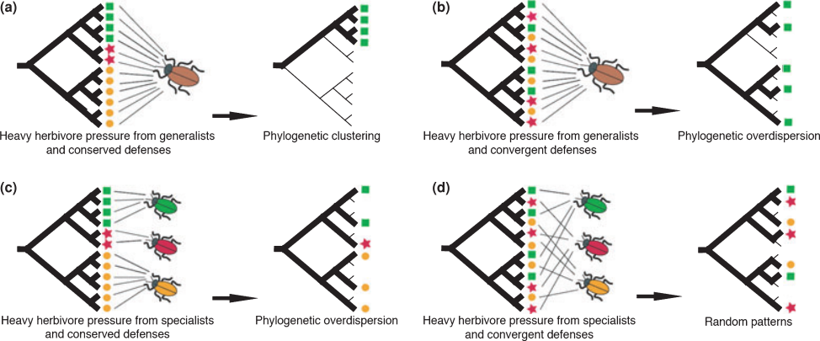
Cavender-Bares et al. (2009) Ecology Letters

Slide 29
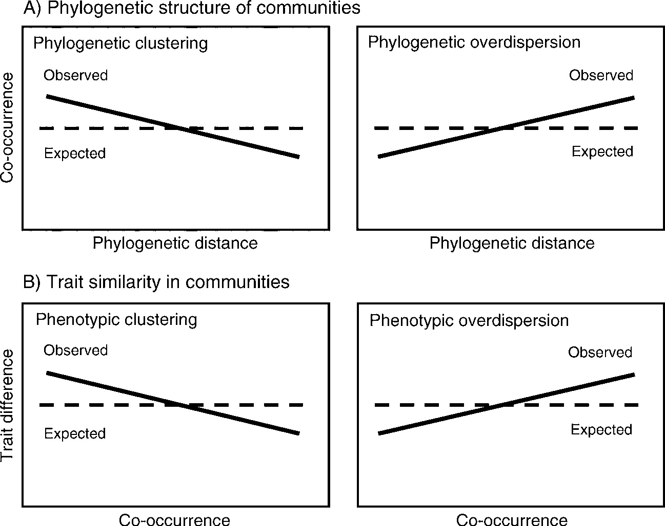
Cavender-Bares et al. (2006) Ecology 87(7) Suppl.

Slide 30
Cavender-Bares et al. (2004) American Naturalist

Slide 31
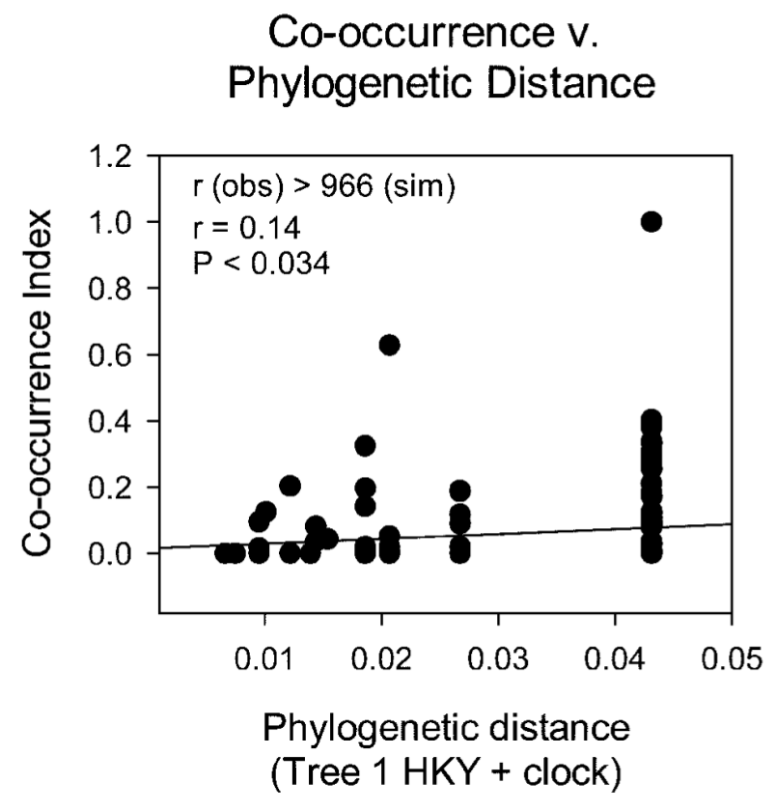
Floridian oak species are phylogenetically overdispersed
Cavender-Bares et al. (2004) American Naturalist

Slide 32
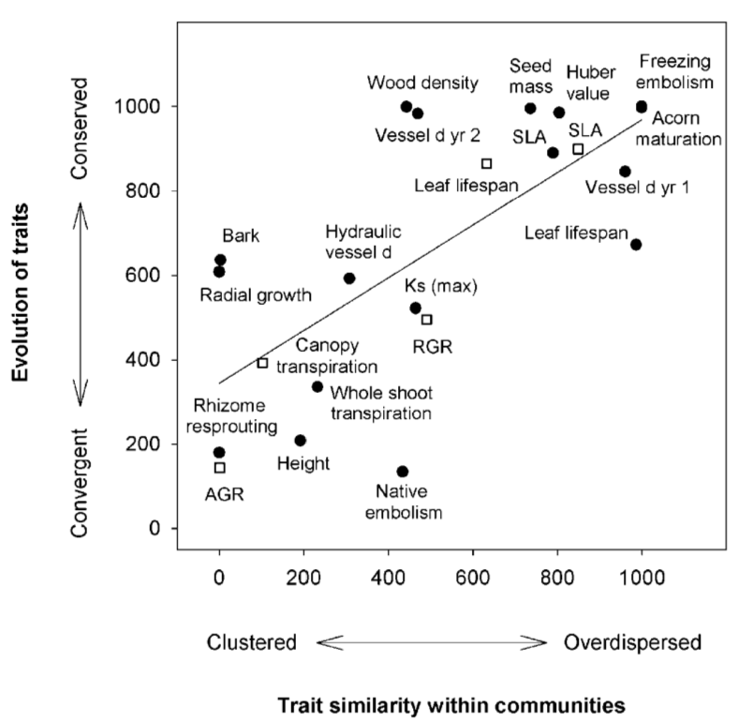
Cavender-Bares et al. (2004) American Naturalist

Slide 33
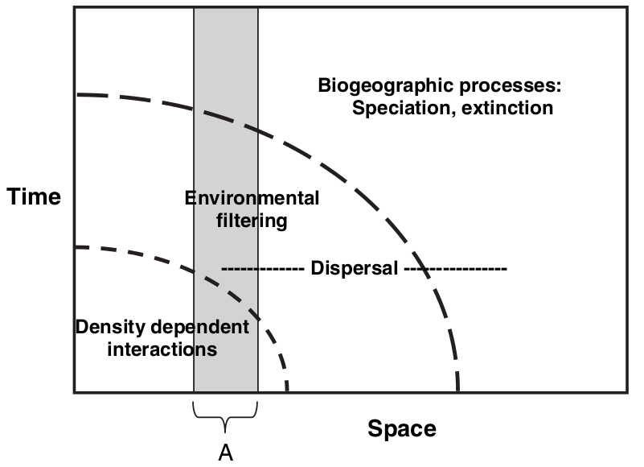
What governs species distributions?
clades
populations
communities
continents
Cavender-Bares et al. (2009) Ecology Letters

Slide 34
Discussion: Cavender-Bares et al. 2004
Oaks are diverse and widespread. For many of the species in this study, their closest relatives are not in North Central Florida. Are these unsampled species relevant to the analysis?
Does it make sense to talk about the phylogenetic structure of communities of close relatives, if the “community phylogeny” does not include all the interacting species (e.g., plants and herbivores, pollinators, etc.)?

Slide 35
Discussion – Forest et al. 2007
Should phylogenetic information be used to make conservation decisions, e.g., reserve design?
If so, what phylogenetic scale(s) should be considered?
Is preserving an area of rapid evolutionary diversification (with many young species) more or less important than preserving an area with a smaller number of relictual EDGE species?

