Slide 1
IBM Capstone Project
A Classification Study of Mushroom Toxicity
Richard S. Landry, Ph.D.

Slide 2
Introduction and Motivation
foraged mushrooms such as truffles and morels sell at very high prices
market value remains fairly constant for the varieties that cannot be commercially mass harvested
we provide a first automated step to rule out verifiable inedible species a priori
several predictive models compared to guess the type (edible/poisonous) of the species

Slide 3
Data Integration
our product model does not require streaming or time train based data, so streaming analytics and relevant technologies not used
classification scheme has a fixed number of parameters and therefore needs only to be run on a new specimen with previous training data
we are only using one large collection of data (to be split into a testing and training set) so we will only need to load it into our analysis software
we will be using a combination of R and Python

Slide 4
Data Repository
the Mushrooms Database has been obtained throughhttps://archive.ics.uci.edu/ml/datasets/mushroom
we start by reading CSV data from the current working directory using the R programming language into a Jupyter notebook (see associated notebook for details)
we have 8124 different samples with 22 characteristics per sample
with each sample we also have a classification: edible or poisonous

Slide 5
Discovery and Exploration
we explore the features using R in the first part of the notebook
R is chosen because the data set is not too large and some of the plot routines are superior to other programming languages
when initially working with the data set, the necessary libraries and utilities can be found in the fully functional notebook associated with this report (refer to the top of that notebook)
the field class has either an e (edible) or p (poisonous) value
we also check how many species are in each category to verify there are enough of each to make a meaningful analysis
Edible: 4208 | Poisonous: 3916

Slide 6
Features Analysis
we re-frame the features by converting the factor data into numeric data
for a visualization of the features we will use density plots to represent both the values density and the degree of separation of the two sets of values, on each feature dimension (next slide)
there is no perfect separation between any of the features, as expected
but we do have fairly good separations for spore.print.color, ring.type, population, and habitat. There is also a tight correspondence for some of the values, like veil.type and stalk.shape

Slide 7
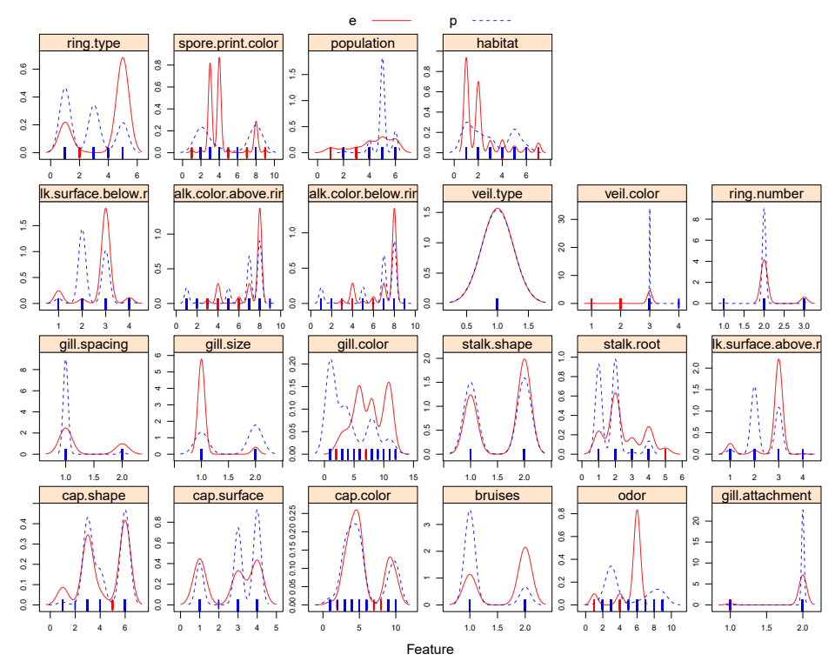
Features Analysis

Slide 8
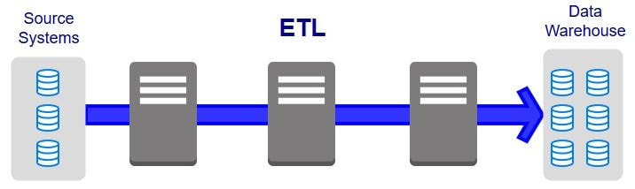
Predictive Models
we will use three models in R and one more model using a neural network in Python to determine which is the best way to train the data
R implementation:
Random Forest Model
Gradient Boosting Machine Model
XGBoost Model (eXtreme Gradient Boosting Machine Model)
Python implementation:
Neural Network with ADAM optimization

Slide 9
Decision Trees
a classification model which works on the concept of information gain at every node
for all data points, decision tree will try to classify data points at each of the nodes and check for information gain at each node
then classifies at the node where information gain is maximum
Random Forest is an ensemble machine learning algorithm that functions by creating multiple decision trees and then combining the output generated by each of the decision trees

Slide 10
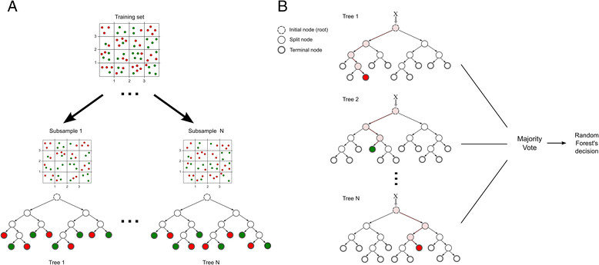
Random Forest Model
Random Forest works like decision trees but does not select all data points and variables in the trees
randomly samples data points and variables in each created tree and combines the end output
removes the bias that a decision tree model might introduce in the system improving the predictive power significantly

Slide 11
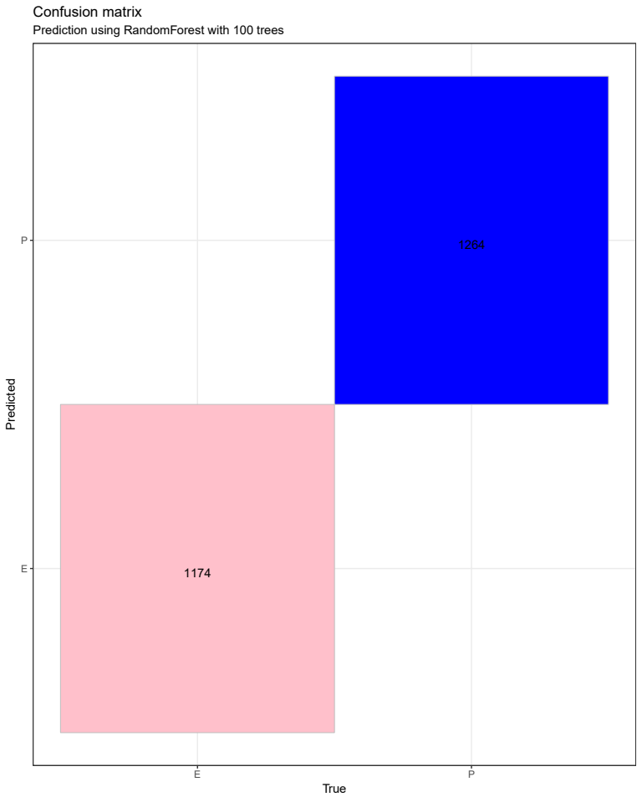
Random Forest Model
Confusion matrix demonstrates the model correctly predicts all test samples
The metric we will use for all models is AUC%
AUC in this case is 100%

Slide 12
Gradient Boosting Model
Random Forests build an ensemble of deep independent trees
GBMs build an ensemble of shallow, weak successive trees with each tree learning and improving on the previous level
boosting adds new models to the ensemble sequentially
each iteration trains a new weak, base-learner model with respect to the error of the whole ensemble
when combined, the weak successive trees produce a powerful collective
gradient boosting is a gradient descent algorithm that can be performed on any differentiable loss function
the process continues improving to minimize all errors, which can overemphasize outliers causing over-fitting so cross-validation is used

Slide 13
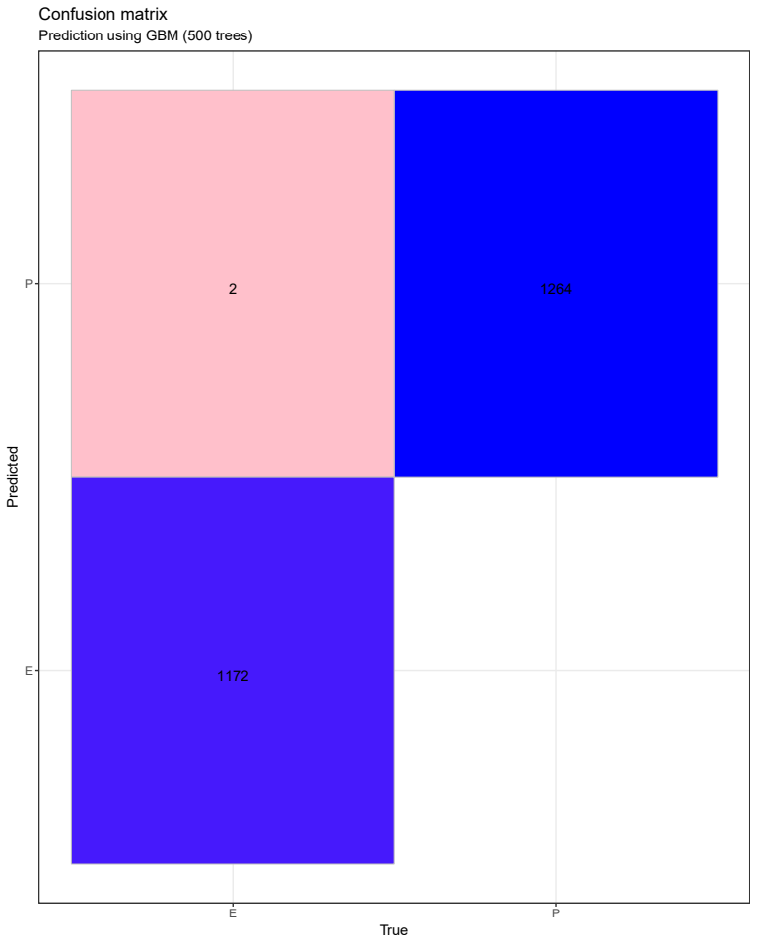
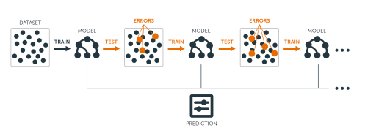
Gradient Boosting Model
Confusion matrix for GBM shows 2 incorrect choices
Choices are safe false positives
AUC = 99.9%

Slide 14
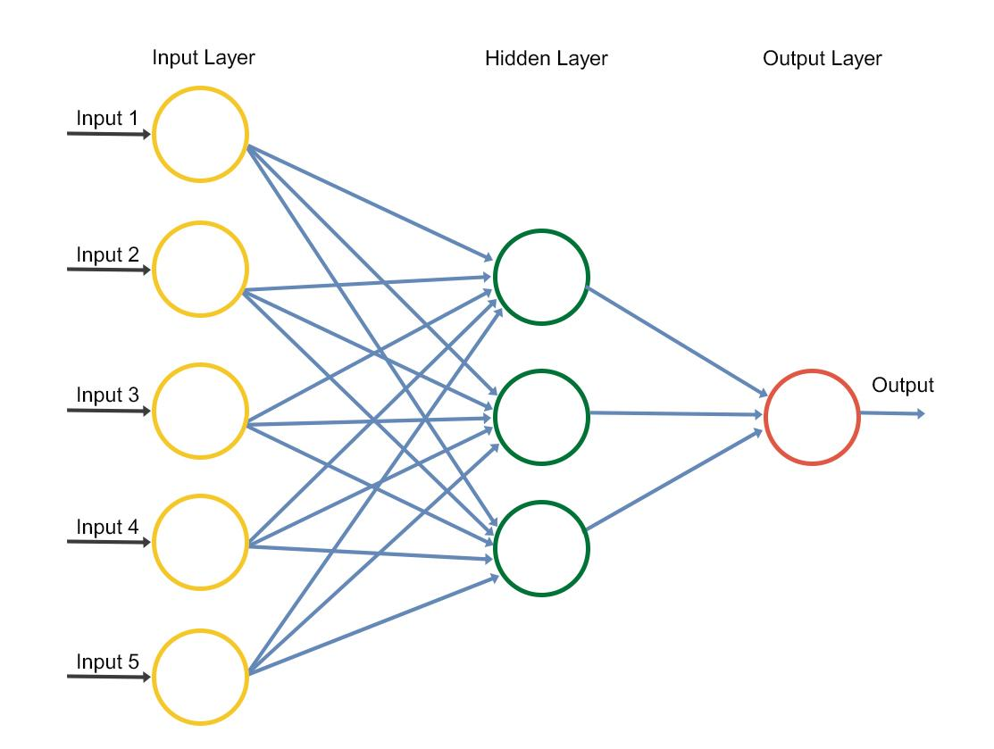
Neural Network Model
using the TensorFlow back-end under the Keras framework
Keras is a high-level neural network API written in Python
we will only look at the “adam” optimization, which is a variation on a stochastic gradient optimizing scheme
it supports convolutional and recurrent Neural Networks.
we first import the Keras library to create the neural network layers

Slide 15
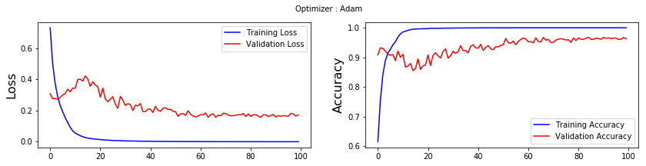
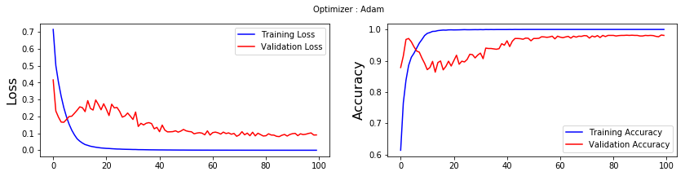
Neural Network Model
In our first tests we found that the batch size should be set to 128 and epochs to 100
There are two hidden layers dropping from 11 to 5 nodes
AUC = 95.3%
overall best situation requires that the hidden layers retain the same number of nodes as the input (22)
after a few tests we view the output which is performing better than before
AUC = 98.1%

Slide 16
Security and Future Directions
for our case study, the need for security measures on a database lookup table would be minimal
the main database would need only retain the original measurement of classifications and the relevant characteristics used in this experimental model
future design would permit updating the data set with new measurements on new specimens determined to be either poisonous or edible
added to the overall set as needed

Slide 17
Conclusions
we were able to predict with very high accuracy the poisonous and edible mushrooms based on the models used, Random Forest, Gradient Boosting Machine, XGBoost (included in report), and finally a neural network using the ADAM optimizer
for the GBM we were also using cross validation
the best prediction was obtained using the Random Forest model

