Slide 1

Flood Detection Team 20
Osama Magdy Reem Emad Zyad Atef Yousef Gamal
Notes:
slidesppt.net

Slide 2

Contents
1
Preprocessing
2
Feature Extraction
3
Classification
4
Segmentation

Slide 3


01
Preprocessing
Notes:
slidesppt.net

Slide 4
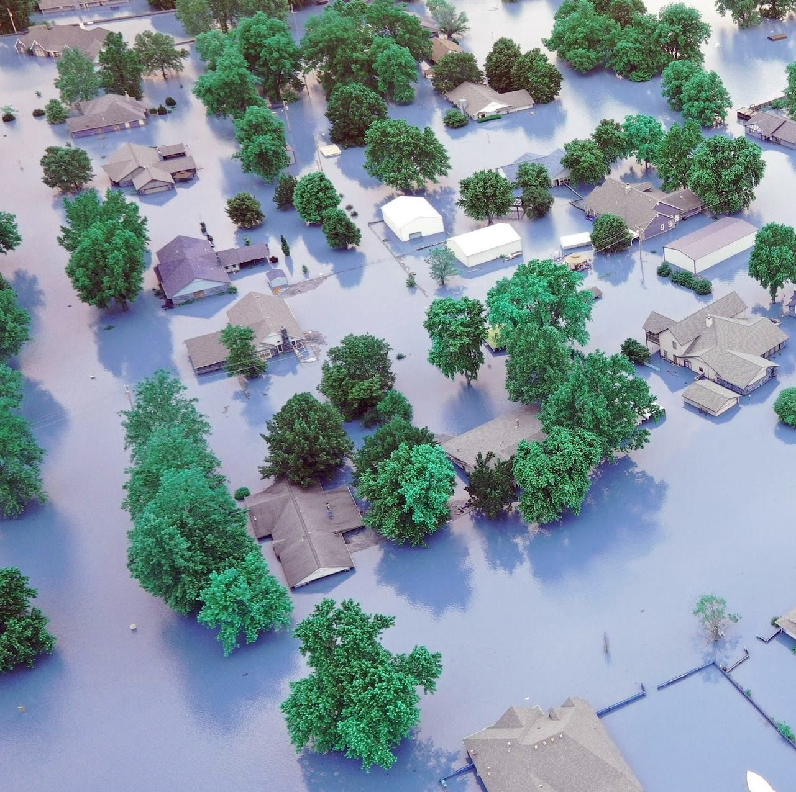


Original Image
DESTINY
FREEDOM
We had so many images of different sizes and illuminations. So we had to normalize all images before extracting features

Slide 5
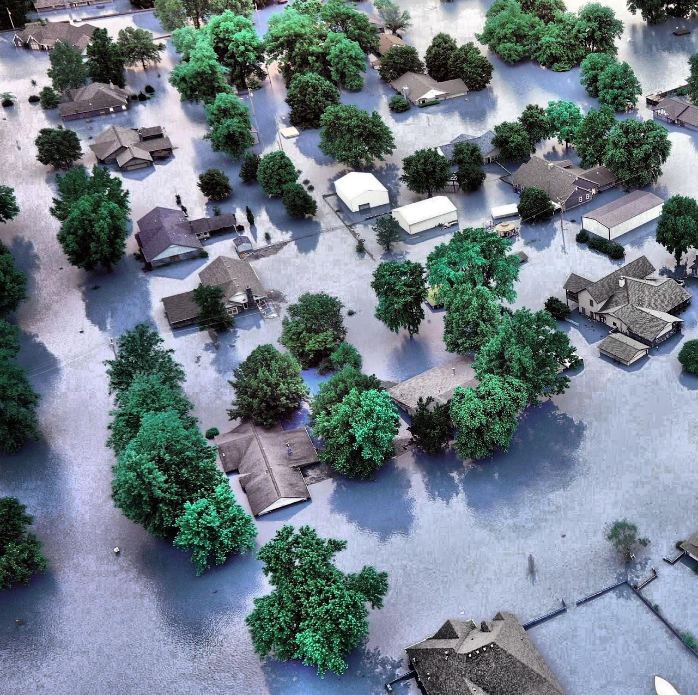
Contrast Enhancement
DESTINY
FREEDOM
As the problem is close to the segmentation problems we found it’s a good choice to perform contrast enhancement over all images to distinguish better between water regions and land regions (just preprocessing)

Slide 6
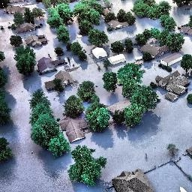
Resizing Image
DESTINY
FREEDOM
All images are from different sizes which is not suitable for many cases in the learning algorithms and even feature extraction. Resizing each image to 256*256

Slide 7
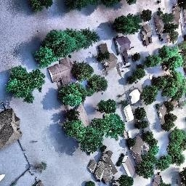
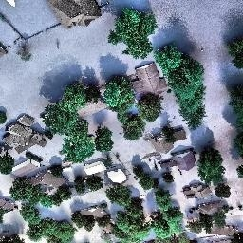
Data Augmentation
DESTINY
FREEDOM
We noticed that the data size is small and not much suitable for learning, especially deep learning techniques. Data augmentation is done by rotating each image 90 degrees and 180 degrees. Thus, increasing the size 2 times more.

Slide 8
02
Feature Extraction

Slide 9


Feature Extraction
Indexes
Color features
Texture features
Shape features
Notes:
slidesppt.net

Slide 10


Indexes
Following indexes will be estimated depending on the RGB image channels
Normalized Difference Water Index
Calculated using Green & Blue channels
B. Normalized Difference Vegetation Index
You can simply impress your audience and add a unique zing and appeal to your Presentations.

Slide 11
Color Features
Color features: Color variance significantly differs between flooded and non-flooded images. Difference in blue color value between 2 flooded images is too small, while this difference between flood and non-flooded images is large. So we tried following color features
Color averaging
Getting average color of the image
B. Color variance
Calculate variance in color across image
C. Color histogram
Generating image color histogram

Slide 12
Texture features
Texture energy and texture homogeneity have slight difference with 2 flooded images, while it differs with the flooded and non-flooded images
Texture gradient
Feature that describes how quickly the texture changes in an image
B. Texture energy
Texture energy describes the overall amount of texture in an image.
C. Texture correlation
Texture correlation measures the similarity between different parts of an image in terms of their texture
D. Texture homogeneity
Texture homogeneity measures the similarity of the texture within a small patch of an image

Slide 13
Shape Feature
Those features mainly depend on dividing images into regions then calculating the sum of the following over different regions
Area
getting area sum across regions
B. Perimeter
getting perimeter sum across regions
C. Compactness
calculating compactness using area and perimeter across regions
D. Eccentricity
getting eccentricity sum across regions

Slide 14
03
Flood Classification
Notes:
slidesppt.net

Slide 15
Classification
Classical Machine Learning F1 score
Classifier\ Feature | Texture and Shape features only | With all features summarized | PCA with all features summarized | Augmented Data with all features summarized
Adaboost | 89% | 88% | 72% | 88%
Random forest | 86% | 93% | 70% | 92%
Knn | 85% | 72% | 66% | 66%
Logistic regression | 75% | 77% | 67% | 83%
SVM (rbf kernel) | 52% | 68% | 70% | 70%

Slide 16
Classification
Deep Learning F1 score
Classifier | End to End | Use Deep Learning for Feature extraction: Resnet | Use Deep Learning for Feature extraction: Concatenate (Resnet, Inception V3, Xception)
CNN | 91% | - | -
VGG16 | 100% | - | -
Logistic Regression | - | 93.5% | 98.9%
SVM (rbf kernel) | - | - | 80%
Adaboost | - | - | 91%
Random Forest | - | - | 95.5%

Slide 17
04
Clustering / Segmentation

Slide 18
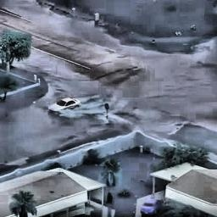
Clustering Flooded Regions
Clustering is used over all flooded images to detect which parts of the image are flooded and which are not. We used clustering techniques for segmenting the image
Notes:
slidesppt.net

Slide 19
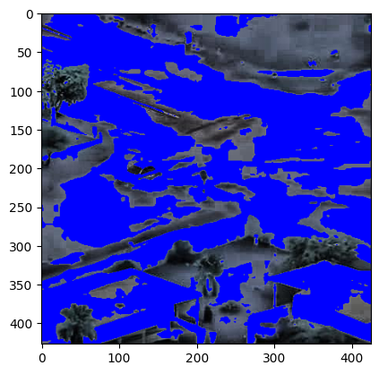

Binarization

Slide 20
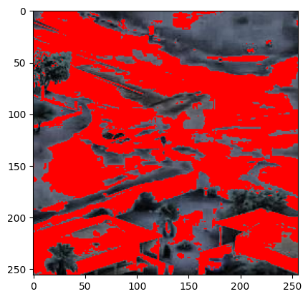
K means (K=2)

Slide 21
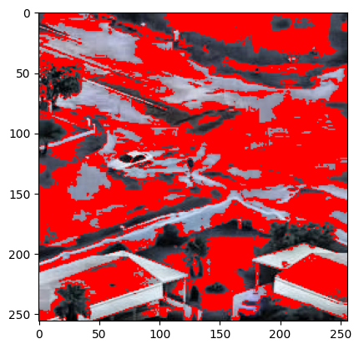
K means (K=3)

Slide 22
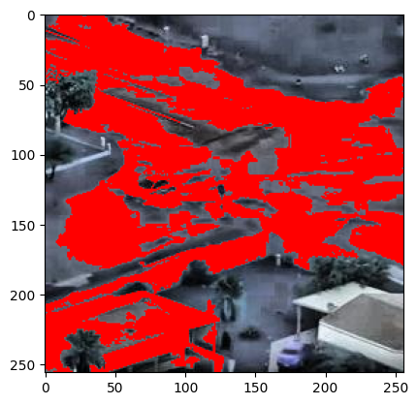
Region Growing

Slide 23
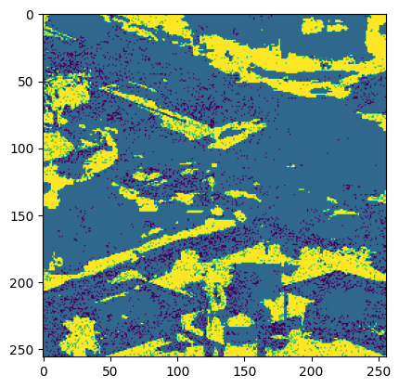
ISODATA

Slide 24

THANKS!
Notes:
slidesppt.net

