Slide 1

Online Home​
Automation​
Control System​
Graduation Project ２ Presentation​
Group 45 - JC8​
Dr Abeer Mahmoud​

Slide 2

Introduction
Very fast increase in automation in the recent decade
Higher demand for applications that can support remote control
especially electrically controlled house appliances

Slide 3
Problem Statement
Many applications available providing remote control at home
All work in a small set of devices and sensors
Main challenge: control these devices through the Internet
Important for pet owners with UV lights, parents waking their children up etc

Slide 4
Objective and Proposed Solution
Objective:
  remote control of house appliances through IoT
Solution:
  creating Android mobile application that controls switches/lights etc by issuing commands
  using Raspberry Pi to switch the lights/switches on and off
  creating a web application interface between the mobile application and laptop

Slide 5
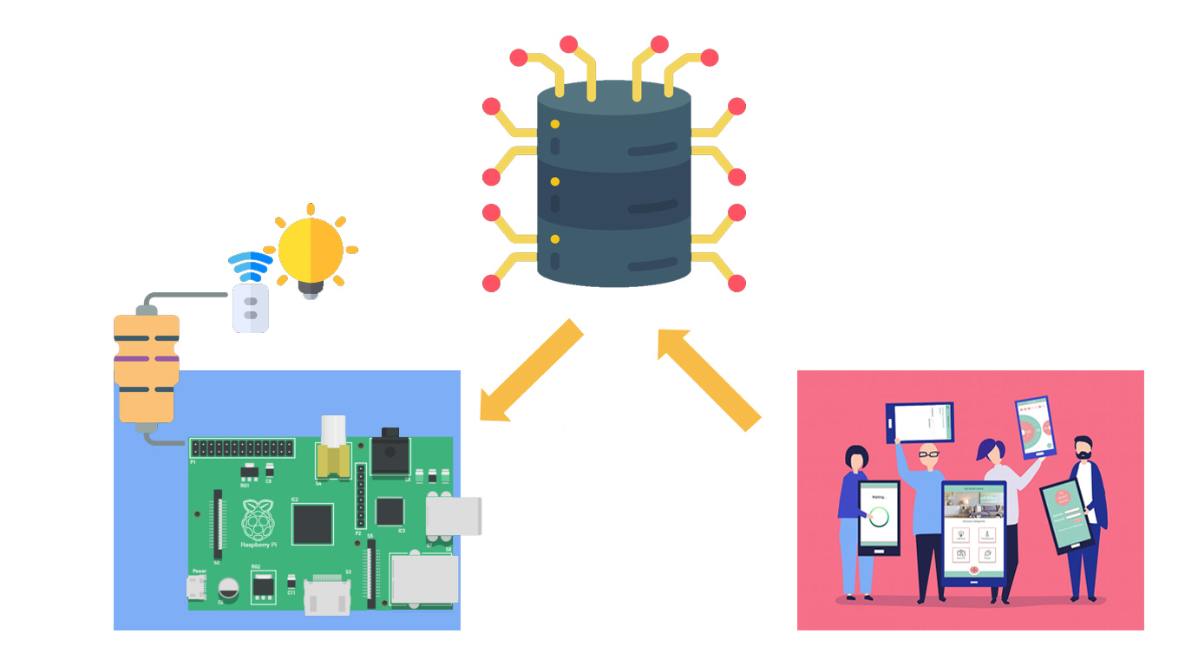

Slide 6
Related Work
Some examples of similar applications:
  Insteon
  Wink hub 2
  Samsung smart things
Flexibility
Cost
Usability

Slide 7
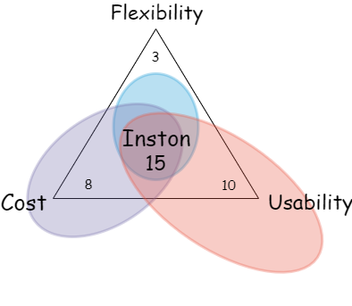
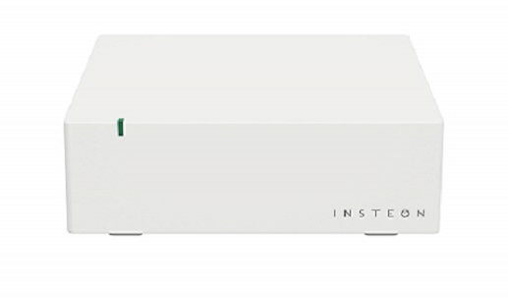
Related Work - Insteon

Slide 8

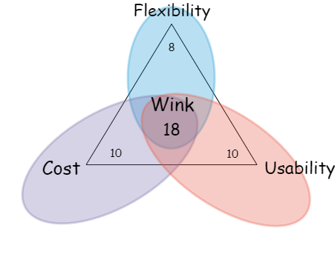
Related Work - Wink

Slide 9
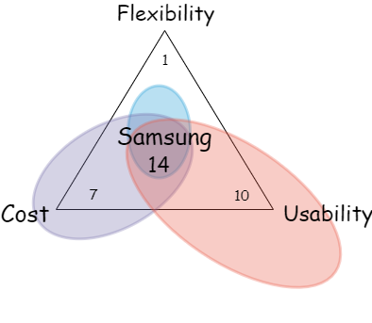
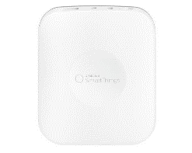
Related Work - Samsung

Slide 10
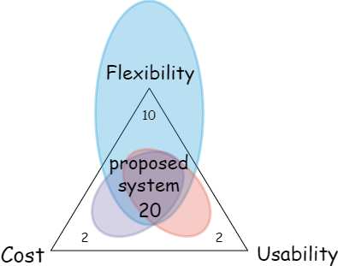
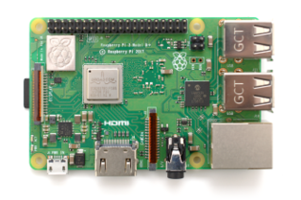
Related Work - Proposed

Slide 11
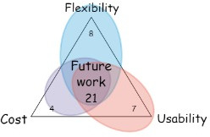
Related Work - Future

Slide 12
Methodology

Slide 13
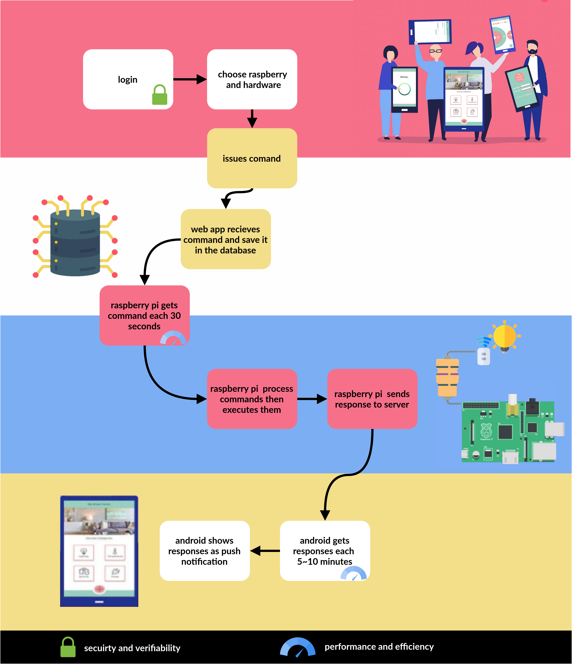

Slide 14
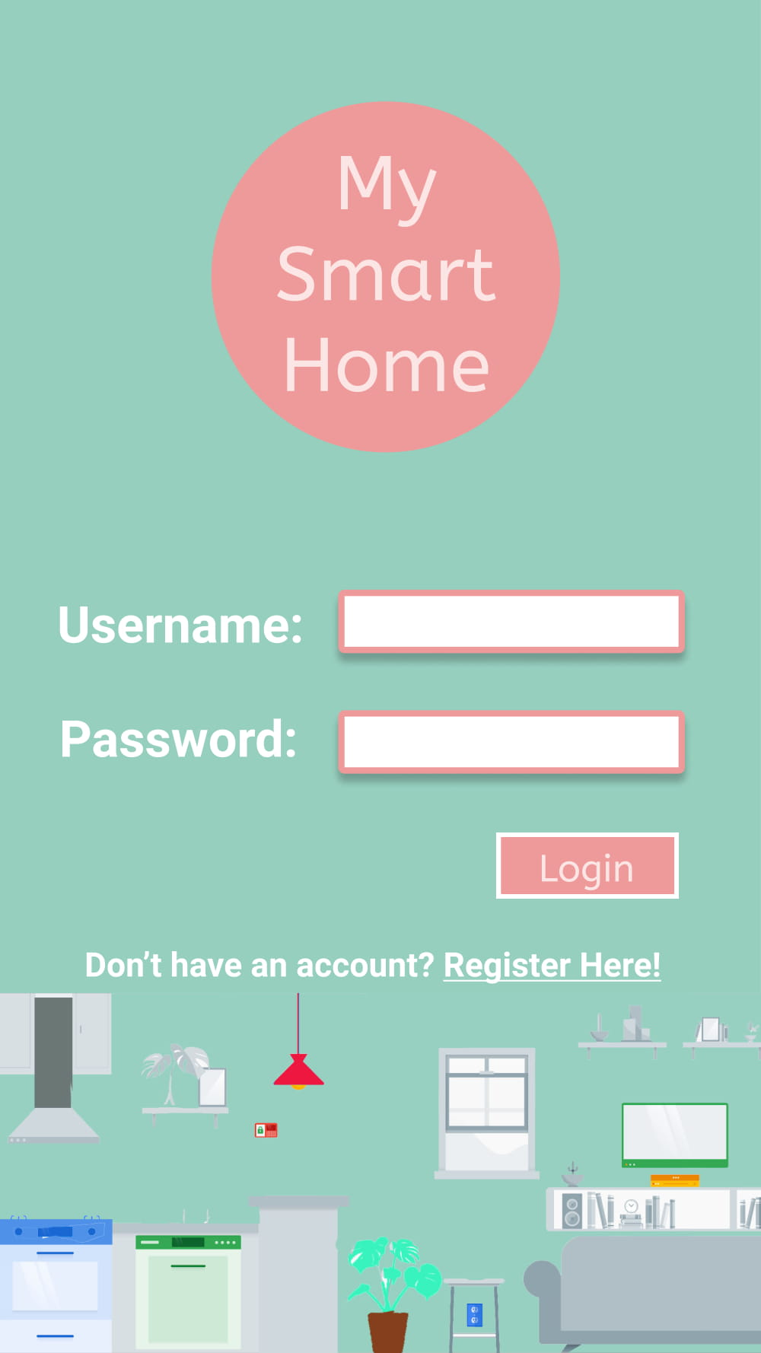
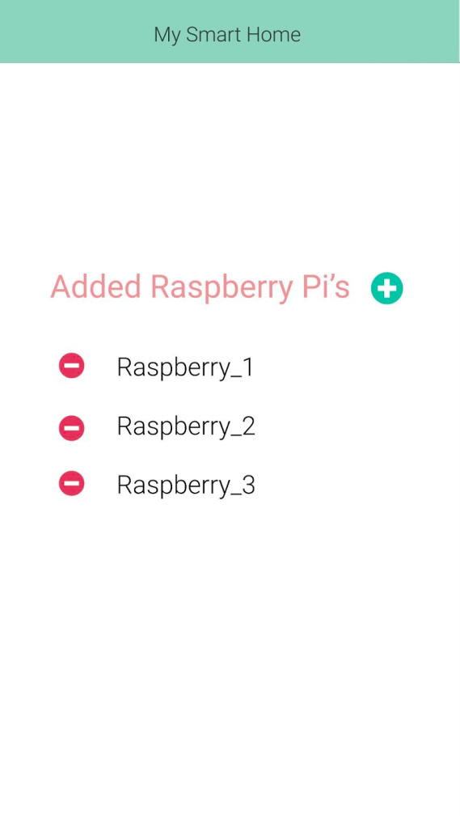
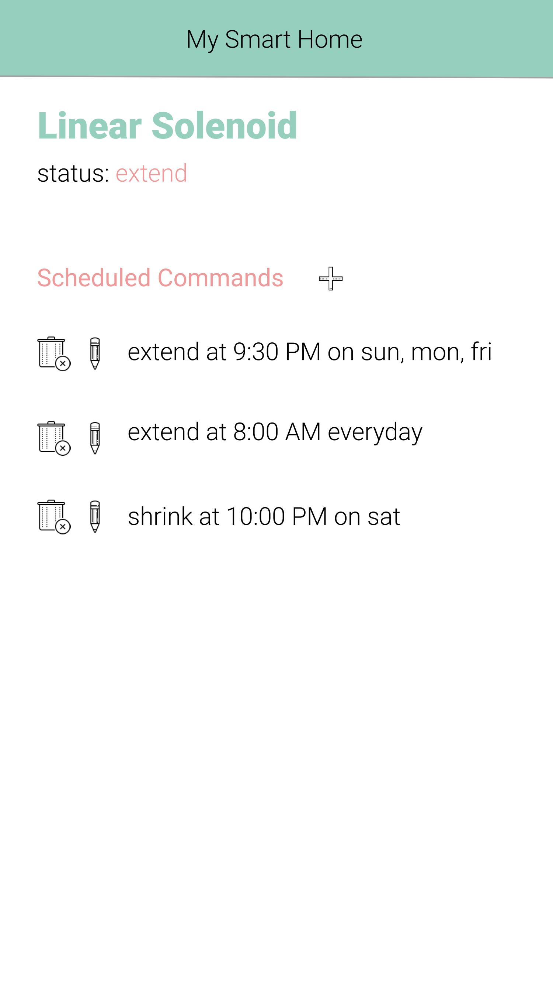

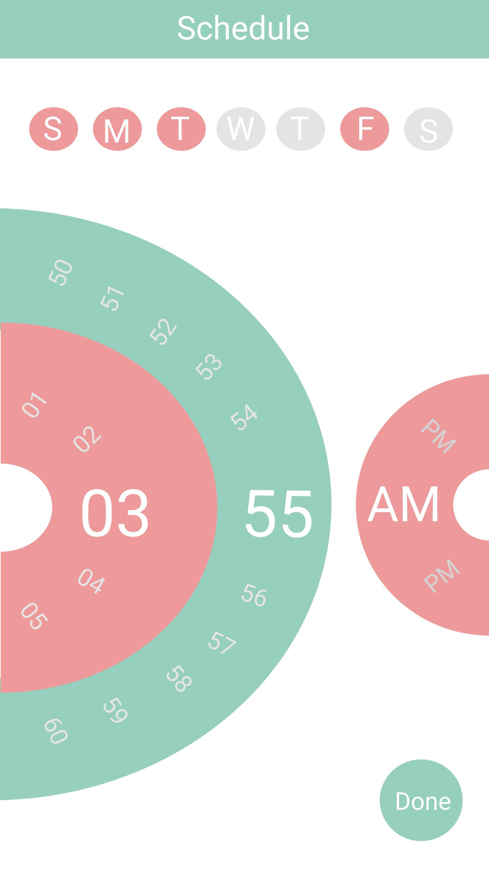


Slide 15
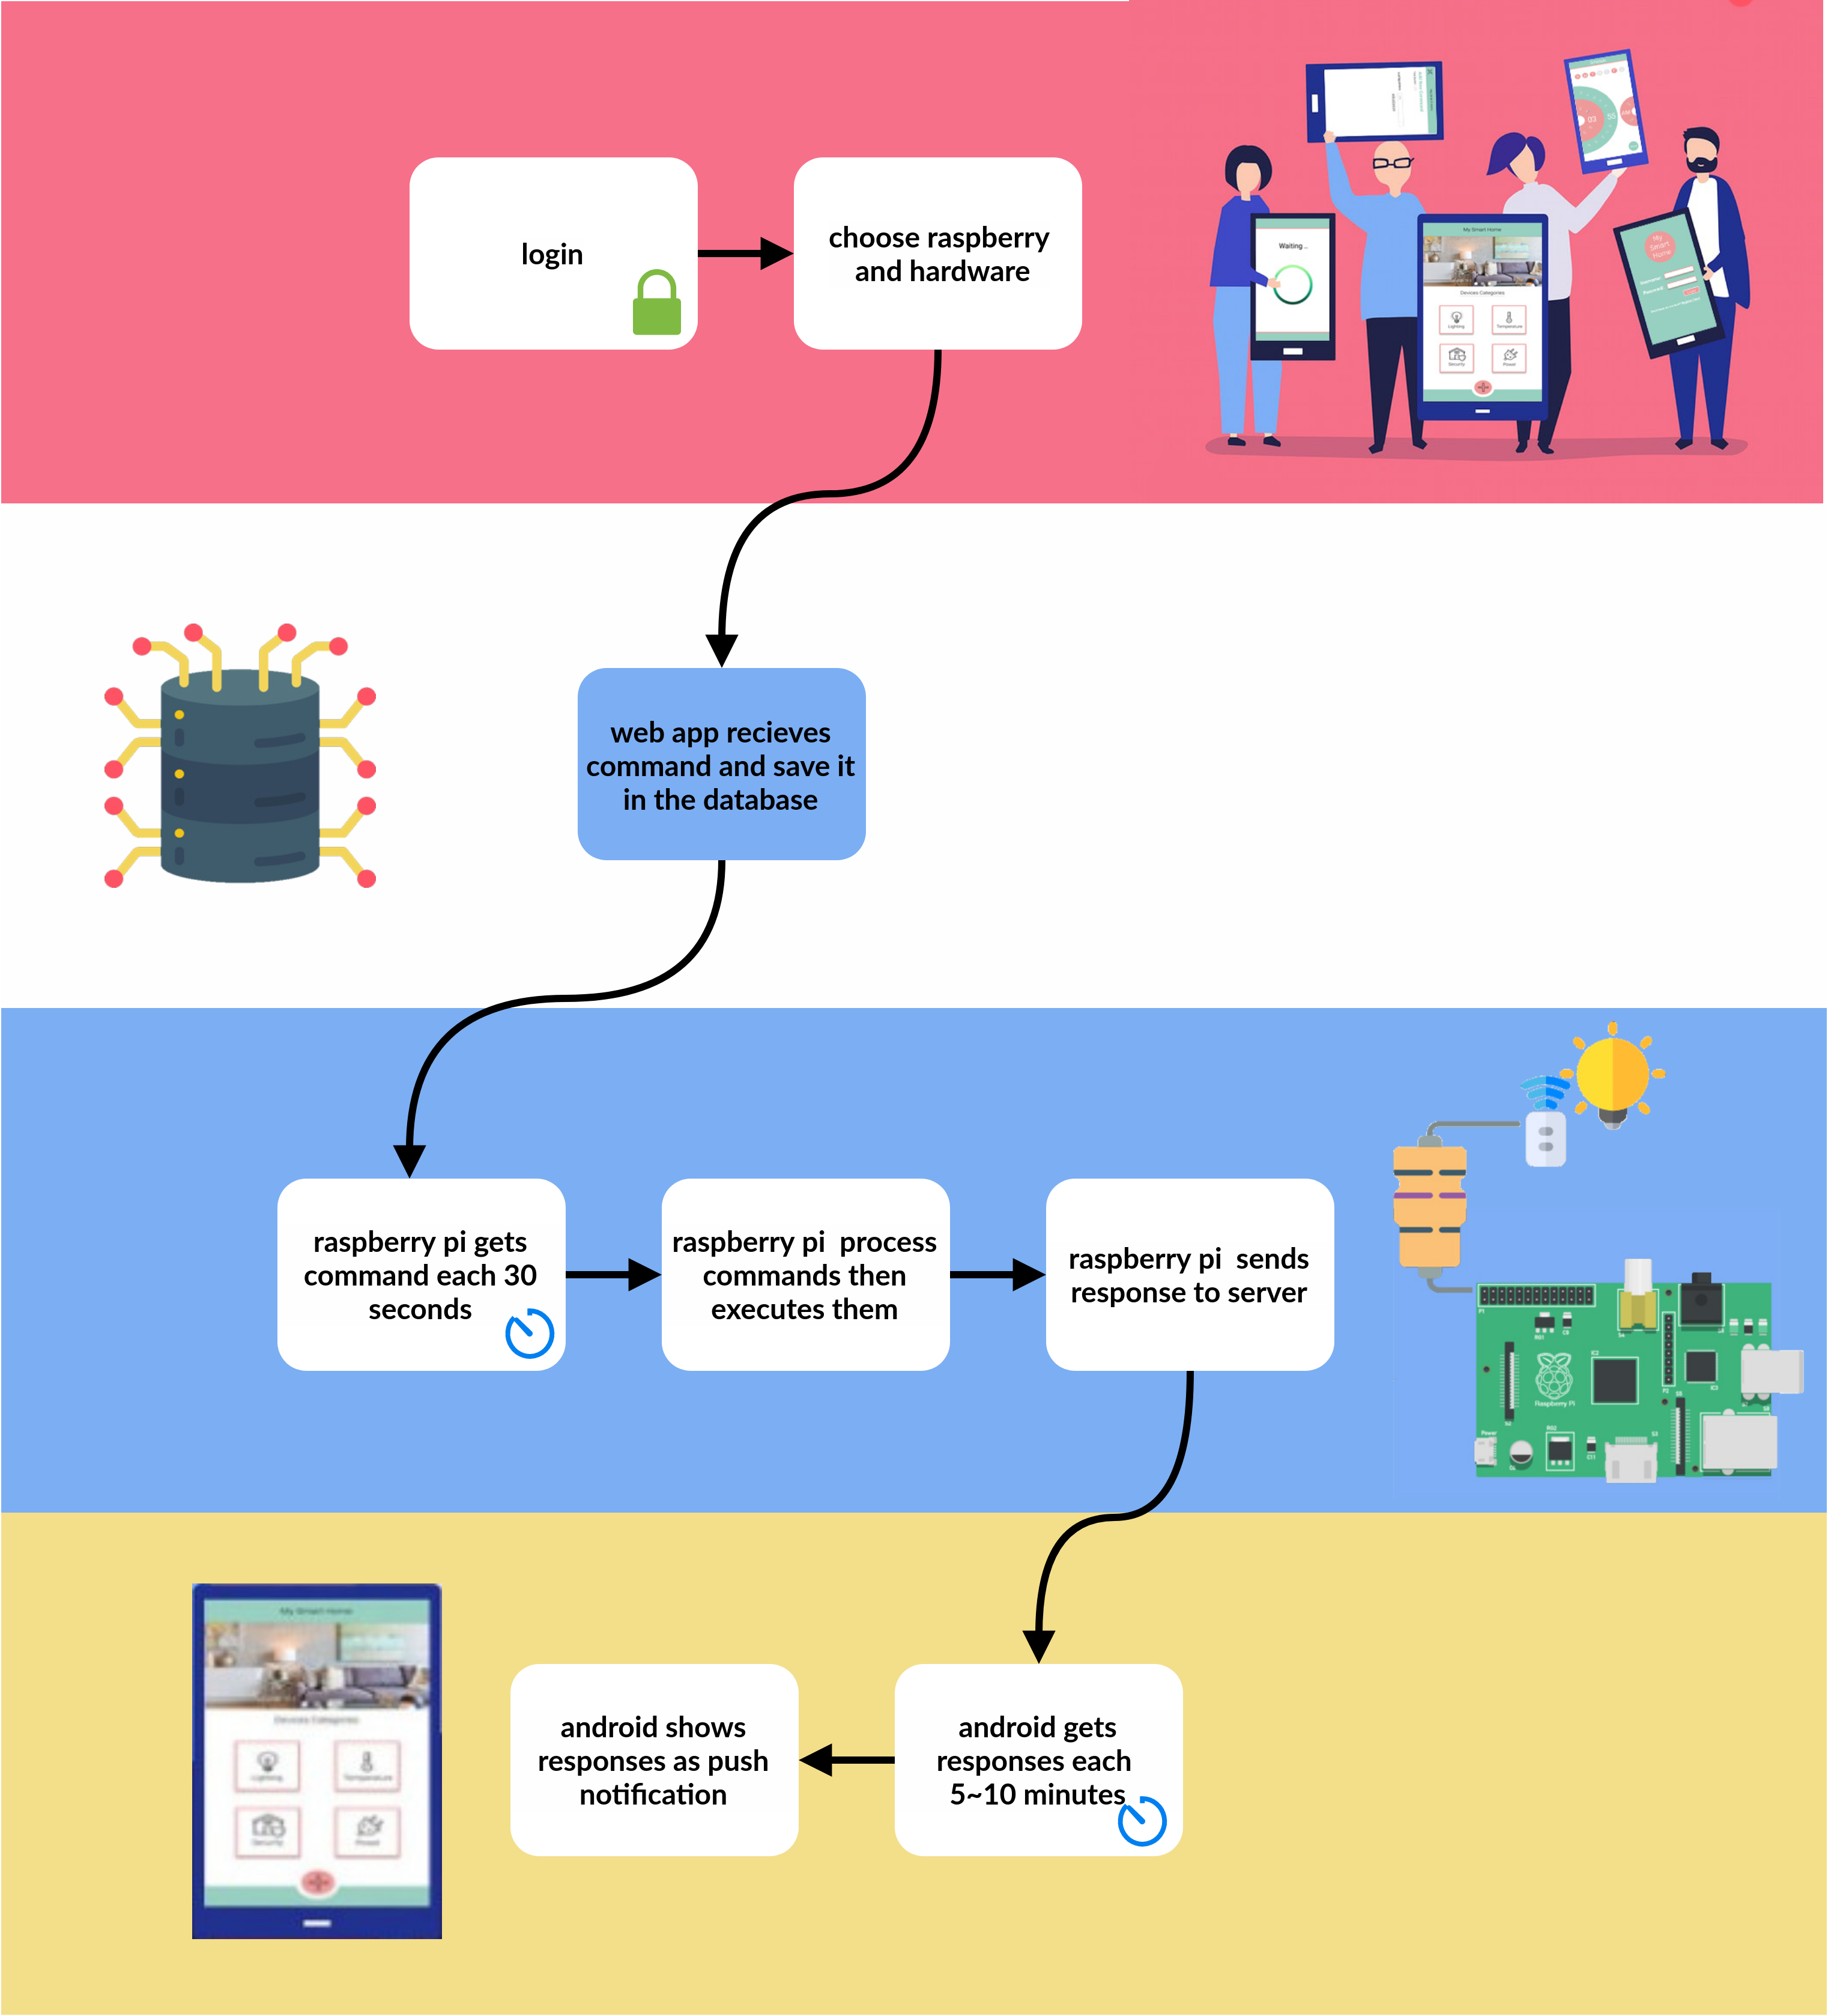

Slide 18
Implementation

Slide 19



Slide 20
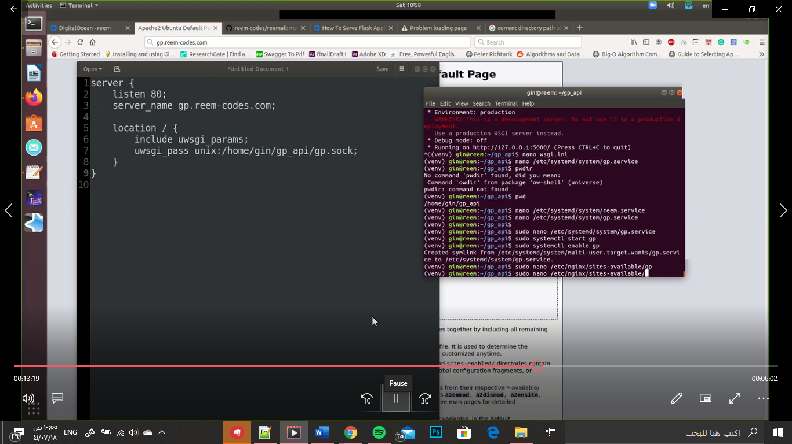
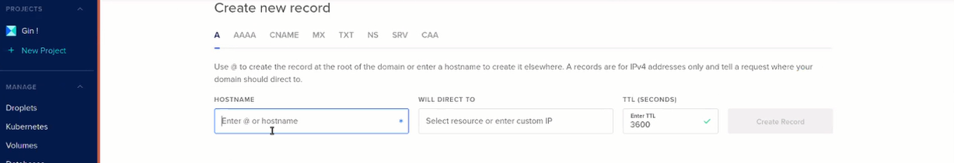

Slide 21
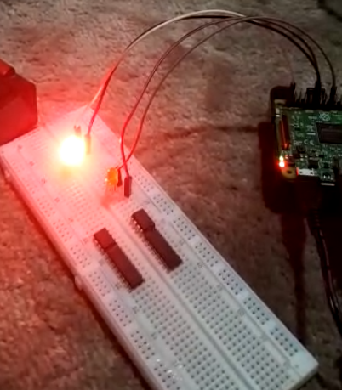
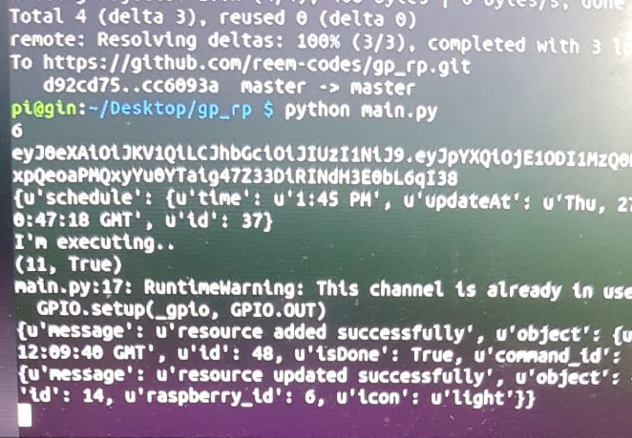

Slide 22
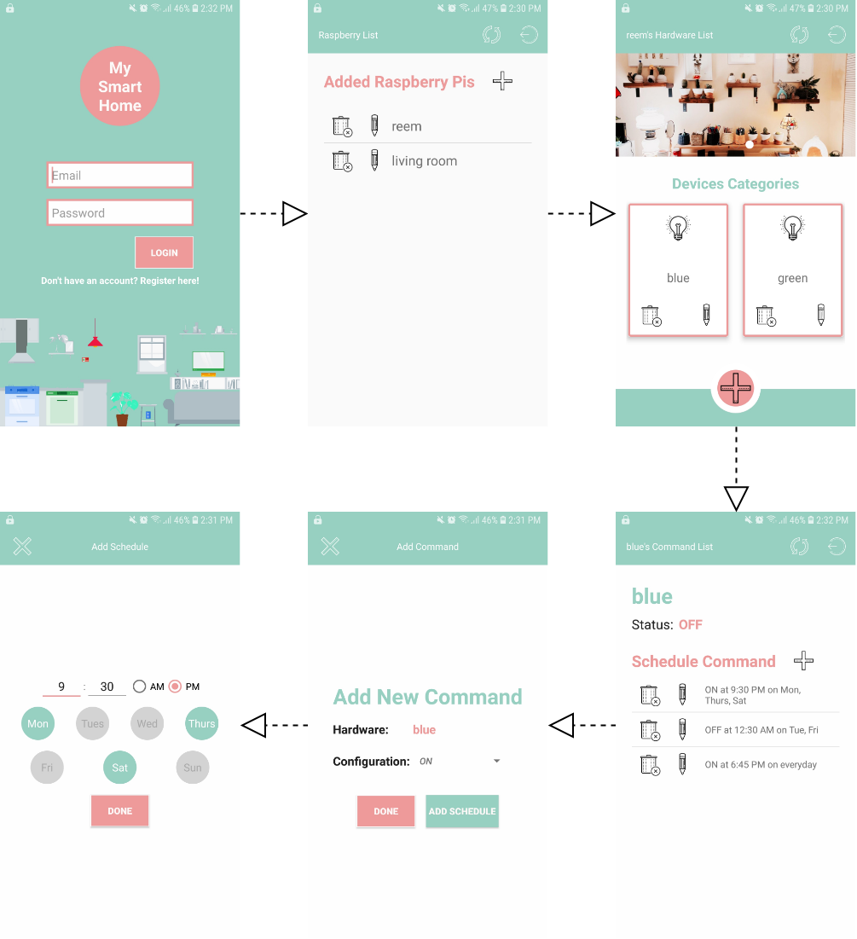
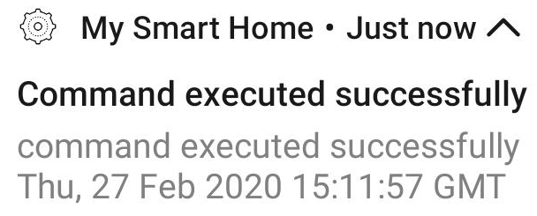

Slide 23




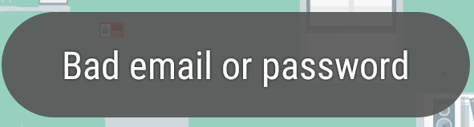



Testing and Validation - Validation

Slide 24
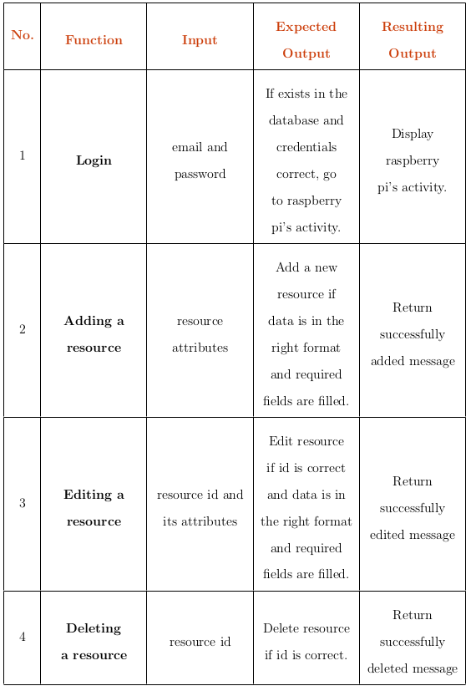
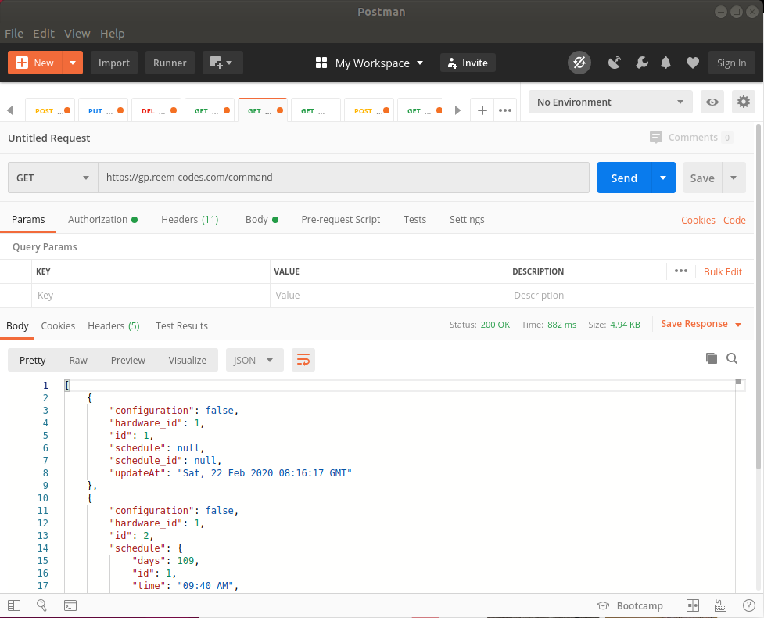
Testing and Validation - Testing

Slide 25
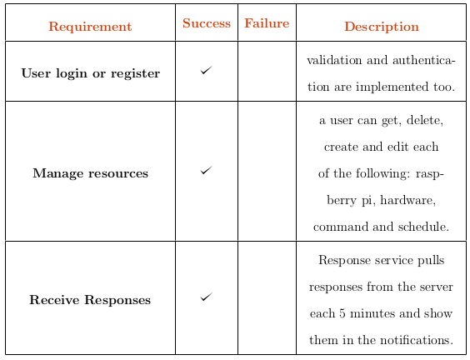
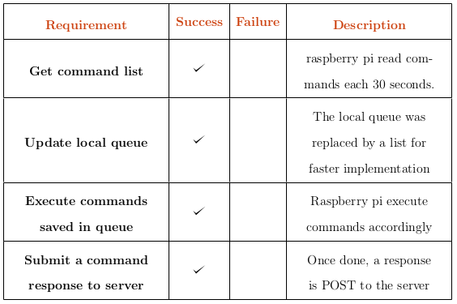
Testing and Validation - Testing

Slide 26
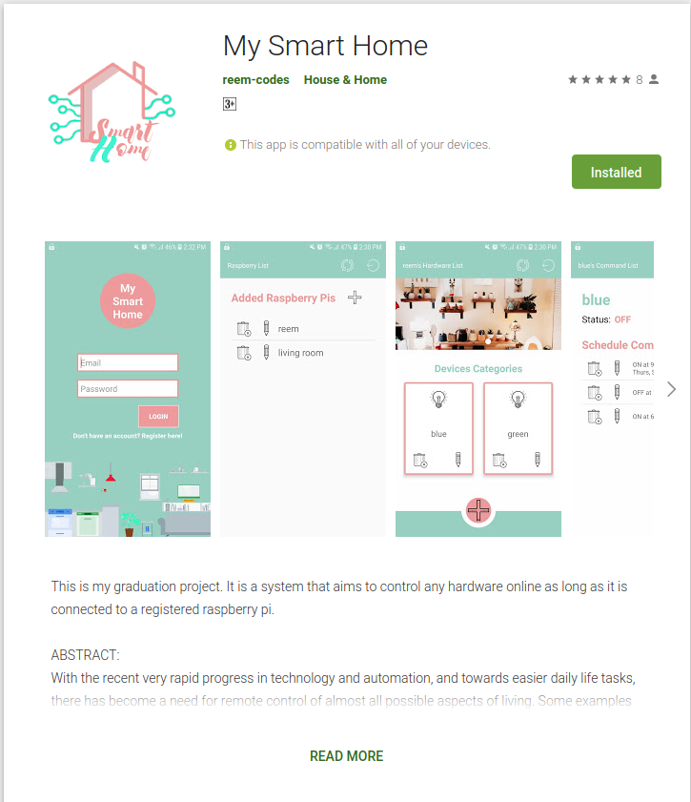
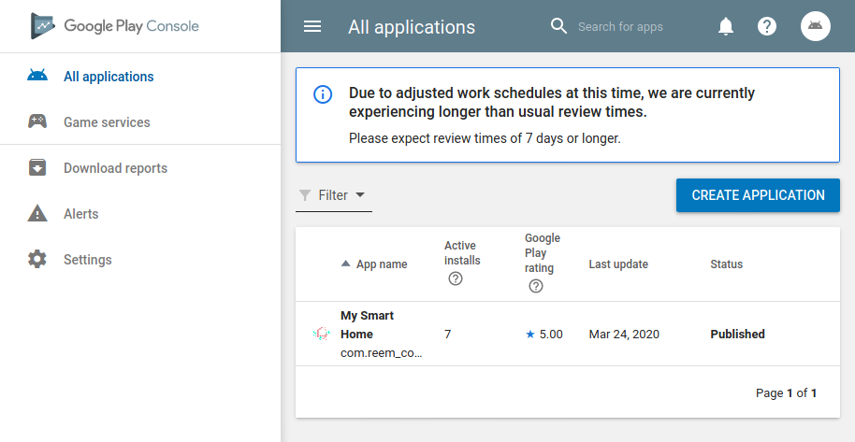
Deployment - Android
https://play.google.com/store/apps/details?id=com.reem_codes.gp_android

Slide 27
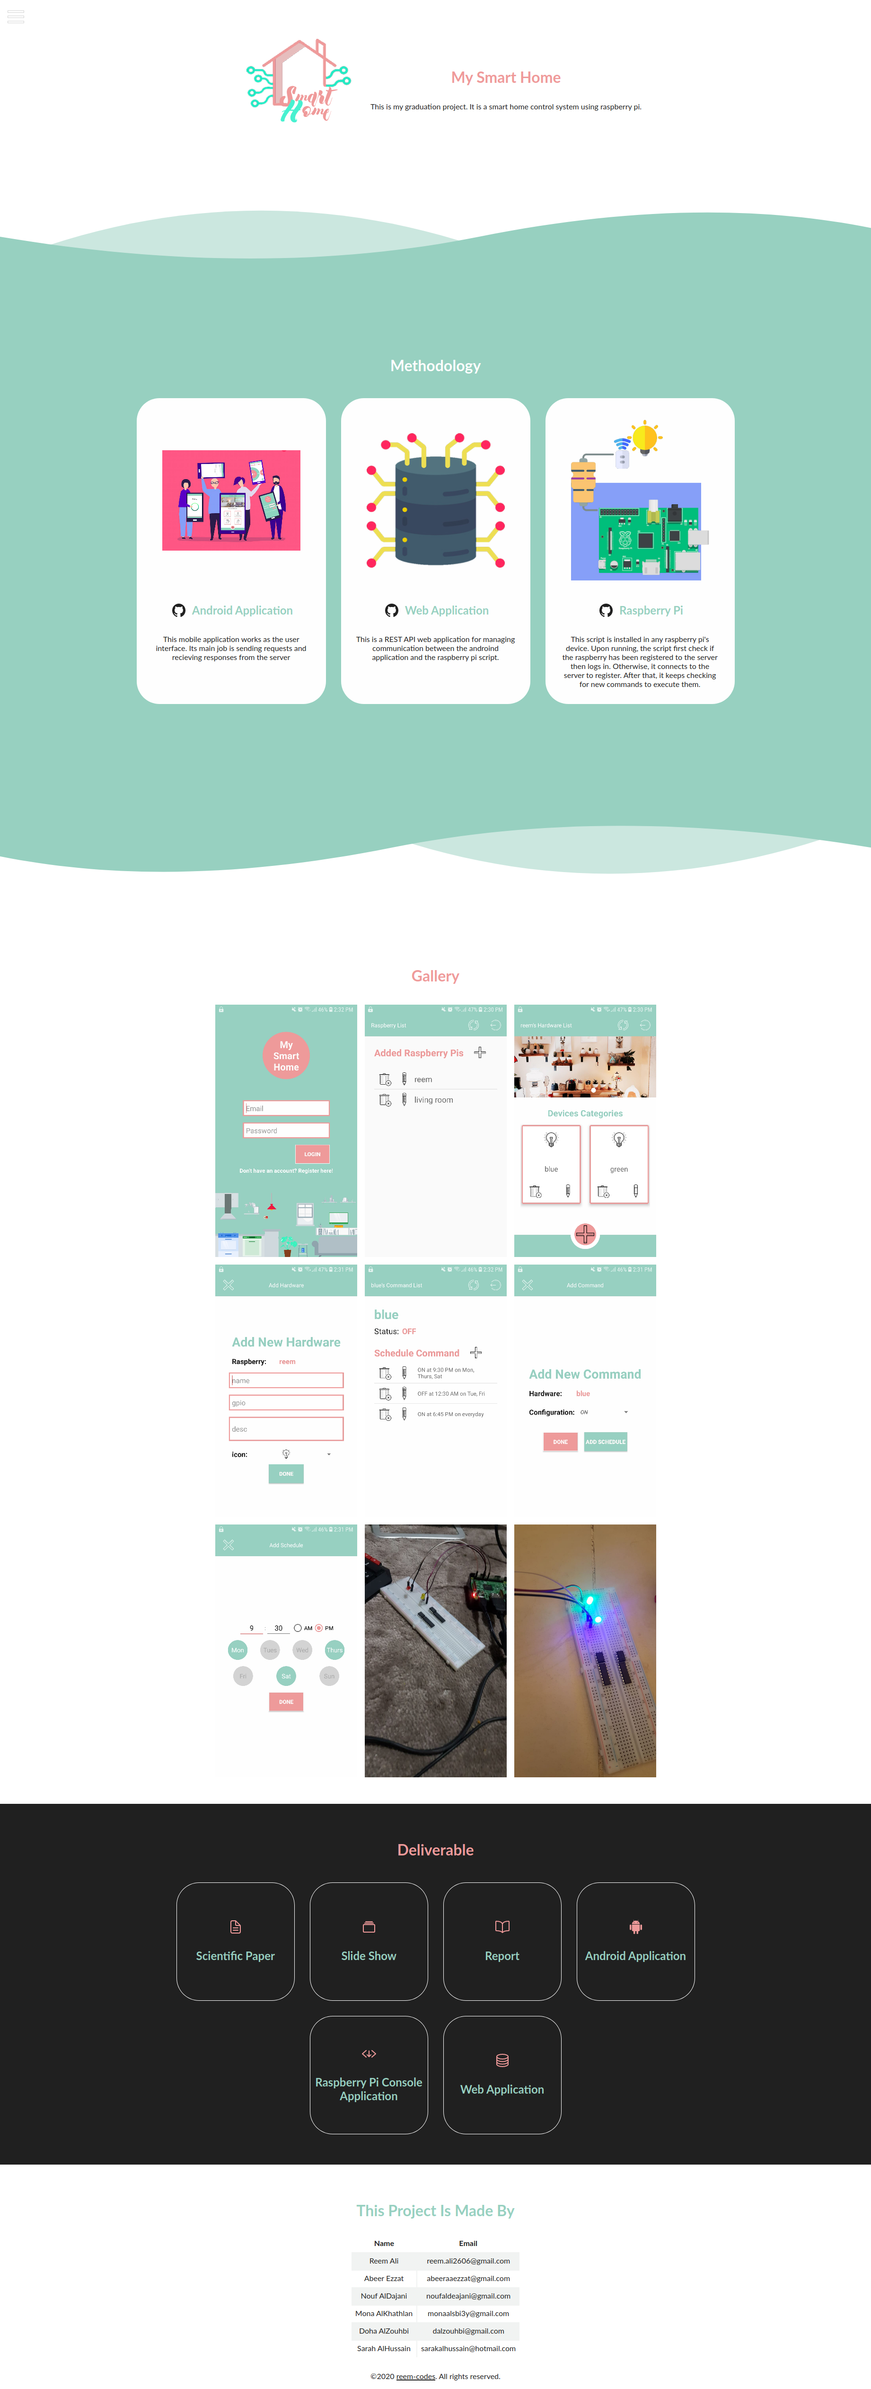
Deployment – Web Application
https://gp.reem-codes.com/

Slide 28
Conclusion - Evaluation

Slide 29
Conclusion – Problems Faced
Time management: making 3 applications
Configuring the server
Publishing application to google play

Slide 30
Conclusion – Future Work
Add configuration table
Test on multiple devices
Make an iOS version

Slide 31
THANK YOU!
436200058 | Abeer Ahmed Ezzat
436200063 | Doha Nidal AlZouhbi
437004005 | Mona Saud AlKhathlan
437004100 | Nouf Abdullah AlDajani
437004875 | Reem Ali AlGhamdi
436006939 | Sarah Khalid AlHussain

Slide 32
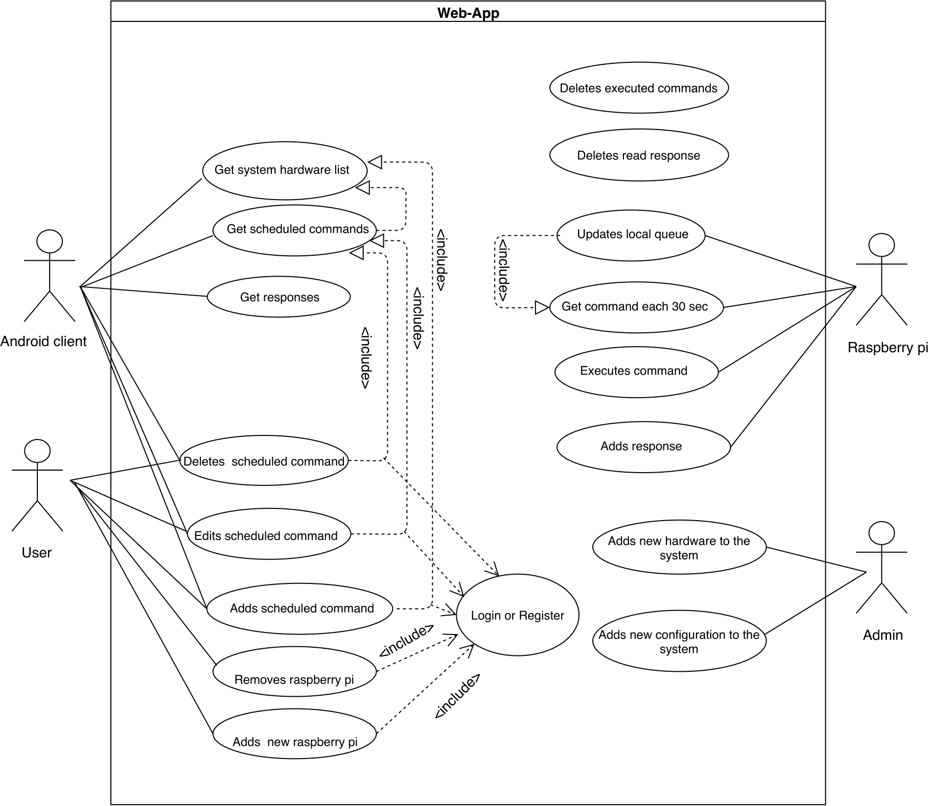

Slide 33
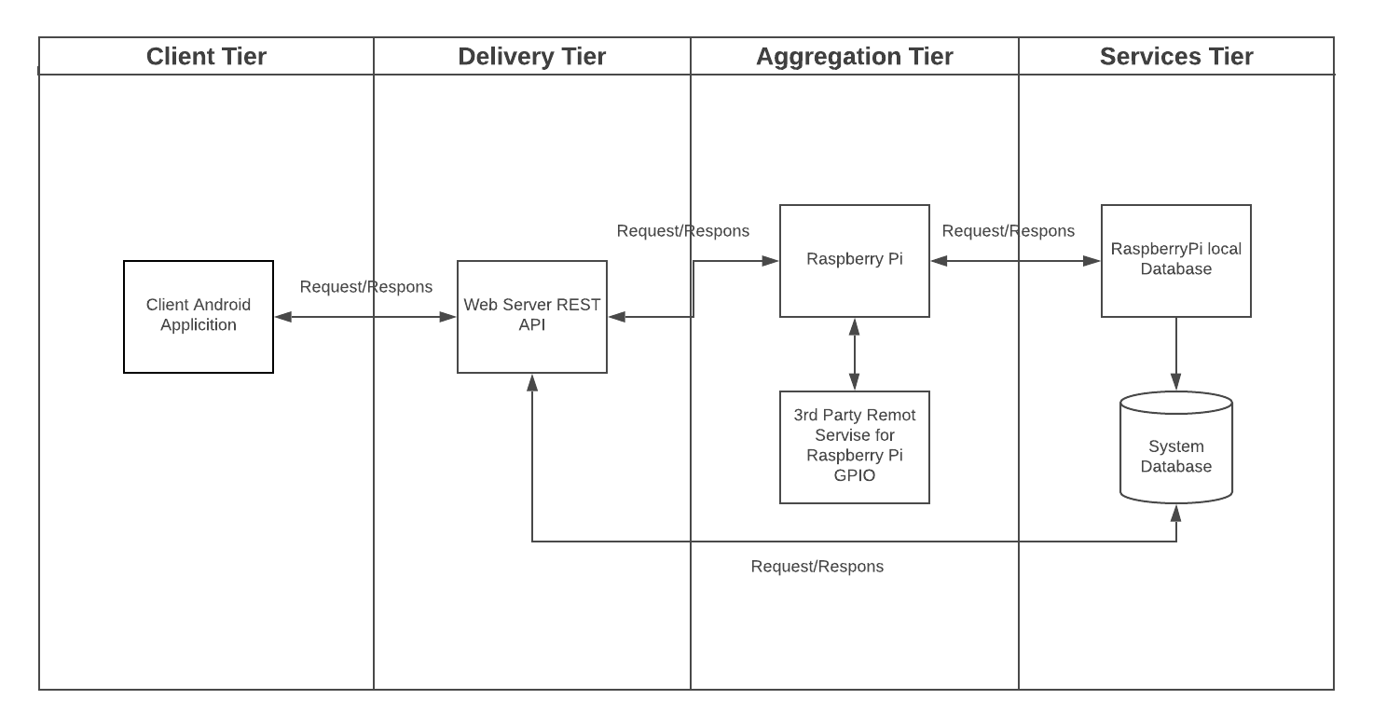

Slide 34
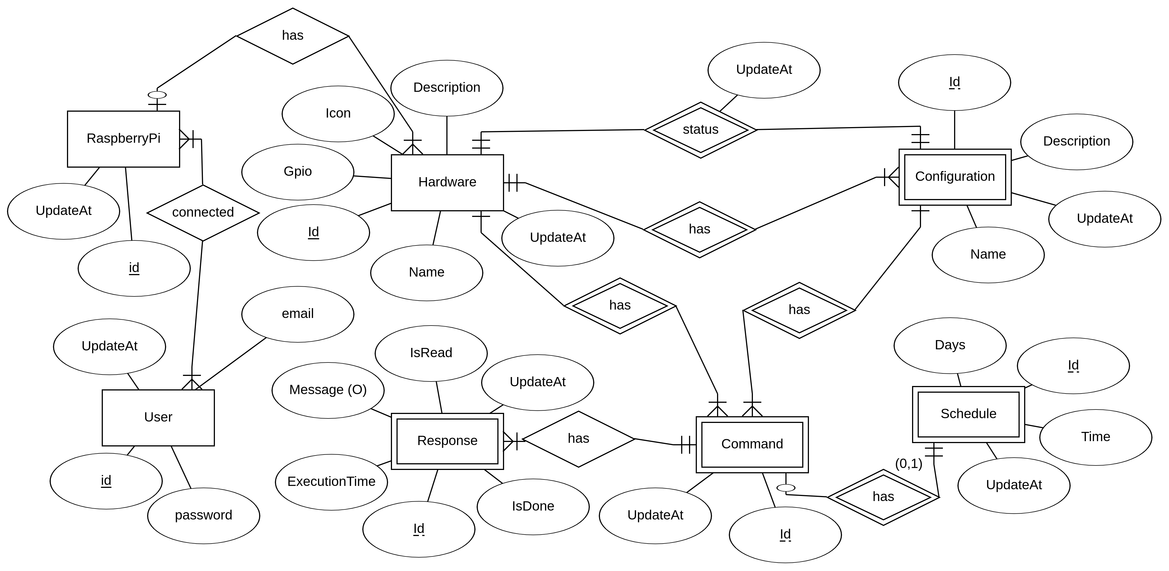

Slide 35
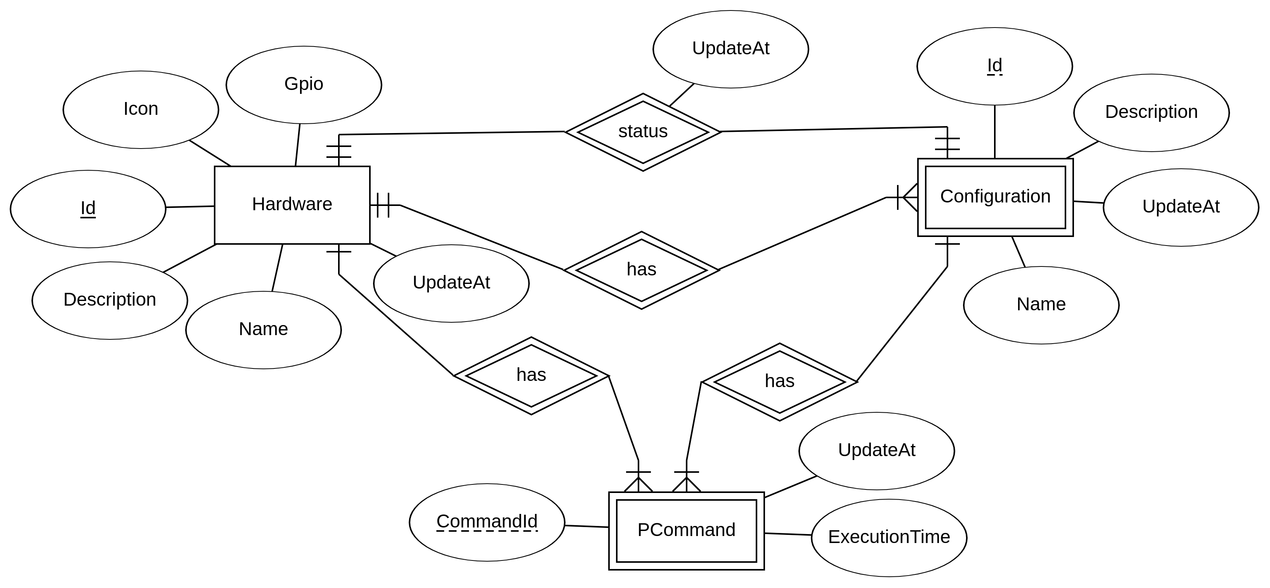

Slide 36


