Slide 1
Machine Learning.
Reinforcement Learning.
Panin, Vladimir 12238682
Dass, Reema 12144026
Schweitzer,Valentin 51829840

Slide 2
Implementation
BRICKS:
Layout of the bricks based on option selection.
Reset the layout of the bricks.
PADDLE:
Creation of the paddle.
Paddle movement.
BOARD:
Construct and display the board.
BALL:
Collision behaviour with the paddle.
Collision behaviour with the bricks.
Collision behaviour with the walls.
Direction of the ball movement.
Checking if the game is over.
Updating the speed of the ball.

Slide 3
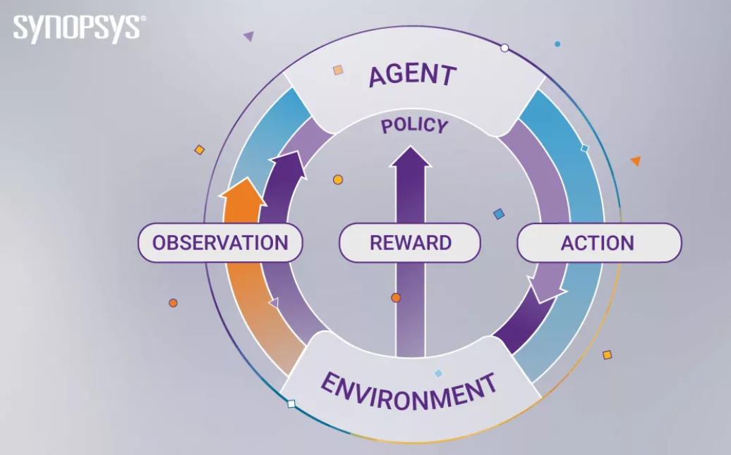
Implementation 2
AGENT:
MONTE CARLO: Greedy epsilon with threshold 0.5.
ACTIONS:
Reward:
Ball bounces on the paddle.
Hitting the bricks.
Paddle tracking the ball.
Penalty:
Game lost.
Time taken to finish the game.
ENVIRONMENT:
The game with the specific layout of the bricks with ball and paddle.
OBSERVATION:
Learning based on each action taken during the game.
Game State:
X axis offset between ball and paddle.
Paddle speed.
Ball speed.

Slide 4
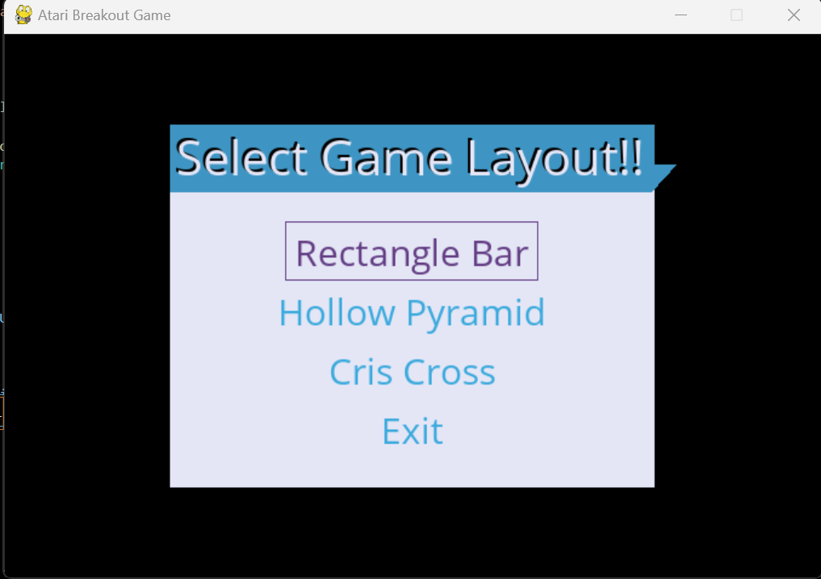
Layouts and Results.
Trajectories of the optimal solution.

Slide 5
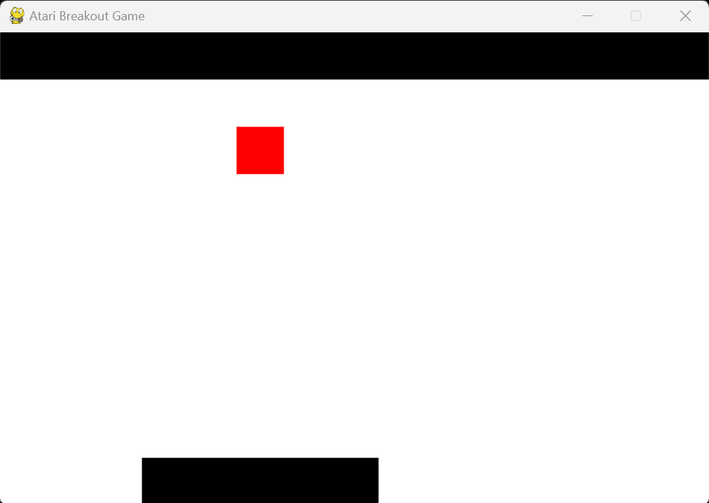
Layout 1.

Slide 6
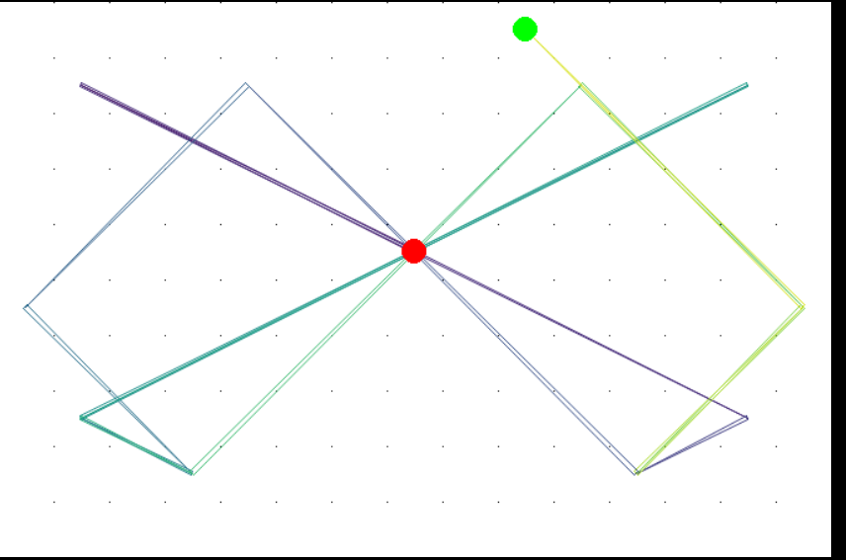
Trajectories of the optimal solution for Layout 1

Slide 7
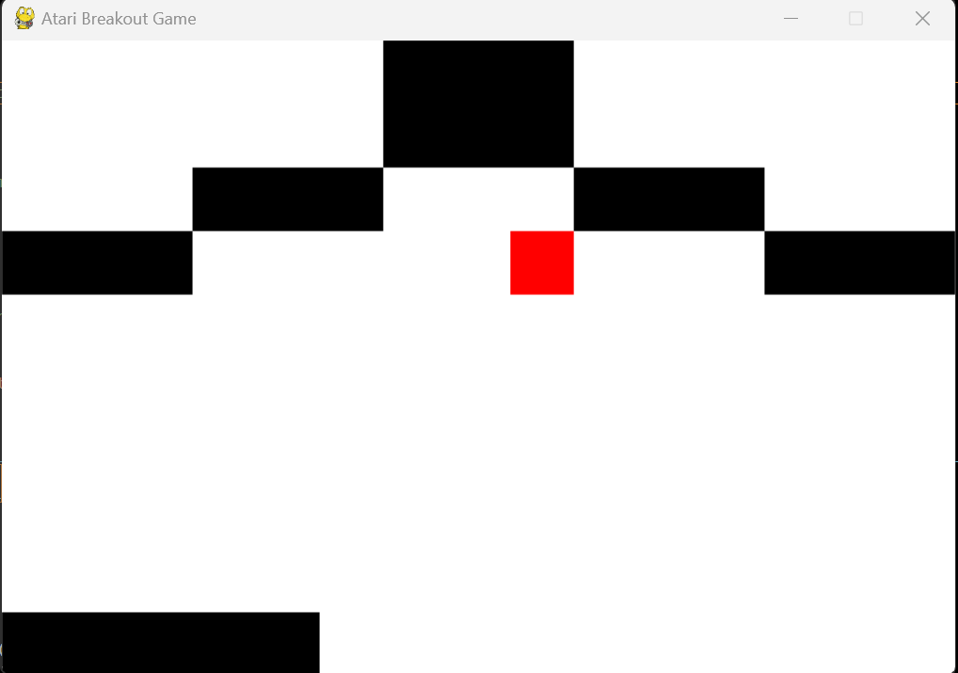
Layout 2.

Slide 8
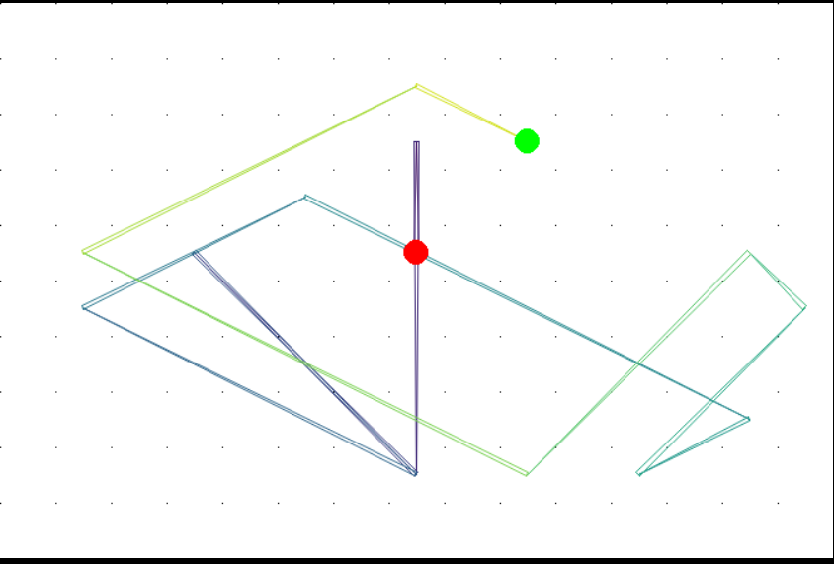
Trajectories of the optimal solution for Layout 2

Slide 9
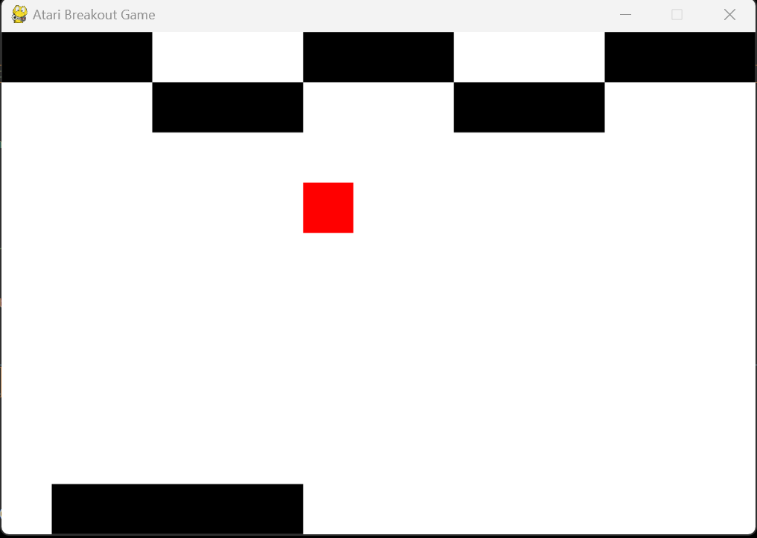
Layout 3.

Slide 10
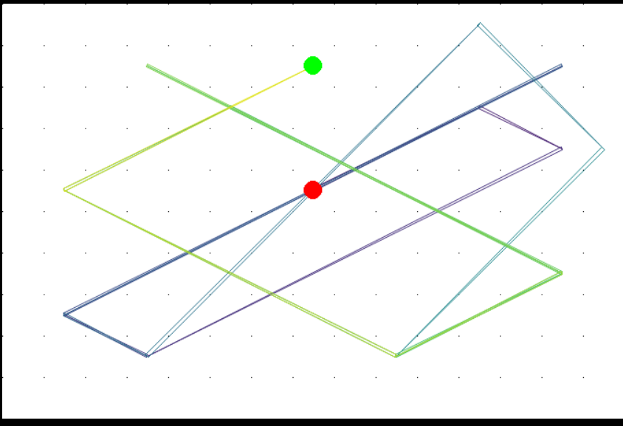
Trajectories of the optimal solution for Layout 3

Slide 11
Comparisons between the Layouts, 50 wins
Types of Layouts | Rectangle Bar | Hollow Pyramid | Criss Cross
Mean iterations taken for game completion | 94.38+110+98.4 =100.93 | 76.84+ 79.82+77.44 =78.03 | 84.04+81.04+81.5 =82.2
Mean fails for won game | 17.22+12.52+13.28 =14.34 | 29.2+24.92+26.7 =26.94 | 23.16+32.58+20.48 =25.41

Slide 12
Comparisons between the Layouts, 100 wins
Types of Layouts | Rectangle Bar | Hollow Pyramid | Criss Cross
Mean iterations taken for game completion | 99.49+110.1+101.9 =103.88 | 78.38+76.67+80.21 =78.42 | 84.17+83.25+80.31 =82.58
Mean fails for won game | 14.55+12.47+11.23 =12.75 | 28.78+21.55+23.78 =24.7 | 24.55+28.23+22.39 =25.06

Slide 13
Comparisons between the Layouts, 150 wins
Types of Layouts | Rectangle Bar | Hollow Pyramid | Criss Cross
Mean iterations taken for game completion | 101.6+111.43+104.68 =105.9 | 82.49+77.84+83.2 =81.18 | 85.9+83.28+81.73 =83.64
Mean fails for won game | 13.72+11.41+11.76 =12.3 | 25.13+21.9+23.9 =23.63 | 24.93+26.98+21.98 =24.63

Slide 14
Conclusions and discussions
Small improvement with increasing iterations
Rectangle Bar is easier to learn than other layouts
Hollow Pyramid and Criss Cross perform similiar
Iteration highest for Rectangle Bar

Slide 15
THANKS!

