Slide 1
Machine Learning.
Reinforcement Learning.
Panin, Vladimir 12238682
Dass, Reema 12144026
Schweitzer,Valentin 51829840

Slide 2
Implementation
BRICKS:
Layout of the bricks based on option selection.
Reset the layout of the bricks.
PADDLE:
Creation of the paddle.
BOARD:
Construct and display the board.
BALL:
Collision behaviour with the paddle.
Collision behaviour with the bricks.
Direction of the ball movement.
Checking if the game is over.
Updating the speed of the ball.

Slide 3
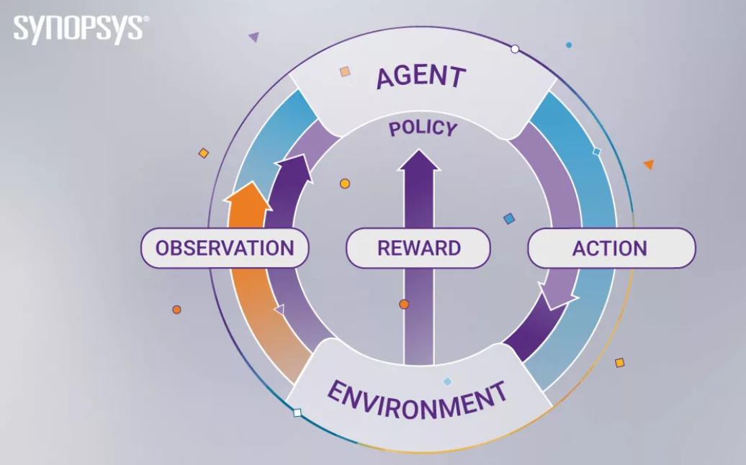
Implementation 2
AGENT:
MONTE CARLO:
ACTIONS:
Rewarding:
Moving the paddle to let the ball bounce.
Hitting the bricks.
Directing the ball to a specific direction.
Time taken to finish the game.
Penalty:
Missing the ball.
Time taken to finish the game.
Missing the bricks during each turn.
OBSERVATION:
Learning based on each action taken during the game.
ENVIRONMENT:
The game with the specific layout with ball and paddle.

Slide 4
Layouts and Results.
Trajectories of the optimal solution.

Slide 5

Layout 1.

Slide 6
Trajectories of the optimal solution for Layout 1

Slide 7
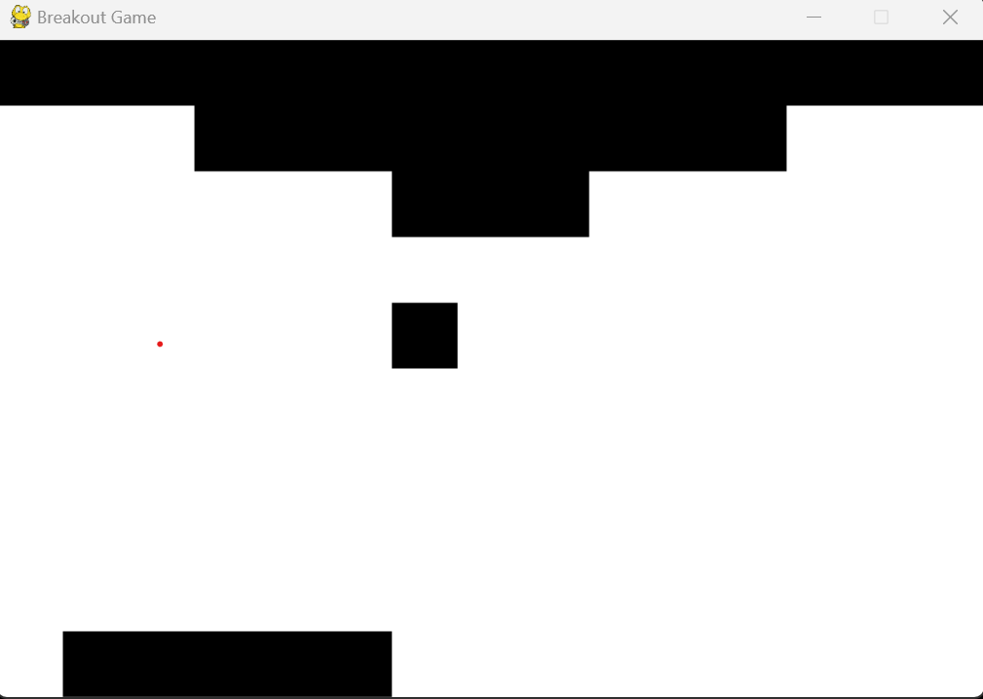
Layout 2.

Slide 8
Trajectories of the optimal solution for Layout 2

Slide 9
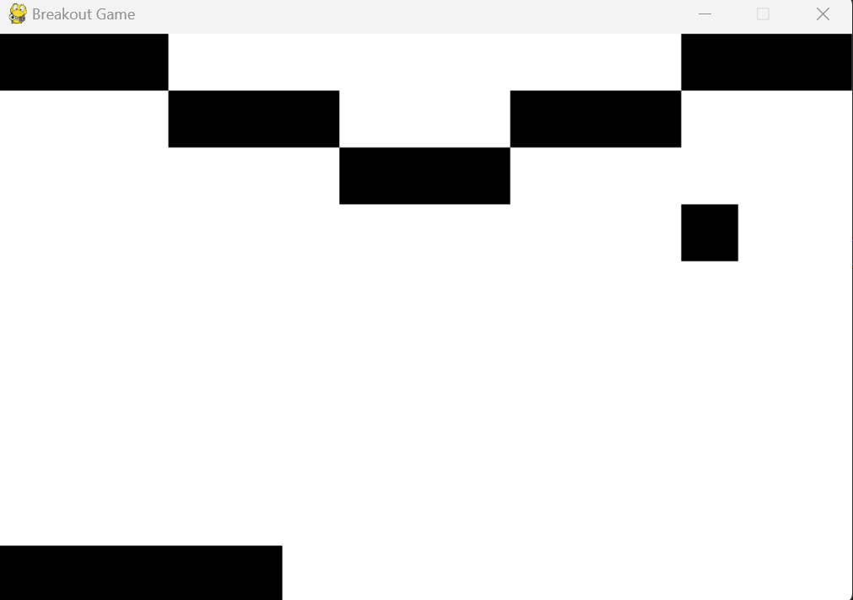
Layout 3.

Slide 10
Trajectories of the optimal solution for Layout 3

Slide 11
Comparisons between the Layouts
Types of Layouts | Layout 1 | Layout 2 | Layout 3
Time taken for game completion
Complexity of the game

Slide 12
Conclusions and discussions

Slide 13
THANKS!

