Slide 1
Machine Learning.
Reinforcement Learning.
Panin, Vladimir 12238682
Dass, Reema 12144026
Schweitzer,Valentin 51829840

Slide 2
Implementation
BRICKS:
Layout of the bricks based on option selection.
Reset the layout of the bricks.
PADDLE:
Creation of the paddle.
Paddle movement.
BOARD:
Construct and display the board.
BALL:
Collision behaviour with the paddle.
Collision behaviour with the bricks.
Collision behaviour with the walls.
Direction of the ball movement.
Checking if the game is over.
Updating the speed of the ball.

Slide 3
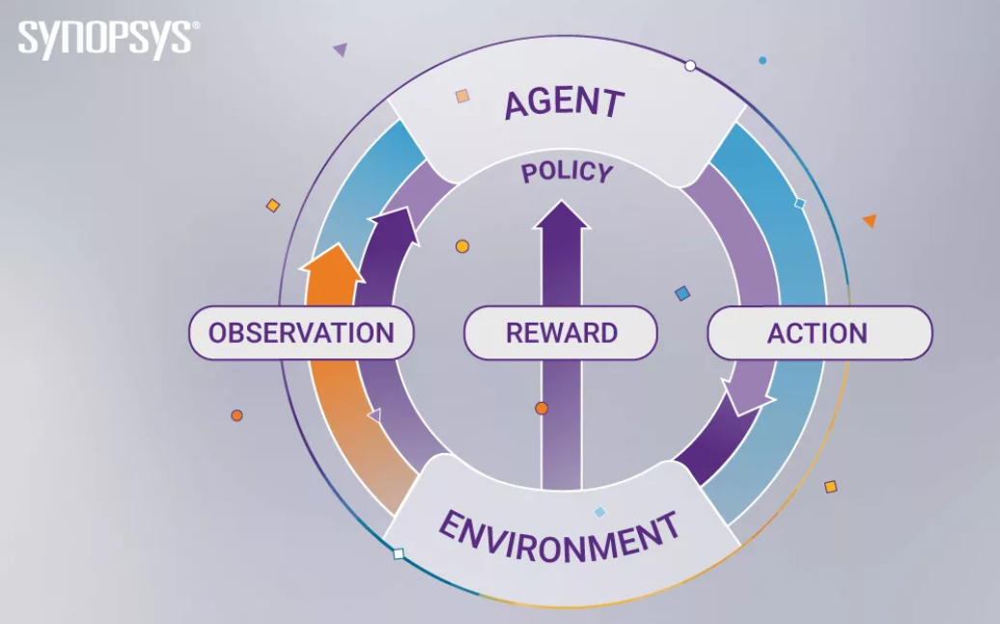
Implementation 2
AGENT:
MONTE CARLO: Greedy epsilon with threshold 0.5.
ACTIONS:
Reward:
Ball bounces on the paddle.
Hitting the bricks.
Paddle tracking the ball.
Penalty:
Game lost.
Time taken to finish the game.
ENVIRONMENT:
The game with the specific layout of the bricks with ball and paddle.
OBSERVATION:
Learning based on each action taken during the game.
Game State:
X axis offset between ball and paddle.
Paddle speed.
Ball speed.

Slide 4
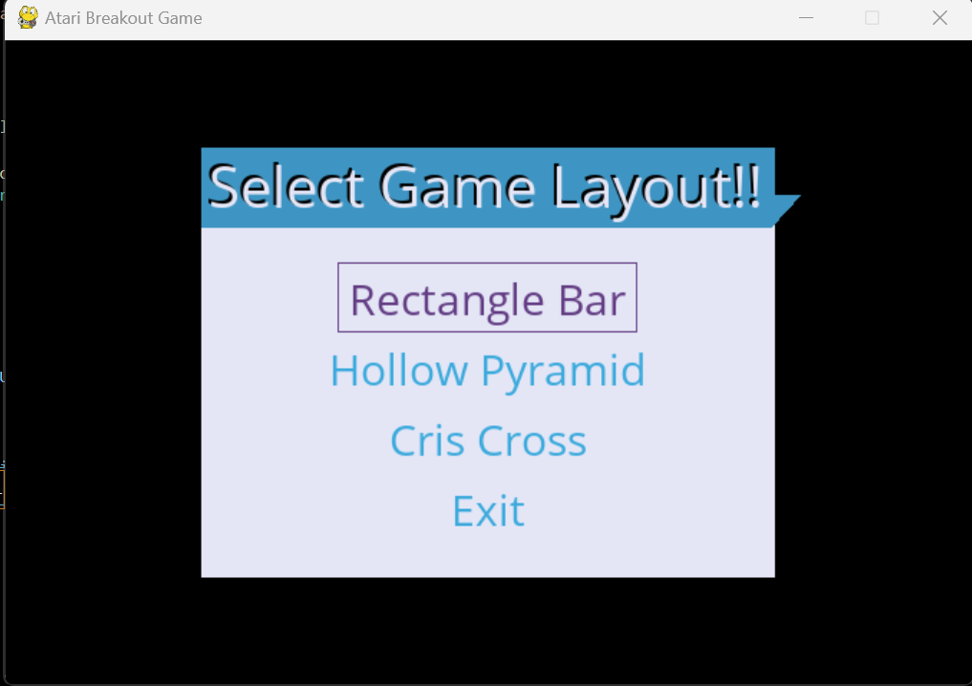
Layouts and Results.
Trajectories of the optimal solution.

Slide 5
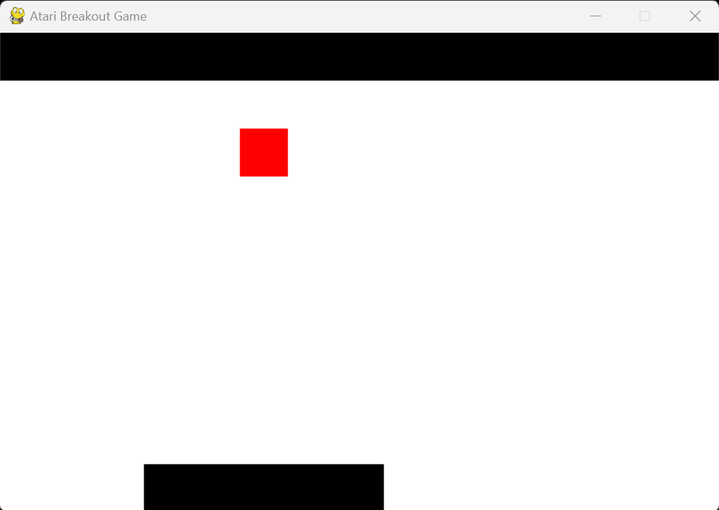
Layout 1.

Slide 6
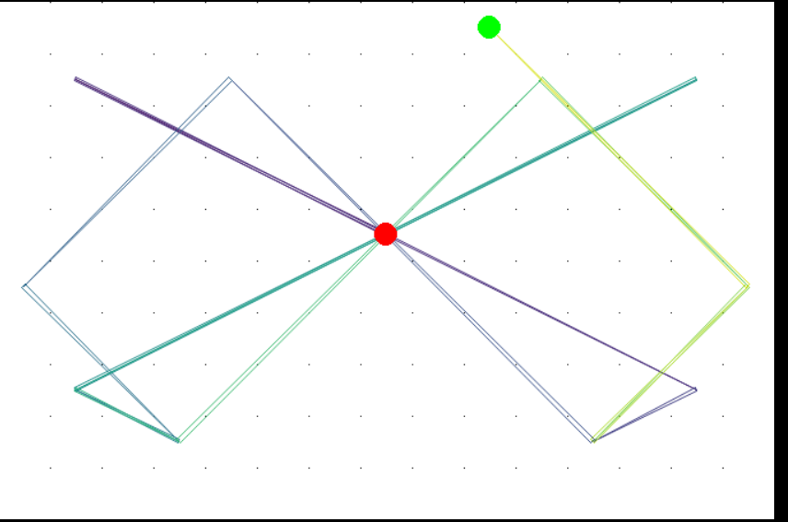
Trajectories of the optimal solution for Layout 1

Slide 7
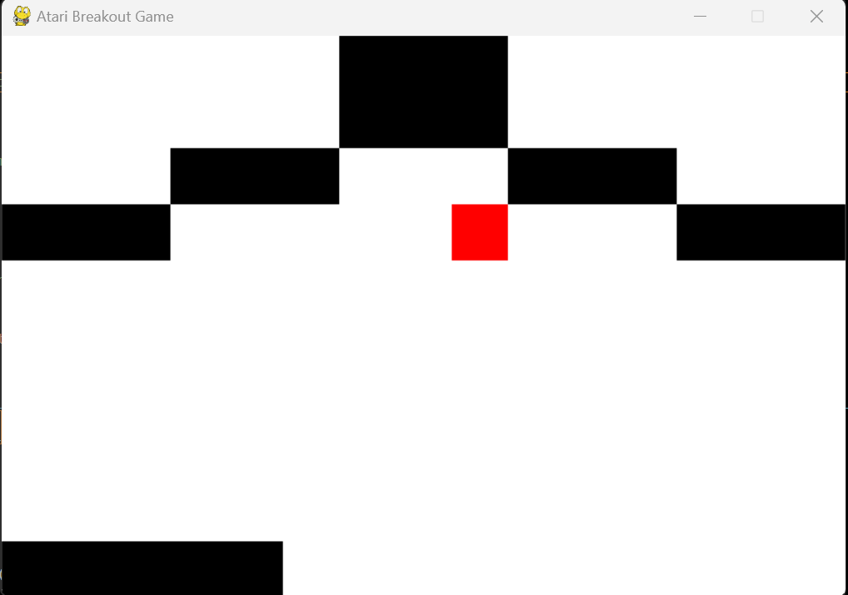
Layout 2.

Slide 8
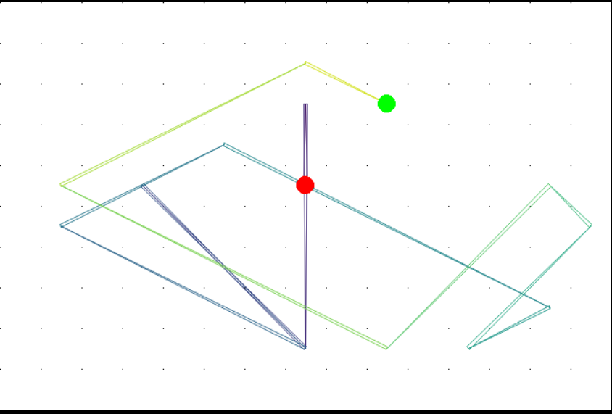
Trajectories of the optimal solution for Layout 2

Slide 9
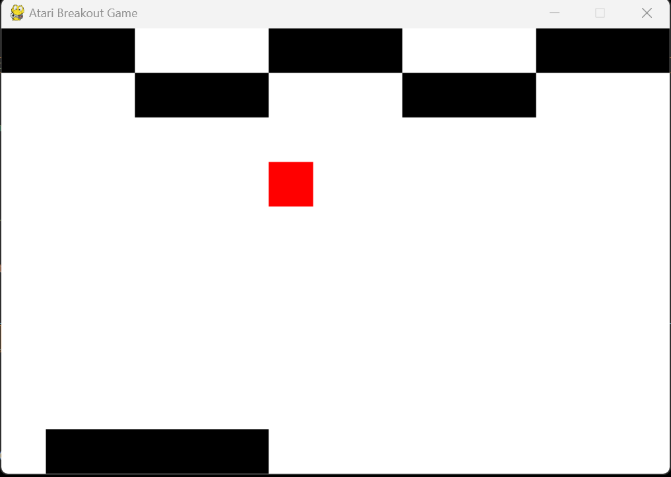
Layout 3.

Slide 10
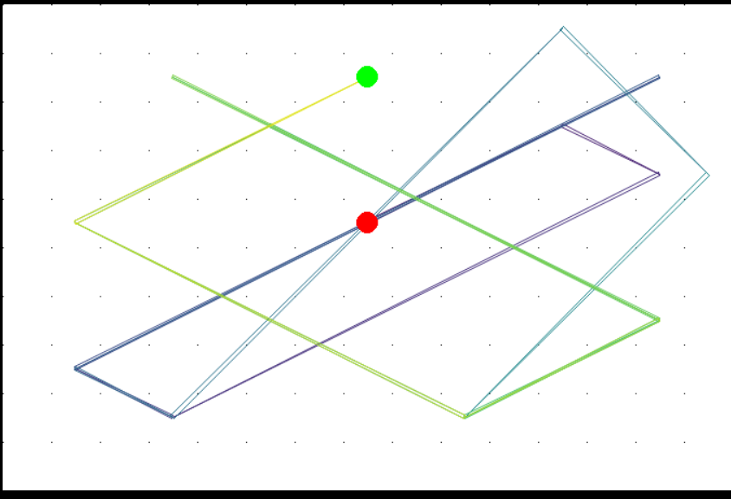
Trajectories of the optimal solution for Layout 3

Slide 11
Comparisons between the Layouts
Types of Layouts | Layout 1 | Layout 2 | Layout 3
Time taken for game completion.
Number of iterations.
Number of the bricks.

Slide 12
Conclusions and discussions

Slide 13
THANKS!

